Slide 1
JDM Legende
Vuk Delibašić

Slide 2
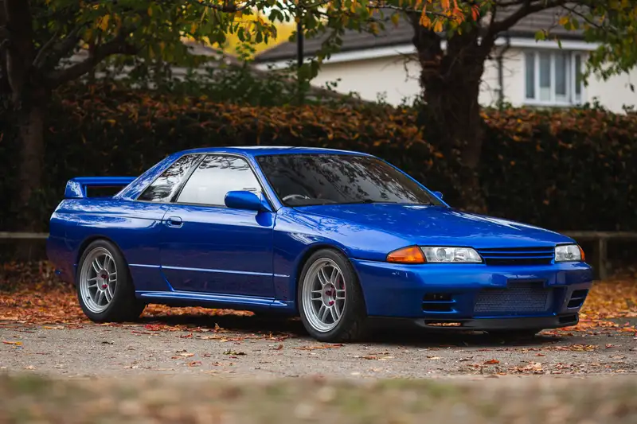
Nissan skyline GT-R (R32), “GodzilLa”

Slide 3
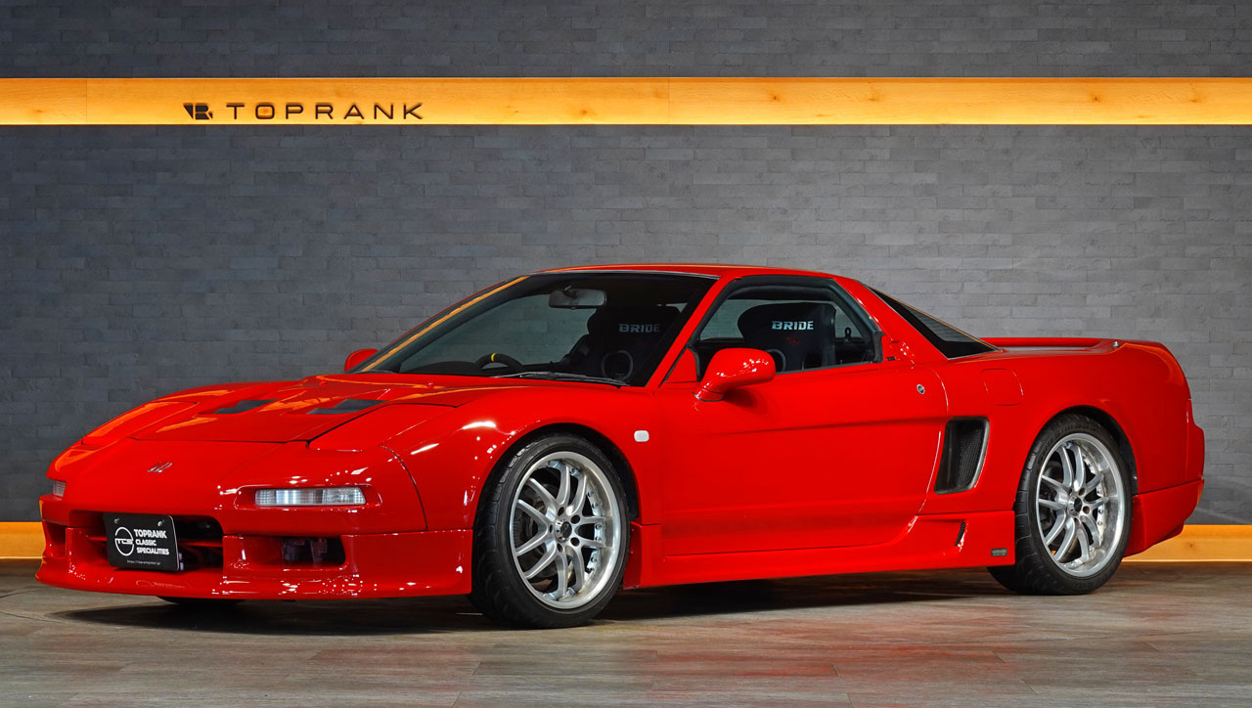
Honda NSX(Zenki)”Japanski Ferrari”

Slide 4
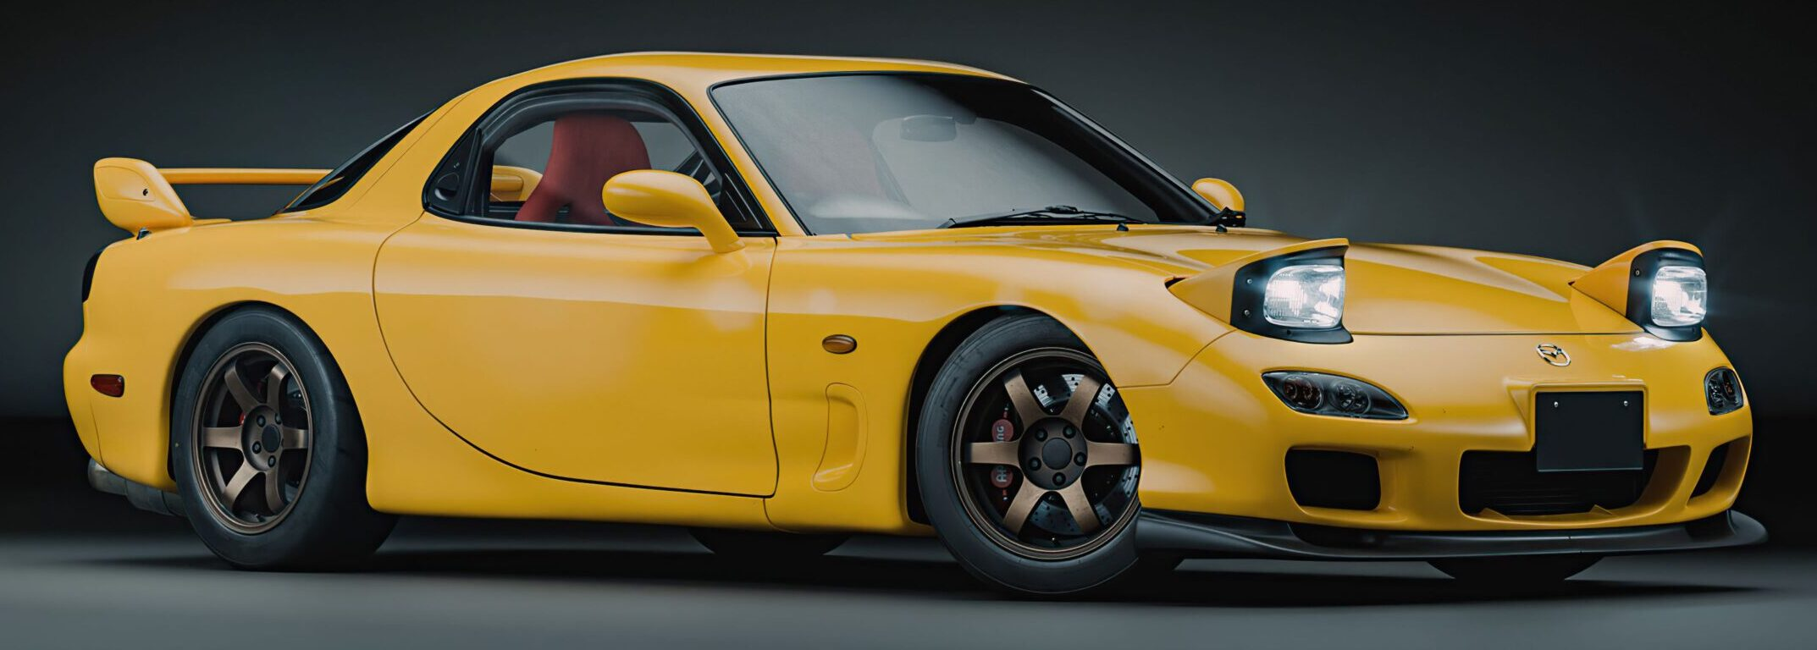
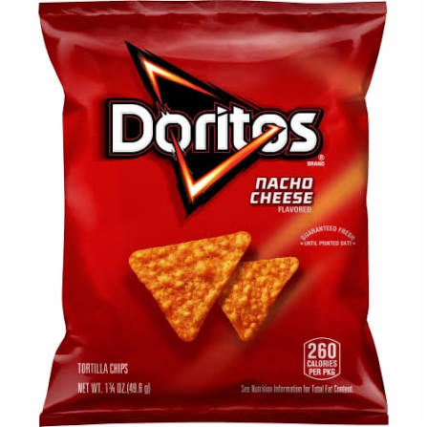
Mazda RX-7

Slide 5
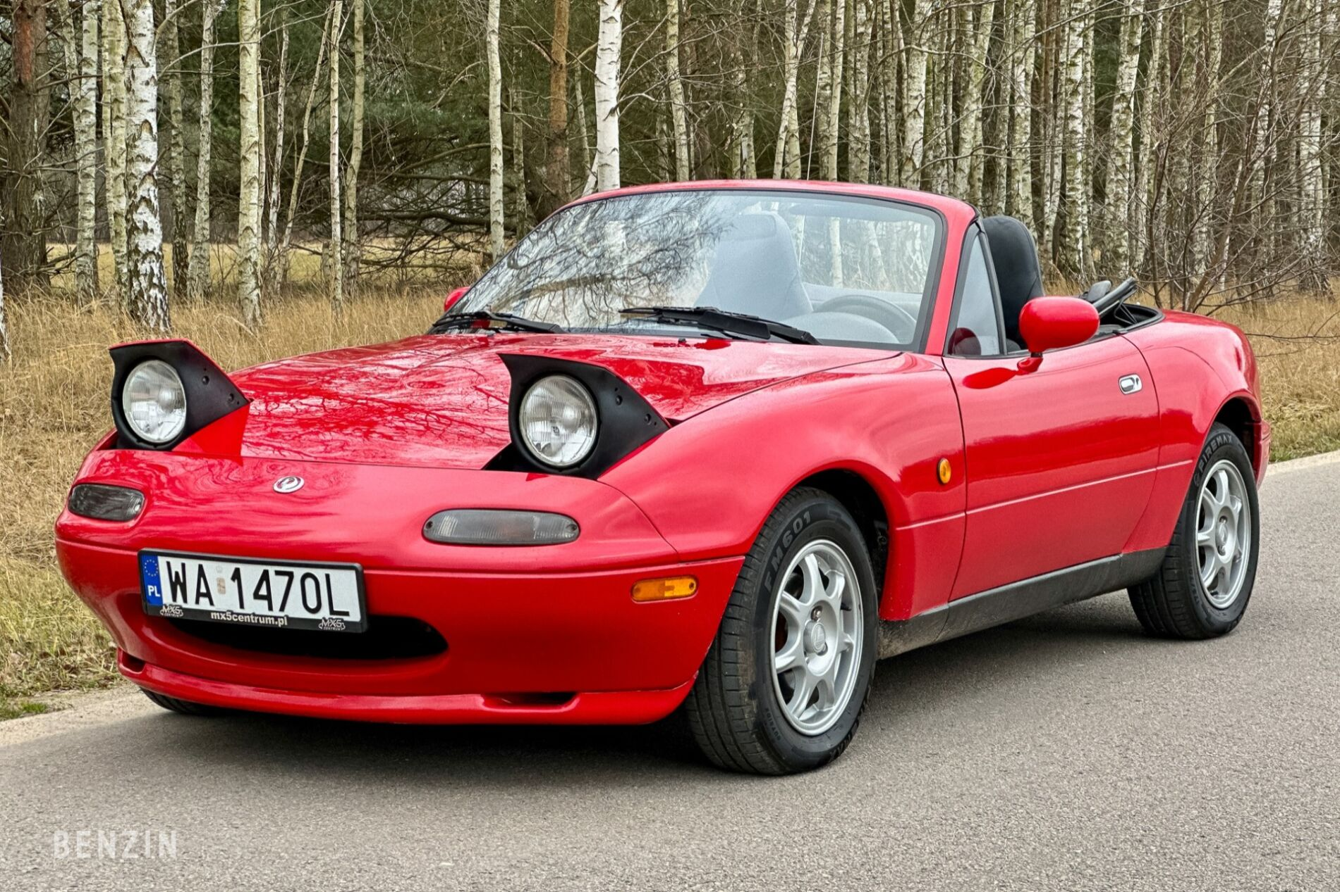
Mazda Mx-5 (NA)

Slide 6
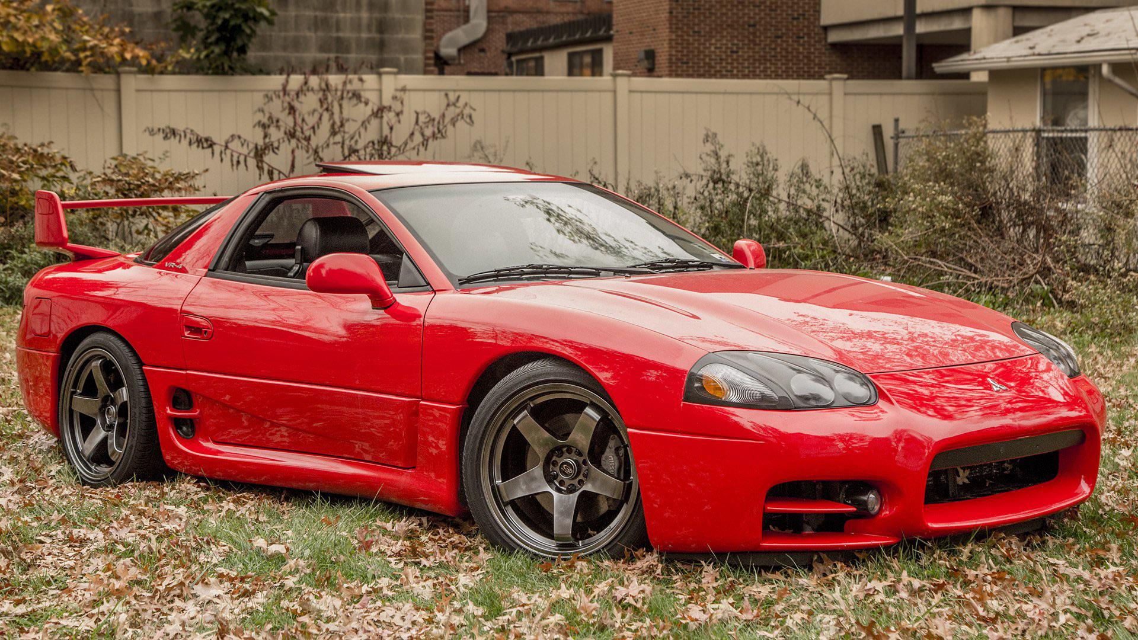
Mitsubishi 3000GT VR4

Slide 7
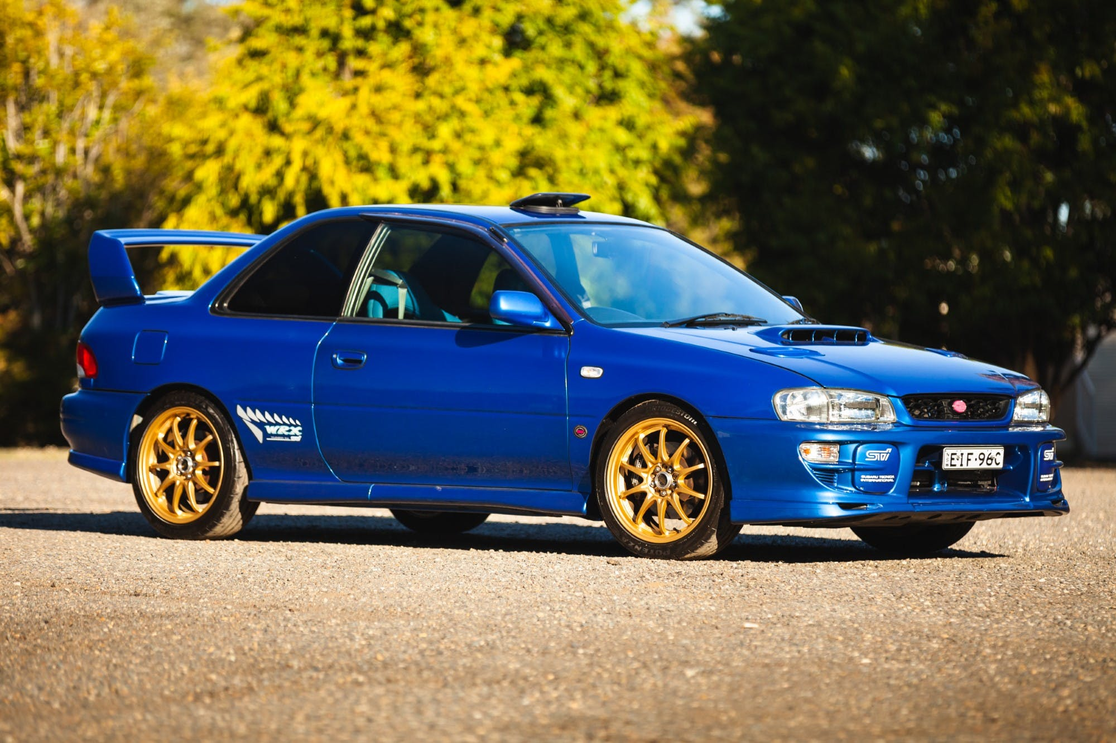
Subaru Imreza wrx sti(Rally Legend)

Slide 8
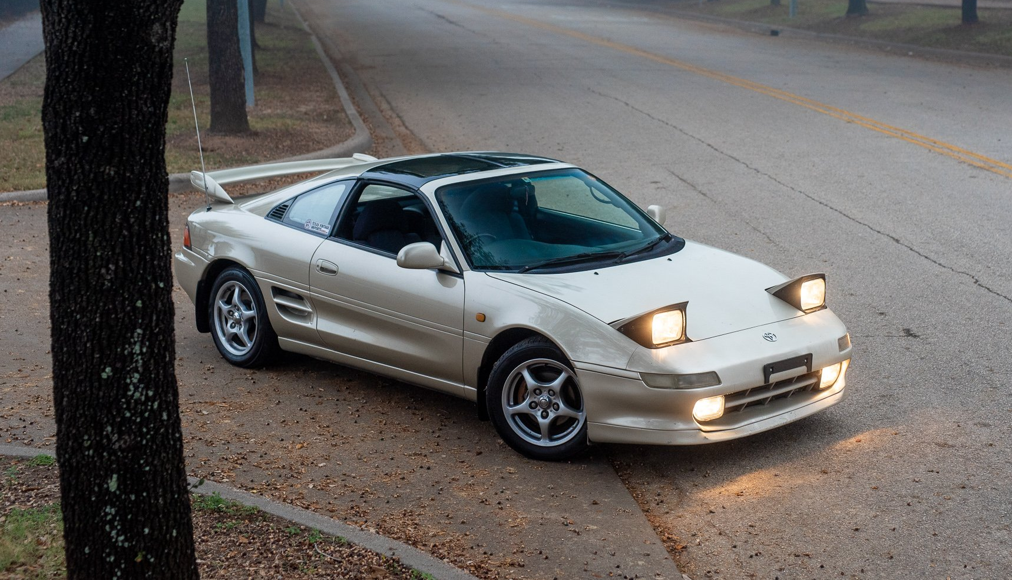
Toyota MR2 Turbo (SW20 Rev3)

Slide 9
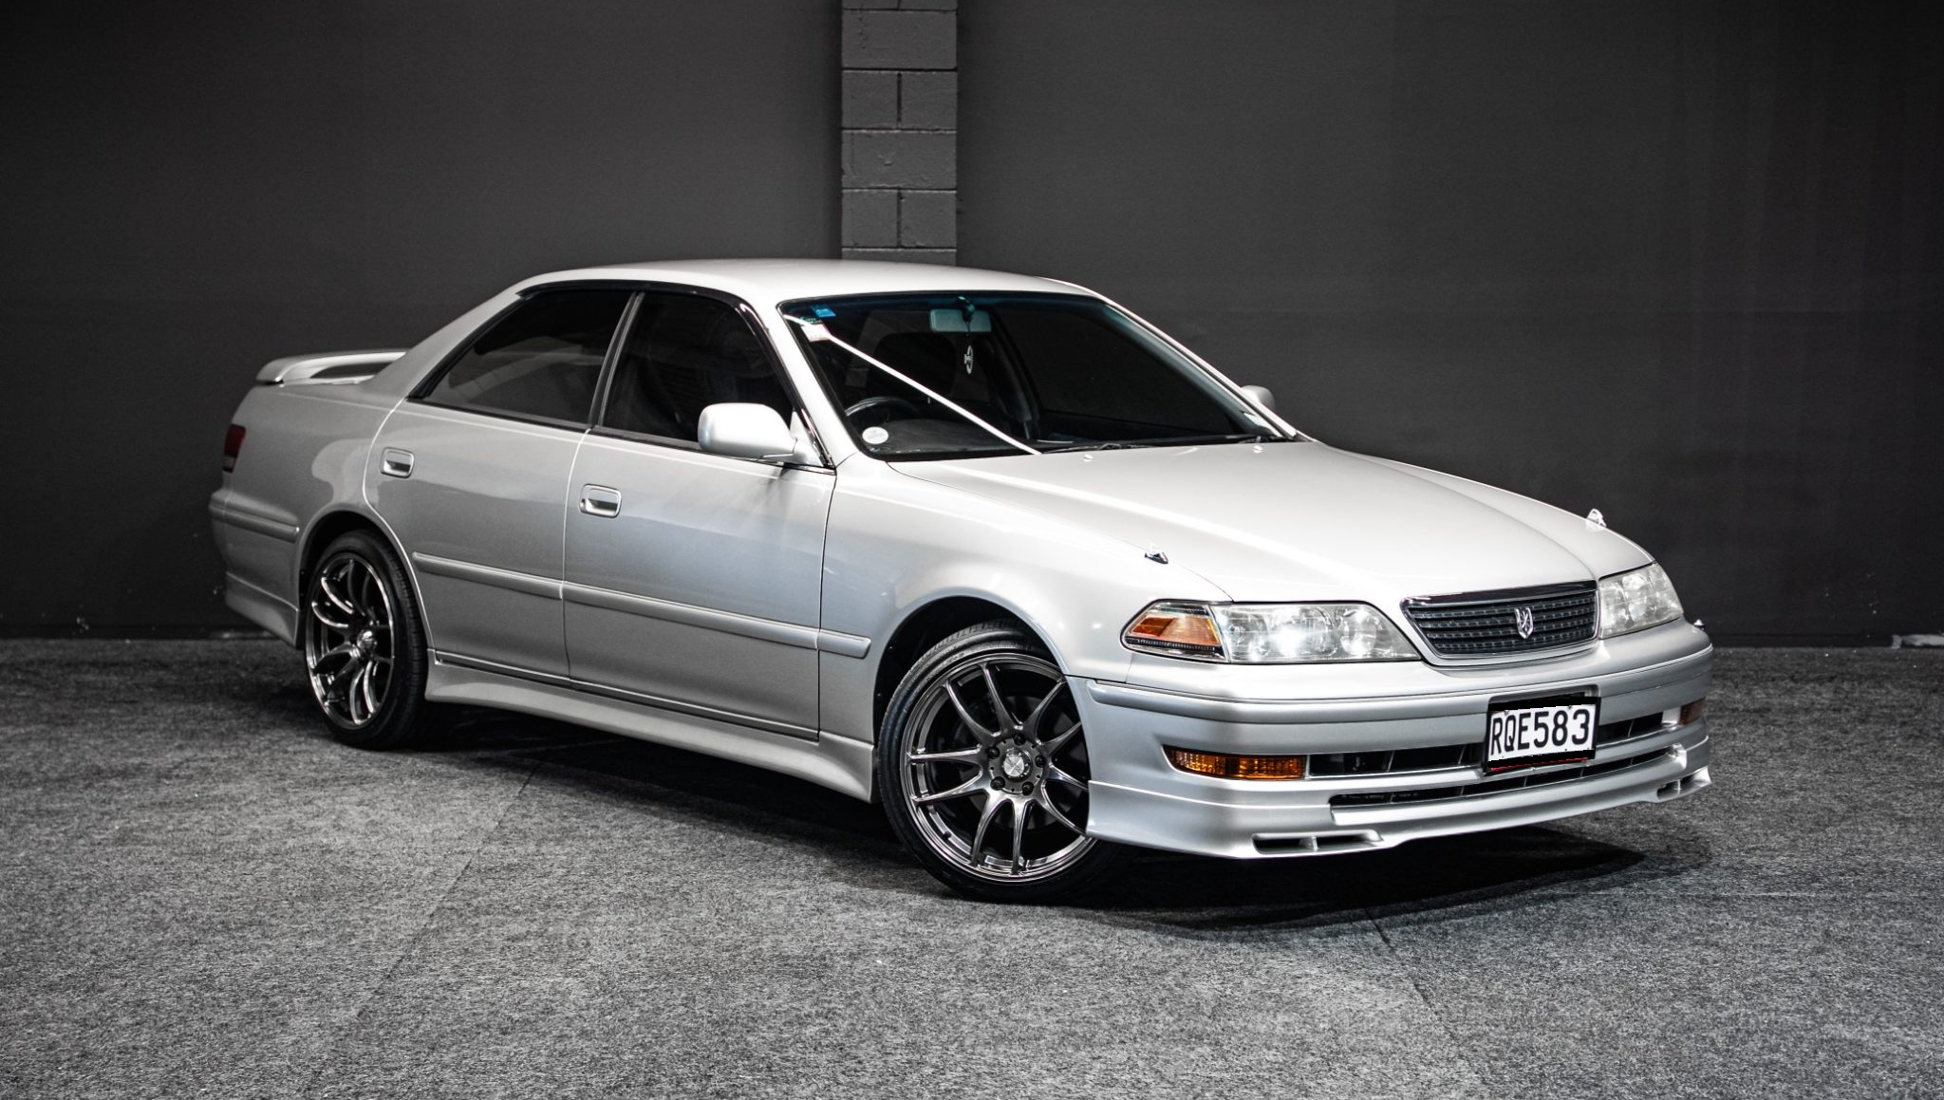
Toyota Mark ii Tourer v (jzx100)

