Slide 1
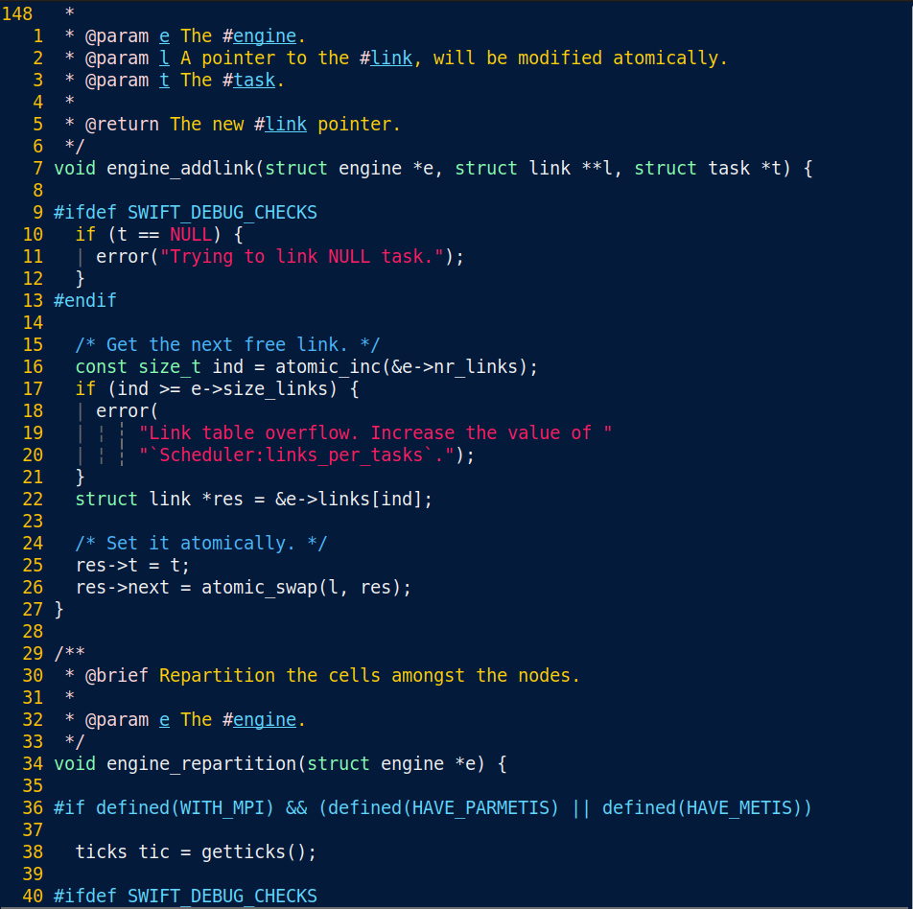
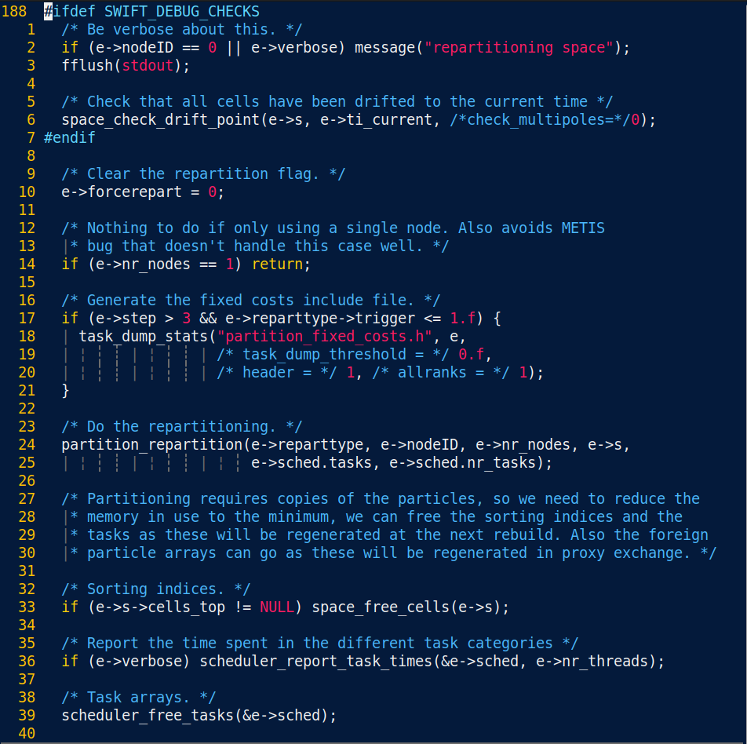
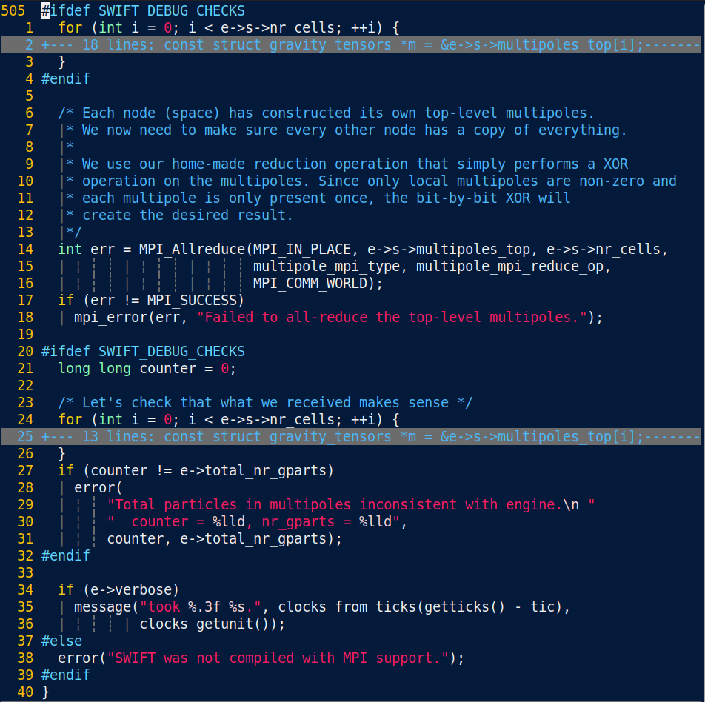
Code Development: Best Practices
Generally and in SWIFT
Mladen Ivkovic
Durham University
Leiden, 19. September 2023

Slide 2
Note
  These slides contain only the part of my talk relating to the gdb/valgrind live demo.
  The state of the demos as presented then are stored in the git repository in the branch freeze-swiftcon-2023-09
  full slides of the workshop are available on
        https://1drv.ms/b/s!Aq715l3GOLnojmRg-YWc45UN9m0z?e=vabJ3l
        https://mladenivkovic.github.io/work.html

Slide 3
External Debugging Tools
gdb
  tracebacks, inspection
valgrind
  memory leaks
Live demo scripts
  https://github.com/mladenivkovic/debugging-essentials-demo

Slide 4
gdb
Compile your program with debug symbols -g
$ gdb /path/to/executable
$ gdb --args path/to/executable --arg1 --arg2
Useful commands:
  b (break) : set a break point
  l (list): show source code in CLI
  p (print): print variables
    For pointers: p *pointer works too!
  bt (backtrace): show stack trace
  c (continue): continue run
  pi (python-interactive): open a python interpreter

Slide 5
gdb + core dumps
It’s possible to enable core dumps:
  when program encounters error, write down what is currently in memory instead of just quitting
  Enabling core dumps on linux:
    $ ulimit -S -c unlimited
    Note: your sysadmins may have disabled this.
    Default core dump location may vary. On HPC systems, it’s often set to workdir. On Ubuntu 21+, var/lib/apport/coredump/
gdb can read that back in and allow you to debug!
$ gdb -c core.XXXX path/to/executable

Slide 6
gdb – some tricks
„value has been optimized out” workaround
  Compile entire program without optimization
  … or tell compiler not to optimize specific function you’re looking at:
    #pragma GCC push_options
    #pragma GCC optimize ("O0")
    your code
    #pragma GCC pop_options

Slide 7
gdb + MPI
$ mpirun -n 4 xterm -e gdb -ex run \
--args ../../swift_mpi --arg1 --arg2
  Launch 4 MPI ranks
  Launch a terminal (xterm) and execute subsequent command (-e)
  Launch gdb and immediately execute „run” command
  gdb flag: The executable (swift_mpi) will need command line arguments (--arg1, --arg2)
  Launch swift
MPI_Abort() may exit gracefully instead of raising/signalling an error.
  Simplest workaround: Replace with abort() while debugging

Slide 8
valgrind
Track down memory leaks
$ valgrind path/to/your/executable
$ valgrind –leak-check=full path/to/executable
  For more details, traces, etc

