Slide 1

Correctness and Debugging Workshop
Debugging Principles or
The Essentials of gdb
Mladen Ivkovic
Durham University
November 2025

Slide 2
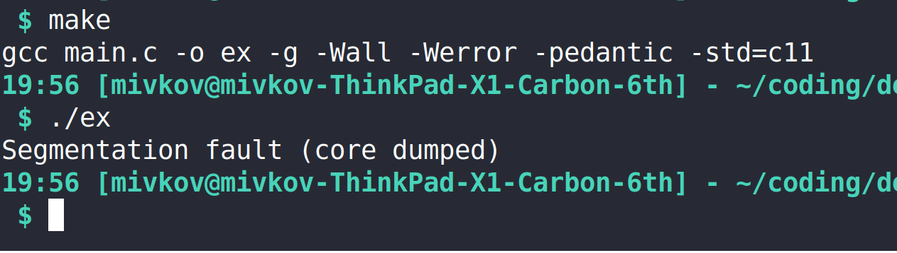
The Joy Of Finding Bugs

Slide 3
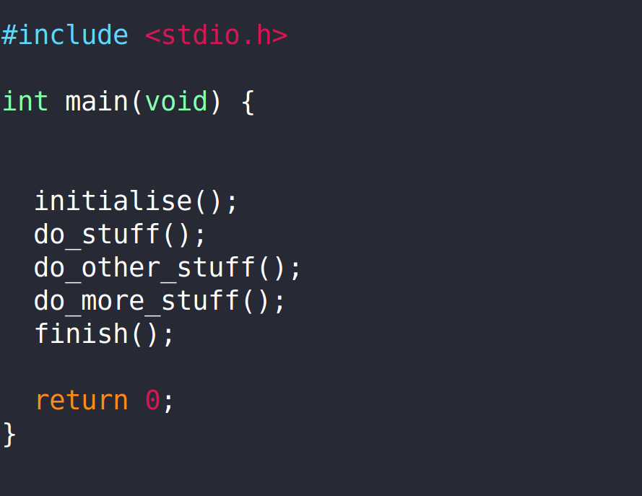
printf – The Ol’ Reliable

Slide 4
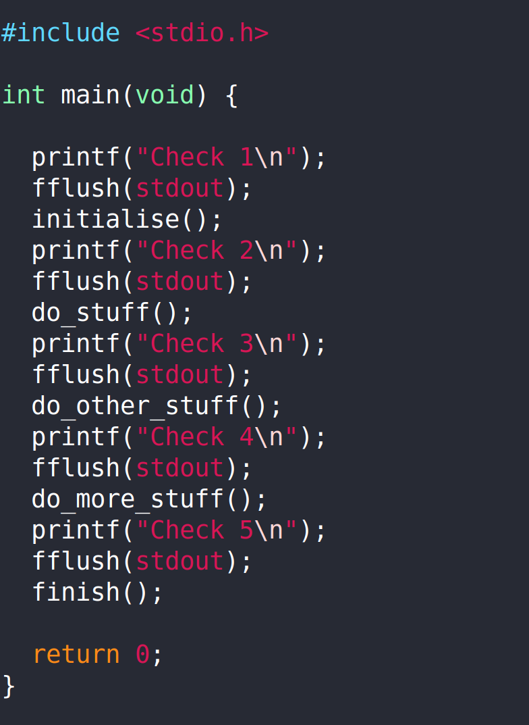
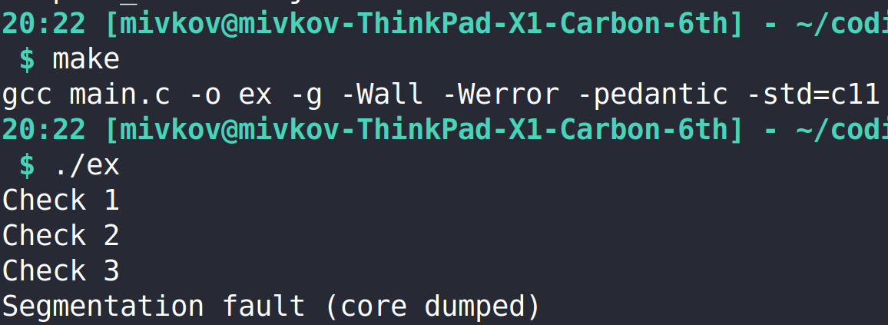
printf – The Ol’ Reliable
  Bisect the program – find out how far it gets

Slide 5
printf – The Ol’ Reliable
Rinse and repeat, until you find where the problem is
WARNING: Don’t forget to flush the stdout – the buffering may not display all the output!
Alternative: Set the stdbuf to unbuffered:
$ stdbuf -o0 ./your_program

Slide 6
printf – The Ol’ Reliable
Bisection with printouts is good and well – but not very efficient.
  Bisection usually means running your code over and over again until you zero in on where the program finds an error.
  Meanwhile, the cause of the error may be somewhere else entirely.
  Typically, you’d remove your checks again after you’re done.
  So, if a similar issue arises, you need to start from scratch.

Slide 7
External Debugging Tools
There are tools which can help you to deal with them:
  e.g. gdb, DDT, lldb, mdb, et al. for stack traces, live inspection, monitoring
  e.g. valgrind, address sanitizer for memory leaks, memory issues
  e.g. MUST for MPI issues
  and many more

Slide 8
Today’s Schedule: gdb
Live demo how to use gdb
Hands-on exercise
github.com/mladenivkovic/debugging-essentials-demo
$ git clone git@github.com:mladenivkovic/debugging-essentials-demo.git

Slide 9
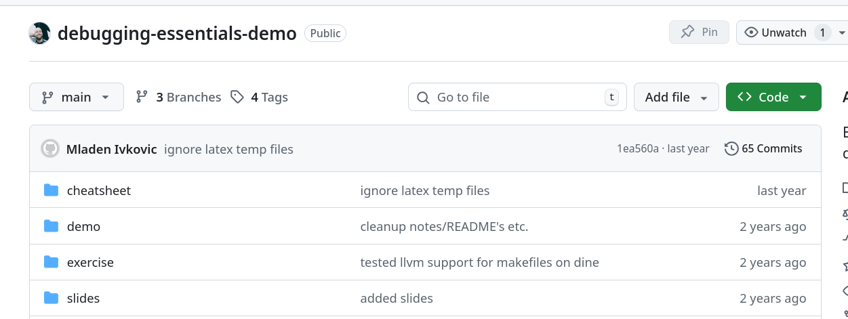
github.com/mladenivkovic/debugging-essentials-demo
gdb cheatsheet
Examples used in live-demo
Hands-on exercises
These (and older) slides

Slide 10
gdb – Basic Usage
1. Compilation:
  Compile your program with debug symbols:
  add -g or -ggdb flag
2. Running: run gdb executable
  $ gdb /path/to/your/executable
  $ gdb --args path/to/your/executable --arg1 --arg2

Slide 11
gdb – Basic Commands
r (run) run the program
b (break) set a break point
l (list) show source code in CLI
p (print) print variables. For pointers: p *pointer works too!
bt (backtrace) show stack trace
c (continue) continue run (e.g. after hitting breakpoint, halting...)
n (next) execute next line
frame or where show current location in trace
frame <frame nr> change into <frame nr>

Slide 12
gdb – Breakpoints
Set breakpoint: (before you execute run)
  break <line number in main file>
    e.g. break 12 to break on line 12
  break path/to/file.c:<line number>
    e.g. break includes/my_includes.h:13
  break file.c:function_name
    To break when a function is called

Slide 13
gdb – Breakpoints Navigation
l (list) show source code
l <line number> show source code at line number
bt (backtrace) show stack trace
c (continue) continue run
where show current location in trace
frame show current location in trace
frame <frame nr> change into <frame nr>

Slide 14
gdb – More on Breakpoints
info break : show information on currently set breakpoints
del 1 : delete breakpoint 1.
  You can find breakpoint numbers using info break
break <location> if <condition>
  Set a conditional breakpoint at location (e.g. line number, function) and break only if condition is satisfied, e.g.
  break main.c:12 if i == 12 && j < 23

Slide 15
gdb – Watchpoints
watch <variable> : halt program execution when value of variable is changed.
  You can set watchpoints at startup (before executing run) if the variable is in global scope.
  Otherwise, you need to first set a breakpoint at a point where the variable is in scope.

Slide 16
gdb – Watchpoints Scope Example
Variable sum in global scope
Variable sum not in global scope
// you can set watchpoint
// at `sum` before `run`
int sum;
int main(void){
  // do stuff
}
// you need to set a
// breakpoint inside main() // and then set a
// watchpoint for `sum`
int main(void){
  int sum;
  // do stuff
}

Slide 17
gdb - reverse
It is possible to run a program in reverse with gdb, but the functionality is very restricted.
Many optimizations/vectorizations break it. So make sure to compile and run without any optimizations enabled.
Chances are it might still not work with modern instructions.
Recording significantly slows down execution time. May require a lot of memory.

Slide 18
gdb – reverse: How-To
Set a breakpoint from which to record the program execution.
Run the record command when this breakpoint is hit.
Set a different breakpoint at the point you wish to examine.
Once you hit the second breakpoint , you can go back through the code using
rs (reverse-step) go in reverse line by line
rc (reverse-continue) go in reverse until last breakpoint

Slide 19
gdb – Segfaults and Other Errors
One of the most useful features of gdb is to catch signals which would usually kill your program and halt it before it aborts.
This permits you to explore the current state of your program just before your crash.
This doesn’t need any special activation. Just run your code with gdb!
  But don’t forget to compile it with debug symbols (-g or -ggdb) to get meaningful traces!

Slide 20
gdb – Core Dumps
When running code, it is possible to enable core dumps:
  when program encounters error, write down what is currently in memory instead of just quitting
  Typically writes core.XXXX files, where XXXX are some numbers.
gdb can read that back in and allow you to debug!
$ gdb -c core.XXXX path/to/your/executable

Slide 21
gdb – Core Dumps: How to Enable and Where to Find
Enabling core dumps on linux:
$ ulimit -S -c unlimited
Note: your sysadmins may have disabled core dumps.
Default core dump location may vary:
  On HPC systems, it’s often set to $workdir
  Ubuntu 21+: /var/lib/apport/coredump/
  Manjaro: /var/lib/systemd/coredump/

Slide 22
gdb – Core Dumps With coredumpctl
$ coredumpctl info
  Show info of last core dump.
  To find out where it’s stored, look for line starting with “Storage”
$ coredumpctl debug
  Launch the debugger on the last available core dump
$ coredumpctl debug –debugger=/path/to/gdb
  Specify which debugger to use
$ coredumpctl dump --output core.out
$ gdb -c core.out /path/to/your/executable
  Some operating systems will compress their core dumps, making them unreadable by gdb. These two lines uncompress the last core dump into core.out and read them in using gdb

Slide 23
gdb – “value has been optimized out”
„value has been optimized out” workarounds:
  Compile entire program without optimisation: -O0 compiler flag
  (You may be able to recompile only a handful of files you’re interested in using that flag, leaving the rest optimised)
  Or tell compiler not to optimize specific function you’re looking at:
GCC:
#pragma GCC push_options
#pragma GCC optimize ("O0")
void your_function(){...}
#pragma GCC pop_options
Intel:
#pragma optimize( "", off )
void your_function() {...}
#pragma optimize( "", on )
// ---- or, alternatively -----
#pragma intel optimization_level 0
void your_funtction(){...}
Clang:
__attribute__((optnone))
void your_function()
{…}

Slide 24
FPEs – Floating Point Exceptions
There are ways of telling the compiler to raise an error if an invalid arithmetic operation (FPE) has occurred
This is unfortunately not standardised – it depends on the compiler and the hardware.

Slide 25
FPEs – Types of Floating Point Exceptions
FE_DIVBYZERO | Pole error: division by zero, or some other asymptotically infinite result (from finite arguments).
FE_INEXACT | Inexact: the result is not exact.
FE_INVALID | Domain error: At least one of the arguments is a value for which the function is not defined.
FE_OVERFLOW | Overflow range error: The result is too large in magnitude to be represented as a value of the return type.
FE_UNDERFLOW | Underflow range error: The result is too small in magnitude to be represented as a value of the return type.

Slide 26
FPEs – Floating Point Exceptions in C
// `feenableexcept()` is a GNU extension, not
// standard C. We need to define _GNU_SOURCE
#define _GNU_SOURCE
#include <fenv.h>
// make sure to link with -lm as well
int main(void){
// combine options using binary OR
feenableexcept(FE_DIVBYZERO | FE_INEXACT | FE_INVALID |
FE_OVERFLOW | FE_UNDERFLOW);
// rest of your code
}

Slide 27
gdb + MPI: Poor Man’s Parallel Debugger
Running gdb with MPI: Simultaneously launch one gdb instance per MPI rank in a terminal emulator (xterm)
$ mpirun -n 4 xterm -e gdb -ex run --args your_program --arg1 --arg2
  Launch 4 MPI ranks
  Launch a terminal (xterm) and execute subsequent command (-e)
  Launch gdb and immediately execute „run” command
  gdb flag: The executable (your_program) will need command line arguments
  (--arg1, --arg2)
  Launch your program with extra cmdline arguments

Slide 28
gdb + MPI: Poor Man’s Parallel Debugger
Warning: depending on the implementaiton, MPI_Abort() may exit gracefully instead of raising/signalling an error, killing the gdb session instead of letting it catch and handle the abort.
Simplest workaround: Replace MPI_Abort() with abort() while debugging.

Slide 29
gdb – Additional Topics, Tricks etc
display <variable>
print variable every time it is touched throughout the run.
finish
after a breakpoint, run function until the end, and halt there.
info locals
print all local variables.
s (step)
like n (next), but execute a single step of the line, instead of the full line.
disable <breakpoint-nr>/<watchpoint-nr> :
disable breakpoint or watchpoint by number (use info break or info watch to find number), but don’t delete it.
You can undo that with the enable command.
tbreak
set temporary breakpoint: will be automatically deleted after being hit once.

Slide 30
gdb – Additional Topics, Tricks etc
tui enable :
start a fancy text user interface to look through program’s source code.
See https://sourceware.org/gdb/current/onlinedocs/gdb.html/TUI.html for more.
make: run make from within gdb
shell : open a shell (bash/zsh/csh etc, your default) inside gdb
python : open a python interpreter within gdb
save breakpoints <filename> :
Save breakpoints of current session into <filename>
source <filename> :
Load (e.g. saved breakpoints) from <filename>

Slide 31
Hands-On Exercise
$ git clone git@github.com:mladenivkovic/debugging-essentials-demo.git
gdb cheatsheet
Examples used in live-demo
Hands-on exercises
These (and older) slides

Slide 32
How the Game Is Played
The exercise/ directory contains a small toy code.
I have planted bugs in that code.
You go and find them!
  ... after a short introduction that follows

Slide 33
Directory Contents
  exercise/src
    source files of toy code with planted bugs in C and in Fortran
  exercise/solution
    correct versions of the code.
    (You can compile and run this to see what the results should be.)
  exercise/theory
    TeX documentation on what code does and how it works.
    Everything you need to know about this code is on the first 2 pages!
  exercise/plot_solution.py
    python3 script which will plot the program’s output for you

Slide 34
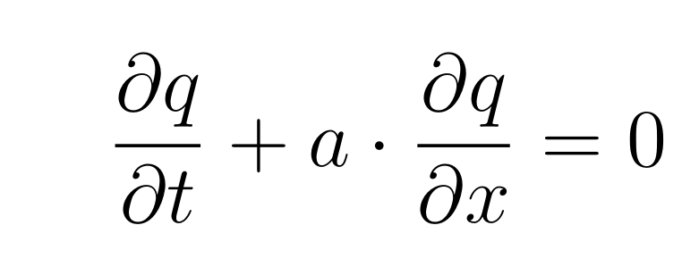
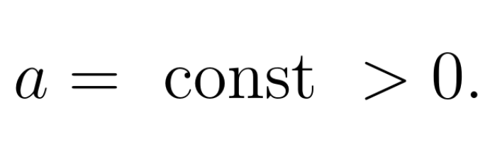
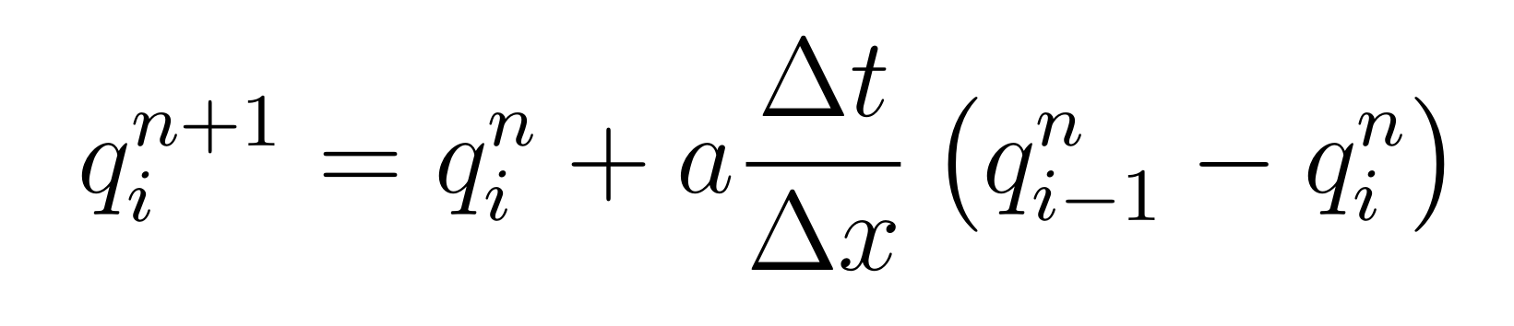
The Toy Code: linear_advection
Solves the equation of linear advection in 1D:
Using a very simple numerical method:

Slide 35
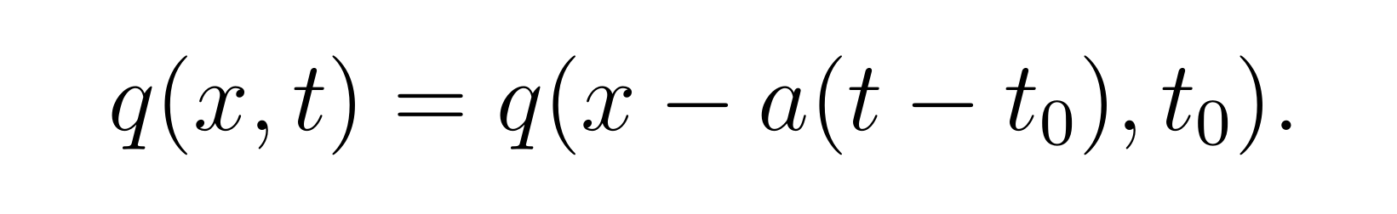
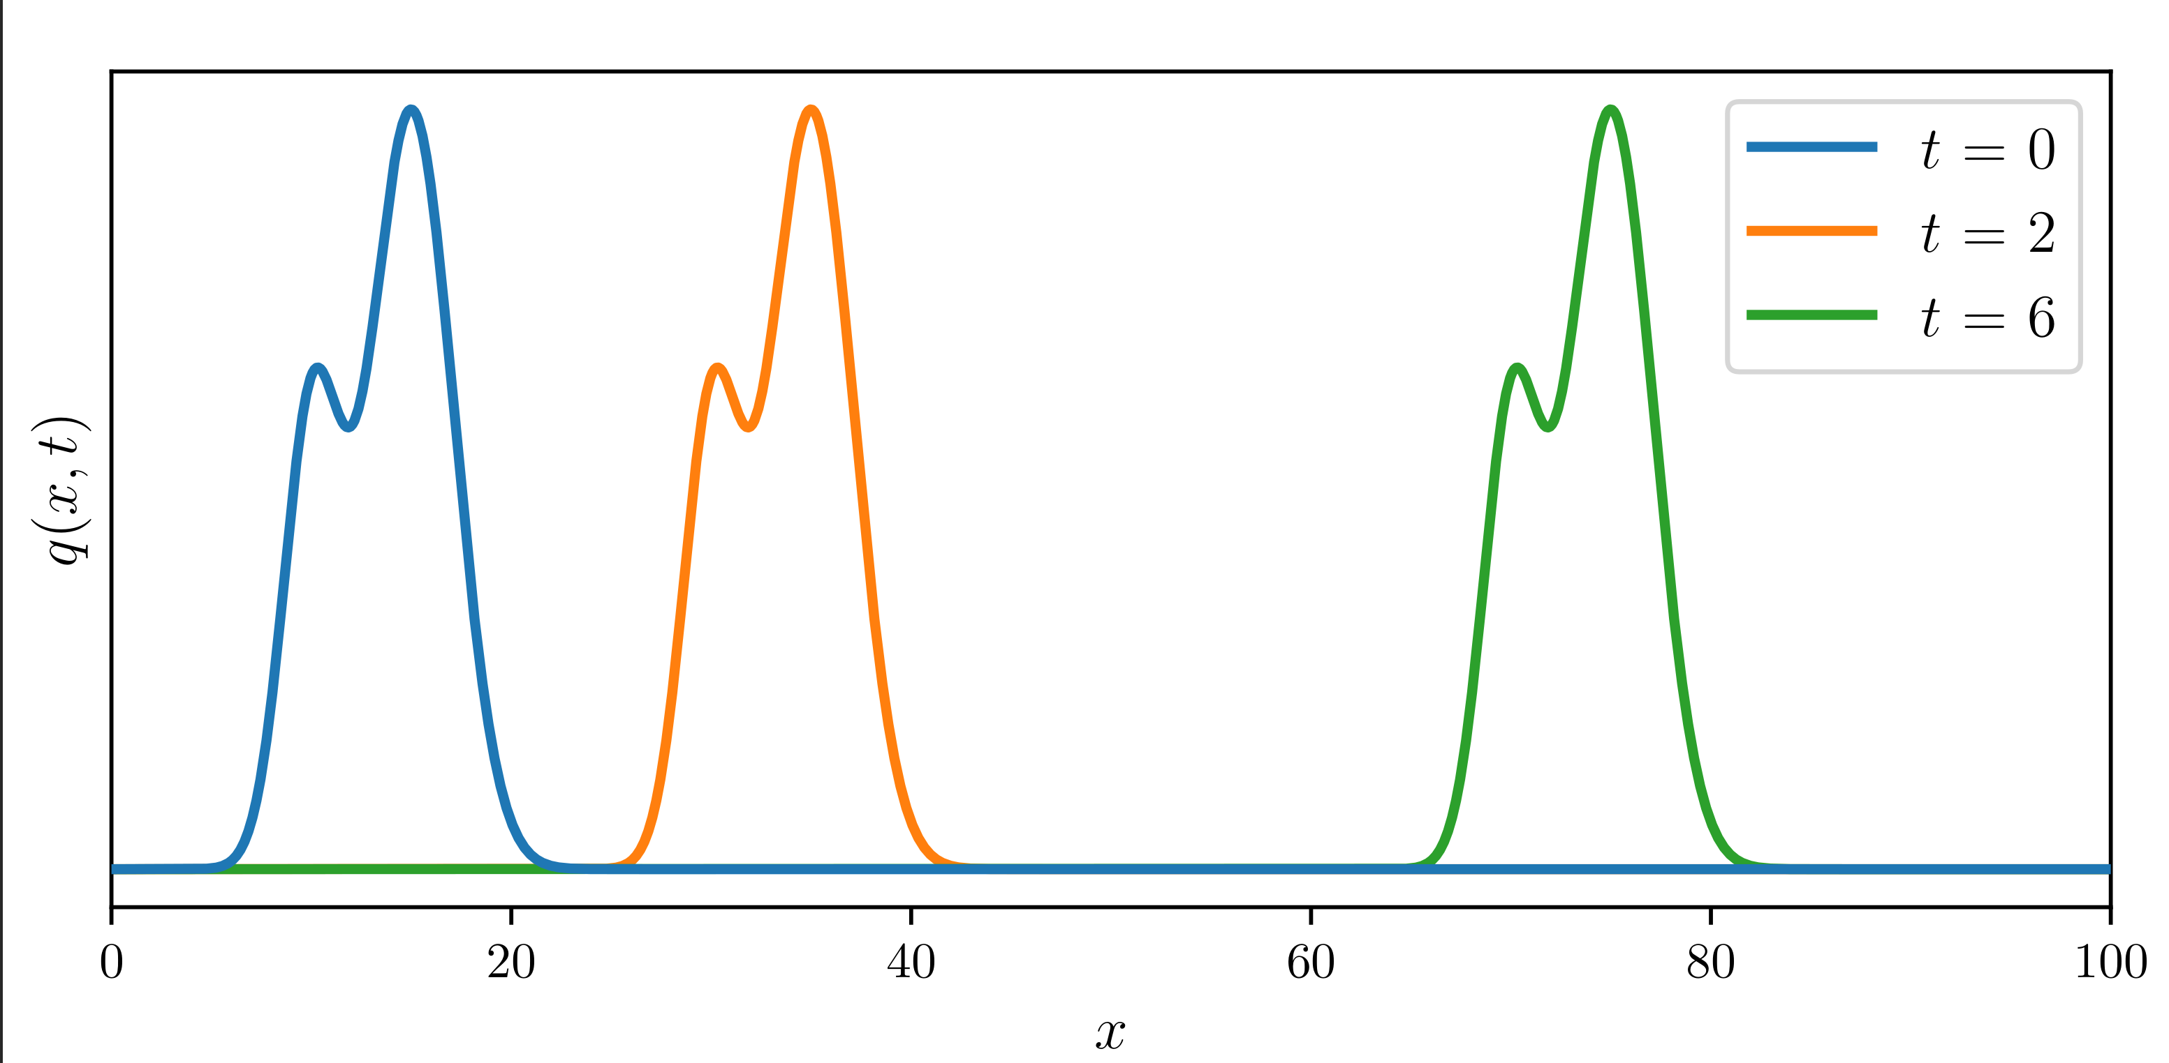
Analytical Solution
Original solution at t = t0 moved (advected) by a(t - t0)

Slide 36
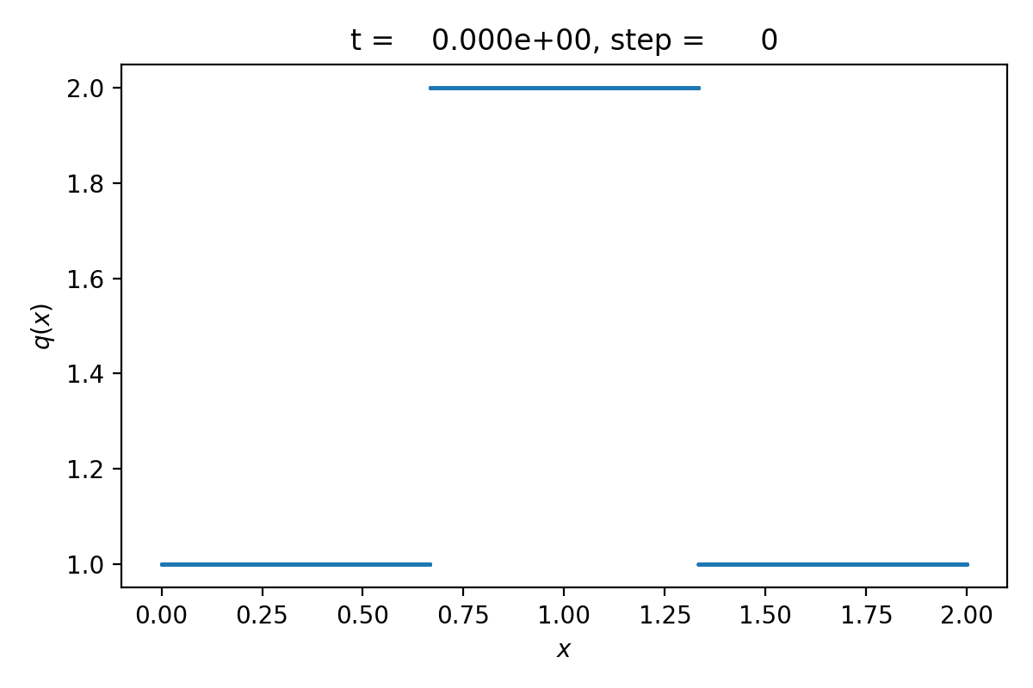
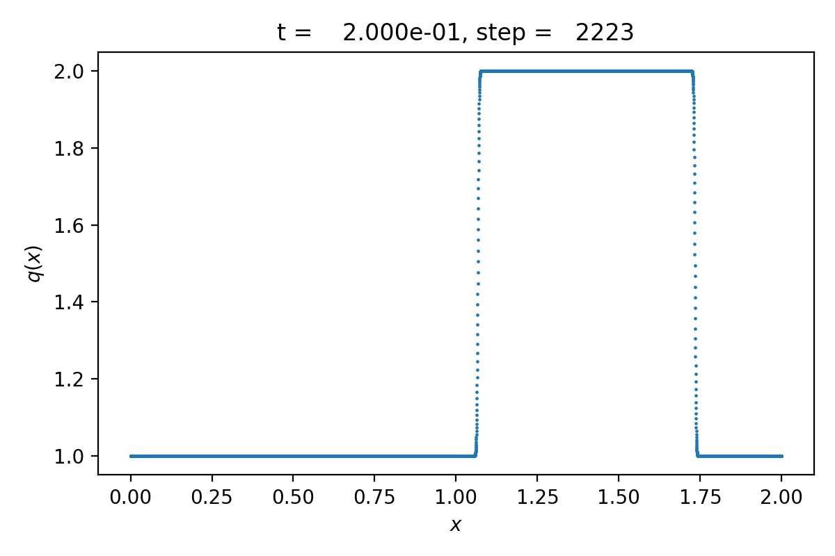
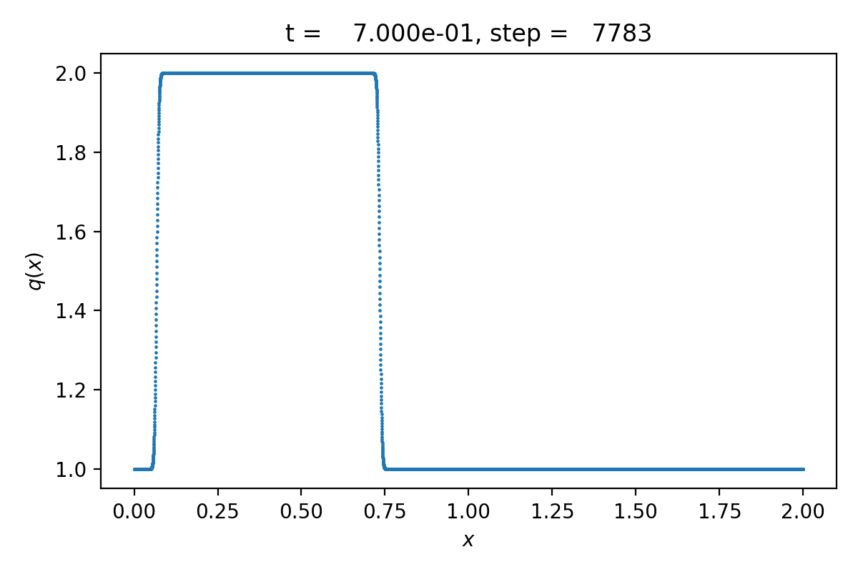
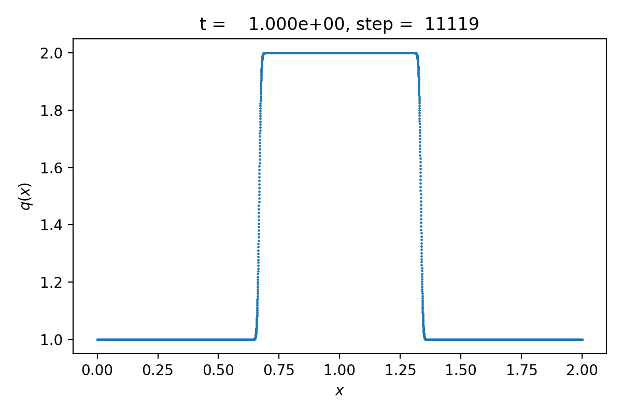
Numerical Solution

Slide 37
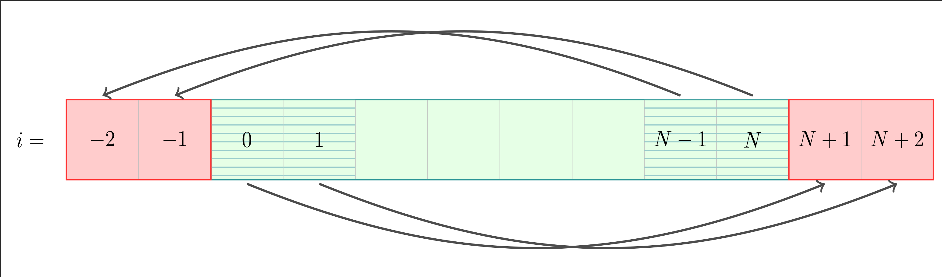
Periodic Boundary Conditions
We add “ghost cells” along on the boundary
Copy content of cells from boundary into ghost cells on other side

Slide 38
Base Algorithm of the Toy Code
Initial Setup:
  set tcurrent = 0
  set up the initial states qi⁰ for each cell i.
While tcurrent < tend , solve the n-th time step:
  Apply periodic boundary conditions
  Find the maximal permissible time step ∆t
  For each cell i, find the updated states qi^{n+1}
  Update the current time: tcurrent= t^{n+1} = t^{n} + ∆t

Slide 39

Determining the Time Step Size
“CFL condition”
Ccfl є [0, 1) : user set parameter
∆x : cell width
a: advection coefficient. Constant, positive, non-zero.

Slide 40
Where to Start?
Grab it from github:
https://github.com/mladenivkovic/debugging-essentials-demo/
$ git clone git@github.com:mladenivkovic/debugging-essentials-demo.git
Check out the theory document – everything you need to know about the code is in the first 2 pages
Compile and run the code, see what happens
Take a look at the Makefile – you might want to make some changes in there
Try using gdb to fix it!

Slide 41
Final Slide

Slide 42
Backup Slides

Slide 43
valgrind
Track down memory leaks
  $ valgrind path/to/your/executable
  $ valgrind --leak-check=full path/to/executable
    For more details, traces, etc.

Slide 44
Address Sanitizer
valgrind is somewhat old software which might slow down your code drastically, require too much memory, or not be up-to-date with newer instructions.
Using the address sanitizer may be a better choice.
That is activated during compilation:
  GCC example:
  $ gcc main.c -o ex -fsanitize=address
  Works the same for clang and icx.
Note: for more complex compilations -fsanitize=address must also be passed to the linker!

