Slide 1

From printf to a Proper Bug Finding Strategy
Debugging and Testing Basics
Mladen Ivkovic
Durham University
November 2023

Slide 2
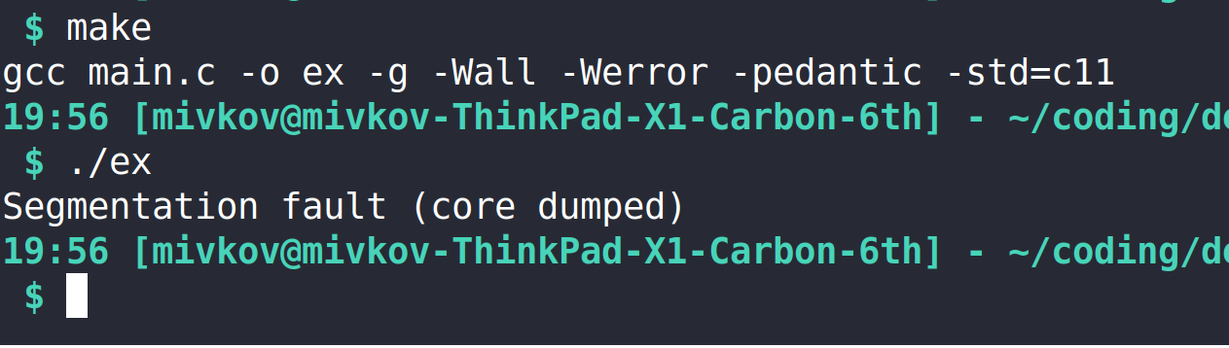
The Joy Of Finding Bugs

Slide 3
How to Approach Bugs
Don’t panic.
Take a systematic approach. Find out:
  What is happening?
  Why is it happening?
  Where is it happening?
Design a unit test that reproduces the bug
Fix the bug
Document the fix (at least a comment in the code) – your future self and collaborators will thank you!
This is what I want
to talk about today

Slide 4
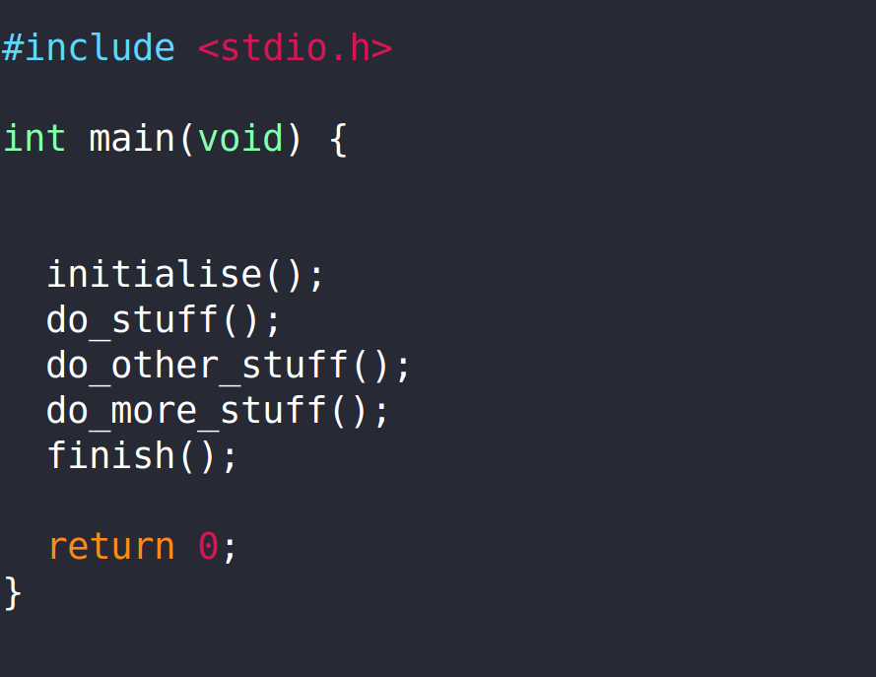
printf – The Ol’ Reliable

Slide 5
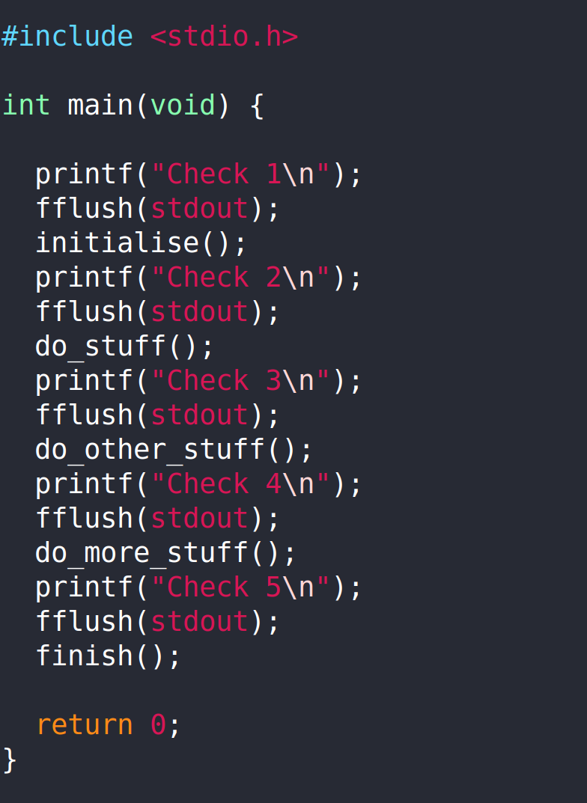
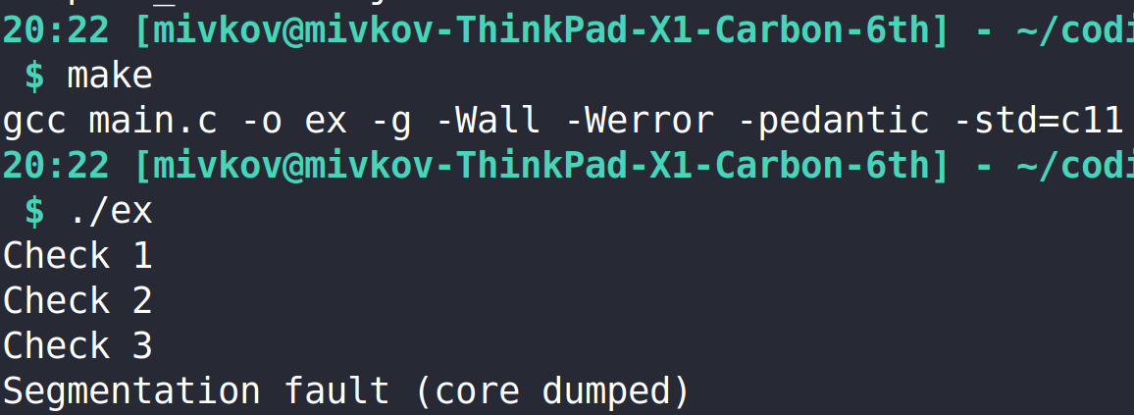
printf – The Ol’ Reliable
Bisect the program – find out how far it gets
WARNING: Don’t forget to flush the stdout – the buffering may not display all the output!
Alternative: Set the stdbuf to unbuffered:
$ stdbuf -o0 ./your_program

Slide 6
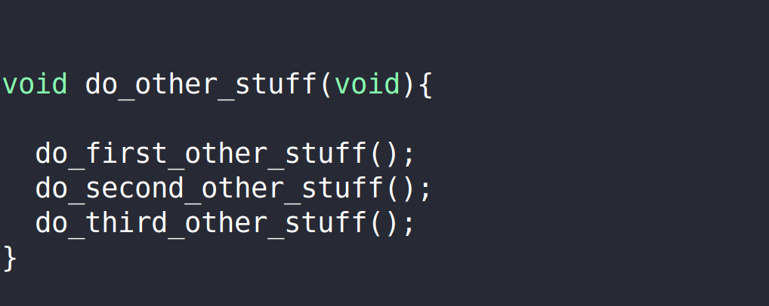
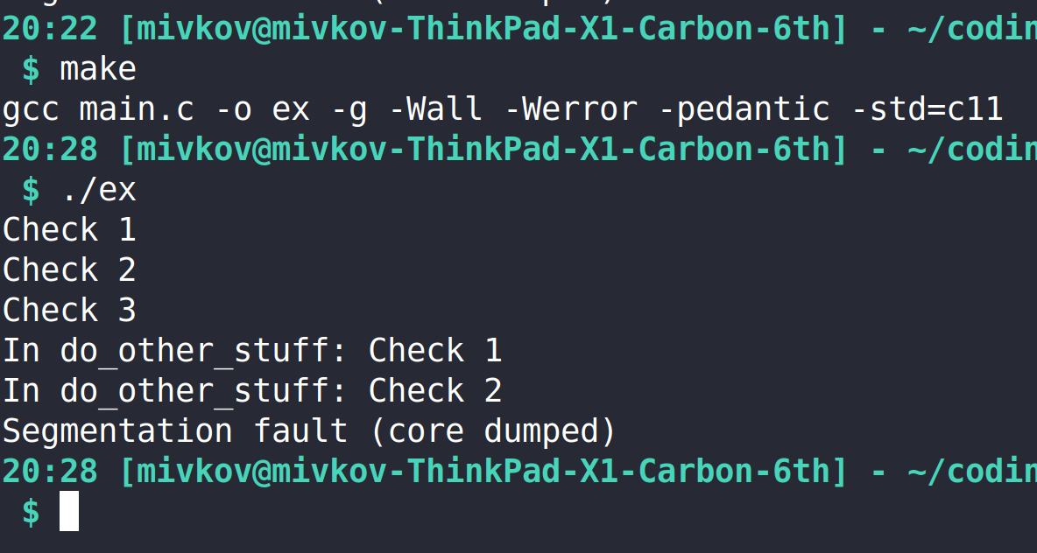
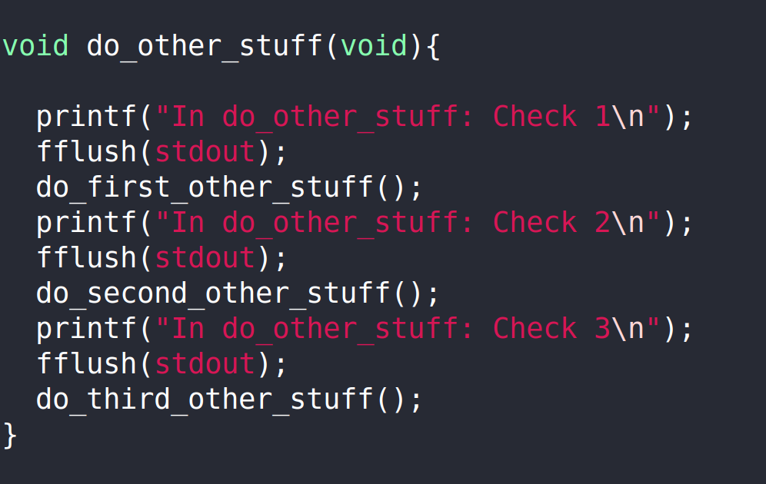
printf – The Ol’ Reliable
Rinse and repeat, until you find where the problem is

Slide 7
printf – The Ol’ Reliable
Bisection with printouts is good and well – but not very efficient.
  Bisection usually means running your code over and over again until you zero in on where the program finds an error.
  Meanwhile, the cause of the error may be somewhere else entirely.
  Typically, you’d remove your checks again after you’re done.
  So if a similar issue arises, you need to start from scratch.

Slide 8
Debugging Strategy
Design your project with debugging in mind
  Keep things clean and documented
  Have an option to make your code talkative
  Add tests, validations, assertions inside and
  outside of your code
    Outside: Regular testing and verification.
    Inside: On-the-fly validation,
    defensive programming
Make your life easier with external tools
Let’s look
at these now

Slide 9
Talkative Code
Supercharge The Ol’ Reliable printf
Typically implemented as a runtime option determining how verbose you want your code to be.
You can set several levels of verbosity!

Slide 10
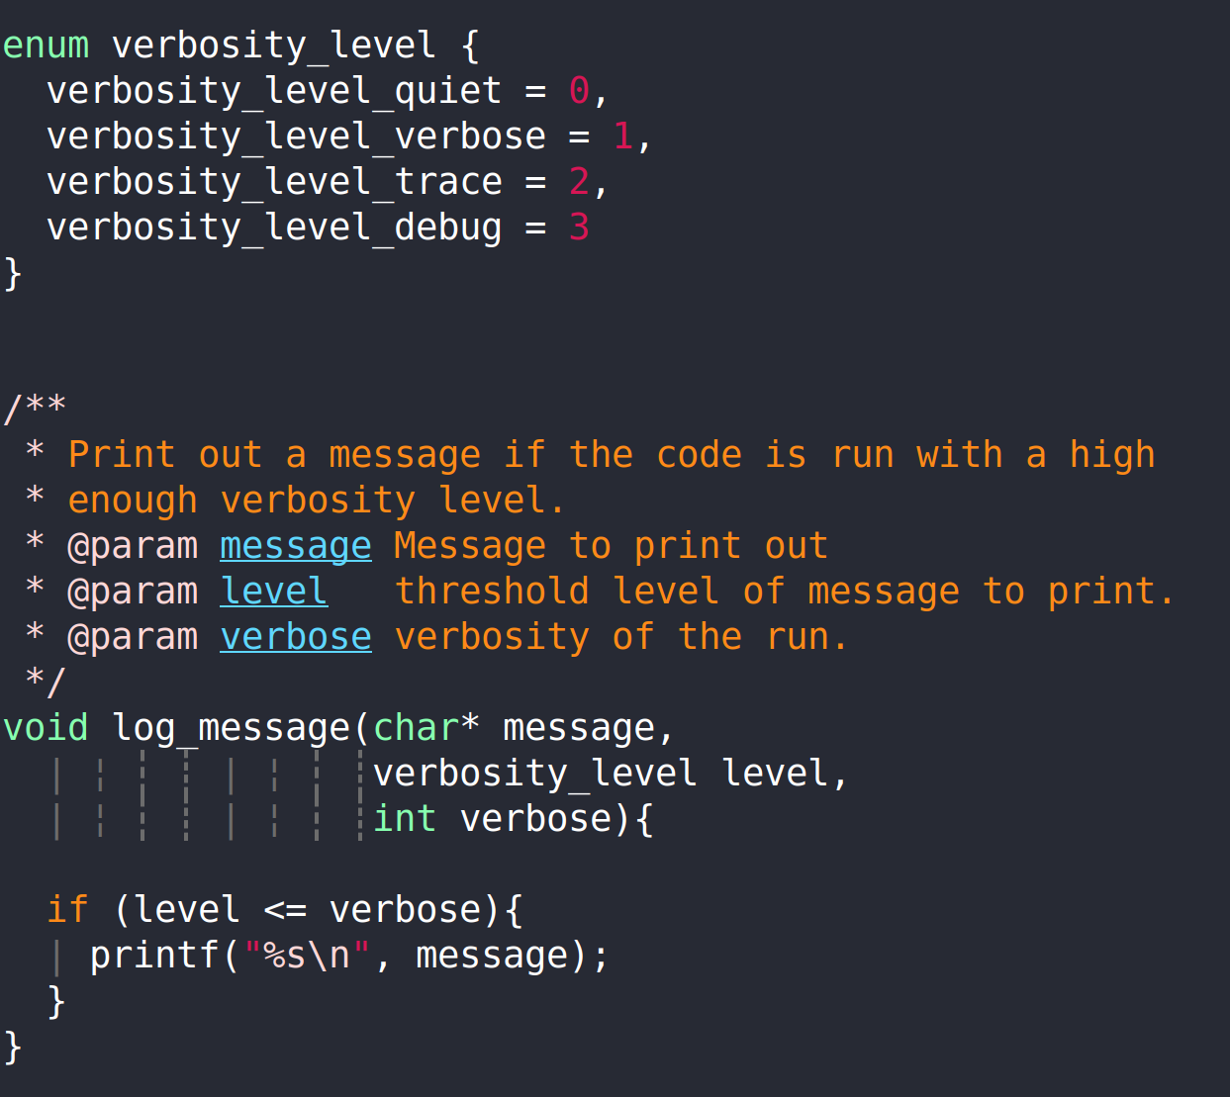
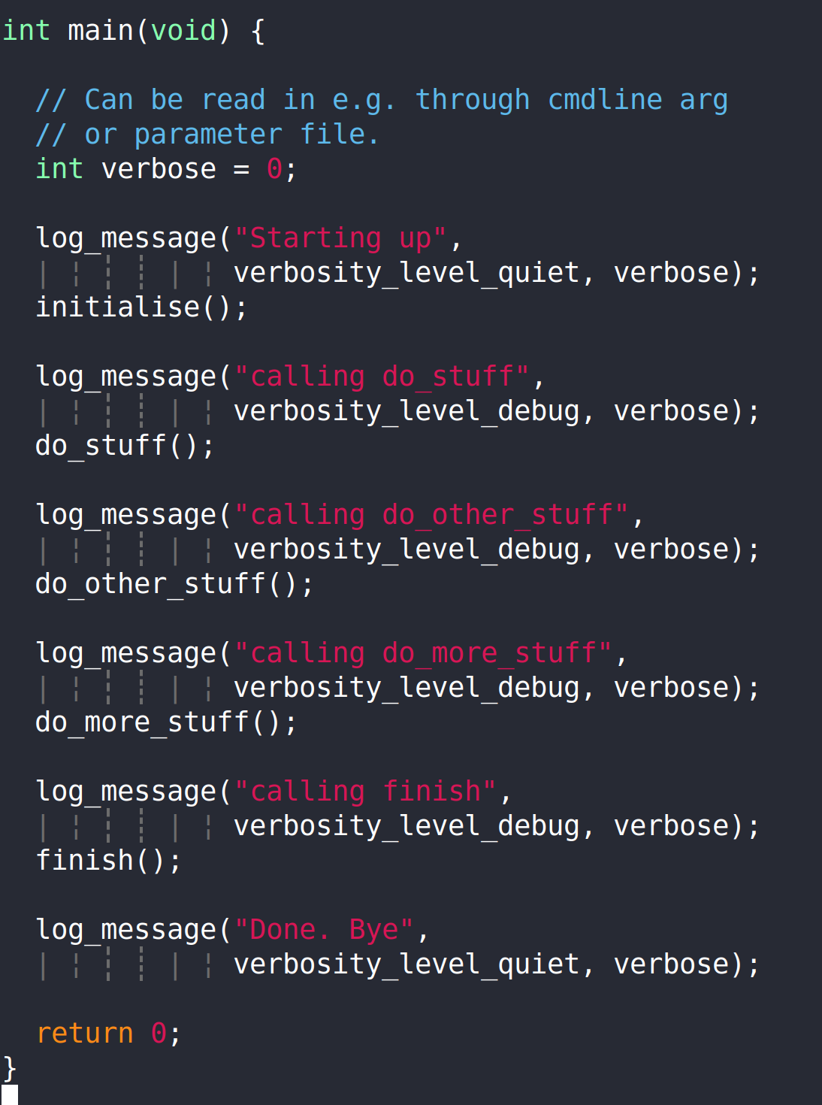
Example

Slide 11
Supercharging the Logs
You might want to consider adding:
  Default flushing to stdout if verbosity level is intended for debugging
  Writing different verbosity level outputs to different log files
  Applying additional filters to your logs
  All sorts of bells and whistles, e.g.
    Which file, function, line number is this message coming from?
    What is the elapsed time since startup?
    What thread/rank is this message from?

Slide 12
External Testing
We differentiate between
  Unit Testing
  Functional Testing
  Regression Testing
Ideally, you automate these tests.
  e.g. every time you update your main git branch,
  you run a full test suite. (→ continuous integration)

Slide 13
Unit Testing
Tests for small units of your code
  e.g. individual functions, objects, …
Test that it does what it’s supposed to, and nothing else
Test corner cases, limits, how it deals with wrong data, input etc.

Slide 14
Unit Testing: How-To
Split your code into logical units, and test that the units behave exactly how you want them to.
Ideally, you have a unit test for each function you write.
In practice, you need to have unit tests for your core routines.

Slide 15
Unit Testing – What to test?
Main use case
  Does the code do what I want it to do?
Every corner case you can think of
  Correct values, wrong values, unexpected values, …
Every corner case you can’t think of
  Try your luck here! Use randomly generated setups, values, …
  Advice: If you are using random numbers:
    set a random seed to make your run reproducible
    make your program write out the used random seed so you can reproduce the test.

Slide 16
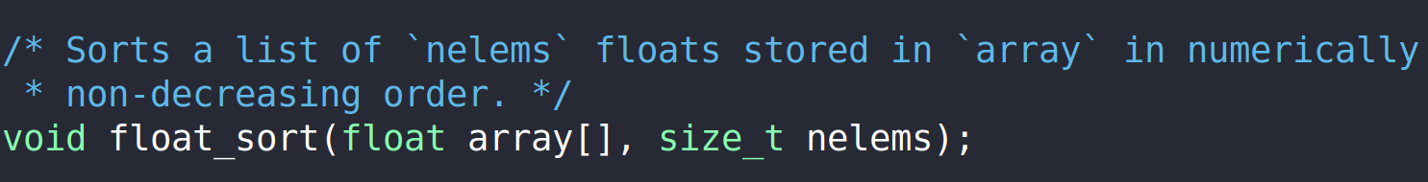
Unit Testing - Example
What if nelems == 0?
What if array has only one element?
What if array has multiple identical elements?
What if array is already sorted? Or reverse sorted?
Does it work with an even number of elements? Odd number of elements?
What if array contains inf, -inf, NaN, FLT_MIN, FLT_MAX ?

Slide 17
Functional Testing
Similar to unit testing in the sense that it tests (parts of) the code
(Parts of) code not restricted to individual units any more.
Typically functional testing isn’t concerned with the source code, but with some external specification.
  E.g. “this program must be able to read in data written in format X and create a plot.”
In short: Test specific functionalities of (parts of) your code.

Slide 18
Regression Testing
Test the actual result/output of your program for correctness.
In a nutshell: test that known correct results are still correct.
It’s vital to have a suite of tests, experiments, benchmarks etc. to validate current state of your code.

Slide 19
Something Broke After I Changed It
Strategy: Look into what you changed, and how that could have caused a problem.
Advice: Make use of git (or any other version control)
  If you aren’t using git already, you really really should be

Slide 20
Internal Testing
Tests performed on-the-fly while your program runs
Some of the trickiest bugs to uncover are due to faulty assumptions.
  Example:
  “My code has been running correctly so far.”
  Your code may end up in a faulty state without you noticing or it being detected.
    → try to detect it!
    Explicitly verify current state of the running program satisfies assumptions and restrictions.

Slide 21
Internal Testing
Two branches of internal tests:
  Validate the current state of your program
    Is everything as it should be?
    Did an unexpected situation occur?
  Defensive programming
    Anticipate what state could break things, and guard against them, or raise an error notifying yourself what is wrong

Slide 22
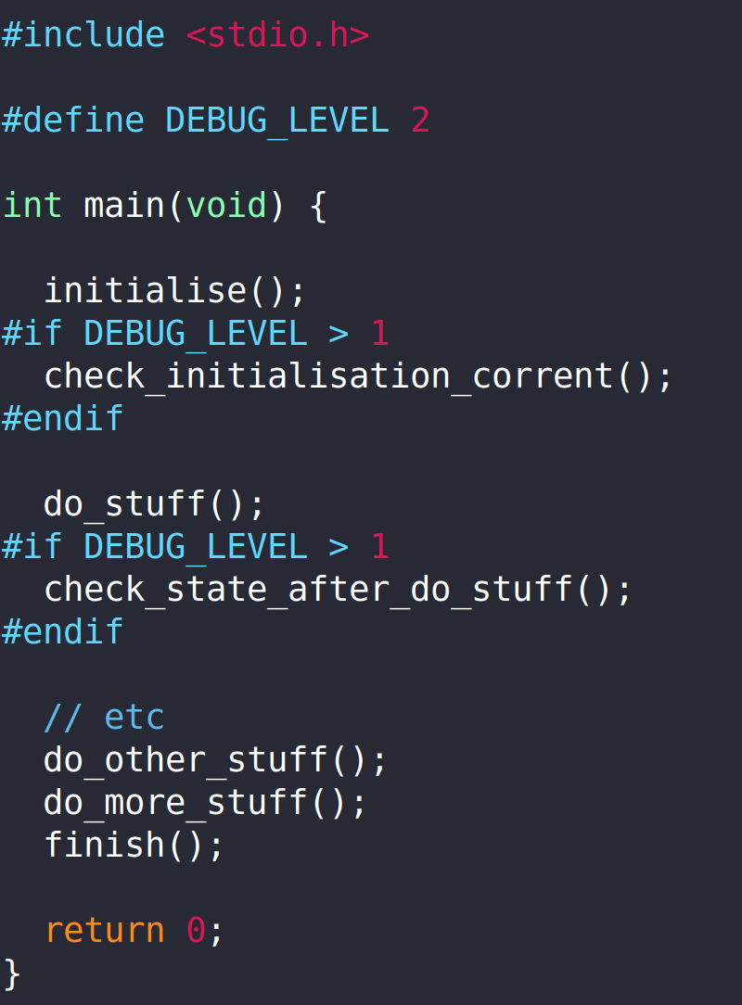
Validation Example

Slide 23
Validation Example
Very often you write your validation tests while first developing a new feature.
  Keep them! Don’t throw them away.
  If you’re worried about performance, you can hide them behind a compile time macro such as
  #if DEBUG_LEVEL > 1
  or
  #ifdef DEBUG_CHECKS
They might automatically uncover bugs for you.
If they don’t, they will provide you with a palette of checks telling you what the problem isn’t. That is valuable information.

Slide 24
Defensive Programming
Anticipate what state could break things, and then explicitly check that you aren’t in that state.

Slide 25
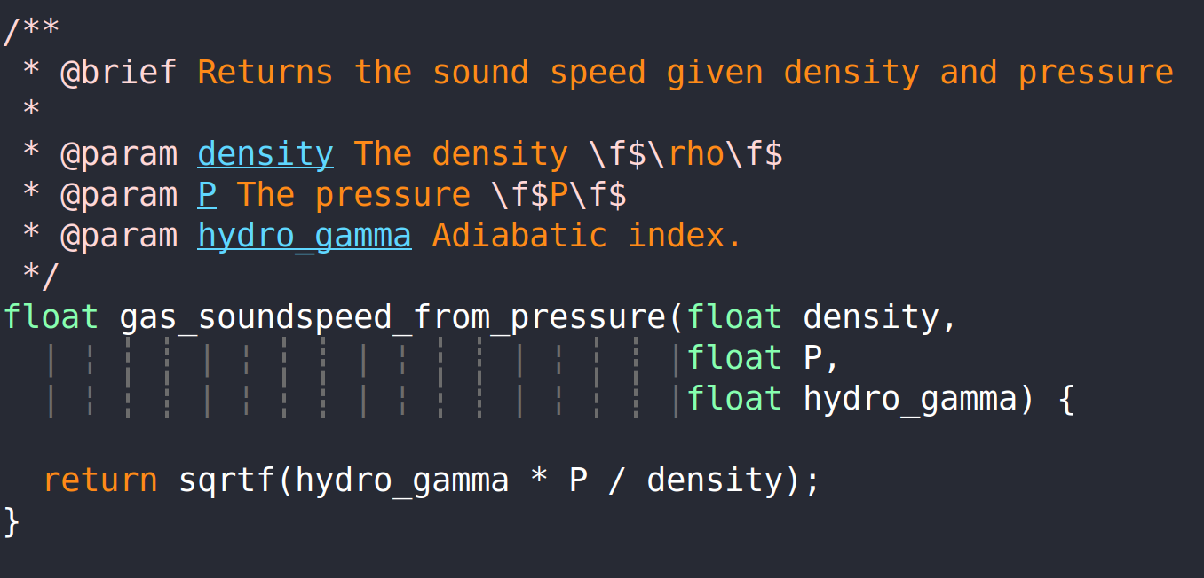
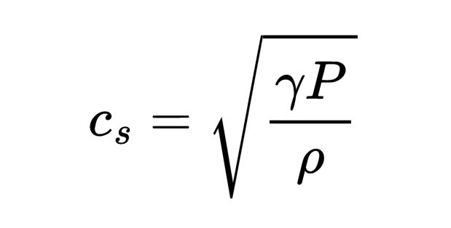
Defensive Programming - Example
What can go wrong?
  density == 0 → division by zero
  Any of the variables < 0 → undefined operation
  Any of the variables is inf or NaN

Slide 26
Summary So Far
printf bisection does the trick, but isn’t the best way of doing things.
Design your code with debugging in mind:
  Make it talkative, enable logging relevant information
  Add tests and validations
    External: Unit tests, functional tests, regression tests
    Internal: Validation tests, defensive programming

Slide 27
External Debugging Tools
Even with a good defence, bugs happen.
Some tools to deal with them:
  gdb
    tracebacks, live inspection
  Valgrind, address sanitizer
    memory leaks, memory issues
Live demo scripts (+ hands on exercise)
  https://github.com/mladenivkovic/debugging-essentials-demo

Slide 28
gdb
Compile your program with debug symbols -g, or -ggdb
  $ gdb /path/to/executable
  $ gdb --args path/to/executable --arg1 --arg2
Useful commands:
  b (break) set a break point
  l (list) show source code in CLI
  p (print) print variables
    For pointers: p *pointer works too!
  bt (backtrace) show stack trace
  c (continue) continue run
  n (next) execute next line
  frame show current location in trace
  frame <frame nr> change into <frame nr>

Slide 29
gdb breakpoints
Set breakpoint: (before you execute run)
  break <line number in main file>
    e.g. break 12 to break on line 12
  break path/to/file.c:<line number>
    e.g. break includes/my_includes.h:13
  break file.c:function_name
    To break when a function is called

Slide 30
gdb breakpoints
Navigation:
  l (list) show source code
    l <line number> show source code starting at line number
  bt (backtrace) show stack trace
  c (continue) continue run
  where show current location in trace
  frame show current location in trace
  frame <frame nr> change into <frame nr>
info break : show information on currently set breakpoints
del 1 : delete breakpoint 1.
  You can find breakpoint numbers using info break

Slide 31
gdb watchpoints
watch <variable> : halt program execution when value of variable is changed.
  You can set watchpoints at startup (before executing run) if the variable is in global scope.
  Otherwise, you need to first set a breakpoint at a point where the variable is in scope.
  Example:
// you can set watchpoint at
// `sum` before `run`
int sum;
int main(void){
  // do stuff
}
// you need to set a breakpoint
// inside main() and then set a
// watchpoint
int main(void){
  int sum;
  // do stuff
}

Slide 32
gdb reverse
It is possible to run a program in reverse with gdb, but the functionality is very restricted.
  Many optimizations/vectorizations break it. So make sure to compile and run without any optimizations enabled.
  Chances are it might still not work with modern instructions.
  Recording significantly slows down execution time. May require a lot of memory.
How-To:
  Set a breakpoint from which to record the program execution.
  Run the record command when this breakpoint is hit.
  Set a different breakpoint at the point you wish to examine.
  Once you hit the breakpoint, you can go back through the code using
    rs (reverse-step) : go in reverse line by line
    rc (reverse-continue) : go in reverse until last breakpoint

Slide 33
gdb + segfaults and other errors
One of the most useful features of gdb is to catch signals which would usually kill your program and halt it before it aborts.
This permits you to explore the current state of your program just before your crash.
This doesn’t need any special activation. Just run your code with gdb!
  But don’t forget to compile it with debug symbols
  (-g or -ggdb) to get meaningful traces

Slide 34
gdb + core dumps
It’s possible to enable core dumps:
  when program encounters error, write down what is currently in memory instead of just quitting
  Enabling core dumps on linux:
    $ ulimit -S -c unlimited
    Note: your sysadmins may have disabled this.
    Default core dump location may vary.
      On HPC systems, it’s often set to $workdir.
      On Ubuntu 21+, /var/lib/apport/coredump/
gdb can read that back in and allow you to debug!
$ gdb -c core.XXXX path/to/executable

Slide 35
gdb – “value has been optimized out”
„value has been optimized out” workaround
  Compile entire program without optimization
  … or tell compiler not to optimize specific function you’re looking at:
GCC:
#pragma GCC push_options
#pragma GCC optimize ("O0")
void your_function(){...}
#pragma GCC pop_options
Intel:
#pragma optimize( "", off )
void your_function() {...}
#pragma optimize( "", on )
// or
#pragma intel optimization_level 0
void your_funtction(){...}
Clang:
__attribute__((optnone))
void your_function()
{...}

Slide 36
FPEs – Floating Point Exceptions
There are ways of telling the compiler to raise an error if an invalid arithmetic operation (FPE) has occurred
This is unfortunately not standardised – it depends on the compiler and the hardware.
FPE types:
FE_DIVBYZERO | Pole error: division by zero, or some other asymptotically infinite result (from finite arguments).
FE_INEXACT | Inexact: the result is not exact.
FE_INVALID | Domain error: At least one of the arguments is a value for which the function is not defined.
FE_OVERFLOW | Overflow range error: The result is too large in magnitude to be represented as a value of the return type.
FE_UNDERFLOW | Underflow range error: The result is too small in magnitude to be represented as a value of the return type.

Slide 37
FPEs – Floating Point Exceptions
// `feenableexcept()` is a GNU extension, not
// standard C. We need to define _GNU_SOURCE
#define _GNU_SOURCE
#include <fenv.h>
// make sure to link with -lm as well
int main(void){
// combine options using binary OR
feenableexcept( FE_DIVBYZERO |
FE_INEXACT | FE_INVALID |
FE_OVERFLOW | FE_UNDERFLOW);
// rest of your code
}

Slide 38
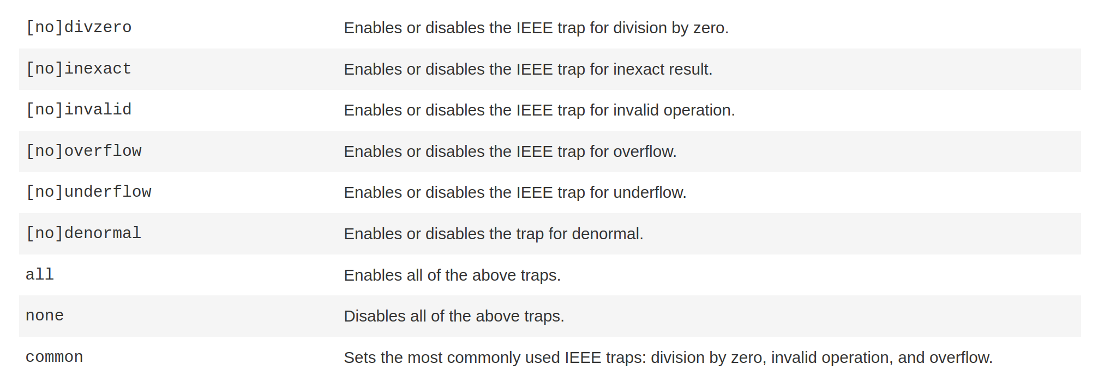
FPEs – Floating Point Exceptions
With classic intel compiler:
  Compile with
  $ icc main.c -fp-trap=mode -g
    (don’t need to do all the feenableexcept() stuff)
    Modes:

Slide 39
gdb + MPI: Poor Man’s Parallel Debugger
$ mpirun -n 4 xterm -e gdb -ex run \
--args your_program --arg1 --arg2
    Launch 4 MPI ranks
    Launch a terminal (xterm) and execute subsequent command (-e)
    Launch gdb and immediately execute „run” command
    gdb flag: The executable (your_program) will need command line arguments
    (--arg1, --arg2)
    Launch your program with extra cmdline arguments
MPI_Abort() may exit gracefully instead of raising/signalling an error.
  Simplest workaround: Replace with abort() while debugging.

Slide 40
valgrind
Track down memory leaks
  $ valgrind path/to/your/executable
  $ valgrind --leak-check=full path/to/executable
    For more details, traces, etc.

Slide 41
Address Sanitizer
valgrind is somewhat old software which might slow down your code drastically, require too much memory, or not be up-to-date with newer instructions.
Using the address sanitizer may be a better choice.
That is activated during compilation:
  GCC example:
  $ gcc main.c -o ex -fsanitize=address
  Works the same for clang and icx.

Slide 42
Additional Topics
Some additional tips and tricks with gdb, which aren’t covered by the live demo.
display <variable> :
print variable every time it is touched throughout the run.
finish :
after a breakpoint, run function until the end, and halt there.
info locals :
print all local variables.
s (step):
like n (next), but execute a single step of the line, instead of the full line.
disable breakpoint/watchpoint :
disable breakpoint or watchpoint, but don’t delete it. You can undo that with
the enable command.
tbreak :
set temporary breakpoint. Is automatically deleted after being hit once.
tui enable :
  start a fancy text user interface to look through program’s source code. See https://sourceware.org/gdb/current/onlinedocs/gdb.html/TUI.html for more.

Slide 43
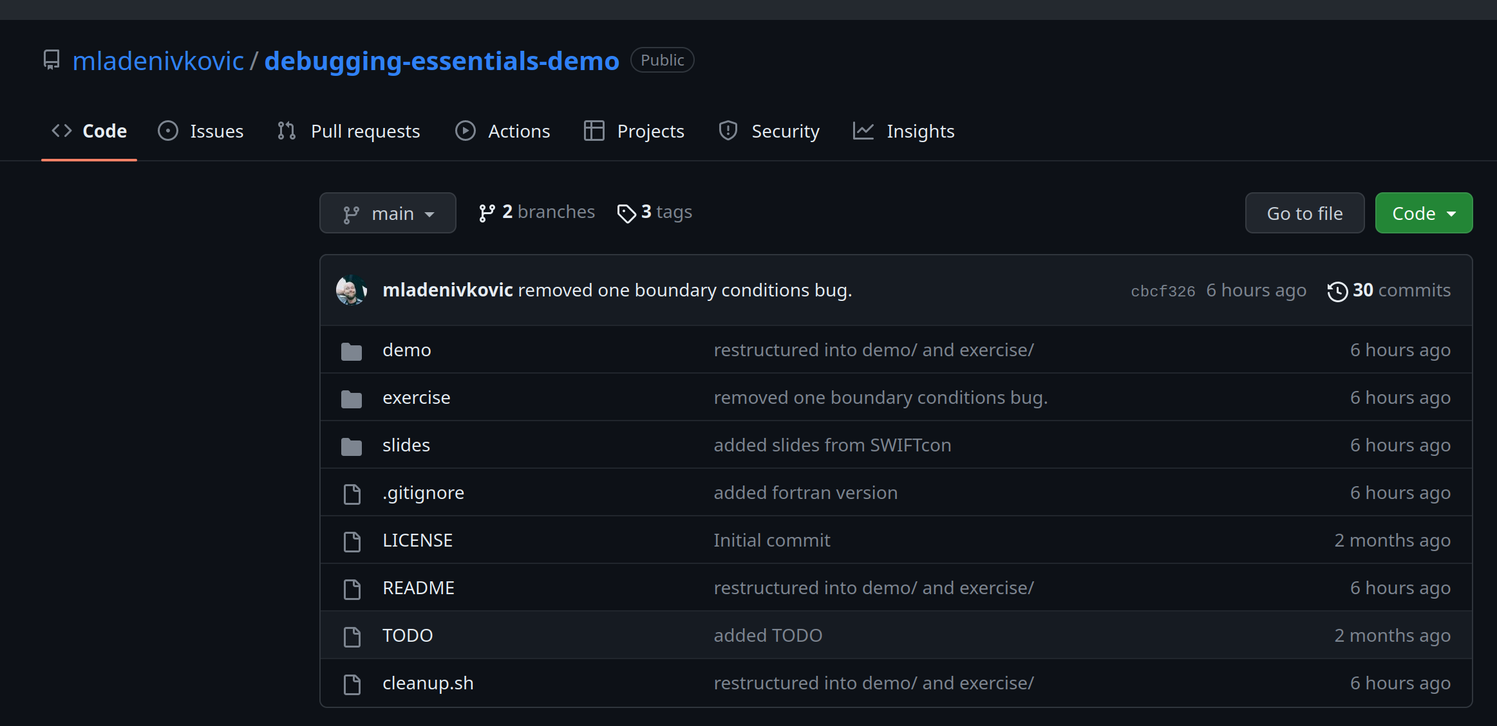
Hands-On Exercise
Grab it from github:
https://github.com/mladenivkovic/debugging-essentials-demo/
the demos I just
went through
what we’ll be
doing now
these slides

Slide 44
How the Game Is Played
The exercise/ directory contains a small toy code.
I have planted bugs in that code.
You go and find them!
  ... after a short introduction that follows

Slide 45
Directory Contents
exercise/src
  source files of toy code with planted bugs in C and in Fortran
exercise/solution
  correct versions of the code.
  (You can compile and run this to see what the results should be.)
exercise/theory
  TeX documentation on what code does and how it works.
  Everything you need to know about this code is on the first 2 pages!
exercise/plot_solution.py
  python3 script which will plot the program’s output for you

Slide 46
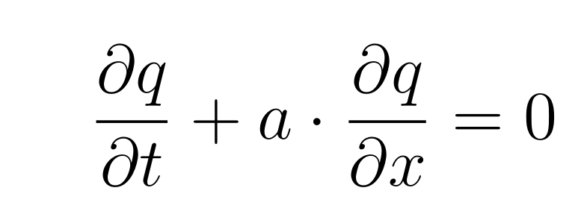
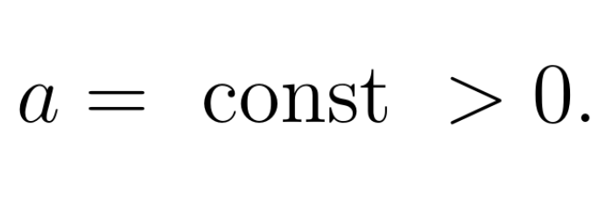
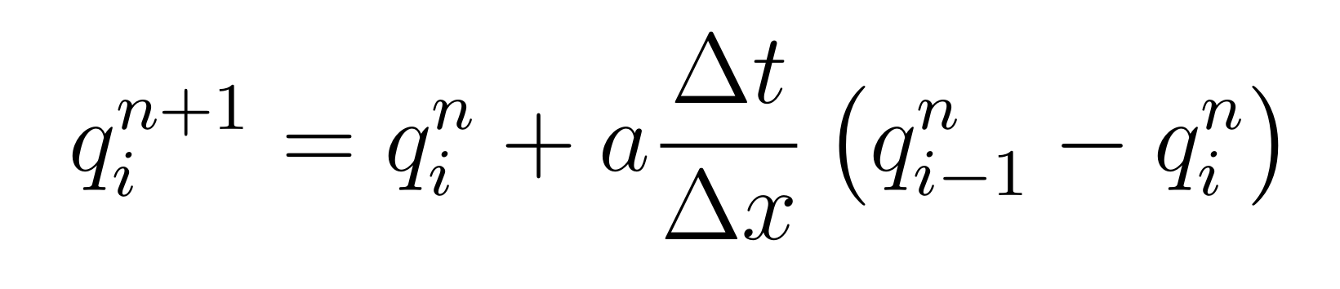
The Toy Code: linear_advection
Solves the equation of linear advection in 1D:
Using a very simple numerical method:

Slide 47
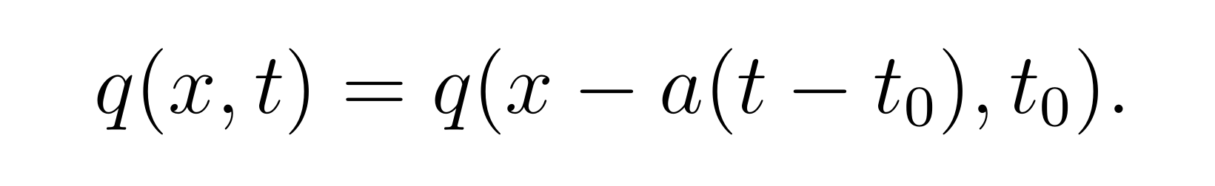
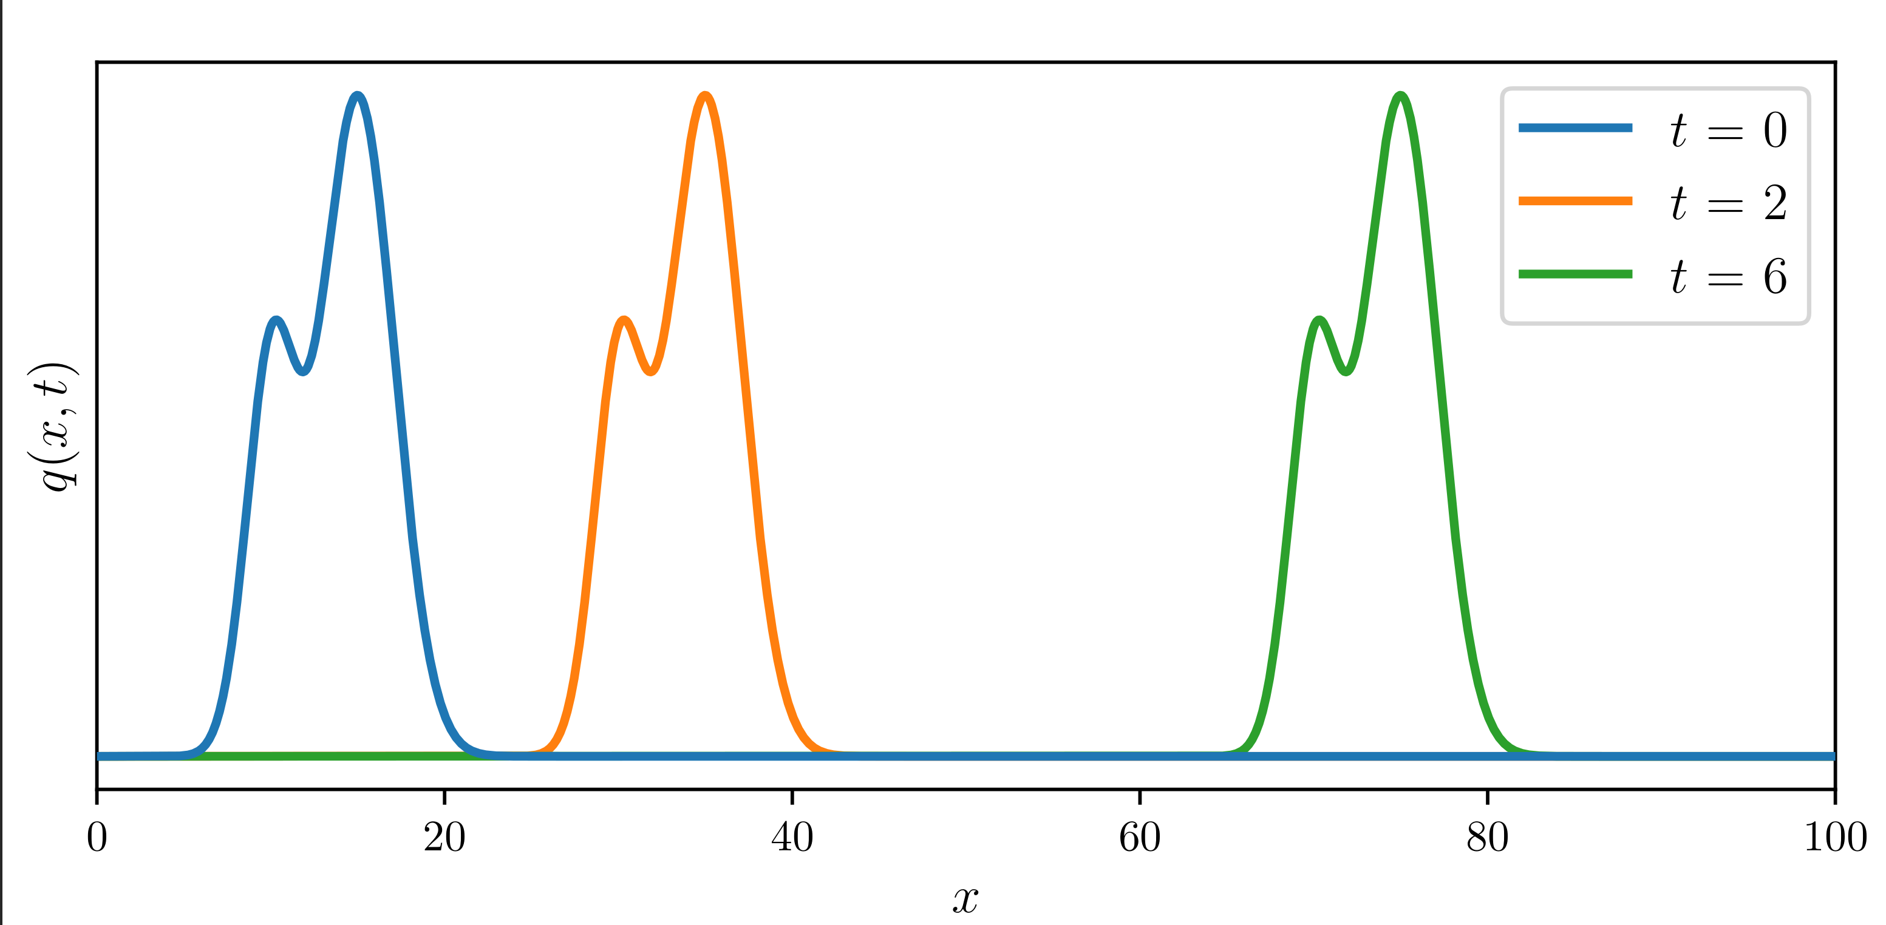
Analytical Solution

Slide 48
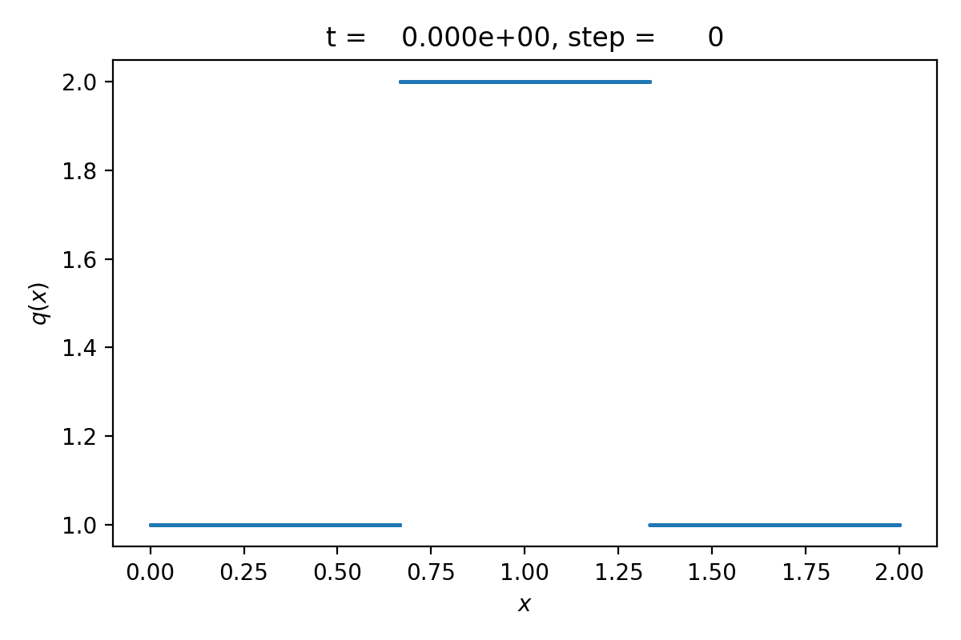
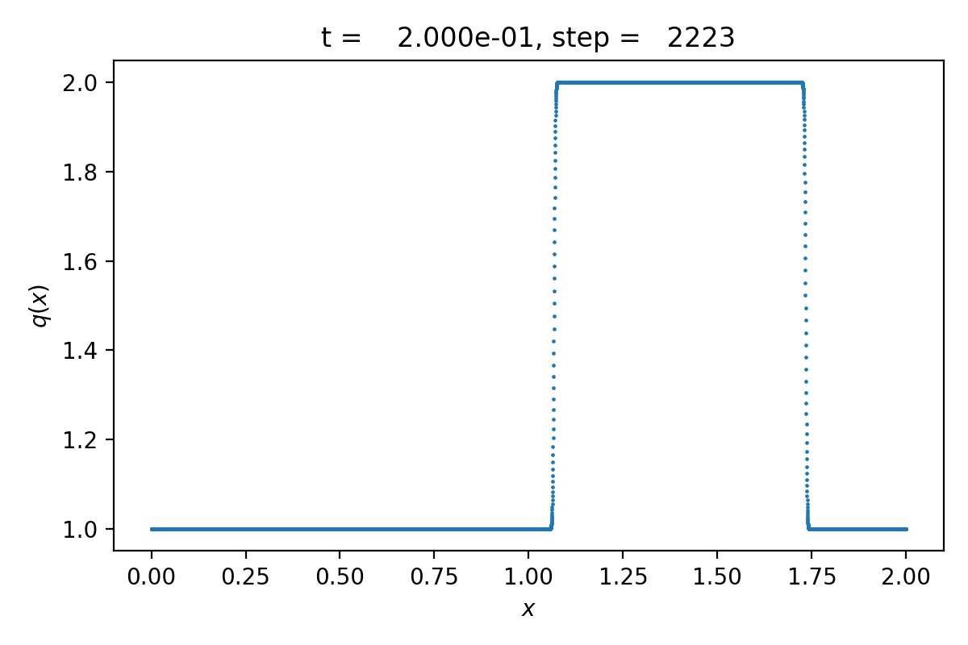
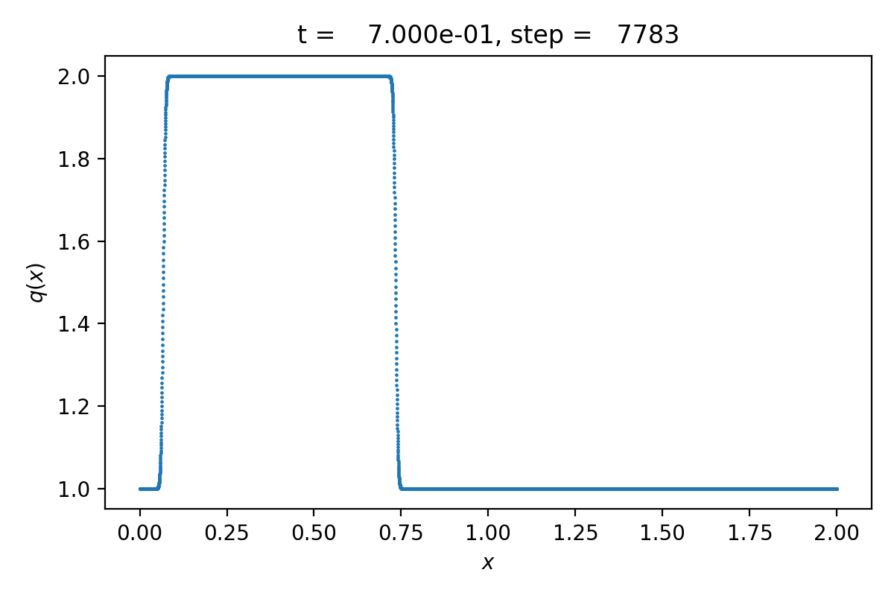
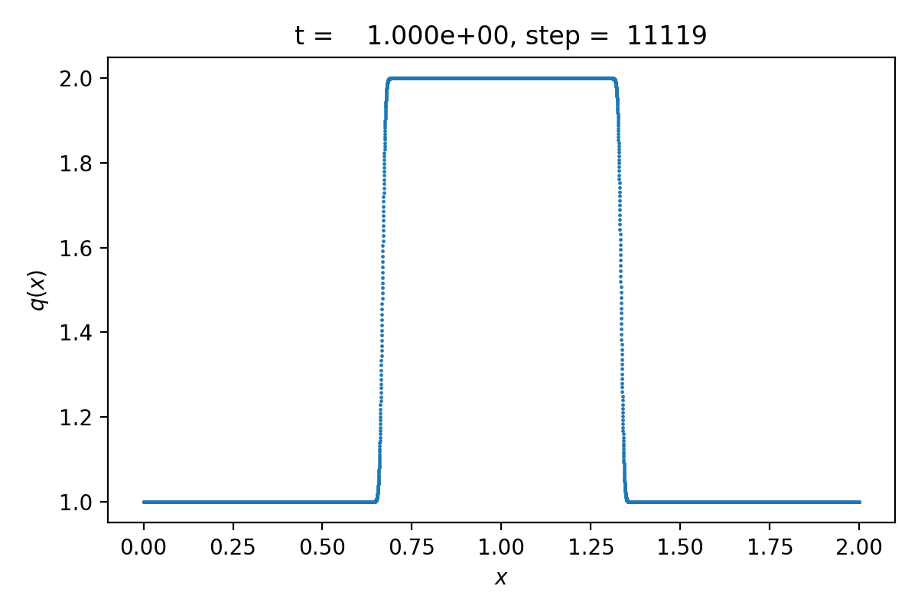
Numerical Solution

Slide 49
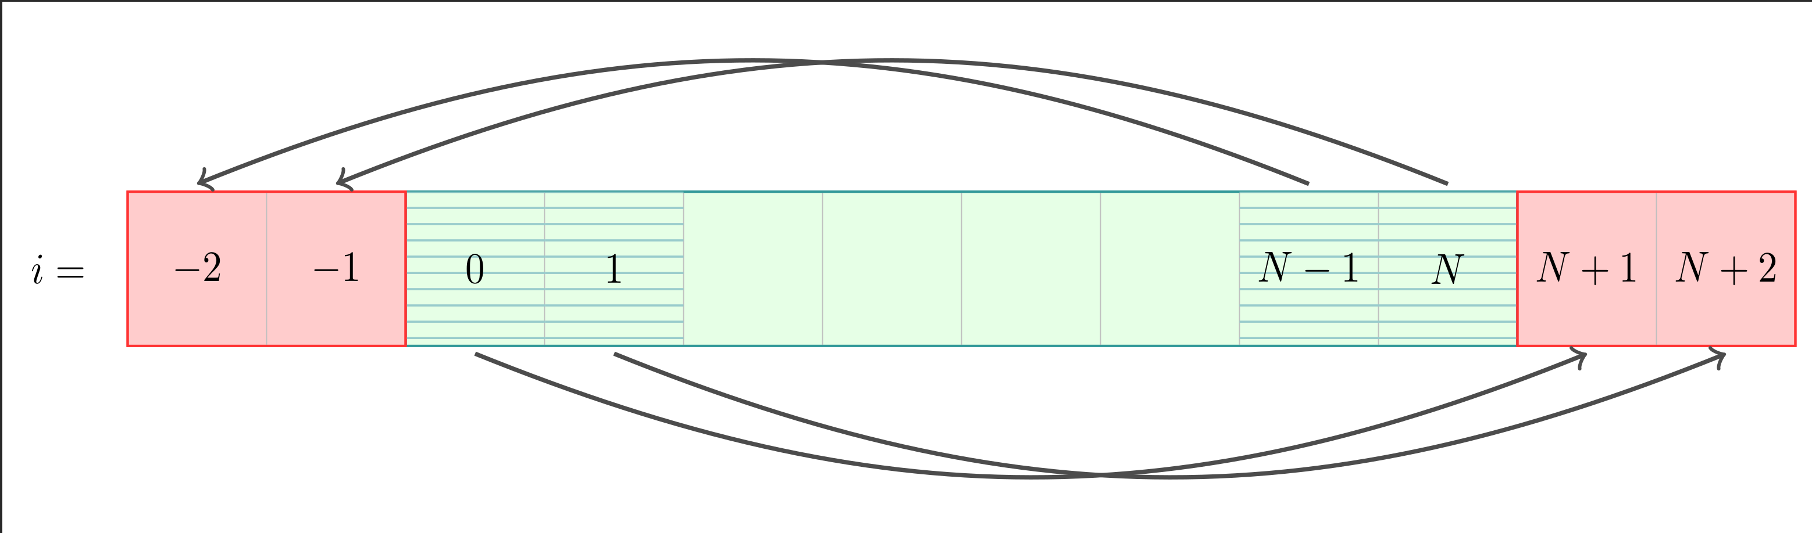
Periodic Boundary Conditions
We add “ghost cells” along on the boundary
Copy content of cells from boundary into
ghost cells on other side

Slide 50
Base Algorithm of the Toy Code
Initial Setup:
  set tcurrent = 0
  set up the initial states qi⁰ for each cell i.
While tcurrent < tend , solve the n-th time step:
  Apply periodic boundary conditions
  Find the maximal permissible time step ∆t
  For each cell i, find the updated states qi^{n+1}
  Update the current time: tcurrent= t^{n+1} = t^{n} + ∆t

Slide 51

Determining the Time Step Size
“CFL condition”
Ccfl є [0, 1) : user set parameter
∆x : cell width
a: advection coefficient. Constant, > 0

Slide 52
Where to Start?
Grab it from github:
https://github.com/mladenivkovic/debugging-essentials-demo/
Check out the theory document – everything you need to know about the code is in the first 2 pages
Run and compile the code, see what happens
Take a look at the Makefile – you might want to make some changes in there
Try using new techniques to fix it!

Slide 53
Instructions for DINE
The toy program should work on your own machines. You can however also work on DINE.
  https://www.dur.ac.uk/icc/cosma/facilities/dine/
  https://www.dur.ac.uk/icc/cosma/facilities/dine/notes/
Required modules:
  A compiler:
    Intel Classic: module load intel_comp/2018
    Intel oneAPI: module load oneAPI/2022.3.0
    gnu: module load gnu_comp/10.2.0
    LLVM: module load llvm/13.0.0
  gdb: module load gdb
  valgrind: module load valgrind
    WARNING: needs gnu compiler: module load gnu_comp/10.2.0
  Python: module load python/3.9.1-C8

