Slide 1
Welcome to Linear

Slide 2
About Us :
Lets make our life interesting by putting ourselves into the most enjoyable jobs around .
It isn’t enough to just do your job, you had to have an interest in it, even a passion for it.
Now there is time, Where you love to work.

Slide 3
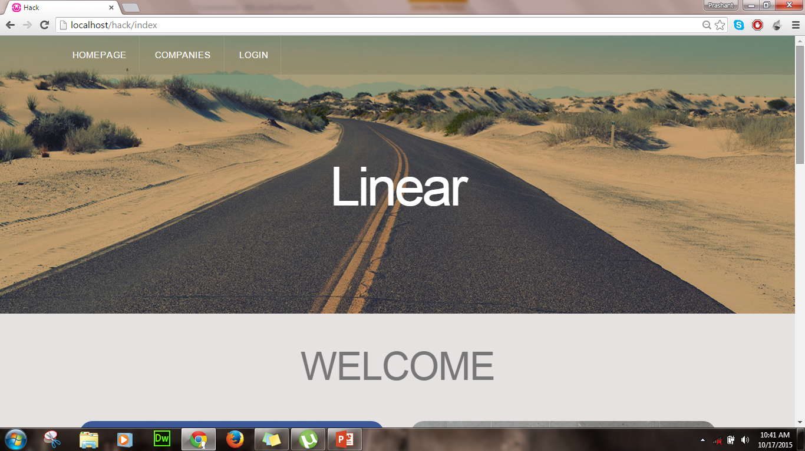
Lets now, Begin our Journey !! ☺

Slide 4
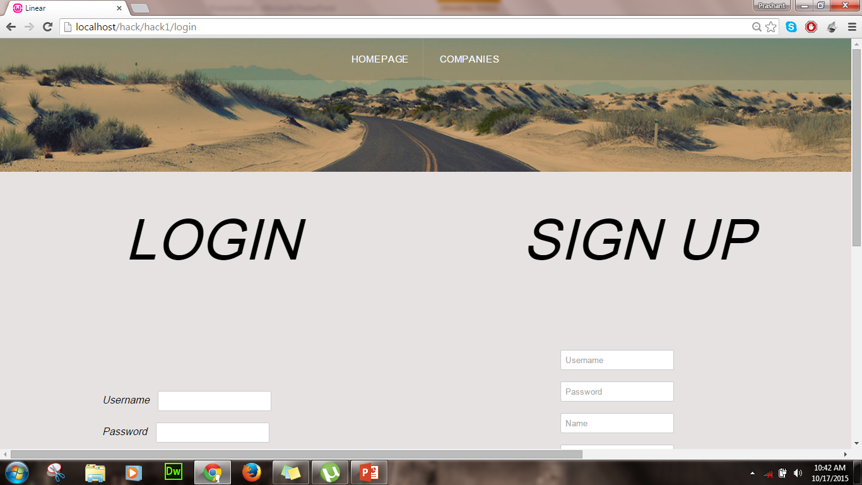
Now one step ahead !! By entering yourselves into a new world

Slide 5
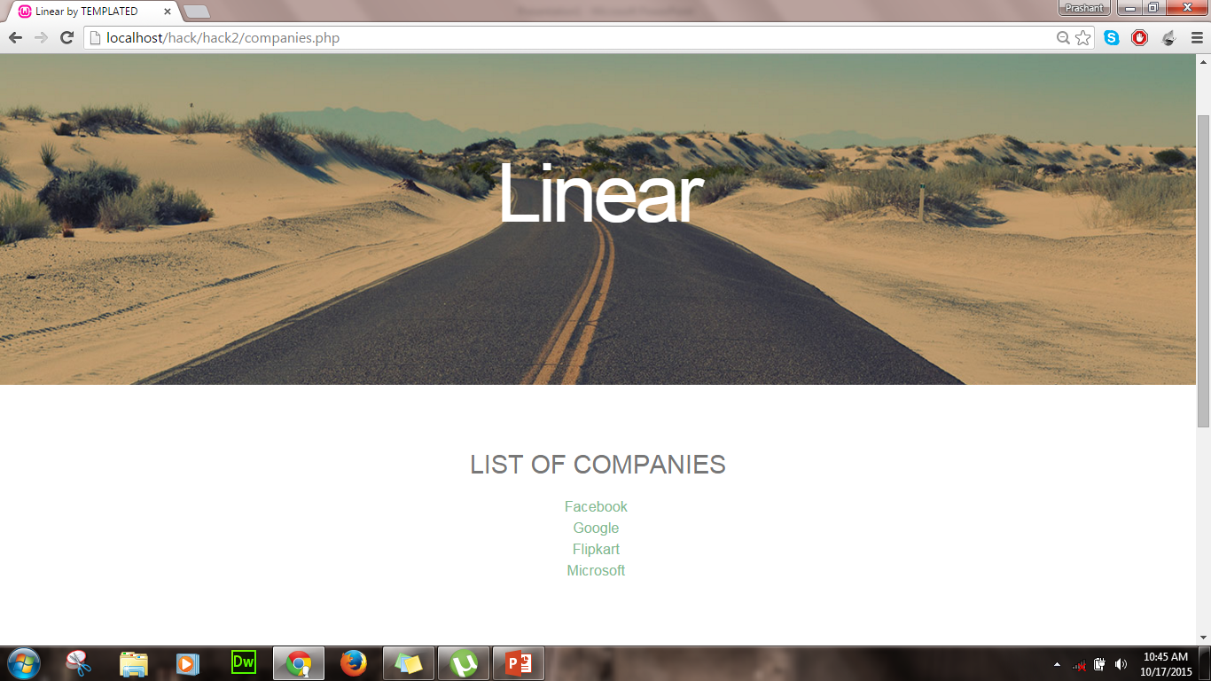
Now, lets a take a tour !!

Slide 6
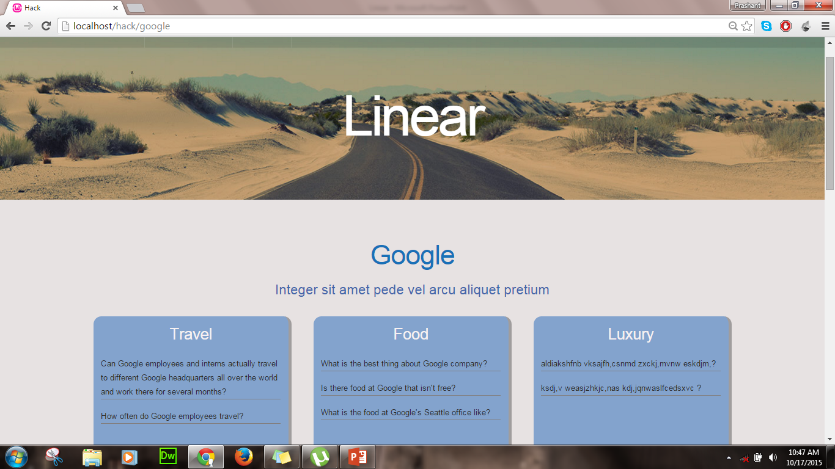
Lets have overview, Google !! Seems interesting…. Moving ahead ☺

Slide 7
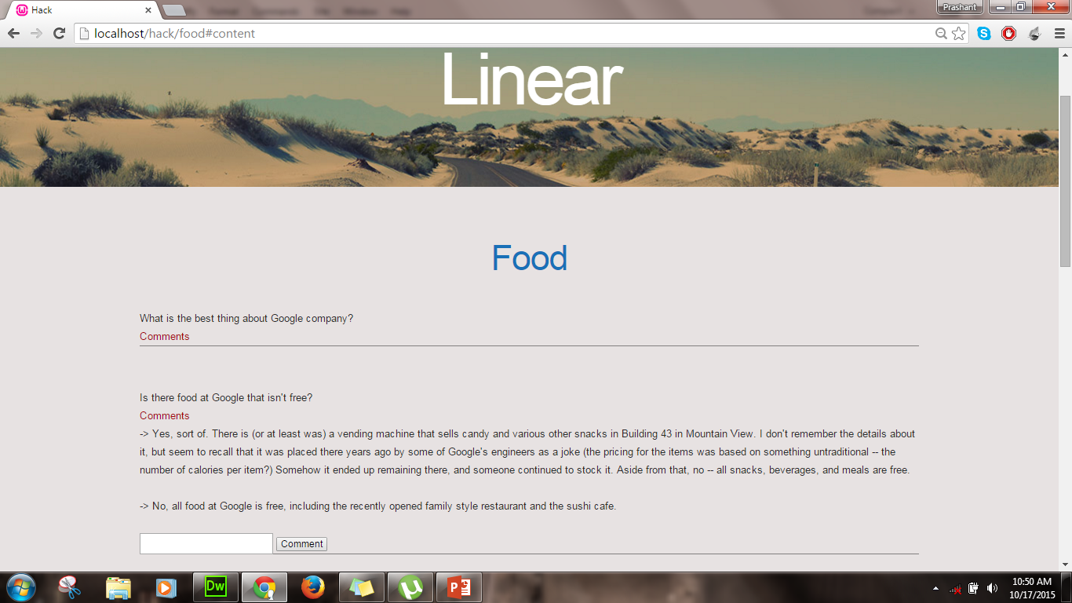
Lets take insight last view ….

Slide 8
Sorry ☹ .… I can understand, But you have to use in order to know more !! ☺
Thanks a lot for patience!!
Mayank Ladia - 981479163☺
Jasdeep Singh Arora - 9650833414 ☺

