Slide 1
W3C WoT - Bundang Plugfest
Intel

Slide 2
Goals
Demonstrate “descriptive” capability
Give Thing descriptions for existing devices
Automatically or semi-automatically if possible, eg by translating existing metadata
Bridge multiple ecosystems
OCF, web services, node-wot based Things
NAT Traversal
Demonstrate application of semantics
Semantic voice interface to “generic” Alexa service
Support secure authentication and confidentiality
All interfaces to use one of {basic,digest,bearer} auth and HTTPS (self-signed certs if necessary, external CA if possible)
Make systems available online pre- and post- plugfest

Slide 3
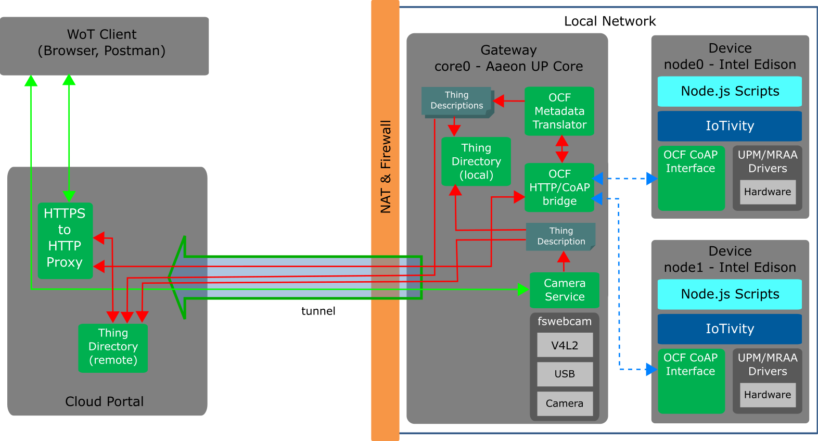
Current Architecture

Slide 4
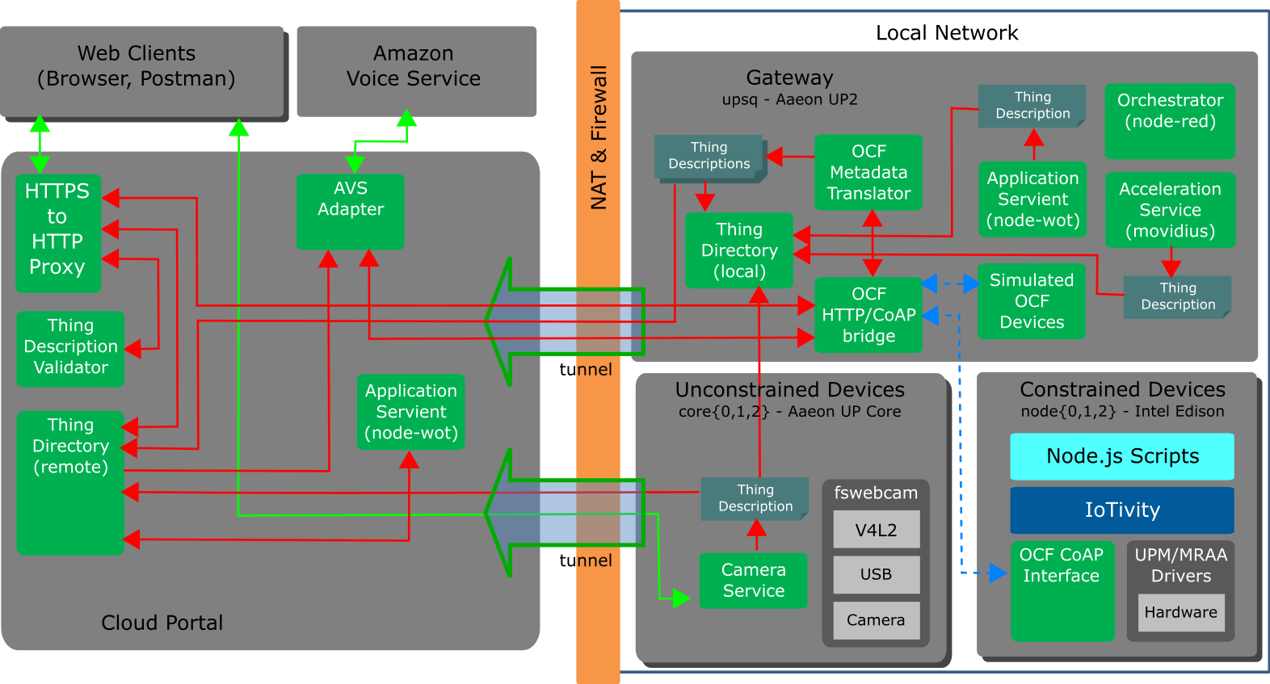
Planned Architecture

Slide 5
To Do
Application servients
Local (gateway, device) and cloud
To use node-wot and thereby demonstrate interoperabilty
Semantic Voice Interface
Now that I finally have a cloud-visible HTTPS interface and a semantically-searchable Thing Directory service running…
Enhanced security
Need to add bearer tokens to non-node-wot implementations and proxy

Slide 6
Collaborations and Use Cases
Accessibility
Continue defining accessibility use cases with Paciello group
AI Integration
Connecting WoT Things with local/remote AI services, specifically object recognition
Use Case: Security; PIR sensor detects motion, camera takes picture, object recognition service confirms presence of person in forbidden zone, alarm is sounded.
Smart Building Vertical Use Cases
Building management system and IP camera integration

