Slide 1
Introduction to RDBMS

Slide 2
RDBMS
Relational database management system.
Data is stored in the form of tables and there is a relationship between these tables.

Slide 3
DATA PROCESSING
Sequence of operations on data to convert it into useful information.
Different operations and methods are applied on the data.
OPERATIONS-
Arithmetic and logical operations.
To send and receive data from one location to other.
Classification of data.
Arranging data into a specific order etc.

Slide 4
METHODS OF DATA PROCESSING
Manual data processing.
Mechanical data processing.
Electronic data processing.

Slide 5
DATA MODELS
Data Model can be defined as an integrated collection of concepts for describing and manipulating data, relationships between data, and constraints on the data in an organization.
It is used for representing entities of interest and their relationships in database.

Slide 6
TYPES OF DATA MODELS
Record-based data model
Object- based data model
Physical data model

Slide 7
RECORD BASED DATA MODELS
Record based data models specify the overall logical structure of the database and provides a higher-level description of the implementation.
Record based models are so named because the database is structured in fixed format records of several types.
The three most widely accepted record based data models are:
• Hierarchical Model
• Network Model
• Relational Model

Slide 8
OBJECT BASED MODELS
Object–based data models are used to describe data and its relationships.
It uses concepts such as entities, attributes and relationships.
Following are the common types of object-based data models:
• Entity-Relationship
• Object Oriented
• Semantic
• Functional

Slide 9
PHYSICAL DATA MODELS
Physical data models describe how data is stored in the computer, representing information such as record structures, record ordering, and access paths.
Two types of physical data models are:
• Unifying model
• Frame memory model

Slide 10
HIERARCHICAL DATA MODEL
A hierarchical database model is a data model in which the data is organized into a tree-like structure. The data is stored as records which are connected to one another through links.
E.g.
University
Department
Faculty

Slide 11
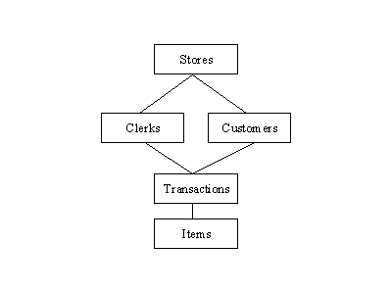
NETWORK DATA MODEL
This model is same as hierarchical model, except that a record can have multiple parents.
Network model has three basic components- record type , data items and links.

Slide 12
RELATIONAL DATA MODEL
Relational model stores data in the form of tables. The relational model consists of three major components:
The set of relations and set of domains that defines the way data can be represented (data structure).
Integrity rules that define the procedure to protect the data (data integrity).
The operations that can be performed on data (data manipulation).

Slide 13
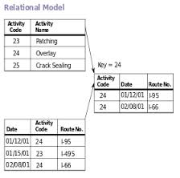

Slide 14
SQL (Structured Query Language)
SQL is a relational the query language. It is the standard command set used to communicate with the relational database management system (RDBMS).
It is a non-procedural language.
SQL is both data definition language and data manipulation language.

Slide 15
COMPONENTS OF SQL
Data structure.
Data type.
SQL operators.
Data definition language (DDL)
Data query language (DQL)
Data manipulation language (DML)
Data control language (DCL)
Data administration statements (DAS)
Transaction control statements (TCS)

Slide 16
ADVANTAGES AND DISADVANTAGES
Advantages:
very flexible , free-format syntax.
Supported by every product.
It can express arithmetic operations as well as operations to aggregate data and sort data for output.
Disadvantages:
It is not a general-purpose programming language and thus the development of an application requires the use of a SQL with a programming language.

Slide 17
ANY QUERIES???

