Slide 1
Summary II
SWE2016-44

Slide 2
Minimum Spanning Tree

Slide 3
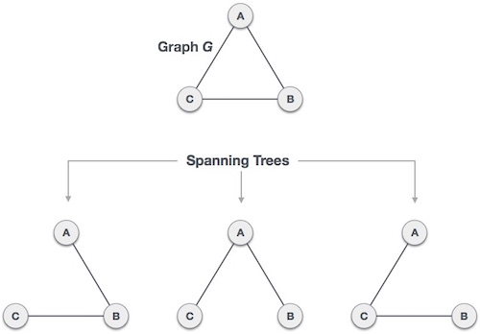
Definitions
Spanning Tree
  Given a connected and undirected graph, a spanning tree of that graph is a subgraph that is a tree connects all the vertices together.

Slide 4
Definitions
Spanning Tree
  Given a connected and undirected graph, a spanning tree of that graph is a subgraph that is a tree connects all the vertices together.
  Properties
    The spanning tree does not have any cycle
    Spanning tree has n-1 edges, where n is the number of vertices
    From a complete graph, by removing maximum e - n + 1 edges, we can construct a spanning tree.

Slide 5
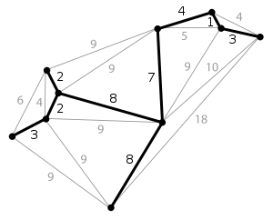
Definitions
Minimum Spanning Tree (MST)
  The spanning tree of the graph whose sum of weights of edges is minimum.
    A graph may have more than 1 minimum spanning tree.

Slide 6
Definitions
Minimum Spanning Tree (MST)
  The spanning tree of the graph whose sum of weights of edges is minimum.
    A graph may have more than 1 minimum spanning tree.
  Two most important MST
    Kruskal’s Algorithm
    Prim’s Algorithm
    ※ Both are greedy algorithms.

Slide 7
Kruskal’s Algorithm
Sort all the edges in non-decreasing order of their weight.
Pick the smallest edge. Check if it forms a cycle with the spanning tree formed so far. If cycle is not formed, include this edge. Else, discard it.
Repeat step#2 until there are (V-1) edges in the spanning tree.

Slide 8
Examples
Sort all the edges in non-decreasing order of their weight.
|V|=9
V₁
8
V₂
7
V₃
Pick the smallest edge. Check if it forms a cycle with the spanning tree formed so far. If cycle is not formed, include this edge. Else, discard it.
4
2
9
V₀
V₈
V₄
11
4
14
7
8
6
10
V₇
V₆
V₅
Repeat step#2 until there are (V-1) edges in the spanning tree.
1
2

Slide 9
Examples
Sort all the edges in non-decreasing order of their weight.
|V|=9
V₁
8
V₂
7
V₃
Pick the smallest edge. Check if it forms a cycle with the spanning tree formed so far. If cycle is not formed, include this edge. Else, discard it.
4
2
9
V₀
V₈
V₄
11
4
14
7
8
6
10
V₇
V₆
V₅
Repeat step#2 until there are (V-1) edges in the spanning tree.
1
2
v₇,v₆ | v₈,v₂ | v₆,v₅ | v₀,v₁ | v₂,v₅ | v₈,v₆ | v₂,v₃ | v₇,v₈ | v₀,v₇ | v₁,v₂ | v₃,v₄ | v₅,v₄ | v₁,v₇ | v₃,v₅
1 | 2 | 2 | 4 | 4 | 6 | 7 | 7 | 8 | 8 | 9 | 10 | 11 | 14

Slide 10
Examples
Sort all the edges in non-decreasing order of their weight.
|V|=9
V₁
8
V₂
7
V₃
Pick the smallest edge. Check if it forms a cycle with the spanning tree formed so far. If cycle is not formed, include this edge. Else, discard it.
4
2
9
V₀
V₈
V₄
11
4
14
7
8
6
10
V₇
V₆
V₅
Repeat step#2 until there are (V-1) edges in the spanning tree.
1
2
v₇,v₆ | v₈,v₂ | v₆,v₅ | v₀,v₁ | v₂,v₅ | v₈,v₆ | v₂,v₃ | v₇,v₈ | v₀,v₇ | v₁,v₂ | v₃,v₄ | v₅,v₄ | v₁,v₇ | v₃,v₅
1 | 2 | 2 | 4 | 4 | 6 | 7 | 7 | 8 | 8 | 9 | 10 | 11 | 14

Slide 11
Examples
Sort all the edges in non-decreasing order of their weight.
|V|=9
V₁
8
V₂
7
V₃
Pick the smallest edge. Check if it forms a cycle with the spanning tree formed so far. If cycle is not formed, include this edge. Else, discard it.
4
2
9
V₀
V₈
V₄
11
4
14
7
8
6
10
V₇
V₆
V₅
Repeat step#2 until there are (V-1) edges in the spanning tree.
1
2
# of Edges in MST = 1
v₇,v₆ | v₈,v₂ | v₆,v₅ | v₀,v₁ | v₂,v₅ | v₈,v₆ | v₂,v₃ | v₇,v₈ | v₀,v₇ | v₁,v₂ | v₃,v₄ | v₅,v₄ | v₁,v₇ | v₃,v₅
1 | 2 | 2 | 4 | 4 | 6 | 7 | 7 | 8 | 8 | 9 | 10 | 11 | 14

Slide 12
Examples
Sort all the edges in non-decreasing order of their weight.
|V|=9
V₁
8
V₂
7
V₃
Pick the smallest edge. Check if it forms a cycle with the spanning tree formed so far. If cycle is not formed, include this edge. Else, discard it.
4
2
9
V₀
V₈
V₄
11
4
14
7
8
6
10
V₇
V₆
V₅
Repeat step#2 until there are (V-1) edges in the spanning tree.
1
2
# of Edges in MST = 1
v₇,v₆ | v₈,v₂ | v₆,v₅ | v₀,v₁ | v₂,v₅ | v₈,v₆ | v₂,v₃ | v₇,v₈ | v₀,v₇ | v₁,v₂ | v₃,v₄ | v₅,v₄ | v₁,v₇ | v₃,v₅
1 | 2 | 2 | 4 | 4 | 6 | 7 | 7 | 8 | 8 | 9 | 10 | 11 | 14

Slide 13
Examples
Sort all the edges in non-decreasing order of their weight.
|V|=9
V₁
8
V₂
7
V₃
Pick the smallest edge. Check if it forms a cycle with the spanning tree formed so far. If cycle is not formed, include this edge. Else, discard it.
4
2
9
V₀
V₈
V₄
11
4
14
7
8
6
10
V₇
V₆
V₅
Repeat step#2 until there are (V-1) edges in the spanning tree.
1
2
# of Edges in MST = 2
v₇,v₆ | v₈,v₂ | v₆,v₅ | v₀,v₁ | v₂,v₅ | v₈,v₆ | v₂,v₃ | v₇,v₈ | v₀,v₇ | v₁,v₂ | v₃,v₄ | v₅,v₄ | v₁,v₇ | v₃,v₅
1 | 2 | 2 | 4 | 4 | 6 | 7 | 7 | 8 | 8 | 9 | 10 | 11 | 14

Slide 14
Examples
Sort all the edges in non-decreasing order of their weight.
|V|=9
V₁
8
V₂
7
V₃
Pick the smallest edge. Check if it forms a cycle with the spanning tree formed so far. If cycle is not formed, include this edge. Else, discard it.
4
2
9
V₀
V₈
V₄
11
4
14
7
8
6
10
V₇
V₆
V₅
Repeat step#2 until there are (V-1) edges in the spanning tree.
1
2
# of Edges in MST = 3
v₇,v₆ | v₈,v₂ | v₆,v₅ | v₀,v₁ | v₂,v₅ | v₈,v₆ | v₂,v₃ | v₇,v₈ | v₀,v₇ | v₁,v₂ | v₃,v₄ | v₅,v₄ | v₁,v₇ | v₃,v₅
1 | 2 | 2 | 4 | 4 | 6 | 7 | 7 | 8 | 8 | 9 | 10 | 11 | 14

Slide 15
Examples
Sort all the edges in non-decreasing order of their weight.
|V|=9
V₁
8
V₂
7
V₃
Pick the smallest edge. Check if it forms a cycle with the spanning tree formed so far. If cycle is not formed, include this edge. Else, discard it.
4
2
9
V₀
V₈
V₄
11
4
14
7
8
6
10
V₇
V₆
V₅
Repeat step#2 until there are (V-1) edges in the spanning tree.
1
2
# of Edges in MST = 4
v₇,v₆ | v₈,v₂ | v₆,v₅ | v₀,v₁ | v₂,v₅ | v₈,v₆ | v₂,v₃ | v₇,v₈ | v₀,v₇ | v₁,v₂ | v₃,v₄ | v₅,v₄ | v₁,v₇ | v₃,v₅
1 | 2 | 2 | 4 | 4 | 6 | 7 | 7 | 8 | 8 | 9 | 10 | 11 | 14

Slide 16
Examples
Sort all the edges in non-decreasing order of their weight.
|V|=9
V₁
8
V₂
7
V₃
Pick the smallest edge. Check if it forms a cycle with the spanning tree formed so far. If cycle is not formed, include this edge. Else, discard it.
4
2
9
V₀
V₈
V₄
11
4
14
7
8
6
10
V₇
V₆
V₅
Repeat step#2 until there are (V-1) edges in the spanning tree.
1
2
# of Edges in MST = 5
v₇,v₆ | v₈,v₂ | v₆,v₅ | v₀,v₁ | v₂,v₅ | v₈,v₆ | v₂,v₃ | v₇,v₈ | v₀,v₇ | v₁,v₂ | v₃,v₄ | v₅,v₄ | v₁,v₇ | v₃,v₅
1 | 2 | 2 | 4 | 4 | 6 | 7 | 7 | 8 | 8 | 9 | 10 | 11 | 14

Slide 17
Examples
Sort all the edges in non-decreasing order of their weight.
|V|=9
V₁
8
V₂
7
V₃
Pick the smallest edge. Check if it forms a cycle with the spanning tree formed so far. If cycle is not formed, include this edge. Else, discard it.
4
2
9
V₀
V₈
V₄
11
4
14
7
8
6
10
V₇
V₆
V₅
Repeat step#2 until there are (V-1) edges in the spanning tree.
1
2
# of Edges in MST = 5
v₇,v₆ | v₈,v₂ | v₆,v₅ | v₀,v₁ | v₂,v₅ | v₈,v₆ | v₂,v₃ | v₇,v₈ | v₀,v₇ | v₁,v₂ | v₃,v₄ | v₅,v₄ | v₁,v₇ | v₃,v₅
1 | 2 | 2 | 4 | 4 | 6 | 7 | 7 | 8 | 8 | 9 | 10 | 11 | 14

Slide 18
Examples
Sort all the edges in non-decreasing order of their weight.
|V|=9
V₁
8
V₂
7
V₃
Pick the smallest edge. Check if it forms a cycle with the spanning tree formed so far. If cycle is not formed, include this edge. Else, discard it.
4
2
9
V₀
V₈
V₄
11
4
14
7
8
6
10
V₇
V₆
V₅
Repeat step#2 until there are (V-1) edges in the spanning tree.
1
2
# of Edges in MST = 6
v₇,v₆ | v₈,v₂ | v₆,v₅ | v₀,v₁ | v₂,v₅ | v₈,v₆ | v₂,v₃ | v₇,v₈ | v₀,v₇ | v₁,v₂ | v₃,v₄ | v₅,v₄ | v₁,v₇ | v₃,v₅
1 | 2 | 2 | 4 | 4 | 6 | 7 | 7 | 8 | 8 | 9 | 10 | 11 | 14

Slide 19
Examples
Sort all the edges in non-decreasing order of their weight.
|V|=9
V₁
8
V₂
7
V₃
Pick the smallest edge. Check if it forms a cycle with the spanning tree formed so far. If cycle is not formed, include this edge. Else, discard it.
4
2
9
V₀
V₈
V₄
11
4
14
7
8
6
10
V₇
V₆
V₅
Repeat step#2 until there are (V-1) edges in the spanning tree.
1
2
# of Edges in MST = 6
v₇,v₆ | v₈,v₂ | v₆,v₅ | v₀,v₁ | v₂,v₅ | v₈,v₆ | v₂,v₃ | v₇,v₈ | v₀,v₇ | v₁,v₂ | v₃,v₄ | v₅,v₄ | v₁,v₇ | v₃,v₅
1 | 2 | 2 | 4 | 4 | 6 | 7 | 7 | 8 | 8 | 9 | 10 | 11 | 14

Slide 20
Examples
Sort all the edges in non-decreasing order of their weight.
|V|=9
V₁
8
V₂
7
V₃
Pick the smallest edge. Check if it forms a cycle with the spanning tree formed so far. If cycle is not formed, include this edge. Else, discard it.
4
2
9
V₀
V₈
V₄
11
4
14
7
8
6
10
V₇
V₆
V₅
Repeat step#2 until there are (V-1) edges in the spanning tree.
1
2
# of Edges in MST = 7
v₇,v₆ | v₈,v₂ | v₆,v₅ | v₀,v₁ | v₂,v₅ | v₈,v₆ | v₂,v₃ | v₇,v₈ | v₀,v₇ | v₁,v₂ | v₃,v₄ | v₅,v₄ | v₁,v₇ | v₃,v₅
1 | 2 | 2 | 4 | 4 | 6 | 7 | 7 | 8 | 8 | 9 | 10 | 11 | 14

Slide 21
Examples
Sort all the edges in non-decreasing order of their weight.
|V|=9
V₁
8
V₂
7
V₃
Pick the smallest edge. Check if it forms a cycle with the spanning tree formed so far. If cycle is not formed, include this edge. Else, discard it.
4
2
9
V₀
V₈
V₄
11
4
14
7
8
6
10
V₇
V₆
V₅
Repeat step#2 until there are (V-1) edges in the spanning tree.
1
2
# of Edges in MST = 7
v₇,v₆ | v₈,v₂ | v₆,v₅ | v₀,v₁ | v₂,v₅ | v₈,v₆ | v₂,v₃ | v₇,v₈ | v₀,v₇ | v₁,v₂ | v₃,v₄ | v₅,v₄ | v₁,v₇ | v₃,v₅
1 | 2 | 2 | 4 | 4 | 6 | 7 | 7 | 8 | 8 | 9 | 10 | 11 | 14

Slide 22
Examples
Sort all the edges in non-decreasing order of their weight.
|V|=9
V₁
8
V₂
7
V₃
Pick the smallest edge. Check if it forms a cycle with the spanning tree formed so far. If cycle is not formed, include this edge. Else, discard it.
4
2
9
V₀
V₈
V₄
11
4
14
7
8
6
10
V₇
V₆
V₅
Repeat step#2 until there are (V-1) edges in the spanning tree.
1
2
# of Edges in MST = 8
v₇,v₆ | v₈,v₂ | v₆,v₅ | v₀,v₁ | v₂,v₅ | v₈,v₆ | v₂,v₃ | v₇,v₈ | v₀,v₇ | v₁,v₂ | v₃,v₄ | v₅,v₄ | v₁,v₇ | v₃,v₅
1 | 2 | 2 | 4 | 4 | 6 | 7 | 7 | 8 | 8 | 9 | 10 | 11 | 14

Slide 23
Examples
Sort all the edges in non-decreasing order of their weight.
|V|=9
V₁
8
V₂
7
V₃
Pick the smallest edge. Check if it forms a cycle with the spanning tree formed so far. If cycle is not formed, include this edge. Else, discard it.
4
2
9
V₀
V₈
V₄
11
4
14
7
8
6
10
V₇
V₆
V₅
Repeat step#2 until there are (V-1) edges in the spanning tree.
1
2
Terminate!!!
v₇,v₆ | v₈,v₂ | v₆,v₅ | v₀,v₁ | v₂,v₅ | v₈,v₆ | v₂,v₃ | v₇,v₈ | v₀,v₇ | v₁,v₂ | v₃,v₄ | v₅,v₄ | v₁,v₇ | v₃,v₅
1 | 2 | 2 | 4 | 4 | 6 | 7 | 7 | 8 | 8 | 9 | 10 | 11 | 14

Slide 24
Examples
Sort all the edges in non-decreasing order of their weight.
V₁
V₂
7
V₃
Pick the smallest edge. Check if it forms a cycle with the spanning tree formed so far. If cycle is not formed, include this edge. Else, discard it.
4
2
9
V₀
V₈
V₄
4
8
V₇
V₆
V₅
Repeat step#2 until there are (V-1) edges in the spanning tree.
1
2
Now we have our MST!
v₇,v₆ | v₈,v₂ | v₆,v₅ | v₀,v₁ | v₂,v₅ | v₈,v₆ | v₂,v₃ | v₇,v₈ | v₀,v₇ | v₁,v₂ | v₃,v₄ | v₅,v₄ | v₁,v₇ | v₃,v₅
1 | 2 | 2 | 4 | 4 | 6 | 7 | 7 | 8 | 8 | 9 | 10 | 11 | 14

Slide 25
Examples
Sort all the edges in non-decreasing order of their weight.
Weights of MST = 37
V₁
V₂
7
V₃
Pick the smallest edge. Check if it forms a cycle with the spanning tree formed so far. If cycle is not formed, include this edge. Else, discard it.
4
2
9
V₀
V₈
V₄
4
8
V₇
V₆
V₅
Repeat step#2 until there are (V-1) edges in the spanning tree.
1
2
Now we have our MST!
v₇,v₆ | v₈,v₂ | v₆,v₅ | v₀,v₁ | v₂,v₅ | v₈,v₆ | v₂,v₃ | v₇,v₈ | v₀,v₇ | v₁,v₂ | v₃,v₄ | v₅,v₄ | v₁,v₇ | v₃,v₅
1 | 2 | 2 | 4 | 4 | 6 | 7 | 7 | 8 | 8 | 9 | 10 | 11 | 14

Slide 26
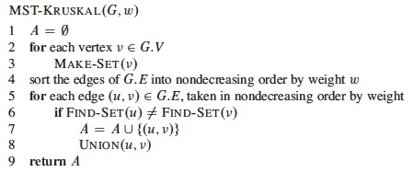
Pseudocode
O(1)
O(E log E)
O(E log V)
Overall Complexity = O(E Log E + E Log V)
→ V-1 $≤$ E $≤$ (V²-V)/2 → O(Log E) $≈$ O(Log V)
→ Therefore, time complexity is O(E Log E) or O(E Log V)

Slide 27
Prim’s Algorithm (1)
Create a set mstSet that keeps track of vertices already included in MST.
Assign a key value to all vertices in the input graph. Initialize all key values as INFINITE. Assign key value as 0 for the first vertex so that it is picked first.

Slide 28
Prim’s Algorithm (2)
While mstSet doesn’t include all vertices
  Pick a vertex u which is not there in mstSet and has minimum key value.
  Include u to mstSet.
  Update key value of all adjacent vertices of u.
To update the key values, iterate through all adjacent vertices. For every adjacent vertex v, if weight of edge u-v is less than the previous key value of v, update the key value as weight of u-v

Slide 29
Examples
Create a set mstSet that keeps track of vertices already included in MST.
V₁
8
V₂
7
V₃
Assign a key value to all vertices in the input graph. Initialize all key values as INFINITE. Assign key value as 0 for the first vertex so that it is picked first.
4
2
9
V₀
V₈
V₄
11
4
14
7
While mstSet doesn’t include all vertices
  Pick a vertex u which is not there in mstSet and has minimum key value.
  Include u to mstSet.
  Update key value of all adjacent vertices of u.
8
6
10
V₇
V₆
V₅
1
2

Slide 30
Examples
mstSet={}
Create a set mstSet that keeps track of vertices already included in MST.
V₁
8
V₂
7
V₃
Assign a key value to all vertices in the input graph. Initialize all key values as INFINITE. Assign key value as 0 for the first vertex so that it is picked first.
4
2
9
V₀
V₈
V₄
11
4
14
7
While mstSet doesn’t include all vertices
  Pick a vertex u which is not there in mstSet and has minimum key value.
  Include u to mstSet.
  Update key value of all adjacent vertices of u.
8
6
10
V₇
V₆
V₅
1
2

Slide 31
Examples
mstSet={}
Create a set mstSet that keeps track of vertices already included in MST.
V₁
8
V₂
7
V₃
Assign a key value to all vertices in the input graph. Initialize all key values as INFINITE. Assign key value as 0 for the first vertex so that it is picked first.
4
2
9
V₀
V₈
V₄
11
4
14
7
While mstSet doesn’t include all vertices
  Pick a vertex u which is not there in mstSet and has minimum key value.
  Include u to mstSet.
  Update key value of all adjacent vertices of u.
8
6
10
V₇
V₆
V₅
1
2
Ver. | v₀ | v₁ | v₂ | v₃ | v₄ | v₅ | v₆ | v₇ | v₈
Key | 0 | $$∞$$ | $$∞$$ | $$∞$$ | $$∞$$ | $$∞$$ | $$∞$$ | $$∞$$ | $$∞$$

Slide 32
Examples
mstSet={}
Create a set mstSet that keeps track of vertices already included in MST.
V₁
8
V₂
7
V₃
Assign a key value to all vertices in the input graph. Initialize all key values as INFINITE. Assign key value as 0 for the first vertex so that it is picked first.
4
2
9
V₀
V₈
V₄
11
4
14
7
While mstSet doesn’t include all vertices
  Pick a vertex u which is not there in mstSet and has minimum key value.
  Include u to mstSet.
  Update key value of all adjacent vertices of u.
8
6
10
V₇
V₆
V₅
1
2
Ver. | v₀ | v₁ | v₂ | v₃ | v₄ | v₅ | v₆ | v₇ | v₈
Key | 0 | $$∞$$ | $$∞$$ | $$∞$$ | $$∞$$ | $$∞$$ | $$∞$$ | $$∞$$ | $$∞$$

Slide 33
Examples
mstSet={v₀}
Create a set mstSet that keeps track of vertices already included in MST.
V₁
8
V₂
7
V₃
Assign a key value to all vertices in the input graph. Initialize all key values as INFINITE. Assign key value as 0 for the first vertex so that it is picked first.
4
2
9
u
V₀
V₈
V₄
11
4
14
7
While mstSet doesn’t include all vertices
  Pick a vertex u which is not there in mstSet and has minimum key value.
  Include u to mstSet.
  Update key value of all adjacent vertices of u.
8
6
10
V₇
V₆
V₅
1
2
u
If w(u,v)<v.key, v.key=w(u,v)
Ver. | v₀ | v₁ | v₂ | v₃ | v₄ | v₅ | v₆ | v₇ | v₈
Key | 0 | $$∞$$ | $$∞$$ | $$∞$$ | $$∞$$ | $$∞$$ | $$∞$$ | $$∞$$ | $$∞$$

Slide 34
Examples
mstSet={v₀}
Create a set mstSet that keeps track of vertices already included in MST.
V₁
8
V₂
7
V₃
Assign a key value to all vertices in the input graph. Initialize all key values as INFINITE. Assign key value as 0 for the first vertex so that it is picked first.
4
2
9
V₀
V₈
V₄
11
4
14
7
While mstSet doesn’t include all vertices
  Pick a vertex u which is not there in mstSet and has minimum key value.
  Include u to mstSet.
  Update key value of all adjacent vertices of u.
8
6
10
V₇
V₆
V₅
1
2
Ver. | v₀ | v₁ | v₂ | v₃ | v₄ | v₅ | v₆ | v₇ | v₈
Key | 0 | 4 | $$∞$$ | $$∞$$ | $$∞$$ | $$∞$$ | $$∞$$ | 8 | $$∞$$

Slide 35
Examples
mstSet={v_{0,} v₁}
Create a set mstSet that keeps track of vertices already included in MST.
u
V₁
8
V₂
7
V₃
Assign a key value to all vertices in the input graph. Initialize all key values as INFINITE. Assign key value as 0 for the first vertex so that it is picked first.
4
2
9
V₀
V₈
V₄
11
4
14
7
While mstSet doesn’t include all vertices
  Pick a vertex u which is not there in mstSet and has minimum key value.
  Include u to mstSet.
  Update key value of all adjacent vertices of u.
8
6
10
V₇
V₆
V₅
1
2
u
Ver. | v₀ | v₁ | v₂ | v₃ | v₄ | v₅ | v₆ | v₇ | v₈
Key | 0 | 4 | $$∞$$ | $$∞$$ | $$∞$$ | $$∞$$ | $$∞$$ | 8 | $$∞$$

Slide 36
Examples
mstSet={v_{0,} v₁}
Create a set mstSet that keeps track of vertices already included in MST.
V₁
8
V₂
7
V₃
Assign a key value to all vertices in the input graph. Initialize all key values as INFINITE. Assign key value as 0 for the first vertex so that it is picked first.
4
2
9
V₀
V₈
V₄
11
4
14
7
While mstSet doesn’t include all vertices
  Pick a vertex u which is not there in mstSet and has minimum key value.
  Include u to mstSet.
  Update key value of all adjacent vertices of u.
8
6
10
V₇
V₆
V₅
1
2
Ver. | v₀ | v₁ | v₂ | v₃ | v₄ | v₅ | v₆ | v₇ | v₈
Key | 0 | 4 | 8 | $$∞$$ | $$∞$$ | $$∞$$ | $$∞$$ | 8 | $$∞$$

Slide 37
Examples
mstSet={v_{0,}v_{1,}v₇}
Create a set mstSet that keeps track of vertices already included in MST.
V₁
8
V₂
7
V₃
Assign a key value to all vertices in the input graph. Initialize all key values as INFINITE. Assign key value as 0 for the first vertex so that it is picked first.
4
2
9
V₀
V₈
V₄
11
4
14
7
While mstSet doesn’t include all vertices
  Pick a vertex u which is not there in mstSet and has minimum key value.
  Include u to mstSet.
  Update key value of all adjacent vertices of u.
8
6
10
V₇
V₆
V₅
u
1
2
u
Ver. | v₀ | v₁ | v₂ | v₃ | v₄ | v₅ | v₆ | v₇ | v₈
Key | 0 | 4 | 8 | $$∞$$ | $$∞$$ | $$∞$$ | $$∞$$ | 8 | $$∞$$

Slide 38
Examples
mstSet={v_{0,}v_{1,}v₇}
Create a set mstSet that keeps track of vertices already included in MST.
V₁
8
V₂
7
V₃
Assign a key value to all vertices in the input graph. Initialize all key values as INFINITE. Assign key value as 0 for the first vertex so that it is picked first.
4
2
9
V₀
V₈
V₄
11
4
14
7
While mstSet doesn’t include all vertices
  Pick a vertex u which is not there in mstSet and has minimum key value.
  Include u to mstSet.
  Update key value of all adjacent vertices of u.
8
6
10
V₇
V₆
V₅
1
2
Ver. | v₀ | v₁ | v₂ | v₃ | v₄ | v₅ | v₆ | v₇ | v₈
Key | 0 | 4 | 8 | $$∞$$ | $$∞$$ | $$∞$$ | 1 | 8 | 7

Slide 39
Examples
mstSet={v_{0,}v_{1,}v_{7,}v₆}
Create a set mstSet that keeps track of vertices already included in MST.
V₁
8
V₂
7
V₃
Assign a key value to all vertices in the input graph. Initialize all key values as INFINITE. Assign key value as 0 for the first vertex so that it is picked first.
4
2
9
V₀
V₈
V₄
11
4
14
7
While mstSet doesn’t include all vertices
  Pick a vertex u which is not there in mstSet and has minimum key value.
  Include u to mstSet.
  Update key value of all adjacent vertices of u.
8
6
10
V₇
V₆
V₅
1
2
u
u
Ver. | v₀ | v₁ | v₂ | v₃ | v₄ | v₅ | v₆ | v₇ | v₈
Key | 0 | 4 | 8 | $$∞$$ | $$∞$$ | $$∞$$ | 1 | 8 | 7

Slide 40
Examples
mstSet={v_{0,}v_{1,}v_{7,}v₆}
Create a set mstSet that keeps track of vertices already included in MST.
V₁
8
V₂
7
V₃
Assign a key value to all vertices in the input graph. Initialize all key values as INFINITE. Assign key value as 0 for the first vertex so that it is picked first.
4
2
9
V₀
V₈
V₄
11
4
14
7
While mstSet doesn’t include all vertices
  Pick a vertex u which is not there in mstSet and has minimum key value.
  Include u to mstSet.
  Update key value of all adjacent vertices of u.
8
6
10
V₇
V₆
V₅
1
2
Ver. | v₀ | v₁ | v₂ | v₃ | v₄ | v₅ | v₆ | v₇ | v₈
Key | 0 | 4 | 8 | $$∞$$ | $$∞$$ | 2 | 1 | 8 | 6

Slide 41
Examples
mstSet={v_{0,}v_{1,}v_{7,}v_{6,}v₅}
Create a set mstSet that keeps track of vertices already included in MST.
V₁
8
V₂
7
V₃
Assign a key value to all vertices in the input graph. Initialize all key values as INFINITE. Assign key value as 0 for the first vertex so that it is picked first.
4
2
9
V₀
V₈
V₄
11
4
14
7
While mstSet doesn’t include all vertices
  Pick a vertex u which is not there in mstSet and has minimum key value.
  Include u to mstSet.
  Update key value of all adjacent vertices of u.
8
6
10
V₇
V₆
V₅
1
2
u
u
Ver. | v₀ | v₁ | v₂ | v₃ | v₄ | v₅ | v₆ | v₇ | v₈
Key | 0 | 4 | 8 | $$∞$$ | $$∞$$ | 2 | 1 | 8 | 6

Slide 42
Examples
mstSet={v_{0,}v_{1,}v_{7,}v_{6,}v₅}
Create a set mstSet that keeps track of vertices already included in MST.
V₁
8
V₂
7
V₃
Assign a key value to all vertices in the input graph. Initialize all key values as INFINITE. Assign key value as 0 for the first vertex so that it is picked first.
4
2
9
V₀
V₈
V₄
11
4
14
7
While mstSet doesn’t include all vertices
  Pick a vertex u which is not there in mstSet and has minimum key value.
  Include u to mstSet.
  Update key value of all adjacent vertices of u.
8
6
10
V₇
V₆
V₅
1
2
Ver. | v₀ | v₁ | v₂ | v₃ | v₄ | v₅ | v₆ | v₇ | v₈
Key | 0 | 4 | 4 | 14 | 10 | 2 | 1 | 8 | 6

Slide 43
Examples
mstSet={v_{0,}v_{1,}v_{7,}v_{6,}v_{5,}v₂}
Create a set mstSet that keeps track of vertices already included in MST.
u
V₁
8
V₂
7
V₃
Assign a key value to all vertices in the input graph. Initialize all key values as INFINITE. Assign key value as 0 for the first vertex so that it is picked first.
4
2
9
V₀
V₈
V₄
11
4
14
7
While mstSet doesn’t include all vertices
  Pick a vertex u which is not there in mstSet and has minimum key value.
  Include u to mstSet.
  Update key value of all adjacent vertices of u.
8
6
10
V₇
V₆
V₅
1
2
u
Ver. | v₀ | v₁ | v₂ | v₃ | v₄ | v₅ | v₆ | v₇ | v₈
Key | 0 | 4 | 4 | 14 | 10 | 2 | 1 | 8 | 6

Slide 44
Examples
mstSet={v_{0,}v_{1,}v_{7,}v_{6,}v_{5,}v₂}
Create a set mstSet that keeps track of vertices already included in MST.
V₁
8
V₂
7
V₃
Assign a key value to all vertices in the input graph. Initialize all key values as INFINITE. Assign key value as 0 for the first vertex so that it is picked first.
4
2
9
V₀
V₈
V₄
11
4
14
7
While mstSet doesn’t include all vertices
  Pick a vertex u which is not there in mstSet and has minimum key value.
  Include u to mstSet.
  Update key value of all adjacent vertices of u.
8
6
10
V₇
V₆
V₅
1
2
Ver. | v₀ | v₁ | v₂ | v₃ | v₄ | v₅ | v₆ | v₇ | v₈
Key | 0 | 4 | 4 | 7 | 10 | 2 | 1 | 8 | 2

Slide 45
Examples
mstSet={v_{0,}v_{1,}v_{7,}v_{6,}v_{5,}v_{2,}v₈}
Create a set mstSet that keeps track of vertices already included in MST.
V₁
8
V₂
7
V₃
Assign a key value to all vertices in the input graph. Initialize all key values as INFINITE. Assign key value as 0 for the first vertex so that it is picked first.
4
2
9
u
V₀
V₈
V₄
11
4
14
7
While mstSet doesn’t include all vertices
  Pick a vertex u which is not there in mstSet and has minimum key value.
  Include u to mstSet.
  Update key value of all adjacent vertices of u.
8
6
10
V₇
V₆
V₅
1
2
u
Ver. | v₀ | v₁ | v₂ | v₃ | v₄ | v₅ | v₆ | v₇ | v₈
Key | 0 | 4 | 4 | 7 | 10 | 2 | 1 | 8 | 2

Slide 46
Examples
mstSet={v_{0,}v_{1,}v_{7,}v_{6,}v_{5,}v_{2,}v₈}
Create a set mstSet that keeps track of vertices already included in MST.
V₁
8
V₂
7
V₃
Assign a key value to all vertices in the input graph. Initialize all key values as INFINITE. Assign key value as 0 for the first vertex so that it is picked first.
4
2
9
V₀
V₈
V₄
11
4
14
7
While mstSet doesn’t include all vertices
  Pick a vertex u which is not there in mstSet and has minimum key value.
  Include u to mstSet.
  Update key value of all adjacent vertices of u.
8
6
10
V₇
V₆
V₅
1
2
Ver. | v₀ | v₁ | v₂ | v₃ | v₄ | v₅ | v₆ | v₇ | v₈
Key | 0 | 4 | 4 | 7 | 10 | 2 | 1 | 8 | 2

Slide 47
Examples
mstSet={v_{0,}v_{1,}v_{7,}v_{6,}v_{5,}v_{2,}v_{8,}v₃}
Create a set mstSet that keeps track of vertices already included in MST.
u
V₁
8
V₂
7
V₃
Assign a key value to all vertices in the input graph. Initialize all key values as INFINITE. Assign key value as 0 for the first vertex so that it is picked first.
4
2
9
V₀
V₈
V₄
11
4
14
7
While mstSet doesn’t include all vertices
  Pick a vertex u which is not there in mstSet and has minimum key value.
  Include u to mstSet.
  Update key value of all adjacent vertices of u.
8
6
10
V₇
V₆
V₅
1
2
u
Ver. | v₀ | v₁ | v₂ | v₃ | v₄ | v₅ | v₆ | v₇ | v₈
Key | 0 | 4 | 4 | 7 | 10 | 2 | 1 | 8 | 2

Slide 48
Examples
mstSet={v_{0,}v_{1,}v_{7,}v_{6,}v_{5,}v_{2,}v_{8,}v₃}
Create a set mstSet that keeps track of vertices already included in MST.
V₁
8
V₂
7
V₃
Assign a key value to all vertices in the input graph. Initialize all key values as INFINITE. Assign key value as 0 for the first vertex so that it is picked first.
4
2
9
V₀
V₈
V₄
11
4
14
7
While mstSet doesn’t include all vertices
  Pick a vertex u which is not there in mstSet and has minimum key value.
  Include u to mstSet.
  Update key value of all adjacent vertices of u.
8
6
10
V₇
V₆
V₅
1
2
Ver. | v₀ | v₁ | v₂ | v₃ | v₄ | v₅ | v₆ | v₇ | v₈
Key | 0 | 4 | 4 | 7 | 9 | 2 | 1 | 8 | 2

Slide 49
Examples
mstSet={v_{0,}v_{1,}v_{7,}v_{6,}v_{5,}v_{2,}v_{8,}v_{3,}v₄}
Create a set mstSet that keeps track of vertices already included in MST.
V₁
8
V₂
7
V₃
Assign a key value to all vertices in the input graph. Initialize all key values as INFINITE. Assign key value as 0 for the first vertex so that it is picked first.
4
2
9
u
V₀
V₈
V₄
11
4
14
7
While mstSet doesn’t include all vertices
  Pick a vertex u which is not there in mstSet and has minimum key value.
  Include u to mstSet.
  Update key value of all adjacent vertices of u.
8
6
10
V₇
V₆
V₅
1
2
u
Ver. | v₀ | v₁ | v₂ | v₃ | v₄ | v₅ | v₆ | v₇ | v₈
Key | 0 | 4 | 4 | 7 | 9 | 2 | 1 | 8 | 2

Slide 50
Examples
mstSet={v_{0,}v_{1,}v_{7,}v_{6,}v_{5,}v_{2,}v_{8,}v_{3,}v₄}
Create a set mstSet that keeps track of vertices already included in MST.
V₁
8
V₂
7
V₃
Assign a key value to all vertices in the input graph. Initialize all key values as INFINITE. Assign key value as 0 for the first vertex so that it is picked first.
4
2
9
V₀
V₈
V₄
11
4
14
7
While mstSet doesn’t include all vertices
  Pick a vertex u which is not there in mstSet and has minimum key value.
  Include u to mstSet.
  Update key value of all adjacent vertices of u.
8
6
10
V₇
V₆
V₅
1
2
Terminate!!
Ver. | v₀ | v₁ | v₂ | v₃ | v₄ | v₅ | v₆ | v₇ | v₈
Key | 0 | 4 | 4 | 7 | 9 | 2 | 1 | 8 | 2

Slide 51
Examples
Weights of MST = 37
Time Complexity
Time Complexity of Prim’s Algorithm is O(V²) if adjacency matrix is used.
If adjacency list is used, then the time complexity of Prim’s algorithm can be reduced to O(E Log V) with the help of binary heap and O(E + V Log V) with the help of Fibonacci heap.
V₁
V₂
7
V₃
4
2
9
u
V₀
V₈
V₄
4
8
V₇
V₆
V₅
1
2
Ver. | v₀ | v₁ | v₂ | v₃ | v₄ | v₅ | v₆ | v₇ | v₈
Key | 0 | 4 | 4 | 7 | 9 | 2 | 1 | 8 | 2

Slide 52
Pseudocode (when we use Binary Heap)
O(log V)
O(log V)
→ O(E log V + V log V) = O(E log V)

Slide 53
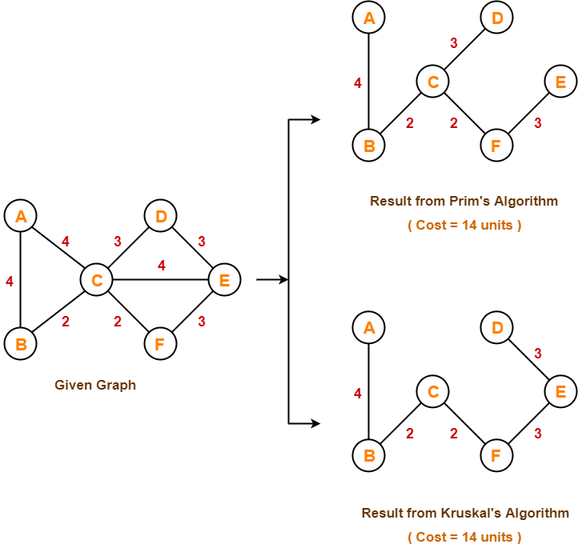
Kruskal’s Algorithm vs Prim’s Algorithm

Slide 54
Shortest Path Problem

Slide 55
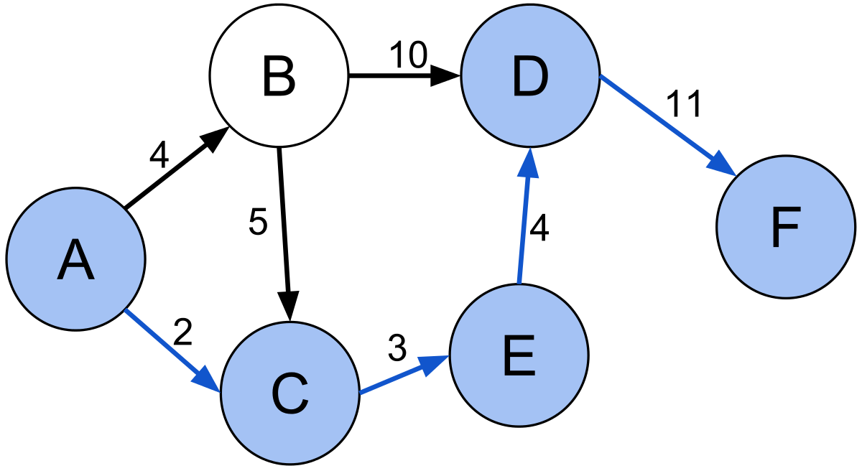
Problem Statement
Find a path between two vertices in a graph such that the sum of the weights of its constituent edges is minimized.
A graph is a series of nodes connected by edges. Graphs can be weighted and directional.

Slide 56
Shortest Path Algorithms
Dijkstra's algorithm: solves the single-source shortest path problem with non-negative edge weight.
Bellman–Ford algorithm: solves the single-source problem if edge weights may be negative.
A* search algorithm: solves for single pair shortest path using heuristics to try to speed up the search.
Floyd–Warshall algorithm: solves all pairs shortest paths.
Johnson's algorithm: solves all pairs shortest paths, and may be faster than Floyd–Warshall on sparse graphs.
Viterbi algorithm: solves the shortest stochastic path problem with an additional probabilistic weight on each node.

Slide 57
Dijkstra's algorithm
distance
parent
Vertex | d | $$π$$
A | 0 | NIL
B | $$∞$$ | NIL
C | $$∞$$ | NIL
D | $$∞$$ | NIL
E | $$∞$$ | NIL
F | $$∞$$ | NIL
G | $$∞$$ | NIL
H | $$∞$$ | NIL
I | $$∞$$ | NIL
B
8
C
7
D
Source
4
2
9
A
I
E
11
4
14
7
8
6
10
H
G
F
1
2

Slide 58
Dijkstra's algorithm
distance
parent
Vertex | d | $$π$$
A | 0 | NIL
B | $$∞$$ | NIL
C | $$∞$$ | NIL
D | $$∞$$ | NIL
E | $$∞$$ | NIL
F | $$∞$$ | NIL
G | $$∞$$ | NIL
H | $$∞$$ | NIL
I | $$∞$$ | NIL
B
8
C
7
D
Source
4
2
9
0
A
I
E
11
4
14
u
7
8
6
10
H
G
F
1
2
Update B: d[u]+4=4 < $∞$
Update H: d[u]+8=8 < $∞$

Slide 59
Dijkstra's algorithm
distance
parent
Vertex | d | $$π$$
A | 0 | NIL
B | 4 | A
C | $$∞$$ | NIL
D | $$∞$$ | NIL
E | $$∞$$ | NIL
F | $$∞$$ | NIL
G | $$∞$$ | NIL
H | 8 | A
I | $$∞$$ | NIL
B
8
C
7
D
Source
4
2
9
0
A
I
E
11
4
14
u
7
8
6
10
H
G
F
1
2
Update B: d[u]+4=4 < $∞$
Update H: d[u]+8=8 < $∞$

Slide 60
Dijkstra's algorithm
distance
parent
Vertex | d | $$π$$
A | 0 | NIL
B | 4 | A
C | $$∞$$ | NIL
D | $$∞$$ | NIL
E | $$∞$$ | NIL
F | $$∞$$ | NIL
G | $$∞$$ | NIL
H | 8 | A
I | $$∞$$ | NIL
4
B
8
C
7
D
u
Source
4
2
9
0
A
I
E
11
4
14
7
8
6
10
H
G
F
1
2
Update C: d[u]+8=12 < $∞$
Update H: d[u]+11=15 > 8

Slide 61
Dijkstra's algorithm
distance
parent
Vertex | d | $$π$$
A | 0 | NIL
B | 4 | A
C | 12 | B
D | $$∞$$ | NIL
E | $$∞$$ | NIL
F | $$∞$$ | NIL
G | $$∞$$ | NIL
H | 8 | A
I | $$∞$$ | NIL
4
B
8
C
7
D
u
Source
4
2
9
0
A
I
E
11
4
14
7
8
6
10
H
G
F
1
2
Update C: d[u]+8=12 < $∞$
Update H: d[u]+11=15 > 8

Slide 62
Dijkstra's algorithm
distance
parent
Vertex | d | $$π$$
A | 0 | NIL
B | 4 | A
C | 12 | B
D | $$∞$$ | NIL
E | $$∞$$ | NIL
F | $$∞$$ | NIL
G | $$∞$$ | NIL
H | 8 | A
I | $$∞$$ | NIL
4
B
8
C
7
D
Source
4
2
9
0
A
I
E
11
4
14
7
8
6
10
u
H
G
F
1
2
8
Update G: d[u]+1=9 < $∞$
Update I: d[u]+7=15 < $∞$

Slide 63
Dijkstra's algorithm
distance
parent
Vertex | d | $$π$$
A | 0 | NIL
B | 4 | A
C | 12 | B
D | $$∞$$ | NIL
E | $$∞$$ | NIL
F | $$∞$$ | NIL
G | 9 | H
H | 8 | A
I | 15 | H
4
B
8
C
7
D
Source
4
2
9
0
A
I
E
11
4
14
7
8
6
10
u
H
G
F
1
2
8
Update G: d[u]+1=9 < $∞$
Update I: d[u]+7=15 < $∞$

Slide 64
Dijkstra's algorithm
distance
parent
Vertex | d | $$π$$
A | 0 | NIL
B | 4 | A
C | 12 | B
D | $$∞$$ | NIL
E | $$∞$$ | NIL
F | $$∞$$ | NIL
G | 9 | H
H | 8 | A
I | 15 | H
4
B
8
C
7
D
Source
4
2
9
0
A
I
E
11
4
14
7
8
6
10
H
G
F
1
2
8
u
9
Update F: d[u]+2=11 < $∞$
Update I: d[u]+6=15 = 15

Slide 65
Dijkstra's algorithm
distance
parent
Vertex | d | $$π$$
A | 0 | NIL
B | 4 | A
C | 12 | B
D | $$∞$$ | NIL
E | $$∞$$ | NIL
F | 11 | G
G | 9 | H
H | 8 | A
I | 15 | H
4
B
8
C
7
D
Source
4
2
9
0
A
I
E
11
4
14
7
8
6
10
H
G
F
1
2
8
u
9
Update F: d[u]+2=11 < $∞$
Update I: d[u]+6=15 = 15

Slide 66
Dijkstra's algorithm
distance
parent
Vertex | d | $$π$$
A | 0 | NIL
B | 4 | A
C | 12 | B
D | $$∞$$ | NIL
E | $$∞$$ | NIL
F | 11 | G
G | 9 | H
H | 8 | A
I | 15 | H
4
B
8
C
7
D
Source
4
2
9
0
A
I
E
11
4
14
7
8
6
10
H
G
F
1
2
8
9
u
11
Update C: d[u]+4=15 > 12
Update D: d[u]+14=25 < $∞$
Update E: d[u]+10=21 < $∞$

Slide 67
Dijkstra's algorithm
distance
parent
Vertex | d | $$π$$
A | 0 | NIL
B | 4 | A
C | 12 | B
D | 25 | F
E | 21 | F
F | 11 | G
G | 9 | H
H | 8 | A
I | 15 | H
4
B
8
C
7
D
Source
4
2
9
0
A
I
E
11
4
14
7
8
6
10
H
G
F
1
2
8
9
u
11
Update C: d[u]+4=15 > 12
Update D: d[u]+14=25 < $∞$
Update E: d[u]+10=21 < $∞$

Slide 68
Dijkstra's algorithm
distance
parent
Vertex | d | $$π$$
A | 0 | NIL
B | 4 | A
C | 12 | B
D | 25 | F
E | 21 | F
F | 11 | G
G | 9 | H
H | 8 | A
I | 15 | H
4
12
u
B
8
C
7
D
Source
4
2
9
0
A
I
E
11
4
14
7
8
6
10
H
G
F
1
2
8
9
11
Update D: d[u]+7=19 < 25
Update I: d[u]+2=14 < 15

Slide 69
Dijkstra's algorithm
distance
parent
Vertex | d | $$π$$
A | 0 | NIL
B | 4 | A
C | 12 | B
D | 19 | C
E | 21 | F
F | 11 | G
G | 9 | H
H | 8 | A
I | 14 | C
4
12
u
B
8
C
7
D
Source
4
2
9
0
A
I
E
11
4
14
7
8
6
10
H
G
F
1
2
8
9
11
Update D: d[u]+7=19 < 25
Update I: d[u]+2=14 < 15

Slide 70
Dijkstra's algorithm
distance
parent
Vertex | d | $$π$$
A | 0 | NIL
B | 4 | A
C | 12 | B
D | 19 | C
E | 21 | F
F | 11 | G
G | 9 | H
H | 8 | A
I | 14 | C
4
12
B
8
C
7
D
Source
4
2
9
0
14
A
I
E
11
4
14
u
7
8
6
10
H
G
F
1
2
8
9
11

Slide 71
Dijkstra's algorithm
distance
parent
Vertex | d | $$π$$
A | 0 | NIL
B | 4 | A
C | 12 | B
D | 19 | C
E | 21 | F
F | 11 | G
G | 9 | H
H | 8 | A
I | 14 | C
4
12
19
u
B
8
C
7
D
Source
4
2
9
0
14
A
I
E
11
4
14
7
8
6
10
H
G
F
1
2
8
9
11
Update E: d[u]+9=28 > 21

Slide 72
Dijkstra's algorithm
distance
parent
Vertex | d | $$π$$
A | 0 | NIL
B | 4 | A
C | 12 | B
D | 19 | C
E | 21 | F
F | 11 | G
G | 9 | H
H | 8 | A
I | 14 | C
4
12
19
B
8
C
7
D
Source
4
2
9
0
14
21
A
I
E
11
4
14
u
7
8
6
10
H
G
F
1
2
8
9
11

Slide 73
Dijkstra's algorithm
distance
parent
Vertex | d | $$π$$
A | 0 | NIL
B | 4 | A
C | 12 | B
D | 19 | C
E | 21 | F
F | 11 | G
G | 9 | H
H | 8 | A
I | 14 | C
4
12
19
B
8
C
7
D
Source
4
2
9
0
14
21
A
I
E
11
4
14
7
8
6
10
H
G
F
1
2
8
9
11

Slide 74
Dijkstra's algorithm
distance
parent
Vertex | d | $$π$$
A | 0 | NIL
B | 4 | A
C | 12 | B
D | 19 | C
E | 21 | F
F | 11 | G
G | 9 | H
H | 8 | A
I | 14 | C
4
12
19
B
8
C
7
D
Source
4
2
9
0
14
21
A
I
E
11
4
14
7
8
6
10
H
G
F
1
2
8
9
11

Slide 75
Dijkstra's algorithm
distance
parent
Vertex | d | $$π$$
A | 0 | NIL
B | 4 | A
C | 12 | B
D | 19 | C
E | 21 | F
F | 11 | G
G | 9 | H
H | 8 | A
I | 14 | C
4
12
19
B
8
C
7
D
Source
4
2
0
14
21
A
I
E
8
10
H
G
F
1
2
8
9
11

Slide 76
Complexity
Time Complexity: O(V²)
If the input graph is represented using adjacency list, it can be reduced to O(E log V) with the help of binary heap.

Slide 77
Pseudo-Code
$d\left[s\right]←0$
$for each v∈V−\left\{s\right\}:$
  $do d\left[v\right]←∞$
$S←∅$
$Q←V$
$while Q≠∅$:
  $do u←Extract−Min\left(Q\right):$
    $S←S∪\left\{u\right\}$
    $for each v∈Adj\left[u\right]:$
      $if d\left[v\right]>d\left[u\right]+w\left(u, v\right):$
        $$d\left[v\right]=d\left[u\right]+w(u, v)$$

Slide 78
Bellman Ford's algorithm
distance
parent
B
-1
2
Vertex | d | $$π$$
A | 0 | NIL
B | $$∞$$ | NIL
C | $$∞$$ | NIL
D | $$∞$$ | NIL
E | $$∞$$ | NIL
Source
A
E
2
3
1
4
-3
C
D
5
Let all edges are processed in following order:
(B, E), (D, B), (B, D), (A, B), (A, C), (D, C), (B, C), (E, D)

Slide 79
Bellman Ford's algorithm
Iteration 1
$$∞$$
distance
parent
B
-1
2
Vertex | d | $$π$$
A | 0 | NIL
B | $$∞$$ | NIL
C | $$∞$$ | NIL
D | $$∞$$ | NIL
E | $$∞$$ | NIL
Source
$$∞$$
A
E
0
2
3
1
4
-3
C
D
$$∞$$
$$∞$$
5
(B, E), (D, B), (B, D), (A, B), (A, C), (D, C), (B, C), (E, D)
(B, E), (D, B), (B, D): d[u]+edge(u,v)=$∞$ = $∞$

Slide 80
Bellman Ford's algorithm
Iteration 1
$$∞$$
distance
parent
B
-1
2
Vertex | d | $$π$$
A | 0 | NIL
B | $$∞$$ | NIL
C | $$∞$$ | NIL
D | $$∞$$ | NIL
E | $$∞$$ | NIL
Source
$$∞$$
A
E
0
2
3
1
4
-3
C
D
$$∞$$
$$∞$$
5
(B, E), (D, B), (B, D), (A, B), (A, C), (D, C), (B, C), (E, D)
(A, B): d[u]+edge(u,v)=0+(-1) < $∞$

Slide 81
Bellman Ford's algorithm
Iteration 1
-1
distance
parent
B
-1
2
Vertex | d | $$π$$
A | 0 | NIL
B | -1 | A
C | $$∞$$ | NIL
D | $$∞$$ | NIL
E | $$∞$$ | NIL
Source
$$∞$$
A
E
0
2
3
1
4
-3
C
D
$$∞$$
$$∞$$
5
(B, E), (D, B), (B, D), (A, B), (A, C), (D, C), (B, C), (E, D)
(A, B): d[u]+edge(u,v)=0+(-1) < $∞$

Slide 82
Bellman Ford's algorithm
Iteration 1
-1
distance
parent
B
-1
2
Vertex | d | $$π$$
A | 0 | NIL
B | -1 | A
C | $$∞$$ | NIL
D | $$∞$$ | NIL
E | $$∞$$ | NIL
Source
$$∞$$
A
E
0
2
3
1
4
-3
C
D
$$∞$$
$$∞$$
5
(B, E), (D, B), (B, D), (A, B), (A, C), (D, C), (B, C), (E, D)
(A, C): d[u]+edge(u,v)=0+4 < $∞$

Slide 83
Bellman Ford's algorithm
Iteration 1
-1
distance
parent
B
-1
2
Vertex | d | $$π$$
A | 0 | NIL
B | -1 | A
C | 4 | A
D | $$∞$$ | NIL
E | $$∞$$ | NIL
Source
$$∞$$
A
E
0
2
3
1
4
-3
C
D
$$∞$$
4
5
(B, E), (D, B), (B, D), (A, B), (A, C), (D, C), (B, C), (E, D)
(A, C): d[u]+edge(u,v)=0+4 < $∞$

Slide 84
Bellman Ford's algorithm
Iteration 1
-1
distance
parent
B
-1
2
Vertex | d | $$π$$
A | 0 | NIL
B | -1 | A
C | 4 | A
D | $$∞$$ | NIL
E | $$∞$$ | NIL
Source
$$∞$$
A
E
0
2
3
1
4
-3
C
D
$$∞$$
4
5
(B, E), (D, B), (B, D), (A, B), (A, C), (D, C), (B, C), (E, D)
(D, C): d[u]+edge(u,v)=$∞$ > 4

Slide 85
Bellman Ford's algorithm
Iteration 1
-1
distance
parent
B
-1
2
Vertex | d | $$π$$
A | 0 | NIL
B | -1 | A
C | 4 | A
D | $$∞$$ | NIL
E | $$∞$$ | NIL
Source
$$∞$$
A
E
0
2
3
1
4
-3
C
D
$$∞$$
4
5
(B, E), (D, B), (B, D), (A, B), (A, C), (D, C), (B, C), (E, D)
(B, C): d[u]+edge(u,v)=(-1)+3 < 4

Slide 86
Bellman Ford's algorithm
Iteration 1
-1
distance
parent
B
-1
2
Vertex | d | $$π$$
A | 0 | NIL
B | -1 | A
C | 2 | B
D | $$∞$$ | NIL
E | $$∞$$ | NIL
Source
$$∞$$
A
E
0
2
3
1
4
-3
C
D
$$∞$$
2
5
(B, E), (D, B), (B, D), (A, B), (A, C), (D, C), (B, C), (E, D)
(B, C): d[u]+edge(u,v)=(-1)+3=2 < 4

Slide 87
Bellman Ford's algorithm
Iteration 1
-1
distance
parent
B
-1
2
Vertex | d | $$π$$
A | 0 | NIL
B | -1 | A
C | 2 | B
D | $$∞$$ | NIL
E | $$∞$$ | NIL
Source
$$∞$$
A
E
0
2
3
1
4
-3
C
D
$$∞$$
2
5
(B, E), (D, B), (B, D), (A, B), (A, C), (D, C), (B, C), (E, D)
(E, D): d[u]+edge(u,v)= $∞$ = $∞$

Slide 88
Bellman Ford's algorithm
Iteration 1
-1
distance
parent
B
-1
2
Vertex | d | $$π$$
A | 0 | NIL
B | -1 | A
C | 2 | B
D | $$∞$$ | NIL
E | $$∞$$ | NIL
Source
$$∞$$
A
E
0
2
3
1
4
-3
C
D
$$∞$$
2
5
(B, E), (D, B), (B, D), (A, B), (A, C), (D, C), (B, C), (E, D)

Slide 89
Bellman Ford's algorithm
Iteration 2
-1
distance
parent
B
-1
2
Vertex | d | $$π$$
A | 0 | NIL
B | -1 | A
C | 2 | B
D | $$∞$$ | NIL
E | $$∞$$ | NIL
Source
$$∞$$
A
E
0
2
3
1
4
-3
C
D
$$∞$$
2
5
(B, E), (D, B), (B, D), (A, B), (A, C), (D, C), (B, C), (E, D)
(B, E): d[u]+edge(u,v)=(-1)+2=1 < $∞$

Slide 90
Bellman Ford's algorithm
Iteration 2
-1
distance
parent
B
-1
2
Vertex | d | $$π$$
A | 0 | NIL
B | -1 | A
C | 2 | B
D | $$∞$$ | NIL
E | 1 | B
Source
1
A
E
0
2
3
1
4
-3
C
D
$$∞$$
2
5
(B, E), (D, B), (B, D), (A, B), (A, C), (D, C), (B, C), (E, D)
(B, E): d[u]+edge(u,v)=(-1)+2=1 < $∞$

Slide 91
Bellman Ford's algorithm
Iteration 2
-1
distance
parent
B
-1
2
Vertex | d | $$π$$
A | 0 | NIL
B | -1 | A
C | 2 | B
D | $$∞$$ | NIL
E | 1 | B
Source
1
A
E
0
2
3
1
4
-3
C
D
$$∞$$
2
5
(B, E), (D, B), (B, D), (A, B), (A, C), (D, C), (B, C), (E, D)
(D, B): d[u]+edge(u,v)=$∞$ = $∞$

Slide 92
Bellman Ford's algorithm
Iteration 2
-1
distance
parent
B
-1
2
Vertex | d | $$π$$
A | 0 | NIL
B | -1 | A
C | 2 | B
D | $$∞$$ | NIL
E | 1 | B
Source
1
A
E
0
2
3
1
4
-3
C
D
$$∞$$
2
5
(B, E), (D, B), (B, D), (A, B), (A, C), (D, C), (B, C), (E, D)
(B, D): d[u]+edge(u,v)=(-1)+2=1 < $∞$

Slide 93
Bellman Ford's algorithm
Iteration 2
-1
distance
parent
B
-1
2
Vertex | d | $$π$$
A | 0 | NIL
B | -1 | A
C | 2 | B
D | 1 | B
E | 1 | B
Source
1
A
E
0
2
3
1
4
-3
C
D
1
2
5
(B, E), (D, B), (B, D), (A, B), (A, C), (D, C), (B, C), (E, D)
(B, D): d[u]+edge(u,v)=(-1)+2=1 < $∞$

Slide 94
Bellman Ford's algorithm
Iteration 2
-1
distance
parent
B
-1
2
Vertex | d | $$π$$
A | 0 | NIL
B | -1 | A
C | 2 | B
D | 1 | B
E | 1 | B
Source
1
A
E
0
2
3
1
4
-3
C
D
1
2
5
(B, E), (D, B), (B, D), (A, B), (A, C), (D, C), (B, C), (E, D)
(A, B): d[u]+edge(u,v)=0+(-1)=-1 = -1

Slide 95
Bellman Ford's algorithm
Iteration 2
-1
distance
parent
B
-1
2
Vertex | d | $$π$$
A | 0 | NIL
B | -1 | A
C | 2 | B
D | 1 | B
E | 1 | B
Source
1
A
E
0
2
3
1
4
-3
C
D
1
2
5
(B, E), (D, B), (B, D), (A, B), (A, C), (D, C), (B, C), (E, D)
(A, C): d[u]+edge(u,v)=0+4=4 > 2

Slide 96
Bellman Ford's algorithm
Iteration 2
-1
distance
parent
B
-1
2
Vertex | d | $$π$$
A | 0 | NIL
B | -1 | A
C | 2 | B
D | 1 | B
E | 1 | B
Source
1
A
E
0
2
3
1
4
-3
C
D
1
2
5
(B, E), (D, B), (B, D), (A, B), (A, C), (D, C), (B, C), (E, D)
(D, C): d[u]+edge(u,v)=1+5=6 > 2

Slide 97
Bellman Ford's algorithm
Iteration 2
-1
distance
parent
B
-1
2
Vertex | d | $$π$$
A | 0 | NIL
B | -1 | A
C | 2 | B
D | 1 | B
E | 1 | B
Source
1
A
E
0
2
3
1
4
-3
C
D
1
2
5
(B, E), (D, B), (B, D), (A, B), (A, C), (D, C), (B, C), (E, D)
(B, C): d[u]+edge(u,v)=(-1)+3=2 > 2

Slide 98
Bellman Ford's algorithm
Iteration 2
-1
distance
parent
B
-1
2
Vertex | d | $$π$$
A | 0 | NIL
B | -1 | A
C | 2 | B
D | 1 | B
E | 1 | B
Source
1
A
E
0
2
3
1
4
-3
C
D
1
2
5
(B, E), (D, B), (B, D), (A, B), (A, C), (D, C), (B, C), (E, D)
(E, D): d[u]+edge(u,v)=1+(-3)=-2 < 1

Slide 99
Bellman Ford's algorithm
Iteration 2
-1
distance
parent
B
-1
2
Vertex | d | $$π$$
A | 0 | NIL
B | -1 | A
C | 2 | B
D | -2 | E
E | 1 | B
Source
1
A
E
0
2
3
1
4
-3
C
D
-2
2
5
(B, E), (D, B), (B, D), (A, B), (A, C), (D, C), (B, C), (E, D)
(E, D): d[u]+edge(u,v)=1+(-3)=-2 < 1

Slide 100
Bellman Ford's algorithm
Iteration 2
-1
distance
parent
B
-1
2
Vertex | d | $$π$$
A | 0 | NIL
B | -1 | A
C | 2 | B
D | -2 | E
E | 1 | B
Source
1
A
E
0
2
3
1
4
-3
C
D
-2
2
5
(B, E), (D, B), (B, D), (A, B), (A, C), (D, C), (B, C), (E, D)

Slide 101
Bellman Ford's algorithm
Iteration 3
-1
distance
parent
B
-1
2
Vertex | d | $$π$$
A | 0 | NIL
B | -1 | A
C | 2 | B
D | -2 | E
E | 1 | B
Source
1
A
E
0
2
3
1
4
-3
C
D
-2
2
5
(B, E), (D, B), (B, D), (A, B), (A, C), (D, C), (B, C), (E, D)
(B, E): d[u]+edge(u,v)=(-1)+2=1 = 1

Slide 102
Bellman Ford's algorithm
Iteration 3
-1
distance
parent
B
-1
2
Vertex | d | $$π$$
A | 0 | NIL
B | -1 | A
C | 2 | B
D | -2 | E
E | 1 | B
Source
1
A
E
0
2
3
1
4
-3
C
D
-2
2
5
(B, E), (D, B), (B, D), (A, B), (A, C), (D, C), (B, C), (E, D)
(D, B): d[u]+edge(u,v)=(-2)+1=-1 = -1

Slide 103
Bellman Ford's algorithm
Iteration 3
-1
distance
parent
B
-1
2
Vertex | d | $$π$$
A | 0 | NIL
B | -1 | A
C | 2 | B
D | -2 | E
E | 1 | B
Source
1
A
E
0
2
3
1
4
-3
C
D
-2
2
5
(B, E), (D, B), (B, D), (A, B), (A, C), (D, C), (B, C), (E, D)
(B, D): d[u]+edge(u,v)=(-1)+2=1 > -2

Slide 104
Bellman Ford's algorithm
Iteration 3
-1
distance
parent
B
-1
2
Vertex | d | $$π$$
A | 0 | NIL
B | -1 | A
C | 2 | B
D | -2 | E
E | 1 | B
Source
1
A
E
0
2
3
1
4
-3
C
D
-2
2
5
(B, E), (D, B), (B, D), (A, B), (A, C), (D, C), (B, C), (E, D)
(A, B): d[u]+edge(u,v)=0+(-1)=-1 = -1

Slide 105
Bellman Ford's algorithm
Iteration 3
-1
distance
parent
B
-1
2
Vertex | d | $$π$$
A | 0 | NIL
B | -1 | A
C | 2 | B
D | -2 | E
E | 1 | B
Source
1
A
E
0
2
3
1
4
-3
C
D
-2
2
5
(B, E), (D, B), (B, D), (A, B), (A, C), (D, C), (B, C), (E, D)
(A, C): d[u]+edge(u,v)=0+2=2 = 2

Slide 106
Bellman Ford's algorithm
Iteration 3
-1
distance
parent
B
-1
2
Vertex | d | $$π$$
A | 0 | NIL
B | -1 | A
C | 2 | B
D | -2 | E
E | 1 | B
Source
1
A
E
0
2
3
1
4
-3
C
D
-2
2
5
(B, E), (D, B), (B, D), (A, B), (A, C), (D, C), (B, C), (E, D)
(D, C): d[u]+edge(u,v)=(-2)+5=3 > 2

Slide 107
Bellman Ford's algorithm
Iteration 3
-1
distance
parent
B
-1
2
Vertex | d | $$π$$
A | 0 | NIL
B | -1 | A
C | 2 | B
D | -2 | E
E | 1 | B
Source
1
A
E
0
2
3
1
4
-3
C
D
-2
2
5
(B, E), (D, B), (B, D), (A, B), (A, C), (D, C), (B, C), (E, D)
(B, C): d[u]+edge(u,v)=(-1)+3=2 = 2

Slide 108
Bellman Ford's algorithm
Iteration 3
-1
distance
parent
B
-1
2
Vertex | d | $$π$$
A | 0 | NIL
B | -1 | A
C | 2 | B
D | -2 | E
E | 1 | B
Source
1
A
E
0
2
3
1
4
-3
C
D
-2
2
5
(B, E), (D, B), (B, D), (A, B), (A, C), (D, C), (B, C), (E, D)
(E, D): d[u]+edge(u,v)=1+(-3)=-2 = -2

Slide 109
Bellman Ford's algorithm
Iteration 4
-1
distance
parent
B
-1
2
Vertex | d | $$π$$
A | 0 | NIL
B | -1 | A
C | 2 | B
D | -2 | E
E | 1 | B
Source
1
A
E
0
2
3
1
4
-3
C
D
-2
2
5
(B, E), (D, B), (B, D), (A, B), (A, C), (D, C), (B, C), (E, D)

Slide 110
Bellman Ford's algorithm
-1
distance
parent
B
-1
2
Vertex | d | $$π$$
A | 0 | NIL
B | -1 | A
C | 2 | B
D | -2 | E
E | 1 | B
Source
1
A
E
0
2
3
1
4
-3
C
D
-2
2
5

Slide 111
Complexity
Time Complexity: O(VE)

Slide 112
Pseudo-Code
$for v in V:$
  $v.d = ∞$
  $v.π = None$
$s.d = 0$
$for i from 1 to |V|−1:$
  $for (u, v) in E:$
    $relax\left(u, v\right):$
      $if v.d > u.d + w(u, v):$
        $v.d = u.d + w(u, v)$
        $v.π = u$

Slide 113
Shortest Path Algorithms
 | BFS | Dikstra’s | Bellman Ford
Complexity | O(V+E) | O((V+E)logV) | O(VE)
Recommended graph size | Large | Large/Medium | Medium/Small
Good for APSP | Only unweighted graphs | Ok | Bad
Can detect negative cycles | No | No | Yes
SP on graph with weighted edges | Incorrect SP answer | Best algorithm | Works
SP on graph with unweighted edges | Best algorithm | Ok | Bad
Competitive Programming 3, P. 161, Steven & Felix Halim

Slide 114
NP Complete

Slide 115
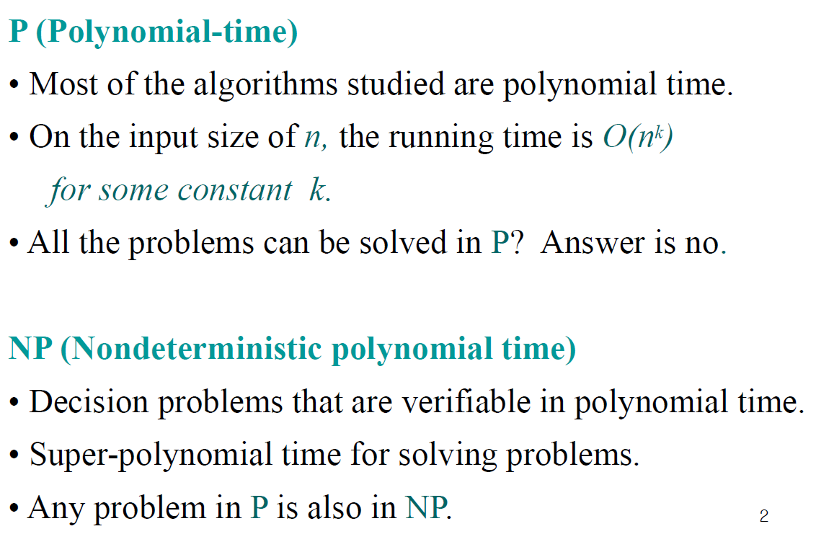
Classes of problems

Slide 116
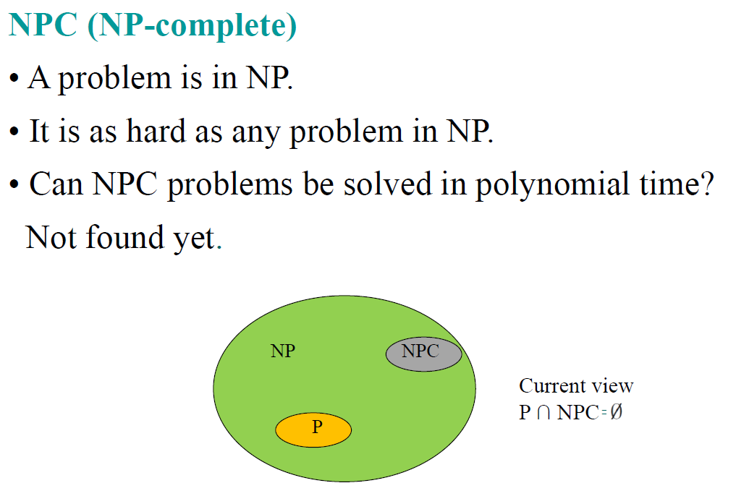
Classes of problems

Slide 117
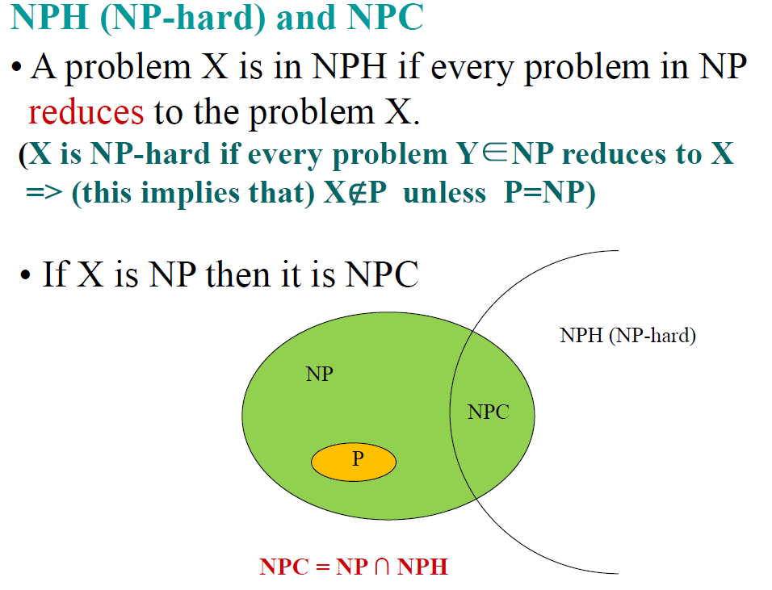
Classes of problems

Slide 118
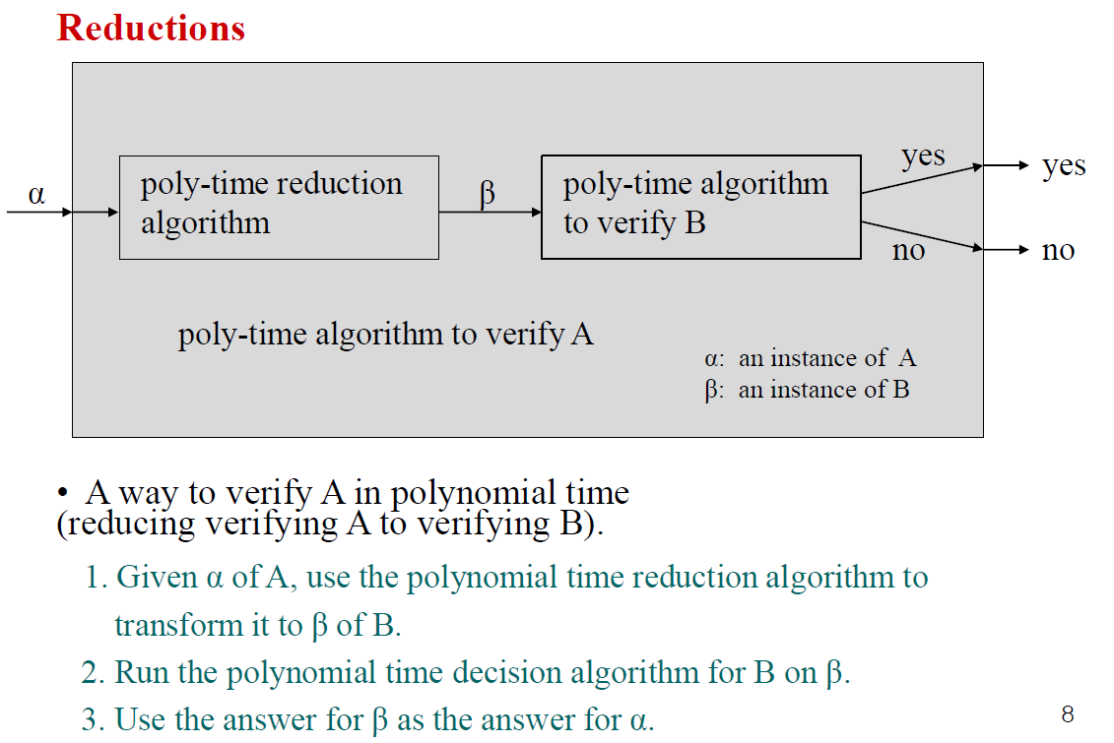
Overview of showing NP-complete

Slide 119
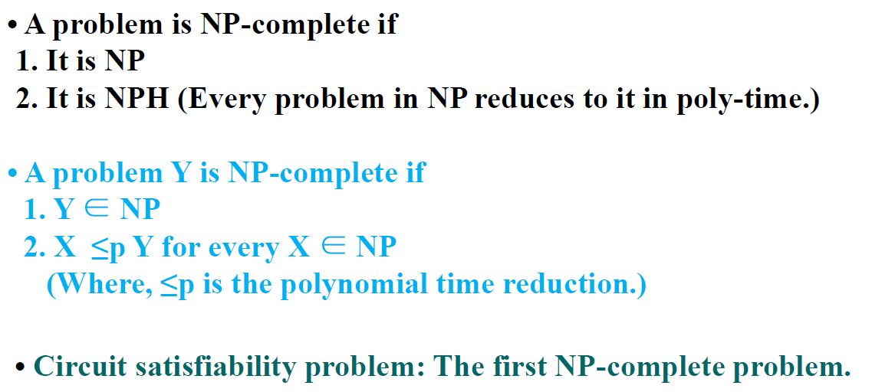
Showing first NP-completeness

Slide 120
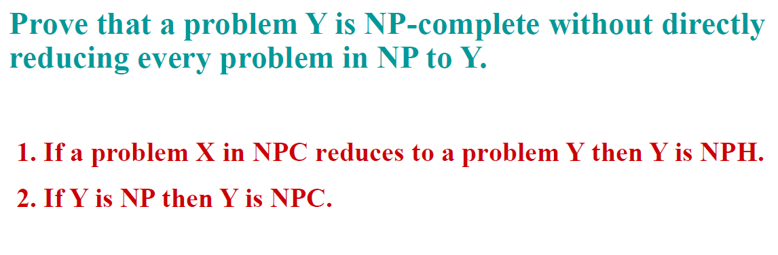
NP-completeness proofs

Slide 121
Reference
Charles Leiserson and Piotr Indyk, “Introduction to Algorithms”, September 29, 2004
https://www.geeksforgeeks.org

