Slide 1
Graph Algorithm
Applications
SWE2016-44

Slide 2
Applications of BFS
Shortest Path in a graph
Social Network
Cycle Detection in undirected graph
To test if a graph is bipartite
Broadcasting in a network
Path Finding

Slide 3

Applications of BFS
Source
0
1
Shortest Path in an unweighted graph
1
1
Initialize:
Dist_Shortest(F)
2
3
$$\left\{\begin{matrix}\text{0 }\text{if} \text{source}\text{=}\text{destination} \\ ∞ \text{otherwise} \end{matrix}\right.$$
2
2
4
5
For each edge E={v, w}:
  If w is unvisited,
  Dist_Shortest(w) = Dist_Shortest(v)+1
6
3
Destination

Slide 4
Applications of BFS
Social Network
In social networks, we can find people within a given distance ‘k’ from a person BFS until ‘k’ levels.
Tom
Sam
Ram
Bill
Joon
Ravi

Slide 5
Applications of BFS
Detecting cycle in undirected graph
For every visited vertex ‘v’, if there is an adjacent ‘u’ such that u is already visited and u is not parent of v, then there is a cycle in graph
A
BFS + Visited
B
C

Slide 6
Applications of BFS
Detecting cycle in undirected graph
For every visited vertex ‘v’, if there is an adjacent ‘u’ such that u is already visited and u is not parent of v, then there is a cycle in graph
A
B
C

Slide 7
Applications of BFS
Detecting cycle in undirected graph
For every visited vertex ‘v’, if there is an adjacent ‘u’ such that u is already visited and u is not parent of v, then there is a cycle in graph
A
B
C

Slide 8
Applications of BFS
Detecting cycle in undirected graph
For every visited vertex ‘v’, if there is an adjacent ‘u’ such that u is already visited and u is not parent of v, then there is a cycle in graph
A
B
C

Slide 9
Applications of BFS
Check if graph is bipartite or not: Bipartite Graph is a graph whose vertices can be divided into two disjoint and independent sets, U and V such that every edge (u, v) either connects a vertex from U to V or a vertex from V to U. In other words, for every edge (u, v), either u belongs to U and v to V, or u belongs to V and v to U. We can also say that there is no edge that connects vertices of same set.

Slide 10
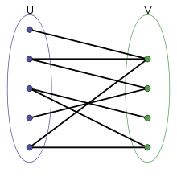
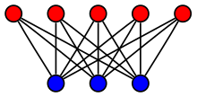
Applications of BFS
Check if graph is bipartite or not
Bipartite Graph

Slide 11
Applications of BFS
Check if graph is bipartite or not
Use the vertex coloring algorithm:
Start with a vertex and give it a color (RED).
Run BFS from this vertex. For each new vertex, color it opposite its parents. (p:RED → v:BLUE, p:BLUE → v:RED)
Check for edges that it doesn’t link two vertices of the same color.
Repeat steps 2 and 3 until all the vertices are colored RED or BLUE.

Slide 12
Applications of BFS
Broadcasting in a Network: Transferring data to all recipients simultaneously. BFS ensures that each node maintain shortest route to the source. Thus, reduces transmission delay and saves battery power.
Src
A
B
C
D
E

Slide 13
Applications of BFS
Path Finding: find a path between two given vertices u and v
Create a queue which will store path(s).
Now run a loop till queue is not empty.
  Get the frontmost path from queue.
  Check if the last vertex of this path is destination. If true then return it.
  Run a loop for all the vertices connected to the current vertex.
  If the vertex is not visited in current path,
    Create a new path from earlier path and append this vertex.
    Insert this new path to queue.

Slide 14
Applications of DFS
Detecting cycle in a graph
Path Finding
To test if a graph is bipartite
Topological Sort
Strongly Connected Components

Slide 15
Applications of DFS
Detecting cycle in a graph
For every visited vertex ‘v’, if there is an adjacent ‘u’ such that u is already visited and u is not parent of v, then there is a cycle in graph
A
DFS + Visited
B
C

Slide 16
Applications of DFS
Detecting cycle in a graph
For every visited vertex ‘v’, if there is an adjacent ‘u’ such that u is already visited and u is not parent of v, then there is a cycle in graph
A
B
C

Slide 17
Applications of DFS
Detecting cycle in a graph
For every visited vertex ‘v’, if there is an adjacent ‘u’ such that u is already visited and u is not parent of v, then there is a cycle in graph
A
B
C

Slide 18
Applications of DFS
Detecting cycle in a graph
For every visited vertex ‘v’, if there is an adjacent ‘u’ such that u is already visited and u is not parent of v, then there is a cycle in graph
A
Only DFS for
directed graph
B
C

Slide 19
Applications of DFS
Path Finding: find a path between two given vertices u and v
Algorithm:
Call DFS(G, u) with u as the start vertex.
Use a stack S to keep track of the path between the start vertex and the current vertex.
As soon as destination vertex v is encountered, return the path as the contents of the stack.

Slide 20
Applications of DFS
Check if graph is bipartite or not: Bipartite Graph is a graph whose vertices can be divided into two disjoint and independent sets, U and V such that every edge (u, v) either connects a vertex from U to V or a vertex from V to U. In other words, for every edge (u, v), either u belongs to U and v to V, or u belongs to V and v to U. We can also say that there is no edge that connects vertices of same set.

Slide 21
Applications of DFS
Check if graph is bipartite or not
Bipartite Graph

Slide 22
Applications of DFS
Check if graph is bipartite or not
Use the vertex coloring algorithm:
Start with a vertex and give it a color (RED).
Run DFS from this vertex. For each new vertex, color it opposite its parents. (p:RED → v:BLUE, p:BLUE → v:RED)
Check for edges that it doesn’t link two vertices of the same color.
Repeat steps 2 and 3 until all the vertices are colored RED or BLUE.

Slide 23
Applications of DFS
Topological Sort: for a DAG (Directed Acyclic Graph) G=(V, E) is a linear ordering of all its vertices such that if G contains an edge (u, v) then u appears before v in ordering.
A
Topological Sort:
F A B C D E
F A C B D E
A B F C D E
B
C
D
F
E

Slide 24
Applications of DFS
Topological Sort
Applications:
Build Systems
Advanced-Packaging Tool
Task Scheduling
Pre-requisite problems

Slide 25
Applications of DFS
Topological Sort:
Use Depth First Search using a temporary stack
A
B
C
D
F
E
Stack

Slide 26
Applications of DFS
Topological Sort:
Use Depth First Search using a temporary stack
A
B
C
D
F
E
Stack

Slide 27
Applications of DFS
Topological Sort:
Use Depth First Search using a temporary stack
A
B
C
D
F
E
Stack

Slide 28
Applications of DFS
Topological Sort:
Use Depth First Search using a temporary stack
A
B
C
D
F
E
Stack

Slide 29
Applications of DFS
Topological Sort:
Use Depth First Search using a temporary stack
A
B
C
D
F
E
Stack

Slide 30
Applications of DFS
Topological Sort:
Use Depth First Search using a temporary stack
A
B
C
D
F
E
E
Stack

Slide 31
Applications of DFS
Topological Sort:
Use Depth First Search using a temporary stack
A
B
C
D
F
E
D
E
Stack

Slide 32
Applications of DFS
Topological Sort:
Use Depth First Search using a temporary stack
A
B
C
D
F
B
E
D
E
Stack

Slide 33
Applications of DFS
Topological Sort:
Use Depth First Search using a temporary stack
A
B
C
D
F
B
E
D
E
Stack

Slide 34
Applications of DFS
Topological Sort:
Use Depth First Search using a temporary stack
A
B
C
C
D
F
B
E
D
E
Stack

Slide 35
Applications of DFS
Topological Sort:
Use Depth First Search using a temporary stack
A
B
C
A
C
D
F
B
E
D
E
Stack

Slide 36
Applications of DFS
Topological Sort:
Use Depth First Search using a temporary stack
A
F
B
C
A
C
D
F
B
E
D
E
F A C B D E
Stack

Slide 37
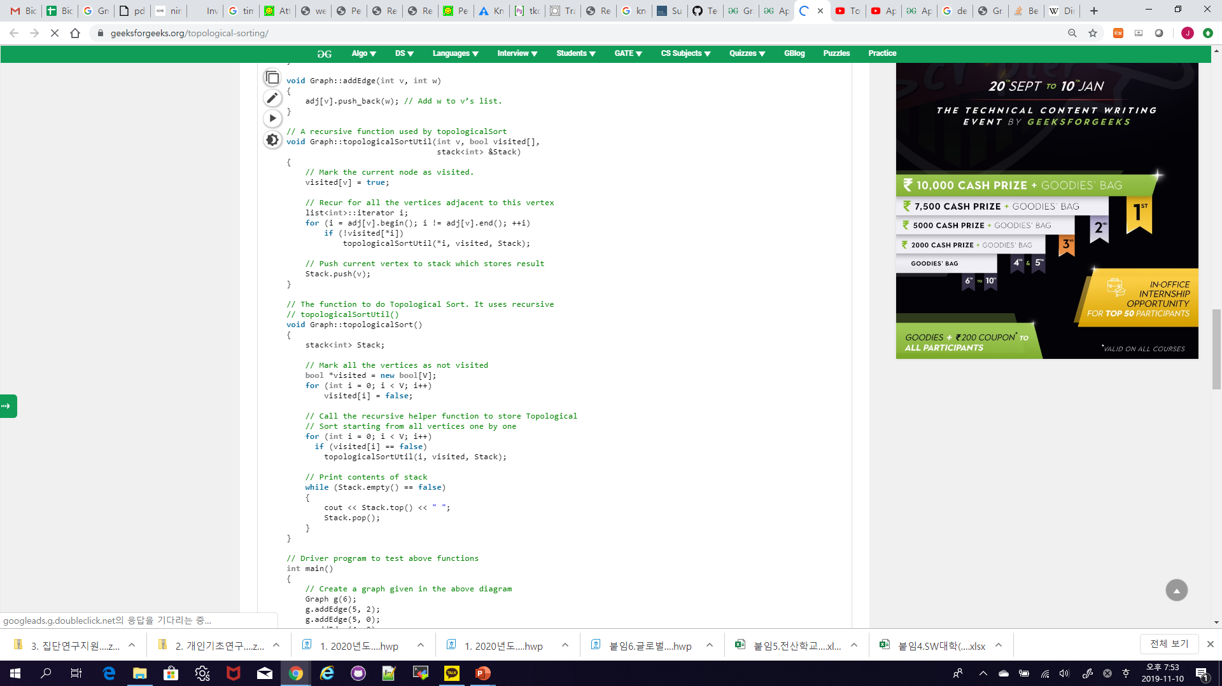
Applications of DFS
Topological Sort

Slide 38
Applications of DFS
Topological Sort
Time Complexity:
O(V+E)
V: Vertices
E: Edges

Slide 39
Applications of DFS
Strongly Connected Components (SCC)
A directed graph is strongly connected if there is a path between all pairs of vertices.
0
1
3
2

Slide 40
Applications of DFS
Strongly Connected Components (SCC)
A strongly connected components (SCC) of a directed graph is a maximal strongly connected subgraph.
1
0
3
strongly connected components
1-0-2
3
4
2
4

Slide 41
Applications of DFS
Strongly Connected Components (SCC)
Kosaraju’s algorithm:
Create an empty stack S.
Do DFS of a graph. In DFS, after calling recursive DFS for adjacent vertices of a vertex, push the vertex to stack.
Reverse directions of all arcs to obtain the transpose graph.
One by one pop a vertex from S while S is not empty. Let the popped vertex be ‘v’. Take v as source and do DFS call on v. The DFS starting from v prints strongly connected component of v.

Slide 42
Applications of DFS
7
Strongly Connected Components (SCC)
8
(4,
5)
10)
9)
18)
14)
(7,
(8,
(15,
(1,
0
3
5
6
7
0
1
G
2
1
2
4
8
4
17)
(2,
(16,
13)
(3,
12)
(6,
11)
5
0
3
5
6
7
6
G^{T}
3
1
2
4
8
S

Slide 43
Applications of DFS
7
Strongly Connected Components (SCC)
8
0
3
5
6
7
0
1
G^{T}
1
2
4
8
2
4
5
6
3
S

Slide 44
Applications of DFS
Strongly Connected Components (SCC)
8
0
3
5
6
7
0
1
G^{T}
1
2
4
8
2
4
Pop 7
Visited: {7}
5
strongly connected components
7
6
3
S

Slide 45
Applications of DFS
Strongly Connected Components (SCC)
0
3
5
6
7
0
1
G^{T}
1
2
4
8
2
4
Pop 8
Visited: {7,8}
5
strongly connected components
7
8
6
3
S

Slide 46
Applications of DFS
Strongly Connected Components (SCC)
0
3
5
6
7
1
G^{T}
1
2
4
8
2
4
Pop 0
Visited: {7,8,0,3,2,1}
5
strongly connected components
7
8
0-3-2-1
6
3
S

Slide 47
Applications of DFS
Strongly Connected Components (SCC)
0
3
5
6
7
G^{T}
1
2
4
8
4
Pop 1 and 2
Visited: {7,8,0,3,2,1}
5
strongly connected components
7
8
0-3-2-1
6
3
S

Slide 48
Applications of DFS
Strongly Connected Components (SCC)
0
3
5
6
7
G^{T}
1
2
4
8
Pop 4
Visited: {7,8,0,3,2,1,4,6,5}
5
strongly connected components
7
8
0-3-2-1
4-6-5
6
3
S

Slide 49
Applications of DFS
Strongly Connected Components (SCC)
0
3
5
6
7
G^{T}
1
2
4
8
Pop 5, 6 and 3
Visited: {7,8,0,3,2,1,4,6,5}
strongly connected components
7
8
0-3-2-1
4-6-5
S

Slide 50
Applications of DFS
Strongly Connected Components (SCC)
0
3
5
6
7
G^{T}
1
2
4
8
Stack is empty → Terminate
strongly connected components
7
8
0-3-2-1
4-6-5
Graph of SCCs
0,3,1,2
4,6,5
7
8
0,3,1,2
4,6,5
7
8
SCCs in reverse graph
S

Slide 51
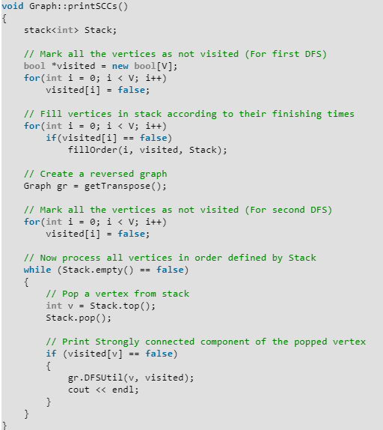
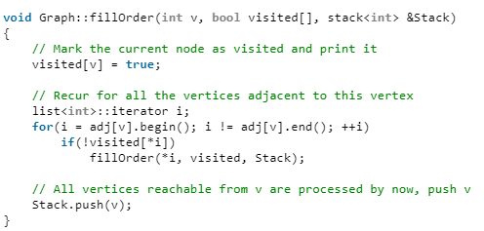
Applications of DFS
Strongly Connected Components

Slide 52
Reference
Charles Leiserson and Piotr Indyk, “Introduction to Algorithms”, September 29, 2004
https://www.geeksforgeeks.org

