Slide 1
Minimum Spanning Tree
SWE2016-44

Slide 2
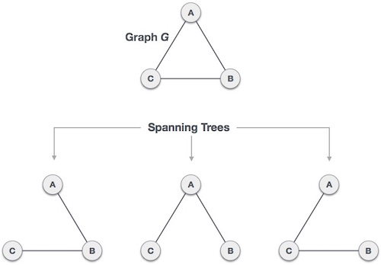
Definitions
Spanning Tree
  Given a connected and undirected graph, a spanning tree of that graph is a subgraph that is a tree connects all the vertices together.

Slide 3
Definitions
Spanning Tree
  Given a connected and undirected graph, a spanning tree of that graph is a subgraph that is a tree connects all the vertices together.
  Properties
    The spanning tree does not have any cycle
    Spanning tree has n-1 edges, where n is the number of vertices
    From a complete graph, by removing maximum e - n + 1 edges, we can construct a spanning tree.

Slide 4
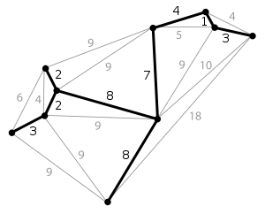
Definitions
Minimum Spanning Tree (MST)
  The spanning tree of the graph whose sum of weights of edges is minimum.
    A graph may have more than 1 minimum spanning tree.

Slide 5
Definitions
Minimum Spanning Tree (MST)
  The spanning tree of the graph whose sum of weights of edges is minimum.
    A graph may have more than 1 minimum spanning tree.
  Two most important MST
    Kruskal’s Algorithm
    Prim’s Algorithm
    ※ Both are greedy algorithms.

Slide 6
Kruskal’s Algorithm

Slide 7
Kruskal’s Algorithm
Sort all the edges in non-decreasing order of their weight.
Pick the smallest edge. Check if it forms a cycle with the spanning tree formed so far. If cycle is not formed, include this edge. Else, discard it.
Repeat step#2 until there are (V-1) edges in the spanning tree.

Slide 8
Examples
Sort all the edges in non-decreasing order of their weight.
|V|=9
V₁
8
V₂
7
V₃
Pick the smallest edge. Check if it forms a cycle with the spanning tree formed so far. If cycle is not formed, include this edge. Else, discard it.
4
2
9
V₀
V₈
V₄
11
4
14
7
8
6
10
V₇
V₆
V₅
Repeat step#2 until there are (V-1) edges in the spanning tree.
1
2

Slide 9
Examples
Sort all the edges in non-decreasing order of their weight.
|V|=9
V₁
8
V₂
7
V₃
Pick the smallest edge. Check if it forms a cycle with the spanning tree formed so far. If cycle is not formed, include this edge. Else, discard it.
4
2
9
V₀
V₈
V₄
11
4
14
7
8
6
10
V₇
V₆
V₅
Repeat step#2 until there are (V-1) edges in the spanning tree.
1
2
v₇,v₆ | v₈,v₂ | v₆,v₅ | v₀,v₁ | v₂,v₅ | v₈,v₆ | v₂,v₃ | v₇,v₈ | v₀,v₇ | v₁,v₂ | v₃,v₄ | v₅,v₄ | v₁,v₇ | v₃,v₅
1 | 2 | 2 | 4 | 4 | 6 | 7 | 7 | 8 | 8 | 9 | 10 | 11 | 14

Slide 10
Examples
Sort all the edges in non-decreasing order of their weight.
|V|=9
V₁
8
V₂
7
V₃
Pick the smallest edge. Check if it forms a cycle with the spanning tree formed so far. If cycle is not formed, include this edge. Else, discard it.
4
2
9
V₀
V₈
V₄
11
4
14
7
8
6
10
V₇
V₆
V₅
Repeat step#2 until there are (V-1) edges in the spanning tree.
1
2
v₇,v₆ | v₈,v₂ | v₆,v₅ | v₀,v₁ | v₂,v₅ | v₈,v₆ | v₂,v₃ | v₇,v₈ | v₀,v₇ | v₁,v₂ | v₃,v₄ | v₅,v₄ | v₁,v₇ | v₃,v₅
1 | 2 | 2 | 4 | 4 | 6 | 7 | 7 | 8 | 8 | 9 | 10 | 11 | 14

Slide 11
Examples
Sort all the edges in non-decreasing order of their weight.
|V|=9
V₁
8
V₂
7
V₃
Pick the smallest edge. Check if it forms a cycle with the spanning tree formed so far. If cycle is not formed, include this edge. Else, discard it.
4
2
9
V₀
V₈
V₄
11
4
14
7
8
6
10
V₇
V₆
V₅
Repeat step#2 until there are (V-1) edges in the spanning tree.
1
2
# of Edges in MST = 1
v₇,v₆ | v₈,v₂ | v₆,v₅ | v₀,v₁ | v₂,v₅ | v₈,v₆ | v₂,v₃ | v₇,v₈ | v₀,v₇ | v₁,v₂ | v₃,v₄ | v₅,v₄ | v₁,v₇ | v₃,v₅
1 | 2 | 2 | 4 | 4 | 6 | 7 | 7 | 8 | 8 | 9 | 10 | 11 | 14

Slide 12
Examples
Sort all the edges in non-decreasing order of their weight.
|V|=9
V₁
8
V₂
7
V₃
Pick the smallest edge. Check if it forms a cycle with the spanning tree formed so far. If cycle is not formed, include this edge. Else, discard it.
4
2
9
V₀
V₈
V₄
11
4
14
7
8
6
10
V₇
V₆
V₅
Repeat step#2 until there are (V-1) edges in the spanning tree.
1
2
# of Edges in MST = 1
v₇,v₆ | v₈,v₂ | v₆,v₅ | v₀,v₁ | v₂,v₅ | v₈,v₆ | v₂,v₃ | v₇,v₈ | v₀,v₇ | v₁,v₂ | v₃,v₄ | v₅,v₄ | v₁,v₇ | v₃,v₅
1 | 2 | 2 | 4 | 4 | 6 | 7 | 7 | 8 | 8 | 9 | 10 | 11 | 14

Slide 13
Examples
Sort all the edges in non-decreasing order of their weight.
|V|=9
V₁
8
V₂
7
V₃
Pick the smallest edge. Check if it forms a cycle with the spanning tree formed so far. If cycle is not formed, include this edge. Else, discard it.
4
2
9
V₀
V₈
V₄
11
4
14
7
8
6
10
V₇
V₆
V₅
Repeat step#2 until there are (V-1) edges in the spanning tree.
1
2
# of Edges in MST = 2
v₇,v₆ | v₈,v₂ | v₆,v₅ | v₀,v₁ | v₂,v₅ | v₈,v₆ | v₂,v₃ | v₇,v₈ | v₀,v₇ | v₁,v₂ | v₃,v₄ | v₅,v₄ | v₁,v₇ | v₃,v₅
1 | 2 | 2 | 4 | 4 | 6 | 7 | 7 | 8 | 8 | 9 | 10 | 11 | 14

Slide 14
Examples
Sort all the edges in non-decreasing order of their weight.
|V|=9
V₁
8
V₂
7
V₃
Pick the smallest edge. Check if it forms a cycle with the spanning tree formed so far. If cycle is not formed, include this edge. Else, discard it.
4
2
9
V₀
V₈
V₄
11
4
14
7
8
6
10
V₇
V₆
V₅
Repeat step#2 until there are (V-1) edges in the spanning tree.
1
2
# of Edges in MST = 3
v₇,v₆ | v₈,v₂ | v₆,v₅ | v₀,v₁ | v₂,v₅ | v₈,v₆ | v₂,v₃ | v₇,v₈ | v₀,v₇ | v₁,v₂ | v₃,v₄ | v₅,v₄ | v₁,v₇ | v₃,v₅
1 | 2 | 2 | 4 | 4 | 6 | 7 | 7 | 8 | 8 | 9 | 10 | 11 | 14

Slide 15
Examples
Sort all the edges in non-decreasing order of their weight.
|V|=9
V₁
8
V₂
7
V₃
Pick the smallest edge. Check if it forms a cycle with the spanning tree formed so far. If cycle is not formed, include this edge. Else, discard it.
4
2
9
V₀
V₈
V₄
11
4
14
7
8
6
10
V₇
V₆
V₅
Repeat step#2 until there are (V-1) edges in the spanning tree.
1
2
# of Edges in MST = 4
v₇,v₆ | v₈,v₂ | v₆,v₅ | v₀,v₁ | v₂,v₅ | v₈,v₆ | v₂,v₃ | v₇,v₈ | v₀,v₇ | v₁,v₂ | v₃,v₄ | v₅,v₄ | v₁,v₇ | v₃,v₅
1 | 2 | 2 | 4 | 4 | 6 | 7 | 7 | 8 | 8 | 9 | 10 | 11 | 14

Slide 16
Examples
Sort all the edges in non-decreasing order of their weight.
|V|=9
V₁
8
V₂
7
V₃
Pick the smallest edge. Check if it forms a cycle with the spanning tree formed so far. If cycle is not formed, include this edge. Else, discard it.
4
2
9
V₀
V₈
V₄
11
4
14
7
8
6
10
V₇
V₆
V₅
Repeat step#2 until there are (V-1) edges in the spanning tree.
1
2
# of Edges in MST = 5
v₇,v₆ | v₈,v₂ | v₆,v₅ | v₀,v₁ | v₂,v₅ | v₈,v₆ | v₂,v₃ | v₇,v₈ | v₀,v₇ | v₁,v₂ | v₃,v₄ | v₅,v₄ | v₁,v₇ | v₃,v₅
1 | 2 | 2 | 4 | 4 | 6 | 7 | 7 | 8 | 8 | 9 | 10 | 11 | 14

Slide 17
Examples
Sort all the edges in non-decreasing order of their weight.
|V|=9
V₁
8
V₂
7
V₃
Pick the smallest edge. Check if it forms a cycle with the spanning tree formed so far. If cycle is not formed, include this edge. Else, discard it.
4
2
9
V₀
V₈
V₄
11
4
14
7
8
6
10
V₇
V₆
V₅
Repeat step#2 until there are (V-1) edges in the spanning tree.
1
2
# of Edges in MST = 5
v₇,v₆ | v₈,v₂ | v₆,v₅ | v₀,v₁ | v₂,v₅ | v₈,v₆ | v₂,v₃ | v₇,v₈ | v₀,v₇ | v₁,v₂ | v₃,v₄ | v₅,v₄ | v₁,v₇ | v₃,v₅
1 | 2 | 2 | 4 | 4 | 6 | 7 | 7 | 8 | 8 | 9 | 10 | 11 | 14

Slide 18
Examples
Sort all the edges in non-decreasing order of their weight.
|V|=9
V₁
8
V₂
7
V₃
Pick the smallest edge. Check if it forms a cycle with the spanning tree formed so far. If cycle is not formed, include this edge. Else, discard it.
4
2
9
V₀
V₈
V₄
11
4
14
7
8
6
10
V₇
V₆
V₅
Repeat step#2 until there are (V-1) edges in the spanning tree.
1
2
# of Edges in MST = 6
v₇,v₆ | v₈,v₂ | v₆,v₅ | v₀,v₁ | v₂,v₅ | v₈,v₆ | v₂,v₃ | v₇,v₈ | v₀,v₇ | v₁,v₂ | v₃,v₄ | v₅,v₄ | v₁,v₇ | v₃,v₅
1 | 2 | 2 | 4 | 4 | 6 | 7 | 7 | 8 | 8 | 9 | 10 | 11 | 14

Slide 19
Examples
Sort all the edges in non-decreasing order of their weight.
|V|=9
V₁
8
V₂
7
V₃
Pick the smallest edge. Check if it forms a cycle with the spanning tree formed so far. If cycle is not formed, include this edge. Else, discard it.
4
2
9
V₀
V₈
V₄
11
4
14
7
8
6
10
V₇
V₆
V₅
Repeat step#2 until there are (V-1) edges in the spanning tree.
1
2
# of Edges in MST = 6
v₇,v₆ | v₈,v₂ | v₆,v₅ | v₀,v₁ | v₂,v₅ | v₈,v₆ | v₂,v₃ | v₇,v₈ | v₀,v₇ | v₁,v₂ | v₃,v₄ | v₅,v₄ | v₁,v₇ | v₃,v₅
1 | 2 | 2 | 4 | 4 | 6 | 7 | 7 | 8 | 8 | 9 | 10 | 11 | 14

Slide 20
Examples
Sort all the edges in non-decreasing order of their weight.
|V|=9
V₁
8
V₂
7
V₃
Pick the smallest edge. Check if it forms a cycle with the spanning tree formed so far. If cycle is not formed, include this edge. Else, discard it.
4
2
9
V₀
V₈
V₄
11
4
14
7
8
6
10
V₇
V₆
V₅
Repeat step#2 until there are (V-1) edges in the spanning tree.
1
2
# of Edges in MST = 7
v₇,v₆ | v₈,v₂ | v₆,v₅ | v₀,v₁ | v₂,v₅ | v₈,v₆ | v₂,v₃ | v₇,v₈ | v₀,v₇ | v₁,v₂ | v₃,v₄ | v₅,v₄ | v₁,v₇ | v₃,v₅
1 | 2 | 2 | 4 | 4 | 6 | 7 | 7 | 8 | 8 | 9 | 10 | 11 | 14

Slide 21
Examples
Sort all the edges in non-decreasing order of their weight.
|V|=9
V₁
8
V₂
7
V₃
Pick the smallest edge. Check if it forms a cycle with the spanning tree formed so far. If cycle is not formed, include this edge. Else, discard it.
4
2
9
V₀
V₈
V₄
11
4
14
7
8
6
10
V₇
V₆
V₅
Repeat step#2 until there are (V-1) edges in the spanning tree.
1
2
# of Edges in MST = 7
v₇,v₆ | v₈,v₂ | v₆,v₅ | v₀,v₁ | v₂,v₅ | v₈,v₆ | v₂,v₃ | v₇,v₈ | v₀,v₇ | v₁,v₂ | v₃,v₄ | v₅,v₄ | v₁,v₇ | v₃,v₅
1 | 2 | 2 | 4 | 4 | 6 | 7 | 7 | 8 | 8 | 9 | 10 | 11 | 14

Slide 22
Examples
Sort all the edges in non-decreasing order of their weight.
|V|=9
V₁
8
V₂
7
V₃
Pick the smallest edge. Check if it forms a cycle with the spanning tree formed so far. If cycle is not formed, include this edge. Else, discard it.
4
2
9
V₀
V₈
V₄
11
4
14
7
8
6
10
V₇
V₆
V₅
Repeat step#2 until there are (V-1) edges in the spanning tree.
1
2
# of Edges in MST = 8
v₇,v₆ | v₈,v₂ | v₆,v₅ | v₀,v₁ | v₂,v₅ | v₈,v₆ | v₂,v₃ | v₇,v₈ | v₀,v₇ | v₁,v₂ | v₃,v₄ | v₅,v₄ | v₁,v₇ | v₃,v₅
1 | 2 | 2 | 4 | 4 | 6 | 7 | 7 | 8 | 8 | 9 | 10 | 11 | 14

Slide 23
Examples
Sort all the edges in non-decreasing order of their weight.
|V|=9
V₁
8
V₂
7
V₃
Pick the smallest edge. Check if it forms a cycle with the spanning tree formed so far. If cycle is not formed, include this edge. Else, discard it.
4
2
9
V₀
V₈
V₄
11
4
14
7
8
6
10
V₇
V₆
V₅
Repeat step#2 until there are (V-1) edges in the spanning tree.
1
2
Terminate!!!
v₇,v₆ | v₈,v₂ | v₆,v₅ | v₀,v₁ | v₂,v₅ | v₈,v₆ | v₂,v₃ | v₇,v₈ | v₀,v₇ | v₁,v₂ | v₃,v₄ | v₅,v₄ | v₁,v₇ | v₃,v₅
1 | 2 | 2 | 4 | 4 | 6 | 7 | 7 | 8 | 8 | 9 | 10 | 11 | 14

Slide 24
Examples
Sort all the edges in non-decreasing order of their weight.
V₁
V₂
7
V₃
Pick the smallest edge. Check if it forms a cycle with the spanning tree formed so far. If cycle is not formed, include this edge. Else, discard it.
4
2
9
V₀
V₈
V₄
4
8
V₇
V₆
V₅
Repeat step#2 until there are (V-1) edges in the spanning tree.
1
2
Now we have our MST!
v₇,v₆ | v₈,v₂ | v₆,v₅ | v₀,v₁ | v₂,v₅ | v₈,v₆ | v₂,v₃ | v₇,v₈ | v₀,v₇ | v₁,v₂ | v₃,v₄ | v₅,v₄ | v₁,v₇ | v₃,v₅
1 | 2 | 2 | 4 | 4 | 6 | 7 | 7 | 8 | 8 | 9 | 10 | 11 | 14

Slide 25
Examples
Sort all the edges in non-decreasing order of their weight.
Weights of MST = 37
V₁
V₂
7
V₃
Pick the smallest edge. Check if it forms a cycle with the spanning tree formed so far. If cycle is not formed, include this edge. Else, discard it.
4
2
9
V₀
V₈
V₄
4
8
V₇
V₆
V₅
Repeat step#2 until there are (V-1) edges in the spanning tree.
1
2
Now we have our MST!
v₇,v₆ | v₈,v₂ | v₆,v₅ | v₀,v₁ | v₂,v₅ | v₈,v₆ | v₂,v₃ | v₇,v₈ | v₀,v₇ | v₁,v₂ | v₃,v₄ | v₅,v₄ | v₁,v₇ | v₃,v₅
1 | 2 | 2 | 4 | 4 | 6 | 7 | 7 | 8 | 8 | 9 | 10 | 11 | 14

Slide 26
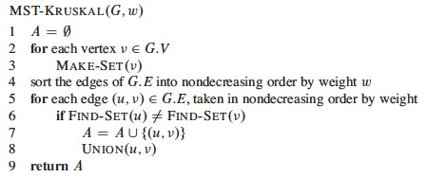
Pseudocode
O(1)
O(E log E)
O(E log V)
Overall Complexity = O(E Log E + E Log V)
→ V-1 $≤$ E $≤$ V² → O(Log E) $≈$ O(Log V)
→ Therefore, time complexity is O(E Log E) or O(E Log V)

Slide 27
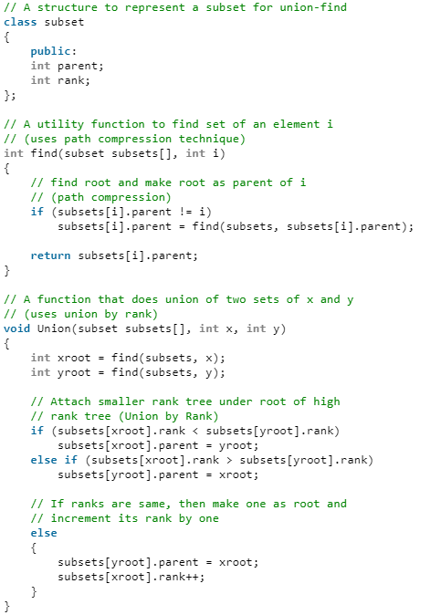
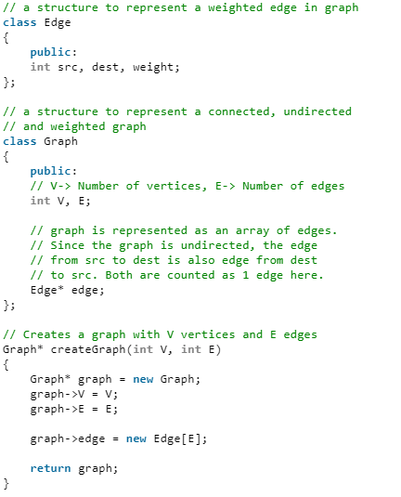
Implementation (1)

Slide 28
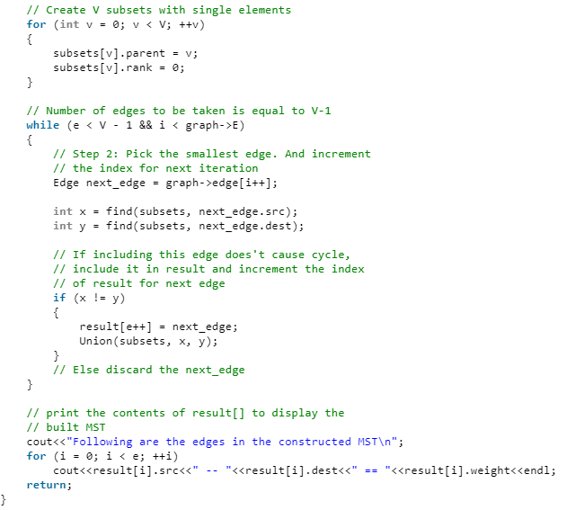
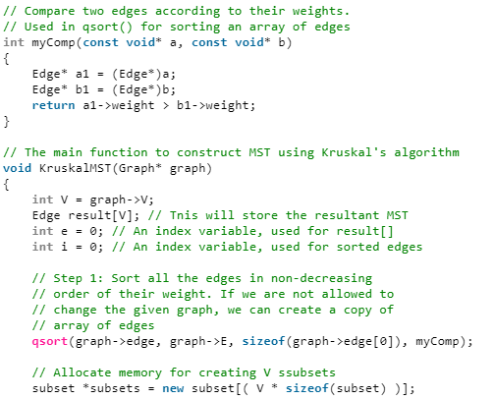
Implementation (2)

Slide 29
Prim’s Algorithm

Slide 30
Prim’s Algorithm (1)
Create a set mstSet that keeps track of vertices already included in MST.
Assign a key value to all vertices in the input graph. Initialize all key values as INFINITE. Assign key value as 0 for the first vertex so that it is picked first.

Slide 31
Prim’s Algorithm (2)
While mstSet doesn’t include all vertices
  Pick a vertex u which is not there in mstSet and has minimum key value.
  Include u to mstSet.
  Update key value of all adjacent vertices of u.
To update the key values, iterate through all adjacent vertices. For every adjacent vertex v, if weight of edge u-v is less than the previous key value of v, update the key value as weight of u-v

Slide 32
Examples
Create a set mstSet that keeps track of vertices already included in MST.
V₁
8
V₂
7
V₃
Assign a key value to all vertices in the input graph. Initialize all key values as INFINITE. Assign key value as 0 for the first vertex so that it is picked first.
4
2
9
V₀
V₈
V₄
11
4
14
7
While mstSet doesn’t include all vertices
  Pick a vertex u which is not there in mstSet and has minimum key value.
  Include u to mstSet.
  Update key value of all adjacent vertices of u.
8
6
10
V₇
V₆
V₅
1
2

Slide 33
Examples
mstSet={}
Create a set mstSet that keeps track of vertices already included in MST.
V₁
8
V₂
7
V₃
Assign a key value to all vertices in the input graph. Initialize all key values as INFINITE. Assign key value as 0 for the first vertex so that it is picked first.
4
2
9
V₀
V₈
V₄
11
4
14
7
While mstSet doesn’t include all vertices
  Pick a vertex u which is not there in mstSet and has minimum key value.
  Include u to mstSet.
  Update key value of all adjacent vertices of u.
8
6
10
V₇
V₆
V₅
1
2

Slide 34
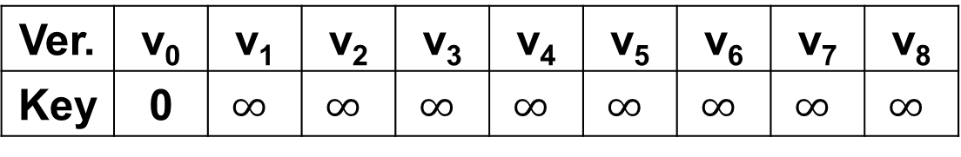
Examples
mstSet={}
Create a set mstSet that keeps track of vertices already included in MST.
V₁
8
V₂
7
V₃
Assign a key value to all vertices in the input graph. Initialize all key values as INFINITE. Assign key value as 0 for the first vertex so that it is picked first.
4
2
9
V₀
V₈
V₄
11
4
14
7
While mstSet doesn’t include all vertices
  Pick a vertex u which is not there in mstSet and has minimum key value.
  Include u to mstSet.
  Update key value of all adjacent vertices of u.
8
6
10
V₇
V₆
V₅
1
2
Ver. | v₀ | v₁ | v₂ | v₃ | v₄ | v₅ | v₆ | v₇ | v₈
Key | 0 | $$∞$$ | $$∞$$ | $$∞$$ | $$∞$$ | $$∞$$ | $$∞$$ | $$∞$$ | $$∞$$

Slide 35
Examples
mstSet={}
Create a set mstSet that keeps track of vertices already included in MST.
V₁
8
V₂
7
V₃
Assign a key value to all vertices in the input graph. Initialize all key values as INFINITE. Assign key value as 0 for the first vertex so that it is picked first.
4
2
9
V₀
V₈
V₄
11
4
14
7
While mstSet doesn’t include all vertices
  Pick a vertex u which is not there in mstSet and has minimum key value.
  Include u to mstSet.
  Update key value of all adjacent vertices of u.
8
6
10
V₇
V₆
V₅
1
2
Ver. | v₀ | v₁ | v₂ | v₃ | v₄ | v₅ | v₆ | v₇ | v₈
Key | 0 | $$∞$$ | $$∞$$ | $$∞$$ | $$∞$$ | $$∞$$ | $$∞$$ | $$∞$$ | $$∞$$

Slide 36
Examples
mstSet={v₀}
Create a set mstSet that keeps track of vertices already included in MST.
V₁
8
V₂
7
V₃
Assign a key value to all vertices in the input graph. Initialize all key values as INFINITE. Assign key value as 0 for the first vertex so that it is picked first.
4
2
9
u
V₀
V₈
V₄
11
4
14
7
While mstSet doesn’t include all vertices
  Pick a vertex u which is not there in mstSet and has minimum key value.
  Include u to mstSet.
  Update key value of all adjacent vertices of u.
8
6
10
V₇
V₆
V₅
1
2
u
If w(u,v)<v.key, v.key=w(u,v)
Ver. | v₀ | v₁ | v₂ | v₃ | v₄ | v₅ | v₆ | v₇ | v₈
Key | 0 | $$∞$$ | $$∞$$ | $$∞$$ | $$∞$$ | $$∞$$ | $$∞$$ | $$∞$$ | $$∞$$

Slide 37
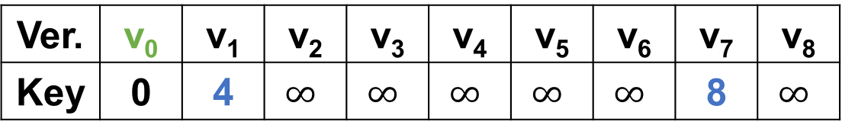
Examples
mstSet={v₀}
Create a set mstSet that keeps track of vertices already included in MST.
V₁
8
V₂
7
V₃
Assign a key value to all vertices in the input graph. Initialize all key values as INFINITE. Assign key value as 0 for the first vertex so that it is picked first.
4
2
9
V₀
V₈
V₄
11
4
14
7
While mstSet doesn’t include all vertices
  Pick a vertex u which is not there in mstSet and has minimum key value.
  Include u to mstSet.
  Update key value of all adjacent vertices of u.
8
6
10
V₇
V₆
V₅
1
2
Ver. | v₀ | v₁ | v₂ | v₃ | v₄ | v₅ | v₆ | v₇ | v₈
Key | 0 | 4 | $$∞$$ | $$∞$$ | $$∞$$ | $$∞$$ | $$∞$$ | 8 | $$∞$$

Slide 38
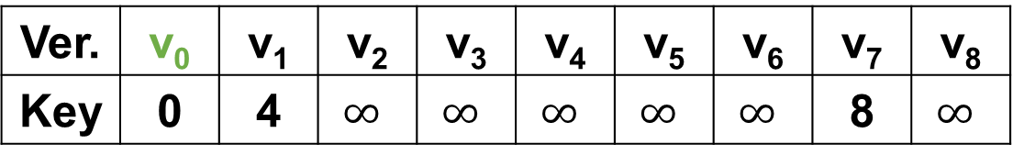
Examples
mstSet={v_{0,} v₁}
Create a set mstSet that keeps track of vertices already included in MST.
u
V₁
8
V₂
7
V₃
Assign a key value to all vertices in the input graph. Initialize all key values as INFINITE. Assign key value as 0 for the first vertex so that it is picked first.
4
2
9
V₀
V₈
V₄
11
4
14
7
While mstSet doesn’t include all vertices
  Pick a vertex u which is not there in mstSet and has minimum key value.
  Include u to mstSet.
  Update key value of all adjacent vertices of u.
8
6
10
V₇
V₆
V₅
1
2
u
Ver. | v₀ | v₁ | v₂ | v₃ | v₄ | v₅ | v₆ | v₇ | v₈
Key | 0 | 4 | $$∞$$ | $$∞$$ | $$∞$$ | $$∞$$ | $$∞$$ | 8 | $$∞$$

Slide 39
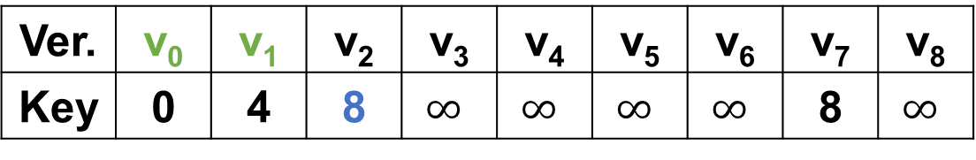
Examples
mstSet={v_{0,} v₁}
Create a set mstSet that keeps track of vertices already included in MST.
V₁
8
V₂
7
V₃
Assign a key value to all vertices in the input graph. Initialize all key values as INFINITE. Assign key value as 0 for the first vertex so that it is picked first.
4
2
9
V₀
V₈
V₄
11
4
14
7
While mstSet doesn’t include all vertices
  Pick a vertex u which is not there in mstSet and has minimum key value.
  Include u to mstSet.
  Update key value of all adjacent vertices of u.
8
6
10
V₇
V₆
V₅
1
2
Ver. | v₀ | v₁ | v₂ | v₃ | v₄ | v₅ | v₆ | v₇ | v₈
Key | 0 | 4 | 8 | $$∞$$ | $$∞$$ | $$∞$$ | $$∞$$ | 8 | $$∞$$

Slide 40
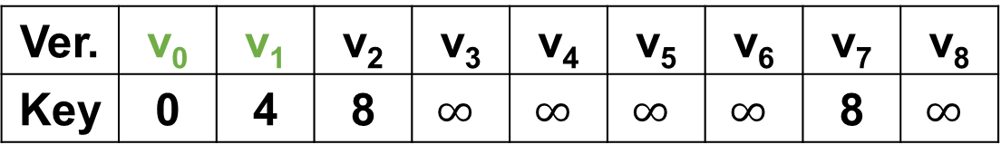
Examples
mstSet={v_{0,}v_{1,}v₇}
Create a set mstSet that keeps track of vertices already included in MST.
V₁
8
V₂
7
V₃
Assign a key value to all vertices in the input graph. Initialize all key values as INFINITE. Assign key value as 0 for the first vertex so that it is picked first.
4
2
9
V₀
V₈
V₄
11
4
14
7
While mstSet doesn’t include all vertices
  Pick a vertex u which is not there in mstSet and has minimum key value.
  Include u to mstSet.
  Update key value of all adjacent vertices of u.
8
6
10
V₇
V₆
V₅
u
1
2
u
Ver. | v₀ | v₁ | v₂ | v₃ | v₄ | v₅ | v₆ | v₇ | v₈
Key | 0 | 4 | 8 | $$∞$$ | $$∞$$ | $$∞$$ | $$∞$$ | 8 | $$∞$$

Slide 41
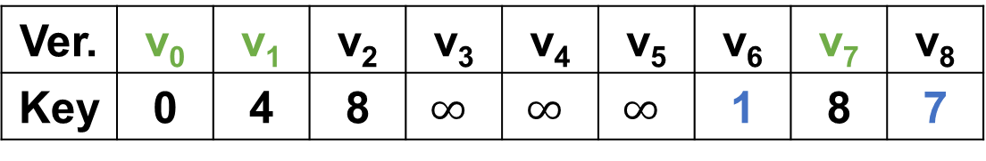
Examples
mstSet={v_{0,}v_{1,}v₇}
Create a set mstSet that keeps track of vertices already included in MST.
V₁
8
V₂
7
V₃
Assign a key value to all vertices in the input graph. Initialize all key values as INFINITE. Assign key value as 0 for the first vertex so that it is picked first.
4
2
9
V₀
V₈
V₄
11
4
14
7
While mstSet doesn’t include all vertices
  Pick a vertex u which is not there in mstSet and has minimum key value.
  Include u to mstSet.
  Update key value of all adjacent vertices of u.
8
6
10
V₇
V₆
V₅
1
2
Ver. | v₀ | v₁ | v₂ | v₃ | v₄ | v₅ | v₆ | v₇ | v₈
Key | 0 | 4 | 8 | $$∞$$ | $$∞$$ | $$∞$$ | 1 | 8 | 7

Slide 42
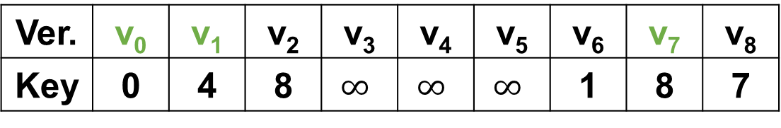
Examples
mstSet={v_{0,}v_{1,}v_{7,}v₆}
Create a set mstSet that keeps track of vertices already included in MST.
V₁
8
V₂
7
V₃
Assign a key value to all vertices in the input graph. Initialize all key values as INFINITE. Assign key value as 0 for the first vertex so that it is picked first.
4
2
9
V₀
V₈
V₄
11
4
14
7
While mstSet doesn’t include all vertices
  Pick a vertex u which is not there in mstSet and has minimum key value.
  Include u to mstSet.
  Update key value of all adjacent vertices of u.
8
6
10
V₇
V₆
V₅
1
2
u
u
Ver. | v₀ | v₁ | v₂ | v₃ | v₄ | v₅ | v₆ | v₇ | v₈
Key | 0 | 4 | 8 | $$∞$$ | $$∞$$ | $$∞$$ | 1 | 8 | 7

Slide 43
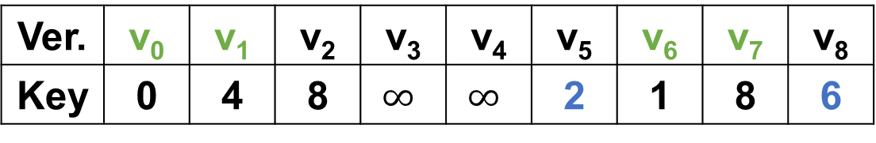
Examples
mstSet={v_{0,}v_{1,}v_{7,}v₆}
Create a set mstSet that keeps track of vertices already included in MST.
V₁
8
V₂
7
V₃
Assign a key value to all vertices in the input graph. Initialize all key values as INFINITE. Assign key value as 0 for the first vertex so that it is picked first.
4
2
9
V₀
V₈
V₄
11
4
14
7
While mstSet doesn’t include all vertices
  Pick a vertex u which is not there in mstSet and has minimum key value.
  Include u to mstSet.
  Update key value of all adjacent vertices of u.
8
6
10
V₇
V₆
V₅
1
2
Ver. | v₀ | v₁ | v₂ | v₃ | v₄ | v₅ | v₆ | v₇ | v₈
Key | 0 | 4 | 8 | $$∞$$ | $$∞$$ | 2 | 1 | 8 | 6

Slide 44
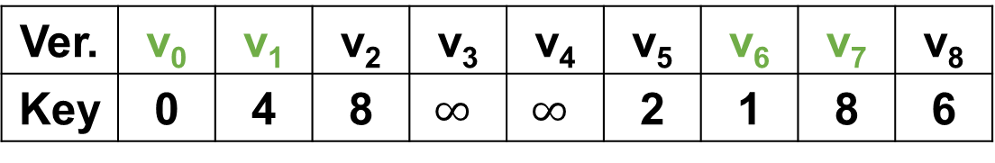
Examples
mstSet={v_{0,}v_{1,}v_{7,}v_{6,}v₅}
Create a set mstSet that keeps track of vertices already included in MST.
V₁
8
V₂
7
V₃
Assign a key value to all vertices in the input graph. Initialize all key values as INFINITE. Assign key value as 0 for the first vertex so that it is picked first.
4
2
9
V₀
V₈
V₄
11
4
14
7
While mstSet doesn’t include all vertices
  Pick a vertex u which is not there in mstSet and has minimum key value.
  Include u to mstSet.
  Update key value of all adjacent vertices of u.
8
6
10
V₇
V₆
V₅
1
2
u
u
Ver. | v₀ | v₁ | v₂ | v₃ | v₄ | v₅ | v₆ | v₇ | v₈
Key | 0 | 4 | 8 | $$∞$$ | $$∞$$ | 2 | 1 | 8 | 6

Slide 45
Examples
mstSet={v_{0,}v_{1,}v_{7,}v_{6,}v₅}
Create a set mstSet that keeps track of vertices already included in MST.
V₁
8
V₂
7
V₃
Assign a key value to all vertices in the input graph. Initialize all key values as INFINITE. Assign key value as 0 for the first vertex so that it is picked first.
4
2
9
V₀
V₈
V₄
11
4
14
7
While mstSet doesn’t include all vertices
  Pick a vertex u which is not there in mstSet and has minimum key value.
  Include u to mstSet.
  Update key value of all adjacent vertices of u.
8
6
10
V₇
V₆
V₅
1
2
Ver. | v₀ | v₁ | v₂ | v₃ | v₄ | v₅ | v₆ | v₇ | v₈
Key | 0 | 4 | 4 | 14 | 10 | 2 | 1 | 8 | 6

Slide 46
Examples
mstSet={v_{0,}v_{1,}v_{7,}v_{6,}v_{5,}v₂}
Create a set mstSet that keeps track of vertices already included in MST.
u
V₁
8
V₂
7
V₃
Assign a key value to all vertices in the input graph. Initialize all key values as INFINITE. Assign key value as 0 for the first vertex so that it is picked first.
4
2
9
V₀
V₈
V₄
11
4
14
7
While mstSet doesn’t include all vertices
  Pick a vertex u which is not there in mstSet and has minimum key value.
  Include u to mstSet.
  Update key value of all adjacent vertices of u.
8
6
10
V₇
V₆
V₅
1
2
u
Ver. | v₀ | v₁ | v₂ | v₃ | v₄ | v₅ | v₆ | v₇ | v₈
Key | 0 | 4 | 4 | 14 | 10 | 2 | 1 | 8 | 6

Slide 47
Examples
mstSet={v_{0,}v_{1,}v_{7,}v_{6,}v_{5,}v₂}
Create a set mstSet that keeps track of vertices already included in MST.
V₁
8
V₂
7
V₃
Assign a key value to all vertices in the input graph. Initialize all key values as INFINITE. Assign key value as 0 for the first vertex so that it is picked first.
4
2
9
V₀
V₈
V₄
11
4
14
7
While mstSet doesn’t include all vertices
  Pick a vertex u which is not there in mstSet and has minimum key value.
  Include u to mstSet.
  Update key value of all adjacent vertices of u.
8
6
10
V₇
V₆
V₅
1
2
Ver. | v₀ | v₁ | v₂ | v₃ | v₄ | v₅ | v₆ | v₇ | v₈
Key | 0 | 4 | 4 | 7 | 10 | 2 | 1 | 8 | 2

Slide 48
Examples
mstSet={v_{0,}v_{1,}v_{7,}v_{6,}v_{5,}v_{2,}v₈}
Create a set mstSet that keeps track of vertices already included in MST.
V₁
8
V₂
7
V₃
Assign a key value to all vertices in the input graph. Initialize all key values as INFINITE. Assign key value as 0 for the first vertex so that it is picked first.
4
2
9
u
V₀
V₈
V₄
11
4
14
7
While mstSet doesn’t include all vertices
  Pick a vertex u which is not there in mstSet and has minimum key value.
  Include u to mstSet.
  Update key value of all adjacent vertices of u.
8
6
10
V₇
V₆
V₅
1
2
u
Ver. | v₀ | v₁ | v₂ | v₃ | v₄ | v₅ | v₆ | v₇ | v₈
Key | 0 | 4 | 4 | 7 | 10 | 2 | 1 | 8 | 2

Slide 49
Examples
mstSet={v_{0,}v_{1,}v_{7,}v_{6,}v_{5,}v_{2,}v₈}
Create a set mstSet that keeps track of vertices already included in MST.
V₁
8
V₂
7
V₃
Assign a key value to all vertices in the input graph. Initialize all key values as INFINITE. Assign key value as 0 for the first vertex so that it is picked first.
4
2
9
V₀
V₈
V₄
11
4
14
7
While mstSet doesn’t include all vertices
  Pick a vertex u which is not there in mstSet and has minimum key value.
  Include u to mstSet.
  Update key value of all adjacent vertices of u.
8
6
10
V₇
V₆
V₅
1
2
Ver. | v₀ | v₁ | v₂ | v₃ | v₄ | v₅ | v₆ | v₇ | v₈
Key | 0 | 4 | 4 | 7 | 10 | 2 | 1 | 8 | 2

Slide 50
Examples
mstSet={v_{0,}v_{1,}v_{7,}v_{6,}v_{5,}v_{2,}v_{8,}v₃}
Create a set mstSet that keeps track of vertices already included in MST.
u
V₁
8
V₂
7
V₃
Assign a key value to all vertices in the input graph. Initialize all key values as INFINITE. Assign key value as 0 for the first vertex so that it is picked first.
4
2
9
V₀
V₈
V₄
11
4
14
7
While mstSet doesn’t include all vertices
  Pick a vertex u which is not there in mstSet and has minimum key value.
  Include u to mstSet.
  Update key value of all adjacent vertices of u.
8
6
10
V₇
V₆
V₅
1
2
u
Ver. | v₀ | v₁ | v₂ | v₃ | v₄ | v₅ | v₆ | v₇ | v₈
Key | 0 | 4 | 4 | 7 | 10 | 2 | 1 | 8 | 2

Slide 51
Examples
mstSet={v_{0,}v_{1,}v_{7,}v_{6,}v_{5,}v_{2,}v_{8,}v₃}
Create a set mstSet that keeps track of vertices already included in MST.
V₁
8
V₂
7
V₃
Assign a key value to all vertices in the input graph. Initialize all key values as INFINITE. Assign key value as 0 for the first vertex so that it is picked first.
4
2
9
V₀
V₈
V₄
11
4
14
7
While mstSet doesn’t include all vertices
  Pick a vertex u which is not there in mstSet and has minimum key value.
  Include u to mstSet.
  Update key value of all adjacent vertices of u.
8
6
10
V₇
V₆
V₅
1
2
Ver. | v₀ | v₁ | v₂ | v₃ | v₄ | v₅ | v₆ | v₇ | v₈
Key | 0 | 4 | 4 | 7 | 9 | 2 | 1 | 8 | 2

Slide 52
Examples
mstSet={v_{0,}v_{1,}v_{7,}v_{6,}v_{5,}v_{2,}v_{8,}v_{3,}v₄}
Create a set mstSet that keeps track of vertices already included in MST.
V₁
8
V₂
7
V₃
Assign a key value to all vertices in the input graph. Initialize all key values as INFINITE. Assign key value as 0 for the first vertex so that it is picked first.
4
2
9
u
V₀
V₈
V₄
11
4
14
7
While mstSet doesn’t include all vertices
  Pick a vertex u which is not there in mstSet and has minimum key value.
  Include u to mstSet.
  Update key value of all adjacent vertices of u.
8
6
10
V₇
V₆
V₅
1
2
u
Ver. | v₀ | v₁ | v₂ | v₃ | v₄ | v₅ | v₆ | v₇ | v₈
Key | 0 | 4 | 4 | 7 | 9 | 2 | 1 | 8 | 2

Slide 53
Examples
mstSet={v_{0,}v_{1,}v_{7,}v_{6,}v_{5,}v_{2,}v_{8,}v_{3,}v₄}
Create a set mstSet that keeps track of vertices already included in MST.
V₁
8
V₂
7
V₃
Assign a key value to all vertices in the input graph. Initialize all key values as INFINITE. Assign key value as 0 for the first vertex so that it is picked first.
4
2
9
V₀
V₈
V₄
11
4
14
7
While mstSet doesn’t include all vertices
  Pick a vertex u which is not there in mstSet and has minimum key value.
  Include u to mstSet.
  Update key value of all adjacent vertices of u.
8
6
10
V₇
V₆
V₅
1
2
Terminate!!
Ver. | v₀ | v₁ | v₂ | v₃ | v₄ | v₅ | v₆ | v₇ | v₈
Key | 0 | 4 | 4 | 7 | 9 | 2 | 1 | 8 | 2

Slide 54
Examples
Weights of MST = 37
Time Complexity
Time Complexity of Prim’s Algorithm is O(V²) if adjacency matrix is used.
If adjacency list is used, then the time complexity of Prim’s algorithm can be reduced to O(E Log V) with the help of binary heap.
V₁
V₂
7
V₃
4
2
9
u
V₀
V₈
V₄
4
8
V₇
V₆
V₅
1
2
Ver. | v₀ | v₁ | v₂ | v₃ | v₄ | v₅ | v₆ | v₇ | v₈
Key | 0 | 4 | 4 | 7 | 9 | 2 | 1 | 8 | 2

Slide 55
Pseudocode

Slide 56
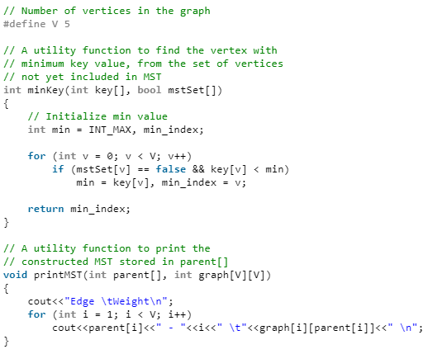
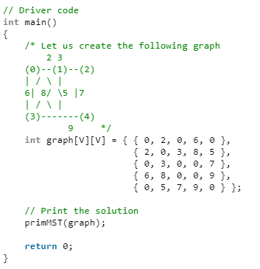
Implementation (1)

Slide 57
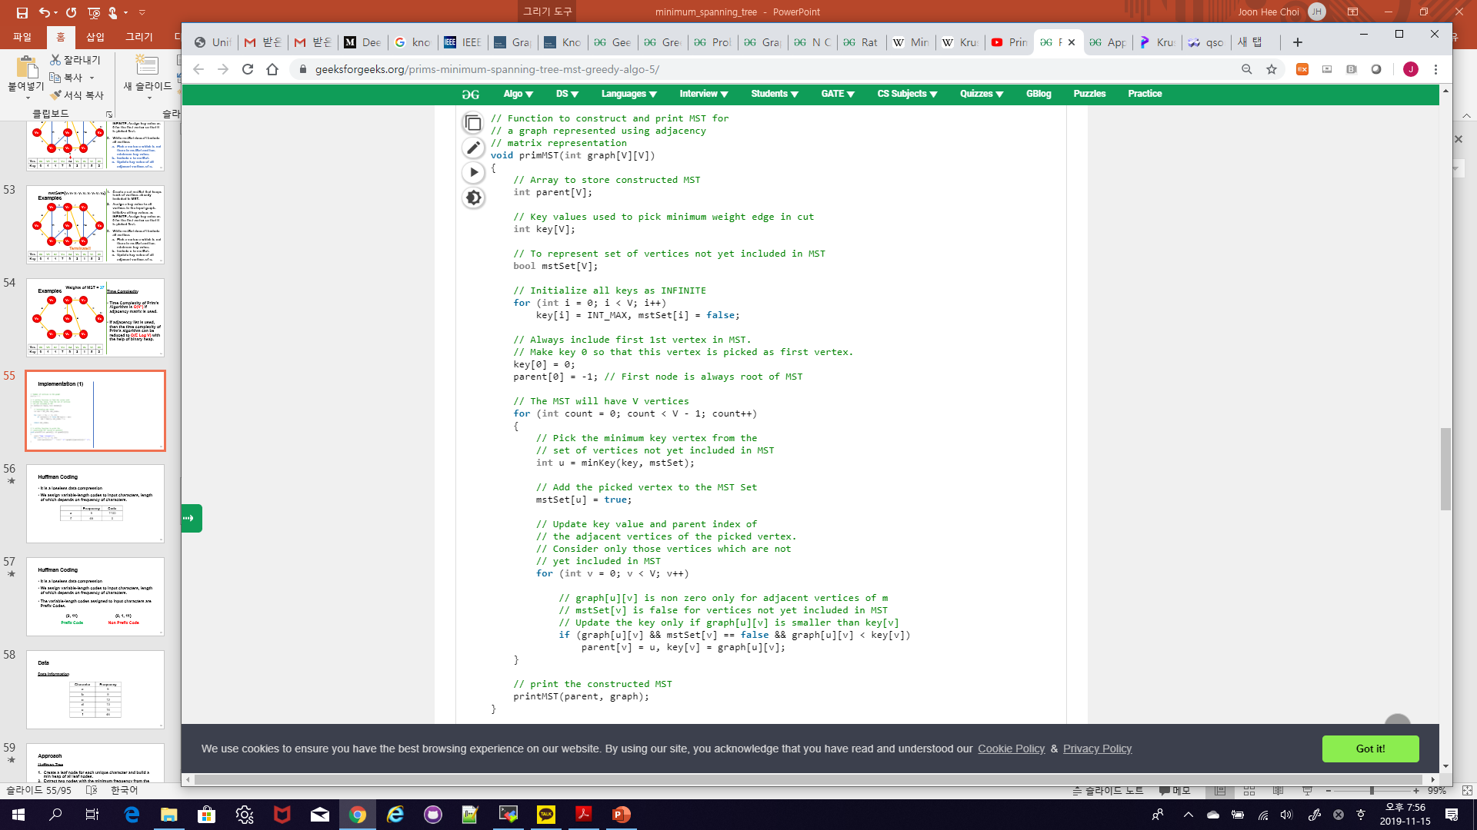
Implementation (2)

Slide 58
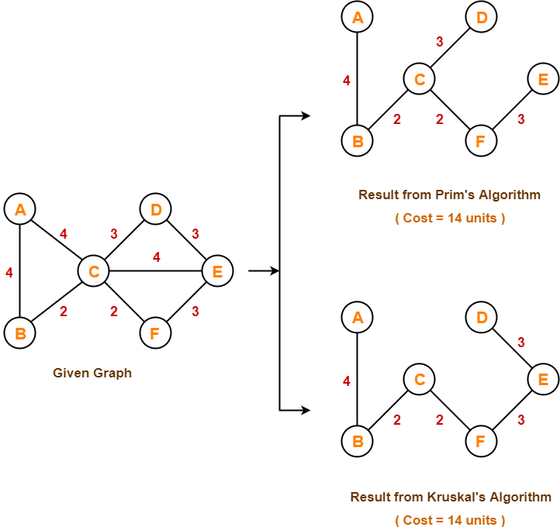
Kruskal’s Algorithm vs Prim’s Algorithm

Slide 59
Kruskal’s Algorithm vs Prim’s Algorithm
Kruskal’s Algorithm | Prim’s Algorithm
Start to build MST from minimum edge in the graph | Start to build MST from any vertices
Disjoint Set | Adjacency Matrix, Binary Heap, Fibonacci Heap
Run faster in sparse graphs | Run faster in dense graphs
O(E Log V) | O(E Log V) with Binary Heap
Traverse the edge only once. Based on cycle, it will either reject it or accept it | Traverse the one node several time in order to get minimum distance
Greedy Algorithm | Greedy Algorithm

Slide 60
Reference
Charles Leiserson and Piotr Indyk, “Introduction to Algorithms”, September 29, 2004
https://www.geeksforgeeks.org

