Slide 1
Shortest Path Problem I
SWE2016-44

Slide 2
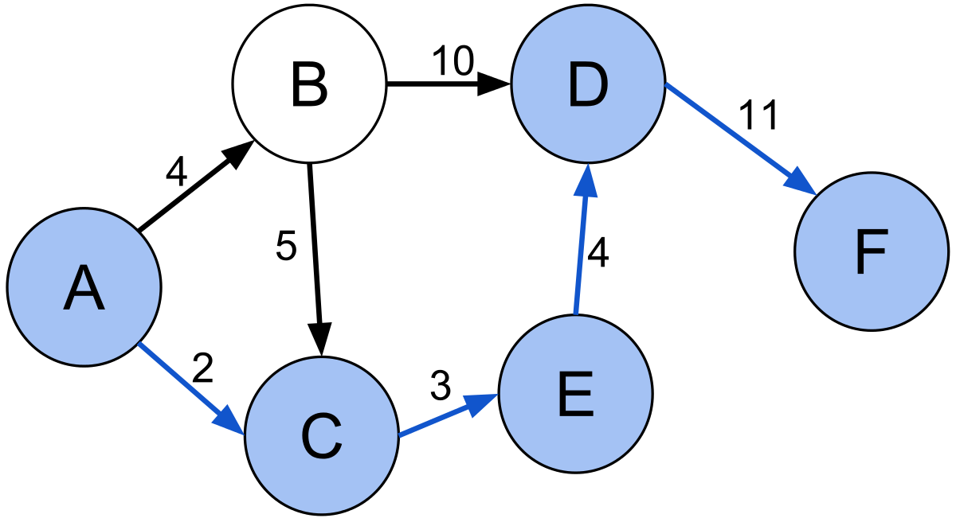
Problem Statement
Find a path between two vertices in a graph such that the sum of the weights of its constituent edges is minimized.
A graph is a series of nodes connected by edges. Graphs can be weighted and directional.

Slide 3
Shortest Path Algorithms
Dijkstra's algorithm: solves the single-source shortest path problem with non-negative edge weight.
Bellman–Ford algorithm: solves the single-source problem if edge weights may be negative.
A* search algorithm: solves for single pair shortest path using heuristics to try to speed up the search.
Floyd–Warshall algorithm: solves all pairs shortest paths.
Johnson's algorithm: solves all pairs shortest paths, and may be faster than Floyd–Warshall on sparse graphs.
Viterbi algorithm: solves the shortest stochastic path problem with an additional probabilistic weight on each node.

Slide 4
Dijkstra's algorithm

Slide 5
Dijkstra's algorithm
10
B
10
16
Source
26
A
5
D
0
20
20
C
15
Similar to Prim’s Algorithm

Slide 6
Dijkstra's algorithm
Create an empty set (sptSet) that keeps track of vertices included in shortest path tree
Initialize all vertices distances as INFINITE except for the source vertex. Initialize the source distance=0.
While sptSet doesn’t include all vertices
  Pick a vertex u which is not there in sptSet and has minimum distance value.
  Include u to the set.
  Update distance value of all adjacent vertices of u. To update the distance values, iterate through all adjacent vertices. For every adjacent vertex v, if sum of distance value of u and weight of edge u-v, is less than the distance value of v, then update the distance value of v.

Slide 7
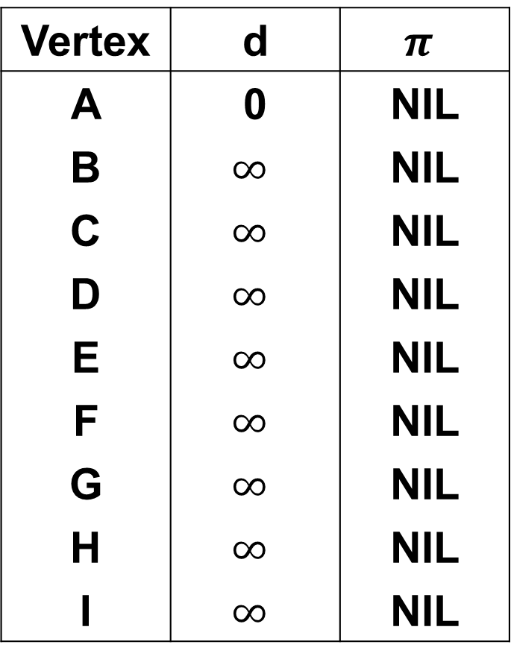
Dijkstra's algorithm
distance
parent
Vertex | d | $$π$$
A | 0 | NIL
B | $$∞$$ | NIL
C | $$∞$$ | NIL
D | $$∞$$ | NIL
E | $$∞$$ | NIL
F | $$∞$$ | NIL
G | $$∞$$ | NIL
H | $$∞$$ | NIL
I | $$∞$$ | NIL
B
8
C
7
D
Source
4
2
9
A
I
E
11
4
14
7
8
6
10
H
G
F
1
2

Slide 8

Dijkstra's algorithm
distance
parent
Vertex | d | $$π$$
A | 0 | NIL
B | $$∞$$ | NIL
C | $$∞$$ | NIL
D | $$∞$$ | NIL
E | $$∞$$ | NIL
F | $$∞$$ | NIL
G | $$∞$$ | NIL
H | $$∞$$ | NIL
I | $$∞$$ | NIL
B
8
C
7
D
Source
4
2
9
0
A
I
E
11
4
14
u
7
8
6
10
H
G
F
1
2
Update B: d[u]+4=4 < $∞$
Update H: d[u]+8=8 < $∞$

Slide 9
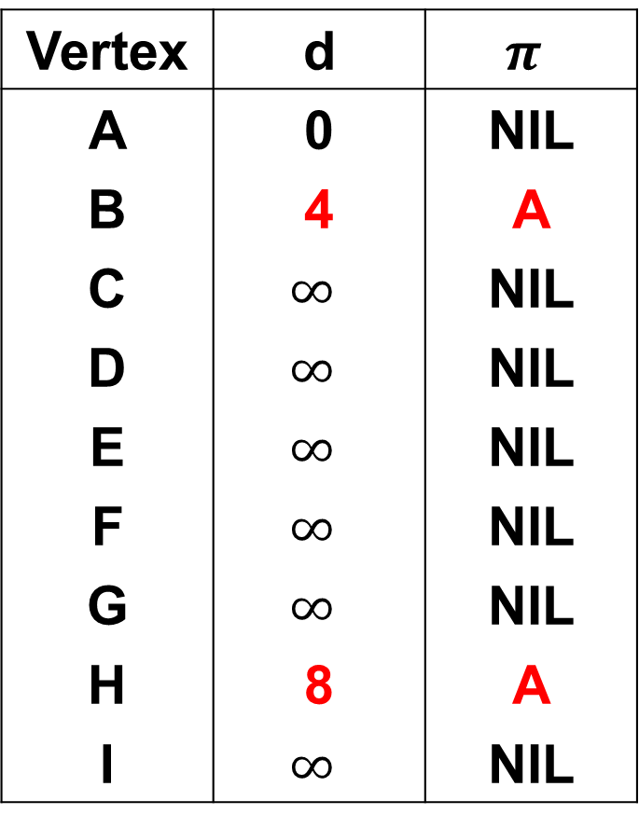
Dijkstra's algorithm
distance
parent
Vertex | d | $$π$$
A | 0 | NIL
B | 4 | A
C | $$∞$$ | NIL
D | $$∞$$ | NIL
E | $$∞$$ | NIL
F | $$∞$$ | NIL
G | $$∞$$ | NIL
H | 8 | A
I | $$∞$$ | NIL
B
8
C
7
D
Source
4
2
9
0
A
I
E
11
4
14
u
7
8
6
10
H
G
F
1
2
Update B: d[u]+4=4 < $∞$
Update H: d[u]+8=8 < $∞$

Slide 10

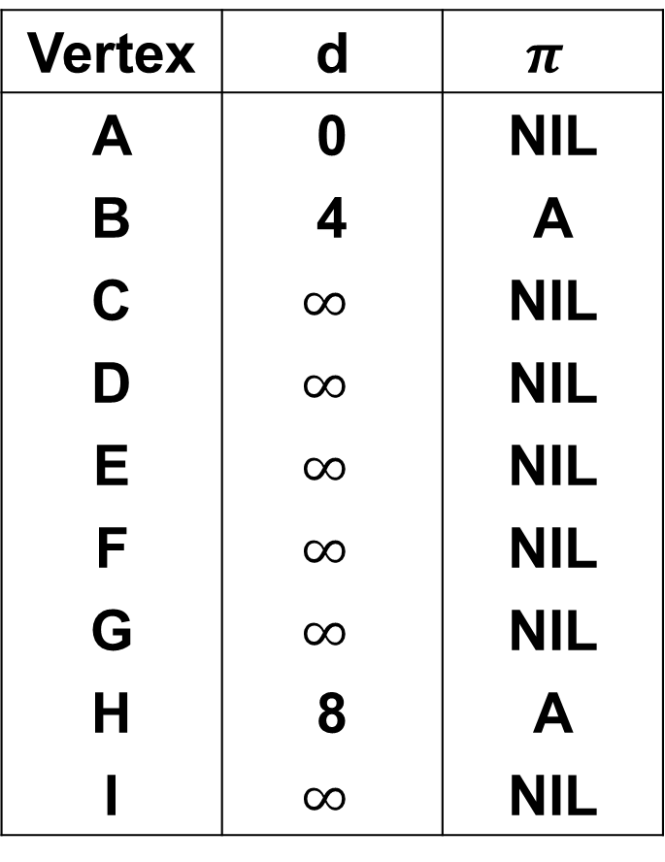
Dijkstra's algorithm
distance
parent
Vertex | d | $$π$$
A | 0 | NIL
B | 4 | A
C | $$∞$$ | NIL
D | $$∞$$ | NIL
E | $$∞$$ | NIL
F | $$∞$$ | NIL
G | $$∞$$ | NIL
H | 8 | A
I | $$∞$$ | NIL
4
B
8
C
7
D
u
Source
4
2
9
0
A
I
E
11
4
14
7
8
6
10
H
G
F
1
2
Update C: d[u]+8=12 < $∞$
Update H: d[u]+11=15 > 8

Slide 11
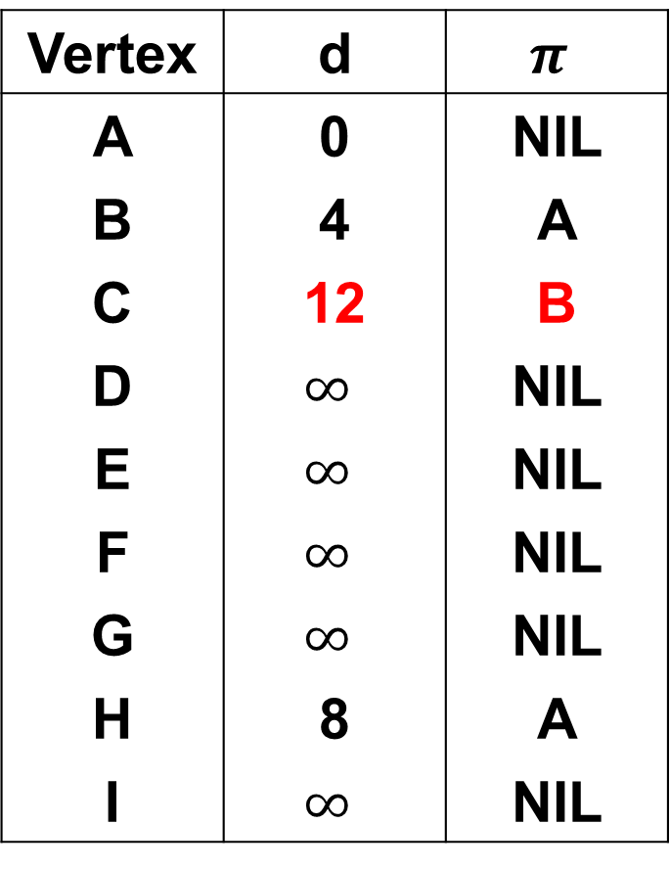
Dijkstra's algorithm
distance
parent
Vertex | d | $$π$$
A | 0 | NIL
B | 4 | A
C | 12 | B
D | $$∞$$ | NIL
E | $$∞$$ | NIL
F | $$∞$$ | NIL
G | $$∞$$ | NIL
H | 8 | A
I | $$∞$$ | NIL
4
B
8
C
7
D
u
Source
4
2
9
0
A
I
E
11
4
14
7
8
6
10
H
G
F
1
2
Update C: d[u]+8=12 < $∞$
Update H: d[u]+11=15 > 8

Slide 12

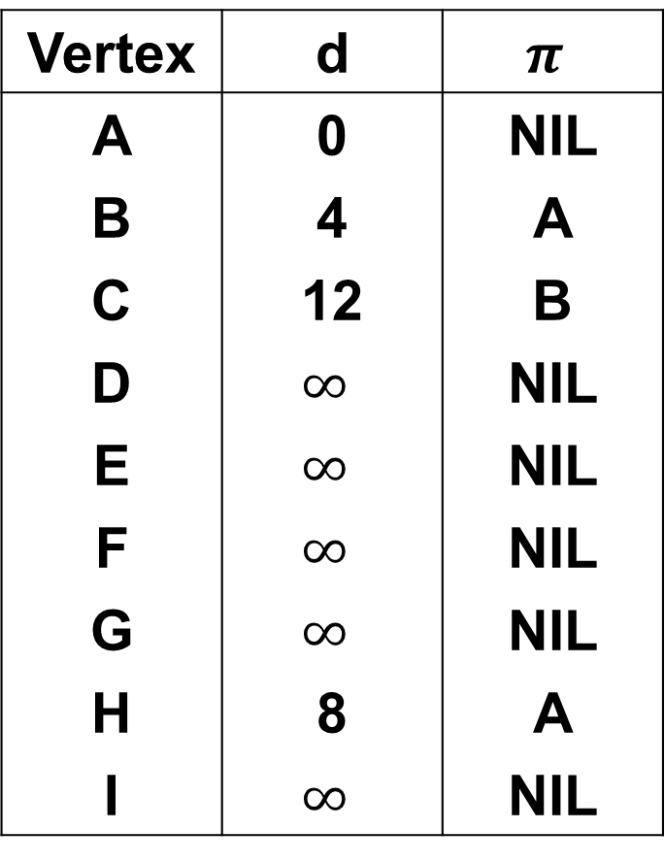
Dijkstra's algorithm
distance
parent
Vertex | d | $$π$$
A | 0 | NIL
B | 4 | A
C | 12 | B
D | $$∞$$ | NIL
E | $$∞$$ | NIL
F | $$∞$$ | NIL
G | $$∞$$ | NIL
H | 8 | A
I | $$∞$$ | NIL
4
B
8
C
7
D
Source
4
2
9
0
A
I
E
11
4
14
7
8
6
10
u
H
G
F
1
2
8
Update G: d[u]+1=9 < $∞$
Update I: d[u]+7=15 < $∞$

Slide 13
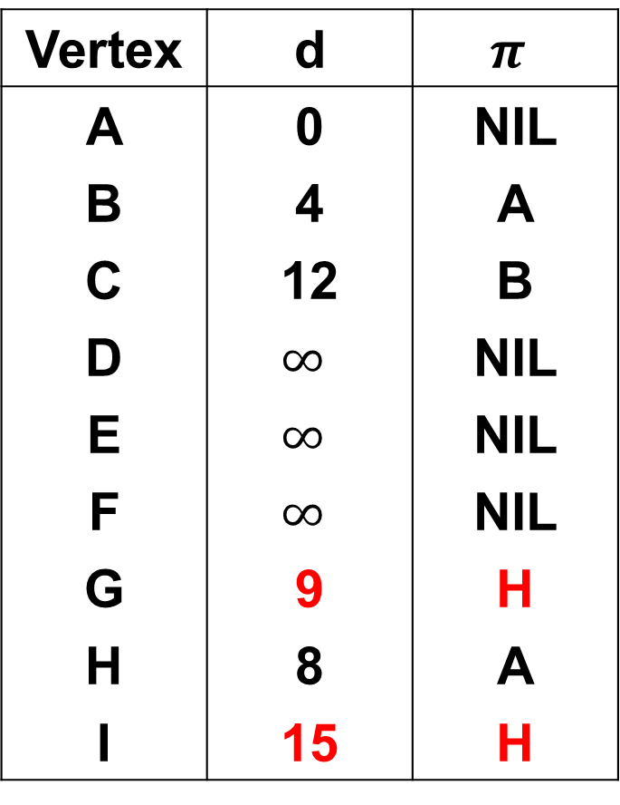
Dijkstra's algorithm
distance
parent
Vertex | d | $$π$$
A | 0 | NIL
B | 4 | A
C | 12 | B
D | $$∞$$ | NIL
E | $$∞$$ | NIL
F | $$∞$$ | NIL
G | 9 | H
H | 8 | A
I | 15 | H
4
B
8
C
7
D
Source
4
2
9
0
A
I
E
11
4
14
7
8
6
10
u
H
G
F
1
2
8
Update G: d[u]+1=9 < $∞$
Update I: d[u]+7=15 < $∞$

Slide 14

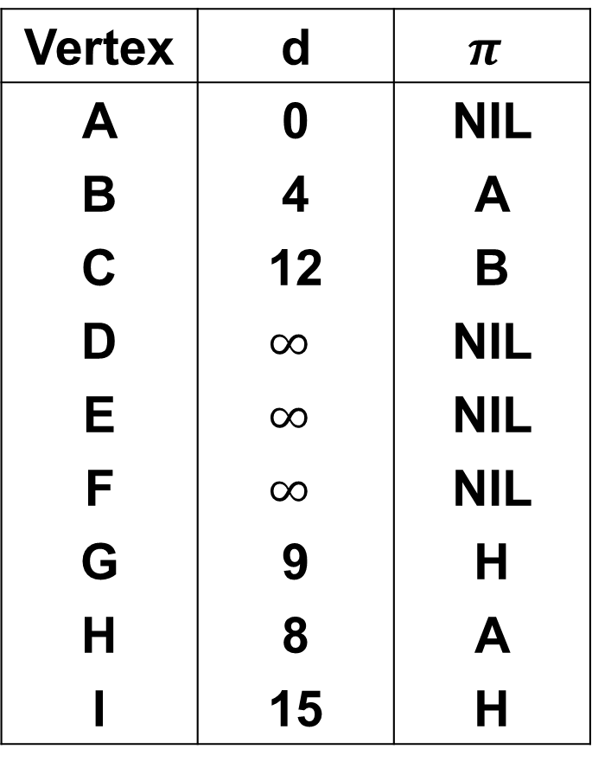
Dijkstra's algorithm
distance
parent
Vertex | d | $$π$$
A | 0 | NIL
B | 4 | A
C | 12 | B
D | $$∞$$ | NIL
E | $$∞$$ | NIL
F | $$∞$$ | NIL
G | 9 | H
H | 8 | A
I | 15 | H
4
B
8
C
7
D
Source
4
2
9
0
A
I
E
11
4
14
7
8
6
10
H
G
F
1
2
8
u
9
Update F: d[u]+2=11 < $∞$
Update I: d[u]+6=15 = 15

Slide 15
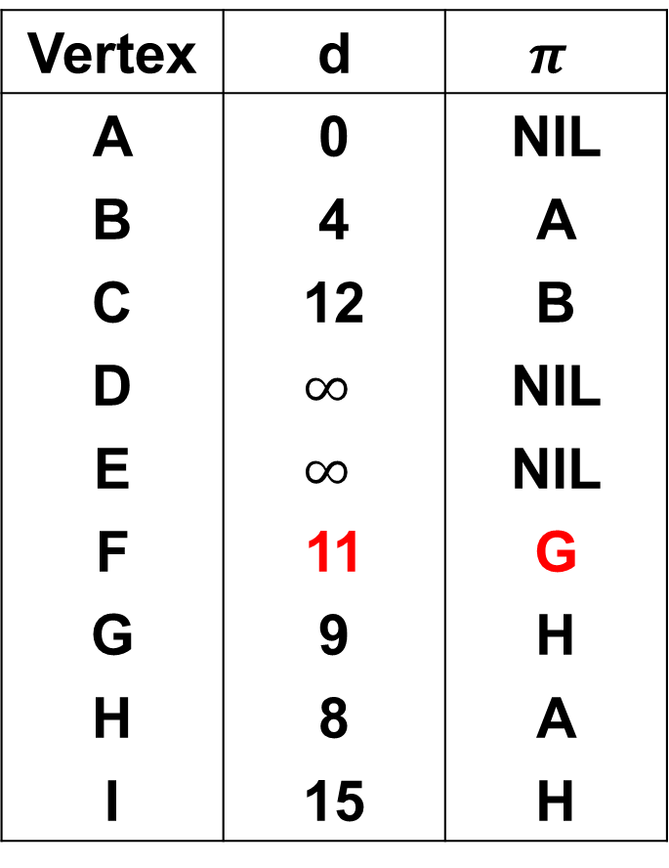
Dijkstra's algorithm
distance
parent
Vertex | d | $$π$$
A | 0 | NIL
B | 4 | A
C | 12 | B
D | $$∞$$ | NIL
E | $$∞$$ | NIL
F | 11 | G
G | 9 | H
H | 8 | A
I | 15 | H
4
B
8
C
7
D
Source
4
2
9
0
A
I
E
11
4
14
7
8
6
10
H
G
F
1
2
8
u
9
Update F: d[u]+2=11 < $∞$
Update I: d[u]+6=15 = 15

Slide 16
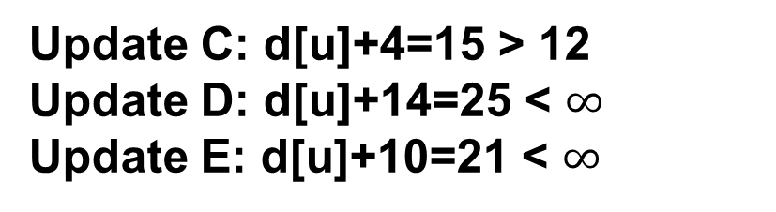
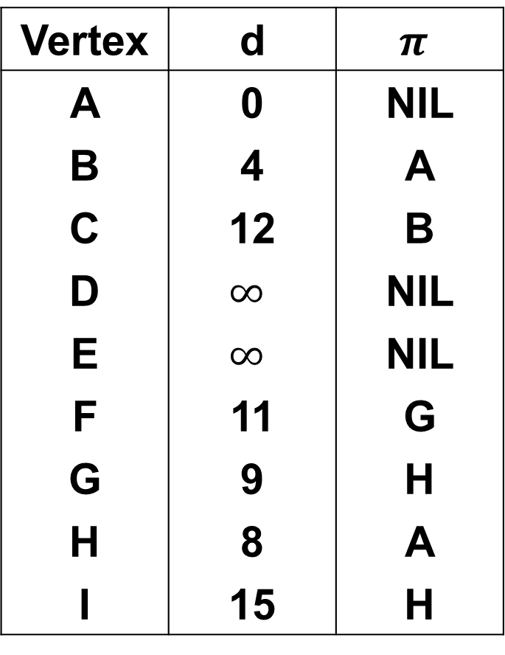
Dijkstra's algorithm
distance
parent
Vertex | d | $$π$$
A | 0 | NIL
B | 4 | A
C | 12 | B
D | $$∞$$ | NIL
E | $$∞$$ | NIL
F | 11 | G
G | 9 | H
H | 8 | A
I | 15 | H
4
B
8
C
7
D
Source
4
2
9
0
A
I
E
11
4
14
7
8
6
10
H
G
F
1
2
8
9
u
11
Update C: d[u]+4=15 > 12
Update D: d[u]+14=25 < $∞$
Update E: d[u]+10=21 < $∞$

Slide 17
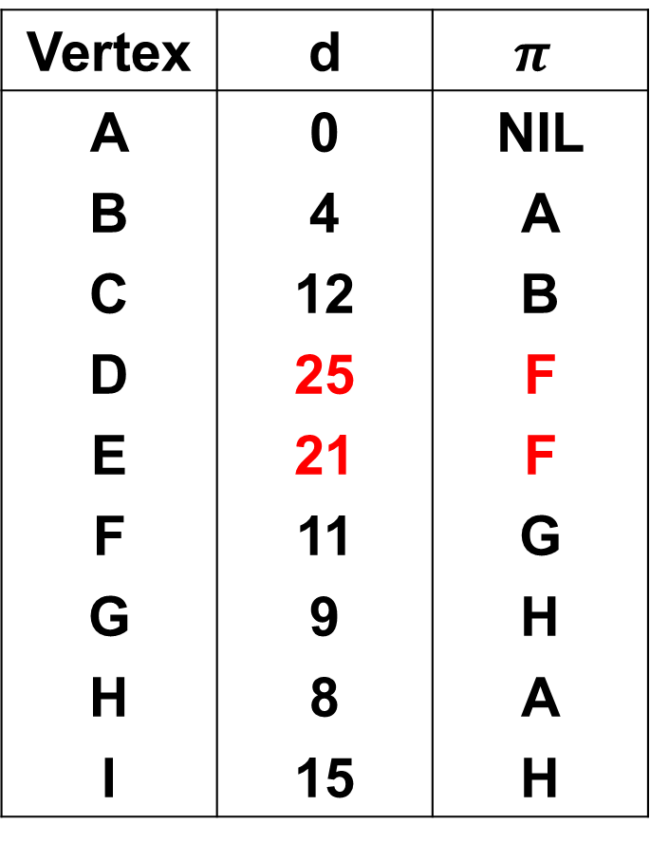
Dijkstra's algorithm
distance
parent
Vertex | d | $$π$$
A | 0 | NIL
B | 4 | A
C | 12 | B
D | 25 | F
E | 21 | F
F | 11 | G
G | 9 | H
H | 8 | A
I | 15 | H
4
B
8
C
7
D
Source
4
2
9
0
A
I
E
11
4
14
7
8
6
10
H
G
F
1
2
8
9
u
11
Update C: d[u]+4=15 > 12
Update D: d[u]+14=25 < $∞$
Update E: d[u]+10=21 < $∞$

Slide 18
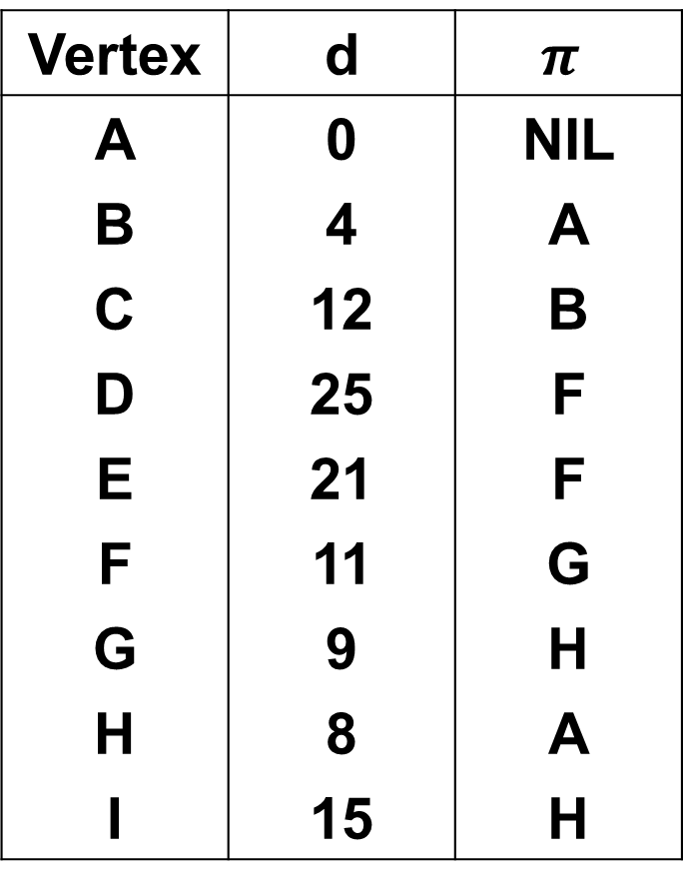
Dijkstra's algorithm
distance
parent
Vertex | d | $$π$$
A | 0 | NIL
B | 4 | A
C | 12 | B
D | 25 | F
E | 21 | F
F | 11 | G
G | 9 | H
H | 8 | A
I | 15 | H
4
12
u
B
8
C
7
D
Source
4
2
9
0
A
I
E
11
4
14
7
8
6
10
H
G
F
1
2
8
9
11
Update D: d[u]+7=19 < 25
Update I: d[u]+2=14 < 15

Slide 19
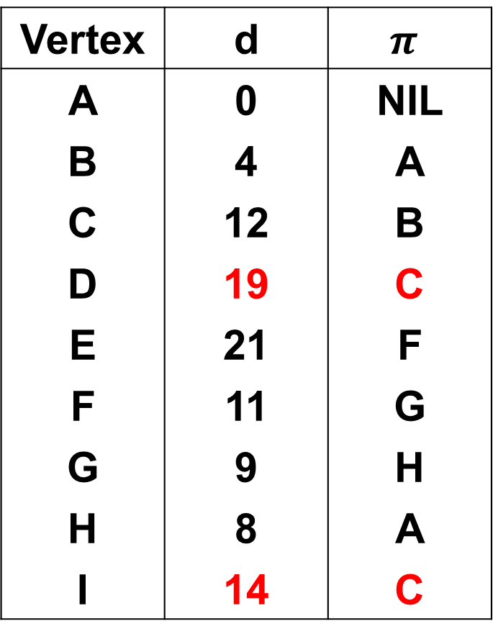
Dijkstra's algorithm
distance
parent
Vertex | d | $$π$$
A | 0 | NIL
B | 4 | A
C | 12 | B
D | 19 | C
E | 21 | F
F | 11 | G
G | 9 | H
H | 8 | A
I | 14 | C
4
12
u
B
8
C
7
D
Source
4
2
9
0
A
I
E
11
4
14
7
8
6
10
H
G
F
1
2
8
9
11
Update D: d[u]+7=19 < 25
Update I: d[u]+2=14 < 15

Slide 20
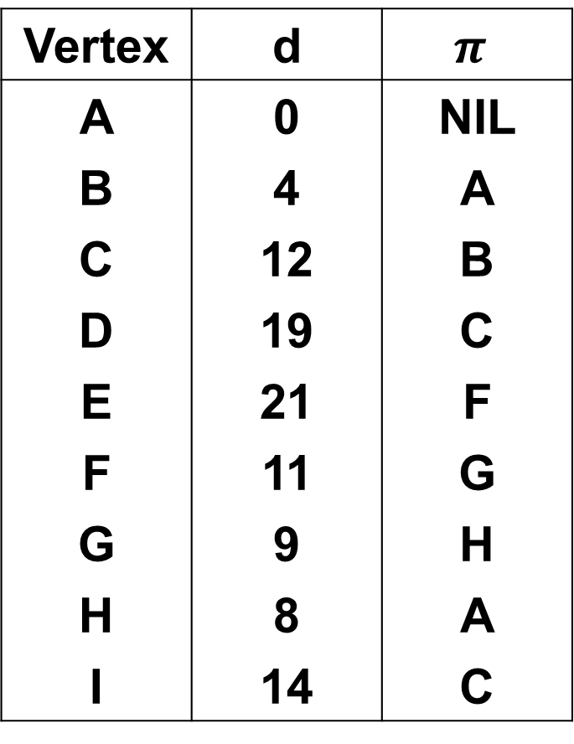
Dijkstra's algorithm
distance
parent
Vertex | d | $$π$$
A | 0 | NIL
B | 4 | A
C | 12 | B
D | 19 | C
E | 21 | F
F | 11 | G
G | 9 | H
H | 8 | A
I | 14 | C
4
12
B
8
C
7
D
Source
4
2
9
0
14
A
I
E
11
4
14
u
7
8
6
10
H
G
F
1
2
8
9
11

Slide 21
Dijkstra's algorithm
distance
parent
Vertex | d | $$π$$
A | 0 | NIL
B | 4 | A
C | 12 | B
D | 19 | C
E | 21 | F
F | 11 | G
G | 9 | H
H | 8 | A
I | 14 | C
4
12
19
u
B
8
C
7
D
Source
4
2
9
0
14
A
I
E
11
4
14
7
8
6
10
H
G
F
1
2
8
9
11
Update E: d[u]+9=28 > 21

Slide 22
Dijkstra's algorithm
distance
parent
Vertex | d | $$π$$
A | 0 | NIL
B | 4 | A
C | 12 | B
D | 19 | C
E | 21 | F
F | 11 | G
G | 9 | H
H | 8 | A
I | 14 | C
4
12
19
B
8
C
7
D
Source
4
2
9
0
14
21
A
I
E
11
4
14
u
7
8
6
10
H
G
F
1
2
8
9
11

Slide 23
Dijkstra's algorithm
distance
parent
Vertex | d | $$π$$
A | 0 | NIL
B | 4 | A
C | 12 | B
D | 19 | C
E | 21 | F
F | 11 | G
G | 9 | H
H | 8 | A
I | 14 | C
4
12
19
B
8
C
7
D
Source
4
2
9
0
14
21
A
I
E
11
4
14
7
8
6
10
H
G
F
1
2
8
9
11

Slide 24
Dijkstra's algorithm
distance
parent
Vertex | d | $$π$$
A | 0 | NIL
B | 4 | A
C | 12 | B
D | 19 | C
E | 21 | F
F | 11 | G
G | 9 | H
H | 8 | A
I | 14 | C
4
12
19
B
8
C
7
D
Source
4
2
9
0
14
21
A
I
E
11
4
14
7
8
6
10
H
G
F
1
2
8
9
11

Slide 25
Dijkstra's algorithm
distance
parent
Vertex | d | $$π$$
A | 0 | NIL
B | 4 | A
C | 12 | B
D | 19 | C
E | 21 | F
F | 11 | G
G | 9 | H
H | 8 | A
I | 14 | C
4
12
19
B
8
C
7
D
Source
4
2
0
14
21
A
I
E
8
10
H
G
F
1
2
8
9
11

Slide 26
Complexity
Time Complexity: O(V²)
If the input graph is represented using adjacency list, it can be reduced to O(E log V) with the help of binary heap.

Slide 27
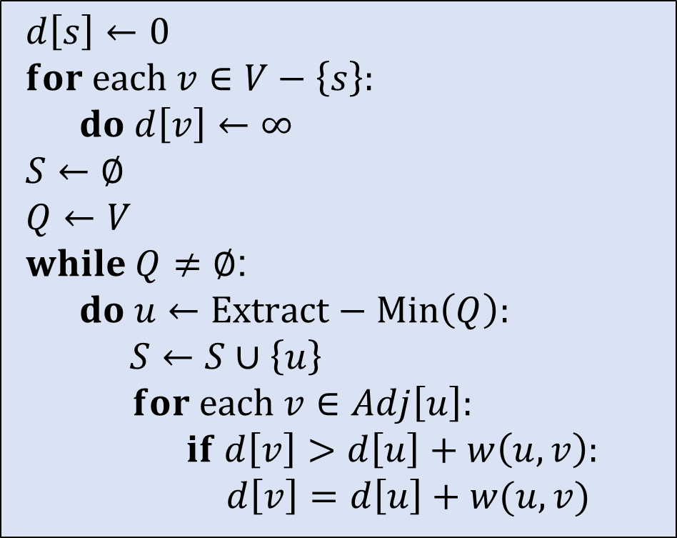
Pseudo-Code
$d\left[s\right]←0$
$for each v∈V−\left\{s\right\}:$
  $do d\left[v\right]←∞$
$S←∅$
$Q←V$
$while Q≠∅$:
  $do u←Extract−Min\left(Q\right):$
    $S←S∪\left\{u\right\}$
    $for each v∈Adj\left[u\right]:$
      $if d\left[v\right]>d\left[u\right]+w\left(u, v\right):$
        $$d\left[v\right]=d\left[u\right]+w(u, v)$$

Slide 28
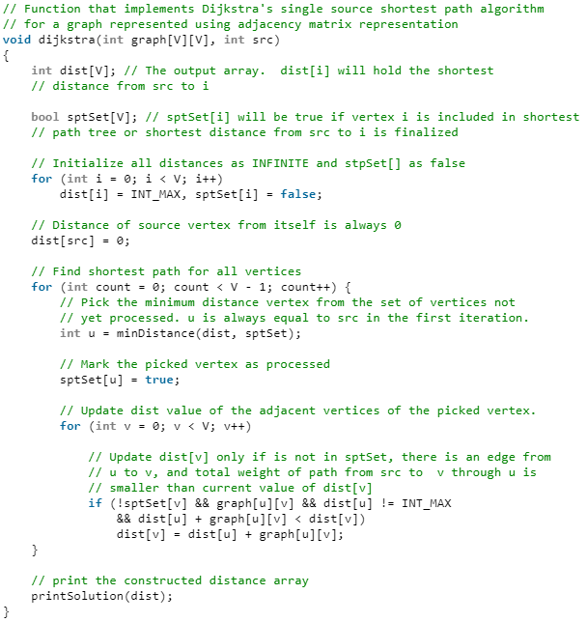
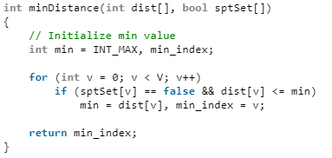
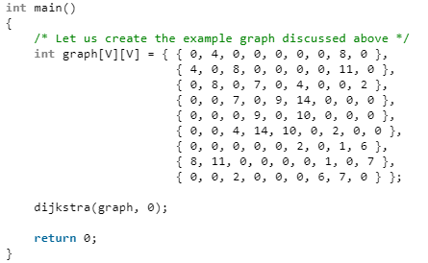
Implementation

Slide 29
Bellman Ford's algorithm

Slide 30
Bellman Ford's algorithm
10
B
10
16
Source
26
A
5
D
0
20
20
C
15
Similar to Prim’s Algorithm

Slide 31
Bellman Ford's algorithm
Initialize distances from source to all vertices as infinite and distance to source itself as 0. Create an array dist[] of size |V| with all values as infinite except dist[src] where src is source vertex.
Calculate shortest distances. Do following |V|-1 times for each edge u-v:
  If dist[v] > dist[u]+weight of edge uv, then update dist[v] (=dist[u]+weight of edge uv).
This step reports if there is a negative weight cycle in graph. Do following for each edge u-v
  If dist[v] > dist[u]+weight of edge uv, then “Graph contains negative weight cycle”

Slide 32
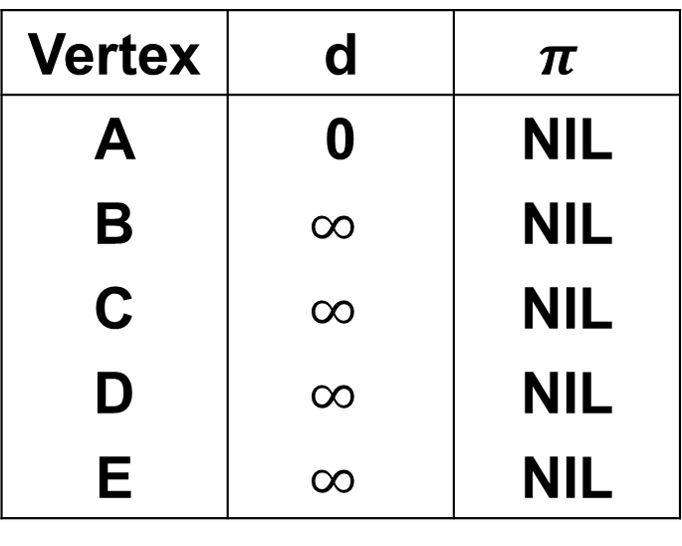
Bellman Ford's algorithm
distance
parent
B
-1
2
Vertex | d | $$π$$
A | 0 | NIL
B | $$∞$$ | NIL
C | $$∞$$ | NIL
D | $$∞$$ | NIL
E | $$∞$$ | NIL
Source
A
E
2
3
1
4
-3
C
D
5
Let all edges are processed in following order:
(B, E), (D, B), (B, D), (A, B), (A, C), (D, C), (B, C), (E, D)

Slide 33




Bellman Ford's algorithm
Iteration 1
$$∞$$
distance
parent
B
-1
2
Vertex | d | $$π$$
A | 0 | NIL
B | $$∞$$ | NIL
C | $$∞$$ | NIL
D | $$∞$$ | NIL
E | $$∞$$ | NIL
Source
$$∞$$
A
E
0
2
3
1
4
-3
C
D
$$∞$$
$$∞$$
5
(B, E), (D, B), (B, D), (A, B), (A, C), (D, C), (B, C), (E, D)
(B, E), (D, B), (B, D): d[u]+edge(u,v)=$∞$ = $∞$

Slide 34
Bellman Ford's algorithm
Iteration 1
$$∞$$
distance
parent
B
-1
2
Vertex | d | $$π$$
A | 0 | NIL
B | $$∞$$ | NIL
C | $$∞$$ | NIL
D | $$∞$$ | NIL
E | $$∞$$ | NIL
Source
$$∞$$
A
E
0
2
3
1
4
-3
C
D
$$∞$$
$$∞$$
5
(B, E), (D, B), (B, D), (A, B), (A, C), (D, C), (B, C), (E, D)
(A, B): d[u]+edge(u,v)=0+(-1) < $∞$

Slide 35
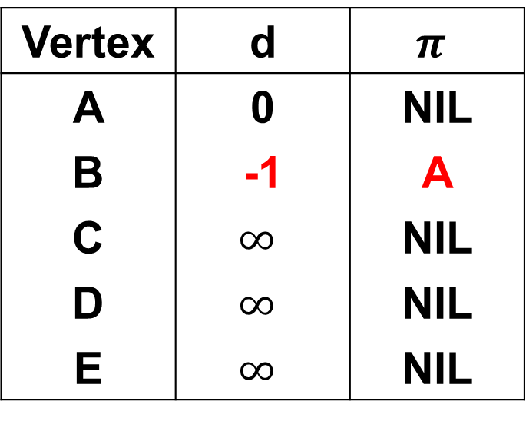
Bellman Ford's algorithm
Iteration 1
-1
distance
parent
B
-1
2
Vertex | d | $$π$$
A | 0 | NIL
B | -1 | A
C | $$∞$$ | NIL
D | $$∞$$ | NIL
E | $$∞$$ | NIL
Source
$$∞$$
A
E
0
2
3
1
4
-3
C
D
$$∞$$
$$∞$$
5
(B, E), (D, B), (B, D), (A, B), (A, C), (D, C), (B, C), (E, D)
(A, B): d[u]+edge(u,v)=0+(-1) < $∞$

Slide 36
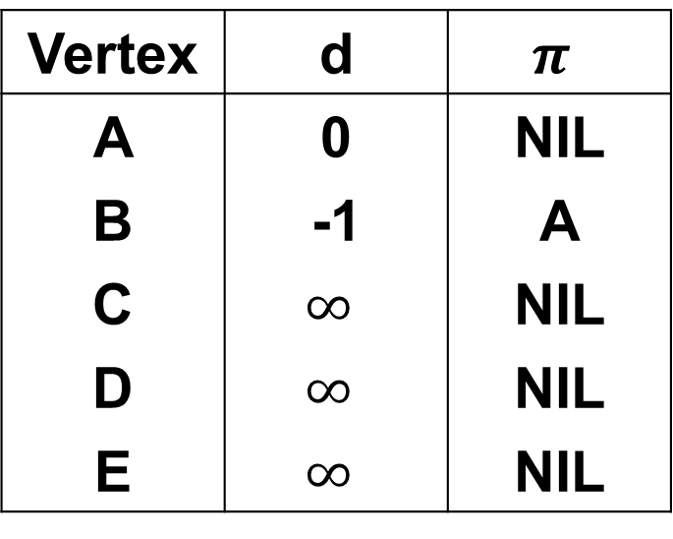
Bellman Ford's algorithm
Iteration 1
-1
distance
parent
B
-1
2
Vertex | d | $$π$$
A | 0 | NIL
B | -1 | A
C | $$∞$$ | NIL
D | $$∞$$ | NIL
E | $$∞$$ | NIL
Source
$$∞$$
A
E
0
2
3
1
4
-3
C
D
$$∞$$
$$∞$$
5
(B, E), (D, B), (B, D), (A, B), (A, C), (D, C), (B, C), (E, D)
(A, C): d[u]+edge(u,v)=0+4 < $∞$

Slide 37
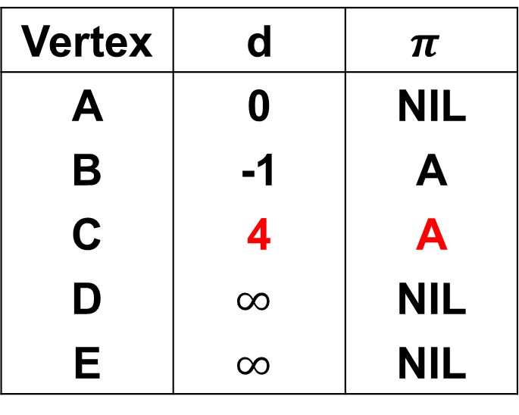
Bellman Ford's algorithm
Iteration 1
-1
distance
parent
B
-1
2
Vertex | d | $$π$$
A | 0 | NIL
B | -1 | A
C | 4 | A
D | $$∞$$ | NIL
E | $$∞$$ | NIL
Source
$$∞$$
A
E
0
2
3
1
4
-3
C
D
$$∞$$
4
5
(B, E), (D, B), (B, D), (A, B), (A, C), (D, C), (B, C), (E, D)
(A, C): d[u]+edge(u,v)=0+4 < $∞$

Slide 38
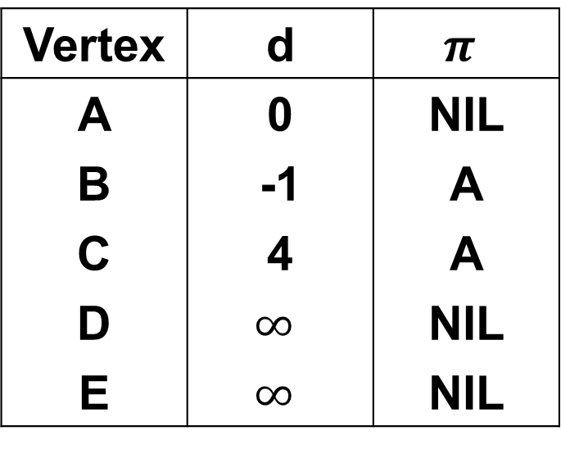
Bellman Ford's algorithm
Iteration 1
-1
distance
parent
B
-1
2
Vertex | d | $$π$$
A | 0 | NIL
B | -1 | A
C | 4 | A
D | $$∞$$ | NIL
E | $$∞$$ | NIL
Source
$$∞$$
A
E
0
2
3
1
4
-3
C
D
$$∞$$
4
5
(B, E), (D, B), (B, D), (A, B), (A, C), (D, C), (B, C), (E, D)
(D, C): d[u]+edge(u,v)=$∞$ > 4

Slide 39
Bellman Ford's algorithm
Iteration 1
-1
distance
parent
B
-1
2
Vertex | d | $$π$$
A | 0 | NIL
B | -1 | A
C | 4 | A
D | $$∞$$ | NIL
E | $$∞$$ | NIL
Source
$$∞$$
A
E
0
2
3
1
4
-3
C
D
$$∞$$
4
5
(B, E), (D, B), (B, D), (A, B), (A, C), (D, C), (B, C), (E, D)
(B, C): d[u]+edge(u,v)=(-1)+3 < 4

Slide 40

Bellman Ford's algorithm
Iteration 1
-1
distance
parent
B
-1
2
Vertex | d | $$π$$
A | 0 | NIL
B | -1 | A
C | 2 | B
D | $$∞$$ | NIL
E | $$∞$$ | NIL
Source
$$∞$$
A
E
0
2
3
1
4
-3
C
D
$$∞$$
2
5
(B, E), (D, B), (B, D), (A, B), (A, C), (D, C), (B, C), (E, D)
(B, C): d[u]+edge(u,v)=(-1)+3=2 < 4

Slide 41
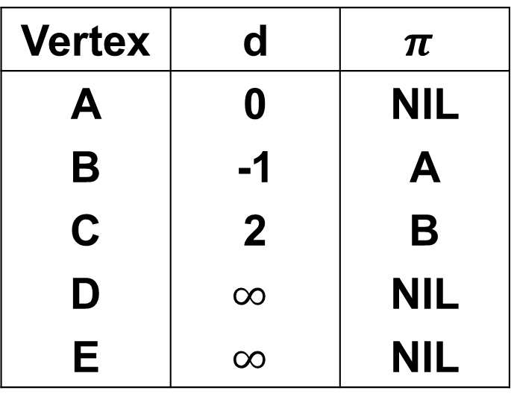
Bellman Ford's algorithm
Iteration 1
-1
distance
parent
B
-1
2
Vertex | d | $$π$$
A | 0 | NIL
B | -1 | A
C | 2 | B
D | $$∞$$ | NIL
E | $$∞$$ | NIL
Source
$$∞$$
A
E
0
2
3
1
4
-3
C
D
$$∞$$
2
5
(B, E), (D, B), (B, D), (A, B), (A, C), (D, C), (B, C), (E, D)
(E, D): d[u]+edge(u,v)= $∞$ = $∞$

Slide 42
Bellman Ford's algorithm
Iteration 1
-1
distance
parent
B
-1
2
Vertex | d | $$π$$
A | 0 | NIL
B | -1 | A
C | 2 | B
D | $$∞$$ | NIL
E | $$∞$$ | NIL
Source
$$∞$$
A
E
0
2
3
1
4
-3
C
D
$$∞$$
2
5
(B, E), (D, B), (B, D), (A, B), (A, C), (D, C), (B, C), (E, D)

Slide 43
Bellman Ford's algorithm
Iteration 2
-1
distance
parent
B
-1
2
Vertex | d | $$π$$
A | 0 | NIL
B | -1 | A
C | 2 | B
D | $$∞$$ | NIL
E | $$∞$$ | NIL
Source
$$∞$$
A
E
0
2
3
1
4
-3
C
D
$$∞$$
2
5
(B, E), (D, B), (B, D), (A, B), (A, C), (D, C), (B, C), (E, D)
(B, E): d[u]+edge(u,v)=(-1)+2=1 < $∞$

Slide 44
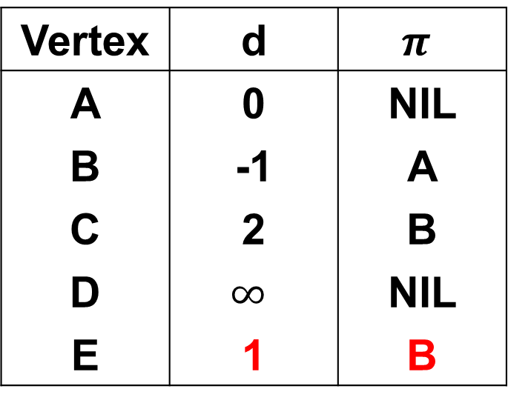
Bellman Ford's algorithm
Iteration 2
-1
distance
parent
B
-1
2
Vertex | d | $$π$$
A | 0 | NIL
B | -1 | A
C | 2 | B
D | $$∞$$ | NIL
E | 1 | B
Source
1
A
E
0
2
3
1
4
-3
C
D
$$∞$$
2
5
(B, E), (D, B), (B, D), (A, B), (A, C), (D, C), (B, C), (E, D)
(B, E): d[u]+edge(u,v)=(-1)+2=1 < $∞$

Slide 45
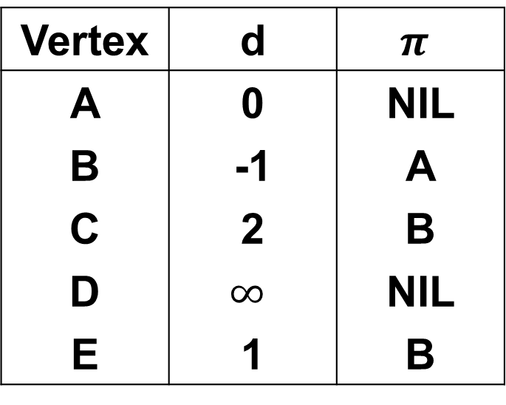
Bellman Ford's algorithm
Iteration 2
-1
distance
parent
B
-1
2
Vertex | d | $$π$$
A | 0 | NIL
B | -1 | A
C | 2 | B
D | $$∞$$ | NIL
E | 1 | B
Source
1
A
E
0
2
3
1
4
-3
C
D
$$∞$$
2
5
(B, E), (D, B), (B, D), (A, B), (A, C), (D, C), (B, C), (E, D)
(D, B): d[u]+edge(u,v)=$∞$ = $∞$

Slide 46
Bellman Ford's algorithm
Iteration 2
-1
distance
parent
B
-1
2
Vertex | d | $$π$$
A | 0 | NIL
B | -1 | A
C | 2 | B
D | $$∞$$ | NIL
E | 1 | B
Source
1
A
E
0
2
3
1
4
-3
C
D
$$∞$$
2
5
(B, E), (D, B), (B, D), (A, B), (A, C), (D, C), (B, C), (E, D)
(B, D): d[u]+edge(u,v)=(-1)+2=1 < $∞$

Slide 47
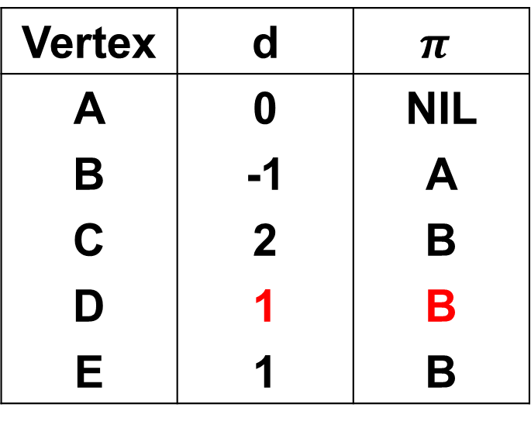
Bellman Ford's algorithm
Iteration 2
-1
distance
parent
B
-1
2
Vertex | d | $$π$$
A | 0 | NIL
B | -1 | A
C | 2 | B
D | 1 | B
E | 1 | B
Source
1
A
E
0
2
3
1
4
-3
C
D
1
2
5
(B, E), (D, B), (B, D), (A, B), (A, C), (D, C), (B, C), (E, D)
(B, D): d[u]+edge(u,v)=(-1)+2=1 < $∞$

Slide 48
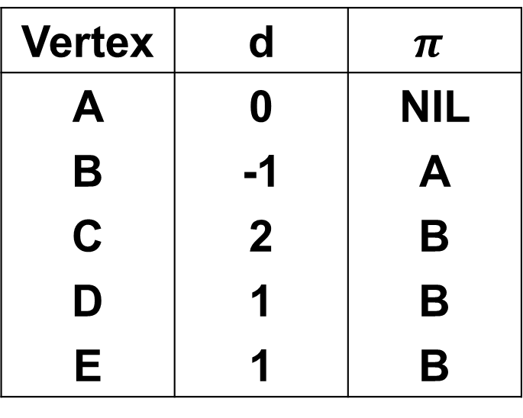
Bellman Ford's algorithm
Iteration 2
-1
distance
parent
B
-1
2
Vertex | d | $$π$$
A | 0 | NIL
B | -1 | A
C | 2 | B
D | 1 | B
E | 1 | B
Source
1
A
E
0
2
3
1
4
-3
C
D
1
2
5
(B, E), (D, B), (B, D), (A, B), (A, C), (D, C), (B, C), (E, D)
(A, B): d[u]+edge(u,v)=0+(-1)=-1 = -1

Slide 49
Bellman Ford's algorithm
Iteration 2
-1
distance
parent
B
-1
2
Vertex | d | $$π$$
A | 0 | NIL
B | -1 | A
C | 2 | B
D | 1 | B
E | 1 | B
Source
1
A
E
0
2
3
1
4
-3
C
D
1
2
5
(B, E), (D, B), (B, D), (A, B), (A, C), (D, C), (B, C), (E, D)
(A, C): d[u]+edge(u,v)=0+4=4 > 2

Slide 50
Bellman Ford's algorithm
Iteration 2
-1
distance
parent
B
-1
2
Vertex | d | $$π$$
A | 0 | NIL
B | -1 | A
C | 2 | B
D | 1 | B
E | 1 | B
Source
1
A
E
0
2
3
1
4
-3
C
D
1
2
5
(B, E), (D, B), (B, D), (A, B), (A, C), (D, C), (B, C), (E, D)
(D, C): d[u]+edge(u,v)=1+5=6 > 2

Slide 51
Bellman Ford's algorithm
Iteration 2
-1
distance
parent
B
-1
2
Vertex | d | $$π$$
A | 0 | NIL
B | -1 | A
C | 2 | B
D | 1 | B
E | 1 | B
Source
1
A
E
0
2
3
1
4
-3
C
D
1
2
5
(B, E), (D, B), (B, D), (A, B), (A, C), (D, C), (B, C), (E, D)
(B, C): d[u]+edge(u,v)=(-1)+3=2 > 2

Slide 52
Bellman Ford's algorithm
Iteration 2
-1
distance
parent
B
-1
2
Vertex | d | $$π$$
A | 0 | NIL
B | -1 | A
C | 2 | B
D | 1 | B
E | 1 | B
Source
1
A
E
0
2
3
1
4
-3
C
D
1
2
5
(B, E), (D, B), (B, D), (A, B), (A, C), (D, C), (B, C), (E, D)
(E, D): d[u]+edge(u,v)=1+(-3)=-2 < 1

Slide 53
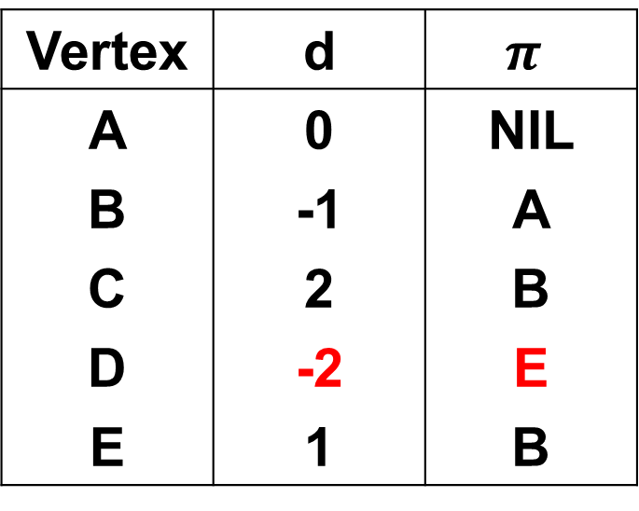
Bellman Ford's algorithm
Iteration 2
-1
distance
parent
B
-1
2
Vertex | d | $$π$$
A | 0 | NIL
B | -1 | A
C | 2 | B
D | -2 | E
E | 1 | B
Source
1
A
E
0
2
3
1
4
-3
C
D
-2
2
5
(B, E), (D, B), (B, D), (A, B), (A, C), (D, C), (B, C), (E, D)
(E, D): d[u]+edge(u,v)=1+(-3)=-2 < 1

Slide 54
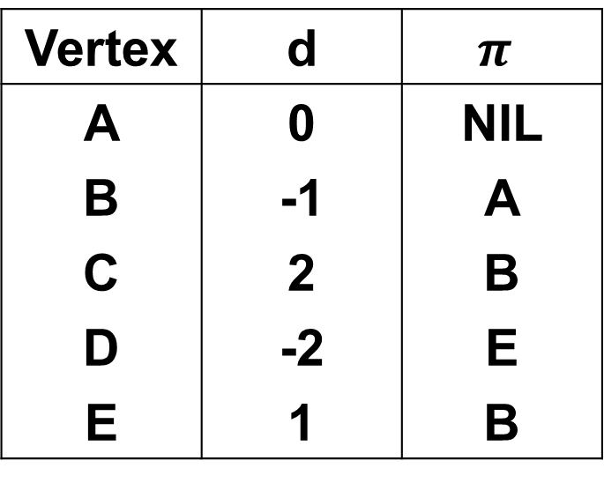
Bellman Ford's algorithm
Iteration 2
-1
distance
parent
B
-1
2
Vertex | d | $$π$$
A | 0 | NIL
B | -1 | A
C | 2 | B
D | -2 | E
E | 1 | B
Source
1
A
E
0
2
3
1
4
-3
C
D
-2
2
5
(B, E), (D, B), (B, D), (A, B), (A, C), (D, C), (B, C), (E, D)

Slide 55
Bellman Ford's algorithm
Iteration 3
-1
distance
parent
B
-1
2
Vertex | d | $$π$$
A | 0 | NIL
B | -1 | A
C | 2 | B
D | -2 | E
E | 1 | B
Source
1
A
E
0
2
3
1
4
-3
C
D
-2
2
5
(B, E), (D, B), (B, D), (A, B), (A, C), (D, C), (B, C), (E, D)
(B, E): d[u]+edge(u,v)=(-1)+2=1 = 1

Slide 56
Bellman Ford's algorithm
Iteration 3
-1
distance
parent
B
-1
2
Vertex | d | $$π$$
A | 0 | NIL
B | -1 | A
C | 2 | B
D | -2 | E
E | 1 | B
Source
1
A
E
0
2
3
1
4
-3
C
D
-2
2
5
(B, E), (D, B), (B, D), (A, B), (A, C), (D, C), (B, C), (E, D)
(D, B): d[u]+edge(u,v)=(-2)+1=-1 = -1

Slide 57
Bellman Ford's algorithm
Iteration 3
-1
distance
parent
B
-1
2
Vertex | d | $$π$$
A | 0 | NIL
B | -1 | A
C | 2 | B
D | -2 | E
E | 1 | B
Source
1
A
E
0
2
3
1
4
-3
C
D
-2
2
5
(B, E), (D, B), (B, D), (A, B), (A, C), (D, C), (B, C), (E, D)
(B, D): d[u]+edge(u,v)=(-1)+2=1 > -2

Slide 58
Bellman Ford's algorithm
Iteration 3
-1
distance
parent
B
-1
2
Vertex | d | $$π$$
A | 0 | NIL
B | -1 | A
C | 2 | B
D | -2 | E
E | 1 | B
Source
1
A
E
0
2
3
1
4
-3
C
D
-2
2
5
(B, E), (D, B), (B, D), (A, B), (A, C), (D, C), (B, C), (E, D)
(A, B): d[u]+edge(u,v)=0+(-1)=-1 = -1

Slide 59
Bellman Ford's algorithm
Iteration 3
-1
distance
parent
B
-1
2
Vertex | d | $$π$$
A | 0 | NIL
B | -1 | A
C | 2 | B
D | -2 | E
E | 1 | B
Source
1
A
E
0
2
3
1
4
-3
C
D
-2
2
5
(B, E), (D, B), (B, D), (A, B), (A, C), (D, C), (B, C), (E, D)
(A, C): d[u]+edge(u,v)=0+2=2 = 2

Slide 60
Bellman Ford's algorithm
Iteration 3
-1
distance
parent
B
-1
2
Vertex | d | $$π$$
A | 0 | NIL
B | -1 | A
C | 2 | B
D | -2 | E
E | 1 | B
Source
1
A
E
0
2
3
1
4
-3
C
D
-2
2
5
(B, E), (D, B), (B, D), (A, B), (A, C), (D, C), (B, C), (E, D)
(D, C): d[u]+edge(u,v)=(-2)+5=3 > 2

Slide 61
Bellman Ford's algorithm
Iteration 3
-1
distance
parent
B
-1
2
Vertex | d | $$π$$
A | 0 | NIL
B | -1 | A
C | 2 | B
D | -2 | E
E | 1 | B
Source
1
A
E
0
2
3
1
4
-3
C
D
-2
2
5
(B, E), (D, B), (B, D), (A, B), (A, C), (D, C), (B, C), (E, D)
(B, C): d[u]+edge(u,v)=(-1)+3=2 = 2

Slide 62
Bellman Ford's algorithm
Iteration 3
-1
distance
parent
B
-1
2
Vertex | d | $$π$$
A | 0 | NIL
B | -1 | A
C | 2 | B
D | -2 | E
E | 1 | B
Source
1
A
E
0
2
3
1
4
-3
C
D
-2
2
5
(B, E), (D, B), (B, D), (A, B), (A, C), (D, C), (B, C), (E, D)
(E, D): d[u]+edge(u,v)=1+(-3)=-2 = -2

Slide 63
Bellman Ford's algorithm
Iteration 4
-1
distance
parent
B
-1
2
Vertex | d | $$π$$
A | 0 | NIL
B | -1 | A
C | 2 | B
D | -2 | E
E | 1 | B
Source
1
A
E
0
2
3
1
4
-3
C
D
-2
2
5
(B, E), (D, B), (B, D), (A, B), (A, C), (D, C), (B, C), (E, D)

Slide 64
Bellman Ford's algorithm
-1
distance
parent
B
-1
2
Vertex | d | $$π$$
A | 0 | NIL
B | -1 | A
C | 2 | B
D | -2 | E
E | 1 | B
Source
1
A
E
0
2
3
1
4
-3
C
D
-2
2
5

Slide 65
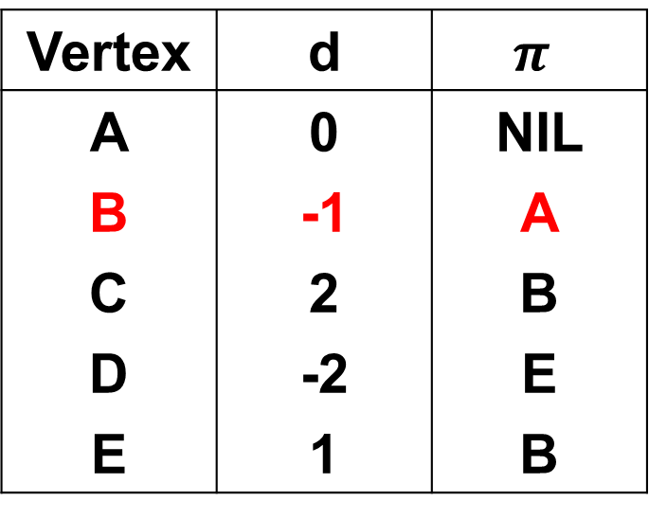
Bellman Ford's algorithm
-1
distance
parent
B
-1
2
Vertex | d | $$π$$
A | 0 | NIL
B | -1 | A
C | 2 | B
D | -2 | E
E | 1 | B
Source
1
A
E
0
2
3
1
4
-3
C
D
-2
2
5

Slide 66
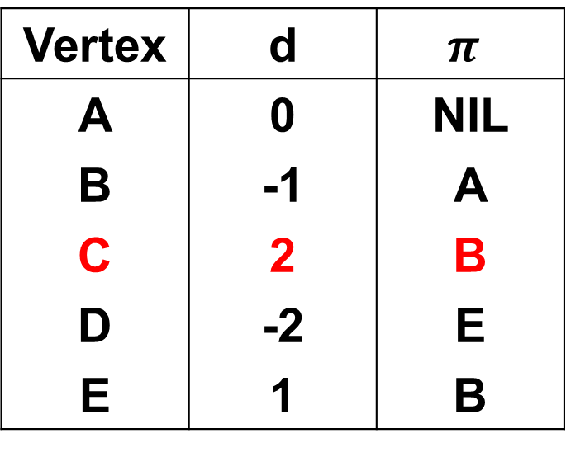
Bellman Ford's algorithm
-1
distance
parent
B
-1
2
Vertex | d | $$π$$
A | 0 | NIL
B | -1 | A
C | 2 | B
D | -2 | E
E | 1 | B
Source
1
A
E
0
2
3
1
4
-3
C
D
-2
2
5

Slide 67
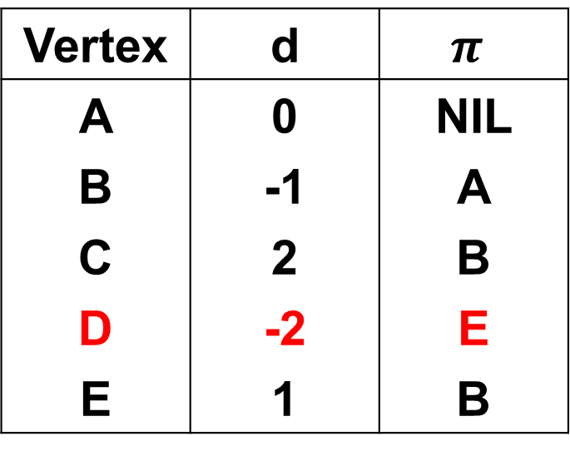
Bellman Ford's algorithm
-1
distance
parent
B
-1
2
Vertex | d | $$π$$
A | 0 | NIL
B | -1 | A
C | 2 | B
D | -2 | E
E | 1 | B
Source
1
A
E
0
2
3
1
4
-3
C
D
-2
2
5

Slide 68
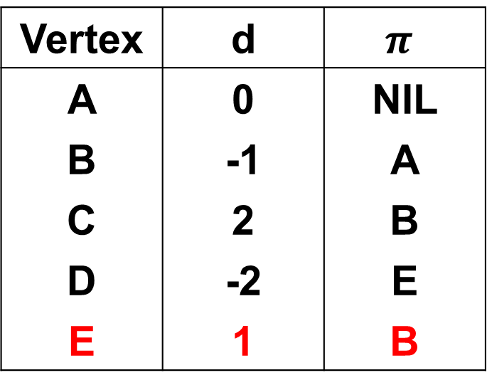
Bellman Ford's algorithm
-1
distance
parent
B
-1
2
Vertex | d | $$π$$
A | 0 | NIL
B | -1 | A
C | 2 | B
D | -2 | E
E | 1 | B
Source
1
A
E
0
2
3
1
4
-3
C
D
-2
2
5

Slide 69
Complexity
Time Complexity: O(VE)

Slide 70



Why do we need |V|-1 times
1st Iteration
0
$$∞$$
$$∞$$
$$∞$$
A
B
C
D
2
3
2
C → D
A → B
B → C
B → C
A → B
C → D

Slide 71
Why do we need |V|-1 times
1st Iteration
0
2
$$∞$$
$$∞$$
A
B
C
D
2
3
2
C → D
A → B
B → C
B → C
A → B
C → D

Slide 72
Why do we need |V|-1 times
2nd Iteration
0
2
$$∞$$
$$∞$$
A
B
C
D
2
3
2
C → D
A → B
B → C
B → C
A → B
C → D

Slide 73
Why do we need |V|-1 times
2nd Iteration
0
2
5
$$∞$$
A
B
C
D
2
3
2
C → D
A → B
B → C
B → C
A → B
C → D

Slide 74
Why do we need |V|-1 times
3rd Iteration
0
2
5
$$∞$$
A
B
C
D
2
3
2
C → D
A → B
B → C
B → C
A → B
C → D

Slide 75
Why do we need |V|-1 times
3rd Iteration
0
2
5
7
A
B
C
D
2
3
2
C → D
A → B
B → C
B → C
A → B
C → D

Slide 76
Bellman‐Ford in practice
Distance‐vector routing protocol
– Repeatedly relax edges until convergence
– Relaxation is local!
On the Internet
– Routing Information Protocol (RIP)
– Interior Gateway Routing Protocol (IGRP)

Slide 77
Complexity
Time Complexity: O(VE)

Slide 78
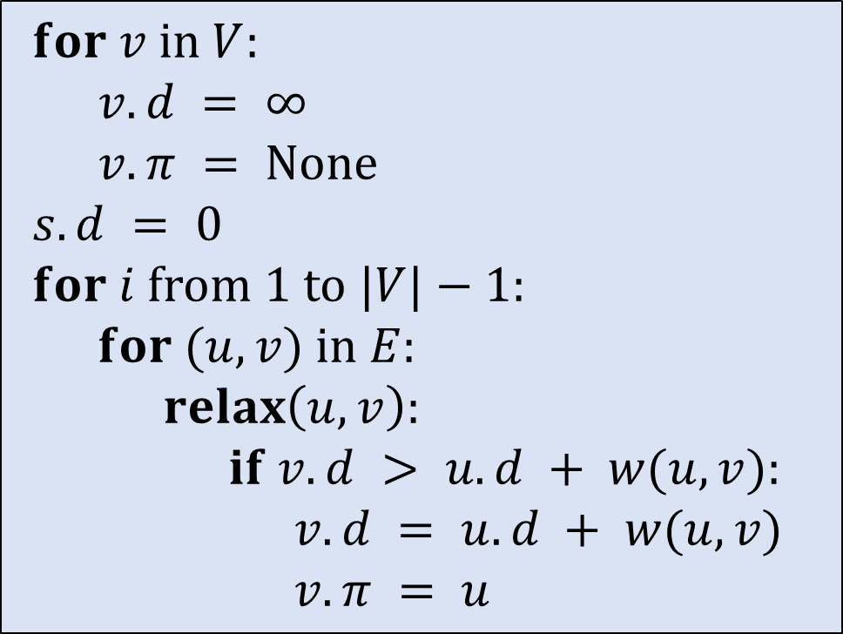
Pseudo-Code
$for v in V:$
  $v.d = ∞$
  $v.π = None$
$s.d = 0$
$for i from 1 to |V|−1:$
  $for (u, v) in E:$
    $relax\left(u, v\right):$
      $if v.d > u.d + w(u, v):$
        $v.d = u.d + w(u, v)$
        $v.π = u$

Slide 79
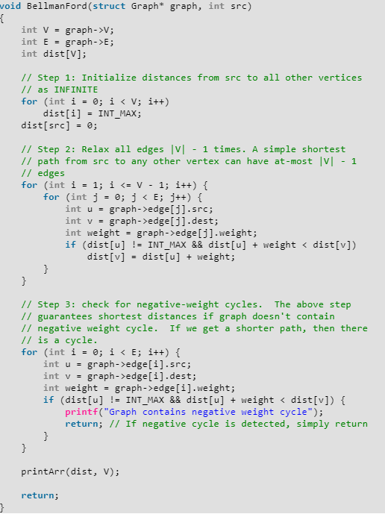
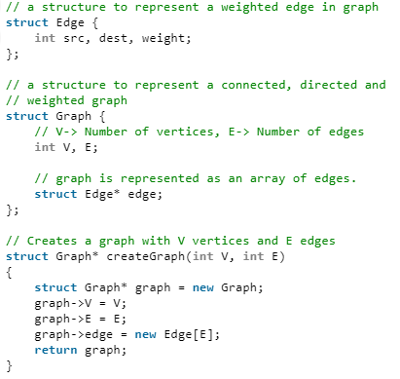
Implementation

Slide 80
Reference
Charles Leiserson and Piotr Indyk, “Introduction to Algorithms”, September 29, 2004
https://www.geeksforgeeks.org
https://en.wikipedia.org/wiki

