Slide 1
Introduction
SWE2016-44

Slide 2
Course Intro.
Focus on the analysis, design, and implementation of computer algoritms.
Analyze the asymtotic performance of agorithms, demonstrate a familiarity with major algorithms and data structures, apply important algorithms to programming related problems, and design and implement the algorithms in computer languages.
The primary language for the course is English.
Course Website: https://mllab-skku.github.io/algorithm/

Slide 3

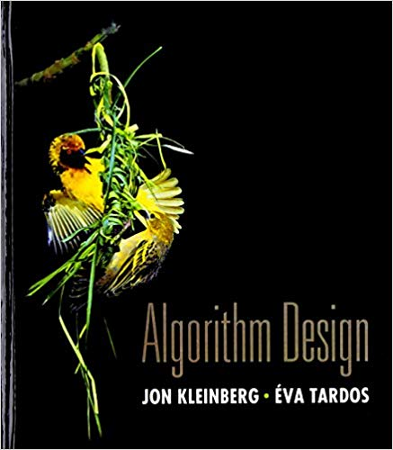
Textbooks
Introduction to Algorithms
Algorithm Design

Slide 4
Instructor
Joon Hee Choi
  Email: jhchoi2019@skku.edu, Office: 23120
  Office Hour: Tuesday 14:00-15:00
  Assistant Professor, Department of Software, SKKU (09/2019 - )
  Staff Engineer, Qualcomm Inc. (06/2018 – 08/2019)
  Ph.D., ECE, Purdue University (2018)
  M.S., ECE, Purdue University (2014)
  Assistant Manager, Samsung Electronics Co. (12/2003 – 01/2012)
  B.S., Electronics, Sogang University (2004)

Slide 5
Evaluation
2 Exams (Mid-term 25%, Final 35%): 60%
5 Homeworks (each 6%): 30%
Attendance and Quiz: 10%

Slide 6
Exams
Mid term: Week 8 (9/21-9/25)
Final: Week 16 (12/16-12/20)

Slide 7
Homeworks
Coding and written assignments
Due - 11:59pm at the appointed date
  HW1: out (09/19), due (09/26)
  HW2: out (10/10), due (10/17)
  HW3: out (11/07), due (11/14)
  HW4: out (11/21), due (11/28)
  HW5: out (12/05), due (12/12)
Submission: by email (skku.algorithm.2019fall@gmail.com)
Late Submission Penalty – 10% per day until 3 days

Slide 8
Contact
Joon Hee Choi: jhchoi2019@skku.edu

