Slide 1
Quick Sort
SWE2016-44

Slide 2
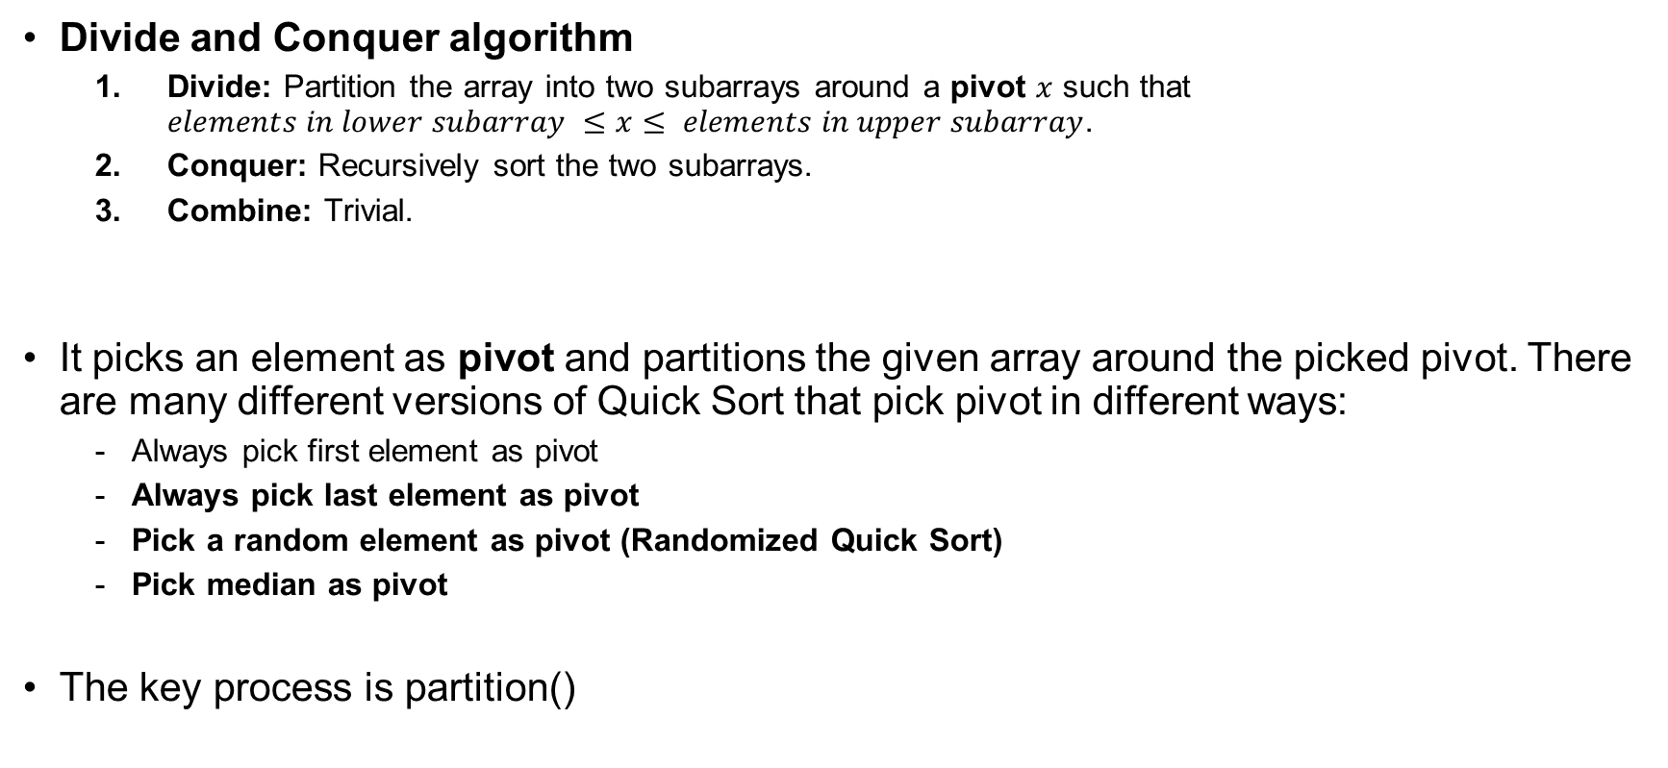
Quick Sort
Divide and Conquer algorithm
  Divide: Partition the array into two subarrays around a pivot $x$ such that $elements in lower subarray ≤x≤ elements in upper subarray$.
  Conquer: Recursively sort the two subarrays.
  Combine: Trivial.
It picks an element as pivot and partitions the given array around the picked pivot. There are many different versions of Quick Sort that pick pivot in different ways:
  Always pick first element as pivot
  Always pick last element as pivot
  Pick a random element as pivot (Randomized Quick Sort)
  Pick median as pivot
The key process is partition()

Slide 3
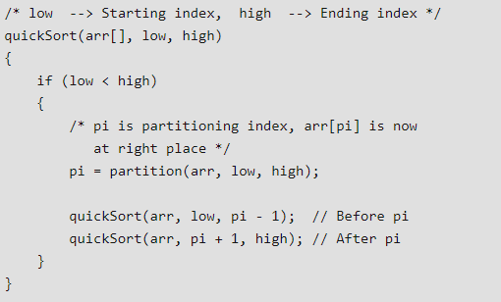
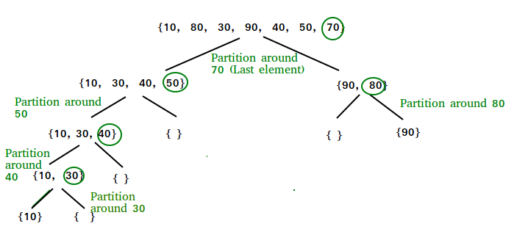
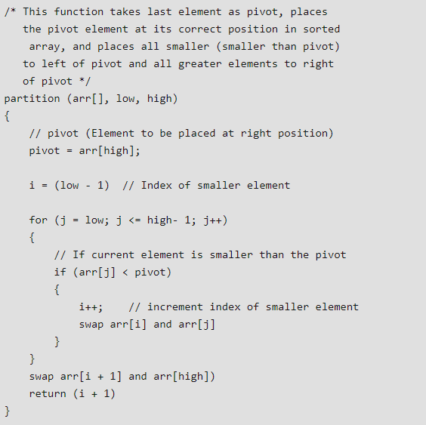
Quick Sort 1
Pseudo Code for recursive quickSort function
Always pick last element as pivot
Pseudo code for partition()

Slide 4
Quick Sort 1
Pseudo Code for recursive quickSort function
Always pick last element as pivot
Pseudo code for partition()
arr[] = {10, 80, 30, 90, 40, 50, 70}
Indexes: 0 1 2 3 4 5 6
low = 0, high = 6, pivot = arr[h] = 70
Initialize index of smaller element, i = -1
Traverse elements from j = low to high-1

Slide 5
Quick Sort 1
Pseudo Code for recursive quickSort function
Always pick last element as pivot
Pseudo code for partition()
arr[] = {10, 80, 30, 90, 40, 50, 70}
Indexes: 0 1 2 3 4 5 6
low = 0, high = 6, pivot = arr[h] = 70
Initialize index of smaller element, i = -1
Traverse elements from j = low to high-1
j = 0: Since arr[j] <= pivot, do i++ and swap(arr[i], arr[j])
i = 0
arr[] = {10, 80, 30, 90, 40, 50, 70} // No change as i and j are same

Slide 6
Quick Sort 1
Pseudo Code for recursive quickSort function
Always pick last element as pivot
Pseudo code for partition()
arr[] = {10, 80, 30, 90, 40, 50, 70}
Indexes: 0 1 2 3 4 5 6
low = 0, high = 6, pivot = arr[h] = 70
Initialize index of smaller element, i = -1
Traverse elements from j = low to high-1
j = 0: Since arr[j] <= pivot, do i++ and swap(arr[i], arr[j])
i = 0
arr[] = {10, 80, 30, 90, 40, 50, 70} // No change as i and j are same
j = 1: Since arr[j] > pivot, do nothing // No change in i and arr[]

Slide 7
Quick Sort 1
Pseudo Code for recursive quickSort function
Always pick last element as pivot
Pseudo code for partition()
arr[] = {10, 80, 30, 90, 40, 50, 70}
Indexes: 0 1 2 3 4 5 6
low = 0, high = 6, pivot = arr[h] = 70
Initialize index of smaller element, i = -1
Traverse elements from j = low to high-1
j = 0: Since arr[j] <= pivot, do i++ and swap(arr[i], arr[j])
i = 0
arr[] = {10, 80, 30, 90, 40, 50, 70} // No change as i and j are same
j = 1: Since arr[j] > pivot, do nothing // No change in i and arr[]
j = 2: Since arr[j] <= pivot, do i++ and swap(arr[i], arr[j])
i = 1
arr[] = {10, 30, 80, 90, 40, 50, 70} // We swap 80 and 30

Slide 8
Quick Sort 1
Pseudo Code for recursive quickSort function
Always pick last element as pivot
Pseudo code for partition()
arr[] = {10, 80, 30, 90, 40, 50, 70}
Indexes: 0 1 2 3 4 5 6
j = 3: Since arr[j] > pivot, do nothing // No change in i and arr[]
low = 0, high = 6, pivot = arr[h] = 70
Initialize index of smaller element, i = -1
Traverse elements from j = low to high-1
j = 0: Since arr[j] <= pivot, do i++ and swap(arr[i], arr[j])
i = 0
arr[] = {10, 80, 30, 90, 40, 50, 70} // No change as i and j are same
j = 1: Since arr[j] > pivot, do nothing // No change in i and arr[]
j = 2: Since arr[j] <= pivot, do i++ and swap(arr[i], arr[j])
i = 1
arr[] = {10, 30, 80, 90, 40, 50, 70} // We swap 80 and 30

Slide 9
Quick Sort 1
Pseudo Code for recursive quickSort function
Always pick last element as pivot
Pseudo code for partition()
arr[] = {10, 80, 30, 90, 40, 50, 70}
Indexes: 0 1 2 3 4 5 6
j = 3: Since arr[j] > pivot, do nothing // No change in i and arr[]
low = 0, high = 6, pivot = arr[h] = 70
Initialize index of smaller element, i = -1
Traverse elements from j = low to high-1
j = 4: Since arr[j] <= pivot, do i++ and swap(arr[i], arr[j])
i = 2
arr[] = {10, 30, 40, 90, 80, 50, 70} // 80 and 40 Swapped
j = 0: Since arr[j] <= pivot, do i++ and swap(arr[i], arr[j])
i = 0
arr[] = {10, 80, 30, 90, 40, 50, 70} // No change as i and j are same
j = 1: Since arr[j] > pivot, do nothing // No change in i and arr[]
j = 2: Since arr[j] <= pivot, do i++ and swap(arr[i], arr[j])
i = 1
arr[] = {10, 30, 80, 90, 40, 50, 70} // We swap 80 and 30

Slide 10
Quick Sort 1
Pseudo Code for recursive quickSort function
Always pick last element as pivot
Pseudo code for partition()
arr[] = {10, 80, 30, 90, 40, 50, 70}
Indexes: 0 1 2 3 4 5 6
j = 3: Since arr[j] > pivot, do nothing // No change in i and arr[]
low = 0, high = 6, pivot = arr[h] = 70
Initialize index of smaller element, i = -1
Traverse elements from j = low to high-1
j = 4: Since arr[j] <= pivot, do i++ and swap(arr[i], arr[j])
i = 2
arr[] = {10, 30, 40, 90, 80, 50, 70} // 80 and 40 Swapped
j = 0: Since arr[j] <= pivot, do i++ and swap(arr[i], arr[j])
i = 0
arr[] = {10, 80, 30, 90, 40, 50, 70} // No change as i and j are same
j = 5: Since arr[j] <= pivot, do i++ and swap arr[i] with arr[j]
i = 3
arr[] = {10, 30, 40, 50, 80, 90, 70} // 90 and 50 Swapped
j = 1: Since arr[j] > pivot, do nothing // No change in i and arr[]
j = 2: Since arr[j] <= pivot, do i++ and swap(arr[i], arr[j])
i = 1
arr[] = {10, 30, 80, 90, 40, 50, 70} // We swap 80 and 30

Slide 11
Quick Sort 1
Pseudo Code for recursive quickSort function
Always pick last element as pivot
Pseudo code for partition()
arr[] = {10, 80, 30, 90, 40, 50, 70}
Indexes: 0 1 2 3 4 5 6
j = 3: Since arr[j] > pivot, do nothing // No change in i and arr[]
low = 0, high = 6, pivot = arr[h] = 70
Initialize index of smaller element, i = -1
Traverse elements from j = low to high-1
j = 4: Since arr[j] <= pivot, do i++ and swap(arr[i], arr[j])
i = 2
arr[] = {10, 30, 40, 90, 80, 50, 70} // 80 and 40 Swapped
j = 0: Since arr[j] <= pivot, do i++ and swap(arr[i], arr[j])
i = 0
arr[] = {10, 80, 30, 90, 40, 50, 70} // No change as i and j are same
j = 5: Since arr[j] <= pivot, do i++ and swap arr[i] with arr[j]
i = 3
arr[] = {10, 30, 40, 50, 80, 90, 70} // 90 and 50 Swapped
j = 1: Since arr[j] > pivot, do nothing // No change in i and arr[]
We come out of loop because j is now equal to high-1.
Finally we place pivot at correct position by swapping arr[i+1] and arr[high] (or pivot)
arr[] = {10, 30, 40, 50, 70, 90, 80} // 80 and 70 Swapped
j = 2: Since arr[j] <= pivot, do i++ and swap(arr[i], arr[j])
i = 1
arr[] = {10, 30, 80, 90, 40, 50, 70} // We swap 80 and 30

Slide 12
Quick Sort 1
Pseudo Code for recursive quickSort function
Always pick last element as pivot
Pseudo code for partition()
arr[] = {10, 80, 30, 90, 40, 50, 70}
Indexes: 0 1 2 3 4 5 6
j = 3: Since arr[j] > pivot, do nothing // No change in i and arr[]
low = 0, high = 6, pivot = arr[h] = 70
Initialize index of smaller element, i = -1
Traverse elements from j = low to high-1
j = 4: Since arr[j] <= pivot, do i++ and swap(arr[i], arr[j])
i = 2
arr[] = {10, 30, 40, 90, 80, 50, 70} // 80 and 40 Swapped
j = 0: Since arr[j] <= pivot, do i++ and swap(arr[i], arr[j])
i = 0
arr[] = {10, 80, 30, 90, 40, 50, 70} // No change as i and j are same
j = 5: Since arr[j] <= pivot, do i++ and swap arr[i] with arr[j]
i = 3
arr[] = {10, 30, 40, 50, 80, 90, 70} // 90 and 50 Swapped
j = 1: Since arr[j] > pivot, do nothing // No change in i and arr[]
We come out of loop because j is now equal to high-1.
Finally we place pivot at correct position by swapping arr[i+1] and arr[high] (or pivot)
arr[] = {10, 30, 40, 50, 70, 90, 80} // 80 and 70 Swapped
j = 2: Since arr[j] <= pivot, do i++ and swap(arr[i], arr[j])
i = 1
arr[] = {10, 30, 80, 90, 40, 50, 70} // We swap 80 and 30
Now 70 is at its correct place. All elements smaller than 70 are before it and all elements greater than 70 are after it.

Slide 13
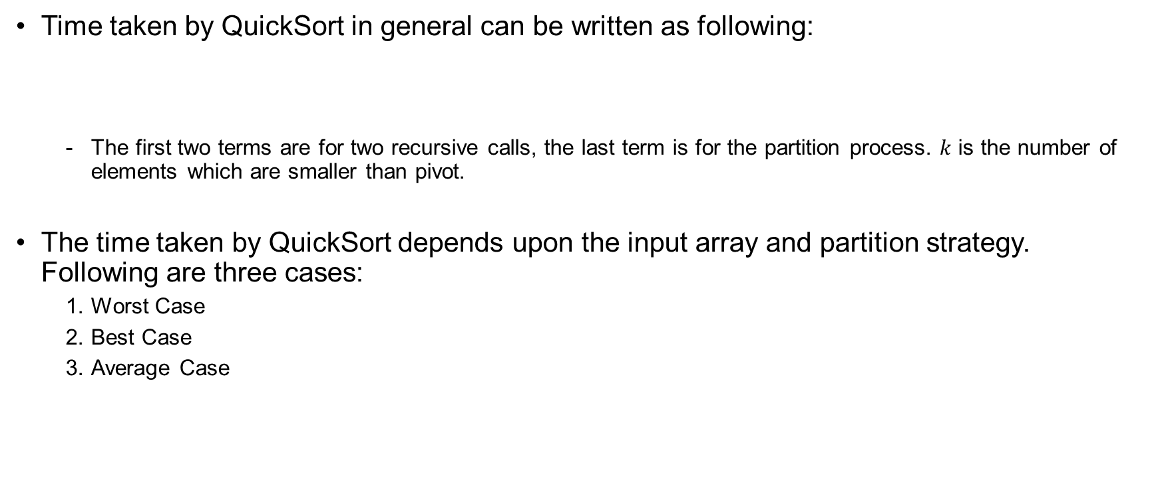
Analysis of Quick Sort 1
Time taken by QuickSort in general can be written as following:
  The first two terms are for two recursive calls, the last term is for the partition process. $k$ is the number of elements which are smaller than pivot.
The time taken by QuickSort depends upon the input array and partition strategy. Following are three cases:
  Worst Case
  Best Case
  Average Case
$T\left(n\right)=T\left(k\right)+T\left(n−k−1\right)+Θ\left(n\right)$

Slide 14
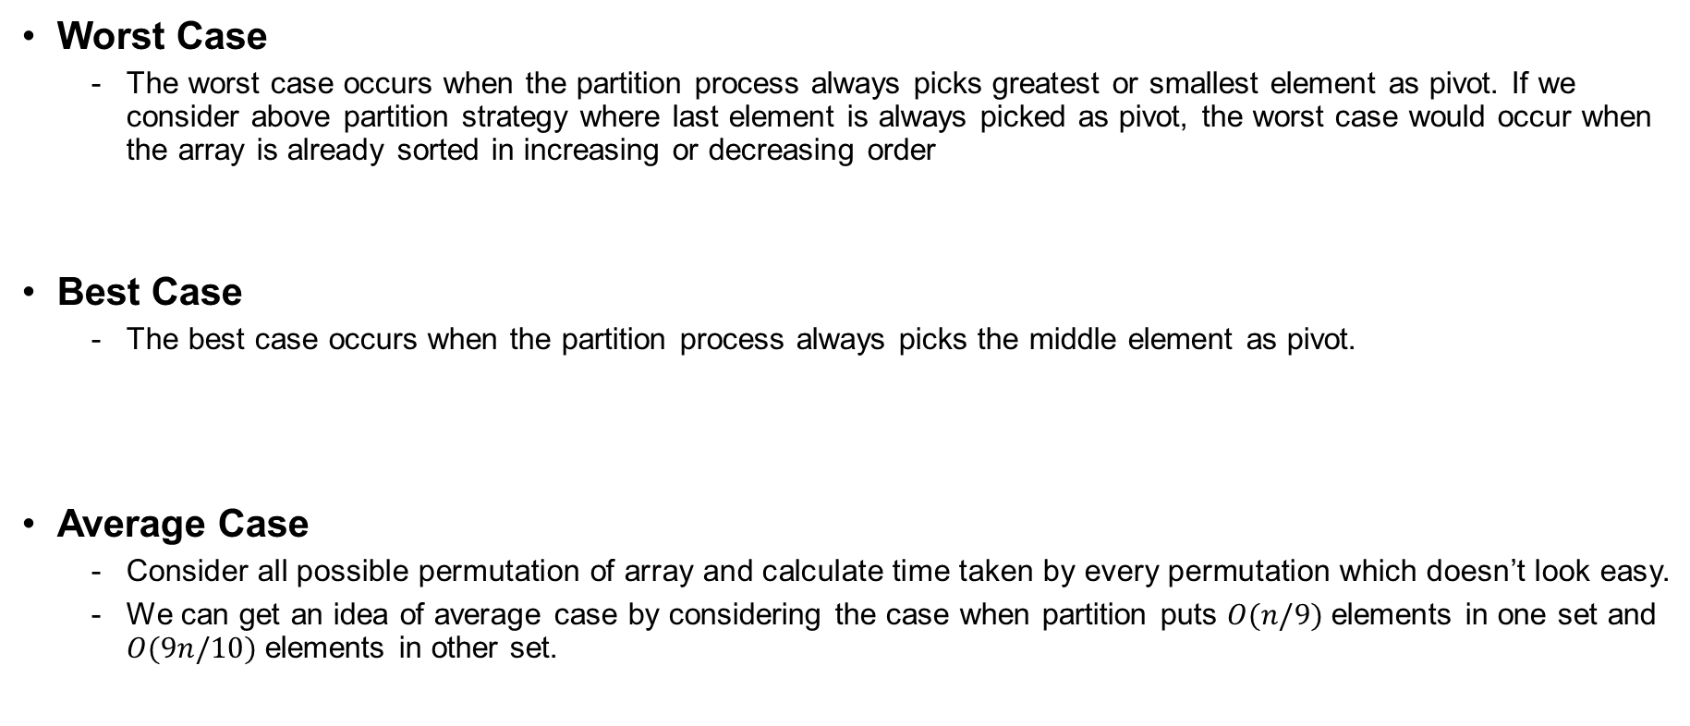


Analysis of Quick Sort 1
$$T\left(n\right)=T\left(k\right)+T\left(n−k−1\right)+Θ\left(n\right)$$
Worst Case
  The worst case occurs when the partition process always picks greatest or smallest element as pivot. If we consider above partition strategy where last element is always picked as pivot, the worst case would occur when the array is already sorted in increasing or decreasing order
Best Case
  The best case occurs when the partition process always picks the middle element as pivot.
Average Case
  Consider all possible permutation of array and calculate time taken by every permutation which doesn’t look easy.
  We can get an idea of average case by considering the case when partition puts $O(n/9)$elements in one set and $O(9n/10)$elements in other set.
$$T\left(n\right)=T\left(0\right)+T\left(n−1\right)+Θ\left(n\right)=T\left(n−1\right)+Θ\left(n\right)$$
$$T\left(n\right)=2T\left(\frac{n}{2}\right)+Θ\left(n\right)$$
$$T\left(n\right)=T\left(\frac{n}{10}\right)+T\left(\frac{9n}{10}\right)+Θ\left(n\right)$$

Slide 15



Analysis of Quick Sort 1
$$T\left(n\right)=T\left(k\right)+T\left(n−k−1\right)+Θ\left(n\right)$$
$$Θ\left(n^{2}\right)$$
Worst Case
  The worst case occurs when the partition process always picks greatest or smallest element as pivot. If we consider above partition strategy where last element is always picked as pivot, the worst case would occur when the array is already sorted in increasing or decreasing order
Best Case
  The best case occurs when the partition process always picks the middle element as pivot.
Average Case
  Consider all possible permutation of array and calculate time taken by every permutation which doesn’t look easy.
  We can get an idea of average case by considering the case when partition puts $O(n/9)$elements in one set and $O(9n/10)$elements in other set.
$$T\left(n\right)=T\left(0\right)+T\left(n−1\right)+Θ\left(n\right)=T\left(n−1\right)+Θ\left(n\right)$$
$$Θ\left(n \log{n}\right)$$
← case 2 of Master Theorem
$$T\left(n\right)=2T\left(\frac{n}{2}\right)+Θ\left(n\right)$$
$$Θ\left(n \log{n}\right)$$
$$T\left(n\right)=T\left(\frac{n}{10}\right)+T\left(\frac{9n}{10}\right)+Θ\left(n\right)$$

Slide 16
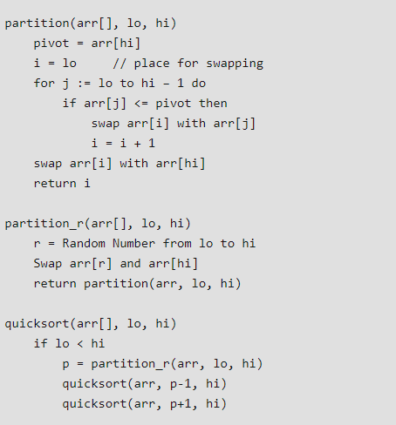
Quick Sort 2
Random Pivoting
  Using a randomly generated pivot we can further improve the time complexity of QuickSort.
  An example:

Slide 17
Quick Sort 2
Random Pivoting
  Using a randomly generated pivot we can further improve the time complexity of QuickSort.
  An example:

Slide 18
Analysis of Quick Sort 2
Random Pivoting
  In Randomized Quick Sort, we use random number to pick the next pivot (or we randomly shuffle the array)
  Time complexity of some randomized algorithms is dependent on value of random variable. Such Randomized algorithms are called Las Vegas Algorithms. These algorithms are typically analyzed for expected worst case.
  To compute expected time taken in worst case, all possible values of the used random variable needs to be considered in worst case and time taken by every possible value needs to be evaluated. Average of all evaluated times is the expected worst case time complexity.

Slide 19
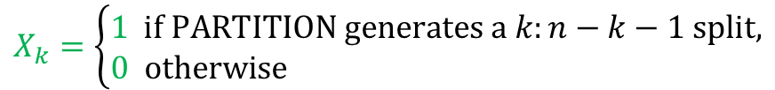
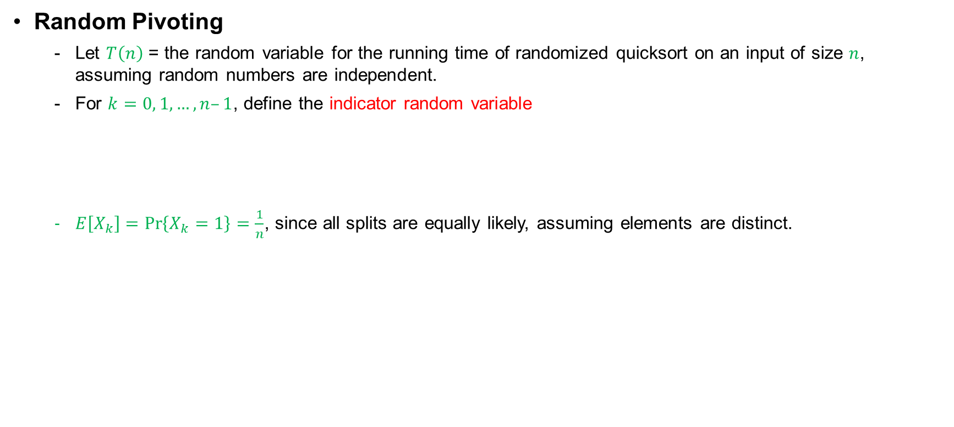
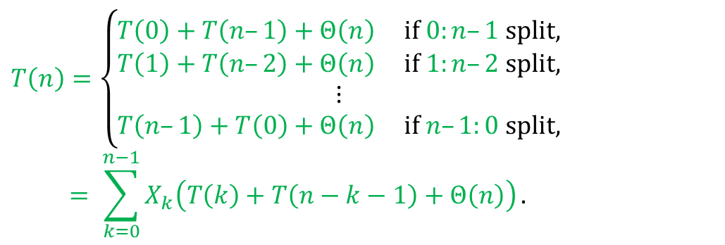
Analysis of Quick Sort 2
Random Pivoting
  Let $T\left(n\right)$ = the random variable for the running time of randomized quicksort on an input of size $n$, assuming random numbers are independent.
  For $k=0, 1, …, n–1$, define the indicator random variable
  $E\left[X_{k}\right]=\operatorname{Pr}\left\{X_{k}=1\right\}=\frac{1}{n}$, since all splits are equally likely, assuming elements are distinct.
$$X_{k}=\left\{\begin{aligned}1 if PARTITION generates a k:n−k−1 split, \\ 0 otherwise \end{aligned}\right.$$
$$T\left(n\right)=\left\{\begin{matrix}\begin{matrix}T\left(0\right)+T\left(n–1\right)+Θ\left(n\right) if 0:n–1 split, \\ T\left(1\right)+T\left(n–2\right)+Θ\left(n\right) if 1:n–2 split,\end{matrix} \\ \begin{matrix}⋮ \\ T\left(n–1\right)+T\left(0\right)+Θ\left(n\right) if n–1:0 split,\end{matrix}\end{matrix}\right.$$
$$= \sum_{k=0}^{n−1}{X_{k}\left(T\left(k\right)+T\left(n−k−1\right)+Θ\left(n\right)\right)}.$$

Slide 20
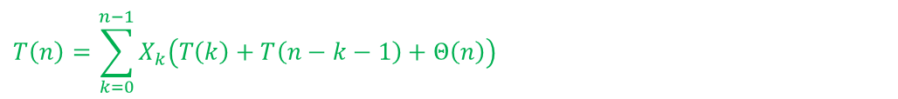
Analysis of Quick Sort 2
Random Pivoting
$$T\left(n\right)=\sum_{k=0}^{n−1}{X_{k}\left(T\left(k\right)+T\left(n−k−1\right)+Θ\left(n\right)\right)}$$

Slide 21
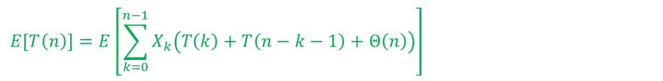
Analysis of Quick Sort 2
Random Pivoting
$$T\left(n\right)=\sum_{k=0}^{n−1}{X_{k}\left(T\left(k\right)+T\left(n−k−1\right)+Θ\left(n\right)\right)}$$
$$E\left[T\left(n\right)\right]=E\left[\sum_{k=0}^{n−1}{X_{k}\left(T\left(k\right)+T\left(n−k−1\right)+Θ\left(n\right)\right)}\right]$$
Take expectations of both sides.

Slide 22
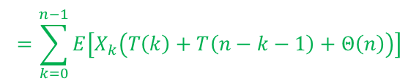
Analysis of Quick Sort 2
Random Pivoting
$$T\left(n\right)=\sum_{k=0}^{n−1}{X_{k}\left(T\left(k\right)+T\left(n−k−1\right)+Θ\left(n\right)\right)}$$
$$E\left[T\left(n\right)\right]=E\left[\sum_{k=0}^{n−1}{X_{k}\left(T\left(k\right)+T\left(n−k−1\right)+Θ\left(n\right)\right)}\right]$$
Linearity of expectation.
$$=\sum_{k=0}^{n−1}{E\left[X_{k}\left(T\left(k\right)+T\left(n−k−1\right)+Θ\left(n\right)\right)\right]}$$

Slide 23
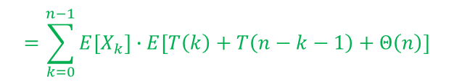
Analysis of Quick Sort 2
Random Pivoting
$$T\left(n\right)=\sum_{k=0}^{n−1}{X_{k}\left(T\left(k\right)+T\left(n−k−1\right)+Θ\left(n\right)\right)}$$
$$E\left[T\left(n\right)\right]=E\left[\sum_{k=0}^{n−1}{X_{k}\left(T\left(k\right)+T\left(n−k−1\right)+Θ\left(n\right)\right)}\right]$$
$$=\sum_{k=0}^{n−1}{E\left[X_{k}\left(T\left(k\right)+T\left(n−k−1\right)+Θ\left(n\right)\right)\right]}$$
Independence of $X_{k}$ from other random choices.
$$=\sum_{k=0}^{n−1}{E\left[X_{k}\right]∙E\left[T\left(k\right)+T\left(n−k−1\right)+Θ\left(n\right)\right]}$$

Slide 24

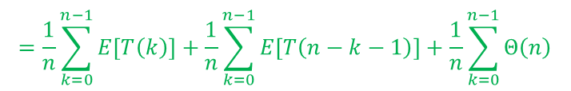
Analysis of Quick Sort 2
Random Pivoting
$$T\left(n\right)=\sum_{k=0}^{n−1}{X_{k}\left(T\left(k\right)+T\left(n−k−1\right)+Θ\left(n\right)\right)}$$
$$E\left[T\left(n\right)\right]=E\left[\sum_{k=0}^{n−1}{X_{k}\left(T\left(k\right)+T\left(n−k−1\right)+Θ\left(n\right)\right)}\right]$$
$$=\sum_{k=0}^{n−1}{E\left[X_{k}\left(T\left(k\right)+T\left(n−k−1\right)+Θ\left(n\right)\right)\right]}$$
$$=\sum_{k=0}^{n−1}{E\left[X_{k}\right]∙E\left[T\left(k\right)+T\left(n−k−1\right)+Θ\left(n\right)\right]}$$
$$=\frac{1}{n}\sum_{k=0}^{n−1}{E\left[T\left(k\right)\right]}+\frac{1}{n}\sum_{k=0}^{n−1}{E\left[T\left(n−k−1\right)\right]}+\frac{1}{n}\sum_{k=0}^{n−1}{Θ\left(n\right)}$$
Linearity of expectation; $E\left[X_{k}\right]=\frac{1}{n}$.

Slide 25
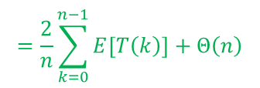
Analysis of Quick Sort 2
Random Pivoting
$$T\left(n\right)=\sum_{k=0}^{n−1}{X_{k}\left(T\left(k\right)+T\left(n−k−1\right)+Θ\left(n\right)\right)}$$
$$E\left[T\left(n\right)\right]=E\left[\sum_{k=0}^{n−1}{X_{k}\left(T\left(k\right)+T\left(n−k−1\right)+Θ\left(n\right)\right)}\right]$$
$$=\sum_{k=0}^{n−1}{E\left[X_{k}\left(T\left(k\right)+T\left(n−k−1\right)+Θ\left(n\right)\right)\right]}$$
$$=\sum_{k=0}^{n−1}{E\left[X_{k}\right]∙E\left[T\left(k\right)+T\left(n−k−1\right)+Θ\left(n\right)\right]}$$
$$=\frac{1}{n}\sum_{k=0}^{n−1}{E\left[T\left(k\right)\right]}+\frac{1}{n}\sum_{k=0}^{n−1}{E\left[T\left(n−k−1\right)\right]}+\frac{1}{n}\sum_{k=0}^{n−1}{Θ\left(n\right)}$$
$$=\frac{2}{n}\sum_{k=0}^{n−1}{E\left[T\left(k\right)\right]}+Θ\left(n\right)$$
Summations have identical terms.

Slide 26
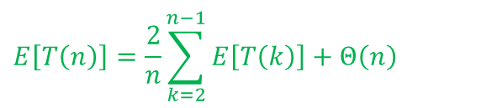
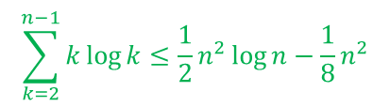

Analysis of Quick Sort 2
Random Pivoting
$$E\left[T\left(n\right)\right]=\frac{2}{n}\sum_{k=2}^{n−1}{E\left[T\left(k\right)\right]}+Θ\left(n\right)$$
(The $k=0, 1$ terms can be absorbed in the $Θ\left(n\right)$.)
Prove: $E\left[T\left(n\right)\right]≤an\log{n}$for constant $a>0$.
Choose $a$ large enough so that $an\log{n}$ dominates $E\left[T\left(n\right)\right]$for sufficiently small $n≥2$.
Use
$$\sum_{k=2}^{n−1}{k\log{k}}≤\frac{1}{2}n^{2}\log{n}−\frac{1}{8}n^{2}$$

Slide 27
Analysis of Quick Sort 2
Random Pivoting
$$E\left[T\left(n\right)\right]=\frac{2}{n}\sum_{k=2}^{n−1}{E\left[T\left(k\right)\right]}+Θ\left(n\right)$$

Slide 28
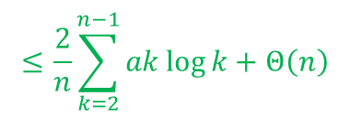
Analysis of Quick Sort 2
Random Pivoting
$$E\left[T\left(n\right)\right]=\frac{2}{n}\sum_{k=2}^{n−1}{E\left[T\left(k\right)\right]}+Θ\left(n\right)$$
Substitute inductive hypothesis.
$$≤\frac{2}{n}\sum_{k=2}^{n−1}{ak\log{k}}+Θ\left(n\right)$$

Slide 29
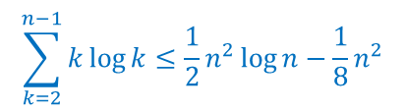
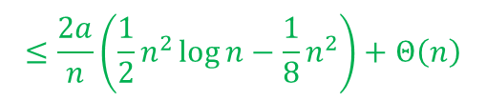
Analysis of Quick Sort 2
Random Pivoting
$$E\left[T\left(n\right)\right]=\frac{2}{n}\sum_{k=2}^{n−1}{E\left[T\left(k\right)\right]}+Θ\left(n\right)$$
$$≤\frac{2}{n}\sum_{k=2}^{n−1}{ak\log{k}}+Θ\left(n\right)$$
$$\sum_{k=2}^{n−1}{k\log{k}}≤\frac{1}{2}n^{2}\log{n}−\frac{1}{8}n^{2}$$
Use
$$≤\frac{2a}{n}\left(\frac{1}{2}n^{2}\log{n}−\frac{1}{8}n^{2}\right)+Θ\left(n\right)$$

Slide 30
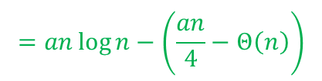
Analysis of Quick Sort 2
Random Pivoting
$$E\left[T\left(n\right)\right]=\frac{2}{n}\sum_{k=2}^{n−1}{E\left[T\left(k\right)\right]}+Θ\left(n\right)$$
$$≤\frac{2}{n}\sum_{k=2}^{n−1}{ak\log{k}}+Θ\left(n\right)$$
$$≤\frac{2a}{n}\left(\frac{1}{2}n^{2}\log{n}−\frac{1}{8}n^{2}\right)+Θ\left(n\right)$$
$$=an\log{n}−\left(\frac{an}{4}−Θ\left(n\right)\right)$$

Slide 31

Analysis of Quick Sort 2
Random Pivoting
$$E\left[T\left(n\right)\right]=\frac{2}{n}\sum_{k=2}^{n−1}{E\left[T\left(k\right)\right]}+Θ\left(n\right)$$
$$≤\frac{2}{n}\sum_{k=2}^{n−1}{ak\log{k}}+Θ\left(n\right)$$
$$≤\frac{2a}{n}\left(\frac{1}{2}n^{2}\log{n}−\frac{1}{8}n^{2}\right)+Θ\left(n\right)$$
$$=an\log{n}−\left(\frac{an}{4}−Θ\left(n\right)\right)$$
if $a$ is chosen large enough so that $\frac{an}{4}$ dominates the $Θ\left(n\right)$.
$$≤an\log{n}$$

Slide 32
Analysis of Quick Sort 2
Random Pivoting
$$E\left[T\left(n\right)\right]=\frac{2}{n}\sum_{k=2}^{n−1}{E\left[T\left(k\right)\right]}+Θ\left(n\right)$$
$$≤\frac{2}{n}\sum_{k=2}^{n−1}{ak\log{k}}+Θ\left(n\right)$$
$$≤\frac{2a}{n}\left(\frac{1}{2}n^{2}\log{n}−\frac{1}{8}n^{2}\right)+Θ\left(n\right)$$
$$=an\log{n}−\left(\frac{an}{4}−Θ\left(n\right)\right)$$
$$≤an\log{n}$$
→ Expected worst case time complexity: O(n Log n)

Slide 33
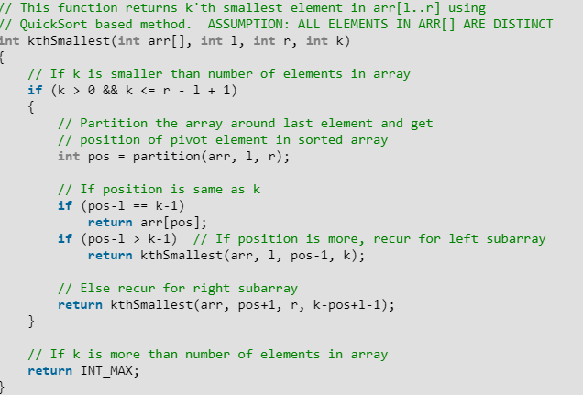
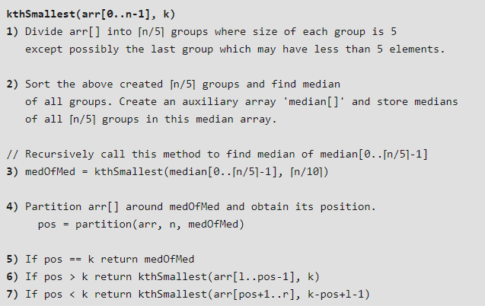


Quick Sort 3
Pick median as pivot
  Find the median first, then partition the array around the median element.
  K’th Smallest/Largest Element in Unsorted Array method for finding the median.
QuickSelect: worst $Θ\left(n^{2}\right)$, average $Θ\left(n\right)$
Modified QuickSelect: worst $Θ\left(n\right)$
  Select a pivot that divides array in a balanced way
→ Worst case time complexity: O(n Log n)

Slide 34
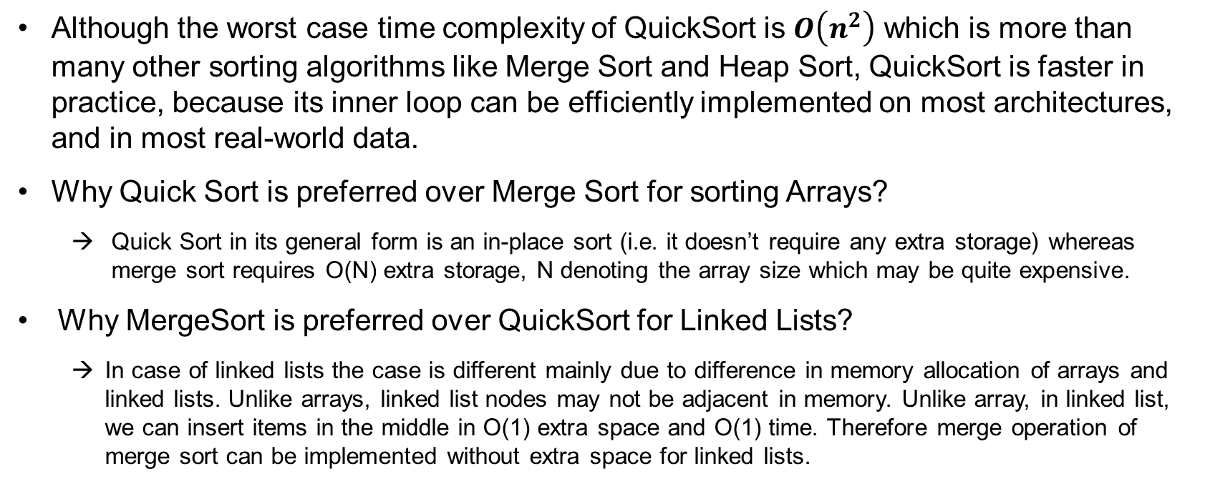
Notes
Although the worst case time complexity of QuickSort is $O\left(n^{2}\right)$ which is more than many other sorting algorithms like Merge Sort and Heap Sort, QuickSort is faster in practice, because its inner loop can be efficiently implemented on most architectures, and in most real-world data.
Why Quick Sort is preferred over Merge Sort for sorting Arrays?
  Quick Sort in its general form is an in-place sort (i.e. it doesn’t require any extra storage) whereas merge sort requires O(N) extra storage, N denoting the array size which may be quite expensive.
Why MergeSort is preferred over QuickSort for Linked Lists?
  In case of linked lists the case is different mainly due to difference in memory allocation of arrays and linked lists. Unlike arrays, linked list nodes may not be adjacent in memory. Unlike array, in linked list, we can insert items in the middle in O(1) extra space and O(1) time. Therefore merge operation of merge sort can be implemented without extra space for linked lists.

