Slide 1
Dynamic Programming I
SWE2016-44

Slide 2
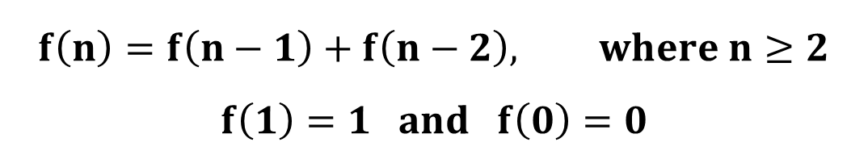
Mathematical Background
Consider the following mathematical function:
$$f\left(n\right)=f\left(n−1\right)+f\left(n−2\right), where n≥2$$
$$f\left(1\right)=1 and f\left(0\right)=0$$

Slide 3
Mathematical Background
Consider the following mathematical function:
Fibonacci series: a series of numbers in which each number (Fibonacci number) is the sum of the two preceding numbers.
$$f\left(n\right)=f\left(n−1\right)+f\left(n−2\right), where n≥2$$
$$f\left(1\right)=1 and f\left(0\right)=0$$
$$f\left(n\right)=\left\{0, 1, 1, 2, 3, 5, 8, 13, 21\right\}$$

Slide 4
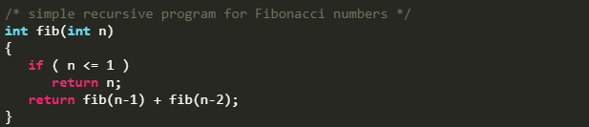
Optimal Substructure

Slide 5
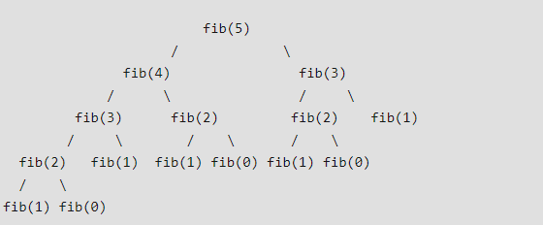
Overlapping Subproblems

Slide 6
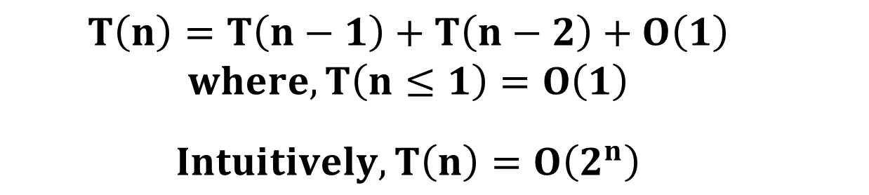
Time Complexity
Recurrent relation
  $$T\left(n\right)=T\left(n−1\right)+T\left(n−2\right)+O\left(1\right)$$
  $$where, T\left(n≤1\right)=O\left(1\right)$$
  $$Intuitively, T\left(n\right)=O\left(2^{n}\right)$$

Slide 7
Solution: Use Memory
“Remember the results.”
Do not solve the same problem again, just recall it from memory.

Slide 8
Solution: Use Memory
“Remember the results.”
Do not solve the same problem again, just recall it from memory.
Two methods of storing the results in memory
Memoization (Top-Down)
Tabulation (Bottom-up)

Slide 9
What is Dynamic Programming?
Dynamic Programming
  Solves a given complex problem by breaking it into subproblems
  Stores the results of subproblems to avoid computing the same results again.

Slide 10
Dynamic Programming vs. Divide and Conquer
Similarities:
  Both paradigms work by combining solutions to sub-problems
Differences:
  Dynamic Programming is mainly used when Overlapping Subproblems property is satisfied.
Examples:
  Binary Search
  Fibonacci Series

Slide 11
Where to use Dynamic Programming?
Following are the two main properties of a problem that suggest that the given problem can be solved using Dynamic Programming:
Overlapping Subproblems
Optimal Substructure

Slide 12
Performance
Time taken for calculating the 40th Fibonacci number (102334155):
Recursive: 14 seconds
Memoization: 0.17 seconds
Tabulation: 0.30 seconds

Slide 13
Memoization

Slide 14
The Algorithm
Initialize a lookup array/table with all its elements as NIL
  NIL is simply a constant value, e.g. -1, that signifies absence of a solution
Call the recursive function f(n) to solve for ‘n’ using memoization

Slide 15
The Algorithm
At every step i, f(i) performs the following steps:
  Checks whether table[i] is NIL or not.
  If it’s not NIL, f(i) returns the value ‘table[i]’.

Slide 16
The Algorithm
At every step i, f(i) performs the following steps:
  Checks whether table[i] is NIL or not.
  If it’s not NIL, f(i) returns the value ‘table[i]’.
  If it’s NIL and ‘i’ satisfies the base condition, we update the lookup table with the base value and return the same.

Slide 17
The Algorithm
At every step i, f(i) performs the following steps:
  Checks whether table[i] is NIL or not.
  If it’s not NIL, f(i) returns the value ‘table[i]’.
  If it’s NIL and ‘i’ satisfies the base condition, we update the lookup table with the base value and return the same.
  If it’s NIL and ‘i’ does not satisfy the base condition, then f(i) splits the problem ‘i’ into subproblems and recursively calls itself to solve them.
  After the recursive calls return, f(i) combines the solutions to subproblems, updates the lookup table and returns the solution for problem ‘i’.

Slide 18
Dry Run for Fibonacci Number
table[5]
table[4]
table[3]
table[2]
table[1]
table[0]

Slide 19
Dry Run for Fibonacci Number
table[5] | NIL
table[4] | NIL
table[3] | NIL
table[2] | NIL
table[1] | NIL
table[0] | NIL

Slide 20
Dry Run for Fibonacci Number
table[5] | NIL
table[4] | NIL
table[3] | NIL
table[2] | NIL
table[1] | NIL
table[0] | NIL

Slide 21
Dry Run for Fibonacci Number
table[5] | NIL
table[4] | NIL
table[3] | NIL
table[2] | NIL
table[1] | 1
table[0] | NIL

Slide 22
Dry Run for Fibonacci Number
table[5] | NIL
table[4] | NIL
table[3] | NIL
table[2] | NIL
table[1] | 1
table[0] | NIL

Slide 23
Dry Run for Fibonacci Number
table[5] | NIL
table[4] | NIL
table[3] | NIL
table[2] | NIL
table[1] | 1
table[0] | 0

Slide 24
Dry Run for Fibonacci Number
table[5] | NIL
table[4] | NIL
table[3] | NIL
table[2] | NIL
table[1] | 1
table[0] | 0

Slide 25
Dry Run for Fibonacci Number
table[5] | NIL
table[4] | NIL
table[3] | NIL
table[2] | 1
table[1] | 1
table[0] | 0

Slide 26
Dry Run for Fibonacci Number
table[5] | NIL
table[4] | NIL
table[3] | NIL
table[2] | 1
table[1] | 1
table[0] | 0

Slide 27
Dry Run for Fibonacci Number
table[5] | NIL
table[4] | NIL
table[3] | 2
table[2] | 1
table[1] | 1
table[0] | 0

Slide 28
Dry Run for Fibonacci Number
table[5] | NIL
table[4] | NIL
table[3] | 2
table[2] | 1
table[1] | 1
table[0] | 0

Slide 29
Dry Run for Fibonacci Number
table[5] | NIL
table[4] | 3
table[3] | 2
table[2] | 1
table[1] | 1
table[0] | 0

Slide 30
Dry Run for Fibonacci Number
table[5] | NIL
table[4] | 3
table[3] | 2
table[2] | 1
table[1] | 1
table[0] | 0

Slide 31
Dry Run for Fibonacci Number
table[5] | 5
table[4] | 3
table[3] | 2
table[2] | 1
table[1] | 1
table[0] | 0

Slide 32
Dry Run for Fibonacci Number
table[5] | 5
table[4] | 3
table[3] | 2
table[2] | 1
table[1] | 1
table[0] | 0
Time Complexity: O(n)

Slide 33
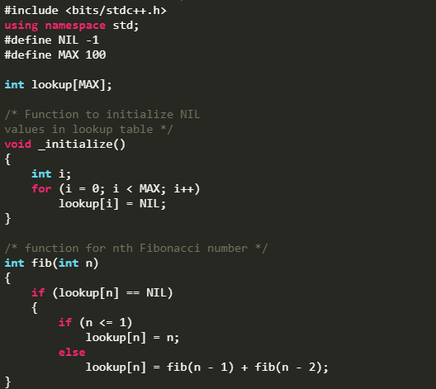
Code for Fibonacci Number

Slide 34
Tabulation

Slide 35
The Algorithm
Build the lookup table in bottom up fashion
After the table is built, simply return table[n]

Slide 36
The Algorithm
Steps:
  We begin with initializing the base values of ‘i’.
  Next, we run a loop that iterates over the remaining values of ‘i’.
  At every iteration i, f(n) updates the ith entry in the lookup table by combining the solutions to the previously solved subproblems.
  Finally, f(n) returns table[n].

Slide 37
Dry Run for Fibonacci Number
table[5]
table[4]
table[3]
table[2]
table[1]
table[0]

Slide 38
Dry Run for Fibonacci Number
table[5]
table[4]
table[3]
table[2]
table[1] | 1
table[0] | 0

Slide 39
Dry Run for Fibonacci Number
table[5]
table[4]
table[3]
table[2] | 1
table[1] | 1
table[0] | 0

Slide 40
Dry Run for Fibonacci Number
table[5]
table[4]
table[3] | 2
table[2] | 1
table[1] | 1
table[0] | 0

Slide 41
Dry Run for Fibonacci Number
table[5]
table[4] | 3
table[3] | 2
table[2] | 1
table[1] | 1
table[0] | 0

Slide 42
Dry Run for Fibonacci Number
table[5] | 5
table[4] | 3
table[3] | 2
table[2] | 1
table[1] | 1
table[0] | 0

Slide 43
Dry Run for Fibonacci Number
table[5] | 5
table[4] | 3
table[3] | 2
table[2] | 1
table[1] | 1
table[0] | 0

Slide 44
Tabulation or Memoization
Tabulation
  Works in bottom up fashion
  Avoids multiple lookups, thus, saves function call overhead time
Memoization
  Works in top down fashion
  Sometimes, avoids computing solutions to subproblems that are not needed, e.g., Longest Common Subsequence
  Sometimes, more intuitive to write, e.g., Matrix Chain Multiplication

Slide 45
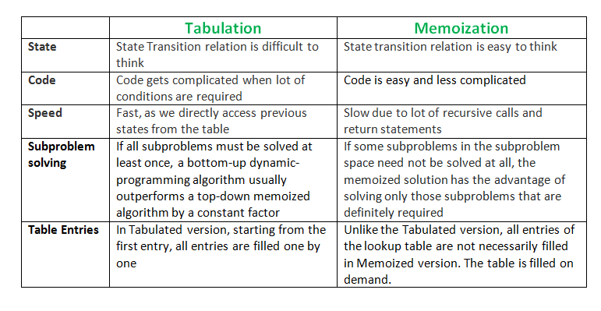
Tabulation or Memoization

Slide 46
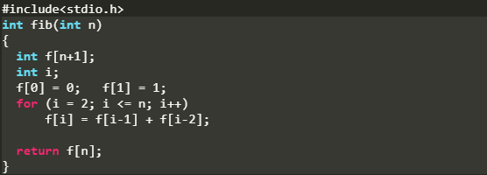
Code for Fibonacci Number

Slide 47
Optimal Substructure

Slide 48
Optimal Substructure
A given problem is said to have the Optimal Substructure property if an optimal solution of the given problem can be obtained by using optimal solutions of its subproblems.

Slide 49
Optimal Substructure
For Example,
The Shortest Path problem has following Optimal Substructure property:
  If a node x lies in the shortest path from source node u to destination node v then, the shortest path from u to v is the combination of shortest path from u to x and shortest path from x to v.
All Pair Shortest Path
  Floyd-Warshall
  Bellman-Ford

Slide 50
Optimal Substructure
On the other hand,
The Longest Path problem doesn’t have the Optimal Substructure property.
Here, by Longest Path we mean longest simple path (path without cycle) between two nodes.

Slide 51
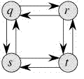
Optimal Substructure
Longest paths from q to t:
  q → r → t
  q → s → t
Longest paths from q to r:
  q → s → t → r
Longest paths from q to r:
  r → q → s → t
The optimal solution to the main problem can not be obtained using optimal solutions to subproblems.

Slide 52
How to solve DP?

Slide 53
How to solve a Dynamic Programming Problem?
Steps to solve a DP
Identify if it is a DP problem
Decide a state expression with least parameters
Formulate state relationship
Do tabulation (or add memoization)

Slide 54
How to solve a Dynamic Programming Problem?
Step 1: How to classify a problem as a DP Problem?
Typically, 1) all the problems that require to maximize or minimize certain quantity or 2) counting problems that say to count the arrangements under certain condition or certain probability problems can be solved by using DP.
All DP problems satisfy the overlapping subproblems property and most of the classic dynamic problems also satisfy the optimal substructure property.

Slide 55
How to solve a Dynamic Programming Problem?
Step 2: Deciding the state
DP problems are all about state and their transition. This is the most basic step which must be done very carefully because the state transition depends on the choice of state definition you make.
State: A state can be defined as the set of parameters that can uniquely identify a certain position or standing in the given problem. This set of parameters should be as small as possible to reduce state space.

Slide 56
How to solve a Dynamic Programming Problem?
Step 2: Deciding the state
table[5] | 5
table[4] | 3
table[3] | 2
table[2] | 1
table[1] | 1
table[0] | 0

Slide 57
How to solve a Dynamic Programming Problem?
Step 3: Formulating a relation among the states
This part is the hardest part of for solving a DP problem and requires a lot of intuition, observation and practice.

Slide 58
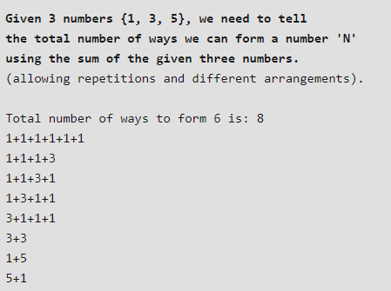
How to solve a Dynamic Programming Problem?
Step 3: Formulating a relation among the states

Slide 59
How to solve a Dynamic Programming Problem?
Step 3: Formulating a relation among the states
Let us assume that we know the result for n = 1, 2, 3, 4, 5, 6
Let us say we know the result for
  state (n=1), state (n=2), state (n=3), ……… state (n = 6)

Slide 60
How to solve a Dynamic Programming Problem?
Step 3: Formulating a relation among the states
Now, we wish to know the result of the state (n = 7). See, we can only add 1, 3 and 5.

Slide 61
How to solve a Dynamic Programming Problem?
Step 3: Formulating a relation among the states
Now, we wish to know the result of the state (n = 7). See, we can only add 1, 3 and 5.
Now we can get a sum total of 7 by the following 3 ways:
Adding 1 to all possible combinations of state (n = 6)
Adding 3 to all possible combinations of state (n = 4)
Adding 5 to all possible combinations of state(n = 2)

Slide 62
How to solve a Dynamic Programming Problem?
Step 3: Formulating a relation among the states
Adding 1 to all possible combinations of state (n = 6):
  [ (1+1+1+1+1+1) + 1]
  [ (1+1+1+3) + 1]
  [ (1+1+3+1) + 1]
  [ (1+3+1+1) + 1]
  [ (3+1+1+1) + 1]
  [ (3+3) + 1]
  [ (1+5) + 1]
  [ (5+1) + 1]

Slide 63
How to solve a Dynamic Programming Problem?
Step 3: Formulating a relation among the states
Adding 3 to all possible combinations of state (n = 4):
  [(1+1+1+1) + 3]
  [(1+3) + 3]
  [(3+1) + 3]

Slide 64
How to solve a Dynamic Programming Problem?
Step 3: Formulating a relation among the states
Therefore, we can say that result for
state(7) = state (6) + state (4) + state (2)
In general,
state(n) = state(n-1) + state(n-3) + state(n-5)

Slide 65
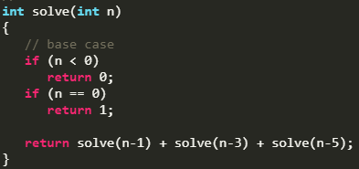
How to solve a Dynamic Programming Problem?
Step 3: Formulating a relation among the states

Slide 66
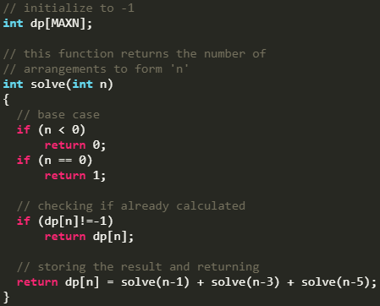
How to solve a Dynamic Programming Problem?
Step 4: Adding memoization or tabulation for the state
Adding memoization

Slide 67
Reference
Charles Leiserson and Piotr Indyk, “Introduction to Algorithms”, September 29, 2004
https://www.geeksforgeeks.org

