Slide 1
Dynamic Programming II
SWE2016-44

Slide 2
Longest Increasing Subsequence

Slide 3
Longest Increasing Subsequence
Find the length of the longest subsequence of a given sequence such that all elements of the subsequence are sorted in increasing order.

Slide 4
Longest Increasing Subsequence
Find the length of the longest subsequence of a given sequence such that all elements of the subsequence are sorted in increasing order.
For example,
Given sequence LIS = {10, 22, 9, 33, 21, 50, 41, 60}

Slide 5
Longest Increasing Subsequence
Find the length of the longest subsequence of a given sequence such that all elements of the subsequence are sorted in increasing order.
For example,
Given sequence LIS = {10, 22, 9, 33, 21, 50, 41, 60}
Subsequences: {10}, {10, 22}, {10, 9, 33}, {9, 21, 60}, {50, 60}, …

Slide 6
Longest Increasing Subsequence
Find the length of the longest subsequence of a given sequence such that all elements of the subsequence are sorted in increasing order.
For example,
Given sequence LIS = {10, 22, 9, 33, 21, 50, 41, 60}
Subsequences: {10}, {10, 22}, {10, 9, 33}, {9, 21, 60}, {50, 60}, …
Increasing Subsequences: {10}, {9, 33, 41}, {33, 41, 60}, {41}, …

Slide 7
Longest Increasing Subsequence
Find the length of the longest subsequence of a given sequence such that all elements of the subsequence are sorted in increasing order.
For example,
Given sequence LIS = {10, 22, 9, 33, 21, 50, 41, 60}
Subsequences: {10}, {10, 22}, {10, 9, 33}, {9, 21, 60}, {50, 60}, …
Increasing Subsequences: {10}, {9, 33, 41}, {33, 41, 60}, {41}, …
Longest Increasing Subsequences: {10, 22, 33, 50, 60} or {10, 22, 33, 41, 60}

Slide 8
Longest Increasing Subsequence
Find the length of the longest subsequence of a given sequence such that all elements of the subsequence are sorted in increasing order.
For example,
Given sequence LIS = {10, 22, 9, 33, 21, 50, 41, 60}
Subsequences: {10}, {10, 22}, {10, 9, 33}, {9, 21, 60}, {50, 60}, …
Increasing Subsequences: {10}, {9, 33, 41}, {33, 41, 60}, {41}, …
Longest Increasing Subsequences: {10, 22, 33, 50, 60} or {10, 22, 33, 41, 60}
So, Length of LIS = 5

Slide 9
Optimal Substructure Property
Let arr[0..n-1] be the input array; and L(i) be the length of the LIS ending at index i such that arr[i] is the last element of the LIS.

Slide 10
Optimal Substructure Property
Let arr[0..n-1] be the input array; and L(i) be the length of the LIS ending at index i such that arr[i] is the last element of the LIS.
L(i) can be recursively written as:
L(i) = 1 + max( L(j) ) where 0 < j < i and arr[j] < arr[i]; or
L(i) = 1, if no such j exists.

Slide 11
Optimal Substructure Property
Let arr[0..n-1] be the input array; and L(i) be the length of the LIS ending at index i such that arr[i] is the last element of the LIS.
L(i) can be recursively written as:
L(i) = 1 + max( L(j) ) where 0 < j < i and arr[j] < arr[i]; or
L(i) = 1, if no such j exists.
To find the LIS for a given array, return max(L(i)) where 0<i<n.

Slide 12
Optimal Substructure Property
Let arr[0..n-1] be the input array; and L(i) be the length of the LIS ending at index i such that arr[i] is the last element of the LIS.
L(i) can be recursively written as:
L(i) = 1 + max( L(j) ) where 0 < j < i and arr[j] < arr[i]; or
L(i) = 1, if no such j exists.
To find the LIS for a given array, return max(L(i)) where 0<i<n.
The LIS problem satisfies the optimal substructure property.

Slide 13
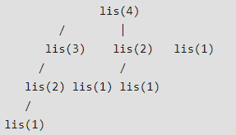
Overlapping Substructure Property

Slide 14
Longest Increasing Subsequence
Initialize LIS value
iterator
arr[] | 10 | 22 | 9 | 33 | 21 | 50 | 41 | 60
LIS | 1 | 1 | 1 | 1 | 1 | 1 | 1 | 1

Slide 15
Longest Increasing Subsequence
For i=1:
iterator | j | i
arr[] | 10 | 22 | 9 | 33 | 21 | 50 | 41 | 60
LIS | 1 | 1 | 1 | 1 | 1 | 1 | 1 | 1

Slide 16
Longest Increasing Subsequence
For i=1:
iterator | j | i
arr[] | 10 | 22 | 9 | 33 | 21 | 50 | 41 | 60
LIS | 1 | 2 | 1 | 1 | 1 | 1 | 1 | 1

Slide 17
Longest Increasing Subsequence
For i=2:
iterator | j |  | i
arr[] | 10 | 22 | 9 | 33 | 21 | 50 | 41 | 60
LIS | 1 | 2 | 1 | 1 | 1 | 1 | 1 | 1

Slide 18
Longest Increasing Subsequence
For i=2:
iterator |  | j | i
arr[] | 10 | 22 | 9 | 33 | 21 | 50 | 41 | 60
LIS | 1 | 2 | 1 | 1 | 1 | 1 | 1 | 1

Slide 19
Longest Increasing Subsequence
For i=3:
iterator | j |  |  | i
arr[] | 10 | 22 | 9 | 33 | 21 | 50 | 41 | 60
LIS | 1 | 2 | 1 | 1 | 1 | 1 | 1 | 1

Slide 20
Longest Increasing Subsequence
For i=3:
iterator | j |  |  | i
arr[] | 10 | 22 | 9 | 33 | 21 | 50 | 41 | 60
LIS | 1 | 2 | 1 | 2 | 1 | 1 | 1 | 1

Slide 21
Longest Increasing Subsequence
For i=3:
iterator |  | j |  | i
arr[] | 10 | 22 | 9 | 33 | 21 | 50 | 41 | 60
LIS | 1 | 2 | 1 | 2 | 1 | 1 | 1 | 1

Slide 22
Longest Increasing Subsequence
For i=3:
iterator |  | j |  | i
arr[] | 10 | 22 | 9 | 33 | 21 | 50 | 41 | 60
LIS | 1 | 2 | 1 | 3 | 1 | 1 | 1 | 1

Slide 23
Longest Increasing Subsequence
For i=3:
iterator |  |  | j | i
arr[] | 10 | 22 | 9 | 33 | 21 | 50 | 41 | 60
LIS | 1 | 2 | 1 | 3 | 1 | 1 | 1 | 1

Slide 24
Longest Increasing Subsequence
For i=4:
iterator | j |  |  |  | i
arr[] | 10 | 22 | 9 | 33 | 21 | 50 | 41 | 60
LIS | 1 | 2 | 1 | 3 | 1 | 1 | 1 | 1

Slide 25
Longest Increasing Subsequence
For i=4:
iterator | j |  |  |  | i
arr[] | 10 | 22 | 9 | 33 | 21 | 50 | 41 | 60
LIS | 1 | 2 | 1 | 3 | 2 | 1 | 1 | 1

Slide 26
Longest Increasing Subsequence
For i=4:
iterator |  | j |  |  | i
arr[] | 10 | 22 | 9 | 33 | 21 | 50 | 41 | 60
LIS | 1 | 2 | 1 | 3 | 2 | 1 | 1 | 1

Slide 27
Longest Increasing Subsequence
For i=4:
iterator |  |  | j |  | i
arr[] | 10 | 22 | 9 | 33 | 21 | 50 | 41 | 60
LIS | 1 | 2 | 1 | 3 | 2 | 1 | 1 | 1

Slide 28
Longest Increasing Subsequence
For i=4:
iterator |  |  |  | j | i
arr[] | 10 | 22 | 9 | 33 | 21 | 50 | 41 | 60
LIS | 1 | 2 | 1 | 3 | 2 | 1 | 1 | 1

Slide 29
Longest Increasing Subsequence
For i=5:
iterator | j |  |  |  |  | i
arr[] | 10 | 22 | 9 | 33 | 21 | 50 | 41 | 60
LIS | 1 | 2 | 1 | 3 | 2 | 1 | 1 | 1

Slide 30
Longest Increasing Subsequence
For i=5:
iterator | j |  |  |  |  | i
arr[] | 10 | 22 | 9 | 33 | 21 | 50 | 41 | 60
LIS | 1 | 2 | 1 | 3 | 2 | 2 | 1 | 1

Slide 31
Longest Increasing Subsequence
For i=5:
iterator |  | j |  |  |  | i
arr[] | 10 | 22 | 9 | 33 | 21 | 50 | 41 | 60
LIS | 1 | 2 | 1 | 3 | 2 | 2 | 1 | 1

Slide 32
Longest Increasing Subsequence
For i=5:
iterator |  | j |  |  |  | i
arr[] | 10 | 22 | 9 | 33 | 21 | 50 | 41 | 60
LIS | 1 | 2 | 1 | 3 | 2 | 3 | 1 | 1

Slide 33
Longest Increasing Subsequence
For i=5:
iterator |  |  | j |  |  | i
arr[] | 10 | 22 | 9 | 33 | 21 | 50 | 41 | 60
LIS | 1 | 2 | 1 | 3 | 2 | 3 | 1 | 1

Slide 34
Longest Increasing Subsequence
For i=5:
iterator |  |  |  | j |  | i
arr[] | 10 | 22 | 9 | 33 | 21 | 50 | 41 | 60
LIS | 1 | 2 | 1 | 3 | 2 | 3 | 1 | 1

Slide 35
Longest Increasing Subsequence
For i=5:
iterator |  |  |  | j |  | i
arr[] | 10 | 22 | 9 | 33 | 21 | 50 | 41 | 60
LIS | 1 | 2 | 1 | 3 | 2 | 4 | 1 | 1

Slide 36
Longest Increasing Subsequence
For i=5:
iterator |  |  |  |  | j | i
arr[] | 10 | 22 | 9 | 33 | 21 | 50 | 41 | 60
LIS | 1 | 2 | 1 | 3 | 2 | 4 | 1 | 1

Slide 37
Longest Increasing Subsequence
For i=6:
iterator | j |  |  |  |  |  | i
arr[] | 10 | 22 | 9 | 33 | 21 | 50 | 41 | 60
LIS | 1 | 2 | 1 | 3 | 2 | 4 | 1 | 1

Slide 38
Longest Increasing Subsequence
For i=6:
iterator | j |  |  |  |  |  | i
arr[] | 10 | 22 | 9 | 33 | 21 | 50 | 41 | 60
LIS | 1 | 2 | 1 | 3 | 2 | 4 | 2 | 1

Slide 39
Longest Increasing Subsequence
For i=6:
iterator |  | j |  |  |  |  | i
arr[] | 10 | 22 | 9 | 33 | 21 | 50 | 41 | 60
LIS | 1 | 2 | 1 | 3 | 2 | 4 | 2 | 1

Slide 40
Longest Increasing Subsequence
For i=6:
iterator |  | j |  |  |  |  | i
arr[] | 10 | 22 | 9 | 33 | 21 | 50 | 41 | 60
LIS | 1 | 2 | 1 | 3 | 2 | 4 | 3 | 1

Slide 41
Longest Increasing Subsequence
For i=6:
iterator |  |  | j |  |  |  | i
arr[] | 10 | 22 | 9 | 33 | 21 | 50 | 41 | 60
LIS | 1 | 2 | 1 | 3 | 2 | 4 | 3 | 1

Slide 42
Longest Increasing Subsequence
For i=6:
iterator |  |  |  | j |  |  | i
arr[] | 10 | 22 | 9 | 33 | 21 | 50 | 41 | 60
LIS | 1 | 2 | 1 | 3 | 2 | 4 | 3 | 1

Slide 43
Longest Increasing Subsequence
For i=6:
iterator |  |  |  | j |  |  | i
arr[] | 10 | 22 | 9 | 33 | 21 | 50 | 41 | 60
LIS | 1 | 2 | 1 | 3 | 2 | 4 | 4 | 1

Slide 44
Longest Increasing Subsequence
For i=6:
iterator |  |  |  |  | j |  | i
arr[] | 10 | 22 | 9 | 33 | 21 | 50 | 41 | 60
LIS | 1 | 2 | 1 | 3 | 2 | 4 | 4 | 1

Slide 45
Longest Increasing Subsequence
For i=6:
iterator |  |  |  |  |  | j | i
arr[] | 10 | 22 | 9 | 33 | 21 | 50 | 41 | 60
LIS | 1 | 2 | 1 | 3 | 2 | 4 | 4 | 1

Slide 46
Longest Increasing Subsequence
Final values:
iterator |  |  |  |  |  |  | j | i
arr[] | 10 | 22 | 9 | 33 | 21 | 50 | 41 | 60
LIS | 1 | 2 | 1 | 3 | 2 | 4 | 4 | 5

Slide 47
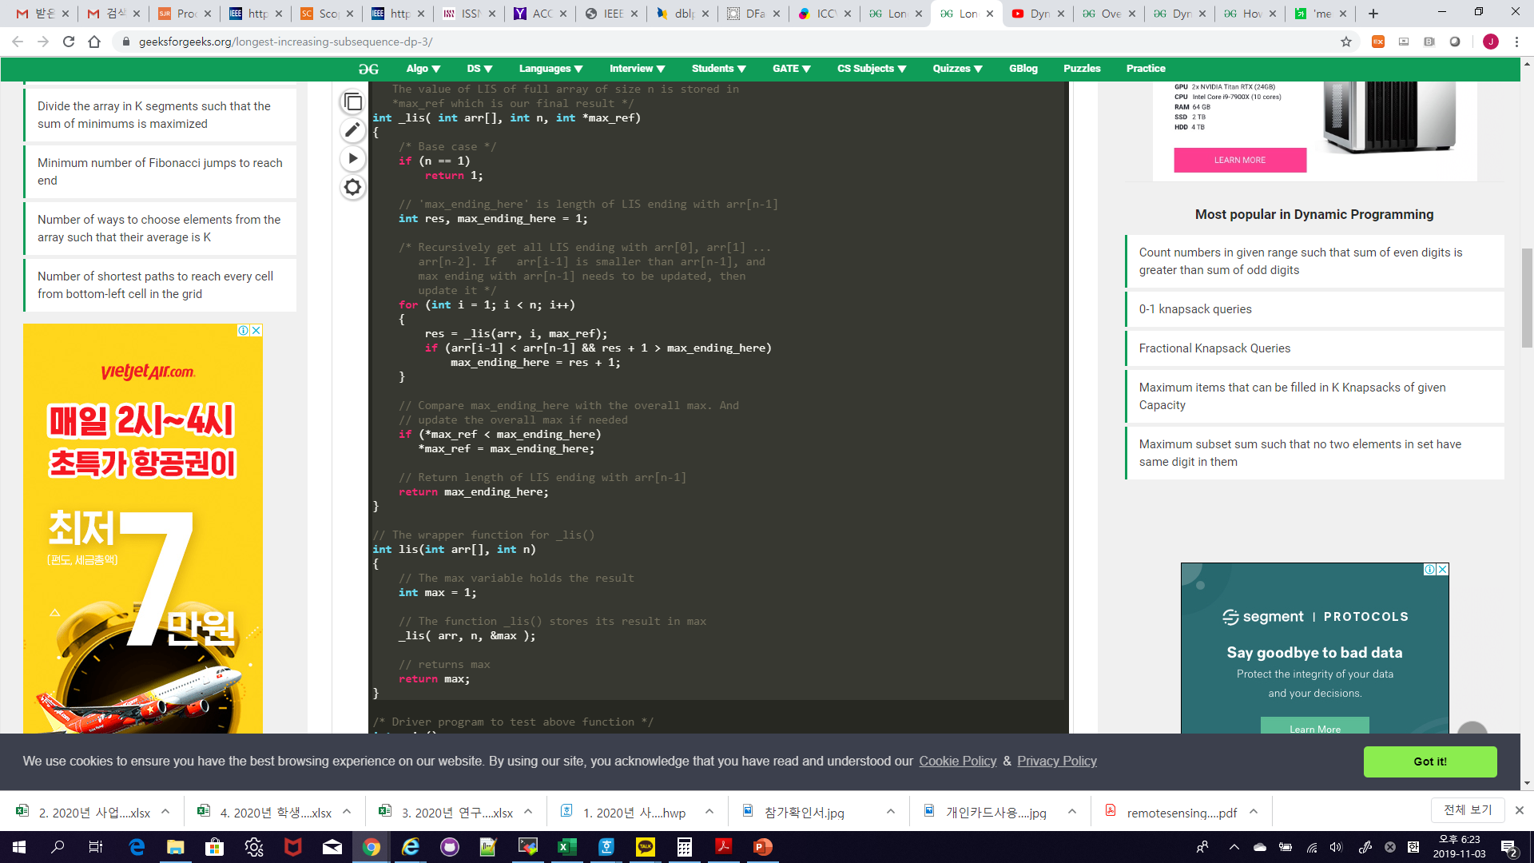
Recursive Implementation

Slide 48
Recursive Implementation
→ Time Complextity: O(2^{n})

Slide 49
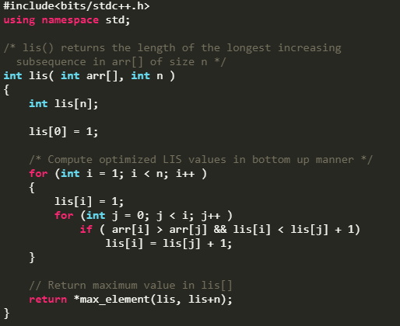
Dynamic Programming
Tabulation

Slide 50
Dynamic Programming
Tabulation
→ Time Complextity: O(n²)

Slide 51
Longest Common Subsequence

Slide 52
Longest Common Subsequence
Given two sequences, find the length of longest subsequence present in both of them.

Slide 53
Longest Common Subsequence
Given two sequences, find the length of longest subsequence present in both of them.
A subsequence is a sequence that appears in the same relative order, but not necessarily contiguous.

Slide 54
Longest Common Subsequence
Given two sequences, find the length of longest subsequence present in both of them.
A subsequence is a sequence that appears in the same relative order, but not necessarily contiguous.
Sequences = “abcdefg”, “abxdfg”

Slide 55
Longest Common Subsequence
Given two sequences, find the length of longest subsequence present in both of them.
A subsequence is a sequence that appears in the same relative order, but not necessarily contiguous.
Sequences = “abcdefg”, “abxdfg”
Common Subsequences = “a”, “b”, “d”, “f”, “g”, “ab”, “df”, “dfg”, “abd”, “abdfg”

Slide 56
Longest Common Subsequence
Given two sequences, find the length of longest subsequence present in both of them.
A subsequence is a sequence that appears in the same relative order, but not necessarily contiguous.
Sequences = “abcdefg”, “abxdfg”
Common Subsequences = “a”, “b”, “d”, “f”, “g”, “ab”, “df”, “dfg”, “abd”, “abdfg”
Longest Common Subsequences (LCS) = “abdfg”

Slide 57
Optimal Substructure Property
Let the input sequences be X[0..m-1] and Y[0..n-1]. And let L(X[0..m-1], Y[0..n-1]) be the length of LCS of the two sequences X and Y.

Slide 58
Optimal Substructure Property
Let the input sequences be X[0..m-1] and Y[0..n-1]. And let L(X[0..m-1], Y[0..n-1]) be the length of LCS of the two sequences X and Y.
If last characters of both sequences match (or X[m-1]==Y[n-1]) then L(X[0..m-1], Y[0..n-1]) = 1 + L(X[0..m-2], Y[0..n-2])

Slide 59
Optimal Substructure Property
Let the input sequences be X[0..m-1] and Y[0..n-1]. And let L(X[0..m-1], Y[0..n-1]) be the length of LCS of the two sequences X and Y.
If last characters of both sequences match (or X[m-1]==Y[n-1]) then L(X[0..m-1], Y[0..n-1]) = 1 + L(X[0..m-2], Y[0..n-2])
If last characters of both sequences don’t match (or X[m-1]!=Y[n-1]) then L(X[0..m-1], Y[0..n-1]) = MAX ( L(X[0..m-2], Y[0..n-1]), L(X[0..m-1], Y[0..n-2]) )

Slide 60
Optimal Substructure Property
Let the input sequences be X[0..m-1] and Y[0..n-1]. And let L(X[0..m-1], Y[0..n-1]) be the length of LCS of the two sequences X and Y.
If last characters of both sequences match (or X[m-1]==Y[n-1]) then L(X[0..m-1], Y[0..n-1]) = 1 + L(X[0..m-2], Y[0..n-2])
If last characters of both sequences don’t match (or X[m-1]!=Y[n-1]) then L(X[0..m-1], Y[0..n-1]) = MAX ( L(X[0..m-2], Y[0..n-1]), L(X[0..m-1], Y[0..n-2]) )
The LIS problem satisfies the optimal substructure property.

Slide 61
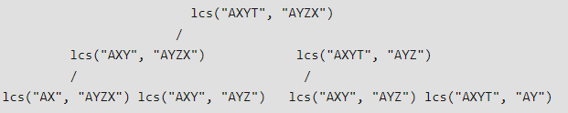
Overlapping Subproblems Property

Slide 62
Longest Common Subsequence
Example: Consider the input strings L₁ with length m and L₂ with length n such that L₁=“AGGTAB” and L₂=“GXTXAYB”

Slide 63
Longest Common Subsequence
Example: Consider the input strings L₁ with length m and L₂ with length n such that L₁=“AGGTAB” and L₂=“GXTXAYB”
There can be two cases. The last characters match or the last characters do not match.

Slide 64
Longest Common Subsequence
Example: Consider the input strings L₁ with length m and L₂ with length n such that L₁=“AGGTAB” and L₂=“GXTXAYB”
There can be two cases. The last characters match or the last characters do not match.
If the last characters match: Increment the length of LCS by 1 and process L₁[m-1] and L₂[n-1].

Slide 65
Longest Common Subsequence
Example: Consider the input strings L₁ with length m and L₂ with length n such that L₁=“AGGTAB” and L₂=“GXTXAYB”
There can be two cases. The last characters match or the last characters do not match.
If the last characters match: Increment the length of LCS by 1 and process L₁[m-1] and L₂[n-1].
If the last characters do not match: Find max( L₁[m-1] L₂[n], L₁[m] L₂[n-1] ).

Slide 66
Dynamic Programming
Approach:
If the last characters match:
  LCS[i][j] = LCS[i-1][j-1] + 1
If the last characters do not match:
  LCS[i][j] = max( LCS[i-1][j], LCS[i][j-1] )

Slide 67
Dynamic Programming
LCS | ø | A | G | G | T | A | B
ø | 0 | 0 | 0 | 0 | 0 | 0 | 0
G | 0
X | 0
T | 0
X | 0
A | 0
Y | 0
B | 0

Slide 68
Dynamic Programming
LCS | ø | A | G | G | T | A | B
ø | 0 | 0 | 0 | 0 | 0 | 0 | 0
G | 0 | 0
X | 0
T | 0
X | 0
A | 0
Y | 0
B | 0

Slide 69
Dynamic Programming
LCS | ø | A | G | G | T | A | B
ø | 0 | 0 | 0 | 0 | 0 | 0 | 0
G | 0 | 0 | 1
X | 0
T | 0
X | 0
A | 0
Y | 0
B | 0

Slide 70
Dynamic Programming
LCS | ø | A | G | G | T | A | B
ø | 0 | 0 | 0 | 0 | 0 | 0 | 0
G | 0 | 0 | 1 | 1
X | 0
T | 0
X | 0
A | 0
Y | 0
B | 0

Slide 71
Dynamic Programming
LCS | ø | A | G | G | T | A | B
ø | 0 | 0 | 0 | 0 | 0 | 0 | 0
G | 0 | 0 | 1 | 1 | 1
X | 0
T | 0
X | 0
A | 0
Y | 0
B | 0

Slide 72
Dynamic Programming
LCS | ø | A | G | G | T | A | B
ø | 0 | 0 | 0 | 0 | 0 | 0 | 0
G | 0 | 0 | 1 | 1 | 1 | 1
X | 0
T | 0
X | 0
A | 0
Y | 0
B | 0

Slide 73
Dynamic Programming
LCS | ø | A | G | G | T | A | B
ø | 0 | 0 | 0 | 0 | 0 | 0 | 0
G | 0 | 0 | 1 | 1 | 1 | 1 | 1
X | 0
T | 0
X | 0
A | 0
Y | 0
B | 0

Slide 74
Dynamic Programming
LCS | ø | A | G | G | T | A | B
ø | 0 | 0 | 0 | 0 | 0 | 0 | 0
G | 0 | 0 | 1 | 1 | 1 | 1 | 1
X | 0 | 0
T | 0
X | 0
A | 0
Y | 0
B | 0

Slide 75
Dynamic Programming
LCS | ø | A | G | G | T | A | B
ø | 0 | 0 | 0 | 0 | 0 | 0 | 0
G | 0 | 0 | 1 | 1 | 1 | 1 | 1
X | 0 | 0 | 1
T | 0
X | 0
A | 0
Y | 0
B | 0

Slide 76
Dynamic Programming
LCS | ø | A | G | G | T | A | B
ø | 0 | 0 | 0 | 0 | 0 | 0 | 0
G | 0 | 0 | 1 | 1 | 1 | 1 | 1
X | 0 | 0 | 1 | 1 | 1 | 1 | 1
T | 0
X | 0
A | 0
Y | 0
B | 0

Slide 77
Dynamic Programming
LCS | ø | A | G | G | T | A | B
ø | 0 | 0 | 0 | 0 | 0 | 0 | 0
G | 0 | 0 | 1 | 1 | 1 | 1 | 1
X | 0 | 0 | 1 | 1 | 1 | 1 | 1
T | 0 | 0
X | 0
A | 0
Y | 0
B | 0

Slide 78
Dynamic Programming
LCS | ø | A | G | G | T | A | B
ø | 0 | 0 | 0 | 0 | 0 | 0 | 0
G | 0 | 0 | 1 | 1 | 1 | 1 | 1
X | 0 | 0 | 1 | 1 | 1 | 1 | 1
T | 0 | 0 | 1
X | 0
A | 0
Y | 0
B | 0

Slide 79
Dynamic Programming
LCS | ø | A | G | G | T | A | B
ø | 0 | 0 | 0 | 0 | 0 | 0 | 0
G | 0 | 0 | 1 | 1 | 1 | 1 | 1
X | 0 | 0 | 1 | 1 | 1 | 1 | 1
T | 0 | 0 | 1 | 1
X | 0
A | 0
Y | 0
B | 0

Slide 80
Dynamic Programming
LCS | ø | A | G | G | T | A | B
ø | 0 | 0 | 0 | 0 | 0 | 0 | 0
G | 0 | 0 | 1 | 1 | 1 | 1 | 1
X | 0 | 0 | 1 | 1 | 1 | 1 | 1
T | 0 | 0 | 1 | 1 | 2
X | 0
A | 0
Y | 0
B | 0

Slide 81
Dynamic Programming
LCS | ø | A | G | G | T | A | B
ø | 0 | 0 | 0 | 0 | 0 | 0 | 0
G | 0 | 0 | 1 | 1 | 1 | 1 | 1
X | 0 | 0 | 1 | 1 | 1 | 1 | 1
T | 0 | 0 | 1 | 1 | 2 | 2 | 2
X | 0
A | 0
Y | 0
B | 0

Slide 82
Dynamic Programming
LCS | ø | A | G | G | T | A | B
ø | 0 | 0 | 0 | 0 | 0 | 0 | 0
G | 0 | 0 | 1 | 1 | 1 | 1 | 1
X | 0 | 0 | 1 | 1 | 1 | 1 | 1
T | 0 | 0 | 1 | 1 | 2 | 2 | 2
X | 0 | 0 | 1 | 1 | 2 | 2 | 2
A | 0
Y | 0
B | 0

Slide 83
Dynamic Programming
LCS | ø | A | G | G | T | A | B
ø | 0 | 0 | 0 | 0 | 0 | 0 | 0
G | 0 | 0 | 1 | 1 | 1 | 1 | 1
X | 0 | 0 | 1 | 1 | 1 | 1 | 1
T | 0 | 0 | 1 | 1 | 2 | 2 | 2
X | 0 | 0 | 1 | 1 | 2 | 2 | 2
A | 0 | 1 | 1 | 1 | 2 | 3 | 3
Y | 0
B | 0

Slide 84
Dynamic Programming
LCS | ø | A | G | G | T | A | B
ø | 0 | 0 | 0 | 0 | 0 | 0 | 0
G | 0 | 0 | 1 | 1 | 1 | 1 | 1
X | 0 | 0 | 1 | 1 | 1 | 1 | 1
T | 0 | 0 | 1 | 1 | 2 | 2 | 2
X | 0 | 0 | 1 | 1 | 2 | 2 | 2
A | 0 | 1 | 1 | 1 | 2 | 3 | 3
Y | 0 | 1 | 1 | 1 | 2 | 3 | 3
B | 0

Slide 85
Dynamic Programming
LCS | ø | A | G | G | T | A | B
ø | 0 | 0 | 0 | 0 | 0 | 0 | 0
G | 0 | 0 | 1 | 1 | 1 | 1 | 1
X | 0 | 0 | 1 | 1 | 1 | 1 | 1
T | 0 | 0 | 1 | 1 | 2 | 2 | 2
X | 0 | 0 | 1 | 1 | 2 | 2 | 2
A | 0 | 1 | 1 | 1 | 2 | 3 | 3
Y | 0 | 1 | 1 | 1 | 2 | 3 | 3
B | 0 | 1 | 1 | 1 | 2 | 3 | 4

Slide 86
Dynamic Programming
LCS | ø | A | G | G | T | A | B
ø | 0 | 0 | 0 | 0 | 0 | 0 | 0
G | 0 | 0 | 1 | 1 | 1 | 1 | 1
X | 0 | 0 | 1 | 1 | 1 | 1 | 1
T | 0 | 0 | 1 | 1 | 2 | 2 | 2
X | 0 | 0 | 1 | 1 | 2 | 2 | 2
A | 0 | 1 | 1 | 1 | 2 | 3 | 3
Y | 0 | 1 | 1 | 1 | 2 | 3 | 3
B | 0 | 1 | 1 | 1 | 2 | 3 | 4

Slide 87
Dynamic Programming
LCS | ø | A | G | G | T | A | B
ø | 0 | 0 | 0 | 0 | 0 | 0 | 0
G | 0 | 0 | 1 | 1 | 1 | 1 | 1
X | 0 | 0 | 1 | 1 | 1 | 1 | 1
T | 0 | 0 | 1 | 1 | 2 | 2 | 2
X | 0 | 0 | 1 | 1 | 2 | 2 | 2
A | 0 | 1 | 1 | 1 | 2 | 3 | 3
Y | 0 | 1 | 1 | 1 | 2 | 3 | 3
B | 0 | 1 | 1 | 1 | 2 | 3 | 4

Slide 88
Dynamic Programming
LCS | ø | A | G | G | T | A | B
ø | 0 | 0 | 0 | 0 | 0 | 0 | 0
G | 0 | 0 | 1 | 1 | 1 | 1 | 1
X | 0 | 0 | 1 | 1 | 1 | 1 | 1
T | 0 | 0 | 1 | 1 | 2 | 2 | 2
X | 0 | 0 | 1 | 1 | 2 | 2 | 2
A | 0 | 1 | 1 | 1 | 2 | 3 | 3
Y | 0 | 1 | 1 | 1 | 2 | 3 | 3
B | 0 | 1 | 1 | 1 | 2 | 3 | 4

Slide 89
Dynamic Programming
LCS | ø | A | G | G | T | A | B
ø | 0 | 0 | 0 | 0 | 0 | 0 | 0
G | 0 | 0 | 1 | 1 | 1 | 1 | 1
X | 0 | 0 | 1 | 1 | 1 | 1 | 1
T | 0 | 0 | 1 | 1 | 2 | 2 | 2
X | 0 | 0 | 1 | 1 | 2 | 2 | 2
A | 0 | 1 | 1 | 1 | 2 | 3 | 3
Y | 0 | 1 | 1 | 1 | 2 | 3 | 3
B | 0 | 1 | 1 | 1 | 2 | 3 | 4

Slide 90
Dynamic Programming
LCS | ø | A | G | G | T | A | B
ø | 0 | 0 | 0 | 0 | 0 | 0 | 0
G | 0 | 0 | 1 | 1 | 1 | 1 | 1
X | 0 | 0 | 1 | 1 | 1 | 1 | 1
T | 0 | 0 | 1 | 1 | 2 | 2 | 2
X | 0 | 0 | 1 | 1 | 2 | 2 | 2
A | 0 | 1 | 1 | 1 | 2 | 3 | 3
Y | 0 | 1 | 1 | 1 | 2 | 3 | 3
B | 0 | 1 | 1 | 1 | 2 | 3 | 4

Slide 91
Dynamic Programming
LCS | ø | A | G | G | T | A | B
ø | 0 | 0 | 0 | 0 | 0 | 0 | 0
G | 0 | 0 | 1 | 1 | 1 | 1 | 1
X | 0 | 0 | 1 | 1 | 1 | 1 | 1
T | 0 | 0 | 1 | 1 | 2 | 2 | 2
X | 0 | 0 | 1 | 1 | 2 | 2 | 2
A | 0 | 1 | 1 | 1 | 2 | 3 | 3
Y | 0 | 1 | 1 | 1 | 2 | 3 | 3
B | 0 | 1 | 1 | 1 | 2 | 3 | 4

Slide 92
Dynamic Programming
LCS | ø | A | G | G | T | A | B
ø | 0 | 0 | 0 | 0 | 0 | 0 | 0
G | 0 | 0 | 1 | 1 | 1 | 1 | 1
X | 0 | 0 | 1 | 1 | 1 | 1 | 1
T | 0 | 0 | 1 | 1 | 2 | 2 | 2
X | 0 | 0 | 1 | 1 | 2 | 2 | 2
A | 0 | 1 | 1 | 1 | 2 | 3 | 3
Y | 0 | 1 | 1 | 1 | 2 | 3 | 3
B | 0 | 1 | 1 | 1 | 2 | 3 | 4

Slide 93
Dynamic Programming
LCS | ø | A | G | G | T | A | B
ø | 0 | 0 | 0 | 0 | 0 | 0 | 0
G | 0 | 0 | 1 | 1 | 1 | 1 | 1
X | 0 | 0 | 1 | 1 | 1 | 1 | 1
T | 0 | 0 | 1 | 1 | 2 | 2 | 2
X | 0 | 0 | 1 | 1 | 2 | 2 | 2
A | 0 | 1 | 1 | 1 | 2 | 3 | 3
Y | 0 | 1 | 1 | 1 | 2 | 3 | 3
B | 0 | 1 | 1 | 1 | 2 | 3 | 4

Slide 94
Dynamic Programming
LCS | ø | A | G | G | T | A | B
ø | 0 | 0 | 0 | 0 | 0 | 0 | 0
G | 0 | 0 | 1 | 1 | 1 | 1 | 1
X | 0 | 0 | 1 | 1 | 1 | 1 | 1
T | 0 | 0 | 1 | 1 | 2 | 2 | 2
X | 0 | 0 | 1 | 1 | 2 | 2 | 2
A | 0 | 1 | 1 | 1 | 2 | 3 | 3
Y | 0 | 1 | 1 | 1 | 2 | 3 | 3
B | 0 | 1 | 1 | 1 | 2 | 3 | 4

Slide 95
Dynamic Programming
LCS | ø | A | G | G | T | A | B
ø | 0 | 0 | 0 | 0 | 0 | 0 | 0
G | 0 | 0 | 1 | 1 | 1 | 1 | 1
X | 0 | 0 | 1 | 1 | 1 | 1 | 1
T | 0 | 0 | 1 | 1 | 2 | 2 | 2
X | 0 | 0 | 1 | 1 | 2 | 2 | 2
A | 0 | 1 | 1 | 1 | 2 | 3 | 3
Y | 0 | 1 | 1 | 1 | 2 | 3 | 3
B | 0 | 1 | 1 | 1 | 2 | 3 | 4
GTAB → Length of LCS = 4

Slide 96
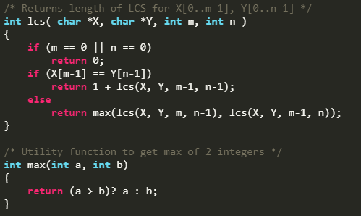
Recursive Implementation

Slide 97
Recursive Implementation
→ Time Complextity: O(2^{n})

Slide 98
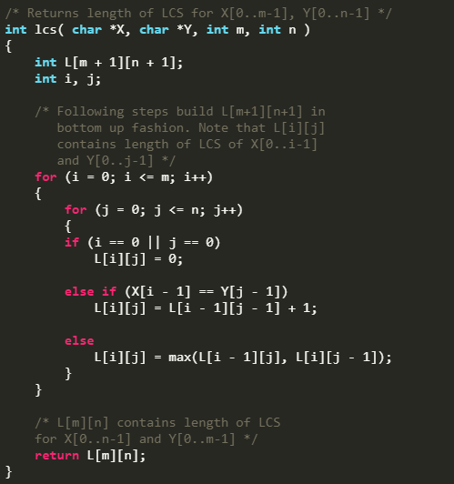
Dynamic Programming
Tabulation

Slide 99
Dynamic Programming
Tabulation
→ Time Complextity: O(mn)

Slide 100
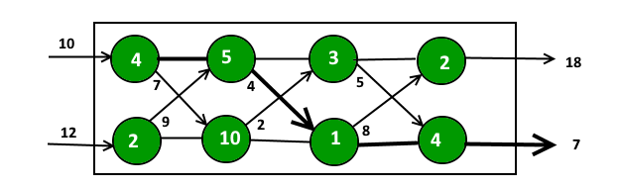
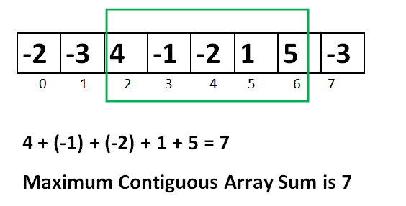
Other Dynamic Programming Questions
Assembly Line Scheduling
Largest Sum Contiguous Subarray

Slide 101
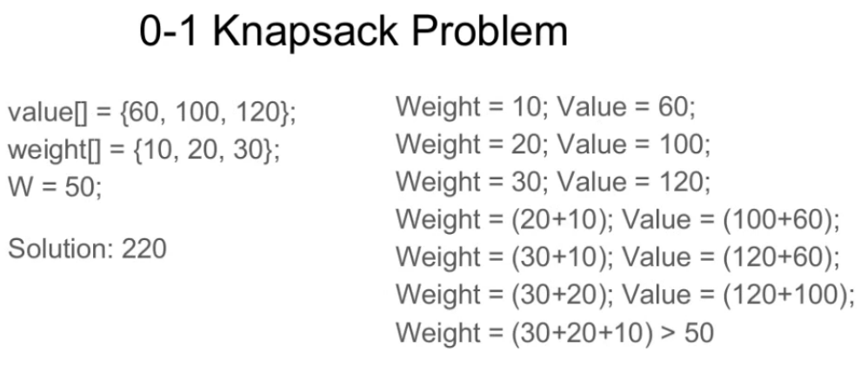
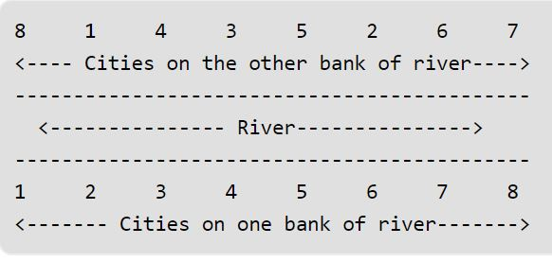
Other Dynamic Programming Questions
0-1 Knapsack Problem
Building Bridges

Slide 102
Reference
Charles Leiserson and Piotr Indyk, “Introduction to Algorithms”, September 29, 2004
https://www.geeksforgeeks.org

