Slide 1
Backtracking
SWE2016-44

Slide 2
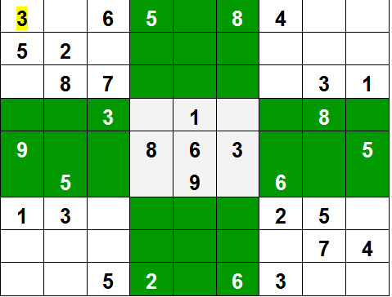
Introduction
Backtracking: an algorithmic-technique for solving problems recursively by trying to build a solution incrementally, one piece at a time, removing those solutions that fail to satisfy the constraints of the problem at any point of time.
Sudoku

Slide 3
Rat in a Maze

Slide 4
Problem Statement
A Maze is given as NxN binary matrix of blocks.
The source or start block is the upper left most block i.e., maze[0][0] and destination block is lower rightmost block i.e., maze[N-1][N-1].
A rat starts from source and has to reach destination.
The rat can move only in two directions: right and down in the matrix.

Slide 5
Solution
Let us solve our problem for the following maze

Slide 6
Solution
The rat can move on the white block only.

Slide 7
Solution
It starts from the top-left and has to go to the bottom right

Slide 8
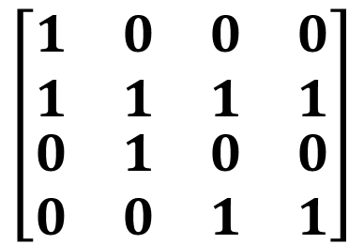
Solution
In the maze matrix, 0 means the block is dead end and 1 means the block can be used in the path from source to destination.
$$\left[\begin{matrix}\begin{matrix}1 & 0 \\ 1 & 1\end{matrix} & \begin{matrix}0 & 0 \\ 1 & 1\end{matrix} \\ \begin{matrix}0 & 1 \\ 0 & 0\end{matrix} & \begin{matrix}0 & 0 \\ 1 & 1\end{matrix}\end{matrix}\right]$$

Slide 9
Solution
Let’s define a function solveMazeUtil(maze, x, y, sol)
maze is the matrix representing the blocked and unblocked bocks in the maze
x, y is the x and y coordinates of the position of the Rat
sol holds the path traversed by the rat so far, also in the form of a matrix

Slide 10
Solution
The function solveMazeUtil(maze, x, y, sol) will return false if there’s no path possible to reach the destination and true if any path is found.
The function will modify the sol matrix with the required path from current position (x, y) to destination (N-1, N-1).

Slide 11
Solution
We will initiate the function at the start position and it will return the required path in the sol matrix.
solveMazeUtil(maze[4][4], 0, 0, sol[4][4])

Slide 12
solveMazeUtil(maze[4][4], 0, 0, sol[4][4])
Now, let’s define the function so that it translates the maze using backtracking and finds the required path.

Slide 13
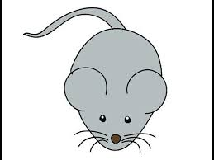
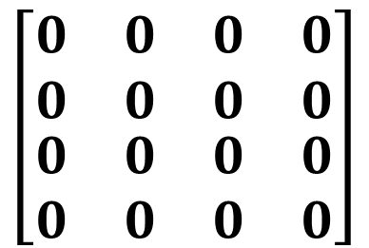
solveMazeUtil(maze[4][4], 0, 0, sol[4][4])
For the current situation, let’s place the Rat at the start position.
sol Matrix
$$\left[\begin{matrix}\begin{matrix}0 & 0 \\ 0 & 0\end{matrix} & \begin{matrix}0 & 0 \\ 0 & 0\end{matrix} \\ \begin{matrix}0 & 0 \\ 0 & 0\end{matrix} & \begin{matrix}0 & 0 \\ 0 & 0\end{matrix}\end{matrix}\right]$$

Slide 14
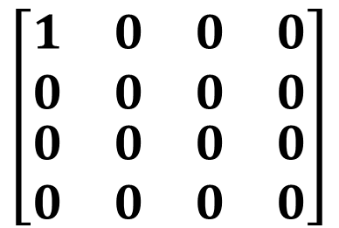
solveMazeUtil(maze[4][4], 0, 0, sol[4][4])
check
if going in x direction i.e., solveMazeUtil(maze[4][4], 1, 0, sol[4][4]),
else go in y direction i.e., solveMazeUtil(maze[4][4], 0, 1, sol[4][4])
x
y
sol Matrix
$$\left[\begin{matrix}\begin{matrix}1 & 0 \\ 0 & 0\end{matrix} & \begin{matrix}0 & 0 \\ 0 & 0\end{matrix} \\ \begin{matrix}0 & 0 \\ 0 & 0\end{matrix} & \begin{matrix}0 & 0 \\ 0 & 0\end{matrix}\end{matrix}\right]$$

Slide 15
solveMazeUtil(maze[4][4], 0, 0, sol[4][4])
solveMazeUtil(maze[4][4], 1, 0, sol[4][4])
solveMazeUtil(maze[4][4], 0, 1, sol[4][4])
sol Matrix
$$\left[\begin{matrix}\begin{matrix}1 & 0 \\ 0 & 0\end{matrix} & \begin{matrix}0 & 0 \\ 0 & 0\end{matrix} \\ \begin{matrix}0 & 0 \\ 0 & 0\end{matrix} & \begin{matrix}0 & 0 \\ 0 & 0\end{matrix}\end{matrix}\right]$$

Slide 16
solveMazeUtil(maze[4][4], 0, 0, sol[4][4])
solveMazeUtil(maze[4][4], 1, 0, sol[4][4])
solveMazeUtil(maze[4][4], 0, 1, sol[4][4])
cannot go in x direction
sol Matrix
$$\left[\begin{matrix}\begin{matrix}1 & 0 \\ 0 & 0\end{matrix} & \begin{matrix}0 & 0 \\ 0 & 0\end{matrix} \\ \begin{matrix}0 & 0 \\ 0 & 0\end{matrix} & \begin{matrix}0 & 0 \\ 0 & 0\end{matrix}\end{matrix}\right]$$

Slide 17
solveMazeUtil(maze[4][4], 0, 0, sol[4][4])
solveMazeUtil(maze[4][4], 1, 0, sol[4][4])
solveMazeUtil(maze[4][4], 0, 1, sol[4][4])
sol Matrix
$$\left[\begin{matrix}\begin{matrix}1 & 0 \\ 0 & 0\end{matrix} & \begin{matrix}0 & 0 \\ 0 & 0\end{matrix} \\ \begin{matrix}0 & 0 \\ 0 & 0\end{matrix} & \begin{matrix}0 & 0 \\ 0 & 0\end{matrix}\end{matrix}\right]$$

Slide 18
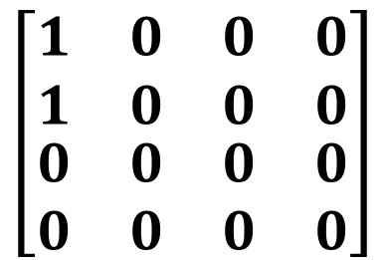
solveMazeUtil(maze[4][4], 0, 0, sol[4][4])
solveMazeUtil(maze[4][4], 1, 0, sol[4][4])
solveMazeUtil(maze[4][4], 0, 1, sol[4][4])
solveMazeUtil(maze[4][4], 1, 1, sol[4][4])
solveMazeUtil(maze[4][4], 0, 2, sol[4][4])
sol Matrix
$$\left[\begin{matrix}\begin{matrix}1 & 0 \\ 1 & 0\end{matrix} & \begin{matrix}0 & 0 \\ 0 & 0\end{matrix} \\ \begin{matrix}0 & 0 \\ 0 & 0\end{matrix} & \begin{matrix}0 & 0 \\ 0 & 0\end{matrix}\end{matrix}\right]$$

Slide 19
solveMazeUtil(maze[4][4], 0, 0, sol[4][4])
solveMazeUtil(maze[4][4], 1, 0, sol[4][4])
solveMazeUtil(maze[4][4], 0, 1, sol[4][4])
solveMazeUtil(maze[4][4], 1, 1, sol[4][4])
solveMazeUtil(maze[4][4], 0, 2, sol[4][4])
sol Matrix
$$\left[\begin{matrix}\begin{matrix}1 & 0 \\ 1 & 0\end{matrix} & \begin{matrix}0 & 0 \\ 0 & 0\end{matrix} \\ \begin{matrix}0 & 0 \\ 0 & 0\end{matrix} & \begin{matrix}0 & 0 \\ 0 & 0\end{matrix}\end{matrix}\right]$$

Slide 20
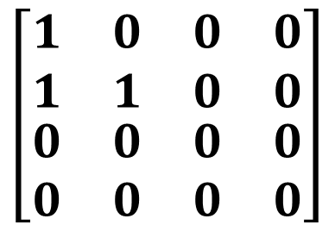
solveMazeUtil(maze[4][4], 0, 0, sol[4][4])
solveMazeUtil(maze[4][4], 1, 0, sol[4][4])
solveMazeUtil(maze[4][4], 0, 1, sol[4][4])
solveMazeUtil(maze[4][4], 1, 1, sol[4][4])
solveMazeUtil(maze[4][4], 0, 2, sol[4][4])
solveMazeUtil(maze[4][4], 2, 1, sol[4][4])
solveMazeUtil(maze[4][4], 1, 2, sol[4][4])
sol Matrix
$$\left[\begin{matrix}\begin{matrix}1 & 0 \\ 1 & 1\end{matrix} & \begin{matrix}0 & 0 \\ 0 & 0\end{matrix} \\ \begin{matrix}0 & 0 \\ 0 & 0\end{matrix} & \begin{matrix}0 & 0 \\ 0 & 0\end{matrix}\end{matrix}\right]$$

Slide 21
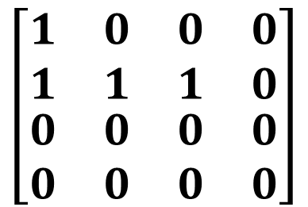
solveMazeUtil(maze[4][4], 0, 0, sol[4][4])
solveMazeUtil(maze[4][4], 1, 0, sol[4][4])
solveMazeUtil(maze[4][4], 0, 1, sol[4][4])
solveMazeUtil(maze[4][4], 1, 1, sol[4][4])
solveMazeUtil(maze[4][4], 0, 2, sol[4][4])
solveMazeUtil(maze[4][4], 2, 1, sol[4][4])
solveMazeUtil(maze[4][4], 1, 2, sol[4][4])
solveMazeUtil(maze[4][4], 3, 1, sol[4][4])
solveMazeUtil(maze[4][4], 2, 2, sol[4][4])
sol Matrix
$$\left[\begin{matrix}\begin{matrix}1 & 0 \\ 1 & 1\end{matrix} & \begin{matrix}0 & 0 \\ 1 & 0\end{matrix} \\ \begin{matrix}0 & 0 \\ 0 & 0\end{matrix} & \begin{matrix}0 & 0 \\ 0 & 0\end{matrix}\end{matrix}\right]$$

Slide 22
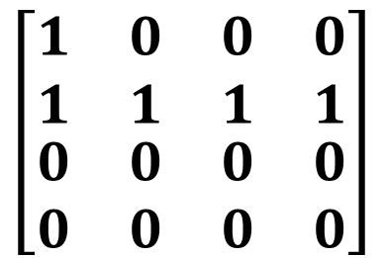
solveMazeUtil(maze[4][4], 0, 0, sol[4][4])
solveMazeUtil(maze[4][4], 1, 0, sol[4][4])
solveMazeUtil(maze[4][4], 0, 1, sol[4][4])
solveMazeUtil(maze[4][4], 1, 1, sol[4][4])
solveMazeUtil(maze[4][4], 0, 2, sol[4][4])
solveMazeUtil(maze[4][4], 2, 1, sol[4][4])
solveMazeUtil(maze[4][4], 1, 2, sol[4][4])
solveMazeUtil(maze[4][4], 3, 1, sol[4][4])
solveMazeUtil(maze[4][4], 2, 2, sol[4][4])
Not possible to go to (4,1)
solveMazeUtil(maze[4][4], 3, 2, sol[4][4])
sol Matrix
$$\left[\begin{matrix}\begin{matrix}1 & 0 \\ 1 & 1\end{matrix} & \begin{matrix}0 & 0 \\ 1 & 1\end{matrix} \\ \begin{matrix}0 & 0 \\ 0 & 0\end{matrix} & \begin{matrix}0 & 0 \\ 0 & 0\end{matrix}\end{matrix}\right]$$

Slide 23
solveMazeUtil(maze[4][4], 0, 0, sol[4][4])
solveMazeUtil(maze[4][4], 1, 0, sol[4][4])
solveMazeUtil(maze[4][4], 0, 1, sol[4][4])
solveMazeUtil(maze[4][4], 1, 1, sol[4][4])
solveMazeUtil(maze[4][4], 0, 2, sol[4][4])
solveMazeUtil(maze[4][4], 2, 1, sol[4][4])
solveMazeUtil(maze[4][4], 1, 2, sol[4][4])
solveMazeUtil(maze[4][4], 3, 1, sol[4][4])
solveMazeUtil(maze[4][4], 2, 2, sol[4][4])
Not possible to go to (4,1)
solveMazeUtil(maze[4][4], 3, 2, sol[4][4])
cannot go in y direction
sol Matrix
So we backtrack
$$\left[\begin{matrix}\begin{matrix}1 & 0 \\ 1 & 1\end{matrix} & \begin{matrix}0 & 0 \\ 1 & 1\end{matrix} \\ \begin{matrix}0 & 0 \\ 0 & 0\end{matrix} & \begin{matrix}0 & 0 \\ 0 & 0\end{matrix}\end{matrix}\right]$$

Slide 24
solveMazeUtil(maze[4][4], 0, 0, sol[4][4])
solveMazeUtil(maze[4][4], 1, 0, sol[4][4])
solveMazeUtil(maze[4][4], 0, 1, sol[4][4])
solveMazeUtil(maze[4][4], 1, 1, sol[4][4])
solveMazeUtil(maze[4][4], 0, 2, sol[4][4])
solveMazeUtil(maze[4][4], 2, 1, sol[4][4])
solveMazeUtil(maze[4][4], 1, 2, sol[4][4])
solveMazeUtil(maze[4][4], 3, 1, sol[4][4])
solveMazeUtil(maze[4][4], 2, 2, sol[4][4])
sol Matrix
$$\left[\begin{matrix}\begin{matrix}1 & 0 \\ 1 & 1\end{matrix} & \begin{matrix}0 & 0 \\ 1 & 1\end{matrix} \\ \begin{matrix}0 & 0 \\ 0 & 0\end{matrix} & \begin{matrix}0 & 0 \\ 0 & 0\end{matrix}\end{matrix}\right]$$

Slide 25
solveMazeUtil(maze[4][4], 0, 0, sol[4][4])
solveMazeUtil(maze[4][4], 1, 0, sol[4][4])
solveMazeUtil(maze[4][4], 0, 1, sol[4][4])
solveMazeUtil(maze[4][4], 1, 1, sol[4][4])
solveMazeUtil(maze[4][4], 0, 2, sol[4][4])
solveMazeUtil(maze[4][4], 2, 1, sol[4][4])
solveMazeUtil(maze[4][4], 1, 2, sol[4][4])
solveMazeUtil(maze[4][4], 3, 1, sol[4][4])
solveMazeUtil(maze[4][4], 2, 2, sol[4][4])
cannot go in y direction
sol Matrix
$$\left[\begin{matrix}\begin{matrix}1 & 0 \\ 1 & 1\end{matrix} & \begin{matrix}0 & 0 \\ 1 & 0\end{matrix} \\ \begin{matrix}0 & 0 \\ 0 & 0\end{matrix} & \begin{matrix}0 & 0 \\ 0 & 0\end{matrix}\end{matrix}\right]$$

Slide 26
solveMazeUtil(maze[4][4], 0, 0, sol[4][4])
solveMazeUtil(maze[4][4], 1, 0, sol[4][4])
solveMazeUtil(maze[4][4], 0, 1, sol[4][4])
solveMazeUtil(maze[4][4], 1, 1, sol[4][4])
solveMazeUtil(maze[4][4], 0, 2, sol[4][4])
solveMazeUtil(maze[4][4], 2, 1, sol[4][4])
solveMazeUtil(maze[4][4], 1, 2, sol[4][4])
sol Matrix
$$\left[\begin{matrix}\begin{matrix}1 & 0 \\ 1 & 1\end{matrix} & \begin{matrix}0 & 0 \\ 1 & 0\end{matrix} \\ \begin{matrix}0 & 0 \\ 0 & 0\end{matrix} & \begin{matrix}0 & 0 \\ 0 & 0\end{matrix}\end{matrix}\right]$$

Slide 27
solveMazeUtil(maze[4][4], 0, 0, sol[4][4])
solveMazeUtil(maze[4][4], 1, 0, sol[4][4])
solveMazeUtil(maze[4][4], 0, 1, sol[4][4])
solveMazeUtil(maze[4][4], 1, 1, sol[4][4])
solveMazeUtil(maze[4][4], 0, 2, sol[4][4])
solveMazeUtil(maze[4][4], 2, 1, sol[4][4])
solveMazeUtil(maze[4][4], 1, 2, sol[4][4])
sol Matrix
$$\left[\begin{matrix}\begin{matrix}1 & 0 \\ 1 & 1\end{matrix} & \begin{matrix}0 & 0 \\ 0 & 0\end{matrix} \\ \begin{matrix}0 & 0 \\ 0 & 0\end{matrix} & \begin{matrix}0 & 0 \\ 0 & 0\end{matrix}\end{matrix}\right]$$

Slide 28
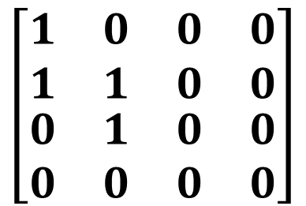
solveMazeUtil(maze[4][4], 0, 0, sol[4][4])
solveMazeUtil(maze[4][4], 1, 0, sol[4][4])
solveMazeUtil(maze[4][4], 0, 1, sol[4][4])
solveMazeUtil(maze[4][4], 1, 1, sol[4][4])
solveMazeUtil(maze[4][4], 0, 2, sol[4][4])
solveMazeUtil(maze[4][4], 2, 1, sol[4][4])
solveMazeUtil(maze[4][4], 1, 2, sol[4][4])
solveMazeUtil(maze[4][4], 2, 2, sol[4][4])
solveMazeUtil(maze[4][4], 1, 3, sol[4][4])
sol Matrix
$$\left[\begin{matrix}\begin{matrix}1 & 0 \\ 1 & 1\end{matrix} & \begin{matrix}0 & 0 \\ 0 & 0\end{matrix} \\ \begin{matrix}0 & 1 \\ 0 & 0\end{matrix} & \begin{matrix}0 & 0 \\ 0 & 0\end{matrix}\end{matrix}\right]$$

Slide 29
solveMazeUtil(maze[4][4], 0, 0, sol[4][4])
solveMazeUtil(maze[4][4], 1, 0, sol[4][4])
solveMazeUtil(maze[4][4], 0, 1, sol[4][4])
solveMazeUtil(maze[4][4], 1, 1, sol[4][4])
solveMazeUtil(maze[4][4], 0, 2, sol[4][4])
solveMazeUtil(maze[4][4], 2, 1, sol[4][4])
solveMazeUtil(maze[4][4], 1, 2, sol[4][4])
solveMazeUtil(maze[4][4], 2, 2, sol[4][4])
solveMazeUtil(maze[4][4], 1, 3, sol[4][4])
cannot go in x direction
sol Matrix
$$\left[\begin{matrix}\begin{matrix}1 & 0 \\ 1 & 1\end{matrix} & \begin{matrix}0 & 0 \\ 0 & 0\end{matrix} \\ \begin{matrix}0 & 1 \\ 0 & 0\end{matrix} & \begin{matrix}0 & 0 \\ 0 & 0\end{matrix}\end{matrix}\right]$$

Slide 30
solveMazeUtil(maze[4][4], 0, 0, sol[4][4])
solveMazeUtil(maze[4][4], 1, 0, sol[4][4])
solveMazeUtil(maze[4][4], 0, 1, sol[4][4])
solveMazeUtil(maze[4][4], 1, 1, sol[4][4])
solveMazeUtil(maze[4][4], 0, 2, sol[4][4])
solveMazeUtil(maze[4][4], 2, 1, sol[4][4])
solveMazeUtil(maze[4][4], 1, 2, sol[4][4])
solveMazeUtil(maze[4][4], 2, 2, sol[4][4])
solveMazeUtil(maze[4][4], 1, 3, sol[4][4])
sol Matrix
$$\left[\begin{matrix}\begin{matrix}1 & 0 \\ 1 & 1\end{matrix} & \begin{matrix}0 & 0 \\ 0 & 0\end{matrix} \\ \begin{matrix}0 & 1 \\ 0 & 0\end{matrix} & \begin{matrix}0 & 0 \\ 0 & 0\end{matrix}\end{matrix}\right]$$

Slide 31
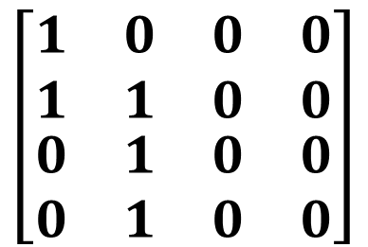
solveMazeUtil(maze[4][4], 0, 0, sol[4][4])
solveMazeUtil(maze[4][4], 1, 0, sol[4][4])
solveMazeUtil(maze[4][4], 0, 1, sol[4][4])
solveMazeUtil(maze[4][4], 1, 1, sol[4][4])
solveMazeUtil(maze[4][4], 0, 2, sol[4][4])
solveMazeUtil(maze[4][4], 2, 1, sol[4][4])
solveMazeUtil(maze[4][4], 1, 2, sol[4][4])
solveMazeUtil(maze[4][4], 2, 2, sol[4][4])
solveMazeUtil(maze[4][4], 1, 3, sol[4][4])
solveMazeUtil(maze[4][4], 2, 3, sol[4][4])
Not possible to go to (1,4)
sol Matrix
$$\left[\begin{matrix}\begin{matrix}1 & 0 \\ 1 & 1\end{matrix} & \begin{matrix}0 & 0 \\ 0 & 0\end{matrix} \\ \begin{matrix}0 & 1 \\ 0 & 1\end{matrix} & \begin{matrix}0 & 0 \\ 0 & 0\end{matrix}\end{matrix}\right]$$

Slide 32
solveMazeUtil(maze[4][4], 1, 0, sol[4][4])
solveMazeUtil(maze[4][4], 0, 1, sol[4][4])
solveMazeUtil(maze[4][4], 1, 1, sol[4][4])
solveMazeUtil(maze[4][4], 0, 2, sol[4][4])
solveMazeUtil(maze[4][4], 2, 1, sol[4][4])
solveMazeUtil(maze[4][4], 1, 2, sol[4][4])
solveMazeUtil(maze[4][4], 2, 2, sol[4][4])
solveMazeUtil(maze[4][4], 1, 3, sol[4][4])
solveMazeUtil(maze[4][4], 2, 3, sol[4][4])
Not possible to go to (1,4)
sol Matrix
$$\left[\begin{matrix}\begin{matrix}1 & 0 \\ 1 & 1\end{matrix} & \begin{matrix}0 & 0 \\ 0 & 0\end{matrix} \\ \begin{matrix}0 & 1 \\ 0 & 1\end{matrix} & \begin{matrix}0 & 0 \\ 0 & 0\end{matrix}\end{matrix}\right]$$

Slide 33
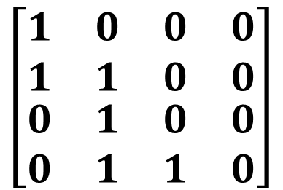
solveMazeUtil(maze[4][4], 1, 0, sol[4][4])
solveMazeUtil(maze[4][4], 0, 1, sol[4][4])
solveMazeUtil(maze[4][4], 1, 1, sol[4][4])
solveMazeUtil(maze[4][4], 0, 2, sol[4][4])
solveMazeUtil(maze[4][4], 2, 1, sol[4][4])
solveMazeUtil(maze[4][4], 1, 2, sol[4][4])
solveMazeUtil(maze[4][4], 2, 2, sol[4][4])
solveMazeUtil(maze[4][4], 1, 3, sol[4][4])
solveMazeUtil(maze[4][4], 2, 3, sol[4][4])
Not possible to go to (1,4)
solveMazeUtil(maze[4][4], 3, 3, sol[4][4])
Not possible to go to (2,4)
sol Matrix
$$\left[\begin{matrix}\begin{matrix}1 & 0 \\ 1 & 1\end{matrix} & \begin{matrix}0 & 0 \\ 0 & 0\end{matrix} \\ \begin{matrix}0 & 1 \\ 0 & 1\end{matrix} & \begin{matrix}0 & 0 \\ 1 & 0\end{matrix}\end{matrix}\right]$$

Slide 34
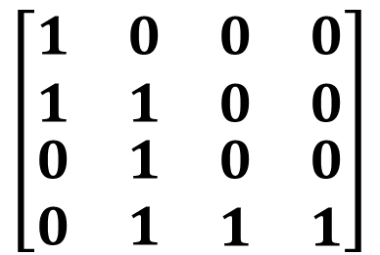
solveMazeUtil(maze[4][4], 1, 0, sol[4][4])
solveMazeUtil(maze[4][4], 0, 1, sol[4][4])
solveMazeUtil(maze[4][4], 1, 1, sol[4][4])
solveMazeUtil(maze[4][4], 0, 2, sol[4][4])
solveMazeUtil(maze[4][4], 2, 1, sol[4][4])
solveMazeUtil(maze[4][4], 1, 2, sol[4][4])
solveMazeUtil(maze[4][4], 2, 2, sol[4][4])
solveMazeUtil(maze[4][4], 1, 3, sol[4][4])
solveMazeUtil(maze[4][4], 2, 3, sol[4][4])
Not possible to go to (1,4)
solveMazeUtil(maze[4][4], 3, 3, sol[4][4])
Not possible to go to (2,4)
sol Matrix
$$\left[\begin{matrix}\begin{matrix}1 & 0 \\ 1 & 1\end{matrix} & \begin{matrix}0 & 0 \\ 0 & 0\end{matrix} \\ \begin{matrix}0 & 1 \\ 0 & 1\end{matrix} & \begin{matrix}0 & 0 \\ 1 & 1\end{matrix}\end{matrix}\right]$$

Slide 35
Pseudo Code
If destination is reached
  print the solution matrix
Else
  Mark current cell in solution matrix as 1.
  Move forward in the horizontal direction and recursively check if this move leads to a solution.
  If the move chosen in the above step doesn’t lead to a solution then move down and check if this move leads to a solution.
  If none of the above solutions works then unmark this cell as 0 (BACKTRACK) and return false.

Slide 36
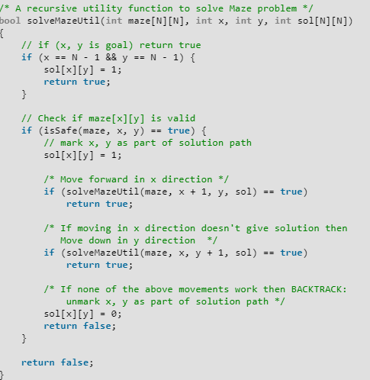
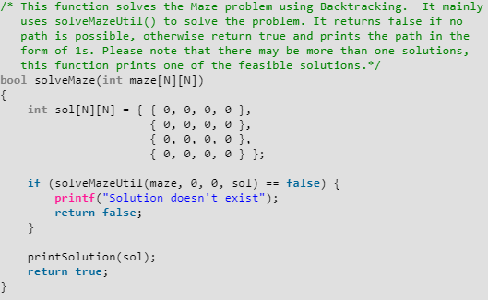
Implementation

Slide 37
Time Complexity
O(N): N is the cell number.

Slide 38
N Queen Problem

Slide 39
Problem Statement
N Queen is the problem of placing N class queens on an NxN chessboard so that no two queens attack each other.

Slide 40
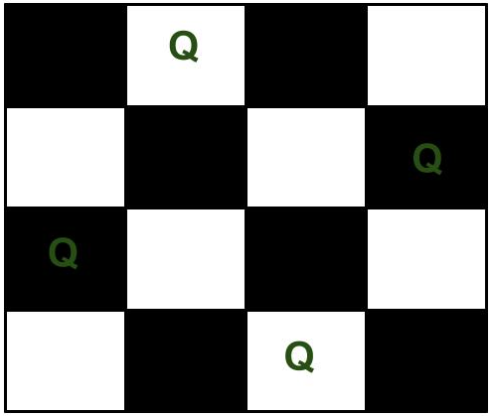
Problem Statement
For example, the following is one of the solutions for 4 Queen problem.
Q
Q
Q
Q
Each queen is placed such that it does not attack any other queen on the board

Slide 41
Problem Statement
Let suppose a Queen was placed at square (1, 2).
Attack Points for (1, 2)
0
1
2
3
row
(1, 0)
(1, 2)
(1, 3)
col
(0, 2)
(2, 2)
(3, 2)
diag1
(0, 1)
(2, 3)
diag2
(3, 0)
(2, 1)
(0, 3)
0
1
Q
2
row-col
row+col
3
We should avoid the attack points as other queens’ locations.

Slide 42
Solutions
Positions:
Col
0
0
1
2
3
1
0
1
2
3
0
1
2
3
0
1
2
3
2
0
1
2
3
0
1
2
3
0
1
2
3
3
0
1
2
3
0
1
2
3
0
1
2
3

Slide 43
Solutions
Positions:
Col
(0, 0)
0
Q
0
1
2
3
1
0
1
2
3
0
1
2
3
0
1
2
3
Q
2
0
1
2
3
0
1
2
3
0
1
2
3
3
0
1
2
3
0
1
2
3
0
1
2
3

Slide 44
Solutions
Positions:
Col
(0, 0)
0
Q
(2, 1)
0
1
2
3
1
 |  | Q
0
1
2
3
0
1
2
3
0
1
2
3
F
Q
2
0
1
2
3
0
1
2
3
0
1
2
3
Q
3
0
1
2
3
0
1
2
3
0
1
2
3

Slide 45
Solutions
Positions:
Col
(0, 0)
0
Q
0
1
2
3
1
0
1
2
3
0
1
2
3
0
1
2
3
Q
2
0
1
2
3
0
1
2
3
0
1
2
3
3
0
1
2
3
0
1
2
3
0
1
2
3

Slide 46
Solutions
Positions:
Col
(0, 0)
0
Q
(3, 1)
0
1
2
3
1
 |  |  | Q
0
1
2
3
0
1
2
3
0
1
2
3
Q
2
0
1
2
3
0
1
2
3
0
1
2
3
3
0
1
2
3
0
1
2
3
0
1
2
3
Q

Slide 47
Solutions
Positions:
Col
(0, 0)
0
Q
(3, 1)
0
1
2
3
(1, 2)
1
 |  |  | Q
0
1
2
3
0
1
2
3
0
1
2
3
Q
2
 | Q
Q
0
1
2
3
0
1
2
3
0
1
2
3
F
3
0
1
2
3
0
1
2
3
0
1
2
3
Q

Slide 48
Solutions
Positions:
Col
(0, 0)
0
Q
(3, 1)
0
1
2
3
1
 |  |  | Q
0
1
2
3
0
1
2
3
0
1
2
3
F
Q
2
0
1
2
3
0
1
2
3
0
1
2
3
3
0
1
2
3
0
1
2
3
0
1
2
3
Q

Slide 49
Solutions
Positions:
Col
(0, 0)
0
Q
0
1
2
3
F
1
0
1
2
3
0
1
2
3
0
1
2
3
Q
2
0
1
2
3
0
1
2
3
0
1
2
3
3
0
1
2
3
0
1
2
3
0
1
2
3

Slide 50
Solutions
Positions:
Col
0
0
1
2
3
1
0
1
2
3
0
1
2
3
0
1
2
3
2
0
1
2
3
0
1
2
3
0
1
2
3
3
0
1
2
3
0
1
2
3
0
1
2
3

Slide 51
Solutions
Positions:
Col
(1, 0)
0
 | Q
0
1
2
3
1
0
1
2
3
0
1
2
3
0
1
2
3
2
Q
0
1
2
3
0
1
2
3
0
1
2
3
3
0
1
2
3
0
1
2
3
0
1
2
3

Slide 52
Solutions
Positions:
Col
(1, 0)
0
 | Q
(3, 1)
0
1
2
3
1
 |  |  | Q
0
1
2
3
0
1
2
3
0
1
2
3
2
Q
0
1
2
3
0
1
2
3
0
1
2
3
3
0
1
2
3
0
1
2
3
0
1
2
3
Q

Slide 53
Solutions
Positions:
Col
(1, 0)
0
 | Q
(3, 1)
0
1
2
3
(0, 2)
1
 |  |  | Q
0
1
2
3
0
1
2
3
0
1
2
3
Q
2
Q
Q
0
1
2
3
0
1
2
3
0
1
2
3
3
0
1
2
3
0
1
2
3
0
1
2
3
Q

Slide 54
Solutions
Positions:
Col
(1, 0)
0
 | Q
(3, 1)
0
1
2
3
(0, 2)
(2, 3)
1
 |  |  | Q
0
1
2
3
0
1
2
3
0
1
2
3
Q
2
Q
Q
0
1
2
3
0
1
2
3
0
1
2
3
Q
3
 |  | Q
0
1
2
3
0
1
2
3
0
1
2
3
Q

Slide 55
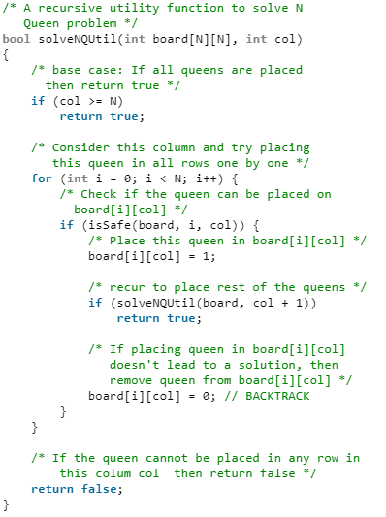
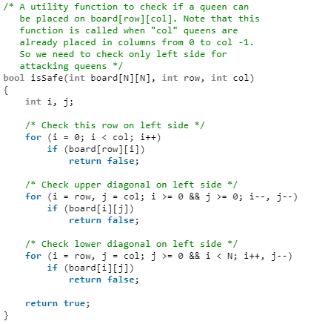
Implementation

Slide 56
Time Complexity
T(n) = n T(n-1) + O(n²)
→ O(n!)

Slide 57
Reference
Charles Leiserson and Piotr Indyk, “Introduction to Algorithms”, September 29, 2004
https://www.geeksforgeeks.org

