Slide 1
Dynamic Programming III
SWE2016-44

Slide 2
Edit Distance

Slide 3
Edit Distance
Given two strings string₁ and string₂ and below operations that can be performed on string₁. Find minimum number of operations or edits required to convert string₁ to string₂.
Insert
Delete
Modify
Assumption: All of the operations are of equal cost.

Slide 4
Edit Distance
Example 1: Input: string₁ = “geek” and string₂ = “gesek”
Output: 1
We can convert string₁ to string₂ by inserting ‘s’ in string₁.

Slide 5
Edit Distance
Example 2: Input: string₁ = “cat” and string₂ = “cut”
Output: 1
We can convert string₁ to string₂ by modifying ‘a’ to ‘u’.

Slide 6
Edit Distance
Approach: Given two strings of length m and n
If the last characters of two strings match, we do not change anything and recur for length m-1 and n-1.
Else we compute minimum cost of all three operations (insert, delete and modify) and take minimum of these three values.
  Insert: Recur for m and n-1
  Delete: Recur for m-1 and n
  Modify: Recur for m-1 and n-1

Slide 7
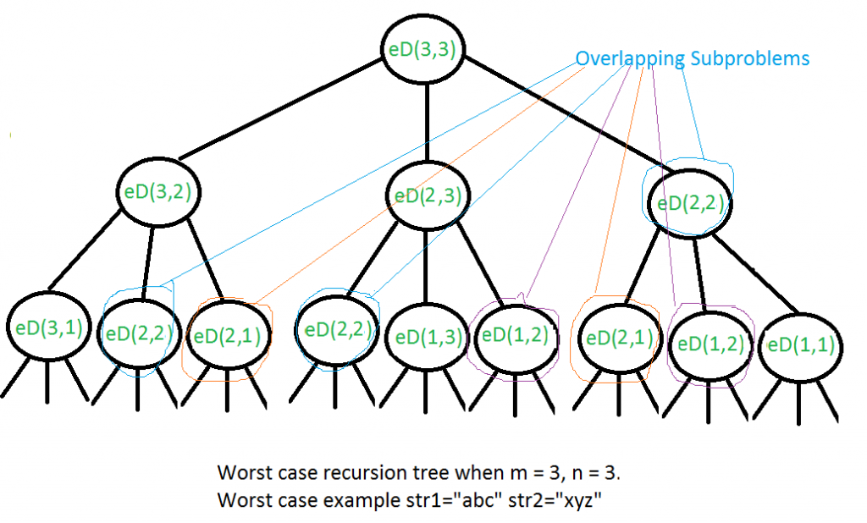
Overlapping Subproblems Property
Modify
Insert
Delete

Slide 8
Dynamic Programming
Given two strings “CART” and “MARCH” find its Edit Distance
To convert “CART” into “MARCH” we need to perform 3 operations on string “CART”.
Modify ‘c’ to ‘m’
Modify ‘t’ to ‘c’
Insert ‘h’

Slide 9
Dynamic Programming
editDist | ø | M | A | R | C | H
ø
C
A
R
T

Slide 10
Dynamic Programming
editDist | ø | M | A | R | C | H
ø | 0
C
A
R
T

Slide 11
Dynamic Programming
editDist | ø | M | A | R | C | H
ø | 0 | 1
C
A
R
T

Slide 12
Dynamic Programming
editDist | ø | M | A | R | C | H
ø | 0 | 1 | 2
C
A
R
T

Slide 13
Dynamic Programming
editDist | ø | M | A | R | C | H
ø | 0 | 1 | 2 | 3 | 4 | 5
C
A
R
T

Slide 14
Dynamic Programming
editDist | ø | M | A | R | C | H
ø | 0 | 1 | 2 | 3 | 4 | 5
C | 1
A
R
T

Slide 15
Dynamic Programming
editDist | ø | M | A | R | C | H
ø | 0 | 1 | 2 | 3 | 4 | 5
C | 1
A | 2
R
T

Slide 16
Dynamic Programming
editDist | ø | M | A | R | C | H
ø | 0 | 1 | 2 | 3 | 4 | 5
C | 1
A | 2
R | 3
T | 4

Slide 17
Dynamic Programming
editDist | ø | M | A | R | C | H
ø | 0 | 1 | 2 | 3 | 4 | 5
C | 1 | 1
A | 2
R | 3
T | 4

Slide 18
Dynamic Programming
editDist | ø | M | A | R | C | H
ø | 0 | 1 | 2 | 3 | 4 | 5
C | 1 | 1 | 2
A | 2
R | 3
T | 4

Slide 19
Dynamic Programming
editDist | ø | M | A | R | C | H
ø | 0 | 1 | 2 | 3 | 4 | 5
C | 1 | 1 | 2 | 3
A | 2
R | 3
T | 4

Slide 20
Dynamic Programming
editDist | ø | M | A | R | C | H
ø | 0 | 1 | 2 | 3 | 4 | 5
C | 1 | 1 | 2 | 3 | 3
A | 2
R | 3
T | 4

Slide 21
Dynamic Programming
editDist | ø | M | A | R | C | H
ø | 0 | 1 | 2 | 3 | 4 | 5
C | 1 | 1 | 2 | 3 | 3
A | 2
R | 3
T | 4

Slide 22
Dynamic Programming
editDist | ø | M | A | R | C | H
ø | 0 | 1 | 2 | 3 | 4 | 5
C | 1 | 1 | 2 | 3 | 3 | 4
A | 2
R | 3
T | 4

Slide 23
Dynamic Programming
editDist | ø | M | A | R | C | H
ø | 0 | 1 | 2 | 3 | 4 | 5
C | 1 | 1 | 2 | 3 | 3 | 4
A | 2 | 2
R | 3
T | 4

Slide 24
Dynamic Programming
editDist | ø | M | A | R | C | H
ø | 0 | 1 | 2 | 3 | 4 | 5
C | 1 | 1 | 2 | 3 | 3 | 4
A | 2 | 2 | 1
R | 3
T | 4

Slide 25
Dynamic Programming
editDist | ø | M | A | R | C | H
ø | 0 | 1 | 2 | 3 | 4 | 5
C | 1 | 1 | 2 | 3 | 3 | 4
A | 2 | 2 | 1 | 2 | 3 | 4
R | 3 | 3 | 2 | 1 | 2 | 3
T | 4 | 4 | 3 | 2 | 2 | 3

Slide 26
Dynamic Programming
editDist | ø | M | A | R | C | H
ø | 0 | 1 | 2 | 3 | 4 | 5
C | 1 | 1 | 2 | 3 | 3 | 4
A | 2 | 2 | 1 | 2 | 3 | 4
R | 3 | 3 | 2 | 1 | 2 | 3
T | 4 | 4 | 3 | 2 | 2 | 3

Slide 27
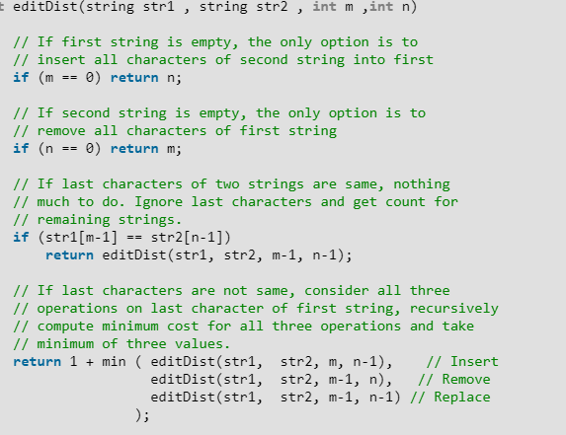
Recursive Implementation
Time Complexity: O(3^{m})

Slide 28
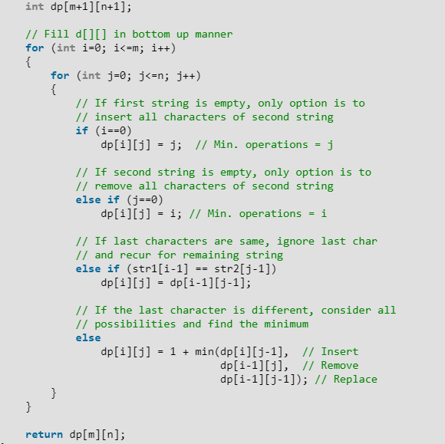
Dynamic Programming
Time Complexity: O(mn)

Slide 29
Longest Palindromic Subsequence

Slide 30
Longest Palindromic Subsequence
Given a sequence, find the length of the longest palindromic subsequence in it.
For example,
Input: BBABCBCAB
Output: 7 (“BABCBAB”)

Slide 31
Longest Palindromic Subsequence
Let’s take the following string
BABCBAB
0 1 2 3 4 5 6
Let’s say L(i, j) represents the length of longest palindromic subsequence in a string from index i to j
Thus, L(0, 6) will present the length of ‘LPS’ for the above string (LPS: Longest Palindromic Subsequence)

Slide 32
Longest Palindromic Subsequence
BABCBAB
If characters at 0th and 6th index are same
L(0, 6) = L(1, 5) + 2
Otherwise,
L(0, 6) = max( L(0, 5), L(1, 6) )

Slide 33
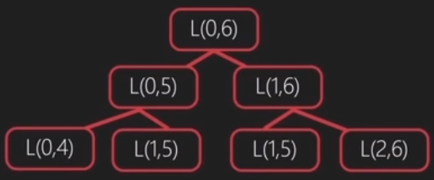
Overlapping Subproblems Property
BABCBAB
So, our solution will follow the following pattern when implemented recursively
As apparent, there are overlapping subproblems which increase the time complexity of our solution

Slide 34
Dynamic Programming
BABCBAB
0 1 2 3 4 5 6
i j
Now, for each value of i we will have a row and for each value of j we will have a column

Slide 35
Dynamic Programming
BABCBAB
0 1 2 3 4 5 6
i j
We will move i and j such that both stay at a constant distance while traversing the string

Slide 36
Dynamic Programming
0 1 2 3 4 5 6
0
1
2
3
4
5
6
BABCBAB
0 1 2 3 4 5 6
i
j
Characters covered by i and j: 1
LPS for 1 character will be 1
thus, L[i][i]=1 for each i in [0, 6]
L[6][6]

Slide 37
Dynamic Programming
0 1 2 3 4 5 6
0
1
2
3
4
5
6
1
BABCBAB
0 1 2 3 4 5 6
i
j
Characters covered by i and j: 1
LPS for 1 character will be 1
thus, L[i][i]=1 for each i in [0, 6]
L[6][6]

Slide 38
Dynamic Programming
0 1 2 3 4 5 6
0
1
2
3
4
5
6
1
 | 1
BABCBAB
0 1 2 3 4 5 6
i
j
Characters covered by i and j: 1
LPS for 1 character will be 1
thus, L[i][i]=1 for each i in [0, 6]
L[6][6]

Slide 39
Dynamic Programming
0 1 2 3 4 5 6
0
1
2
3
4
5
6
1
 | 1
 |  | 1
BABCBAB
0 1 2 3 4 5 6
Characters covered by i and j: 1
LPS for 1 character will be 1
thus, L[i][i]=1 for each i in [0, 6]
L[6][6]

Slide 40
Dynamic Programming
0 1 2 3 4 5 6
0
1
2
3
4
5
6
1
 | 1
 |  | 1
 |  |  | 1
 |  |  |  | 1
 |  |  |  |  | 1
 |  |  |  |  |  | 1
BABCBAB
0 1 2 3 4 5 6
Characters covered by i and j: 1
LPS for 1 character will be 1
thus, L[i][i]=1 for each i in [0, 6]
L[6][6]

Slide 41
Dynamic Programming
0 1 2 3 4 5 6
0
1
2
3
4
5
6
1
 | 1
 |  | 1
 |  |  | 1
 |  |  |  | 1
 |  |  |  |  | 1
 |  |  |  |  |  | 1
BABCBAB
0 1 2 3 4 5 6
i j
Characters covered by i and j: 2
If characters at i and j are same,
then L[i][j]=L[i+1][j-1] + 2
Otherwise,
L[i][j]=max( L[i][j-1], L[i+1][j] )
L[6][6]

Slide 42
Dynamic Programming
0 1 2 3 4 5 6
0
1
2
3
4
5
6
1 | 1
 | 1
 |  | 1
 |  |  | 1
 |  |  |  | 1
 |  |  |  |  | 1
 |  |  |  |  |  | 1
BABCBAB
0 1 2 3 4 5 6
i j
Characters covered by i and j: 2
If characters at i and j are same,
then L[i][j]=L[i+1][j-1] + 2
Otherwise,
L[i][j]=max( L[i][j-1], L[i+1][j] )
L[6][6]

Slide 43
Dynamic Programming
0 1 2 3 4 5 6
0
1
2
3
4
5
6
1 | 1
 | 1 | 1
 |  | 1
 |  |  | 1
 |  |  |  | 1
 |  |  |  |  | 1
 |  |  |  |  |  | 1
BABCBAB
0 1 2 3 4 5 6
Characters covered by i and j: 2
If characters at i and j are same,
then L[i][j]=L[i+1][j-1] + 2
Otherwise,
L[i][j]=max( L[i][j-1], L[i+1][j] )
L[6][6]

Slide 44
Dynamic Programming
0 1 2 3 4 5 6
0
1
2
3
4
5
6
1 | 1
 | 1 | 1
 |  | 1 | 1
 |  |  | 1 | 1
 |  |  |  | 1 | 1
 |  |  |  |  | 1 | 1
 |  |  |  |  |  | 1
BABCBAB
0 1 2 3 4 5 6
Characters covered by i and j: 2
If characters at i and j are same,
then L[i][j]=L[i+1][j-1] + 2
Otherwise,
L[i][j]=max( L[i][j-1], L[i+1][j] )
L[6][6]

Slide 45
Dynamic Programming
0 1 2 3 4 5 6
0
1
2
3
4
5
6
1 | 1
 | 1 | 1
 |  | 1 | 1
 |  |  | 1 | 1
 |  |  |  | 1 | 1
 |  |  |  |  | 1 | 1
 |  |  |  |  |  | 1
BABCBAB
0 1 2 3 4 5 6
i j
Characters covered by i and j: 3
If characters at i and j are same,
then L[i][j]=L[i+1][j-1] + 2
Otherwise,
L[i][j]=max( L[i][j-1], L[i+1][j] )
L[6][6]

Slide 46
Dynamic Programming
0 1 2 3 4 5 6
0
1
2
3
4
5
6
1 | 1 | 3
 | 1 | 1
 |  | 1 | 1
 |  |  | 1 | 1
 |  |  |  | 1 | 1
 |  |  |  |  | 1 | 1
 |  |  |  |  |  | 1
BABCBAB
0 1 2 3 4 5 6
i j
Characters covered by i and j: 3
If characters at i and j are same,
then L[i][j]=L[i+1][j-1] + 2
Otherwise,
L[i][j]=max( L[i][j-1], L[i+1][j] )
L[6][6]

Slide 47
Dynamic Programming
0 1 2 3 4 5 6
0
1
2
3
4
5
6
1 | 1 | 3
 | 1 | 1 | 1
 |  | 1 | 1
 |  |  | 1 | 1
 |  |  |  | 1 | 1
 |  |  |  |  | 1 | 1
 |  |  |  |  |  | 1
BABCBAB
0 1 2 3 4 5 6
i j
Characters covered by i and j: 3
If characters at i and j are same,
then L[i][j]=L[i+1][j-1] + 2
Otherwise,
L[i][j]=max( L[i][j-1], L[i+1][j] )
L[6][6]

Slide 48
Dynamic Programming
0 1 2 3 4 5 6
0
1
2
3
4
5
6
1 | 1 | 3
 | 1 | 1 | 1
 |  | 1 | 1 | 3
 |  |  | 1 | 1
 |  |  |  | 1 | 1
 |  |  |  |  | 1 | 1
 |  |  |  |  |  | 1
BABCBAB
0 1 2 3 4 5 6
i j
Characters covered by i and j: 3
If characters at i and j are same,
then L[i][j]=L[i+1][j-1] + 2
Otherwise,
L[i][j]=max( L[i][j-1], L[i+1][j] )
L[6][6]

Slide 49
Dynamic Programming
0 1 2 3 4 5 6
0
1
2
3
4
5
6
1 | 1 | 3
 | 1 | 1 | 1
 |  | 1 | 1 | 3
 |  |  | 1 | 1 | 1
 |  |  |  | 1 | 1
 |  |  |  |  | 1 | 1
 |  |  |  |  |  | 1
BABCBAB
0 1 2 3 4 5 6
i j
Characters covered by i and j: 3
If characters at i and j are same,
then L[i][j]=L[i+1][j-1] + 2
Otherwise,
L[i][j]=max( L[i][j-1], L[i+1][j] )
L[6][6]

Slide 50
Dynamic Programming
0 1 2 3 4 5 6
0
1
2
3
4
5
6
1 | 1 | 3
 | 1 | 1 | 1
 |  | 1 | 1 | 3
 |  |  | 1 | 1 | 1
 |  |  |  | 1 | 1 | 3
 |  |  |  |  | 1 | 1
 |  |  |  |  |  | 1
BABCBAB
0 1 2 3 4 5 6
Characters covered by i and j: 3
If characters at i and j are same,
then L[i][j]=L[i+1][j-1] + 2
Otherwise,
L[i][j]=max( L[i][j-1], L[i+1][j] )
L[6][6]

Slide 51
Dynamic Programming
0 1 2 3 4 5 6
0
1
2
3
4
5
6
1 | 1 | 3 | 3
 | 1 | 1 | 1 | 3
 |  | 1 | 1 | 3 | 3
 |  |  | 1 | 1 | 1 | 3
 |  |  |  | 1 | 1 | 3
 |  |  |  |  | 1 | 1
 |  |  |  |  |  | 1
BABCBAB
0 1 2 3 4 5 6
Characters covered by i and j: 4
If characters at i and j are same,
then L[i][j]=L[i+1][j-1] + 2
Otherwise,
L[i][j]=max( L[i][j-1], L[i+1][j] )
L[6][6]

Slide 52
Dynamic Programming
0 1 2 3 4 5 6
0
1
2
3
4
5
6
1 | 1 | 3 | 3 | 3
 | 1 | 1 | 1 | 3 | 5
 |  | 1 | 1 | 3 | 3 | 3
 |  |  | 1 | 1 | 1 | 3
 |  |  |  | 1 | 1 | 3
 |  |  |  |  | 1 | 1
 |  |  |  |  |  | 1
BABCBAB
0 1 2 3 4 5 6
Characters covered by i and j: 5
If characters at i and j are same,
then L[i][j]=L[i+1][j-1] + 2
Otherwise,
L[i][j]=max( L[i][j-1], L[i+1][j] )
L[6][6]

Slide 53
Dynamic Programming
0 1 2 3 4 5 6
0
1
2
3
4
5
6
1 | 1 | 3 | 3 | 3 | 5
 | 1 | 1 | 1 | 3 | 5 | 5
 |  | 1 | 1 | 3 | 3 | 3
 |  |  | 1 | 1 | 1 | 3
 |  |  |  | 1 | 1 | 3
 |  |  |  |  | 1 | 1
 |  |  |  |  |  | 1
BABCBAB
0 1 2 3 4 5 6
Characters covered by i and j: 6
If characters at i and j are same,
then L[i][j]=L[i+1][j-1] + 2
Otherwise,
L[i][j]=max( L[i][j-1], L[i+1][j] )
L[6][6]

Slide 54
Dynamic Programming
0 1 2 3 4 5 6
0
1
2
3
4
5
6
1 | 1 | 3 | 3 | 3 | 5 | 7
 | 1 | 1 | 1 | 3 | 5 | 5
 |  | 1 | 1 | 3 | 3 | 3
 |  |  | 1 | 1 | 1 | 3
 |  |  |  | 1 | 1 | 3
 |  |  |  |  | 1 | 1
 |  |  |  |  |  | 1
BABCBAB
0 1 2 3 4 5 6
Characters covered by i and j: 7
If characters at i and j are same,
then L[i][j]=L[i+1][j-1] + 2
Otherwise,
L[i][j]=max( L[i][j-1], L[i+1][j] )
L[6][6]

Slide 55
Dynamic Programming
0 1 2 3 4 5 6
0
1
2
3
4
5
6
1 | 1 | 3 | 3 | 3 | 5 | 7
 | 1 | 1 | 1 | 3 | 5 | 5
 |  | 1 | 1 | 3 | 3 | 3
 |  |  | 1 | 1 | 1 | 3
 |  |  |  | 1 | 1 | 3
 |  |  |  |  | 1 | 1
 |  |  |  |  |  | 1
BABCBAB
0 1 2 3 4 5 6
L[i][j] gives us ‘LPS’ for the string from index i to j
L[0][5] will give us ‘LPS’ for ‘BABCBA’
L[0][5] = 5
L[6][6]

Slide 56
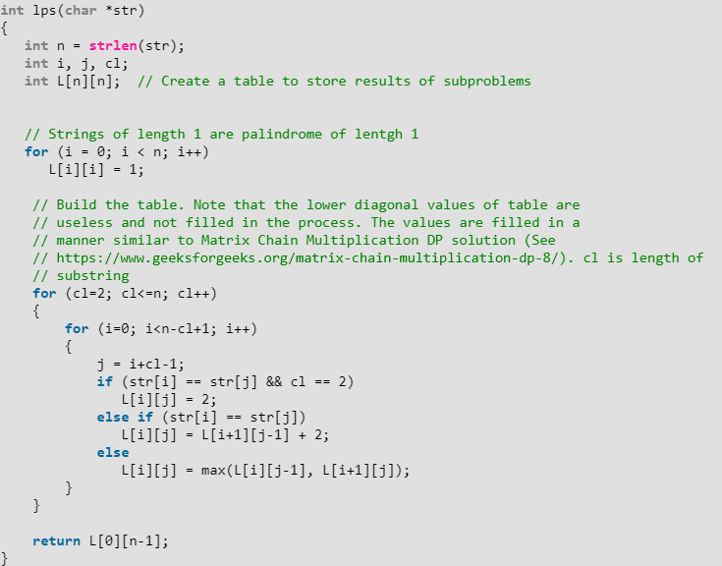
Dynamic Programming
Time Complexity: O(n²)

Slide 57
Reference
Charles Leiserson and Piotr Indyk, “Introduction to Algorithms”, September 29, 2004
https://www.geeksforgeeks.org

