Slide 1
Graph Algorithm
SWE2016-44

Slide 2
Introduction
Graph: Represents pair-wise relationship between a set of objects
Vertex (nodes)
Edges (arc)
Edge
Vertex

Slide 3
Introduction
Directed Graph (di-graph): have pair of ordered vertices (u,v)
Un-Directed Graph: have pair of unordered vertices, (u,v) and (v,u) are same

Slide 4
Graph Applications
Social Networks – Facebook, LinkedIn, etc
City A
City-Road Network
City B
City C
Task A
Precedence Constraints
Success
Failure
Task B
Task C

Slide 5
Graph Representation
There are generally two ways to represent a graph data structure
Adjacency Matrix
Adjacency List

Slide 6
Graph Representation
Adjacency Matrix: Represents graph with ‘V’ nodes into an VxV 0-1 matrix where A_{ij}=1 means that vertex ‘i’ and ‘j’ are connected.
Example
Graph
Adjacency Matrix

Slide 7
Graph Representation
Adjacency Matrix
Pros:
Easy to implement.
Removing an edge takes O(1) time.
Queries like whether there is an edge from vertex ‘u’ to vertex ‘v’ are efficient and can be done O(1) ← Search

Slide 8
Graph Representation
Adjacency Matrix
Cons:
Consumes more spaces O(V²).
Adding a vertex is O(V²) ← if there is to add a new vertex, one has to increase the storage for a |V|² matrix to (|V|+1)²

Slide 9
Graph Representation
Adjacency List: An array of linked lists is used. Size of the array is equal to number of vertices and each entry of array corresponds to a linked list of vertices adjacent to the index
Example
Graph
Adjacency List

Slide 10
Graph Representation
Adjacency List
Pros:
Saves space O(|V|+|E|), worst case O(V²).
Adding a vertex is easier.

Slide 11
Graph Representation
Adjacency List
Cons:
Queries like whether there is an edge from vertex u to vertex v are not efficient and can be done O(V) ← Search

Slide 12
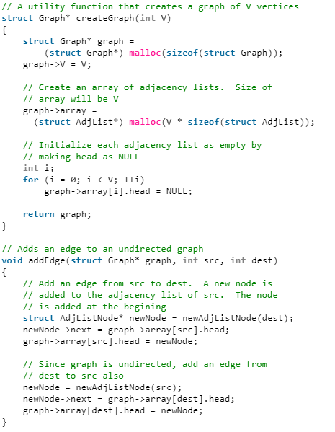
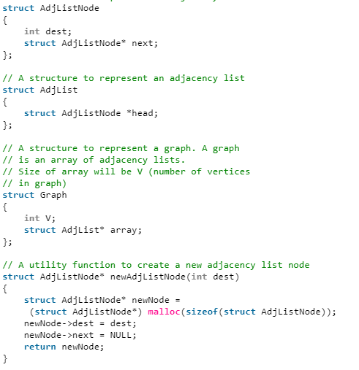
Graph Implementation (C)

Slide 13
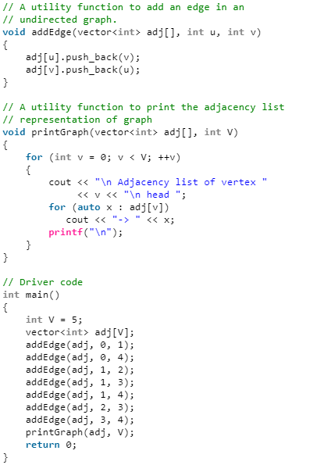
Graph Implementation (C++)

Slide 14
Breadth First Search (BFS)

Slide 15
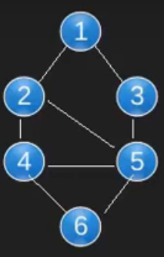
Breadth First Search
Idea: Traverse nodes in layers
L1
L2
L3
L4
Problem: Since we have cycles, each node will be visited infinite times.
Solution: Use a Boolean visited array.

Slide 16
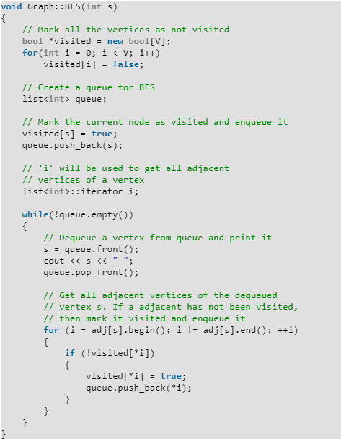
Implementation

Slide 17
1
2
3
4
5
6
1 | 2 | 3 | 4 | 5 | 6
0 | 0 | 0 | 0 | 0 | 0
Visited :
Queue :
Print :

Slide 18
1
2
3
4
5
6
1 | 2 | 3 | 4 | 5 | 6
1 | 0 | 0 | 0 | 0 | 0
Visited :
Queue :
1
Print :
1

Slide 19
1
2
3
4
5
6
1 | 2 | 3 | 4 | 5 | 6
1 | 0 | 0 | 0 | 0 | 0
Visited :
Queue :
Print :
1

Slide 20
1
2
3
4
5
6
1 | 2 | 3 | 4 | 5 | 6
1 | 1 | 1 | 0 | 0 | 0
Visited :
Queue :
2
3
Print :
1

Slide 21
1
2
3
4
5
6
1 | 2 | 3 | 4 | 5 | 6
1 | 1 | 1 | 0 | 0 | 0
Visited :
Queue :
2
3
Print :
1
2

Slide 22
1
2
3
4
5
6
1 | 2 | 3 | 4 | 5 | 6
1 | 1 | 1 | 0 | 0 | 0
Visited :
Queue :
3
Print :
1
2

Slide 23
1
2
3
4
5
6
1 | 2 | 3 | 4 | 5 | 6
1 | 1 | 1 | 1 | 1 | 0
Visited :
Queue :
3
4
5
Print :
1
2

Slide 24
1
2
3
4
5
6
1 | 2 | 3 | 4 | 5 | 6
1 | 1 | 1 | 1 | 1 | 0
Visited :
Queue :
4
5
Print :
1
2
3

Slide 25
1
2
3
4
5
6
1 | 2 | 3 | 4 | 5 | 6
1 | 1 | 1 | 1 | 1 | 1
Visited :
Queue :
5
6
Print :
1
2
3
4

Slide 26
1
2
3
4
5
6
1 | 2 | 3 | 4 | 5 | 6
1 | 1 | 1 | 1 | 1 | 1
Visited :
Queue :
6
Print :
1
2
3
4
5

Slide 27
1
2
3
4
5
6
1 | 2 | 3 | 4 | 5 | 6
1 | 1 | 1 | 1 | 1 | 1
Visited :
Queue :
Print :
1
2
3
4
5
6

Slide 28
Complexity
O(V+E)
Time Complexity:
V: Vertices
E: Edges

Slide 29
Depth First Search (DFS)

Slide 30
Depth First Search
Idea: To go forward (in depth) while there is any such possibility, if not then, backtrack
Problem: Since we have cycles, each node may be visited infinite times.
Solution: Use a Boolean visited array.

Slide 31
Depth First Search
1
2
3
Output:
4
5
6
Stack

Slide 32
Depth First Search
1
2
3
Output:
1
4
5
6
1
Stack

Slide 33
Depth First Search
1
2
3
Output:
1
2
4
5
2
6
1
Stack

Slide 34
Depth First Search
1
2
3
Output:
1
2
4
4
5
4
2
6
1
Stack

Slide 35
Depth First Search
1
2
3
5
Output:
1
2
4
5
4
5
4
2
6
1
Stack

Slide 36
Depth First Search
1
2
3
6
5
Output:
1
2
4
5
6
4
5
4
2
6
1
Stack

Slide 37
Depth First Search
1
2
3
5
Output:
1
2
4
5
6
4
5
4
2
6
1
Stack

Slide 38
Depth First Search
1
2
3
3
5
Output:
1
2
4
5
6
3
4
5
4
2
6
1
Stack

Slide 39
Depth First Search
1
2
3
5
Output:
1
2
4
5
6
3
4
5
4
2
6
1
Stack

Slide 40
Depth First Search
1
2
3
Output:
1
2
4
5
6
3
4
5
4
2
6
1
Stack

Slide 41
Depth First Search
1
2
3
Output:
1
2
4
5
6
3
4
5
2
6
1
Stack

Slide 42
Depth First Search
1
2
3
Output:
1
2
4
5
6
3
4
5
6
1
Stack

Slide 43
Depth First Search
1
2
3
Output:
1
2
4
5
6
3
4
5
6
Stack

Slide 44
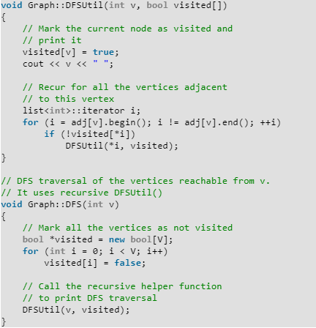
Implementation

Slide 45
Complexity
O(V+E)
Time Complexity:
V: Vertices
E: Edges

Slide 46
Reference
Charles Leiserson and Piotr Indyk, “Introduction to Algorithms”, September 29, 2004
https://www.geeksforgeeks.org

