Slide 1
Greedy Algorithm
SWE2016-44

Slide 2
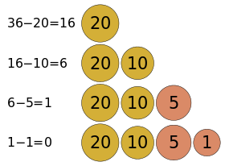
Introduction
How do we represent 36 cents using coins with {1, 5, 10, 20}?
The coin of the highest value, less than the remaining change owed, is the local optimum.

Slide 3
Introduction
Greedy Algorithm – an algorithmic paradigm that follows the problem solving approach of making the locally optimal choice at each stage with the hope of finding a global optimum.
Pros – simple, easy to implement, run fast
Cons – Very often they don’t provide a globally solution

Slide 4
Problem
Greedy Answer:
3+7+11=21
3
3
4
7
7
6
20
9
11
11

Slide 5
Problem
Actual Answer:
3+4+20=27
3
3
4
4
7
6
20
20
9
11

Slide 6
When to use?
Problems on which greedy approach work has two properties.
Greedy – choice property: A global optimum can be arrived at by selecting a local minimum
Optimal substructure: An optimum solution to the problem contains an optimal solution to subproblem

Slide 7
Applications
Activity Selection Problem
Huffman Coding
Job Sequencing Problem
Fractional Knapsack Problem
Prim’s Minimum Spanning Tree (in Graph)

Slide 8
Activity Selection Problem

Slide 9
Problem Statement
Problem: Given n activities with their start and finish times. Select the maximum number of activities that can be performed by a single person, assuming that a person can only work on a single activity at a time.
Example:
Activity | A1 | A2 | A3
Start | 12 | 10 | 20
Finish | 25 | 20 | 30
A2
→
A3
Total = 2 activities

Slide 10
Solution
Greedy Approach
Sort the activities according to their finishing time.
Select the first activity from the sorted array and print it.
Do following for remaining activities in the sorted array.
  If the start time of this activity is greater than or equal to the finish time of previously selected activity then select this activity and print it.

Slide 11
Solution
Greedy Approach
Sort the activities according to their finishing time.
Activity | A1 | A2 | A3 | A4 | A5 | A6
Start | 0 | 3 | 1 | 5 | 5 | 8
Finish | 6 | 4 | 2 | 9 | 7 | 9
Activity | A3 | A2 | A1 | A5 | A6 | A4
Start | 1 | 3 | 0 | 5 | 8 | 5
Finish | 2 | 4 | 6 | 7 | 9 | 9
Sorted

Slide 12
Solution
Greedy Approach
Select the first activity from the sorted array and print it.
Activity | A3 | A2 | A1 | A5 | A6 | A4
Start | 1 | 3 | 0 | 5 | 8 | 5
Finish | 2 | 4 | 6 | 7 | 9 | 9
Answer = A3

Slide 13
Solution
Greedy Approach
If the start time of this activity is greater than or equal to the finish time of previously selected activity then select this activity and print it.
Activity | A3 | A2 | A1 | A5 | A6 | A4
Start | 1 | 3 | 0 | 5 | 8 | 5
Finish | 2 | 4 | 6 | 7 | 9 | 9
Answer = A3
→
A2
→
A5
→
A6
Total = 4 activities

Slide 14
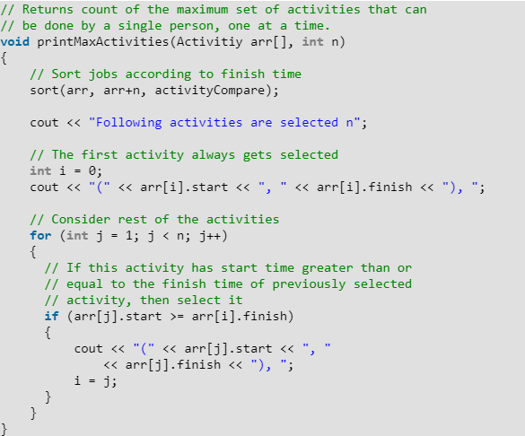
Implementation

Slide 15
Complexity
Time Complexity:
O(n)
For sorted input:
For unsorted input:
O(n log n)
n = number of activities

Slide 16
Huffman Coding

Slide 17
Huffman Coding
It is a loseless data compression
We assign variable-length codes to input characters, length of which depends on frequency of characters.
 | Frequency | Code
a | 5 | 1100
f | 45 | 0

Slide 18
Huffman Coding
It is a loseless data compression
We assign variable-length codes to input characters, length of which depends on frequency of characters.
The variable-length codes assigned to input characters are Prefix Codes.
{0, 11}
{0, 1, 11}
Prefix Code
Non Prefix Code

Slide 19
Data
Data Information
Character | Frequency
a | 5
b | 9
c | 12
d | 13
e | 16
f | 45

Slide 20
Approach
Huffman Tree
Create a leaf node for each unique character and build a min heap of all leaf nodes.
Extract two nodes with the minimum frequency from the min heap.
Create a new interval node with frequency equal to the sum of the two nodes frequencies. Make the first extracted node as its left child and the other extracted node as its right child. Add this node to the min heap.
Repeat Steps 2 and 3 until the heap contains only one node. The remaining tree is the root node and the tree is complete.

Slide 21
Approach
Character | Frequency
a | 5
b | 9
c | 12
d | 13
e | 16
f | 45
Huffman Tree
Create a leaf node for each unique character and build a min heap of all leaf nodes.
a/5
b/9
c/12

Slide 22
Approach
Character | Frequency
a | 5
b | 9
c | 12
d | 13
e | 16
f | 45
Huffman Tree
Extract two nodes with the minimum frequency from the min heap.
a/5
b/9

Slide 23
Approach
Character | Frequency
a | 5
b | 9
c | 12
d | 13
e | 16
f | 45
Huffman Tree
Create a new interval node with frequency equal to the sum of the two nodes frequencies. Make the first extracted node as its left child and the other extracted node as its right child. Add this node to the min heap.

Slide 24
Approach
Character | Frequency
N1 | 14
c | 12
d | 13
e | 16
f | 45
Huffman Tree
Create a new interval node with frequency equal to the sum of the two nodes frequencies. Make the first extracted node as its left child and the other extracted node as its right child. Add this node to the min heap.
N1/14
a/5
b/9

Slide 25
Approach
Character | Frequency
N1 | 14
c | 12
d | 13
e | 16
f | 45
Huffman Tree
Repeat Steps 2 and 3 until the heap contains only one node. The remaining tree is the root node and the tree is complete.

Slide 26
Approach
Character | Frequency
N1 | 14
N2 | 25
e | 16
f | 45
Huffman Tree
Repeat Steps 2 and 3 until the heap contains only one node. The remaining tree is the root node and the tree is complete.
N2/25
c/12
d/13

Slide 27
Approach
Character | Frequency
N2 | 25
N3 | 30
f | 45
Huffman Tree
Repeat Steps 2 and 3 until the heap contains only one node. The remaining tree is the root node and the tree is complete.
N3/30
N1/14
e/16
a/5
b/9

Slide 28
Approach
Character | Frequency
N4 | 55
f | 45
Huffman Tree
Repeat Steps 2 and 3 until the heap contains only one node. The remaining tree is the root node and the tree is complete.
N4/55
N3/30
N2/25
N1/14
e/16
c/12
d/13
a/5
b/9

Slide 29
Approach
Character | Frequency
N5 | 100
Huffman Tree
Repeat Steps 2 and 3 until the heap contains only one node. The remaining tree is the root node and the tree is complete.
N5/100
f/45
N4/55
N3/30
N2/25
N1/14
e/16
c/12
d/13
a/5
b/9

Slide 30
Approach
Character | Frequency
a | 1100
b | 1101
c | 100
d | 101
e | 111
f | 0
Huffman Tree
N5/100
0
1
f/45
N4/55
0
1
N3/30
N2/25
0
1
0
1
N1/14
e/16
c/12
d/13
0
1
a/5
b/9

Slide 31
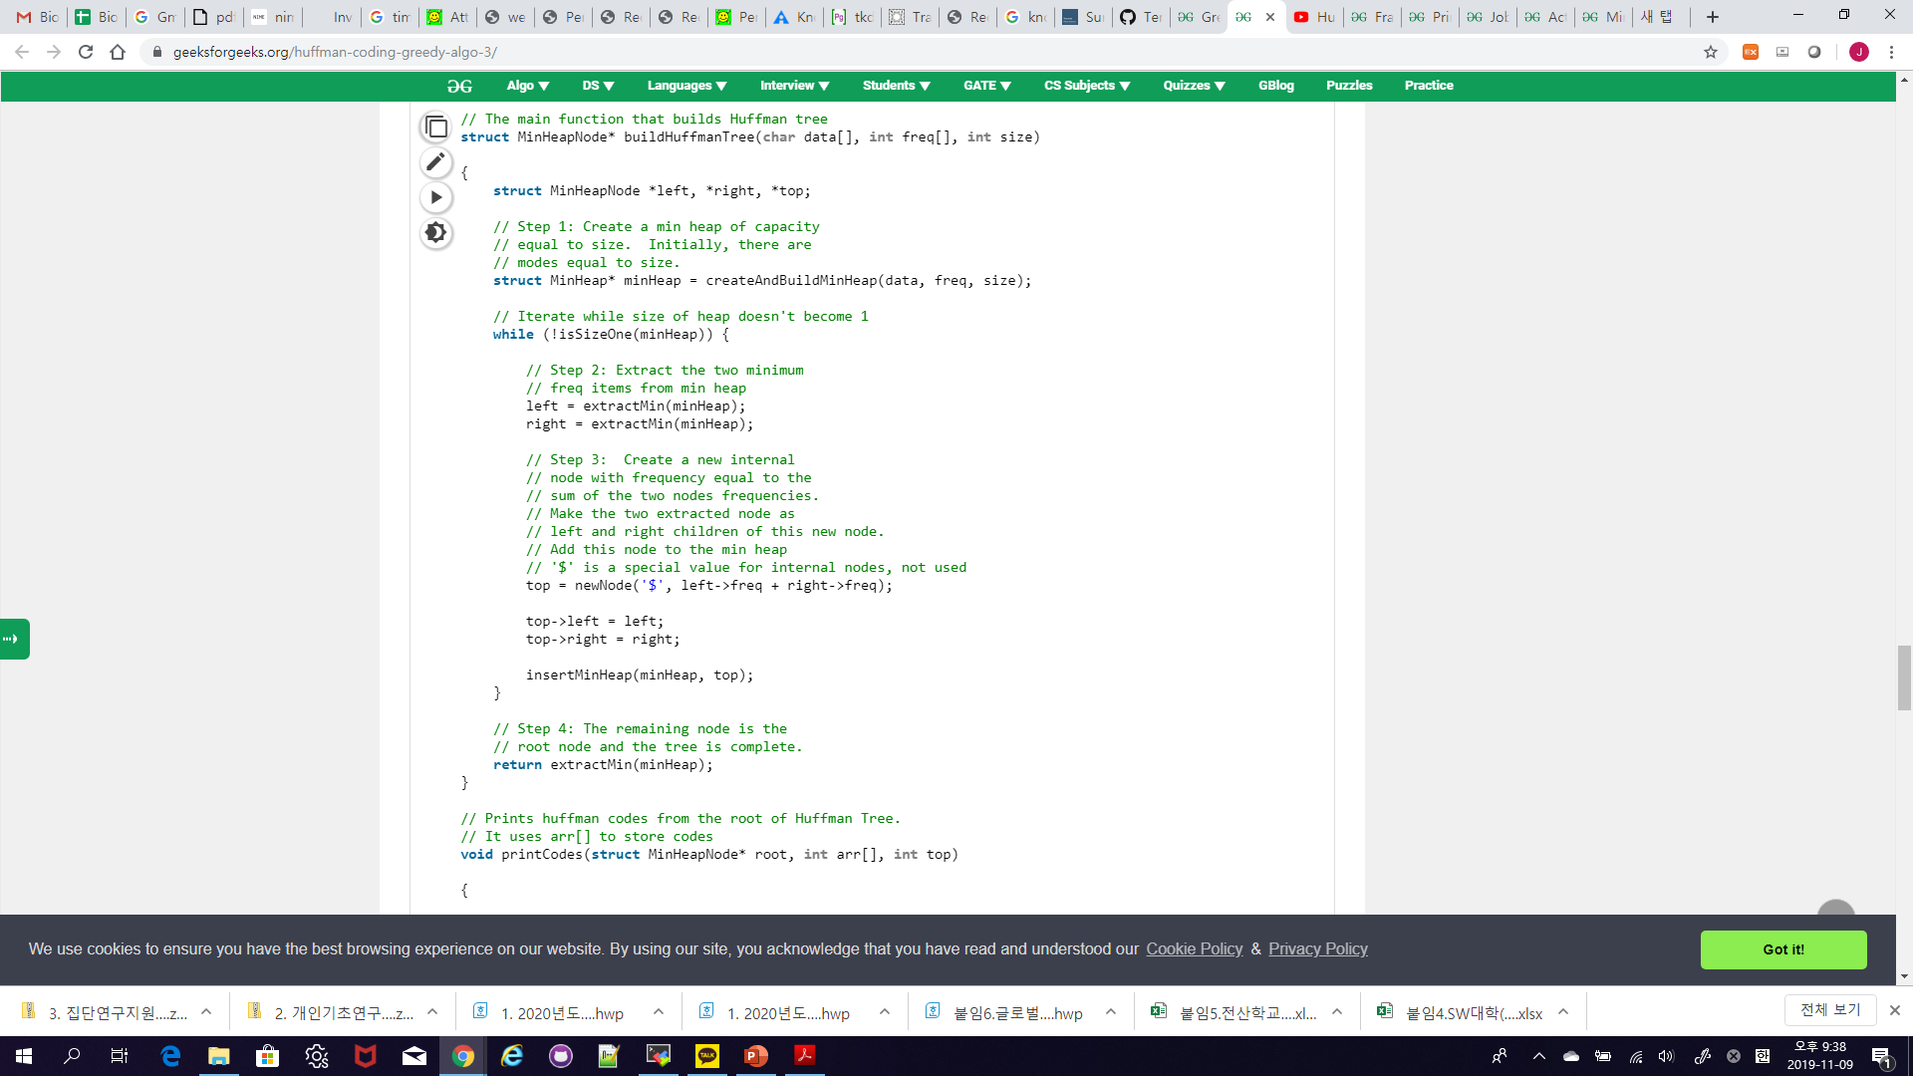
Implementation

Slide 32
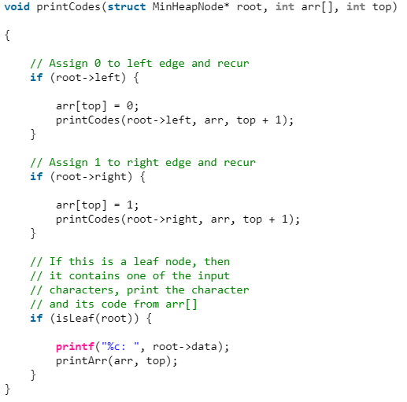
Implementation

Slide 33
Complexity
O(n log n)
Time Complexity:
n = number of unique characters
If there are n nodes, extractMin() is called 2(n-1) times.
extractMin() takes O(log n) time as it calls minHeapify().
So, overall complexity is O(n log n).

Slide 34
Job Sequencing Problem

Slide 35
Problem Statement
Problem: Given an array of jobs where every job has a deadline and associated profit if the job is finished before the deadline. It is also given that every job takes single unit of time, so the minimum possible deadline for any job is 1. How to maximize total profit if only one job can be scheduled at a time.
Example:
Job ID | A | B | C | D | E
Deadline | 2 | 1 | 2 | 1 | 3
Profit | 100 | 19 | 27 | 25 | 15
C
→
A
→
E

Slide 36
Solution
Greedy Approach
Sort all jobs in decreasing order of profit.
Initialize the result sequence as first job in sorted jobs.
Do following for remaining n-1 jobs.
  If the current job can fit in the current result sequence without missing the deadline, add current job to the result, else ignore the current job.

Slide 37
Solution
Greedy Approach
Sort all jobs in decreasing order of profit.
Job ID | A | B | C | D | E
Deadline | 2 | 1 | 2 | 1 | 3
Profit | 100 | 19 | 27 | 25 | 15
Job ID | A | C | D | B | E
Deadline | 2 | 2 | 1 | 1 | 3
Profit | 100 | 27 | 25 | 19 | 15
Sorted

Slide 38
Solution
Greedy Approach
Initialize the result sequence as first job in sorted jobs.
Job ID | A | C | D | B | E
Deadline | 2 | 2 | 1 | 1 | 3
Profit | 100 | 27 | 25 | 19 | 15
0
1
2
3
4
5
Answer
A

Slide 39
Solution
Greedy Approach
Do following for remaining n-1 jobs.
  If the current job can fit in the current result sequence without missing the deadline, add current job to the result, else ignore the current job.
Job ID | A | C | D | B | E
Deadline | 2 | 2 | 1 | 1 | 3
Profit | 100 | 27 | 25 | 19 | 15
0
1
2
3
4
5
Answer
C
A
E

Slide 40
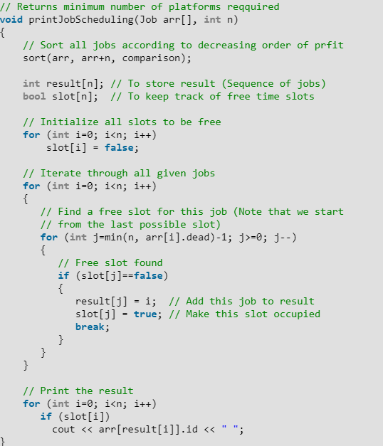
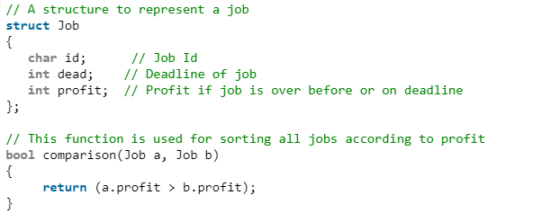
Implementation

Slide 41
Complexity
O(n²)
Time Complexity:
n = number of jobs

Slide 42
Fractional Knapsack Problem

Slide 43
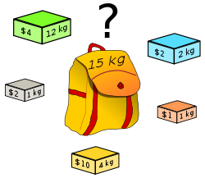
Problem
Goal: Fill knapsack such that value is maximum and total weight is at most W. Items can be broken down to maximize the knapsack value.

Slide 44
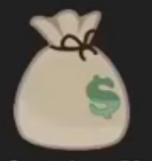
Example
B
C
A
Wt = 10
Value = 60
Wt = 20
Value = 100
Wt = 30
Value = 120
Capacity=50
0-1 Knapsack
Fractional Knapsack
Take B and C
Total Weight = 20+30=50
Total Value = 100+120=220
Take A, B and 2/3 of C
Total Weight = 10 +20+30*2/3=50
Total Value = 60+100+120*2/3=240

Slide 45
Approach
Greedy Approach
Calculate the ratio (value/weight) for each item.
Sort the items based on this ratio.
Take the item with highest ratio and add them until we can’t add the next item as whole.
At the end add the next item as much(fraction) as we can.

Slide 46
Approach
B
C
A
Wt = 10
Value = 60
Wt = 20
Value = 100
Wt = 30
Value = 120
Capacity=50
Ratio = 6
Ratio = 5
Ratio = 4
Calculate the ratio (value/weight) for each item.

Slide 47
Approach
B
C
A
Wt = 10
Value = 60
Wt = 20
Value = 100
Wt = 30
Value = 120
Capacity=50
Ratio = 6
Ratio = 5
Ratio = 4
Sort (descending) the items based on this ratio.

Slide 48
Approach
B
C
A
Wt = 10
Value = 60
Wt = 20
Value = 100
Wt = 30
Value = 120
Capacity=50
Ratio = 6
Ratio = 5
Ratio = 4
Cap Left = 40
Value = 60
Take the item with highest ratio and add them until we can’t add the next item as whole.

Slide 49
Approach
B
C
A
Wt = 10
Value = 60
Wt = 20
Value = 100
Wt = 30
Value = 120
Capacity=50
Ratio = 6
Ratio = 5
Ratio = 4
Cap Left = 40
Value = 60
Take the item with highest ratio and add them until we can’t add the next item as whole.
Cap Left = 20
Value = 160

Slide 50
Approach
B
C
A
Wt = 10
Value = 60
Wt = 20
Value = 100
Wt = 30
Value = 120
Capacity=50
Ratio = 6
Ratio = 5
Ratio = 4
Cap Left = 40
Value = 60
At the end add the next item as much(fraction) as we can.
Cap Left = 20
Value = 160
Take 2/3 of C
Weight: 2/3 * 30 = 20
Value: 2/3 * 120 = 80
Cap Left = 0
Value = 240

Slide 51
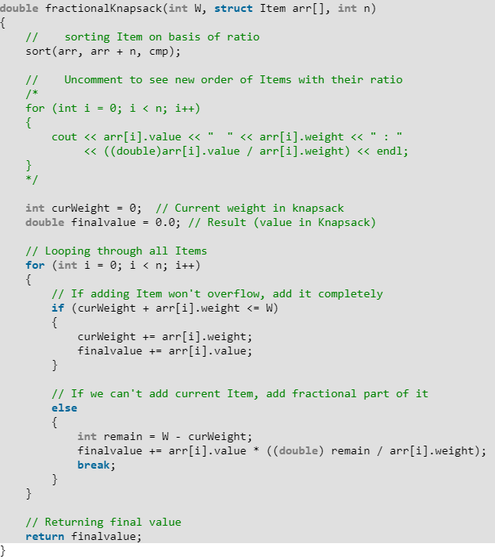
Implementation

Slide 52
Complexity
O(n log n)
Time Complexity:
n = number of items

Slide 53
Greedy Algorithm vs Dynamic Programming
Greedy algorithm: Greedy algorithm is one which finds the feasible solution at every stage with the hope of finding global optimum solution.
Dynamic Programming: Dynamic programming is one which breaks up the problem into series of overlapping sub-problems.

Slide 54
Greedy Algorithm vs Dynamic Programming
Greedy algorithm never reconsiders its choices whereas Dynamic programming may consider the previous state.
Greedy algorithm have a local choice of the sub-problems whereas Dynamic programming would solve the all sub-problems and then select one that would lead to an optimal solution.
Greedy algorithm take decision in one time whereas Dynamic programming take decision at every stage.

Slide 55
Greedy Algorithm vs Dynamic Programming
Greedy algorithm work based on choice property whereas Dynamic programming work based on principle of optimality.
Greedy algorithm follows the top-down strategy whereas Dynamic programming follows the bottom-up strategy.

Slide 56
Reference
Charles Leiserson and Piotr Indyk, “Introduction to Algorithms”, September 29, 2004
https://www.geeksforgeeks.org

