Slide 1
Binary Search Tree
SWE2016-44

Slide 2
BST
Binary Search Tree is a node-based binary tree data structure.
Properties
The left subtree of a node contains nodes with keys less than the node’s key and the right subtree with keys greater than node’s key.
The left and right subtree each must also be a binary search tree and there must be no duplicate nodes.

Slide 3
BST
Insertion
Searching
Delete

Slide 4
Insertion in a BST
While doing insertion in BST the new key is always inserted at leaf.

Slide 5
Insertion in a BST
While doing insertion in BST the new key is always inserted at leaf.
We start searching a key from root till we hit a leaf node.

Slide 6
Insertion in a BST
While doing insertion in BST the new key is always inserted at leaf.
We start searching a key from root till we hit a leaf node.
Once a leaf node is found, the new node is added as a child of the leaf node.

Slide 7
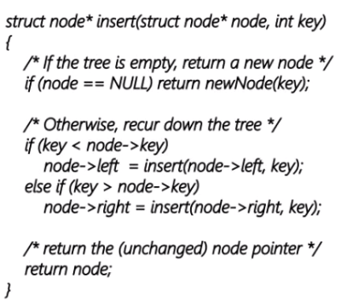
Insertion in a BST
3
8
1
10
6
14
4
7
13
For example, let’s create a BST by inserting multiple keys into it.

Slide 8
Insertion in a BST
3
8
1
10
6
14
4
7
13
For example, let’s create a BST by inserting multiple keys into it.

Slide 9
Insertion in a BST
3
8
1
10
6
14
4
7
13
For example, let’s create a BST by inserting multiple keys into it.

Slide 10
Insertion in a BST
8
1
10
3
6
14
4
7
13
For example, let’s create a BST by inserting multiple keys into it.

Slide 11
Insertion in a BST
8
1
10
3
6
14
4
7
13
Make sure the keys greater than the node’s key are added to the right and the smaller ones are added to the left.

Slide 12
Insertion in a BST
8
1
10
3
6
14
4
7
13
Make sure the keys greater than the node’s key are added to the right and the smaller ones are added to the left.

Slide 13
Insertion in a BST
8
1
10
3
6
14
4
7
13
Make sure the keys greater than the node’s key are added to the right and the smaller ones are added to the left.

Slide 14
Insertion in a BST
8
10
3
6
1
14
4
7
13
Make sure the keys greater than the node’s key are added to the right and the smaller ones are added to the left.

Slide 15
Insertion in a BST
8
10
3
6
1
14
4
7
13
Keep adding the nodes according to the previous rule until no nodes are left.

Slide 16
Insertion in a BST
8
10
3
6
1
14
4
7
13
Keep adding the nodes according to the previous rule until no nodes are left.

Slide 17
Insertion in a BST
8
3
10
6
1
14
4
7
13
Keep adding the nodes according to the previous rule until no nodes are left.

Slide 18
Insertion in a BST
8
3
10
6
1
14
4
7
13
Keep adding the nodes according to the previous rule until no nodes are left.

Slide 19
Insertion in a BST
8
3
10
6
1
14
4
7
13
Keep adding the nodes according to the previous rule until no nodes are left.

Slide 20
Insertion in a BST
8
3
10
6
1
14
4
7
13
Keep adding the nodes according to the previous rule until no nodes are left.

Slide 21
Insertion in a BST
8
3
10
1
6
14
4
7
13
Keep adding the nodes according to the previous rule until no nodes are left.

Slide 22
Insertion in a BST
8
3
10
1
6
14
4
7
13
Similarly add the rest of the nodes and you will get the BST needed.

Slide 23
Insertion in a BST
8
3
10
1
6
14
4
7
13
Similarly add the rest of the nodes and you will get the BST needed.

Slide 24
Insertion in a BST
8
3
10
1
6
14
4
7
13
Similarly add the rest of the nodes and you will get the BST needed.

Slide 25
Insertion in a BST
8
3
10
1
6
14
4
7
13
Similarly add the rest of the nodes and you will get the BST needed.

Slide 26
Searching in a BST
To search a given key in Binary Search Tree, we first compare it with root.

Slide 27
Searching in a BST
To search a given key in Binary Search Tree, we first compare it with root.
If the key is present at root, we return root. If key is greater than root’s key, we recur for right subtree of root node.

Slide 28
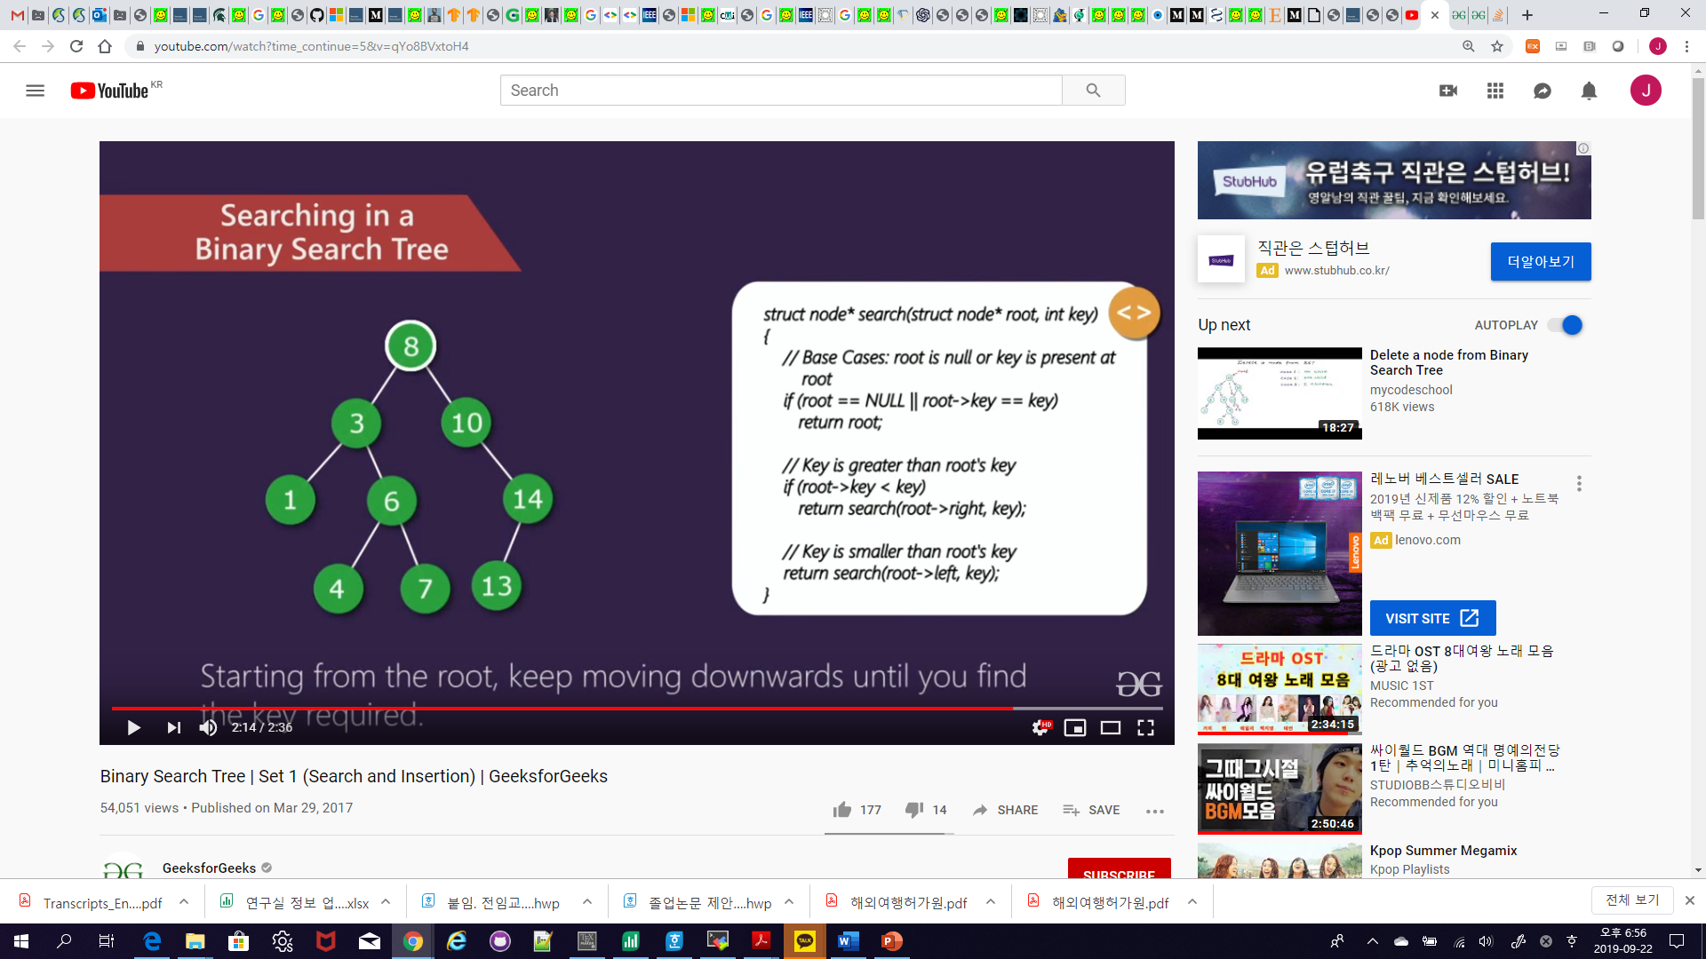
Searching in a BST
8
3
10
1
6
14
4
7
13
Let’s search the key ‘4’ from the BST we made earlier.

Slide 29
Searching in a BST
8
3
10
1
6
14
4
7
13
Starting from the root, keep moving downwards until you find the key required.

Slide 30
Searching in a BST
8
3
10
1
6
14
4
7
13
Move to the right child if the key is greater than the selected node and left if it is smaller.

Slide 31
Searching in a BST
8
3
10
1
6
14
4
7
13
Move to the right child if the key is greater than the selected node and left if it is smaller.

Slide 32
Searching in a BST
8
3
10
1
6
14
4
7
13
Move to the right child if the key is greater than the selected node and left if it is smaller.

Slide 33
Searching in a BST
8
3
10
1
6
14
4
7
13
Move to the right child if the key is greater than the selected node and left if it is smaller.

Slide 34
Searching in a BST
8
3
10
1
6
14
4
7
13
Move to the right child if the key is greater than the selected node and left if it is smaller.

Slide 35
Searching in a BST
8
3
10
1
6
14
4
7
13
Move to the right child if the key is greater than the selected node and left if it is smaller.

Slide 36
Searching in a BST
8
3
10
1
6
14
4
7
13
Move to the right child if the key is greater than the selected node and left if it is smaller.

Slide 37
Insertion and Searching in a BST
Complexity:
h is height of Binary Search Tree.

Slide 38
Insertion and Searching in a BST
Complexity:
h is height of Binary Search Tree.
The worst case time complexity: O(h)

Slide 39
Insertion and Searching in a BST
Complexity:
h is height of Binary Search Tree.
The worst case time complexity: O(h)
If the height of a skewed tree becomes n, the time complexity is O(n).

Slide 40
Insertion and Searching in a BST
Complexity:
h is height of Binary Search Tree.
The worst case time complexity: O(h)
If the height of a skewed tree becomes n, the time complexity is O(n).
On average, h $≈$ log n ➔ O(log n)

Slide 41
Deletion in a BST
Deletion in BST has been divided into 3 cases.
Node to be deleted is leaf.
Node to be deleted has only one child.
Node to be deleted has two children.

Slide 42
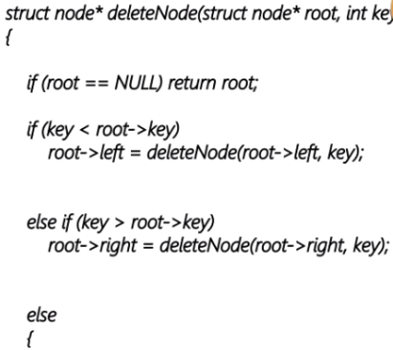
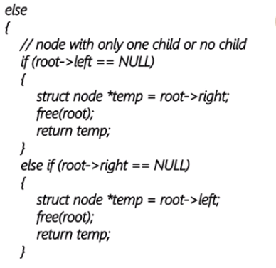
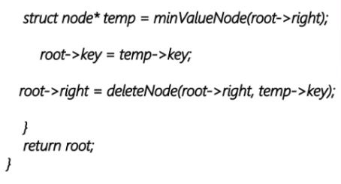
Deletion in a BST
50
30
70
20
40
60
80
Case 1: Node to be deleted is leaf: Let’s delete the node with value '20'

Slide 43
Deletion in a BST
50
30
70
20
40
60
80
To delete a leaf node simply remove it from the tree.

Slide 44
Deletion in a BST
50
30
70
40
60
80
To delete a leaf node simply remove it from the tree.

Slide 45
Deletion in a BST
50
30
70
40
60
80
Since it was a leaf node, we deleted it from the tree without making any other changes.

Slide 46
Deletion in a BST
50
30
70
40
60
80
Case 2: Node to be deleted has only one child: Let’s delete the node with value '30'

Slide 47
Deletion in a BST
50
30
70
40
60
80
To delete this node, copy the child to the node and delete the child.

Slide 48
Deletion in a BST
50
70
40
60
80
To delete this node, copy the child to the node and delete the child.

Slide 49
Deletion in a BST
50
40
70
60
80
To delete this node, copy the child to the node and delete the child.

Slide 50
Deletion in a BST
50
40
70
60
80
The node had only one child so we copied its child’s value to it and deleted its child.

Slide 51
Deletion in a BST
50
40
70
60
80
Case 3: Node to be deleted has two children: Let’s delete the root node with value '50'

Slide 52
Deletion in a BST
50
40
70
60
80
First, find inorder successor of the node.

Slide 53
Deletion in a BST
50
40
70
60
80
40 50 60 70 80: Inorder Traversal
First, find inorder successor of the node.

Slide 54
Deletion in a BST
50
40
70
60
80
40 50 60 70 80: Inorder Traversal
First, find inorder successor of the node.

Slide 55
Deletion in a BST
50
40
70
60
80
Now copy contents of the inorder successor to the node and delete the inorder successor.

Slide 56
Deletion in a BST
60
40
70
80
Now copy contents of the inorder successor to the node and delete the inorder successor.

Slide 57
Deletion in a BST
60
40
70
80
The inorder predecessor can also be used in the same manner.

Slide 58
Deletion in a BST
Complexity:
h is height of Binary Search Tree.

Slide 59
Deletion in a BST
Complexity:
h is height of Binary Search Tree.
The worst case time complexity: O(h)
If the height of a skewed tree becomes n, the time complexity is O(n).
On average, h $≈$ log n ➔ O(log n)

Slide 60
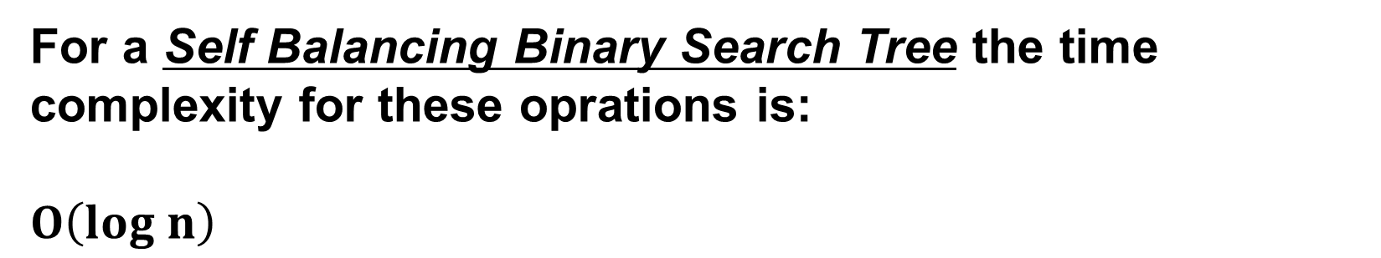
BST vs Hash Table
Hash Table supports following operations in $Θ\left(1\right)$ time:
Search
Insert
Delete
For a Self Balancing Binary Search Tree the time complexity for these oprations is:
$O\left(log n\right)$

Slide 61
Advantages of BST over Hash Table
Can get all keys in sorted order by just doing Inorder Traversal of BST

Slide 62
Advantages of BST over Hash Table
Can get all keys in sorted order by just doing Inorder Traversal of BST
Doing order statistics, finding closest lower and greater elements, doing range queries are easy to do with BSTs

Slide 63
Advantages of BST over Hash Table
Can get all keys in sorted order by just doing Inorder Traversal of BST
Doing order statistics, finding closest lower and greater elements, doing range queries are easy to do with BSTs
BSTs are easy to implement compared to hashing

Slide 64
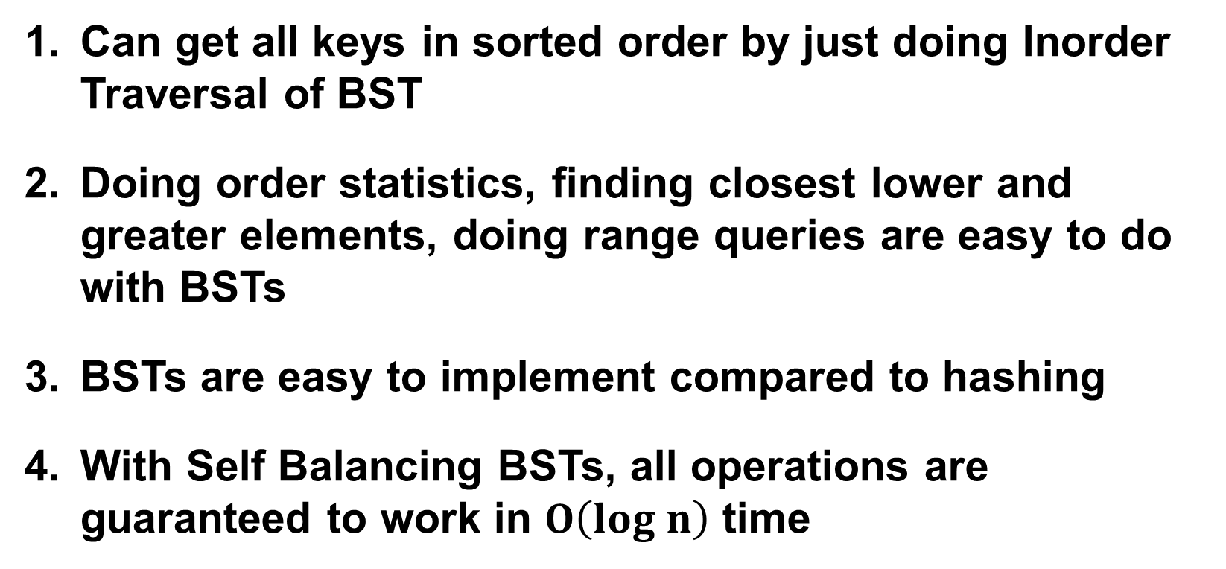
Advantages of BST over Hash Table
Can get all keys in sorted order by just doing Inorder Traversal of BST
Doing order statistics, finding closest lower and greater elements, doing range queries are easy to do with BSTs
BSTs are easy to implement compared to hashing
With Self Balancing BSTs, all operations are guaranteed to work in $O\left(log n\right)$ time

Slide 65
Reference
Charles Leiserson and Piotr Indyk, “Introduction to Algorithms”, September 29, 2004
https://www.geeksforgeeks.org

