Slide 1
Hash Tables
SWE2016-44

Slide 2
Problem
Suppose we are storing employee records, the primary key for which is employee’s telephone number.
Insert Employee Record
Search for an Employee
Delete Employee Record
Telephone | Name | City | Dept | …
9864567654 | Sam | NYC | HR
9854354543 | Tom | DC | IT
…

Slide 3
Solutions
Use an array
  Search takes linear time
  If stores in sorted order, search can be done in O(log n) using binary search but then insertion and deletion becomes costly.
Use a Linked List
  Search takes linear time

Slide 4
Solutions
Use balanced BST to store records
  Insertion takes O(log n)
  Search takes O(log n)
  Deletion takes O(log n)
Create a Direct Access table
  Insertion takes O(1)
  Search takes O(1)
  Deletion takes O(1)

Slide 5
Solutions
Direct Access Table
Telephone | Add
9864567654 | 0x1…
9854354543 | 0x2…
…
Name | City | Dept | …
Sam | NYC | HR
Name | City | Dept | …
Tom | DC | IT

Slide 6
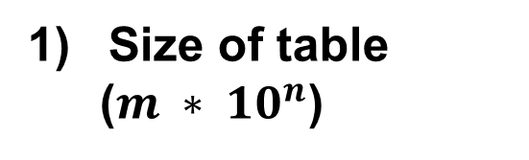
Solutions
Direct Access Table
Limitations
Telephone | Add
9864567654 | 0x1…
9854354543 | 0x2…
…
Name | City | Dept | …
Sam | NYC | HR
Size of table
  ($m ∗ {10}^{n}$)
Name | City | Dept | …
Tom | DC | IT

Slide 7
Solutions
Direct Access Table
Limitations
Telephone | Add
9864567654 | 0x1…
9854354543 | 0x2…
…
Name | City | Dept | …
Sam | NYC | HR
Size of table
  ($m ∗ {10}^{n}$)
Name | City | Dept | …
Tom | DC | IT
Integer may not hold the size of n digits

Slide 8
Solutions
Direct Access Table
(Improvement)
Hashing – provides O(1) time on average for insert,
search and delete

Slide 9
Solutions
Direct Access Table
(Improvement)
Hashing – provides O(1) time on average for insert,
search and delete
Hash function – hash function maps a big number or
string to a small integer that can be
used as index in hash table

Slide 10
Solutions
Direct Access Table
(Improvement)
HASH function h(x):
h(x) = x mod 7

Slide 11
Solutions
Direct Access Table
(Improvement)
HASH function h(x):
h(x) = x mod 7
x = 9864567645
H(x) = 9864567645 mod 7 = 4

Slide 12
Solutions
Direct Access Table
(Improvement)
HASH function h(x):
h(x) = x mod 7
x = 9864567645
H(x) = 9864567645 mod 7 = 4
x = 9854354543
H(x) = 9854354543 mod 7 = 5

Slide 13
Solutions
Direct Access Table
(Improvement)
HASH function h(x):
h(x) = x mod 7
Good h(x) should
Be Efficiently Computable
x = 9864567645
H(x) = 9864567645 mod 7 = 4
x = 9854354543
H(x) = 9854354543 mod 7 = 5

Slide 14
Solutions
Direct Access Table
(Improvement)
HASH function h(x):
h(x) = x mod 7
Good h(x) should
Be Efficiently Computable
Uniformly distribute the keys
x = 9864567645
H(x) = 9864567645 mod 7 = 4
x = 9854354543
H(x) = 9854354543 mod 7 = 5

Slide 15
Collision
Collision – Two keys resulting in same value

Slide 16
Collision
Collision – Two keys resulting in same value
HASH function h(x):
h(x) = x mod 7

Slide 17
Collision
Collision – Two keys resulting in same value
HASH function h(x):
h(x) = x mod 7
x = 9864567645
H(x) = 9864567645 mod 7 = 4
x = 9854354542
H(x) = 9854354542 mod 7 = 4

Slide 18
Collision
Collision Handling
Separate Chaining
Open Addressing

Slide 19
Separate Chaining
The idea is to make each cell of hash table point to a linked list of records that have same hash function value.

Slide 20
Separate Chaining
Hash Function : h(x) = x mod 7

Slide 21
Separate Chaining
0
1
2
3
4
5
6
Hash Function : h(x) = x mod 7
Hash Table

Slide 22
Separate Chaining
0
1
2
3
4
5
6
Hash Function : h(x) = x mod 7
Keys : 50, 700, 76, 85, 92, 73, 101
Hash Table

Slide 23
Separate Chaining
0
1
2
3
4
5
6
Hash Function : h(x) = x mod 7
Keys : 50, 700, 76, 85, 92, 73, 101
50 mod 7 = 1
Hash Table

Slide 24
Separate Chaining
0
1
2
3
4
5
6
50
Hash Function : h(x) = x mod 7
Keys : 50, 700, 76, 85, 92, 73, 101
50 mod 7 = 1
Hash Table

Slide 25
Separate Chaining
0
1
2
3
4
5
6
50
Hash Function : h(x) = x mod 7
Keys : 50, 700, 76, 85, 92, 73, 101
700 mod 7 = 0
Hash Table

Slide 26
Separate Chaining
0
1
2
3
4
5
6
700
50
Hash Function : h(x) = x mod 7
Keys : 50, 700, 76, 85, 92, 73, 101
700 mod 7 = 0
Hash Table

Slide 27
Separate Chaining
0
1
2
3
4
5
6
700
50
Hash Function : h(x) = x mod 7
Keys : 50, 700, 76, 85, 92, 73, 101
76 mod 7 = 6
Hash Table

Slide 28
Separate Chaining
0
1
2
3
4
5
6
700
50
76
Hash Function : h(x) = x mod 7
Keys : 50, 700, 76, 85, 92, 73, 101
76 mod 7 = 6
Hash Table

Slide 29
Separate Chaining
0
1
2
3
4
5
6
700
50
76
Hash Function : h(x) = x mod 7
Keys : 50, 700, 76, 85, 92, 73, 101
85 mod 7 = 1
Hash Table

Slide 30
Separate Chaining
0
1
2
3
4
5
6
700
50
76
Hash Function : h(x) = x mod 7
85
Keys : 50, 700, 76, 85, 92, 73, 101
85 mod 7 = 1
Hash Table

Slide 31
Separate Chaining
0
1
2
3
4
5
6
700
50
76
Hash Function : h(x) = x mod 7
85
Keys : 50, 700, 76, 85, 92, 73, 101
92 mod 7 = 1
Hash Table

Slide 32
Separate Chaining
0
1
2
3
4
5
6
700
50
76
Hash Function : h(x) = x mod 7
85
92
Keys : 50, 700, 76, 85, 92, 73, 101
92 mod 7 = 1
Hash Table

Slide 33
Separate Chaining
0
1
2
3
4
5
6
700
50
76
Hash Function : h(x) = x mod 7
85
92
Keys : 50, 700, 76, 85, 92, 73, 101
73 mod 7 = 3
Hash Table

Slide 34
Separate Chaining
0
1
2
3
4
5
6
700
50
73
76
Hash Function : h(x) = x mod 7
85
92
Keys : 50, 700, 76, 85, 92, 73, 101
73 mod 7 = 3
Hash Table

Slide 35
Separate Chaining
0
1
2
3
4
5
6
700
50
73
76
Hash Function : h(x) = x mod 7
85
92
Keys : 50, 700, 76, 85, 92, 73, 101
101 mod 7 = 3
Hash Table

Slide 36
Separate Chaining
0
1
2
3
4
5
6
700
50
73
76
Hash Function : h(x) = x mod 7
85
92
Keys : 50, 700, 76, 85, 92, 73, 101
101
101 mod 7 = 3
Hash Table

Slide 37
Separate Chaining
Advantages:
Simple to implement.

Slide 38
Separate Chaining
Advantages:
Simple to implement.
Hash table never fills up, we can always add more elements to chain.

Slide 39
Separate Chaining
Advantages:
Simple to implement.
Hash table never fills up, we can always add more elements to chain.
Less sensitive to the hash function or load factors.

Slide 40
Separate Chaining
Advantages:
Simple to implement.
Hash table never fills up, we can always add more elements to chain.
Less sensitive to the hash function or load factors.
It is mostly used when it is unknown how many and how frequently keys may be inserted or deleted.

Slide 41
Separate Chaining
Disadvantages:
Cache performance of chaining is not good as keys are stored using linked list.

Slide 42
Separate Chaining
Disadvantages:
Cache performance of chaining is not good as keys are stored using linked list.
Wastage of Space.

Slide 43
Separate Chaining
Disadvantages:
Cache performance of chaining is not good as keys are stored using linked list.
Wastage of Space.
If the chain becomes long, then search time can become O(n) in worst case.

Slide 44
Separate Chaining
Disadvantages:
Cache performance of chaining is not good as keys are stored using linked list.
Wastage of Space.
If the chain becomes long, then search time can become O(n) in worst case.
Uses extra space for links.

Slide 45
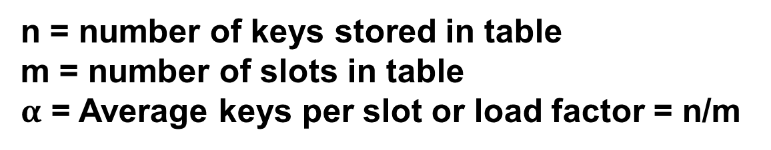
Separate Chaining
Complexity:
n = number of keys stored in table
m = number of slots in table
$α$ = Average keys per slot or load factor = n/m

Slide 46

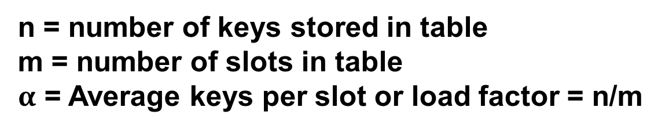
Separate Chaining
0
1
2
3
4
5
6
700
50
73
76
Complexity:
85
92
n = number of keys stored in table
m = number of slots in table
$α$ = Average keys per slot or load factor = n/m
101
Expected time to insert/search/delete:
O(1+$α$)
Hash Table

Slide 47
Collision
Collision Handling
Separate Chaining
Open Addressing

Slide 48
Open Addressing
A hash collision is resolved by probing
Linear Probing
Quadratic Probing
Double Hashing

Slide 49
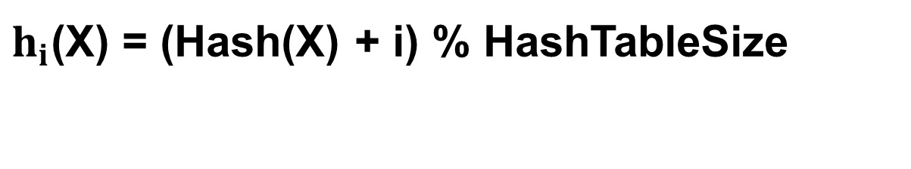
Linear Probing
Linear Probing
$h_{i}$(X) = (Hash(X) + i) % HashTableSize
If $h_{0}$(X) = (Hash(X) + 0) % HashTableSize is full, we try for $h_{1}$
If $h_{1}$(X) = (Hash(X) + 1) % HashTableSize is full, we try for $h_{2}$
And so on ..

Slide 50
Linear Probing
0
1
2
3
4
5
6
7
8
9
10
Keys: 7, 36, 18, 62
Empty
Occupied
Deleted

Slide 51
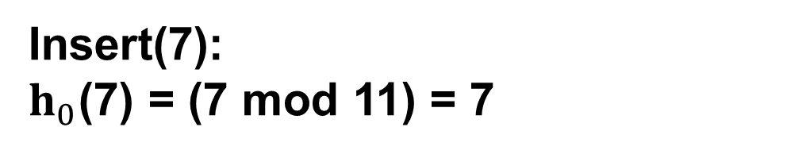
Linear Probing
0
1
2
3
4
5
6
7
8
9
10
Keys: 7, 36, 18, 62
Insert(7):
$h_{0}$(7) = (7 mod 11) = 7
Empty
Occupied
Deleted

Slide 52
Linear Probing
0
1
2
3
4
5
6
7
8
9
10
7
Keys: 7, 36, 18, 62
Insert(7):
$h_{0}$(7) = (7 mod 11) = 7
Empty
Occupied
Deleted

Slide 53
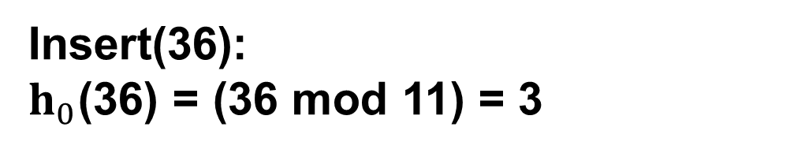
Linear Probing
0
1
2
3
4
5
6
7
8
9
10
7
Keys: 7, 36, 18, 62
Insert(36):
$h_{0}$(36) = (36 mod 11) = 3
Empty
Occupied
Deleted

Slide 54
Linear Probing
0
1
2
3
4
5
6
7
8
9
10
36
7
Keys: 7, 36, 18, 62
Insert(36):
$h_{0}$(36) = (36 mod 11) = 3
Empty
Occupied
Deleted

Slide 55
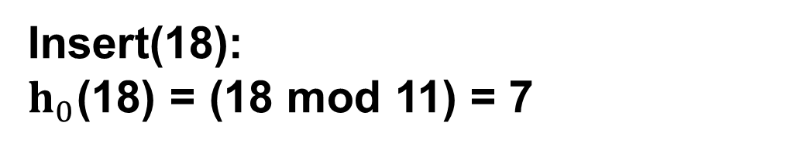
Linear Probing
0
1
2
3
4
5
6
7
8
9
10
36
7
Keys: 7, 36, 18, 62
Insert(18):
$h_{0}$(18) = (18 mod 11) = 7
Empty
Occupied
Deleted

Slide 56
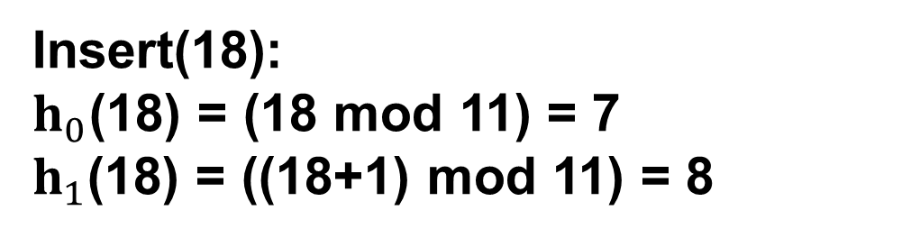
Linear Probing
0
1
2
3
4
5
6
7
8
9
10
36
7
Keys: 7, 36, 18, 62
Insert(18):
$h_{0}$(18) = (18 mod 11) = 7
$h_{1}$(18) = ((18+1) mod 11) = 8
Empty
Occupied
Deleted

Slide 57
Linear Probing
0
1
2
3
4
5
6
7
8
9
10
36
7
18
Keys: 7, 36, 18, 62
Insert(18):
$h_{0}$(18) = (18 mod 11) = 7
$h_{1}$(18) = ((18+1) mod 11) = 8
Empty
Occupied
Deleted

Slide 58
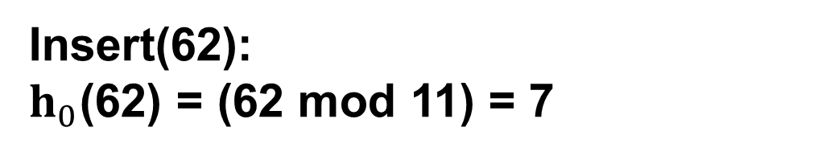
Linear Probing
0
1
2
3
4
5
6
7
8
9
10
36
7
18
Keys: 7, 36, 18, 62
Insert(62):
$h_{0}$(62) = (62 mod 11) = 7
Empty
Occupied
Deleted

Slide 59
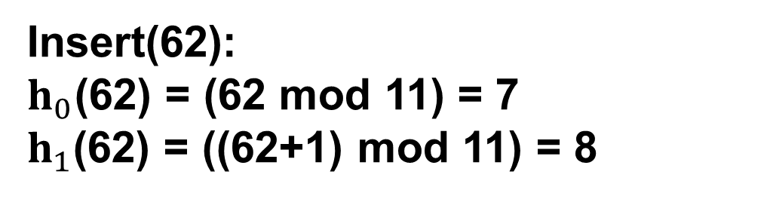
Linear Probing
0
1
2
3
4
5
6
7
8
9
10
36
7
18
Keys: 7, 36, 18, 62
Insert(62):
$h_{0}$(62) = (62 mod 11) = 7
$h_{1}$(62) = ((62+1) mod 11) = 8
Empty
Occupied
Deleted

Slide 60
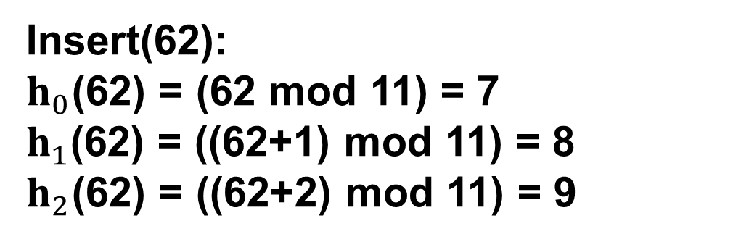
Linear Probing
0
1
2
3
4
5
6
7
8
9
10
36
7
18
Keys: 7, 36, 18, 62
Insert(62):
$h_{0}$(62) = (62 mod 11) = 7
$h_{1}$(62) = ((62+1) mod 11) = 8
$h_{2}$(62) = ((62+2) mod 11) = 9
Empty
Occupied
Deleted

Slide 61
Linear Probing
0
1
2
3
4
5
6
7
8
9
10
36
7
18
62
Keys: 7, 36, 18, 62
Insert(62):
$h_{0}$(62) = (62 mod 11) = 7
$h_{1}$(62) = ((62+1) mod 11) = 8
$h_{2}$(62) = ((62+2) mod 11) = 9
Empty
Occupied
Deleted

Slide 62
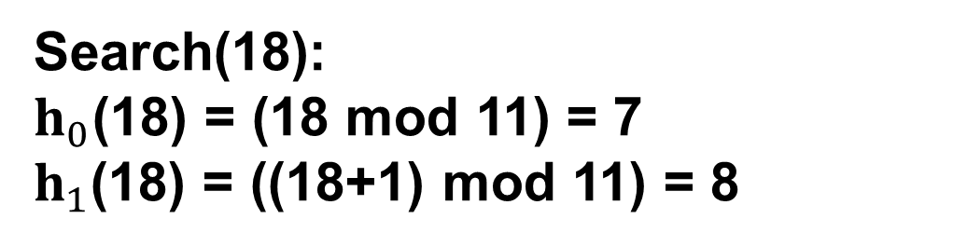
Linear Probing
0
1
2
3
4
5
6
7
8
9
10
36
7
18
62
Keys: 7, 36, 18, 62
Search(18):
$h_{0}$(18) = (18 mod 11) = 7
$h_{1}$(18) = ((18+1) mod 11) = 8
Empty
Occupied
Deleted

Slide 63
Linear Probing
0
1
2
3
4
5
6
7
8
9
10
36
7
18
62
Keys: 7, 36, 18, 62
Delete(18):
Empty
Occupied
Deleted

Slide 64
Linear Probing
0
1
2
3
4
5
6
7
8
9
10
36
7
62
Keys: 7, 36, 18, 62
Delete(18):
Empty
Occupied
Deleted

Slide 65
Open Addressing
A hash collision is resolved by probing
Linear Probing
Quadratic Probing
Double Hashing

Slide 66
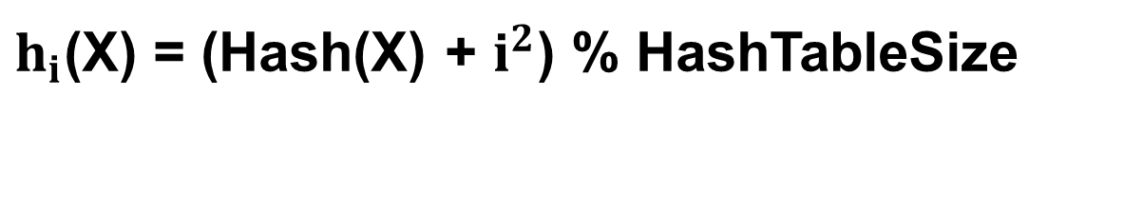
Quadratic Probing
Quadratic Probing
$h_{i}$(X) = (Hash(X) + $i^{2}$) % HashTableSize
If $h_{0}$(X) = (Hash(X) + 0) % HashTableSize is full, we try for $h_{1}$
If $h_{1}$(X) = (Hash(X) + 1) % HashTableSize is full, we try for $h_{2}$
If $h_{1}$(X) = (Hash(X) + 4) % HashTableSize is full, we try for $h_{3}$
And so on ..

Slide 67
Quadratic Probing
0
1
2
3
4
5
6
7
8
9
10
7
Keys: 7, 36, 18, 62
Insert(7)
Empty
Occupied
Deleted

Slide 68
Quadratic Probing
0
1
2
3
4
5
6
7
8
9
10
36
7
Keys: 7, 36, 18, 62
Insert(36)
Empty
Occupied
Deleted

Slide 69
Quadratic Probing
0
1
2
3
4
5
6
7
8
9
10
36
7
18
Keys: 7, 36, 18, 62
Insert(18)
Empty
Occupied
Deleted

Slide 70
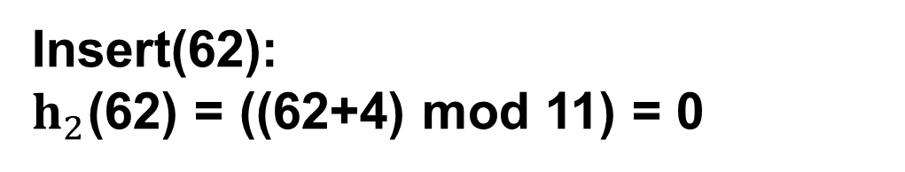
Quadratic Probing
0
1
2
3
4
5
6
7
8
9
10
36
7
18
Keys: 7, 36, 18, 62
Insert(62):
$h_{2}$(62) = ((62+4) mod 11) = 0
Empty
Occupied
Deleted

Slide 71
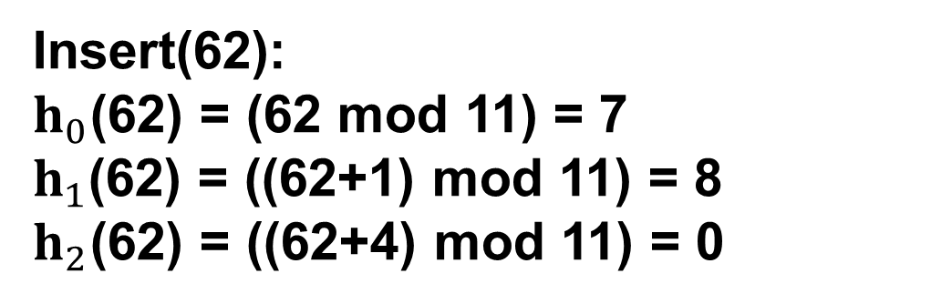
Quadratic Probing
0
1
2
3
4
5
6
7
8
9
10
62
36
7
18
Keys: 7, 36, 18, 62
Insert(62):
$h_{0}$(62) = (62 mod 11) = 7
$h_{1}$(62) = ((62+1) mod 11) = 8
$h_{2}$(62) = ((62+4) mod 11) = 0
Empty
Occupied
Deleted

Slide 72
Open Addressing
A hash collision is resolved by probing
Linear Probing
Quadratic Probing
Double Hashing

Slide 73
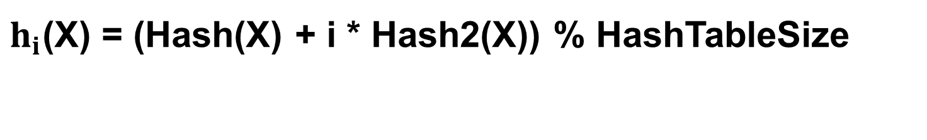
Double Hashing
Double Hashing: use another hash function hash2(x) and look for i*hash2(x) slot in i'th iteration.
$h_{i}$(X) = (Hash(X) + i * Hash2(X)) % HashTableSize
If $h_{0}$(X) = (Hash(X) + 0) % HashTableSize is full, we try for $h_{1}$
If $h_{1}$(X) = (Hash(X) + 1* Hash2(X)) % HashTableSize is full, we try for $h_{2}$
If $h_{1}$(X) = (Hash(X) + 4* Hash2(X)) % HashTableSize is full, we try for $h_{3}$
And so on ..

Slide 74
Open Addressing
Linear Probing
  Easy to implement
  Best Cache Performance
  Suffers from clustering

Slide 75
Open Addressing
Linear Probing
  Easy to implement
  Best Cache Performance
  Suffers from clustering
Quadratic Probing
  Average Cache Performance
  Suffers a lesser clustering than linear probing

Slide 76
Open Addressing
Linear Probing
  Easy to implement
  Best Cache Performance
  Suffers from clustering
Quadratic Probing
  Average Cache Performance
  Suffers a lesser clustering than linear probing
Double Hashing
  Poor Cache Performance
  No clustering
  Requires more computation time

Slide 77
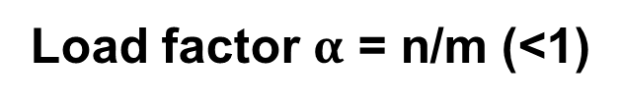
Open Addressing
Complexity:
n = number of keys to be inserted in hash table
m = number of slots in hash table
Load factor $α$ = n/m (<1)

Slide 78
Open Addressing
Complexity:
n = number of keys to be inserted in hash table
m = number of slots in hash table
Load factor $α$ = n/m (<1)
Theorem. Given an open-addressed hash table with load factor α = n/m < 1, the expected number of probes in an unsuccessful search is at most 1/(1–α).

Slide 79
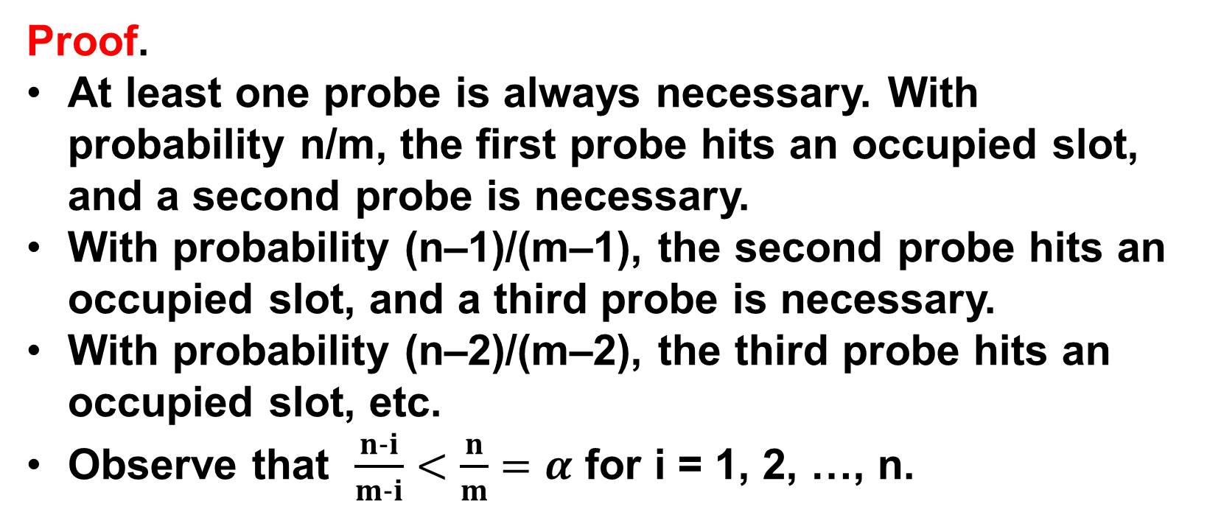
Open Addressing
Proof.
At least one probe is always necessary. With probability n/m, the first probe hits an occupied slot, and a second probe is necessary.
With probability (n–1)/(m–1), the second probe hits an occupied slot, and a third probe is necessary.
With probability (n–2)/(m–2), the third probe hits an occupied slot, etc.
Observe that $\frac{n-i}{m-i}<\frac{n}{m}=α$ for i = 1, 2, …, n.

Slide 80
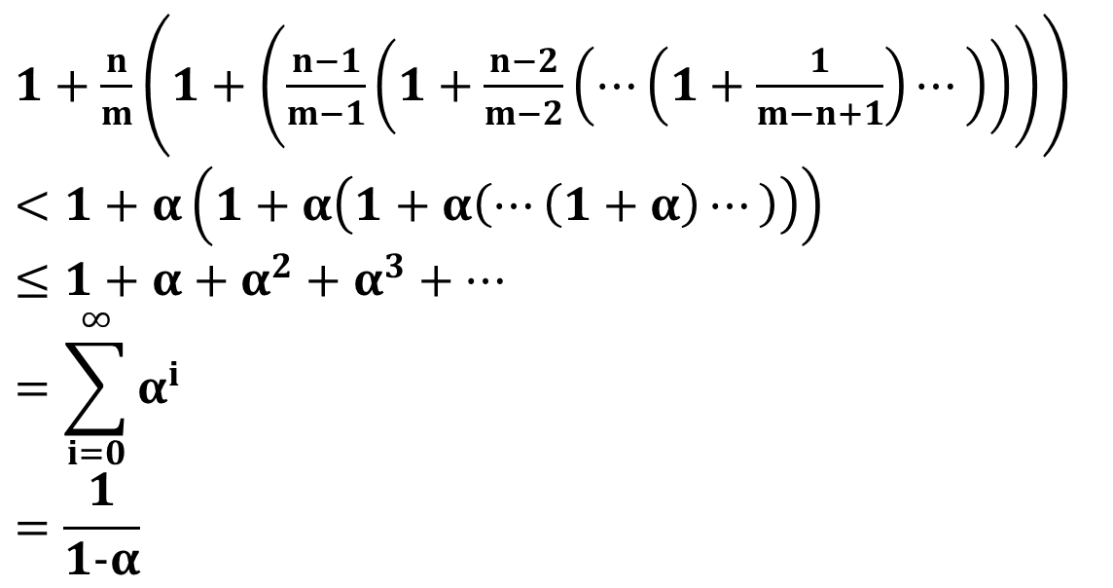
Open Addressing
Proof (continued)
Therefore, the expected number of probes is
$1+\frac{n}{m}\left(1+\left(\frac{n−1}{m−1}\left(1+\frac{n−2}{m−2}\left(⋯\left(1+\frac{1}{m−n+1}\right)⋯\right)\right)\right)\right)$
$<1+α\left(1+α\left(1+α\left(⋯\left(1+α\right)⋯\right)\right)\right)$
$≤1+α+α^{2}+α^{3}+⋯$
$$=\sum_{i=0}^{∞}{α^{i}}$$
$$=\frac{1}{1-α}$$

Slide 81
Open Addressing
Complexity:
n = number of keys to be inserted in hash table
m = number of slots in hash table
Load factor $α$ = n/m (<1)
Expected time to insert/search/delete < $1/\left(1-α\right)$
So Search, Insert and Delete take O($1/\left(1-α\right)$) time

Slide 82
Reference
Charles Leiserson and Piotr Indyk, “Introduction to Algorithms”, September 29, 2004
https://www.geeksforgeeks.org

