Slide 1
Insertion Sort
Merge Sort
SWE2016-44

Slide 2
Insertion Sort

Slide 3
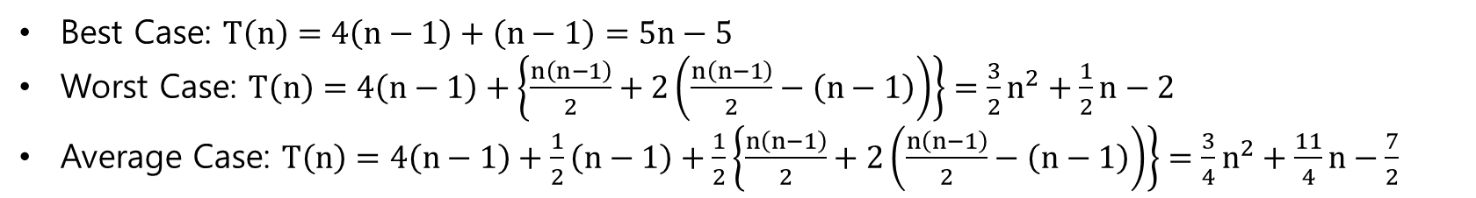
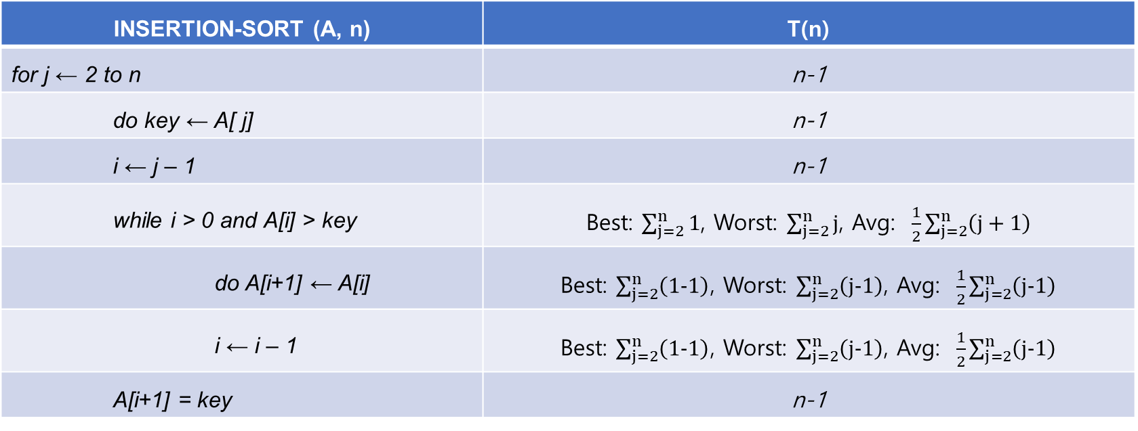
Insertion Sort
INSERTION-SORT (A, n) | T(n)
for j ← 2 to n | n-1
do key ← A[ j] | n-1
i ← j – 1 | n-1
while i > 0 and A[i] > key | Best: $\sum_{j=2}^{n}{1}$, Worst: $\sum_{j=2}^{n}{j}$, Avg: $\frac{1}{2}\sum_{j=2}^{n}{\left(j+1\right)}$
do A[i+1] ← A[i] | Best: $\sum_{j=2}^{n}{\left(1−1\right)}$, Worst: $\sum_{j=2}^{n}{\left(j−1\right)}$, Avg: $\frac{1}{2}\sum_{j=2}^{n}{\left(j−1\right)}$
i ← i – 1 | Best: $\sum_{j=2}^{n}{\left(1−1\right)}$, Worst: $\sum_{j=2}^{n}{\left(j−1\right)}$, Avg: $\frac{1}{2}\sum_{j=2}^{n}{\left(j−1\right)}$
A[i+1] = key | n-1
Best Case: $T\left(n\right)=4\left(n−1\right)+\left(n−1\right)=5n−5$
Worst Case: $T\left(n\right)=4\left(n−1\right)+\left\{\frac{n\left(n−1\right)}{2}+2\left(\frac{n\left(n−1\right)}{2}−\left(n−1\right)\right)\right\}=\frac{3}{2}n^{2}+\frac{1}{2}n−2$
Average Case: $T\left(n\right)=4\left(n−1\right)+\frac{1}{2}\left(n−1\right)+\frac{1}{2}\left\{\frac{n\left(n−1\right)}{2}+2\left(\frac{n\left(n−1\right)}{2}−\left(n−1\right)\right)\right\}=\frac{3}{4}n^{2}+\frac{11}{4}n−\frac{7}{2}$

Slide 4
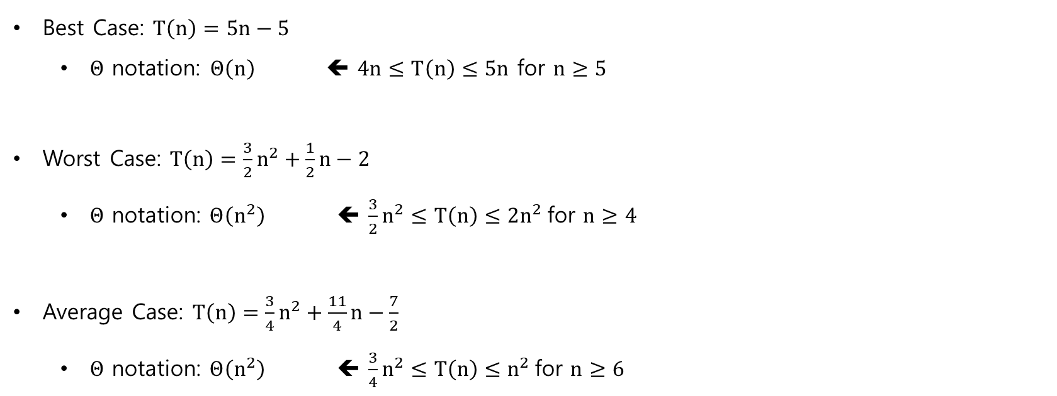
Insertion Sort
Best Case: $T\left(n\right)=5n−5$
  $Θ$ notation: $Θ\left(n\right)$ ⬅ $4n≤T\left(n\right)≤5n$ for $n≥5$
Worst Case: $T\left(n\right)=\frac{3}{2}n^{2}+\frac{1}{2}n−2$
  $Θ \text{notation}\text{: }Θ\left(n^{2}\right) \text{⬅} \frac{3}{2}n^{2}≤T\left(n\right)≤2n^{2} \text{for} n≥4$
Average Case: $T\left(n\right)=\frac{3}{4}n^{2}+\frac{11}{4}n−\frac{7}{2}$
  $Θ \text{notation}\text{: }Θ\left(n^{2}\right) \text{⬅} \frac{3}{4}n^{2}≤T\left(n\right)≤n^{2} \text{for} n≥6$

Slide 5
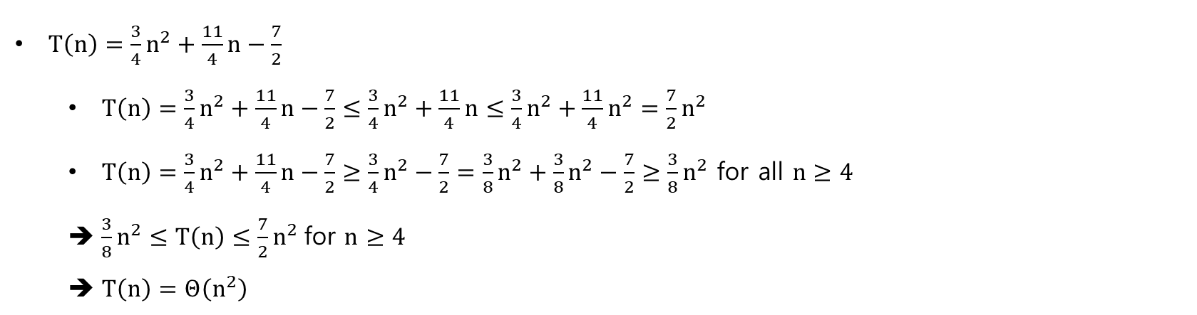
Insertion Sort
$T\left(n\right)=\frac{3}{4}n^{2}+\frac{11}{4}n−\frac{7}{2}$
  $T\left(n\right)=\frac{3}{4}n^{2}+\frac{11}{4}n−\frac{7}{2}≤\frac{3}{4}n^{2}+\frac{11}{4}n≤\frac{3}{4}n^{2}+\frac{11}{4}n^{2}=\frac{7}{2}n^{2}$
  $T\left(n\right)=\frac{3}{4}n^{2}+\frac{11}{4}n−\frac{7}{2}≥\frac{3}{4}n^{2}−\frac{7}{2}=\frac{3}{8}n^{2}+\frac{3}{8}n^{2}−\frac{7}{2}≥\frac{3}{8}n^{2}$ for all $n≥4$
  $\frac{3}{8}n^{2}≤T\left(n\right)≤\frac{7}{2}n^{2} \text{for} n≥4$
  $T\left(n\right)=Θ\left(n^{2}\right)$

Slide 6
Merge two sorted arrays

Slide 7
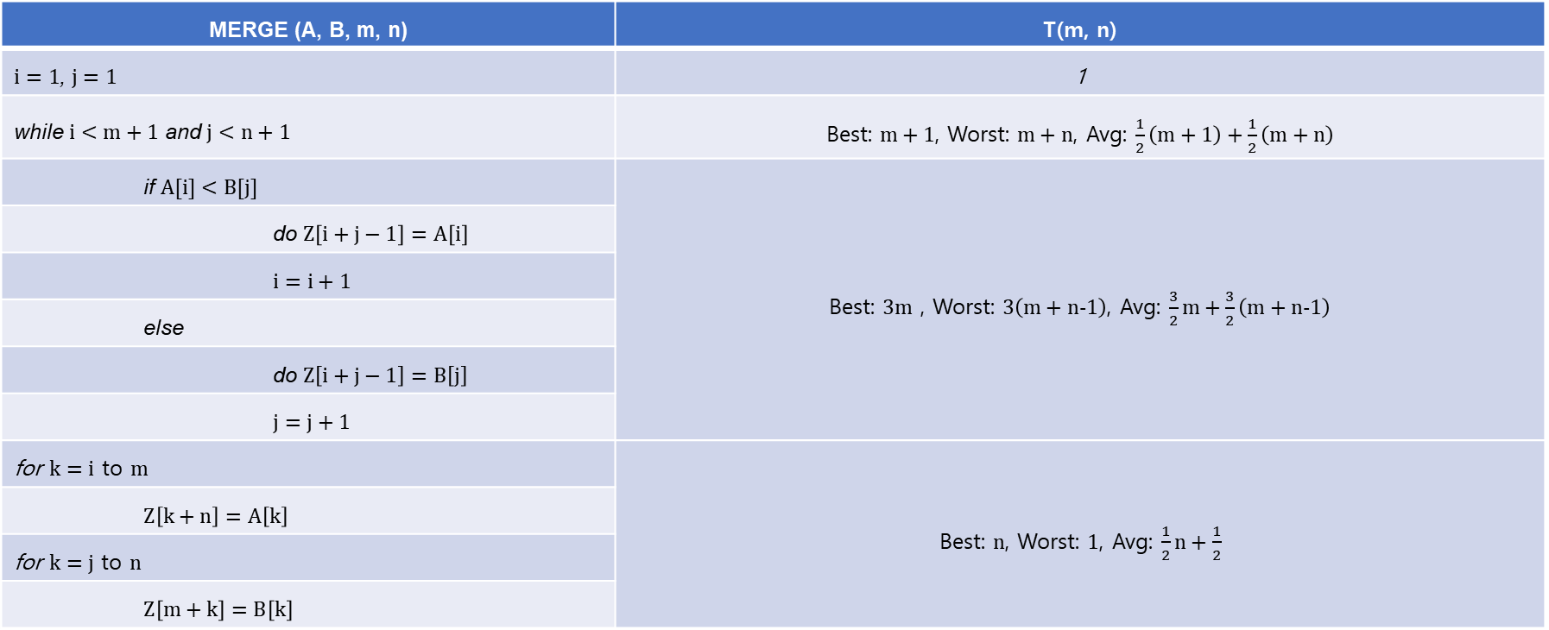
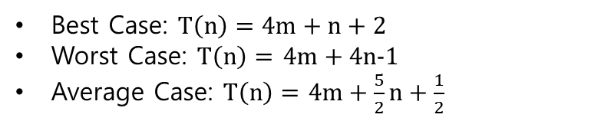
Merge two sorted arrays
* Best Case Assumption: $A\left[i\right]<B\left[j\right]$ for all $i, j$
MERGE (A, B, m, n) | T(m, n)
$i=1$, $j=1$ | 1
while $i<m+1$ and $j<n+1$ | Best: $m+1$, Worst: $m+n$, Avg: $\frac{1}{2}\left(m+1\right)+\frac{1}{2}\left(m+n\right)$
if $A[i]<B[j]$ | Best: $3m$ , Worst: $3\left(m+n−1\right)$, Avg: $\frac{3}{2}m+\frac{3}{2}\left(m+n−1\right)$
do $Z\left[i+j−1\right]=A\left[i\right]$
$i=i+1$
else
do $Z\left[i+j−1\right]=B\left[j\right]$
$j=j+1$
for $k=i$ to $m$ | Best: $n$, Worst: $1$, Avg: $\frac{1}{2}n+\frac{1}{2}$
$Z\left[k+n\right]=A\left[k\right]$
for $k=j$ to $n$
$Z\left[m+k\right]=B\left[k\right]$
Best Case: $T\left(n\right)=4m+n+2$
Worst Case: $T\left(n\right)=$ $4m+4n−1$
Average Case: $T\left(n\right)=$ $4m+\frac{5}{2}n+\frac{1}{2}$

Slide 8
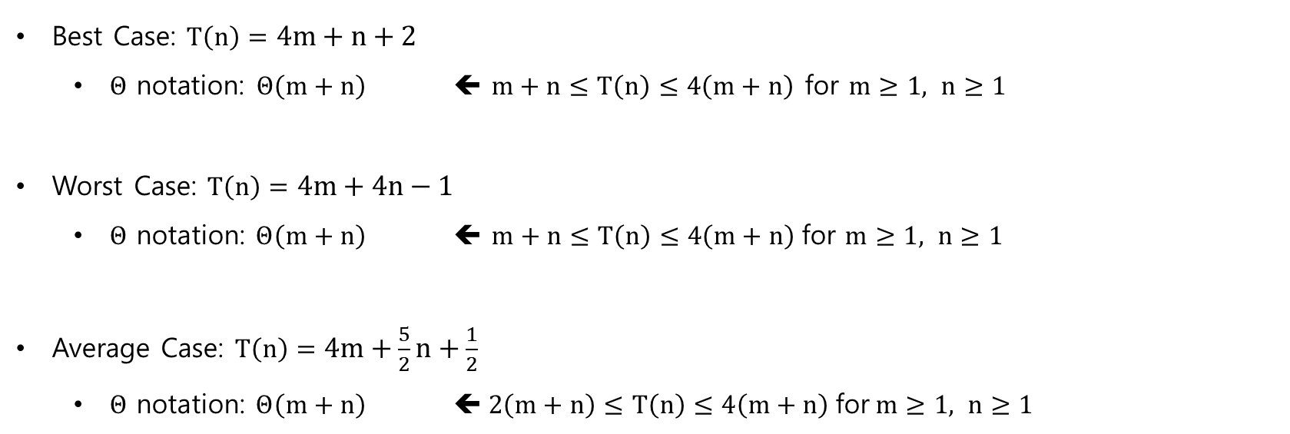
Merge two sorted arrays
Best Case: $T\left(n\right)=4m+n+2$
  $Θ$ notation: $Θ\left(m+n\right)$ ⬅ $m+n≤T\left(n\right)≤4\left(m+n\right)$ for $m≥1, n≥1$
Worst Case: $T\left(n\right)=4m+4n−1$
  $Θ \text{notation}\text{: }Θ\left(m+n\right) \text{⬅} m+n≤T\left(n\right)≤4\left(m+n\right) \text{for} m≥1, n≥1$
Average Case: $T\left(n\right)=4m+\frac{5}{2}n+\frac{1}{2}$
  $Θ \text{notation}\text{: }Θ\left(m+n\right) \text{⬅} 2\left(m+n\right)≤T\left(n\right)≤4\left(m+n\right) \text{for} m≥1, n≥1$

Slide 9
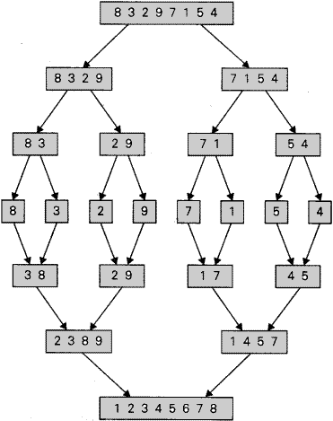
Merge Sort
Divide an array into two arrays
Merge two
sorted arrays
from: https://freefeast.info/general-it-articles/merge-sort-pseudo-code-of-merge-sort-merge-sort-in-data-structure-divide-and-conquer-approach/

Slide 10
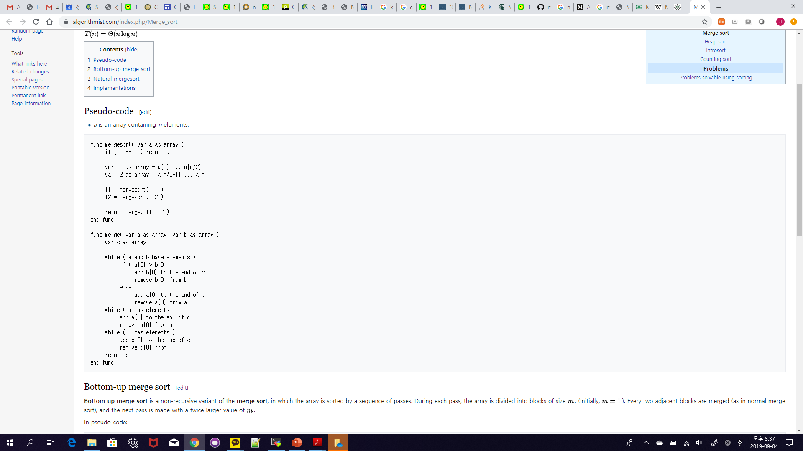
Merge Sort
from: https://www.algorithmist.com/index.php/Merge_sort

Slide 11





Merge Sort
mergesort ($a$)
mergesort ($l_{1}$)
$$l_{1}$$
$$l_{2}$$
mergesort ($l_{2}$)
from: https://www.algorithmist.com/index.php/Merge_sort

Slide 12









Merge Sort
mergesort ($a$)
mergesort ($a$)
$$l_{1}$$
$$l_{2}$$
$$l_{1}$$
$$l_{2}$$
mergesort ($l_{1}$)
mergesort ($l_{2}$)
mergesort ($l_{1}$)
mergesort ($l_{2}$)
from: https://www.algorithmist.com/index.php/Merge_sort

Slide 13








Merge Sort
mergesort ($a$)
mergesort ($a$)
mergesort ($a$)
mergesort ($a$)
$$l_{1}$$
$$l_{2}$$
$$l_{1}$$
$$l_{2}$$
$$l_{1}$$
$$l_{2}$$
$$l_{1}$$
$$l_{2}$$
mergesort ($l_{1}$)
mergesort ($l_{2}$)
mergesort ($l_{1}$)
mergesort ($l_{2}$)
mergesort ($l_{1}$)
mergesort ($l_{2}$)
mergesort ($l_{1}$)
mergesort ($l_{2}$)
$$l_{1}$$
$$l_{2}$$
$$l_{1}$$
$$l_{2}$$
$$l_{1}$$
$$l_{2}$$
$$l_{1}$$
$$l_{2}$$
merge ($l_{1}$, $l_{2}$)
merge ($l_{1}$, $l_{2}$)
merge ($l_{1}$, $l_{2}$)
merge ($l_{1}$, $l_{2}$)
from: https://www.algorithmist.com/index.php/Merge_sort

Slide 14



Merge Sort
mergesort ($a$)
mergesort ($a$)
$$l_{1}$$
$$l_{2}$$
$$l_{1}$$
$$l_{2}$$
mergesort ($l_{1}$)
mergesort ($l_{2}$)
mergesort ($l_{1}$)
mergesort ($l_{2}$)
$$l_{1}$$
$$l_{2}$$
$$l_{1}$$
$$l_{2}$$
merge ($l_{1}$, $l_{2}$)
merge ($l_{1}$, $l_{2}$)
from: https://www.algorithmist.com/index.php/Merge_sort

Slide 15

Merge Sort
mergesort ($a$)
mergesort ($l_{1}$)
$$l_{1}$$
$$l_{2}$$
mergesort ($l_{2}$)
$$l_{1}$$
merge ($l_{1}$, $l_{2}$)
$$l_{2}$$
from: https://www.algorithmist.com/index.php/Merge_sort

Slide 16






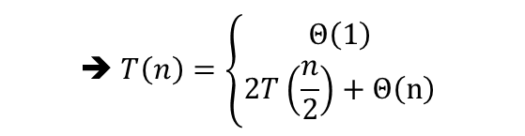




Merge Sort
$$n>1$$
$$n=1$$
$$T\left(n\right)$$
$$T\left(n\right)$$
$$Θ\left(1\right)$$
$$T\left(\frac{n}{2}\right)$$
$$T\left(\frac{n}{2}\right)$$
$$Θ\left(n\right)$$
$$➔ T\left(n\right)=\left\{\begin{aligned}Θ\left(1\right) \\ 2T\left(\frac{n}{2}\right)+Θ\left(n\right)\end{aligned}\right.$$
if $n=1$
if $n>1$

Slide 17

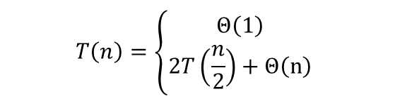



Merge Sort
$$T\left(n\right)=\left\{\begin{aligned}Θ\left(1\right) \\ 2T\left(\frac{n}{2}\right)+Θ\left(n\right)\end{aligned}\right.$$
if $n=1$
$$Θ\left(n\right)≈cn$$
if $n>1$
$$T\left(n\right)$$

Slide 18



Merge Sort
$$T\left(n\right)=\left\{\begin{aligned}Θ\left(1\right) \\ 2T\left(\frac{n}{2}\right)+Θ\left(n\right)\end{aligned}\right.$$
if $n=1$
$$Θ\left(n\right)≈cn$$
if $n>1$
$$cn$$
$$T\left(\frac{n}{2}\right)$$
$$T\left(\frac{n}{2}\right)$$

Slide 19





Merge Sort
$$T\left(n\right)=\left\{\begin{aligned}Θ\left(1\right) \\ 2T\left(\frac{n}{2}\right)+Θ\left(n\right)\end{aligned}\right.$$
if $n=1$
$$Θ\left(n\right)≈cn$$
if $n>1$
$$cn$$
$$\frac{cn}{2}$$
$$\frac{cn}{2}$$
$$T\left(\frac{n}{4}\right)$$
$$T\left(\frac{n}{4}\right)$$
$$T\left(\frac{n}{4}\right)$$
$$T\left(\frac{n}{4}\right)$$

Slide 20



Merge Sort
$$T\left(n\right)=\left\{\begin{aligned}Θ\left(1\right) \\ 2T\left(\frac{n}{2}\right)+Θ\left(n\right)\end{aligned}\right.$$
if $n=1$
$$Θ\left(n\right)≈cn$$
if $n>1$
$$cn$$
$$\frac{cn}{2}$$
$$\frac{cn}{2}$$
$$\frac{cn}{4}$$
$$\frac{cn}{4}$$
$$\frac{cn}{4}$$
$$\frac{cn}{4}$$
$$Θ\left(1\right)$$

Slide 21


Merge Sort
$$T\left(n\right)=\left\{\begin{aligned}Θ\left(1\right) \\ 2T\left(\frac{n}{2}\right)+Θ\left(n\right)\end{aligned}\right.$$
if $n=1$
$$Θ\left(n\right)≈cn$$
if $n>1$
$$cn$$
$$\frac{cn}{2}$$
$$\frac{cn}{2}$$
$$h=\ln{n}$$
$$\frac{cn}{4}$$
$$\frac{cn}{4}$$
$$\frac{cn}{4}$$
$$\frac{cn}{4}$$
$$Θ\left(1\right)$$
$$n$$

Slide 22





Merge Sort
$$T\left(n\right)=\left\{\begin{aligned}Θ\left(1\right) \\ 2T\left(\frac{n}{2}\right)+Θ\left(n\right)\end{aligned}\right.$$
if $n=1$
$$Θ\left(n\right)≈cn$$
if $n>1$
$$cn$$
$$cn$$
$$\frac{cn}{2}$$
$$\frac{cn}{2}$$
$$cn$$
$$h=\ln{n}$$
$$\frac{cn}{4}$$
$$\frac{cn}{4}$$
$$\frac{cn}{4}$$
$$\frac{cn}{4}$$
$$cn$$
$$⋮$$
$$Θ\left(1\right)$$
$$Θ\left(n\right)$$
$$n$$
$$Total=Θ\left(n\ln{n}\right)$$

Slide 23
Reference
Charles Leiserson and Piotr Indyk, “Introduction to Algorithms”, September 29, 2004
https://www.geeksforgeeks.org

