Slide 1
Other Sorting Algorithms
SWE2016-44

Slide 2
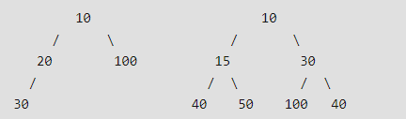
Heap Sort
Heap Sort: a comparison based sorting technique based on Binary Heap data structure
  First find the maximum element and place the maximum element at the end. Repeat the same process for remaining element.
  Binary Heap: a Complete Binary Tree where items are stored in a special order such that value in a parent node is greater(or smaller) than the values in its two children nodes. → Max Heap (Min Heap)
    If the parent node is stored at index i, the left child can be calculated by 2i+1 and right child by 2i+2 (assuming the indexing starts at 0).
→ Min Heap

Slide 3
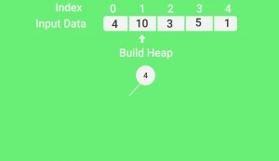
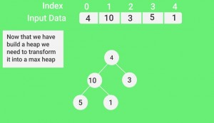
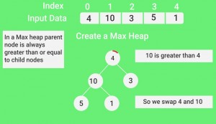
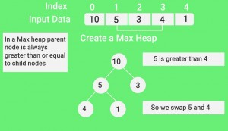
Heap Sort
Heap Sort Algorithm for sorting in increasing order
  Build a max heap from the input data.
  At this point, the largest item is stored at the root of the heap. Replace it with the last item of the heap followed by reducing the size of heap by 1. Finally, heapify the root of tree.
  Repeat above steps while size of heap is greater than 1.

Slide 4
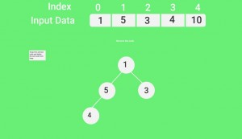
Heap Sort
Heap Sort Algorithm for sorting in increasing order
  Build a max heap from the input data.
  At this point, the largest item is stored at the root of the heap. Replace it with the last item of the heap followed by reducing the size of heap by 1. Finally, heapify the root of tree.
  Repeat above steps while size of heap is greater than 1.

Slide 5
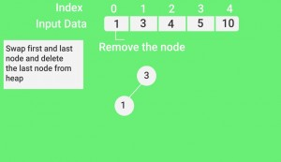
Heap Sort
Heap Sort Algorithm for sorting in increasing order
  Build a max heap from the input data.
  At this point, the largest item is stored at the root of the heap. Replace it with the last item of the heap followed by reducing the size of heap by 1. Finally, heapify the root of tree.
  Repeat above steps while size of heap is greater than 1.

Slide 6
Heap Sort
Heap Sort Algorithm for sorting in increasing order
  Build a max heap from the input data.
  At this point, the largest item is stored at the root of the heap. Replace it with the last item of the heap followed by reducing the size of heap by 1. Finally, heapify the root of tree.
  Repeat above steps while size of heap is greater than 1.
Time complexity of heapify: O(Logn)
Time complexity of createAndBuildHeap(): O(n)
→ Overall time complexity of Heap Sort: O(nLogn)

Slide 7
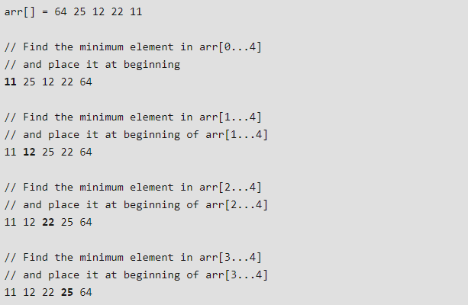
Selection Sort
Sort an array by repeatedly finding the minimum element (considering ascending order) from unsorted part and putting it at the beginning
Time Complexity: O(n²) as there are two nested loops

Slide 8
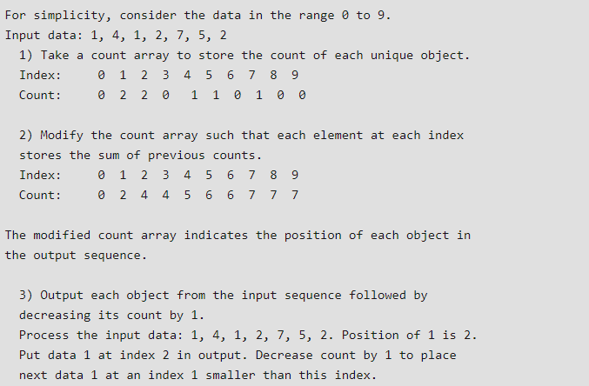
Counting Sort
Counting Sort: A sorting technique based on keys between a specific range. It works by counting the number of objects having distinct key values (kind of hashing).
Time Complexity: O(n+k) where n is the number of elements in input array and k is the range of input.

Slide 9
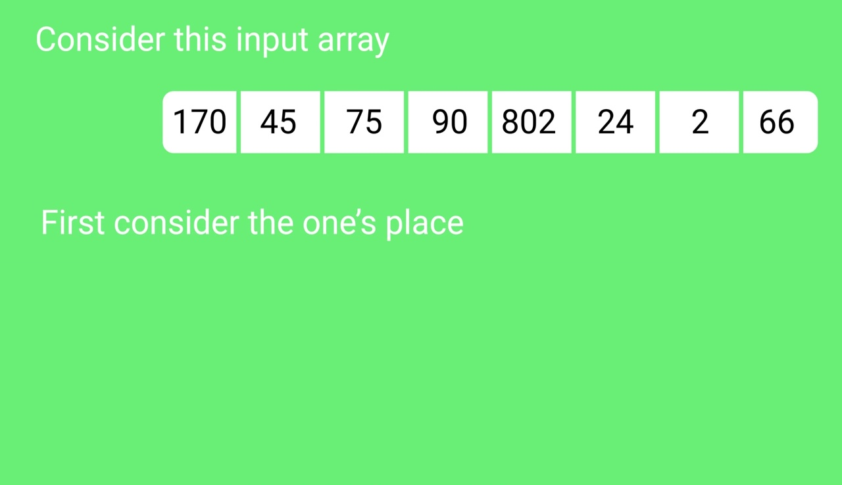
Radix Sort
The idea of Radix Sort is to do digit by digit sort starting from least significant digit to most significant digit.
  Sort input array using counting sort (or any stable sort) according to the i’th digit.

Slide 10
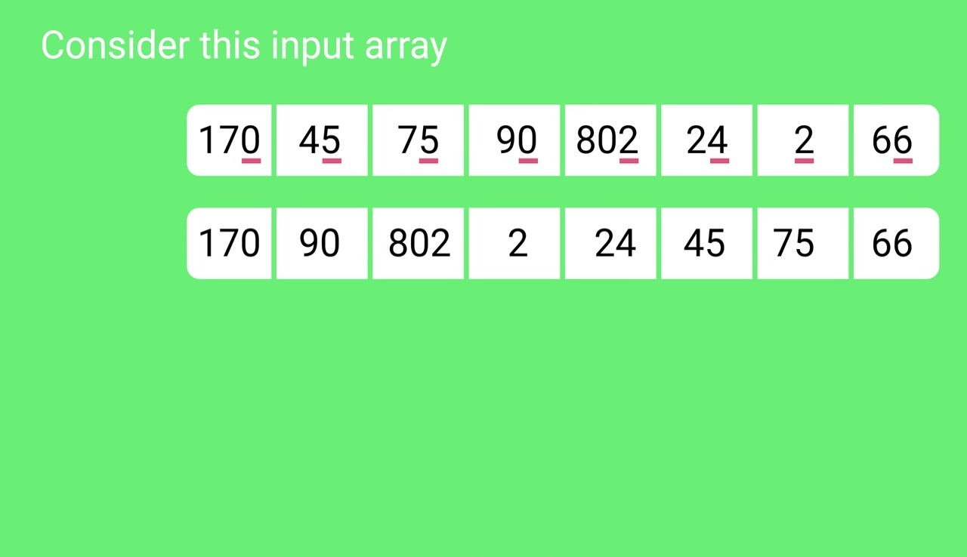
Radix Sort
The idea of Radix Sort is to do digit by digit sort starting from least significant digit to most significant digit.
  Sort input array using counting sort (or any stable sort) according to the i’th digit.

Slide 11
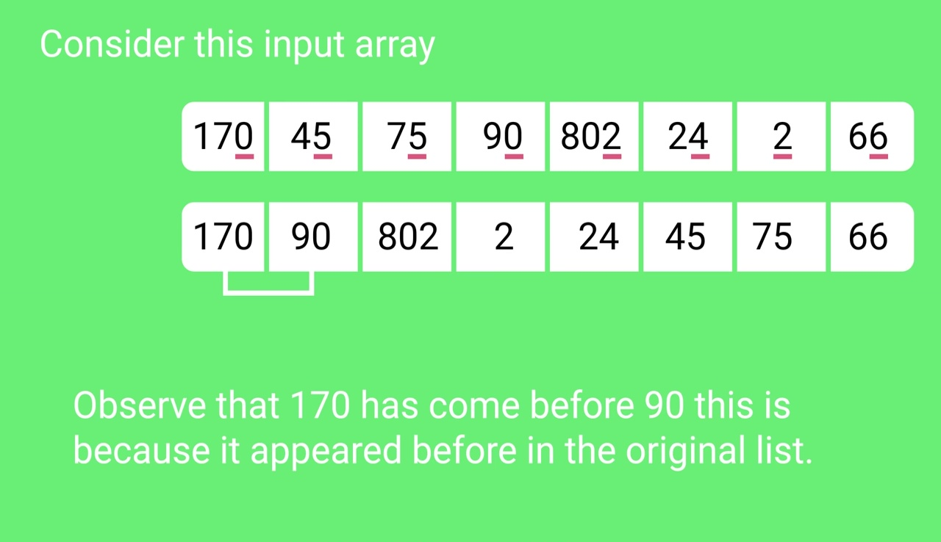
Radix Sort
The idea of Radix Sort is to do digit by digit sort starting from least significant digit to most significant digit.
  Sort input array using counting sort (or any stable sort) according to the i’th digit.

Slide 12
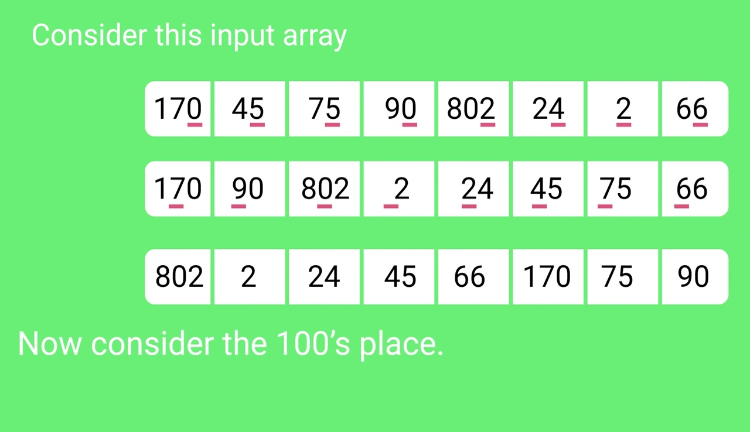
Radix Sort
The idea of Radix Sort is to do digit by digit sort starting from least significant digit to most significant digit.
  Sort input array using counting sort (or any stable sort) according to the i’th digit.

Slide 13
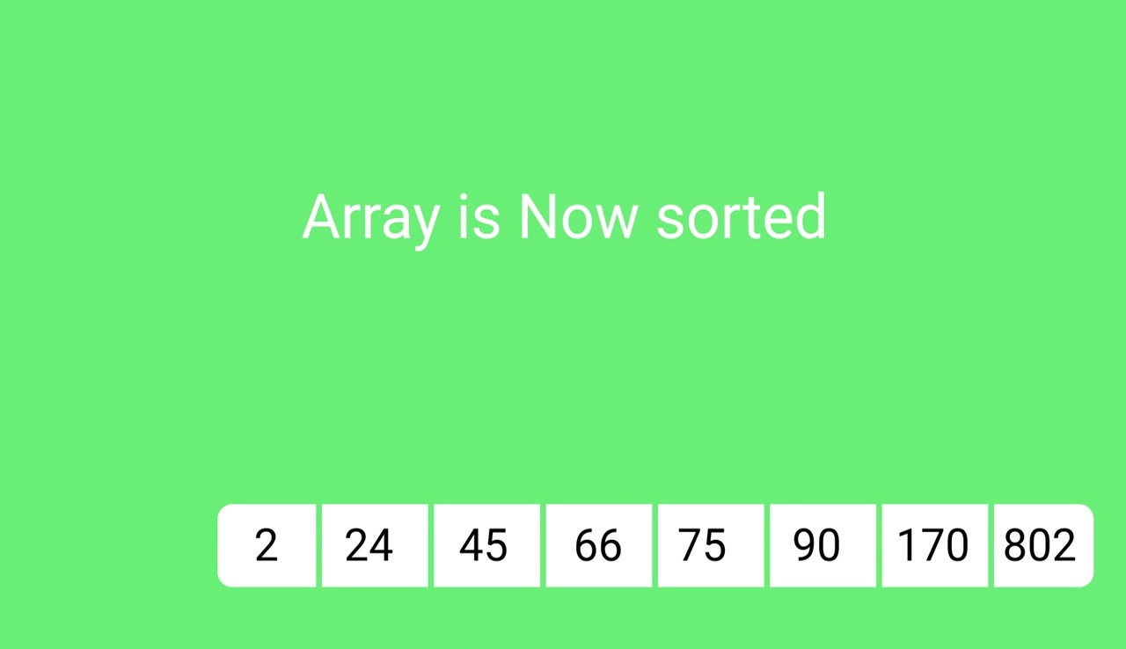
Radix Sort
The idea of Radix Sort is to do digit by digit sort starting from least significant digit to most significant digit.
  Sort input array using counting sort (or any stable sort) according to the i’th digit.

Slide 14
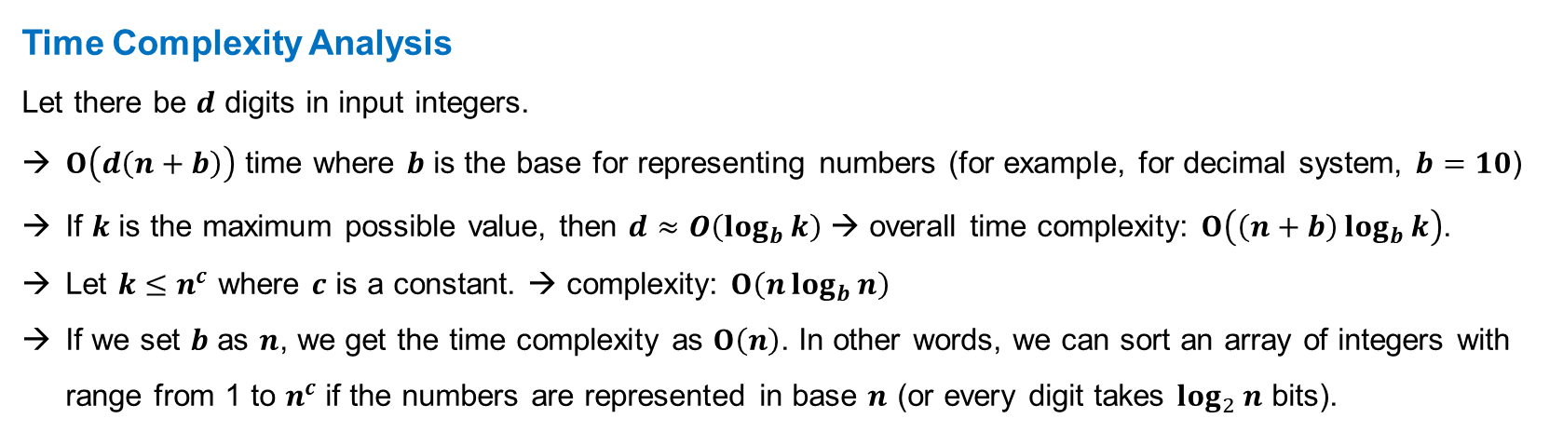
Radix Sort
The idea of Radix Sort is to do digit by digit sort starting from least significant digit to most significant digit.
  Sort input array using counting sort (or any stable sort) according to the i’th digit.
Time Complexity Analysis
Let there be $d$ digits in input integers.
$O\left(d\left(n+b\right)\right)$ time where $b$ is the base for representing numbers (for example, for decimal system, $b=10$)
If $k$ is the maximum possible value, then $d≈O\left(\log_{b}{k}\right)$ → overall time complexity: $O\left(\left(n+b\right)\log_{b}{k}\right)$.
Let $k≤n^{c}$ where $c$ is a constant. → complexity: $O\left(n\log_{b}{n}\right)$
If we set $b$ as $n$, we get the time complexity as $O\left(n\right)$. In other words, we can sort an array of integers with range from 1 to $n^{c}$if the numbers are represented in base $n$ (or every digit takes $\log_{2}{n}$ bits).

Slide 15
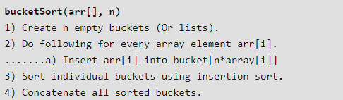
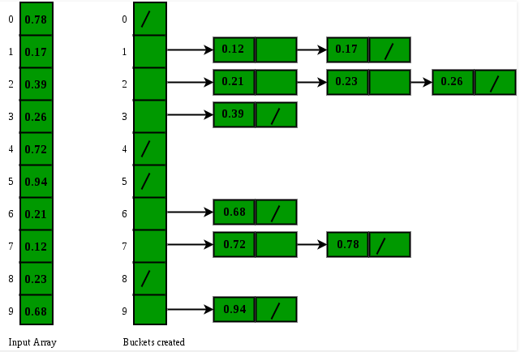
Bucket Sort
Bucket sort is mainly useful when input is uniformly distributed over a range. For example, consider the following problem. Sort a large set of floating point numbers which are in range from 0.0 to 1.0 and are uniformly distributed across the range.
Time Complexity:
  If we assume that insertion in a bucket takes O(1) time then steps 1 and 2 of the above algorithm clearly take O(n) time. The O(1) is easily possible if we use a linked list to represent a bucket.
  Step 3 also takes O(n) time on average if all numbers are uniformly distributed
  Step 4 also takes O(n) time as there will be n items in all buckets.

Slide 16
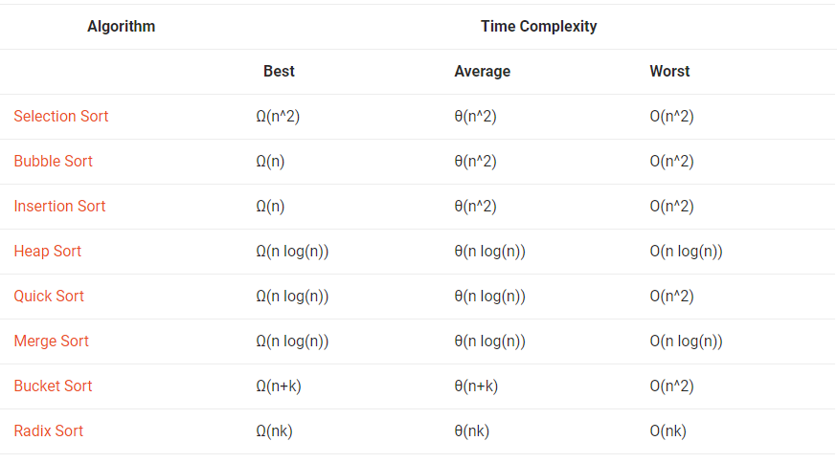
Time Complexities of all Sorting Algorithms

Slide 17
Reference
https://www.geeksforgeeks.org

