Slide 1

Master Deep Learning
Autoescalado horizontal en Kubernetes con Aprendizaje por Refuerzo
Marcial Lalanda González-Bueno
2021

Slide 2
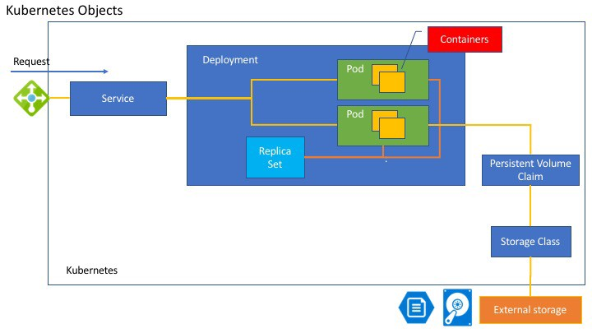


Slide 3
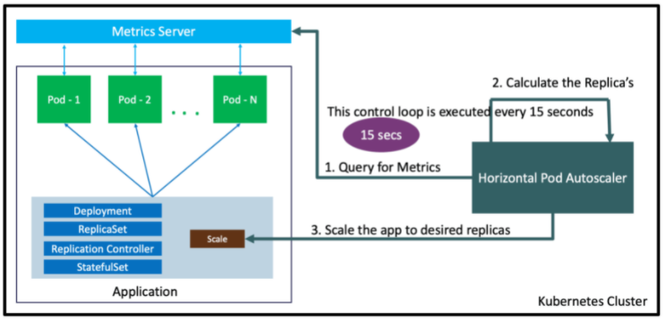


<?php
$x = 0.0001;
for ($i = 0; $i <= 1000000; $i++) {
$x += sqrt($x);
}
echo "OK!";
?>
https://www.stacksimplify.com/aws-eks/aws-eks-kubernetes-autoscaling/learn-to-master-horizontal-pod-autoscaling-on-aws-eks/

Slide 4
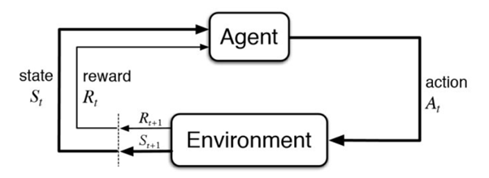
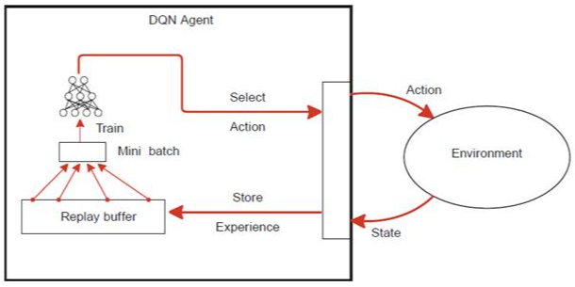
Set pods
Kubernetes Cluster
Calculate Reward
Get State
https://livebook.manning.com/book/grokking-deep-reinforcement-learning

Slide 5
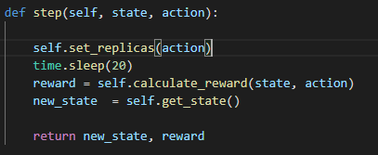
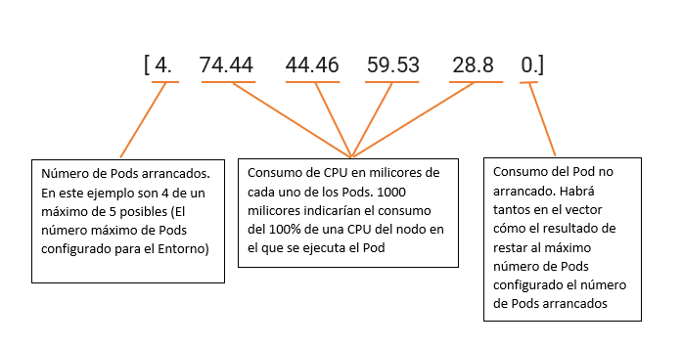
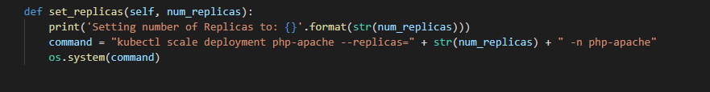
Environment
State
Sleep 20
Dejar tiempo a K8s para establecer
el nuevo estado
Retardo en el aprendizaje
Snapshots del estado

Slide 6
Rewards

Slide 7
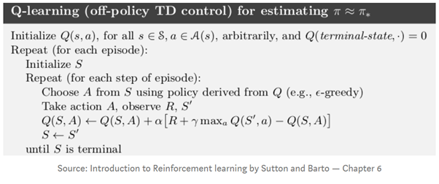
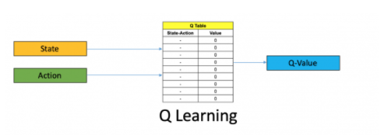
https://www.analyticsvidhya.com/blog/2019/04/introduction-deep-q-learning-python/

Slide 8
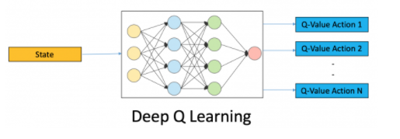
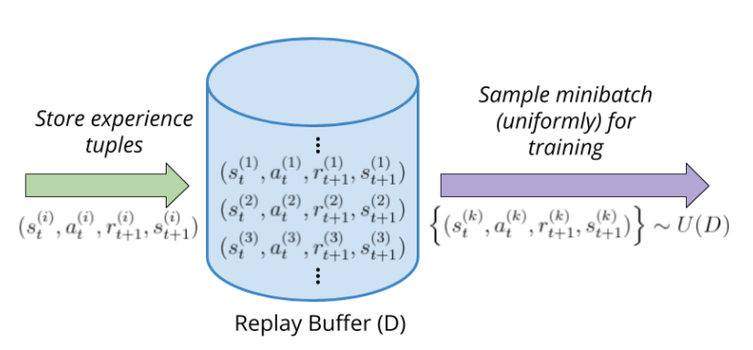
https://wpumacay.github.io/research_blog/posts/deeprlnd-project1-navigation/
https://wpumacay.github.io/research_blog/posts/deeprlnd-project1-navigation/
https://livebook.manning.com/book/grokking-deep-reinforcement-learning

Slide 9
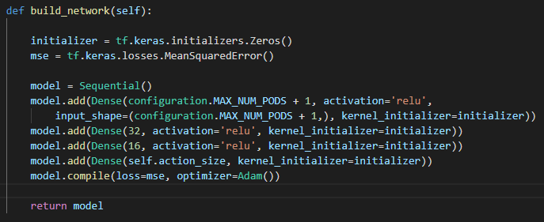
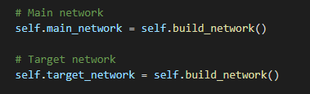
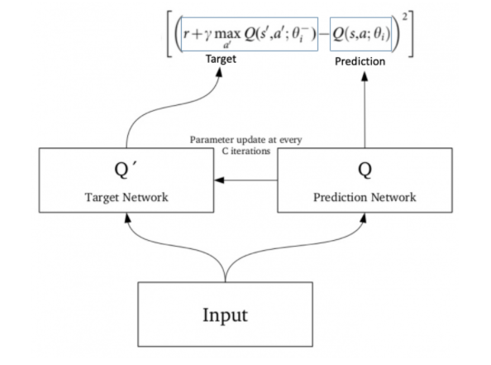

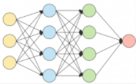
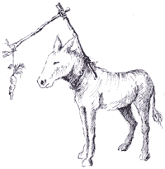
https://www.analyticsvidhya.com/blog/2019/04/introduction-deep-q-learning-python/

Slide 10
Training

Slide 11
Ejecución

Slide 12
Prueba Comparativa
5 Minutos idle
5 media carga
5 Mucha carga
Repetimos

Slide 13
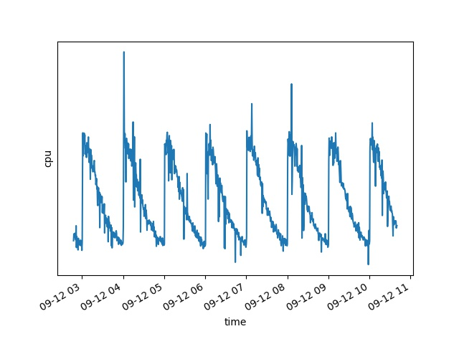
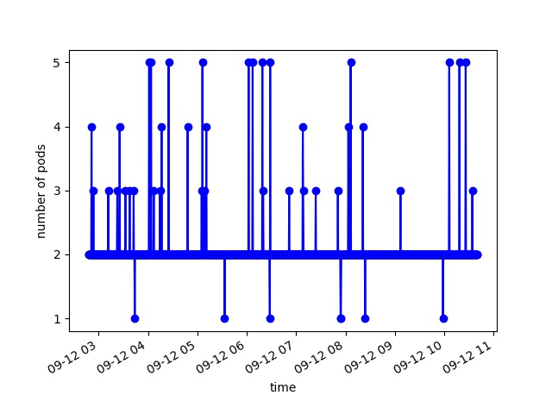
Resultados
HPA
DRL

Slide 14
Conclusiones y nuevas vías de exploración

