Slide 1
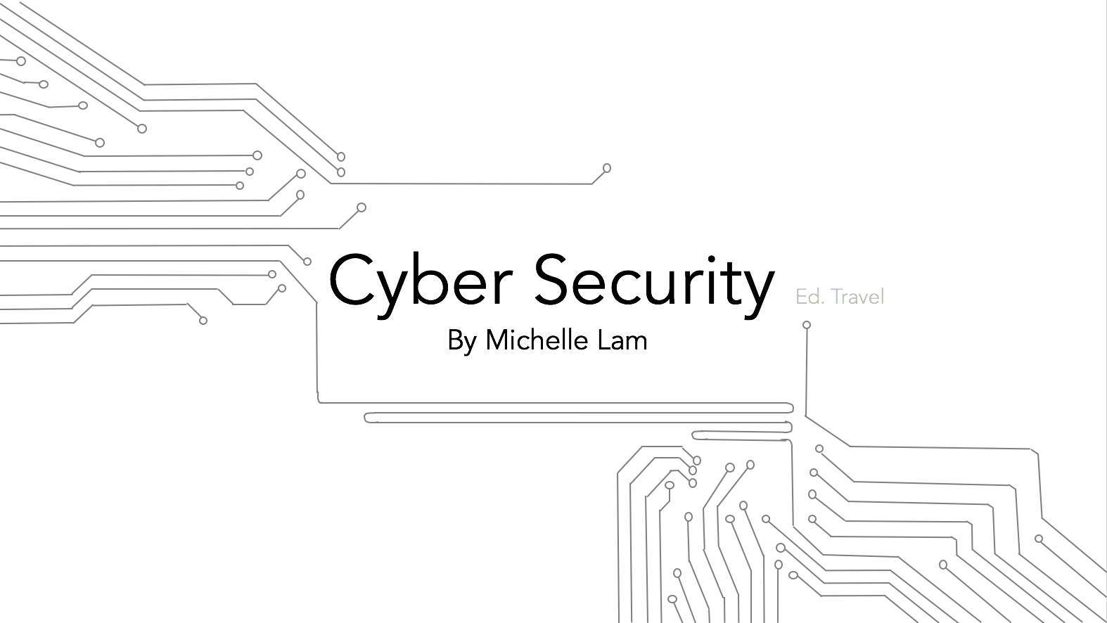

Slide 2
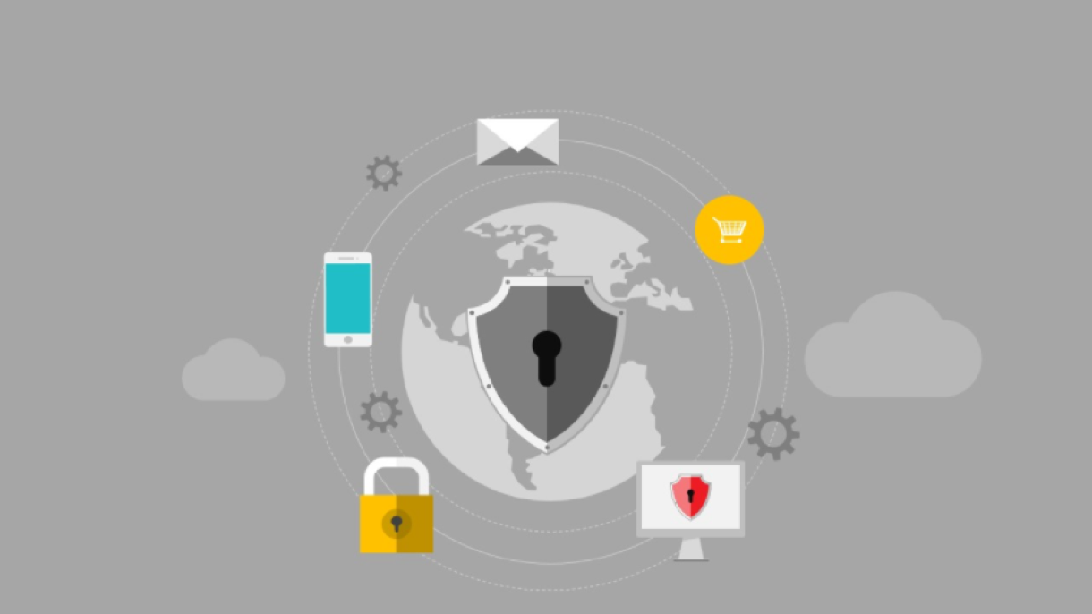

Overview
Notes:
1. Phishing Scams
2. Purchasing → (Credit Cards and Debit Cards)
3. VPN Access
4. Accessing Unencrypted Networks
5. Mobile Devices

Slide 3

Phishing Scams
Always, always think twice before clicking
Consider the source
Know your backups
Notes:
Phishing scams work by tricking you into clicking on a link or attachment that either infects your machine with malware or takes you to a page that looks totally legit, but isn’t and is designed to steal your private information.
Ex. Yahoo breach (spear fished)
Three ways to help increase chances of avoiding phishing scams
Always, always think twice before clicking
They often do so by prying on your emotions
Listen to your gut– if something feels off it probably is
Consider the source
Check to see message is from a legitimate source
Some may not be as apparent
Attacker might be from someone you know → reach out to them separately and ask
Know your backups
Prepare defensively in case you get phished
Enabling multi-factor authentication on all accounts that offer it
Using password manager or strong, random and unique password
Backing up your data

Slide 4
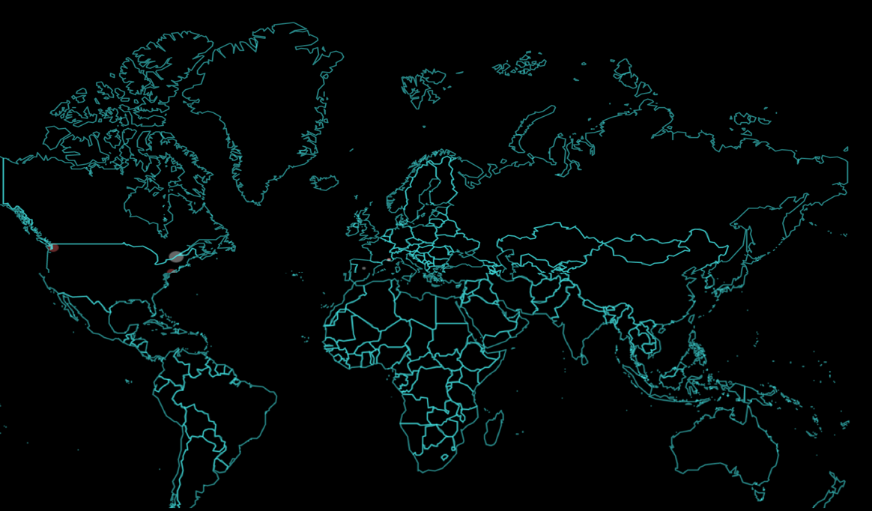

Most Infected Today (Top 5 Countries)
Notes:
Vietnam
Russia
India
Germany
United States
https://cybermap.kaspersky.com/stats/

Slide 5

Credit Cards, Debit Cards & Cash (while traveling)
Highly recommended that you use credit cards
Use debit cards only to withdraw funds at bank ATMs
Carry a little bit of cash for emergencies
Notes:
Recommended using Credit Cards
Anti-Fraud Protection– if someone steals your card or if you use a shady ATM in some tourist trap designed to harvest card data.
Can put a stop to it without being liable for the charges (if the credit card company doesn’t detect it first)
OTHER TIMES CREDIT IS THE BEST OPTION
**Shopping online
• watch for fraudulent charges. If detected you can reverse it– “zero liability”
**Making large purchases or electronics purchases
• warranty protection
Never use Debit Cards Except to Withdraw Funds at Bank ATM
Carry a small amount of cash in case of emergencies
Such as the place you go to doesn’t accept your card
http://www.bankrate.com/finance/credit-cards/avoid-credit-card-fraud-during-travel-1.aspx
http://lifehacker.com/when-should-i-use-credit-and-when-should-i-use-debit-wh-862086499

Slide 6

Virtual Private Network (VPN)
Hides your IP Address & Location
Secures your data
Blocks online trackers
Notes:
-raw data in your traffic is encrypted back to you home, office or school network forming a Virtual Private Network, and then decrypted and sent out onto the internet as though you were at home, work, or school, not on the road.
-The most important thing you need to know about a VPN: It secures your computer’s internet connection to guarantee that all of the data you’re sending and receiving is encrypted and secured from prying eyes.
-There are countless ways you are being tracked by advertisers, social media and other companies. A good VPN blocks this.

Slide 7

Unencrypted Network
Accessing unencrypted networks can be dangerous:
Snooping
Compromised Devices
Honey Pots
Notes:
-When you connected to an open Wi-Fi network like one at a coffee shop or airport your unencrypted network traffic is then clearly visible to everyone in range. People can see what unencrypted web pages you’re visiting, what you’re typing into unencrypted web forms, and even see which encrypted websites you’re connected to — so if you’re connected to your bank’s website, they’d know it, although they wouldn’t know what you were doing.
-Any compromised laptops on the local network could try to infect you.
-That free hotspot may in reality be a “honeypot,” a trap designed to fool unsuspecting travelers into exposing their computers and data to hackers.
https://
***green means that is verified signature (lock)
***red means its https and secure but the source is not verified (red triangle w/ “!”)

Slide 8

Mobile Devices
Mobile devices are just as vulnerable
Don’t charge your phone in public ports
Encrypt memory
Notes:
-Mobile phones share many of the vulnerabilities of PCs. However, the attributes that make mobile phones easy to carry, use, and modify open them to a range of attacks.
-Phone is dead → plug into USB port or outlet → invisible attacker collects information while your phone is plugged in to a hacked outlet.
** if a port is compromised, there's no limit to what information a hacker could take.
→ charge ahead of time. use portable chargers
-Requires an encryption key to access memory

Slide 9
