Slide 1
GEE Approach
Presented by Jianghu Dong
Instructor:
Professor Keumhee Chough (K.C.) Carrière

Slide 2
Outline
Background and justification for using GEE Approach.
Brief review of GEE Approach development
Brief introduce to working correlation matrix
GEE implementation
Data Analysis: a single response and multi-response
Limitation and extension.

Slide 3
Background
Practical Background:
We commonly encounter Longitudinal or clustered data.
There exit correlations between observations on a given subject
If outcomes multivariate normal, then established approachs of analysis are available (See Laird and Ware, Biometrics, 1982).
However, If outcomes are binary or counts, likelihood based inference less tractable.
When T is large and there are many predictors, especially when some are continuous, all the ML approaches aren’t practical.
ML assumes a certain distribution for the response variable. But sometimes it isn’t very clear for us how to select it.

Slide 4
Justification
Why to use GEE
An alternative to ML fitting is Quasi-likelihood equation: The estimates are solutions of quasi-likelihood equations called generalized estimating equations (GEE)
Quasi-likelihood just specifies the first two moments(u and v(u)).
Quasi-likelihood just specifies a link function g(u) which links the mean to a linear predictor (we often use identity link and logit link for binary data ).
Quasi-likelihood just need to specifies how the variance depend on the mean.
When the model applies to the marginal distribution for each response variable, we require a working guess for the correction structure among responses.
It is very often for us that different clusters can have different numbers of observations. GEE don’t need that different clusters can have same numbers of observations. It is very good for us.
GEE computation is simple

Slide 5
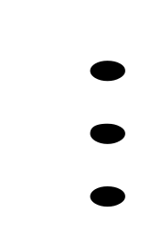
Introduction to GEE Approach development
Liang and Zeger (Biometrika,1986) and Zeger ,and Liang (Biometrics, 1986) extend the generalized linear model to allow for correlated observations.
Lipsitz et al(1994) outlined a GEE approach for cumulative logit models with ordinal responses.

Slide 6
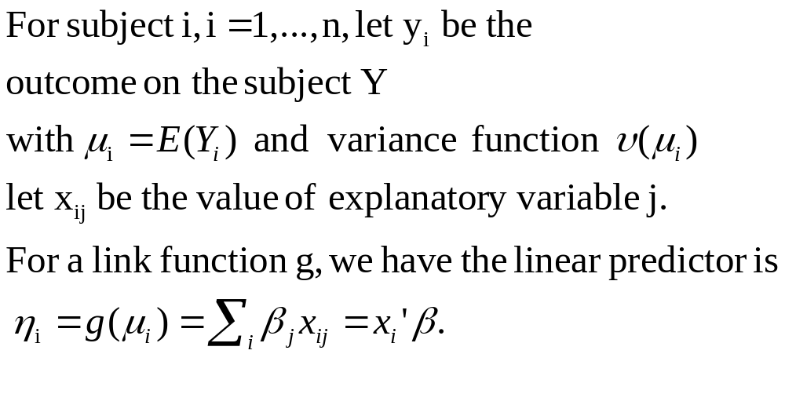
GEE Approach in a univariate case

Slide 7
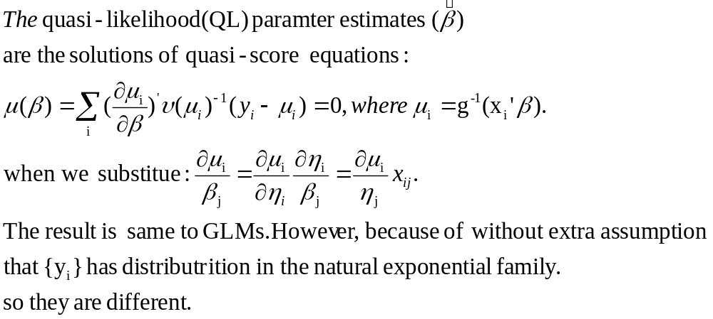
GEE Approach in a univariate case

Slide 8
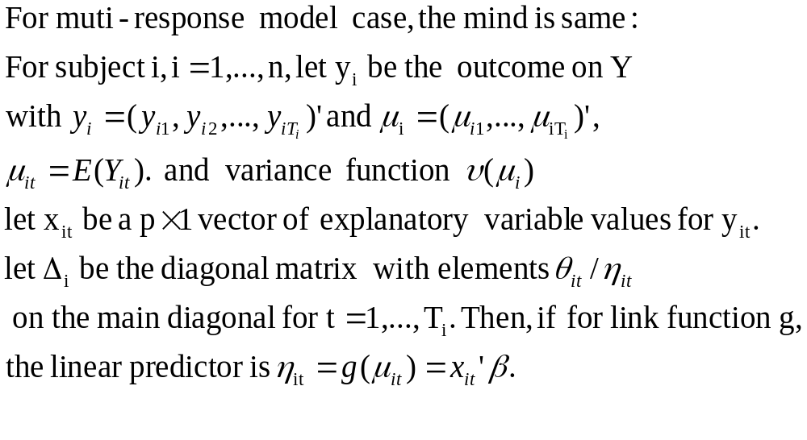
GEE Approach
In the multi-variate case

Slide 9
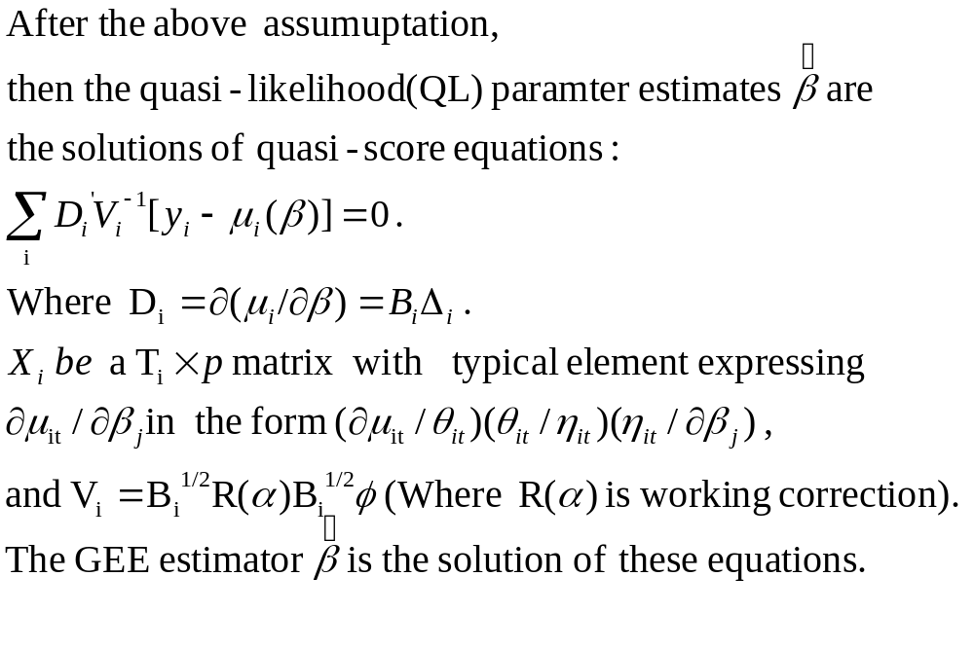
GEE Approach
In multi-variate case

Slide 10
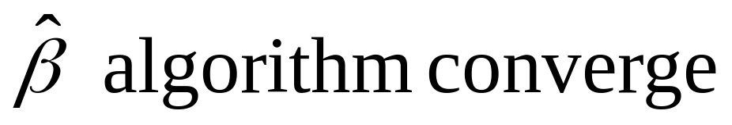
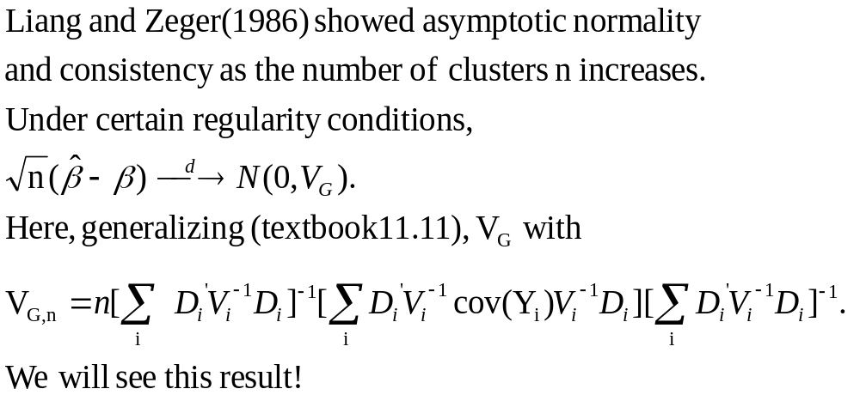

Slide 11
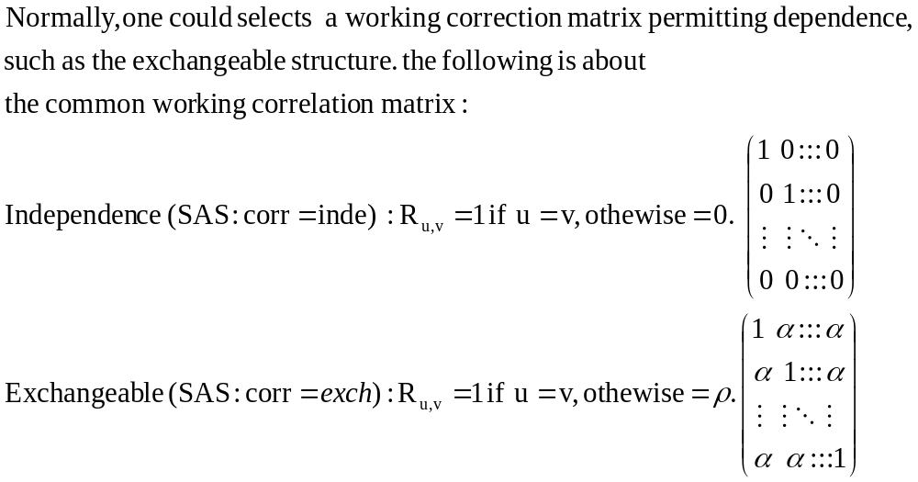
working correction

Slide 12
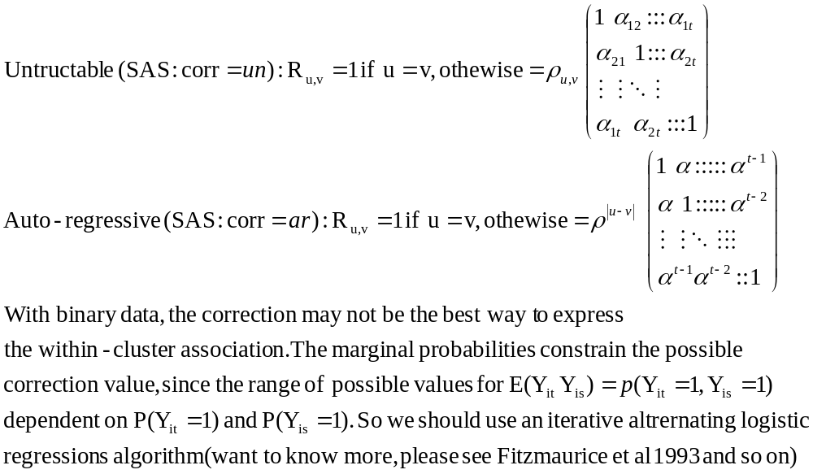
working correction models

Slide 13



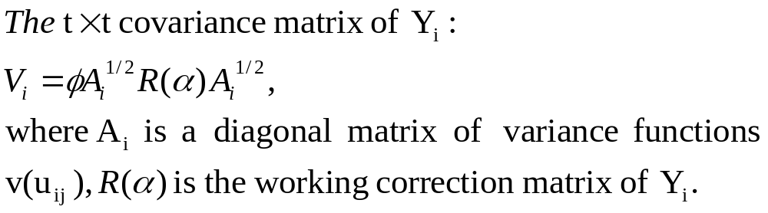
A special case :GEE with the logit link
For binary data with logit link:
Which implies:
And since the outcomes are binary, we have that :
The covariance structure of the correlated observations on a given subject.

Slide 14
Data Analysis
Example 1:using Table 11.2 singe-response
Example 2:using Table 11.4 multi-responses
In both example, We use GEE approach, get the model parameters, then using Random Intercept Cumulative Logit model to test and analysis them. Finally we get the model.

Slide 15
GEE Approach for marginal modeling
Analysis Of Initial Parameter Estimates
Standard Wald 95% Confidence Chi-
Parameter DF Estimate Error Limits Square Pr > ChiSq
Intercept 1 -0.0280 0.1639 -0.3492 0.2933 0.03 0.8644
diagnose 1 -1.3139 0.1464 -1.6009 -1.0269 80.53 <.0001
treat 1 -0.0596 0.2222 -0.4951 0.3759 0.07 0.7885
time 1 0.4824 0.1148 0.2575 0.7073 17.67 <.0001
treat*time 1 1.0174 0.1888 0.6474 1.3875 29.04 <.0001
Scale 0 1.0000 0.0000 1.0000 1.0000

Slide 16
GEE Approach for marginal modeling
GEE Model Information
Correlation Structure Exchangeable
Subject Effect case (340 levels)
Number of Clusters 340
Correlation Matrix Dimension 3
Maximum Cluster Size 3
Minimum Cluster Size 3

Slide 17
Analysis GEE Parameter Estimate
The GENMOD Procedure
Analysis Of GEE Parameter Estimates
Empirical Standard Error Estimates
Standard 95% Confidence
Parameter Estimate Error Limits Z Pr > |Z|
Intercept -0.0281 0.1742 -0.3695 0.3133 -0.16 0.8718
diagnose -1.3139 0.1460 -1.6000 -1.0278 -9.00 <.0001
treat -0.0593 0.2286 -0.5072 0.3887 -0.26 0.7954
time 0.4825 0.1199 0.2474 0.7175 4.02 <.0001
treat*time 1.0172 0.1877 0.6493 1.3851 5.42 <.0001

Slide 18
GEE Approach for response
Score Statistics For Type 3 GEE Analysis
Chi-
Source DF Square Pr > ChiSq
diagnose 1 70.87 <.0001
treat 1 0.07 0.7954
time 1 5.70 <.0001
treat*time 1 28.50 <.0001

Slide 19
SAS CODE
GEE Code
proc genmod descending;
class case;
model outcome =diagnose treat time treat*time /dist=bin link=logit type3;
repeated subject=case/type=exch corrw;
Analysis GEE Parameter Estimate
proc nlmixed qpoints=200;
parms alpha=-.03 beta1=-1.3 beta2=-.06 beta3=.48 beta4=1.02 sigma=.066;
eta =alpha+beta1*diagnose+beta2*treat + beta3*time + beta4*treat*time + u;
p = exp(eta)/(1 + exp(eta));
model outcome ~ binary(p);
random u ~ normal(0, sigma*sigma) subject = case;

Slide 20
GEE Approach for multivariate
The GENMOD Procedure
Analysis Of GEE Parameter Estimates
Empirical Standard Error Estimates
Standard 95% Confidence
Parameter Estimate Error Limits Z Pr > |Z|
Intercept -0.0281 0.1742 -0.3695 0.3133 -0.16 0.8718
diagnose -1.3139 0.1460 -1.6000 -1.0278 -9.00 <.0001
treat -0.0593 0.2286 -0.5072 0.3887 -0.26 0.7954
time 0.4825 0.1199 0.2474 0.7175 4.02 <.0001
treat*time 1.0172 0.1877 0.6493 1.3851 5.42 <.0001

Slide 21
Analysis GEE Parameter Estimate
The GENMOD Procedure
Criteria For Assessing Goodness Of Fit
Criterion DF Value Value/DF
Log Likelihood -620.9942
Algorithm converged.
Analysis Of Initial Parameter Estimates
Standard Wald 95% Confidence Chi-
Parameter DF Estimate Error Limits Square Pr > ChiSq
Intercept1 1 -2.2671 0.2048 -2.6684 -1.8657 122.58 <.0001
Intercept2 1 -0.9515 0.1812 -1.3066 -0.5964 27.58 <.0001
Intercept3 1 0.3517 0.1746 0.0094 0.6940 4.06 0.0440
treat 1 0.0336 0.2377 -0.4324 0.4996 0.02 0.8876
time 1 1.0381 0.2410 0.5657 1.5104 18.55 <.0001
treat*time 1 0.7078 0.3339 0.0532 1.3623 4.49 0.0341
Scale 0 1.0000 0.0000 1.0000 1.0000

Slide 22
GEE Approach for multivariate
GEE Model Information
Correlation Structure Independent
Subject Effect case (239 levels)
Number of Clusters 239
Correlation Matrix Dimension 2
Maximum Cluster Size 2
Minimum Cluster Size 2 Algorithm converged.

Slide 23
Analysis Of GEE Parameter Estimates
Analysis Of GEE Parameter Estimates
Empirical Standard Error Estimates
Standard 95% Confidence
Parameter Estimate Error Limits Z Pr > |Z| ML Estimate
Intercept1 -2.2671 0.2188 -2.6959 -1.8383 -10.36 <.0001
Intercept2 -0.9515 0.1809 -1.3061 -0.5969 -5.26 <.0001
Intercept3 0.3517 0.1784 0.0020 0.7014 1.97 0.0487
treat 0.0336 0.2384 -0.4337 0.5009 0.14 0.8879 0.046(SE=0.236)
time 1.0381 0.1676 0.7096 1.3665 6.19 <.0001 1.074(SE=0.162)
time*treat 0.7078 0.2435 0.2305 1.1850 2.91 0.0037 0.662 (SE=0.244)

Slide 24
SAS CODE
GEE Code data francom; input case treat time outcome ; datalines; …; proc genmod; class case; model outcome = treat time treat*time / dist=multinomial link=clogit; repeated subject=case / type=indep corrw; run;
Random Intercept Cumulative Logit Analyses GEE Code proc nlmixed qpoints=40; bounds i2 > 0; bounds i3 > 0; eta1 = i1 + treat*beta1 + time*beta2 + treat*time*beta3 + u; eta2 = i1 + i2 + treat*beta1 + time*beta2 + treat*time*beta3 + u; eta3 = i1 + i2 + i3 + treat*beta1 + time*beta2 + treat*time*beta3 + u; p1 = exp(eta1)/(1 + exp(eta1)); p2 = exp(eta2)/(1 + exp(eta2)) - exp(eta1)/(1 + exp(eta1)); p3 = exp(eta3)/(1 + exp(eta3)) - exp(eta2)/(1 + exp(eta2)); p4 = 1 - exp(eta3)/(1 + exp(eta3)); ll = y1*log(p1) + y2*log(p2) + y3*log(p3) + y4*log(p4); model y1 ~ general(ll); estimate 'interc2' i1+i2; * this is alpha_2 in model, and i1 is alpha_1; estimate 'interc3' i1+i2+i3; * this is alpha_3 in

Slide 25
Conclusion
Example 1: model outcome = -0.0280+ -1.3139 diagnose +-0.0596 treat+ 0.4824 time + 1.0174 treat*time
Example 2: model outcome1 = -2.2671+ 0.0336 treat+ 1.0381 time +0.7078 treat*time;model outcome2 = -0.9515 + 0.0336 treat+ 1.0381 time +0.7078 treat*time;and model outcome = 0.3517 + 0.0336 treat+ 1.0381 time +0.7078 treat*time

Slide 26
Practical experience
For multinomial models, we only have independent working correlation type.
For uni-response models, many dependent many working correlation type are available, but the results are almost same when using different type.

Slide 27
GEE Limitations and Extension
GEE approach doesn’t completely specify the joint distribution. it doesn’t have a likelihood function. Likelihood-based approachs are not available for testing fit, comparing models, and conductiong inference about parameters.
GEE approach is that it doesn't explicitly model random effects and therefore doesn't allow these effects to be estimated.
Although different clusters can have different numbers of observations ,Bias can arise in GEE estimates unless one can make certain assumption about why the data are missing.

Slide 28
GEE Limitations and Extension
Standard GEE models assume that missing observations are Missing Completely at Random (MCAR) ,But it is very difficult for us.
Little and Rubin (book, 1987) Robins, Rotnitzky and Zhao (JASA, 1995) proposed approachs to allow for data that is missing at random (MAR).
These approachs not yet implemented in standard software (requires estimation of weights and more complicated variance formula) 3/16/2001 Nicholas Horton, BU SPH 16 Variance estimators.

Slide 29
Thank you very much!

