Slide 1
Using R, simulations, and (a little) statistics to predict population viability

Slide 2
Demographic modeling
Populations Ecology
How populations change over time?
How populations change over space?
What is the internal structure of a population?
Autecology – ecology of inviduals
Life-history (e.g., reproduction, phenology)
Behavior affects?
Physiological response to environment?
Population
Ecology
Organismal Ecology
Demographic
Modeling
Applied
Ecology
Integration of ecological knowledge and a little math to answer questions in applied ecology

Slide 3
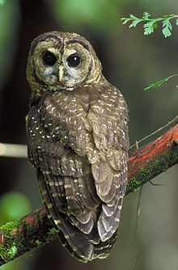
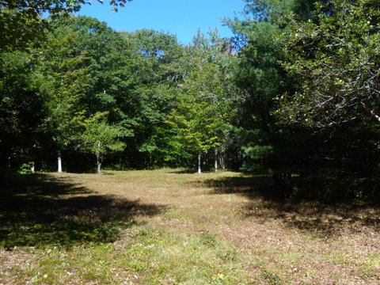
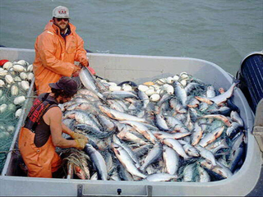

Why model?
Assess vulnerability
Evaluate management options
Assess human impacts
Assess invasion risk
Lots of ‘assessing’ – but ultimately we model to help us understand ecological processes and inform decisions

Slide 4

There are different types of models
Very Flexible
Individual Based
Can Incorporate Many Realistic Factors (e.g. Genetics, Behavior)
Why they’re good
Notes:
Focus is on the individual!

Slide 5
There are different types of models
Data Intensive!
Individual Based
Very sensitive to assumptions
Easy to make numerical and logical mistakes
Why they’re not so good

Slide 6
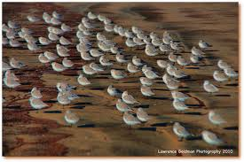
There are different types of models
Flexible and realistic
Age- or Stage- Based
Few implicit assumptions
Why they’re good
Notes:
Focus is on the populations!

Slide 7
There are different types of models
Date intensive
Age- or Stage- Based
Numerical errors possible
Difficult to add individual characteristics (e.g. genetics or behavior)
Why they’re not so good
Notes:
These types of models are my expertise, so I’ll focus on these

Slide 8
A simple model of population growth
Births
Deaths
Population size this year
Population size next year
Immigrants
Emigrants
Notes:
Here’s the Math!
Ecology comes in when we try to describe and predict each B, D, I, E

Slide 9
A simple model of population growth
B
D
N(t+1)
N(t)
I
E
Written as:
N(t+1) = N(t) + B – D + I - E
Notes:
Here’s the Math!
Ecology comes in when we try to describe and predict each B, D, I, E
and experimental design often comes in when estimating N(t)

Slide 10

A very simple model of population growth
Births
Deaths
Population size this year
Population size next year
Immigrants
Emigrants
Annual plant species
Written as:
N(t+1) = B
Notes:
1 - Assume closed population – no immigration or emigration
2 – All individuals from this year die by census next year

Slide 11
A very simple model of population growth
Births
Each individual produces f offspring during it’s life, so
Births = N * f
and
Pop. Size Next Year = N * f
Population size next year
Written as:
N(t+1) = N(t) * f

Slide 12
A little more complicated – a long-lived species
Births
Deaths
Population size this year
Population size next year
Notes:
Still working with a closed population

Slide 13
A little more complicated – a long-lived species
Births
Deaths
Population size this year
Population size next year
Those that didn’t survive. Then, if s is probability of surviving:
Death = (1-s)*N(t)
Written as:
N(t+1) = N(t) + B – D
Notes:
Still working with a closed population

Slide 14
A little more complicated – a long-lived species
Births
Deaths
Population size this year
Population size next year
But using our new equations:
B = N(t) * f
and:
D = (1-s)*N(t)
Written as:
N(t+1) = N(t) + N(t)*f – (1-s)*N(t)
Notes:
Here’s the Math!
Ecology comes in when we try to describe and predict each B, D, I, E
and experimental design often comes in when estimating N(t)

Slide 15
A slide of algebra
Pop. Next Year = N + B - D
Pop. Next Year = N + f*N – (1-s)*N
Pop. Next Year = N + f*N – N + s*N
Pop. Nex Year = (f+s)*N
Notes:
Geometric growth is a discrete time version of exponential growth (which is continuous time)

Slide 16
Another slide of algebra
Pop. Nex Year = (f+s)*N
Let R = (f+s)
Put in time indexes
N(t+1) = R*N(t)
N(t+1) = R*N(t) is the basis for geometric growth
and we call R the ‘replacement’, or growth rate
Notes:
Geometric growth is a discrete time version of exponential growth (which is continuous time)

Slide 17
Multiple time steps – geometric growth
R
R
R
R
N(t=0)
N(t=1)
N(t=2)
N(t=3)
N(t=4)
N(t=1) = R*N(t=0)
N(t=2) = R*{R*N(t=0)}
N(t=2) = R*N(t=1)
This recursive relationship yields the following general relationship: N(t) = R^{t} N(0)

Slide 18
Multiple time steps
N(0) = 1000
Plot of geometric growth: N(t) = R^{t} N(0)

Slide 19
Exponential growth
N(t+1) = N(t) + B - D
ΔN = N(t+1) - N(t) = b*N – d*N
Let ΔN be very small
dN/dt = (b – d)*N = r*N
Solve the differential equation
N(t) = N(0)*e^{rt}
Why go over this?
Exponential growth is a basic demographic model, and usually a good place to start!
Notes:
1 – Start with closed population again
2 – Move a few things around, and used b and d, instead of f and s
3 – Let r = (b – d)
4 – Solve the ODE – not trivial, but is basic calculus

Slide 20
Estimating R
Often our data is in annual time steps
Many organisms have a discrete mating or growing season
Assume discrete annual growth
Many organisms have a discrete reproduction period
Thus, we focus on R (and not r)

Slide 21
Estimating R
R
R
R
R
N(t=0)
N(t=1)
N(t=2)
N(t=3)
N(t=4)

Slide 22
Estimating R
?
?
?
?
1000
1035
1050
1113
1150
2001
2002
2003
2004
2005
Five seasons of census data

Slide 23
Estimating R
N(t+1) = R*N(t)
R = N(t+1) / N(t)
1035/1000
R = 1.035
R = 1.014
R = 1.060
R = 1.033
1000
1035
1050
1113
1150
2001
2002
2003
2004
2005

Slide 24
Estimating R
Year | Estimate for R
2001 - 2002 | 1.035
2002 - 2003 | 1.014
2003 - 2004 | 1.060
2004 - 2005 | 1.033
Geometric Average | 1.036
Standard Deviation | 0.019
Because discrete-time population growth is a multiplicative process, use Geometric Mean
Notes:
Geometric mean = nth root of product of all observations
(x1 * x2 * x3 … * xN)^(1/n)
Usually a bit smaller than arithmetic mean

Slide 25
Estimating R
N(t+1) = R^{t}*N(0)
What if I don’t have consecutive years?
But no St.Dev.
Estimate!
1000
1035
1050
1113
1150
2001
2002
2003
2004
2005

Slide 26
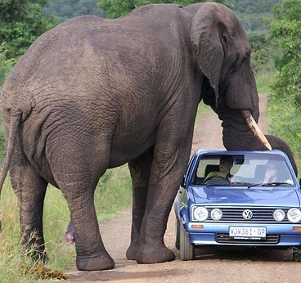
Why is standard deviation important?
Individual Survival Probability
Individual Fecundity Rate
Demographic
Stochasticity
Standard
Deviation
Variability
Uncertainty
Environmental
Stochasticity
Measurement Error
Fluctuations in Temp/Precip
Catastrophes
Variability can have great impacts on population dynamics
Notes:
Stochasticity – unpredictable variation; randomness

Slide 27
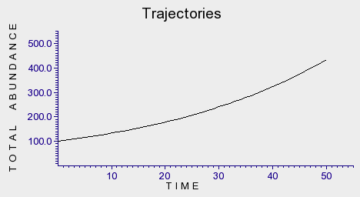
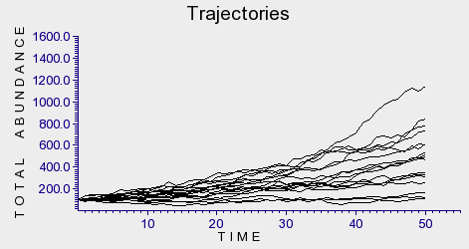
Why is standard deviation important?
Without Demographic
Stochasticity
R = 1.03
With Demographic
Stochasticity
R = 1.03
Variability can have great impacts on population dynamics
Notes:
Stochasticity – unpredictable variation; randomness
Demographic Stochasticity – these are real values of fecundity and survival, but when simulated at individual levels, this is what we get

Slide 28
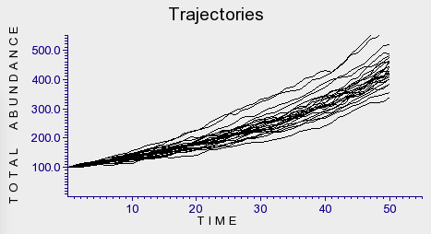
Why is standard deviation important?
Without Environmental
Stochasticity
R = 1.03
With Environmental
Stochasticity
R = 1.03 (SD = 0.019)
Variability can have great impacts on population dynamics
Notes:
Stochasticity – unpredictable variation; randomness

Slide 29
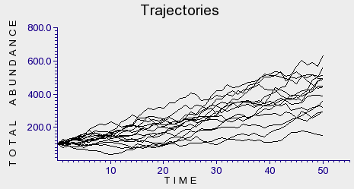
Why is standard deviation important?
Without
Stochasticity
R = 1.03
With Both Environmental
and Demographic
Stochasticity
R = 1.03 (SD = 0.019)
Variability can have great impacts on population dynamics
Notes:
Stochasticity – unpredictable variation; randomness

Slide 30
Why is standard deviation important?
Deterministic
Stochastic
Variability can have great impacts on population dynamics
Notes:
Stochasticity – unpredictable variation; randomness

Slide 31
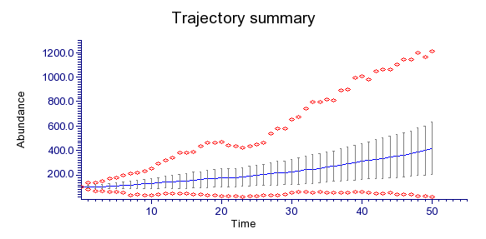
Why is standard deviation important?
Deterministic
Stochastic
Variability can have great impacts on population dynamics
Notes:
Stochasticity – unpredictable variation; randomness

Slide 32
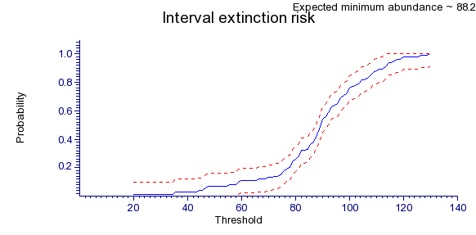
Why is standard deviation important?
Deterministic
Stochastic
Variability can have great impacts on population dynamics
Notes:
Stochasticity – unpredictable variation; randomness

Slide 33
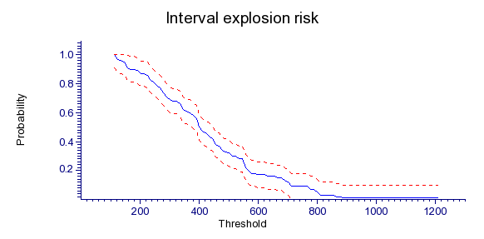
Why is standard deviation important?
Deterministic
Stochastic
Variability can have great impacts on population dynamics
Notes:
Stochasticity – unpredictable variation; randomness

Slide 34
Variability can have great impacts on population dynamics
This does not mean that models are inherently uncertain
Ecology complicates model outcomes

Slide 36
Stage (Age) structured models - adding ecological realism
Survival
Age Matters
Reproduction
Incorporating the effects of age can increase ecological realism of our models

Slide 37
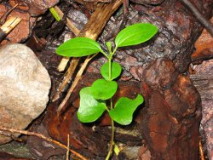
Stage (Age) structured models - adding ecological realism
Age Matters
S_{Seedling}
F_{seedling} = 0
S_{Adult}
F_{adult} = 22.5
Incorporating the effects of age can increase ecological realism of our models

Slide 38
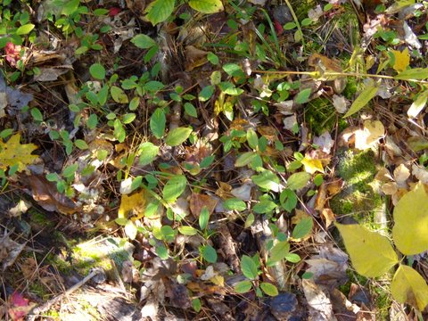
Stage (Age) structured models - adding ecological realism
Age Matters
Age Distribution
The number of individuals in in each age category can vary (e.g. seeds vs. seedlings vs. adults)
Incorporating the effects of age can increase ecological realism of our models

Slide 39
Stage (Age) structured models - adding ecological realism
Age
Stage
Size
Incorporating the effects of stage can increase ecological realism of our models

Slide 40
Stage structured models - adding ecological realism
OK, what does one of these models look like?
Incorporating the effects of stage can increase ecological realism of our models

Slide 41
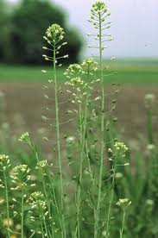
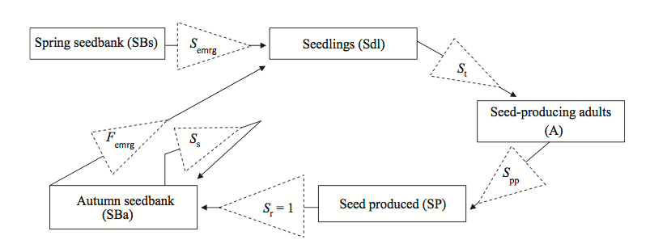
Stage structured models - adding ecological realism
Stage structured model for Camelina sativa
Davis et al. 2011 J. Appl. Ecol.
Incorporating the effects of stage can increase ecological realism of our models

Slide 42
Stage structured models - adding ecological realism
Stage structured model for Camelina sativa
F_{Emerg}
S_{t}
SBa
Sdl
A
S_{S}
S_{pp}
Davis et al. 2011 J. Appl. Ecol.
Incorporating the effects of stage can increase ecological realism of our models

Slide 43
Stage structured models - adding ecological realism
Stage structured model for Camelina sativa
Parameter Estimation
Parameter | Meaning | Data | Estimate
F_{Emerg} | Seed emergence from Fall (Autumn) seedbank | Counts of emergence from marked plots (Fig 2,3) | 0.024 ± 0.02
S_{S} | Seed survival | Unclear, assumed three values in simulation | 0.6 ± 0.4
S_{t} | Survival from emergence to maturity | Counts from marked plots (Tbl 3) | 0.11 ± 0.08
S_{pp} | Seeds produced per plant | Association between seed count and biomass | 64.6± 51.5*
Incorporating the effects of stage can increase ecological realism of our models
Notes:
Very high SD for F_emerg
* this value is based on ESA Abstract, since the values and data are not published
IMPORTANT: The small amount of data collected greatly attributes to the st.dev. (uncertainty)

Slide 44
Stage structured models - adding ecological realism
Stage structured model for Camelina sativa
Calculations and Simulation
Seed Bank (SBa)
Seedlings (Sdl)
Adults (A)
Total Population Size
Incorporating the effects of stage can increase ecological realism of our models

Slide 45
Stage structured models - adding ecological realism
Stage structured model for Camelina sativa
Calculations and Simulation
SBa(t+1)
Sdl(t+1)
A(t+1)
SBa(t) * F_{Emerg}
F_{Emerg}
S_{t}
SBa
Sdl
A
S_{S}
S_{pp}

Slide 46
Stage structured models - adding ecological realism
Stage structured model for Camelina sativa
Calculations and Simulation
SBa(t+1)
Sdl(t+1)
A(t+1)
SBa(t) * F_{Emerg}
Sdl(t) * S_{t}
F_{Emerg}
S_{t}
SBa
Sdl
A
S_{S}
S_{pp}

Slide 47
Stage structured models - adding ecological realism
Stage structured model for Camelina sativa
Calculations and Simulation
SBa(t+1)
Sdl(t+1)
A(t+1)
A(t) * S_{pp}
SBa(t) * F_{Emerg}
Sdl(t) * S_{t}
F_{Emerg}
S_{t}
SBa
Sdl
A
S_{S}
S_{pp}

Slide 48
Stage structured models - adding ecological realism
Stage structured model for Camelina sativa
Calculations and Simulation
SBa(t+1)
Sdl(t+1)
A(t+1)
A(t) * S_{pp} + SBa(t) * (1-F_{emerg})S_{S}
SBa(t) * F_{Emerg}
Sdl(t) * S_{t}
F_{Emerg}
S_{t}
SBa
Sdl
A
S_{S}
S_{pp}

Slide 49
Stage structured models - adding ecological realism
Stage structured model for Camelina sativa
Calculations and Simulation
SBa(t+1)
Sdl(t+1)
A(t+1)
A(t) * S_{pp} + SBa(t) * (1-F_{emerg})S_{S}
SBa(t) * F_{Emerg}
Sdl(t) * S_{t}
F_{Emerg}
S_{t}
SBa
Sdl
A
S_{S}
S_{pp}

Slide 50
Stage structured models - adding ecological realism
Stage structured model for Camelina sativa
Calculations and Simulation
SBa(t+1)
Sdl(t+1)
A(t+1)
S_{s} 0 S_{pp}
F_{emerg} 0 0
0 S_{t} 0
SBa(t)
Sdl(t)
A(t)
Stage Matrix
This type of demographic model is often called a matrix model, or a matrix projection model
Notes:
We can write this in matrix notation, like this!
Fancy words! But not a fancy model!
Just used for simplifying calculations

Slide 51
Stage structured models - adding ecological realism
Current year (t)
Next year (t+1)
SBa
Sdl
A
SBa
Sdl
A
S_{s} 0 S_{pp}
F_{emerg} 0 0
0 S_{t} 0
This type of demographic model is often called a matrix model, or a matrix projection model
Notes:
We can write this in matrix notation, like this!
Fancy words! But not a fancy model!
Just used for simplifying calculations

Slide 52
Stage structured models - adding ecological realism
Current year (t)
Next year (t+1)
SBa
Sdl
A
SBa
Sdl
A
S_{s} 0 S_{pp}
F_{emerg} 0 0
0 S_{t} 0
This type of demographic model is often called a matrix model, or a matrix projection model
Notes:
We can write this in matrix notation, like this!
Fancy words! But not a fancy model!
Just used for simplifying calculations

