Slide 1
Welcome to ENS 610 / EP 603! Why are you here?

Slide 2
Welcome to ENS 610 / EP 603! Why are you here?

Slide 3
Introduction to Environmental Science

Slide 4
What is environmental science?
Write down your thoughts on this in the following shared Google Doc (you can also link to this through Classes):

Slide 5
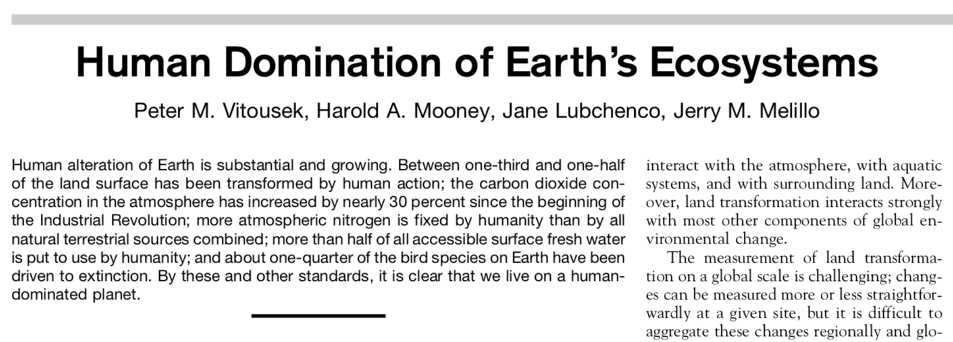

Slide 6
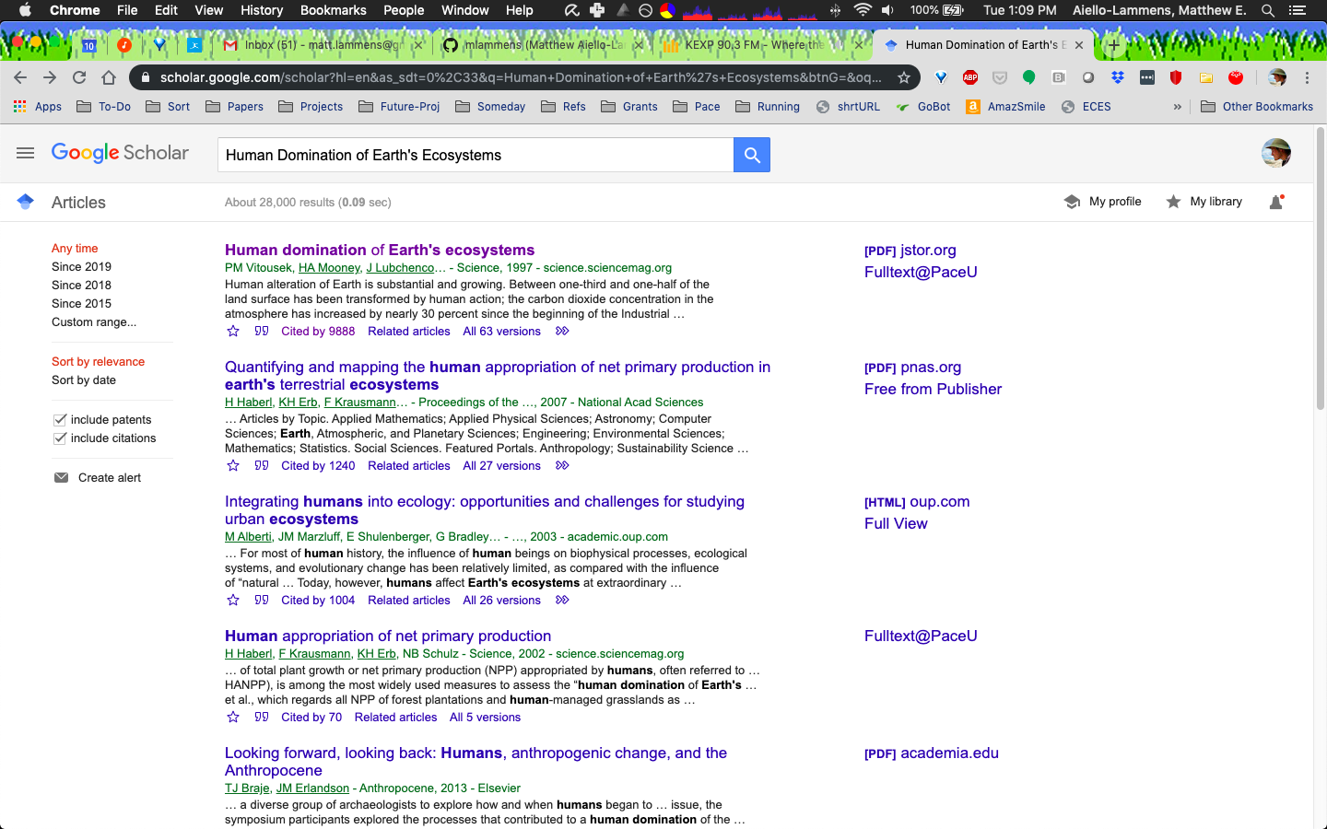

Slide 7
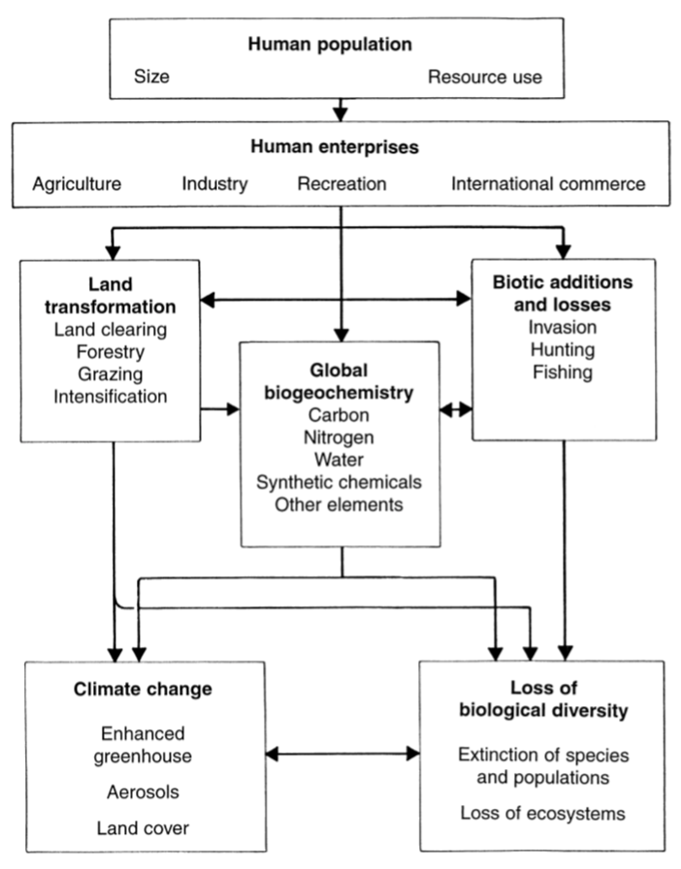

Slide 8
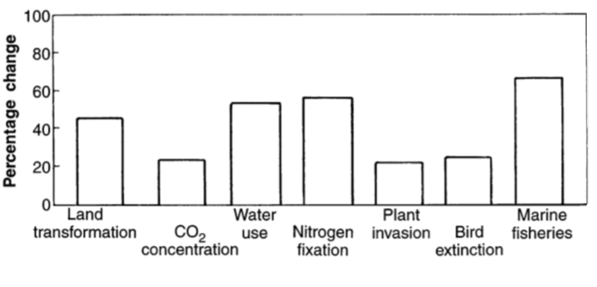

Slide 9
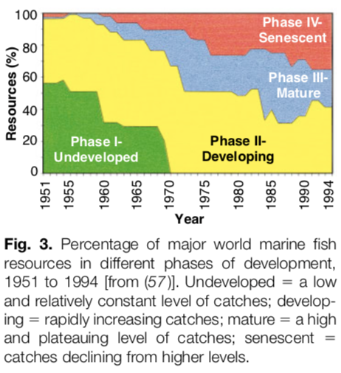

Slide 10
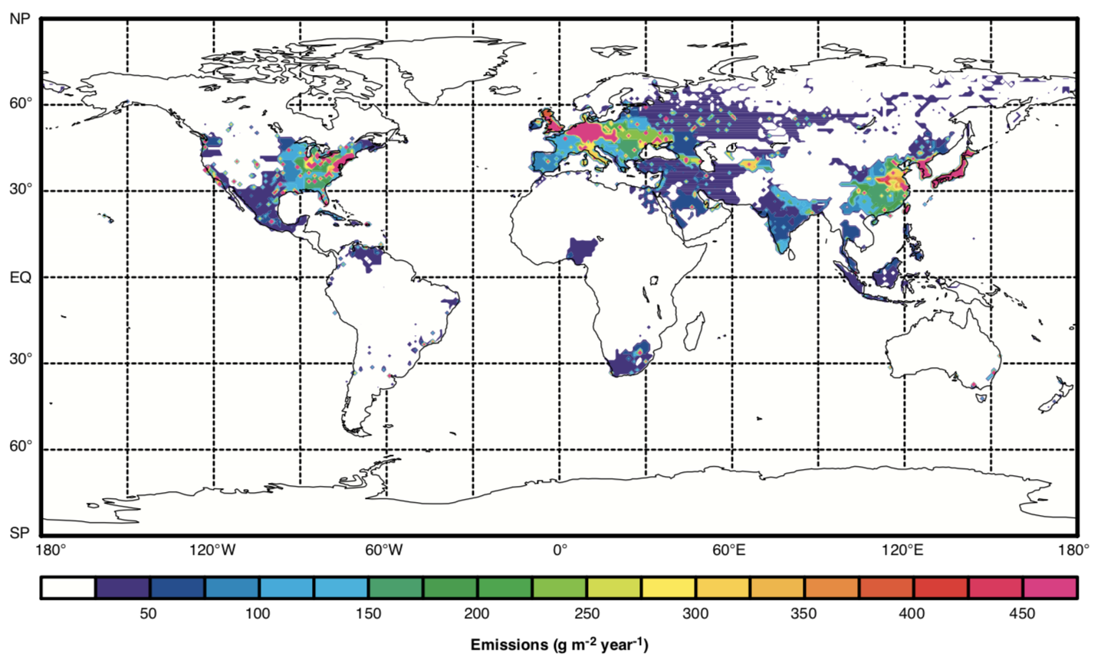

Slide 11
Things to consider
As we go through the semester, approach each of our topics with a critical thinking lens
Be mindful of logical fallacies when discussing these issues!

Slide 12
Logical fallacies are:
Statements that are logically false, regardless of whether factually true or not
Very common and follow specific formats/structures
Helpful when evaluating the validity of a source or statement
Logical fallacy slides adapted from: Bentley et al. (2016). Carbon, Climate, and Energy Resources, InTeGrate. Retrieved Aug 25, 2020, from https://serc.carleton.edu/integrate/teaching_materials/change_inthe_air/index.html

Slide 13
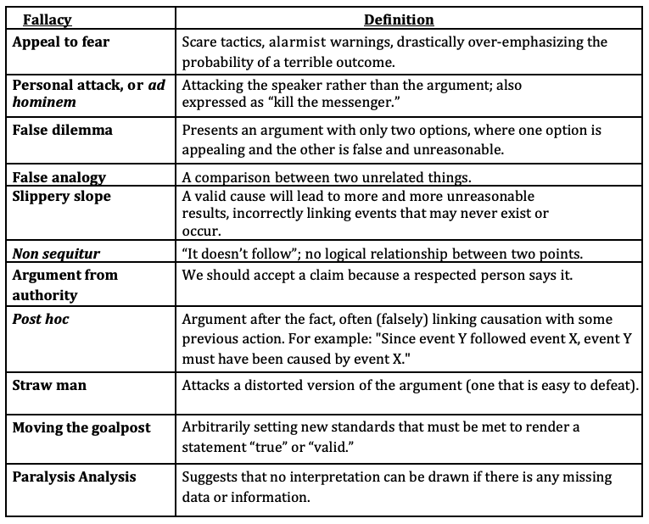

Slide 14
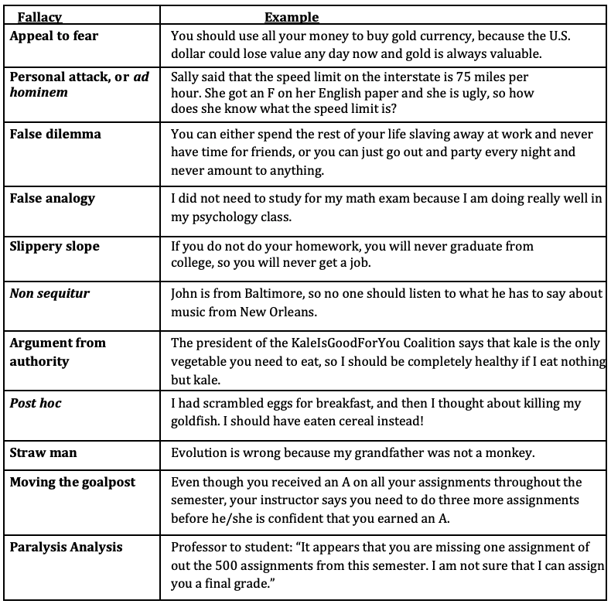

Slide 15
Things to consider
As we go through the semester, approach each of our topics with a critical thinking lens
Be mindful of logical fallacies when discussing these issues!
Which of these is most challenging for you?

