Slide 1
Linear Regression Diagnostics

Slide 2
Conditions for the least squares line
Linearity
Nearly normal residuals
Constant variability

Slide 3
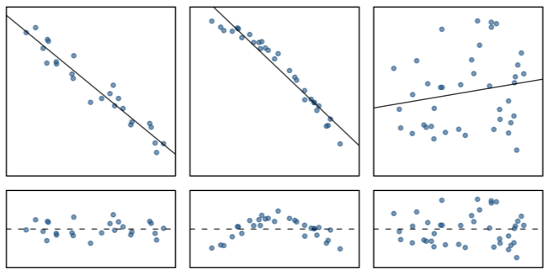
Conditions: (1) Linearity
The relationship between the explanatory and the response variable should be linear.
Methods for fitting a model to non-linear relationships exist, and will be covered in a different video.
Check using a scatterplot of the data, or a residuals plot.

Slide 4
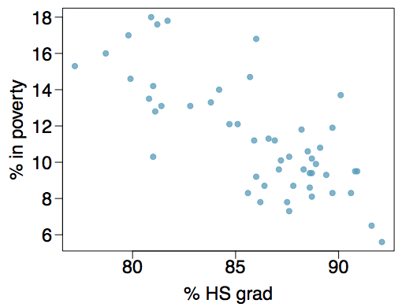
Poverty vs. HS graduate rate
The scatterplot below shows the relationship between HS graduation rate in all 50 US states and DC and the percent of residents who live below the poverty line (income below $23,050 for a family of 4 in 2012).
Response variable
% in poverty
Explanatory variable
% HS grad
Relationship
linear, negative, moderately strong
RI

Slide 5
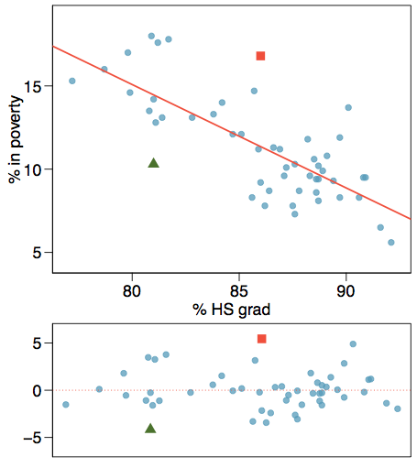
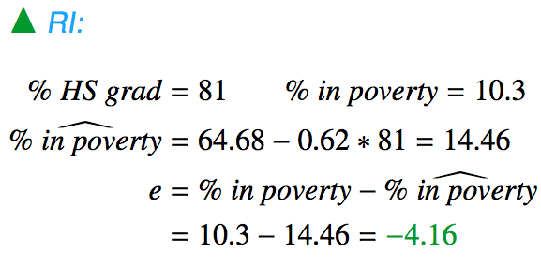
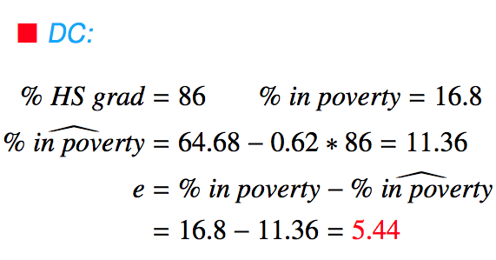
Anatomy of a residuals plot

Slide 6
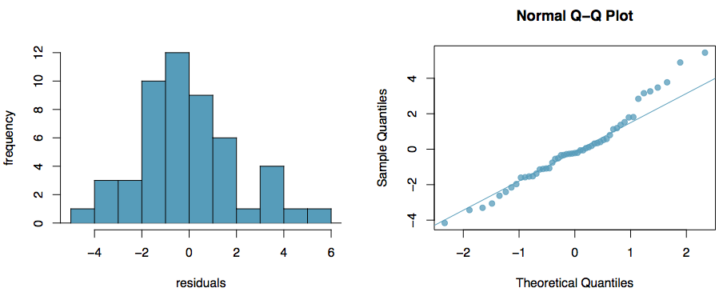
Conditions: (2) Nearly normal residuals
The residuals should be nearly normal.
This condition may not be satisfied when there are unusual observations that don't follow the trend of the rest of the data.
Check using a histogram or normal probability (Q-Q) plot of residuals.

Slide 7
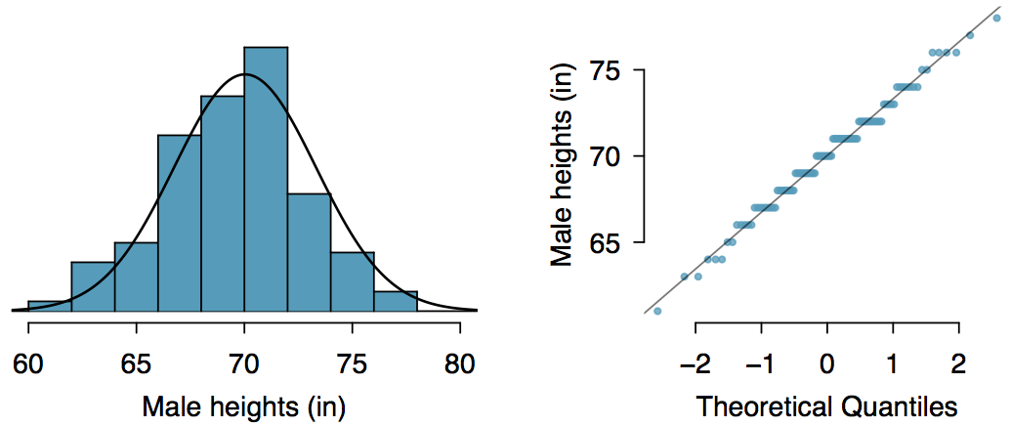
Normal probability plot
A histogram and normal probability plot of a sample of 100 male heights.

Slide 8
Anatomy of a normal probability plot
Data are plotted on the y-axis of a normal probability plot, and theoretical quantiles (following a normal distribution) on the x-axis.
If there is a linear relationship in the plot, then the data follow a nearly normal distribution.
Constructing a normal probability plot requires calculating percentiles and corresponding z-scores for each observation, which is tedious. Therefore we generally rely on software when making these plots.

Slide 9
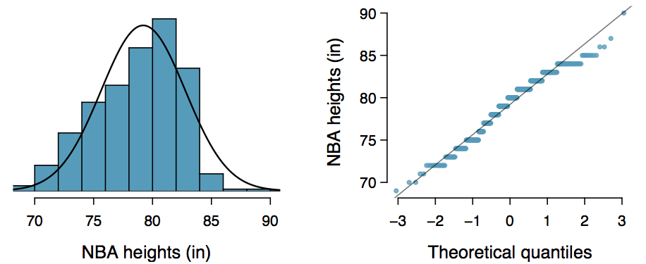
Practice
Below is a histogram and normal probability plot for the NBA heights from the 2008-2009 season. Do these data appear to follow a normal distribution?

Slide 10
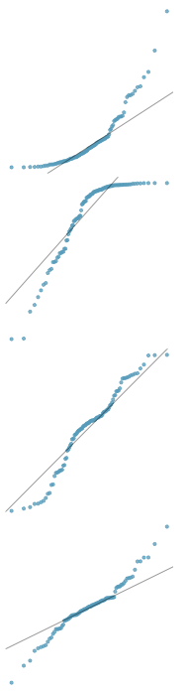
Normal probability plot and skewness
Right skew - Points bend up and to the left of the line.
Left skew - Points bend down and to the right of the line.
Short tails (narrower than the normal distribution) - Points follow an S shaped-curve.
Long tails (wider than the normal distribution) - Points start below the line, bend to follow it, and end above it.

Slide 11
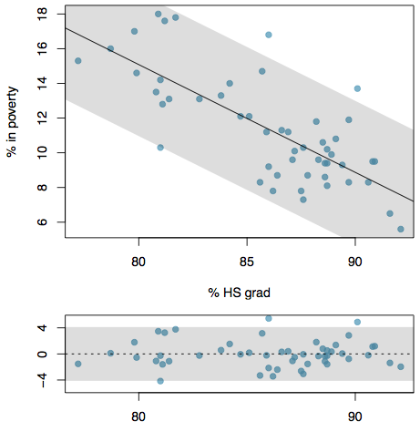
Conditions: (3) Constant variability
The variability of points around the least squares line should be roughly constant.
This implies that the variability of residuals around the 0 line should be roughly constant as well.
Also called homoscedasticity.
Check using a histogram or normal probability plot of residuals.

Slide 12
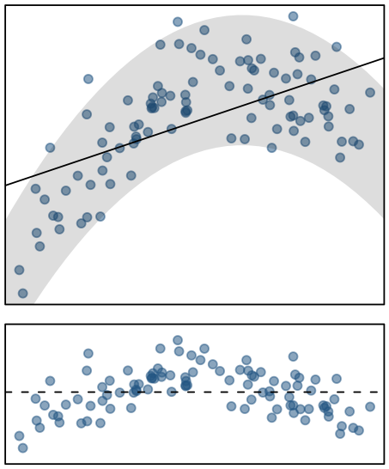
Checking conditions
What condition is this linear model obviously violating?
Constant variability
Linear relationship
Normal residuals
No extreme outliers

Slide 13
Checking conditions
What condition is this linear model obviously violating?
Constant variability
Linear relationship
Normal residuals
No extreme outliers

Slide 14
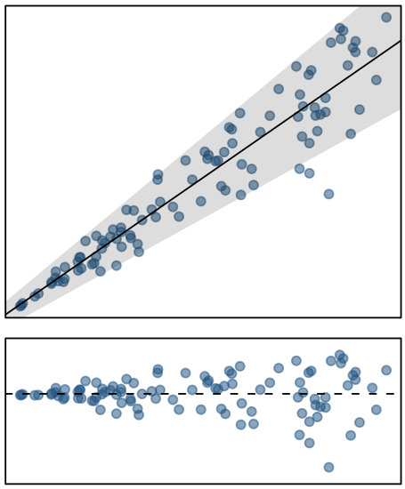
Checking conditions
What condition is this linear model obviously violating?
Constant variability
Linear relationship
Normal residuals
No extreme outliers

Slide 15
Checking conditions
What condition is this linear model obviously violating?
Constant variability
Linear relationship
Normal residuals
No extreme outliers

