Slide 1
What are the core competencies of computational data science?
And how do we get them into our biology curricula?

Slide 2
install.packages(“TeachR”) makeExpert = function(student, tools=NULL){ expert = teach(student, tools=“AllDataScience”) return(expert) }
If only there were a package for that…

Slide 3
What are the core competencies of computational data science?

Slide 4
What are the core competencies of computational data science?
Data management and processing
Data analysis and modelling
Scientific software and coding
Data visualization
Digital collaboration, dissemination, and reproducibility

Slide 5
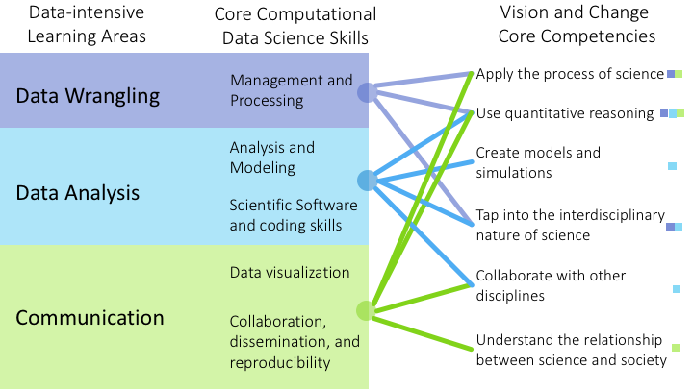
Core computational data science skills

Slide 6
Where do we currently find these skills (if at all) in undergraduate biology curricula?

Slide 7
Students Exposed
Introductory/Core Lectures and Labs
Specialized Courses
Additional Math/Stat or CS Courses
Research
Power of Competency

Slide 8
Students Exposed
Introductory/Core Lectures and Labs
Analysis/Visualization?
Modeling?
Software/Coding?
Management/Processing?
Collaboration/Reproducibility?
Specialized Courses
Additional Math/Stat or CS Courses
Research
Power of Competency

Slide 9
Students Exposed
Introductory/Core Lectures and Labs
Specialized Courses
Additional Math/Stat or CS Courses
Research
How do we go from this?
Power of Competency

Slide 10
Students Exposed
Introductory/Core Lectures and Labs
Specialized Courses
Additional Math/Stat or CS Courses
Research
To this?
Power of Competency

Slide 11
Students Exposed
Introductory/Core Lectures and Labs
Analysis/Visualization
Modeling
Software/Coding
Management/Processing
Collaboration/Reproducibility
Specialized Courses
Additional Math/Stat or CS Courses
Research
Priming: Introduce Skills Early
Power of Competency

Slide 12
Students Exposed
Introductory/Core Lectures and Labs
Analysis/Visualization
Modeling
Software/Coding
Management/Processing
Collaboration/Reproducibility
Analysis/Visualization
Modeling
Software/Coding
Management/Processing
Collaboration/Reproducibility
Analysis/Visualization
Modeling
Software/Coding
Management/Processing
Collaboration/Reproducibility
Specialized Courses
Additional Math/Stat or CS Courses
Research
Iteration: Refine and Expand Skills
Power of Competency

