Slide 1
What are the core competencies of computational data science?
And how do we get them into our biology curricula?

Slide 2
install.packages(“TeachR”) makeExpert = function(student, tools=NULL){ expert = teach(student, tools=“AllDataScience”) return(expert) }
If only there were a package for that…

Slide 3
What are the core competencies of computational data science?

Slide 4
What are the core competencies of computational data science?
Data management and processing
Data analysis and modelling
Scientific software and coding
Data visualization
Digital collaboration, dissemination, and reproducibility

Slide 5
Data management and processing
Introductory: Dataframes, variable types, QAQC, file management
Intermediate: Data manipulation and transformation, data subsets
Advanced: Database queries, joining multiple data sets

Slide 6
Data analysis and modelling
Introductory: Summary statistics, correlation
Intermediate: Linear models, inferential statistics, confidence intervals
Advanced: Model selection, multivariate analysis, simulation, machine learning

Slide 7
Scientific software and coding
Introductory: Spreadsheets, scripting, working within an IDE
Intermediate: Flow control (for, if-else), iteration, packages
Advanced: Functions, pipelines, HPC

Slide 8
Data visualization
Introductory: Scatterplots, boxplots, barcharts
Intermediate: Faceting, layering, mapping geographic data
Advanced: Animation, interactive visualization

Slide 9
Digital collaboration, dissemination, and reproducibility
Introductory: R Projects, Googlesheets, Markdown, Slack
Intermediate: Personal repositories, web publication
Advanced: Shared repositories, version control

Slide 10
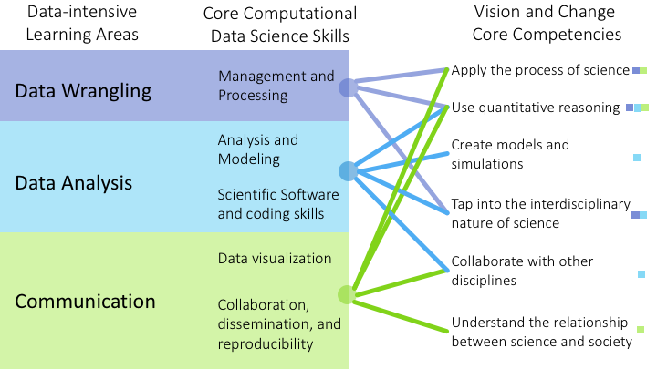
Core computational data science skills

Slide 11
Where do we currently find these skills (if at all) in undergraduate biology curricula?

Slide 12
Students Exposed
Introductory/Core Lectures and Labs
Specialized Courses
Additional Math/Stat or CS Courses
Research
Power of Competency

Slide 13
Students Exposed
Introductory/Core Lectures and Labs
Analysis/Visualization?
Modeling?
Software/Coding?
Management/Processing?
Collaboration/Reproducibility?
Specialized Courses
Additional Math/Stat or CS Courses
Research
Power of Competency

Slide 14
Students Exposed
Introductory/Core Lectures and Labs
Specialized Courses
Additional Math/Stat or CS Courses
Research
How do we go from this?
Power of Competency

Slide 15
Students Exposed
Introductory/Core Lectures and Labs
Specialized Courses
Additional Math/Stat or CS Courses
Research
To this?
Power of Competency

Slide 16
Students Exposed
Introductory/Core Lectures and Labs
Analysis/Visualization
Modeling
Software/Coding
Management/Processing
Collaboration/Reproducibility
Specialized Courses
Additional Math/Stat or CS Courses
Research
Priming: Introduce Skills Early
Power of Competency

Slide 17
Students Exposed
Introductory/Core Lectures and Labs
Analysis/Visualization
Modeling
Software/Coding
Management/Processing
Collaboration/Reproducibility
Analysis/Visualization
Modeling
Software/Coding
Management/Processing
Collaboration/Reproducibility
Analysis/Visualization
Modeling
Software/Coding
Management/Processing
Collaboration/Reproducibility
Specialized Courses
Additional Math/Stat or CS Courses
Research
Iteration: Refine and Expand Skills
Power of Competency

