Slide 1
Recent Advances in Using Predictive Modeling and Other Techniques for Effective Prevention Programs
Raj Nagaraj, Ph.D.
Chief Technology Officer
Deccan International

Slide 2
OUTLINE
About Deccan
Code Enforcement and PM
CRR And Predictive Modelling Techniques
Successful PM Usage
Predictive Modelling And Other Techniques (PM)
Deccan PM work
PM And Marketing Data
PM Based Project Lengths
Current Prevention Programs Vs PM Based
Future of PM In Prevention

Slide 3
ABOUT DECCAN
Decision-Support Software Solutions for Fire and EMS
Founded in 1995
Deccan supports roughly 50% of major North American metro departments

Slide 4
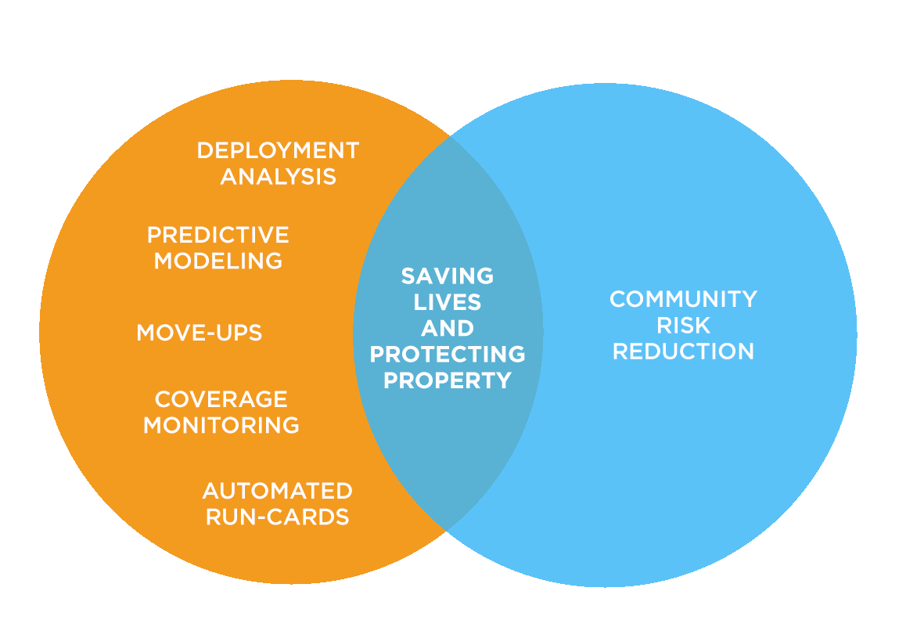
ABOUT DECCAN

Slide 5

Predictive Modelling and CRR
CRR is a comprehensive framework to reduce risks in public and firefighter community and through targeted allocation of preventive and emergency resources following the rigorous and methodical identification and prioritization of the risks.
Predictive Modelling & Other Techniques

Slide 6
Organizations Focused on CRR
Vision 20/20
CPSE
(Center for Public Safety Excellence)
NFPA
(National Fire Protection Association)

Slide 7
Predictive Modelling & Other Techniques
Ad-hoc statistical analysis
Data mining
Risk model based on expert judgment
Survey of line personnel

Slide 8
Current Prevention Programs Vs Predictive Modelling Based
Existing outreach programs fail to effectively:
Select who for outreach programs.
Compose message for maximal effectiveness.
Identify where do the selected group of people live.
Maximize the reach to selected group.
Predictive Modelling based programs:
Exploit all available date for the above.
Isolate outreach programs for measuring effectiveness

Slide 9
Current Code Enforcement Vs Predictive Modelling Based
Currently, same inspection frequency across all buildings
Not enough inspectors so some high risk missed.
With PM, frequency based on risk and other criteria
Buildings scored and ranked
With PM, opportunity for optimal use of inspectors

Slide 10
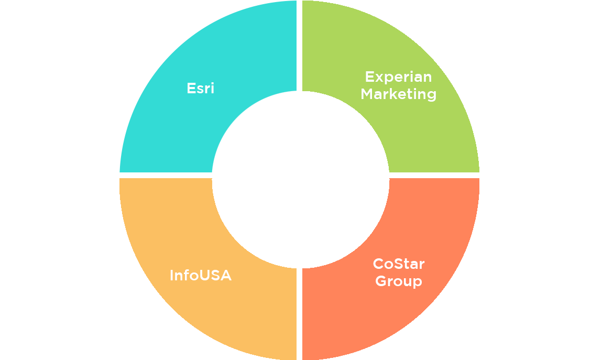
Detailed Market Segment Data Vital For Predictive Modelling

Slide 11
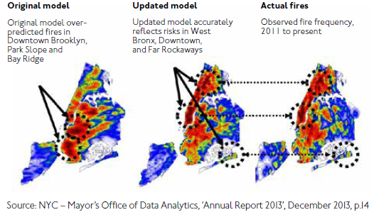
Predictive modeling for Code Enforcement by MODA – FDNY
Use historical incident data to build model that predicts future incidents
Figure 1: Location of fires as predicted before and after the use of MODA’s model

Slide 12
Predictive modeling for Code Enforcement by MODA – FDNY
Big data in the big apple:
Mayor’s office of data analytics (New York)
True positive rate over 70%
Accuracy of the expert judgment-based model was producing less than 50% prediction accuracy
Based on the success of New York, city of London is exploring a similar Major’s office of data analytics

Slide 13

Predictive modeling for Code Enforcement (Firebird) by Data Science for Social Good – Atlanta Fire
Firebird: Predicting Fire Risk and
Prioritizing Fire Inspections in Atlanta
Joins multiple data sources to produce a list of attributes of the properties
Joins the property data with incident data
Applied advanced machine learning (SVM, Random forest)
techniques to build the prediction models
True positive rate as high as over 70%
In addition, their method also help identify properties requiring inspection

Slide 14
Data mining for root cause analysis – Philadelphia Fire
Mined the fire incident data and identified the root causes
Identified target areas for smoke alarm intervention and education programs
Utilized the root causes to develop contents for the education programs
Significant reduction (32%) in the number of incident in the pilot areas
Significant reduction (89%) in the number of injuries and fatalities
Several documented lives saved

Slide 15
Using Experian’s Mosaic consumer classification to help reduce house fires – Cambridgeshire Fire and Rescue, UK
Built predictive models to determine the risk of households
Identified patterns in the households fire incidents
Identified the best locations for community safety visits
Tailored messages to maximize the interest in public
Before intervention, one of the wards, Huntington North was ranked as the ward with the 9th highest proportion of fires per household
After the intervention, Huntington North dropped to 69th highest proportion of fires

Slide 16
Other departments utilizing Predictive Modelling
Surrey, BC, Canada
Hampshire Fire Department, UK
Through targeted smoke alarm intervention program, reduced fire incidents by 63.9%, increased fire confined to room of origin by 27%
Developed predictive models using lifestyle segmentation data
Significantly reduced deliberate and accidental dwelling fires
Reduced fatalities to 0

Slide 17
Other Departments Utilizing Ad-hoc methods for CRR
Tuscaloosa Fire and Rescue Service
Brighton Area Fire Authority (MI)
Community risk reduction through school partnerships
28.34 % decrease in fire incidents
Zero fire deaths in targeted areas
Developed predictive models using lifestyle segmentation data
Significantly reduced deliberate and accidental dwelling fires
Reduced fatalities to 0
Sandusky Fire Department
Reduce/Eliminate cooking fires through smoke alarm installation
0 Cooking fires in targeted households

Slide 18
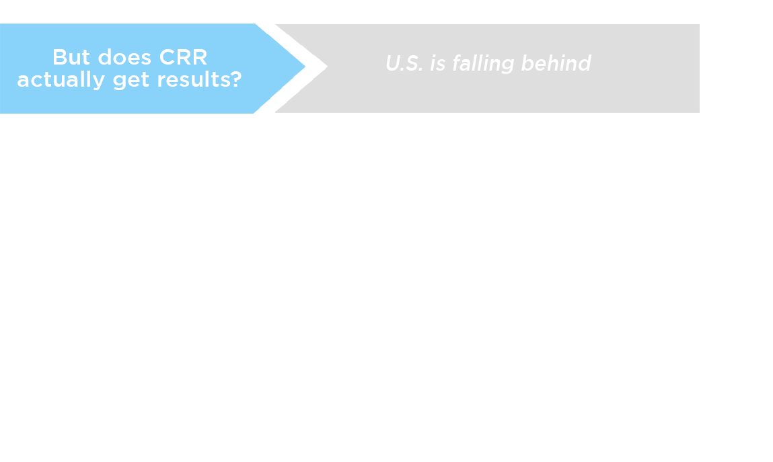
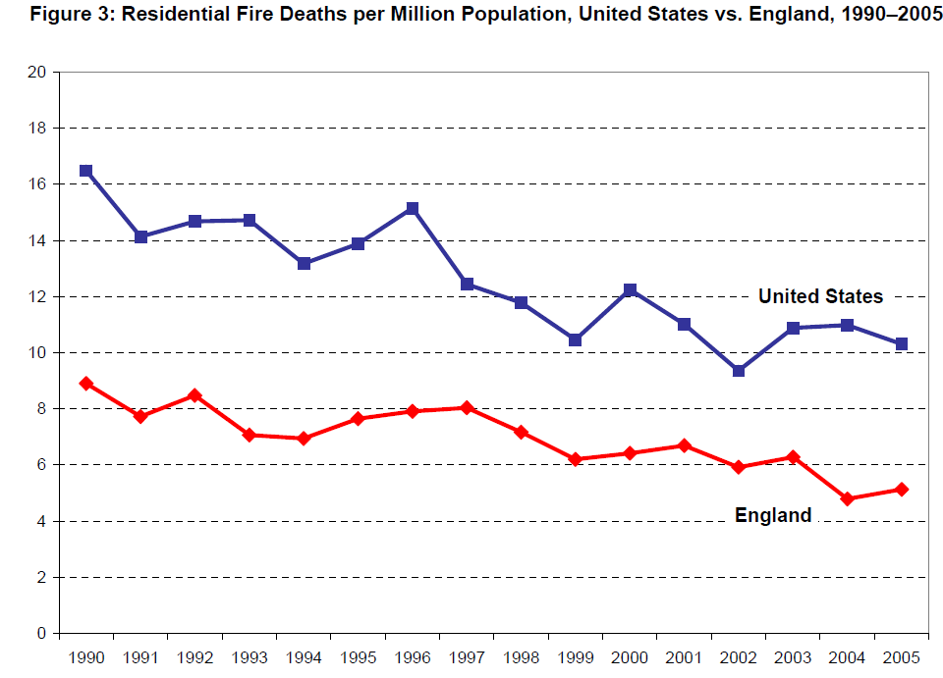
Source: Global concepts in residential fire – by System planning corporation

Slide 19
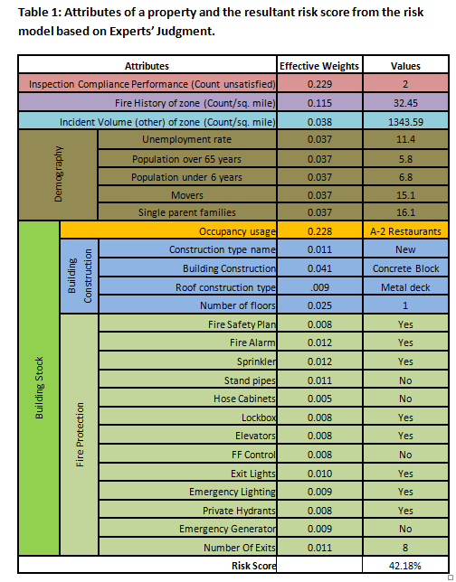
Building Risk Scores Based on Expect Judgments
A formula for calculating the risk score of a building is developed using the relative weights of different attributes of the building.
Relative weights of the attributes are determined using the systematic pairwise comparison of the attributes by the inspectors.
A widely used method called the Analytic Hierarchic process (AHP) is for the deriving the weights.

Slide 20
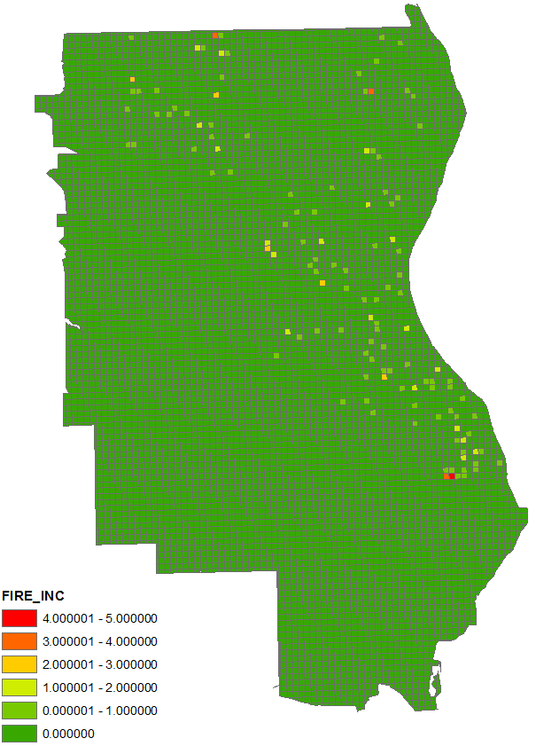
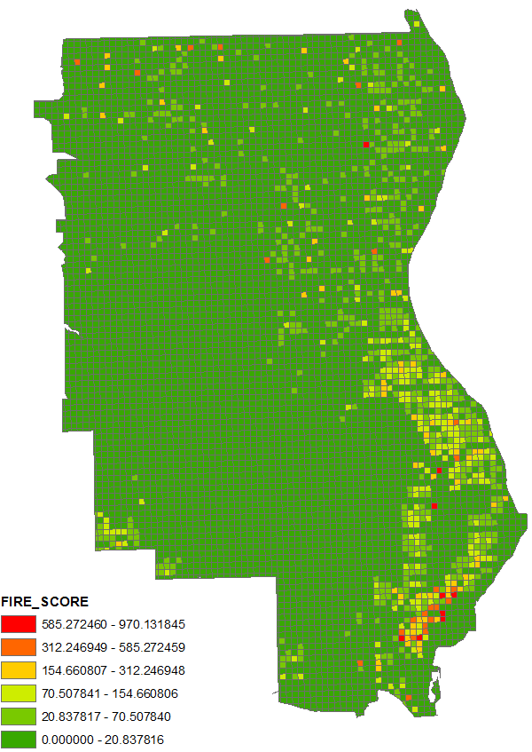
Kitchen Fires: Wired and Connected!
In the left figures, in each of the 0.1*0.1 sq. miles grids, incident volume and incident likelihood scores are plotted.
To compute the risk (likelihood) scores of a grid, at first, the risk scores of each demographic segment is calculated, and then a weighted sum is calculated for the grid based on the demographic composition of the grid.
Figure 4: Incident volume in each grid
Figure 5: Incident likelihood
in future in each grid

Slide 21
Kitchen Fires: Wired and Connected!
The difference between the two figures suggest that each individual in a demographic segment has not suffered an incident yet although they are equally likely to suffer in future.
Therefore, the right figure suggests where in the service area Kitchen fires are likely to happen based on the current demographic composition.
Figure 4: Incident volume in each grid
Figure 5: Incident likelihood
in future in each grid

Slide 22

Predictive Modelling Based CRR Project Lengths
Development of mitigation programs and identification of delivery methods: 1- 2 months
Risk Assessment and prioritization: 2-3 months
Evaluation and modification of the programs: 6 – 24 months
Implementation of the programs: 3 – 12 months

Slide 23
Predictive Modelling Techniques Promise
There have been documented successes.
Key dependence on marketing data for targeted programs.
Tough challenge for limited $ compared to deployment initiatives.
Targeted smoke detector interventions are ripe hanging fruit.
Need dept. long term commitment to see results.

