Slide 1
MicrobeDB Overview
Morgan Langille
morgan.gi.langille@gmail.com

Slide 2
Main Features
Centralized storage and access to completed archaeal and bacterial genomes
  Genomes obtained from NCBI RefSeq: http://www.ncbi.nlm.nih.gov/genomes/lproks.cgi
  Genome/Flat files are stored in one central location
    Including files .gbk, .gff, .fna, .faa, etc.
  Unpublished genomes can be added as well
Information at the genome project, chromosome, and gene level are parsed and stored in a MySQL database
A Perl MicrobeDB API provides non-MySQL interface with the database.

Slide 3
Main MicrobeDB Tables
Version
  Each download of genomes from NCBI is given a new version numbe
  Data will not change if you always use the same version number of microbedb
  Version date can be cited for any method publications
  A version can be saved by users so not automatically deleted.
Genome Project
  Contains information about the genome project and the organism that was sequenced
  Each genome project contains one or more replicons
Replicon
  Chromosome, plasmids, or contigs
  Each replicon contains one or more genes
Gene
  Contains gene annotations and also the DNA and protein sequences (if protein coding gene)

Slide 4
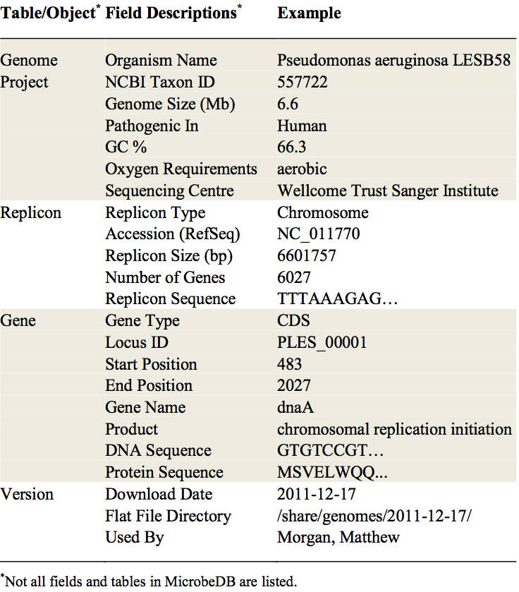
MicrobeDB Annotations

Slide 5
Accessing MicrobeDB
Any traditional MySQL programs
phpMyAdmin:
  Web-based
  http://phpmyadmin.net
MySQL Workbench
  Local desktop client
  http://www.mysql.com/products/workbench/
MicrobeDB Perl API
  Allows interaction with database directly from within a Perl script
  Requires no knowledge of SQL

Slide 6
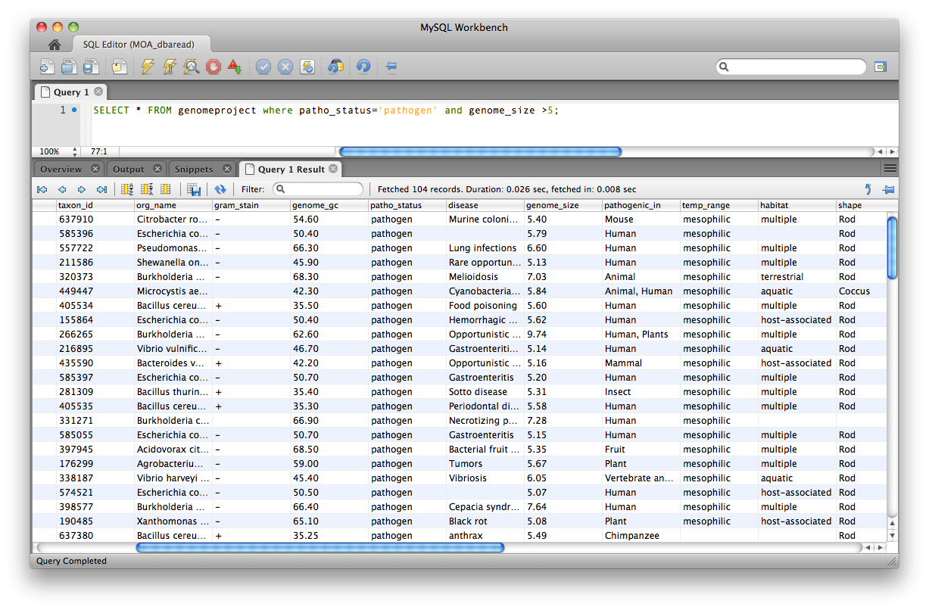
MySQL Workbench

Slide 7
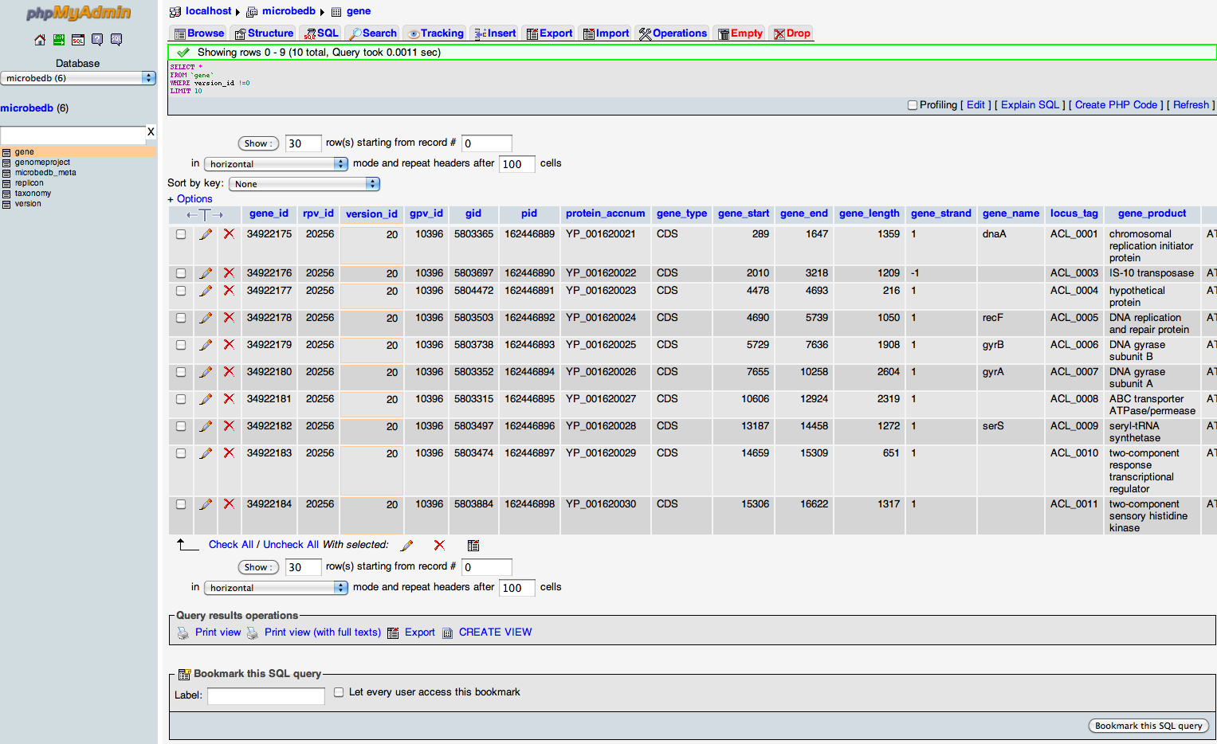
phpMyAdmin

Slide 8
MicrobeDB API Example
#Use the MicrobeDB Search library
use MicrobeDB::Search;
#create the search object
my $search_obj= new MicorbeDB::Search();
#Create an object with certain features that we want (i.e. only pathogens)
my $obj = new GenomeProject( version_id => '1', patho_status => 'pathogen' );
#This does the actual search and returns a list of all genome projects that match search parameters
my @result_objs = $search_obj->object_search($obj);
#Now we can iterate through each genome project
foreach my $gp_obj (@result_objs) {
  #get the name of the genome
  $gp_obj->org_name()
  foreach my $gene_obj ($gp_obj->genes()){
    if($gene_obj->gene_type() eq 'tRNA'){
      #write the genes in fasta format with gid as the identifier
      print '>',$gene_obj->gid,”\n”,$gene_obj->gene_seq();
    }}}

