Slide 1
Lists and keys

Slide 2
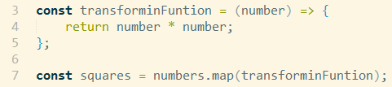
Lists and keys
List is one of primary data structures in JavaScript.
List initialization is done with [ ]
Map is List method, that transforming to new List
How transformation is done is passed as argument of Map method

Slide 3
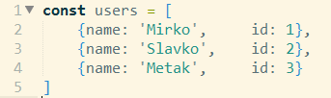
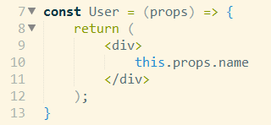
Lists and keys
Map can be also used and with lambda function:
Same principal can be used for components!
We have user data:
And User component:

Slide 4
Lists and keys
Then creating list of user components from user data is done:
Good approach for rendering lists is to have 2 components, one as container and other that renders list item.
In out case it would be UserList component as container, and User and list item.

Slide 5
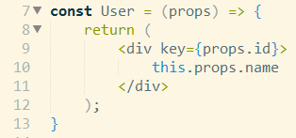
Lists and keys
When rendering lists, it is good practice to put key on item list.
It help React to render only list item that is changed.
It needs to be passed to component, not added inside render method of component.

