Slide 1
Lifting state up

Slide 2
Lifting state up
When we want to share data between sibling components
It’s done by storing data in parent component

Slide 3
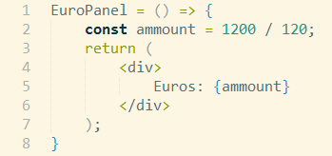
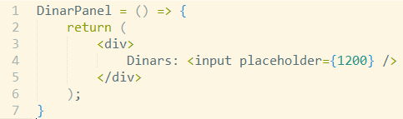
Lifting state up
2 components:
Change in input in DinarPanel is not reflected in EuroPanel.
How to make ‘connected’?

Slide 4
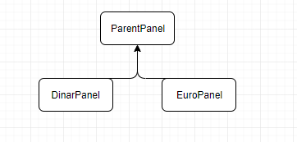
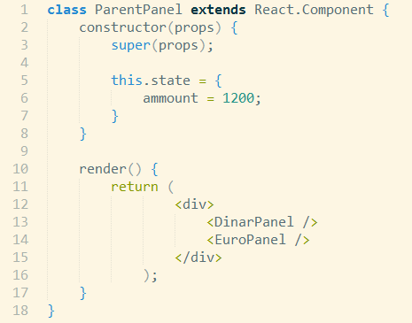
Lifting state up
Create parent component, with state amount and rendering of DinarPanel and EuroPanel:

Slide 5
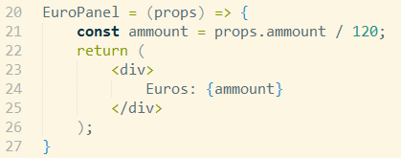

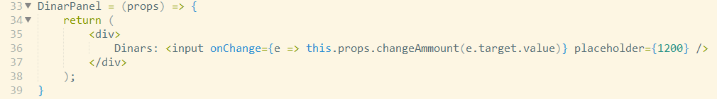
Lifting state up
Adapt EuroPanel to use ParentPanel’s ammout:
To change amount we need function for that on ParentPanel:
And adapt DinarPanel to use that function when input is changed:

Slide 6
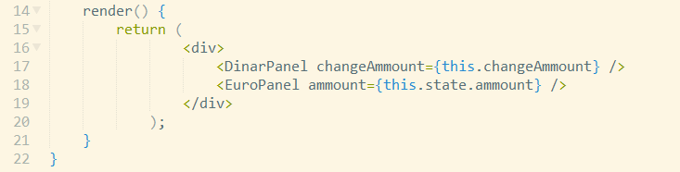
Lifting state up
At the end, pass amount to DinarPanel and EuroPanel:

Slide 7
Lifting state up
TODO: example of data flow

