Slide 1
Conditional Rendering

Slide 2
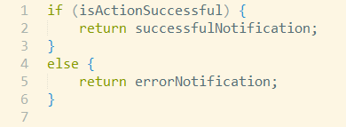
Conditional Rendering
When we need to render component/part of component depending on condition
What needs to be rendered:
What is condition:
How to do check:

Slide 3
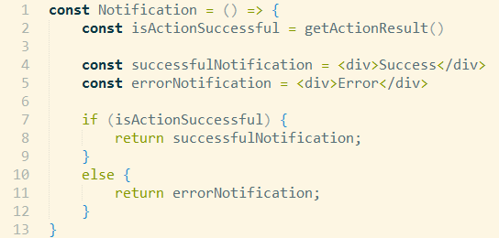
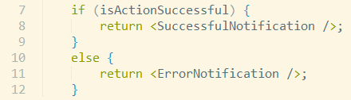
Conditional Rendering
How component looks like:
Also we can use directly React components:

Slide 4
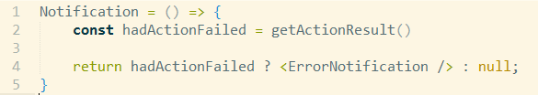
Conditional Rendering
Can be also done with ternary operator:
Only render if condition is fulfilled:

Slide 5
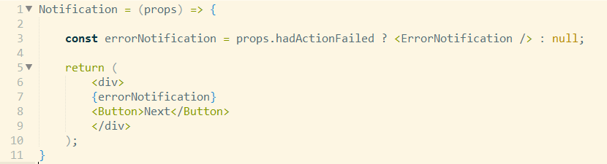
Conditional Rendering
Condition should be variable changeable by React, state or props.
Conditionally rendering part of component:

