Slide 1
Forms

Slide 2

Forms
HTML Form groups together inputs from user
PROBLEM: Data from form is stored in HTML DOM, this is not React way.
SOLUTION: Keep data in component state.
Every change on form data must be reflected on component state.
It’s done via onChange methods.
When clicking Submit button, we read data from component state.

Slide 3
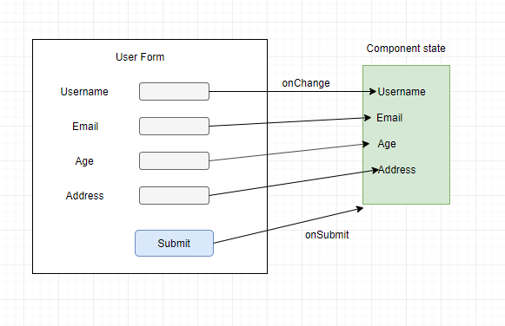
Forms
Data flow:

Slide 4
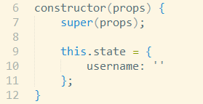


Forms
Set component state: Function for state change:
Added onChange handler on input:

