Slide 2

Have you ever wanted to make a recipe, but weren’t sure how healthy it was for you?
Maybe you have a favorite food, but have trouble determining just how many servings are good for you.
Or you really wish you could figure out which ingredient is unhealthy and substitute.

Slide 3

Coding approach, and data munging technique
Created a function that calls our API to generate and update a list of recipes, and ingredients.
After all the individual recipes and ingredients were updated, we imported glob to merge the individual recipes into a master recipes json, and individual the ingredients into a master ingredients json

Slide 4
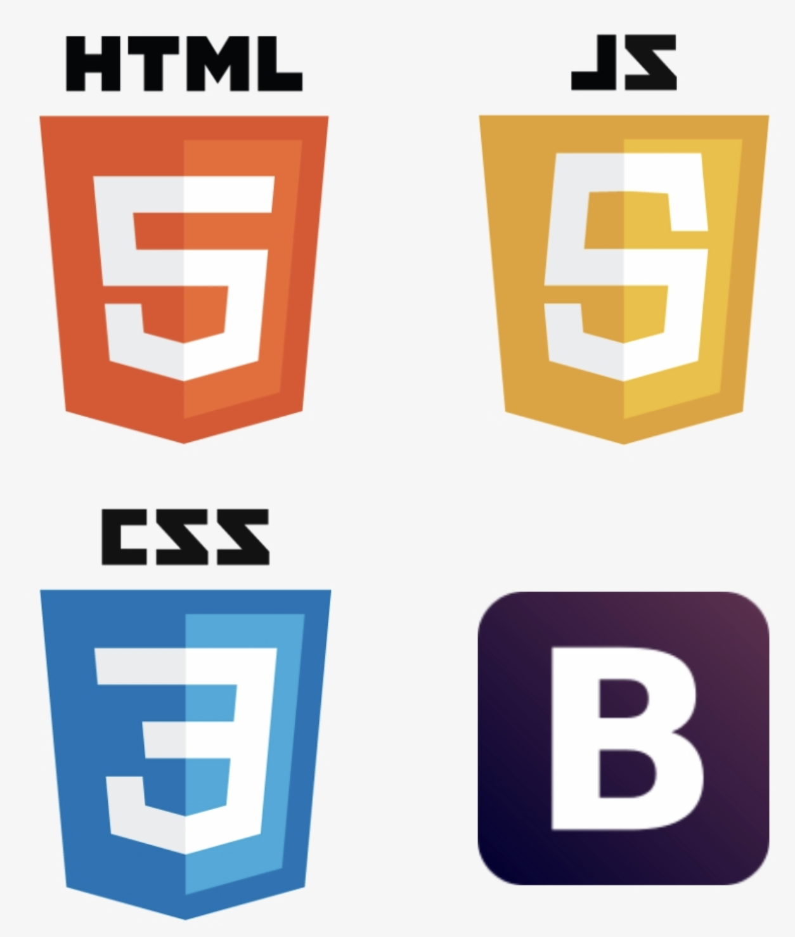


JavaScript

Slide 5
