Slide 2
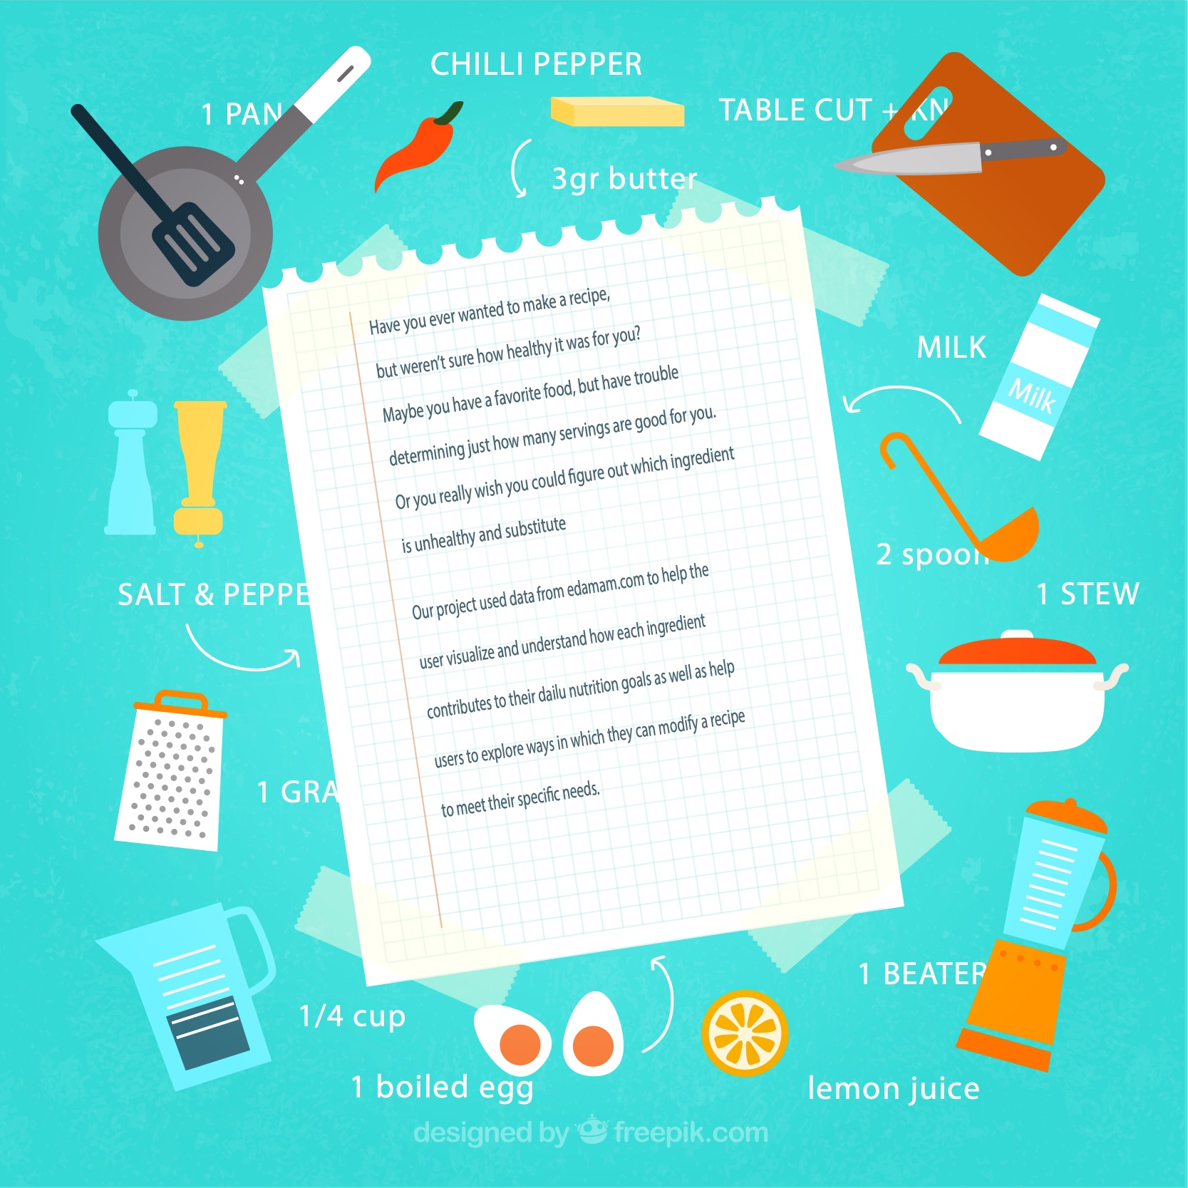

Slide 3
Coding approach, and data munging technique
Created a function that called our API to generate and update a list of recipes, and ingredients.
After all the individual recipes and ingredients were updated, we imported glob to merge the individual recipes into a master recipes json, and individual the ingredients into a master ingredients json.

Slide 4
.

