Slide 2


Slide 3


Coding approach, and data munging technique
API
MongoDB

Slide 4
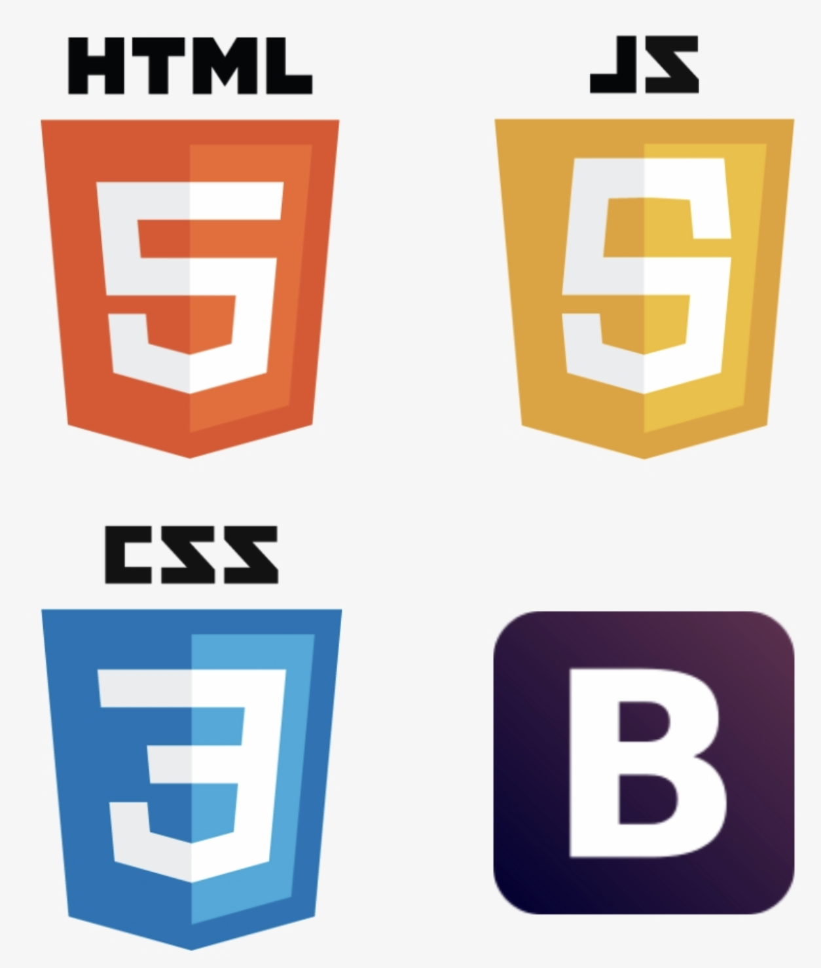


JavaScript

Slide 5


