Slide 1
Databases or: How I learned to stop worrying and love the deadlock
Mario.Lassnig@cern.ch
European Organization for Nuclear Research (CERN)

Slide 2
About me
Software Engineer
  Data Management & Analytics for the ATLAS Experiment, CERN, 2006-ongoing
  Automotive Navigation, AIT Vienna, 2004-2006
  Avionics for autonomous robots, Austrian Space Forum, 2008-ongoing
Education
  Multivariate statistics and machine learning (PhD)
  Graph theory (Master's)
  Cryptography (Undergrad)
Largest 24/7 database built yet
  3+ billion rows
  35'000 IOPS

Slide 3
About this course
For every topic
  We will do some theory
  We will do some hands-on exercises
The contents from the session codes are complete and will give you the solution.
  Don't blindly copy/paste, try to understand what's going on.
  There'll be a challenge/exercise at the end, where you have to apply what you have learned.
Please interrupt me whenever necessary!

Slide 4
Part I — Introduction

Slide 5
CAP Theorem
It is impossible for a distributed computer system to simultaneously provide all three of the following guarantees [Brewer, 2000]
All clients always see the same data.
File systems, single-instance databases, …
All clients can always read and write.
Consistency
Availability
Choose Two
Distributed databases
Web caching, DNS, …
Partition tolerance
The data can be split across the system.

Slide 6
ACID and BASE
ACID
  Atomicity All or nothing operations
  Consistency Always a valid state
  Isolation Operations can be serialised
  Durability Data is never lost
BASE
  Basically available More often than not
  Soft state Data might be lost, but you will only know when you try to access it
  Eventually consistent Your query might return old data

Slide 7
So what is this NoSQL thing anyway?
Carlo Strozzi, 1998
Term invented for a relational database without a SQL interface
Term re-coined by last.fm in 2009
  At an open-source distributed databases workshop
  What they actually meant: how to deal with the exponential increase in storage requirements
Promises of NoSQL databases?
  Relational model might not map well to application's data structures
  Improve productivity by using non-relational stores instead as application backend
Improve performance for "web-scale" applications?
  Remember the CAP theorem
  There is no free lunch

Slide 8
Types of databases
Row stores
  Oracle, PostgreSQL, MySQL, SQLite, …
Column stores
  Hbase, Cassandra, Hypertable, Monet, …
Data structure stores
  ElasticSearch, MongoDB, Redis,
  PostgreSQL, …
Many have overlapping concepts
Get confused here: http://nosql-database.org/
Key/Value stores
  Dynamo, Riak, LevelDB, Kyoto, …
Graph stores
  Neo4j, Titan, Hypergraph, …
Multimodel stores
  ArangoDB, CortexDB, …
Object stores
  Versant, Ceph, …
Relational
Non-relational

Slide 9
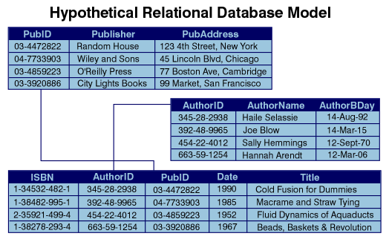
Relational model
Proposed by Edgar F. Codd, 1969
Concept Relations Tuples Attributes
Database Table Row Column
Attribute/Column
Relation/Table
Tuple/Row
http://www.ibm.com/developerworks/library/x-matters8/relat.gif

Slide 10
Structured Query Language (SQL)
Proposed by Edgar F. Codd, 1969
Interaction with DBMS (Database Management System) using declarative language
Developed from SEQUEL language an ANSI/ISO Standard in 1986
Ess Que Ell? Sequel?
  Oracle defines pronunciation as "sequel", then we have "My-S-Q-L", and PostgreSQL is "Postgres"
  Don Chamberlin, one of the original authors of the SEQUEL language suggests to go with ISO: S-Q-L
CREATE TABLE table_name;
SELECT column_name FROM table_name WHERE column_name = value;
INSERT INTO table_name(column_name) VALUES (value);
UPDATE table_name SET column_name = value;
DELETE FROM table_name WHERE column_name = value;
DROP TABLE table_name;

Slide 11
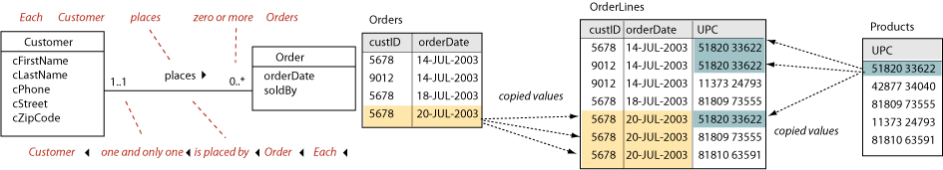
Row Stores
Your classic RDBMS
Physically stores data row-by-row
Easy joining of data between tables
  one-to-one
  one-to-many
  many-to-many
Normalization algorithms to reduce duplicate data and complexity
Not so good for aggregation (RDBMS vendors compete here)
http://www.tomjewett.com/dbdesign/dbdesign.php?page=manymany.php

Slide 12
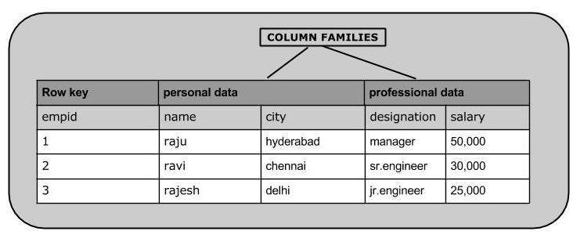
Column Stores
Many applications do not need relations
Row-based systems like traditional RDBMS are ill-suited for aggregation queries
  Things like SUM/AVG of a column?
  Needs to read blocks of columns, sometimes full rows, unnecessarily
Physical layout of data column-wise instead
  saves IO and improves compression, facilitates parallel IO
  makes joins between columns harder
  need to save on joins somehow
  native support for column-families
http://www.tutorialspoint.com/hbase/images/table.jpg

Slide 13
Key/Value Stores
Hashmap for efficient insert and retrieval of data
  You might know this as an associative array, or dictionary, or hashtable, …
Keys and values are usually bytestreams, but practically just strings
Usually there are some performance guarantees, via options like
  sorted keys
  length restrictions
  different hash functions
Simple and easy to use
  Either as compile-time libraries
  Or as a server, usually via wrapped native protocols,
  or via REST
First Key/Value store: dbm, 1979
Key 1
Value 1
Key ...
Value ...
Key n
Value n

Slide 14
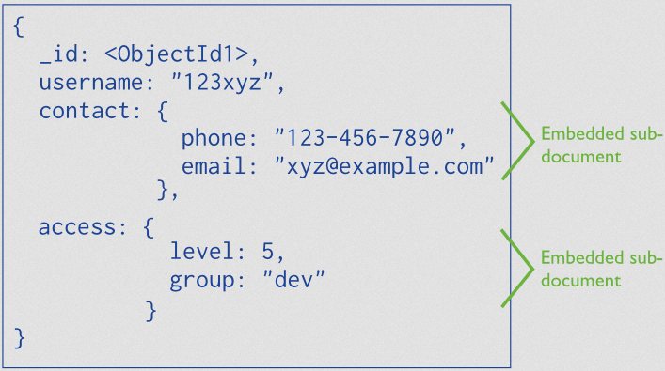
Data Structure Stores
Basically key/value stores, with the added twist that the stores knows something about the internal structure of the value
Very easy to use as a backend for an application
When people think NoSQL, this is usually what they mean
http://docs.mongodb.org/v3.0/_images/data-model-denormalized.png

Slide 15
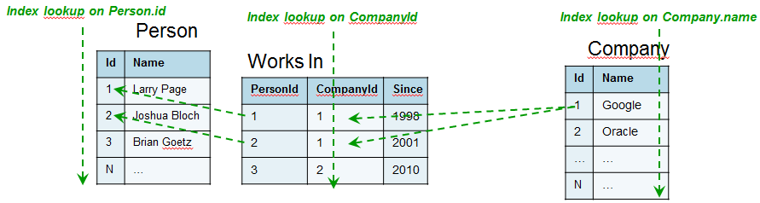
Graph Stores
In the relational world, actual n-to-n relations are cumbersome to model
(despite the name…)
http://blog.octo.com/wp-content/uploads/2012/07/RequestInSQL.png

Slide 16
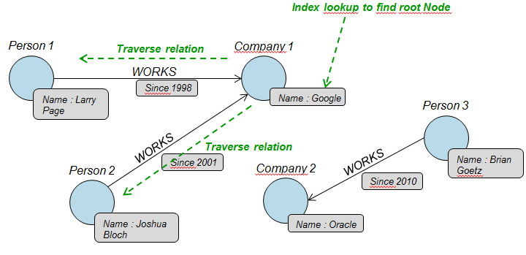
Graph Stores
Make relations first-class citizens
Physical layout optimised for distance between data points
Leads to easy & fast traversal for the graph database engine
http://blog.octo.com/wp-content/uploads/2012/07/RequestInGraph.png

Slide 17
Hands-on Session 1
Create, read, update, delete data
Using C/C++ and Python
On
  PostgreSQL relational row-based
  LevelDB non-relational key/value
  Redis non-relational data structure
  ElasticSearch non-relational data structure
  Neo4j non-relational graph

Slide 18
Part II — Fun and profit

Slide 19
Query plans
IMHO the single most important thing when dealing with databases
You want to avoid going to disk, to reduce the IOPS and CPU usage
In order of excessiveness
  FULL TABLE SCAN
  PARTITION SCAN
  INDEX RANGE SCAN
  PARTITION INDEX RANGE SCAN
  INDEX UNIQUE SCAN
  PARTITION INDEX UNIQUE SCAN
Not all FULL TABLE SCANs are bad
  If you need to retrieve a lot of data, and it is indexed, you will get random IO on the disk. Much better to prefer serial scan (FULL, PARTITION) in such cases
  If you data is low cardinality (few values, lots of rows) then indexes won't help and slow down INSERTs

Slide 20
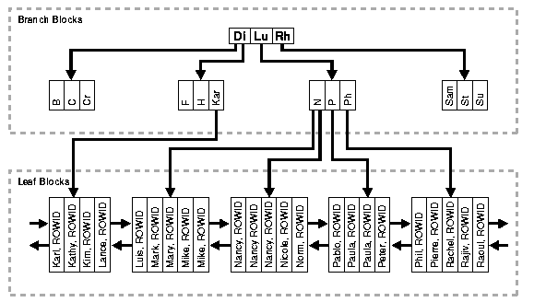
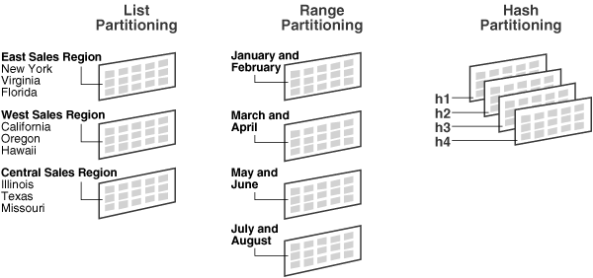
Query plans — How to optimise?
Understand the EXPLAIN PLAN statement, then decide
Partitions
  Physical separation of data
  Costly to introduce afterwards (usually requires downtime with schema migration)
Indexes
  Either global or partition local
  Logarithmic access to data
https://docs.oracle.com/cd/B19306_01/server.102/b14220/img/cncpt158.gif
http://www.mattfleming.com/files/images/example.gif

Slide 21
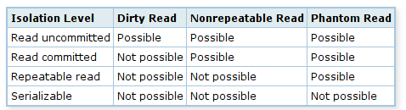
Transactional safety
In multi-threaded environments concurrent access to the same data is likely
Dirty Read
  Read data by uncommitted transaction
Non-Repeatable Read
  Reads previously read data again, but it has changed in the meantime by another transaction
Phantom Read
  Repeated query of the some conditions yields different results due to intermediate other transaction
Different transaction isolation levels provide safeguards
  By locking of rows, or sometimes even tables, and thus making other transactions wait
  The more you lock, the slower you are
  Can lead to deadlocks if the developer is careless — always lock rows in the same order!

Slide 22
Sparse metadata
Think "tagging"/"labelling" datasets — Difficult problem in relational model
  Keep extra columns or implement a relational key/value store?
  Extra columns are bad for physical disk layout
  Relational key/value store requires lots of joins — not good for cache and CPU
Will you ever search on metadata?
  No Store the metadata as a JSON-encoded string in a single column
  Yes Many different kinds of metadata?
      No Maintain a separate metadata table, with pre-created columns
      Yes Use the built-in JSON support of Oracle or PostgreSQL
      or alternatively use a non-relational database and keep the data in sync
There is some really bad advice on StackOverflow promoting a generic key/value model for relational databases — Caveat emptor!

Slide 23
Competitive locking
Many applications have the following use case
  Many processes write something in a queue — the "backlog" of things to do
  Many processes read from that queue — and work it off in parallel
Scheduling problem
  Do things in order? Prioritise certain things?
  How to avoid that multiple workers process the same things?
  Repeat after me: a database is not a queuing system
However, sometimes a DB is all you have... And there are two potential solutions
Database-level (row read lock, easy):
  BEGIN; SELECT row FOR UPDATE; COMMIT/ROLLBACK;
Application-level (no lock, complex)
  When selecting work, compute the row-hash, convert to integer, take modulo #workers
  Then only process rows that match the worker-id

Slide 24
Part III — Survival

Slide 25
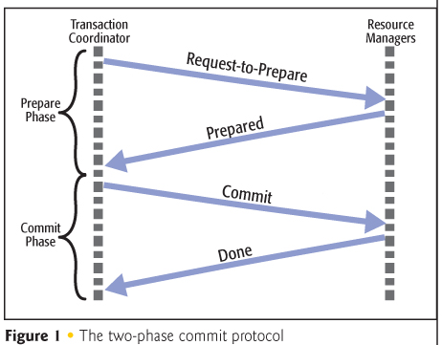
Distributed transactions
Sometimes you really need two different data stores
Sometimes you need to be consistent between both
Consensus protocols are needed
  Two-phase commit
  Paxos
Needs operational support by DBMS
  pending writes / write-ahead log (WAL)
But you still have to code it in the application
  This is where you will lose performance
http://gemsres.com/photos/story/res/43755/fig1.jpg

Slide 26

SQL Injection
https://xkcd.com/327/

Slide 27
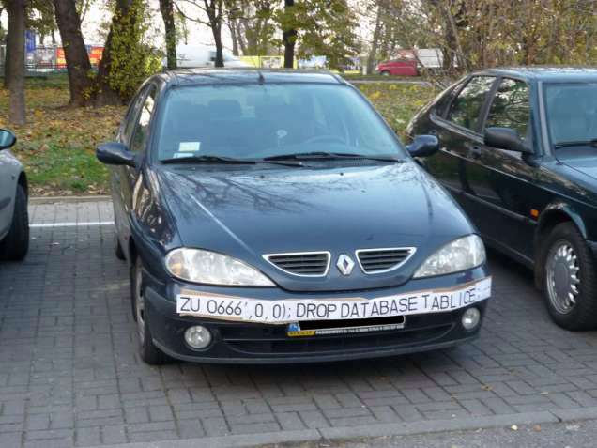
SQL Injection
https://hackadaycom.files.wordpress.com/2014/04/18mpenleoksq8jpg.jpg?w=636

Slide 28
Application level woes
Handling sessions — this will be your major source of pain
  Connections, Sessions, Transactions (and how they are differently named/treated by each DBMS)
Most databases only have a limited number of available connections, or sessions
Some pay with CPU for logons, others with RAM for sessions, etc…
E.g., if you have to channel 100 concurrent transactions across 10 connections
  SessionPooling/QueuePooling — every language/database has its own idea
  Takeaway message: Use an abstraction, and don't code it y ourself
Python SQLAlchemy, Django
  Also comes with Object-Relational Mapper
  Automatically translates Python objects into the relational model
C++ CodeSynthesisODB
  Also supports BOOST datatypes!

Slide 29
Part IV — The Challenge

Slide 30
Challenge description
Write a Twitter clone before time runs out
Choose any database you like, the VMs are preconfigured for all of them
Stick to the following UX — you will need to write four programs
  Inserter periodically inserts new random tweet into the database
  Latest periodically print the latest 10 tweets
  Random periodically print random 5 tweets
  Stats periodically print statistics about the database content
    How many tweets were added in the last minute by each user and overall (insertion rate)
    How often a given tweet was displayed (popularity of a particular twwet)
  Start 10 inserter, 10 latest, 10 random, 1 stat
Use this random tweet/sentence generator (pip install loremipsum)
  import loremipsum loremipsum.generate_sentence()
When stuck, ask me — when done, show me! Good luck and have fun!

Slide 31
Databases or: How I learned to stop worrying and love the deadlock
Mario.Lassnig@cern.ch
European Organization for Nuclear Research (CERN)

Slide 32


