Slide 1
Network Performance Analysis
Neil Lawrence

Slide 2
Schedule
Today: Introduction and Background
2nd Oct | Introduction and Background
9th Oct | Probability review and Poisson Processes (Tutorial 1 set)
16th Oct | Little’s Formula and M/M/1 queues
23rd Oct | M/M/1 simulation and M/M/1/m (Coursework set)
30th Oct | M/M/m & M/M/m/m (Erlang Delay and Loss queues)
6th Nov | Review of Markov Systems and M/G/1 queue
13th Nov | M/G/1 with Vacations
20th Nov | Coursework review and simulations
27th Nov | Advanced topics
10th Dec | Advanced topics
Website: http://www.dcs.shef.ac.uk/~neil/NPA/index.html

Slide 3
Up & Coming
No Thursday session this week.
First Thursday session Week 3.
First tutorial sheet Week 2.

Slide 4
Historical Background
1844 The first telegraph message was sent from Baltimore to Washington D.C.. Ten years later 23,000 miles of wire across the U.S.
  Communications contributed to the speed with which the West could be opened. Both the telegraph and railways contributed to the expansion and the demise of old methods such as the Pony Express.
1876, Patent was granted to Alexander Graham Bell
  for the invention of the telephone.
The next major development was wireless communications. Guglielmo Marconi developed the telegraph in 1897.
  December 1901 short wave transmissions across the Atlantic demonstrated.

Slide 5
Historical Background Contd
The foundations of modern communication systems rely on theory.
  Claude Shannon is the Father of Information theory.
  His 1948 work A Mathematical Theory of Communication established the fundamental principals of communication and information theory.
  All modern communication, coding and storage relies on ideas laid down by him. See module COM3261 Applications of Information Theory.
In practical terms the next big development was
  Store-and-forward packet switching networks. Baran, Davies & Kleinrock in the 1960s. Such designs were initially inspired by military considerations.

Slide 6
Historical Background
ARPA net: Advanced Research Project’s Agency, 1969
  Funded defence money for connecting computers together in a ‘distributed way’.
Internet
  The internet was formed by interconnection of several networks such as ARPA net and networks from major corporations.
  Such interconnections are only possible through the laying out of standards which dictate how interoperation occurs.
TCP/IP
  Is commonly the term used to refer to these standards. TCP/IP gives a set of protocols which determine how networks interoperate.
LANS
  Local area networks, initially developed by Xerox PARC in the late 1970s provide interoperation between computers on a local site. These are extremely common today – all the university networks, wireless networks.

Slide 7
The Future
Ad hoc mobile networks.
  For people …
  For cars …
  For planes …
  For trains …
Home networking – centrally stored video, games, DVDs distributed wirelessly to any room in the home.
Example application: Hypertag.

Slide 8
What does it all mean?
Performance analysis is becoming more important.
In this course you will learn the basics.
Niranjan’s Barber analogy.

Slide 9
Network Performance Analysis
We will analyze the quality of these networks through probabilistic models of the networks.
Only simple networks are tractable (but still useful) but the principles are the same for complex networks.
The first 2/3 of the course will look at simple networks.
In the last 1/3 we will look at more advanced topics.

Slide 10
What is Important
Design Issues
  When designing my network how big shall I make my router’s buffer?
Quality of Service Issues
  What delay will a typical client experience, is it acceptable?
Constraints are placed upon us as resources are finite:
  Bandwidth limitations
  Processor speeds
  Limited buffer sizes
Even as supplies increase demand increases too
  Originally email now … video phone.
  Originally HTTP now … video on demand.

Slide 11
Terminology
A Session:
  A series of interactions between two users.
Messages:
  A session may be split up into one or more messages.
    SMTP (E-mail) has one message per session.
    Telnet (remote terminal) has several messages per session.
Packets:
  Each message may be split up into packets
    Depending on network design packets may travel down
      The same route to their destination.
      Different routes.
Example:
  The lecture could be viewed as a session.
  Messages could be the separate subjects.
  Packets could be the sentences.

Slide 12
Characterising the Session
If we wish to measure performance, we will need to characterise the session in some way.
Features we look to quantify are
  Message/packet arrival rate.
  Variability of message/packet arrivals
  Session holding time: The length of a session.
  Expected message/packet length and length distribution.
  Allowable delay - varies according to application voice vs ftp
  Reliability – Banking data vs email
  Ordering of packets.
In this course we will focus on 1, 2 and 4.

Slide 13
Network types
Let us now introduce the two networks of principal interest.
Circuit switching networks.
  Used for telephone routing.
  Guarantees an open channel between two peers.
Store-and-forward switching
  Used for data. Two types:
    Dynamic routing: Each packet may move through the network independently.
    Virtual circuit routing: A fixed path through the network is provided for the entire message/session.

Slide 14
System Characteristics
Circuit Switching
  Can be wasteful in terms of bandwidth because when the session is idle the channel is not utilised.
  Once connection is established, guaranteed bandwidth is provided.
  The communication delay will be known in advance.
  New sessions may be rejected if congestion occurs.
Store-and-forward switching
  Less wasteful in terms of bandwidth.
  Effective bandwidth depends on level of network activity.
  The communication delay varies (but on average for the same load will be lower).
  New sessions will not be rejected but network delays can increase rapidly and packet loss can occur requiring retransmission and further congestion.

Slide 15
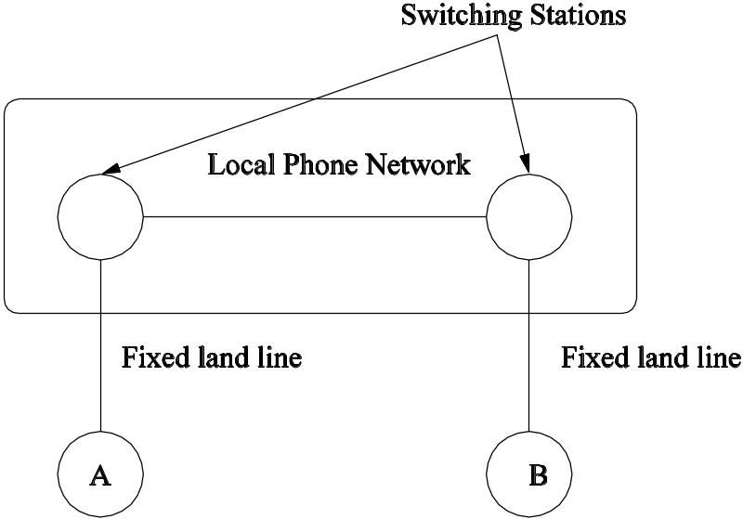
Alice and Bob Example
Circuit switching communication

Slide 16
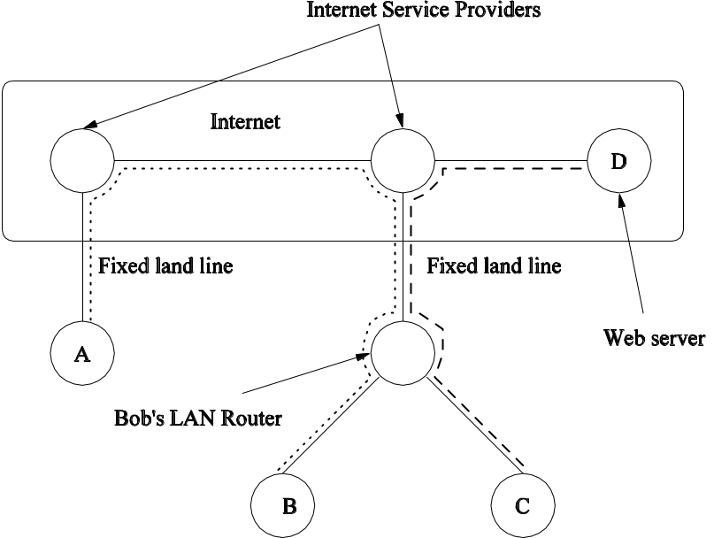
Alice, Bob, Carol and David
Store-and-forward Switching

Slide 17
More on Store-and-Forward
Data Networks involve many elements and protocols.
Here we give a review of those that are normally present.
We use layered models for this purpose.

Slide 18
Layered Model for TCP/IP
By way of review we now consider the layered model for TCP/IP networks.
Generally layered models are considered for the OSI reference model (a seven layer model).
The Layered model abstracts the roles of each part of the network from one another.
Layered models provide an abstraction of communication between clients.
To illustrate this consider the following example.

Slide 19
A Layered Model of the U.N.
George W.
Bush
‘I don’t like you’
Saddam
Hussein
‘I don’t like you either’
U.S.
Ambassador
to U.N.
Iraqi
Ambassador
To U.N.
Any
necessary
translation
Any
necessary
translation
U.N. General
Assembly
U.N. General
Assembly

Slide 20
OSI Reference Model
The original seven layer model (See Tanenbaum Section 1.4)
Application
Application
APDU
Presentation
Presentation
PPDU
Session
Session
SPDU
Transport
Transport
TPDU
Network
Network
Packet
Data link
Data link
Frame
Physical
Physical
Bit
Communication separated by routers

Slide 21
The Layers
Physical Layer
  Concerned with the detail of transmitting raw bits over the communication channel – representation, half-duplex/duplex etc.
Data Link layer
  Handles line errors and retransmission ensuring reliable transmission. Acknowledgement frames. Controlling access to the channel (medium access control).
The Network Layer
  Controls operation of the subnet. How packets are routed (static routing, dynamic routing). Congestion control, internetworking.
The Transport Layer
  Provides an hardware independent interface between the network layer and the session layer. Communication here is direct to destination.

Slide 22
The Layers
Session Layer
  Handles management of ‘sessions’. Such as preventing two users performing same critical operation at the same time.
Presentation Layer
  Standardisation of syntax, enabling computers with different data representations to communicate.
Application Layer
  The protocols that interface with the user. HTTP (web), SMTP (mail), FTP (file transfer), NNTP (news) and many more.

Slide 23
TCP/IP Model
Envisaged from the start to support voice and e-mail communications.
OSI
TCP/IP
Application
Application
Presentation
Session
Transport
Transport
Network
Internet
Data link
Host-to-
network
Physical

Slide 24
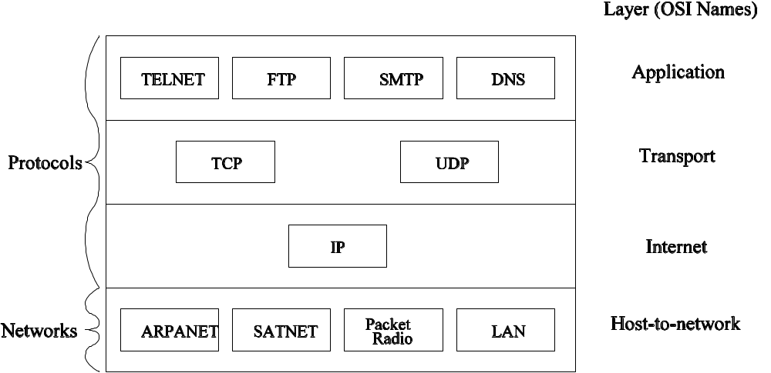
TCP/IP Model

Slide 25
TCP/IP Layers
Host-to-network Layer
  Not really defined.
The Internet Layer
  Defines packet format and IP. Its role is to deliver the packets to the correct place. Packet routing is major part of its functionality.
The Transport Layer
  Contains two different protocols. TCP which contains elements of congestion control and error correction, and UDP where sequential flow control is not provided.
The Application Layer
  No session or presentation layers. Application layer interfaces directly with transport layer.

Slide 26
Why was TCP/IP successful?
It was there at the right time and place.
It was incorporated in to UNIX (4.2BSD) just when LANs were becoming widespread.
OSI’s early implementations were unwieldy (perhaps due to over specification). TCP/IP was what people used.
TCP/IP Lacks formal definition in some areas and suffers as a result.

Slide 27
Telephone Networks
See Chan
Sheffield
Manchester
Local
telephone
network
Local
telephone
network

Slide 28
International Too
U.K.
India
National
Network
National
Network

Slide 29
Communication Media
Splitting Channels through Multiplexing
Time Division Multiplexing.
Frequency Division multiplexing (Radio – Short Wave to Microwave).
Packet switching.
Networks which communicate on one channel ALOHA

Slide 30
Summary
Today was introductory material.
Make yourself familiar and comfortable with the topics mentioned.
You have varied backgrounds so for some this was review.
Next week – probability review & probabilistic processes.
  Bring pen and paper because there will be no printed notes.

