Slide 1
Review of Prediction with Gaussian Processes

Slide 2
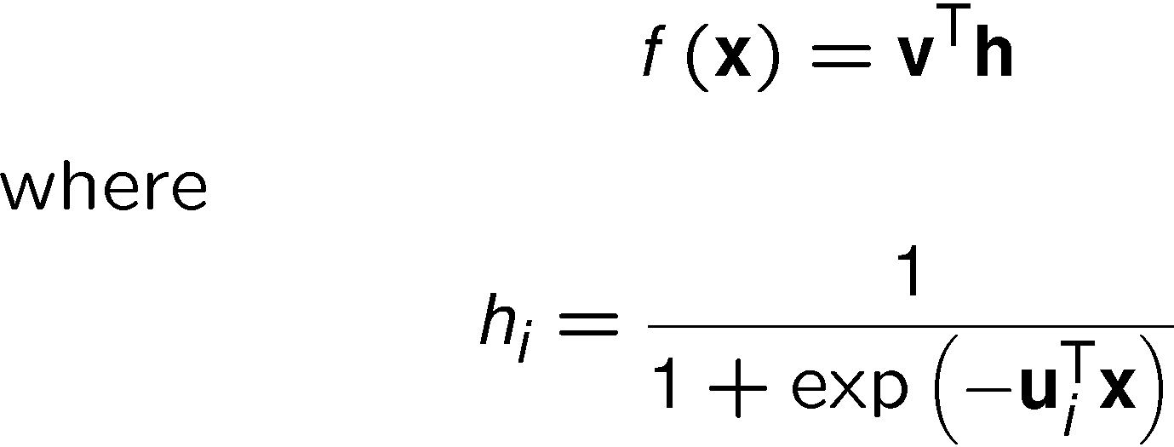
Introduction
Mentions neural networks.
Neural networks for regression are Gaussian processes with mean

Slide 3
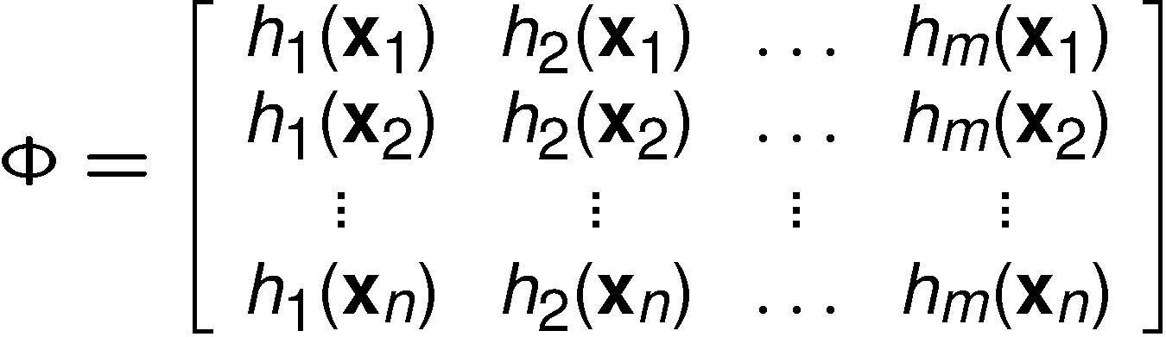
Bayesian Treatment
They are parameterised by a vector v and a matrix U.
We can treat the parameters v in a Bayesian way, we just build a design matrix of h.
Note that the vectors h are equivalent to our vectors φ from before.

Slide 4
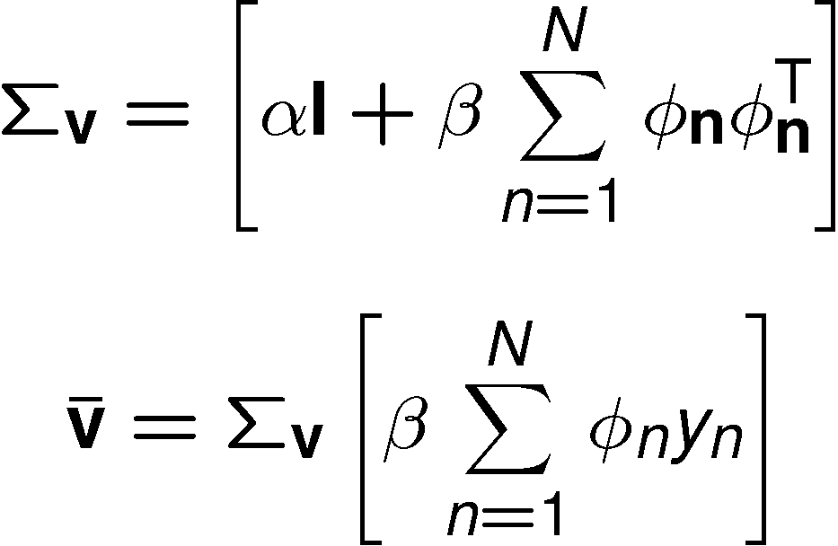

Bayesian Treatment
We then use this in Bayesian regression algorithm and find the vector v.
Where Σ_{v} is the posterior covariance and is the posterior mean.

Slide 5


Treatment of U
However the matrix U cannot be treated in this manner.
We cannot find joint posterior
We can only find

Slide 6
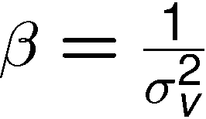
Notation
Williams uses:
  Prior covariance matrix Σ_{w} equation (5).
  He uses noise variance as
  in the likelihood equation (6).
  He uses t_{i} instead of y_{n} for the ‘target values’
  He uses n instead of N for the number of data-points.

Slide 7
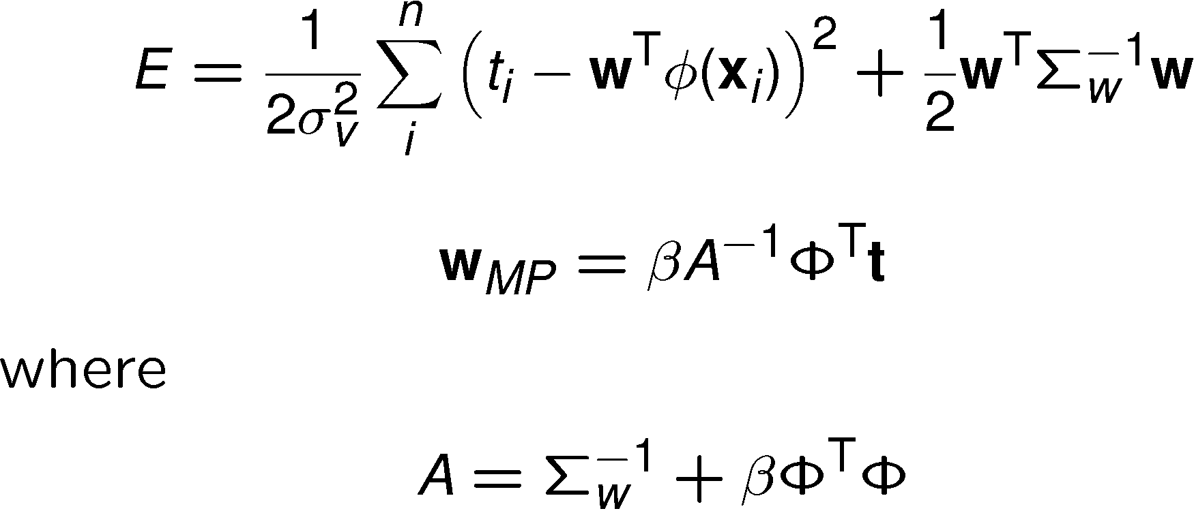

Optimisation
Williams talks about the posterior mean being the choice that minimises the quadratic form.
We can confirm that is the posterior mean and that A⁻¹ is the posterior covariance.

Slide 8

Mean Prediction
Williams uses for the mean of the Gaussian process.
Equation (13) and (14) are the same as those on pages 34 and 35 of your notes.
Williams uses x* to represent ‘any’ value from input space.
He computes the mean value and the covariance of the output function under the posterior distribution.
williamsDemo.m

Slide 9

Priors over Functions
In Gaussian process regression
  Place a prior over function space.
  What?
  Place a prior over function space.
This doesn’t make much sense – a function has infinite possibilities.
Williams notation now uses – equation (17) & (18)

Slide 10
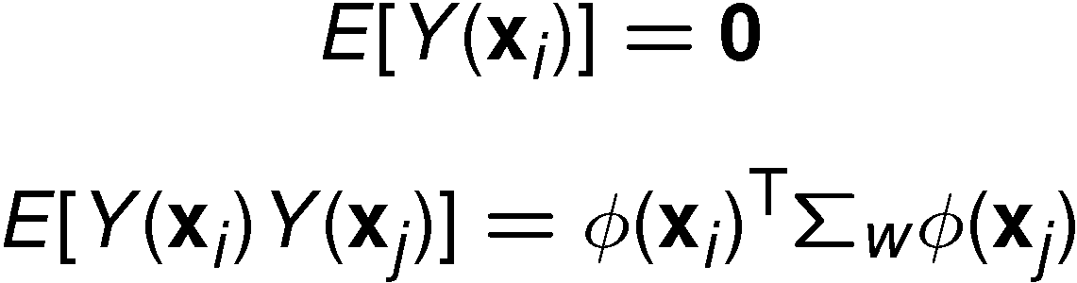
Prior Representation
We have already seen that given our weight posterior leads to certain forms for
Where the expectations here are under the posterior.
We can ask the question what does our prior lead to?
Here Williams used x and x⁰.

Slide 11

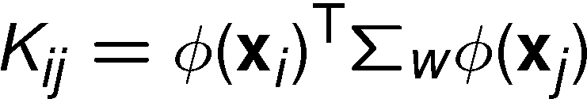
What does this mean?
This means that by specifying a design matrix, and a covariance over the weight space we are implicitly specifying a prior over the values of
The expectations under the prior are
which implies a Gaussian distribution over with mean of 0 and a covariance whose elements are

Slide 12

Priors over Functions contd
In other words we can specify a probabilistic prior over a probabilistic model for directly.
How do we sample from this model?
  There is a problem – if we are interested in a new data-point which is not in our training data, x*
This problem is covered in section 3.3.

Slide 13
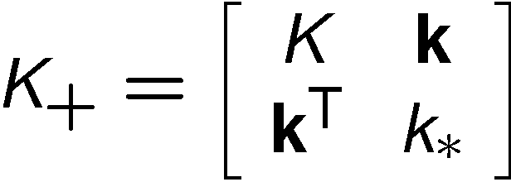
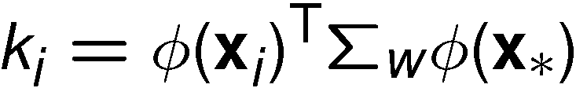
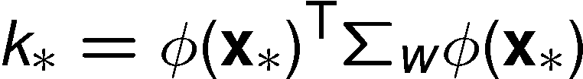
K₊ is now a covariance matrix over the n data-points in the training set, indexed by i, x_{i} and the point where we wish to make a prediction, x*. So K₊ has dimensions n+1 x n+1.
Here the K matrix is as defined before, the ith element of k is
And the scalar k* is

Slide 14
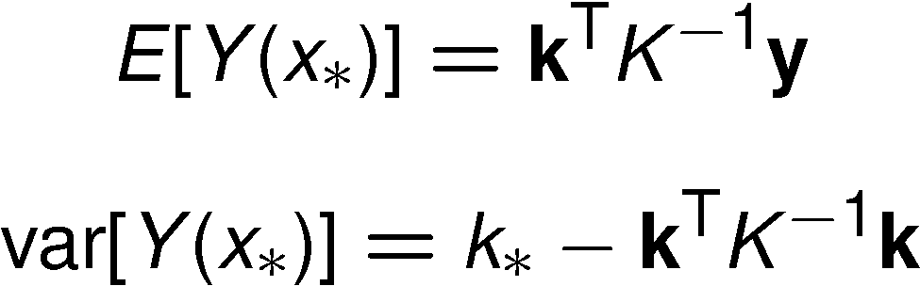
Prediction
In section 3.3 Williams introduces variables Z₁ … Z_{n}, Z*. For the case of linear prediction, if we replace these by Y(x₁) … Y(x_{n}), Y(x*) we can see that the point he is making here is that if we are given old values for Y we can sample values for new Y from a Gaussian with the following mean and variance.

Slide 15
Sampling Scheme
This gives a sampling scheme for a Gaussian process given a prior covariance, Σ_{w}, and a matrix φ.
gpSample.m

Slide 16
Section 3.4
Note the conditions for the addition of the noise σ²_{v}

