Slide 1
EDES 301 PCB Project
Mustafa Latif
Due 12/17/2024 @ 11:59pm

Slide 2
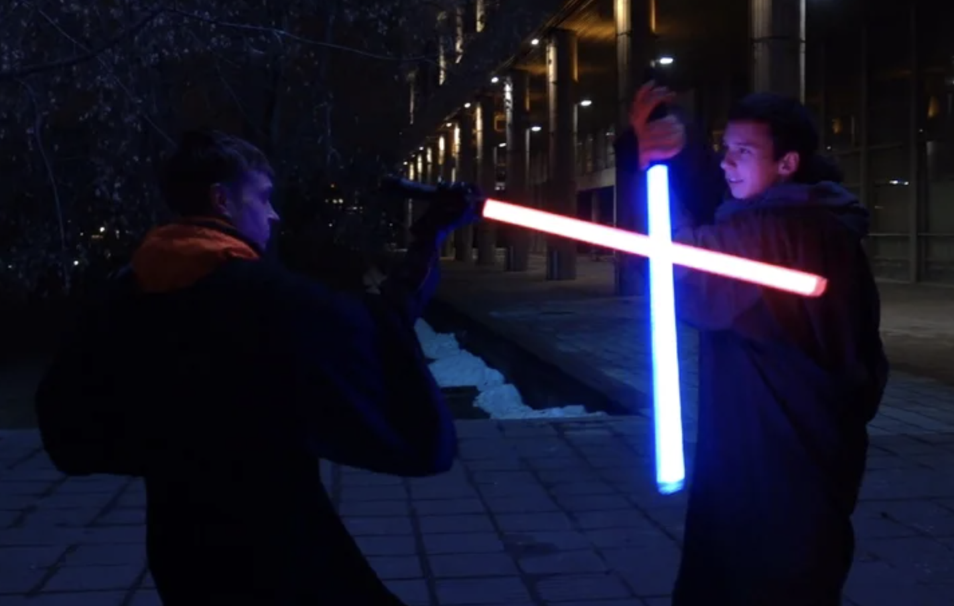
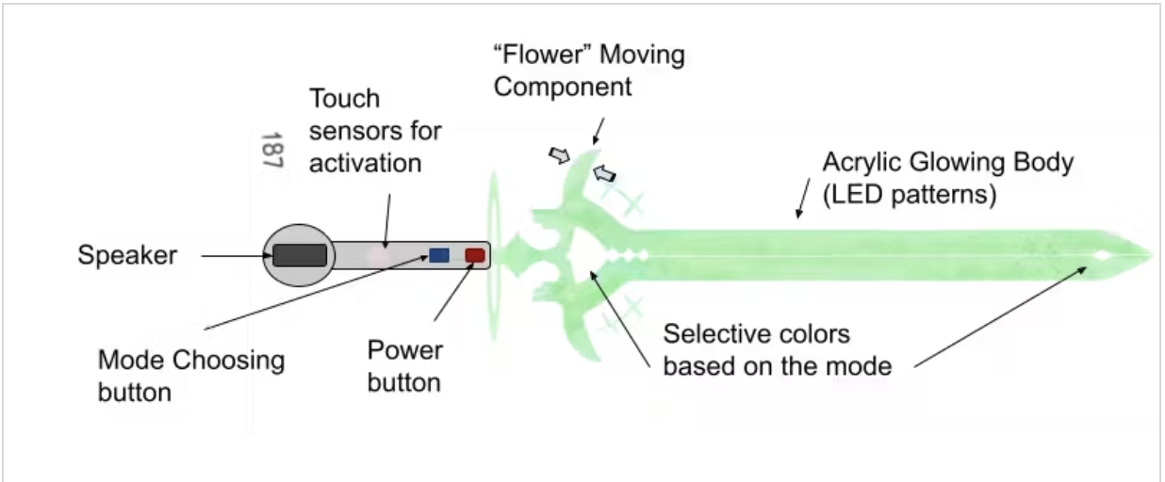
Background Information
We want to have fun lightsaber duels, but prop lightsabers are expensive
Through this project, we can build our own at a much cheaper cost
Cost effective, but also cooler since we built them ourselves
Inspiration/similar projects
Arduino Lightsaber https://www.instructables.com/Arduino-Based-Lightsaber-With-Light-and-Sound-Effe/
ENGI 301 Elemental Cosplay Sword https://www.hackster.io/Eunice011/elemental-cosplay-sword-1821f4
Improve upon previous ENGI projects by providing smoother sound effects, motion and impact sensing, and fluid blade ignition

Slide 3
System Block Diagram
Button
PocketBeagle
(OSD335x-SM SiP)
Level Shifter (TXS0108E)
LED (WS2812B)
GPIO
5V USB battery
Digital Amplifier (MAX98357)
Speaker
(MakerHawk)
PWM/
I2S?
Motion Sensor (MPU-6050)
I2C

Slide 4
Power Block Diagram
3.3V
3X Buttons
PocketBeagle
(OSD335x-SM SiP)
5V
LED (WS2812B)
GPIO
1µA
5V
5V USB battery
Digital Amplifier (MAX98357)
Speaker
(MakerHawk)
5V
3.3/5V
PWM/
I2S?
2.75mA
3.3V
Motion Sensor (MPU-6050)
I2C
3.9mA

Slide 5
Lightsaber ignites with ignition sound and light up
PocketBeagle off
Press button 1
PocketBeagle in idle state
Hold button 2
Press button 1
blade changes color on each press
Lightsaber in idle state.
No motion: slow light flickering, low humming sounds
Cycle through lightsaber colors
Lightsaber de-ignites with de-ignition sound and light off
Tap button 2
Hold button 2
Muted/unmuted current mode feedback sound played
Tap button 3
Lightsaber sound mode muted/unmuted
If lightsaber swung
motion state:
light flickering, swing sounds
Return to idle
Press button 1
If lightsaber contact
Software Block Diagram
PocketBeagle power off at any point
Return to idle
contact state:
light flash white, contact sound

Slide 6
Components / Budget
Component | EDES301 to Buy? | Cost
LED Reel (16.4ft) https://tinyurl.com/4jxemw7m | yes | $27.99
IMU 5pc (1x) https://tinyurl.com/rvzbvbs3 | yes | $12.99
Speakers 2pc (1x) https://tinyurl.com/mrjkcks7 | yes | $11.99
Digital Amplifier 1pc (1x) https://tinyurl.com/ytxx6y4v | yes | $5.95
5V USB battery 2pc (1x) https://tinyurl.com/3b3eus2b | no | $17.99
Note: As some of these parts come with multiple units, Liam and I will be sharing the parts and distributing the costs between us. Thus, the total expenses from EDES301 will not exceed $35 for each of us. Any additional costs will be provided by us.

Slide 7
Division of Labor
As Liam and I are both working on similar projects, we are dividing systems for each of us to individually work on. The division of labor is as follows:
Mustafa
Buttons
LED
IMU
Liam
Touch Screen
Speaker
IMU
Both of us will work on IMU as this is the main source of data that drives the other components

Slide 8
Mechanical Drawing
2.9”
Button
Button
Pocket Beagle
3.8”
LED Strips
Speaker
Level Shifter
Digital Amplifier
IMU
FRONT

