Slide 1
EDES 301 Replica Lightsaber Proposal
30 September 2024
Mustafa Latif

Slide 2
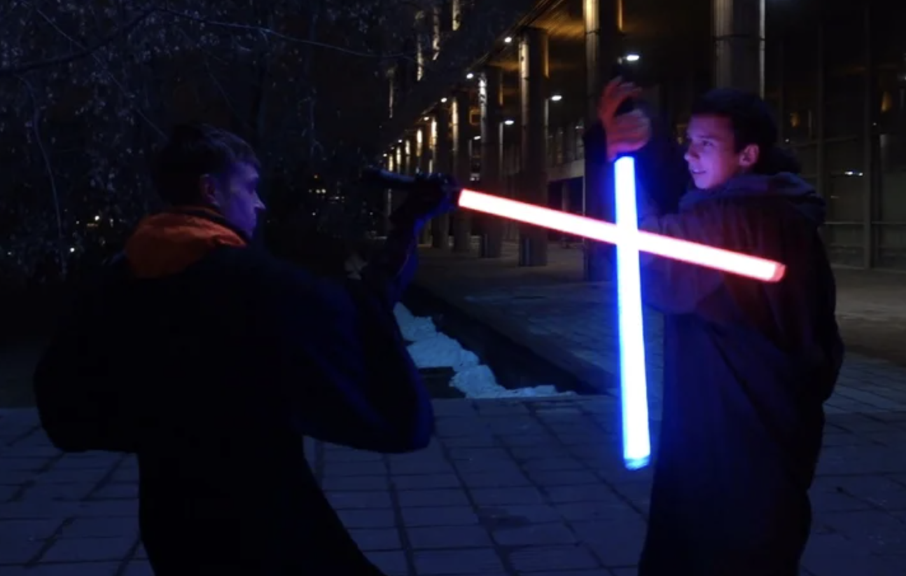
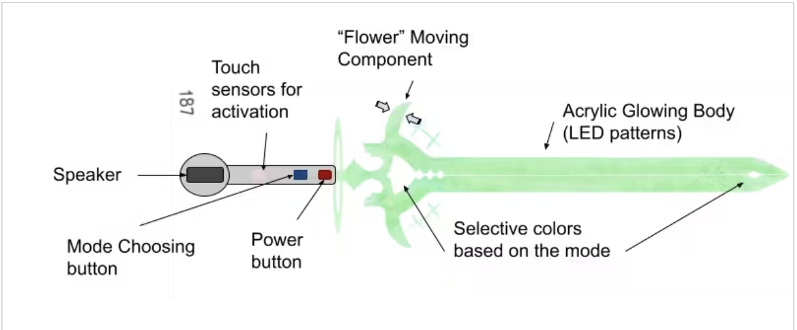
Background Information
We want to have fun lightsaber duels, but prop lightsabers are expensive
Through this project, we can build our own at a much cheaper cost
Cost effective, but also cooler since we built them ourselves
Inspiration/similar projects
Arduino Lightsaber https://www.instructables.com/Arduino-Based-Lightsaber-With-Light-and-Sound-Effe/
ENGI 301 Elemental Cosplay Sword https://www.hackster.io/Eunice011/elemental-cosplay-sword-1821f4
Improve upon previous ENGI projects by providing smoother sound effects, motion and impact sensing, and fluid blade ignition

Slide 3
System Block Diagram
Button
PocketBeagle
(OSD335x-SM SiP)
LED (WS2812B)
GPIO
5V USB battery
Digital Amplifier (MAX98357)
Speaker
(MakerHawk)
PWM/
I2S?
Motion Sensor (MPU-6050)
I2C

Slide 4
Power Block Diagram
Button
PocketBeagle
(OSD335x-SM SiP)
5V
LED (WS2812B)
GPIO
1µA
5V
5V USB battery
Digital Amplifier (MAX98357)
Speaker
(MakerHawk)
5V
3.3/5V
PWM/
I2S?
2.75mA
3.3V
Motion Sensor (MPU-6050)
I2C
3.9mA

Slide 5
Components / Budget
Component | EDES301 to Buy? | Cost
LED Strip Lights 4pc (2x) https://tinyurl.com/5dn9uku5 | yes | $16.99
IMU 5pc (1x) https://tinyurl.com/rvzbvbs3 | yes | $2.10
Speakers 2pc (1x) https://tinyurl.com/mrjkcks7 | yes | $11.99
Digital Amplifier 1pc (1x) https://tinyurl.com/ytxx6y4v | yes | $5.95
5V USB battery 1pc (1x) | no | TBD

