Slide 1
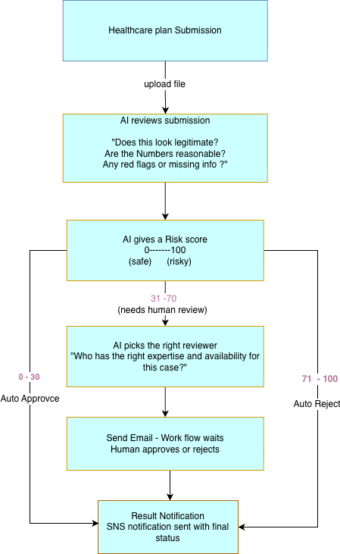
AI-Powered Healthcare Plan Submission workflow

Slide 2
AWS step functions
What is AWS Step Functions?
A fully managed workflow orchestration service that coordinates multiple AWS services into a reliable, scalable business workflow.
Key Features
Workflow Orchestration – Coordinates multiple AWS services in a defined sequence.
Built-in Reliability – Supports retries, timeouts, error handling, and exception management.
Massive Scalability – Can execute thousands of workflows concurrently.
Human-in-the-Loop Support – Enables approval steps, wait states, and long-running workflows.
Visual Workflow – Provides an easy-to-understand graphical representation of the business process.
Focus on Business Logic – Developers focus on implementing business logic while Step Functions manages workflow execution and state transitions.
Native AWS Integration – Seamlessly integrates with Lambda, Bedrock, SQS, SNS, EventBridge, ECS, DynamoDB, and many other AWS services.
Considerations
Simple workflows may be better implemented using Lambda, SQS, or Event Bridge without Step Functions.
256 KB maximum state payload between workflow steps.
Amazon States Language (ASL) has a learning curve for developers new to Step Functions.
Each state transition incurs a cost, so evaluate cost versus workflow complexity.

Slide 3
AWS Bedrock
What is Amazon Bedrock?
A fully managed AWS service that enables developers to build Generative AI applications using leading Foundation Models through a unified API.
Key Features
Access to Multiple Foundation Models – Choose from Anthropic Claude, Amazon Nova, Meta Llama, Mistral, Cohere, and others.
Unified API – Switch between supported models with minimal application changes.
Fully Managed Service – No infrastructure, GPU provisioning, or model hosting required.
Enterprise Security – Integrates with AWS IAM, encryption, VPC, and CloudTrail.
Knowledge Bases – Ground AI responses using enterprise documents (RAG).
Guardrails – Apply safety controls and business policies to AI responses.
Agents – Build AI assistants capable of orchestrating multi-step tasks.
Model Customization – Fine-tune or customize supported models with organization-specific data.
Considerations
Model Selection Matters – Different foundation models have different strengths, performance, and pricing.
Prompt Engineering – The quality and clarity of prompts significantly influence the quality of responses.
Response Validation – Foundation models can generate inaccurate or inconsistent outputs; important responses should be validated.
Cost & Latency – Costs depend on the model used and the number of input/output tokens; response times also vary by model.
Knowledge Grounding – For enterprise use cases, consider using Knowledge Bases (RAG) to ground responses in organization-specific data.
Responsible AI – Apply Guardrails, access controls, and human oversight for sensitive or regulated use cases.

Slide 4
