Slide 1
Digital Camp Aug 2018 Connect with Data & AI
Laura da silva, lead data scientist, elastacloud
Twitter: @lauradatasci, @wogisci

Slide 2
Today topics:
Intro to Data Science
Intro to Machine Learning and AI
Machine Learning techniques: supervised and unsupervised learning
Practical part I: Titanic survivor predictor
Practical part II: Income predictor
Reflections & challenges

Slide 3
What is Data Science?
Data science is about making sense of the world using data.
Data science connects the dots between the business world and the data world.
Data Science solves scientific and business problems by extracting knowledge from data.

Slide 4
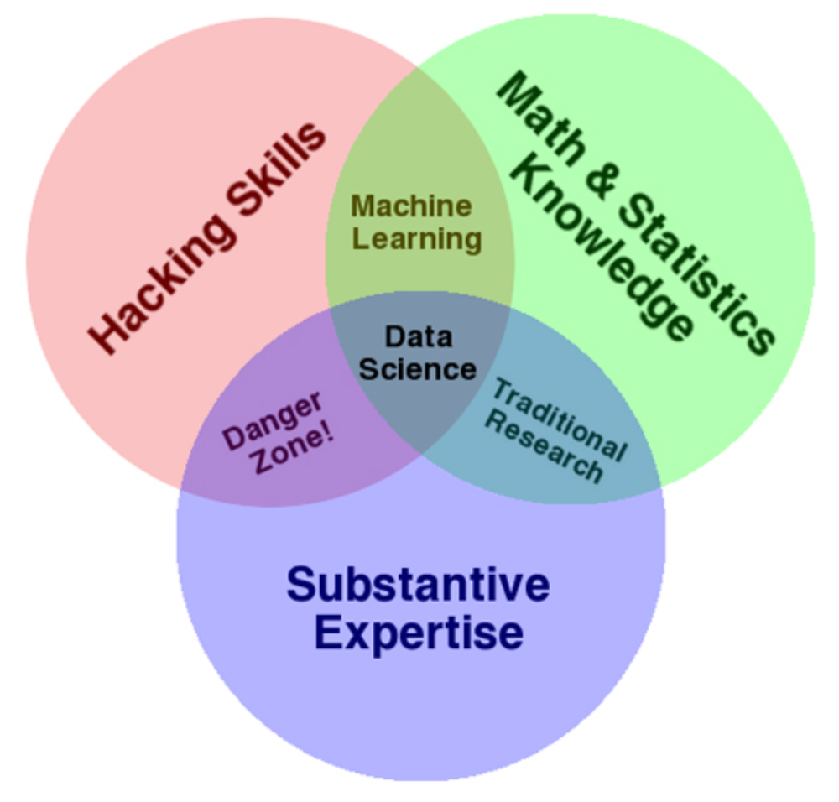
Who and how they can extract knowledge from data?
A data scientist gathers data from multiple sources and applies machine learning, predictive analytics, and sentiment analysis to extract critical information from the collected data sets.
They understand data from a business point of view and are able to provide accurate predictions and insights that can be used to power critical business decisions.

Slide 5
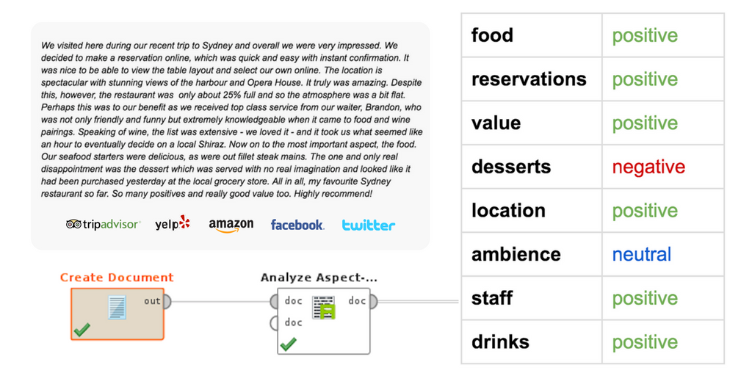
Example of data science to analyse customer satisfaction

Slide 6
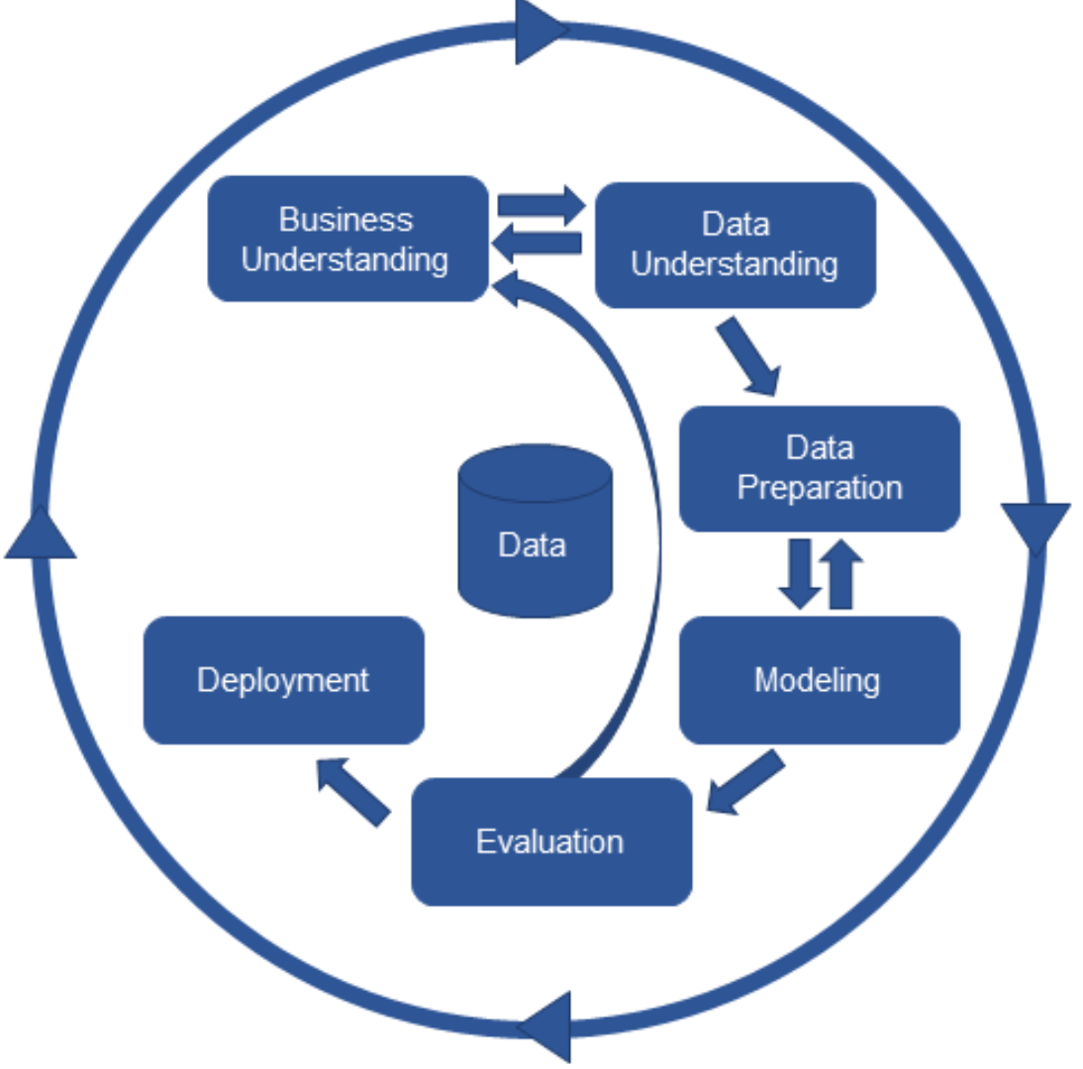
Data Science cycle
Analysis of customer satisfaction
Text data format
Keep only the key words
Installation of the solution in the business system
Multiclass classifier (positive/ negative/ neutral sentiment)
How well is the machine learning?

Slide 7
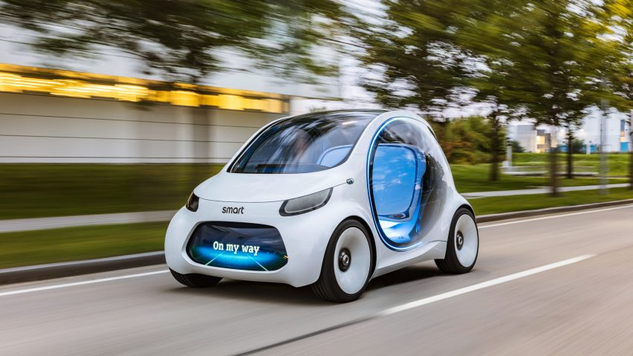
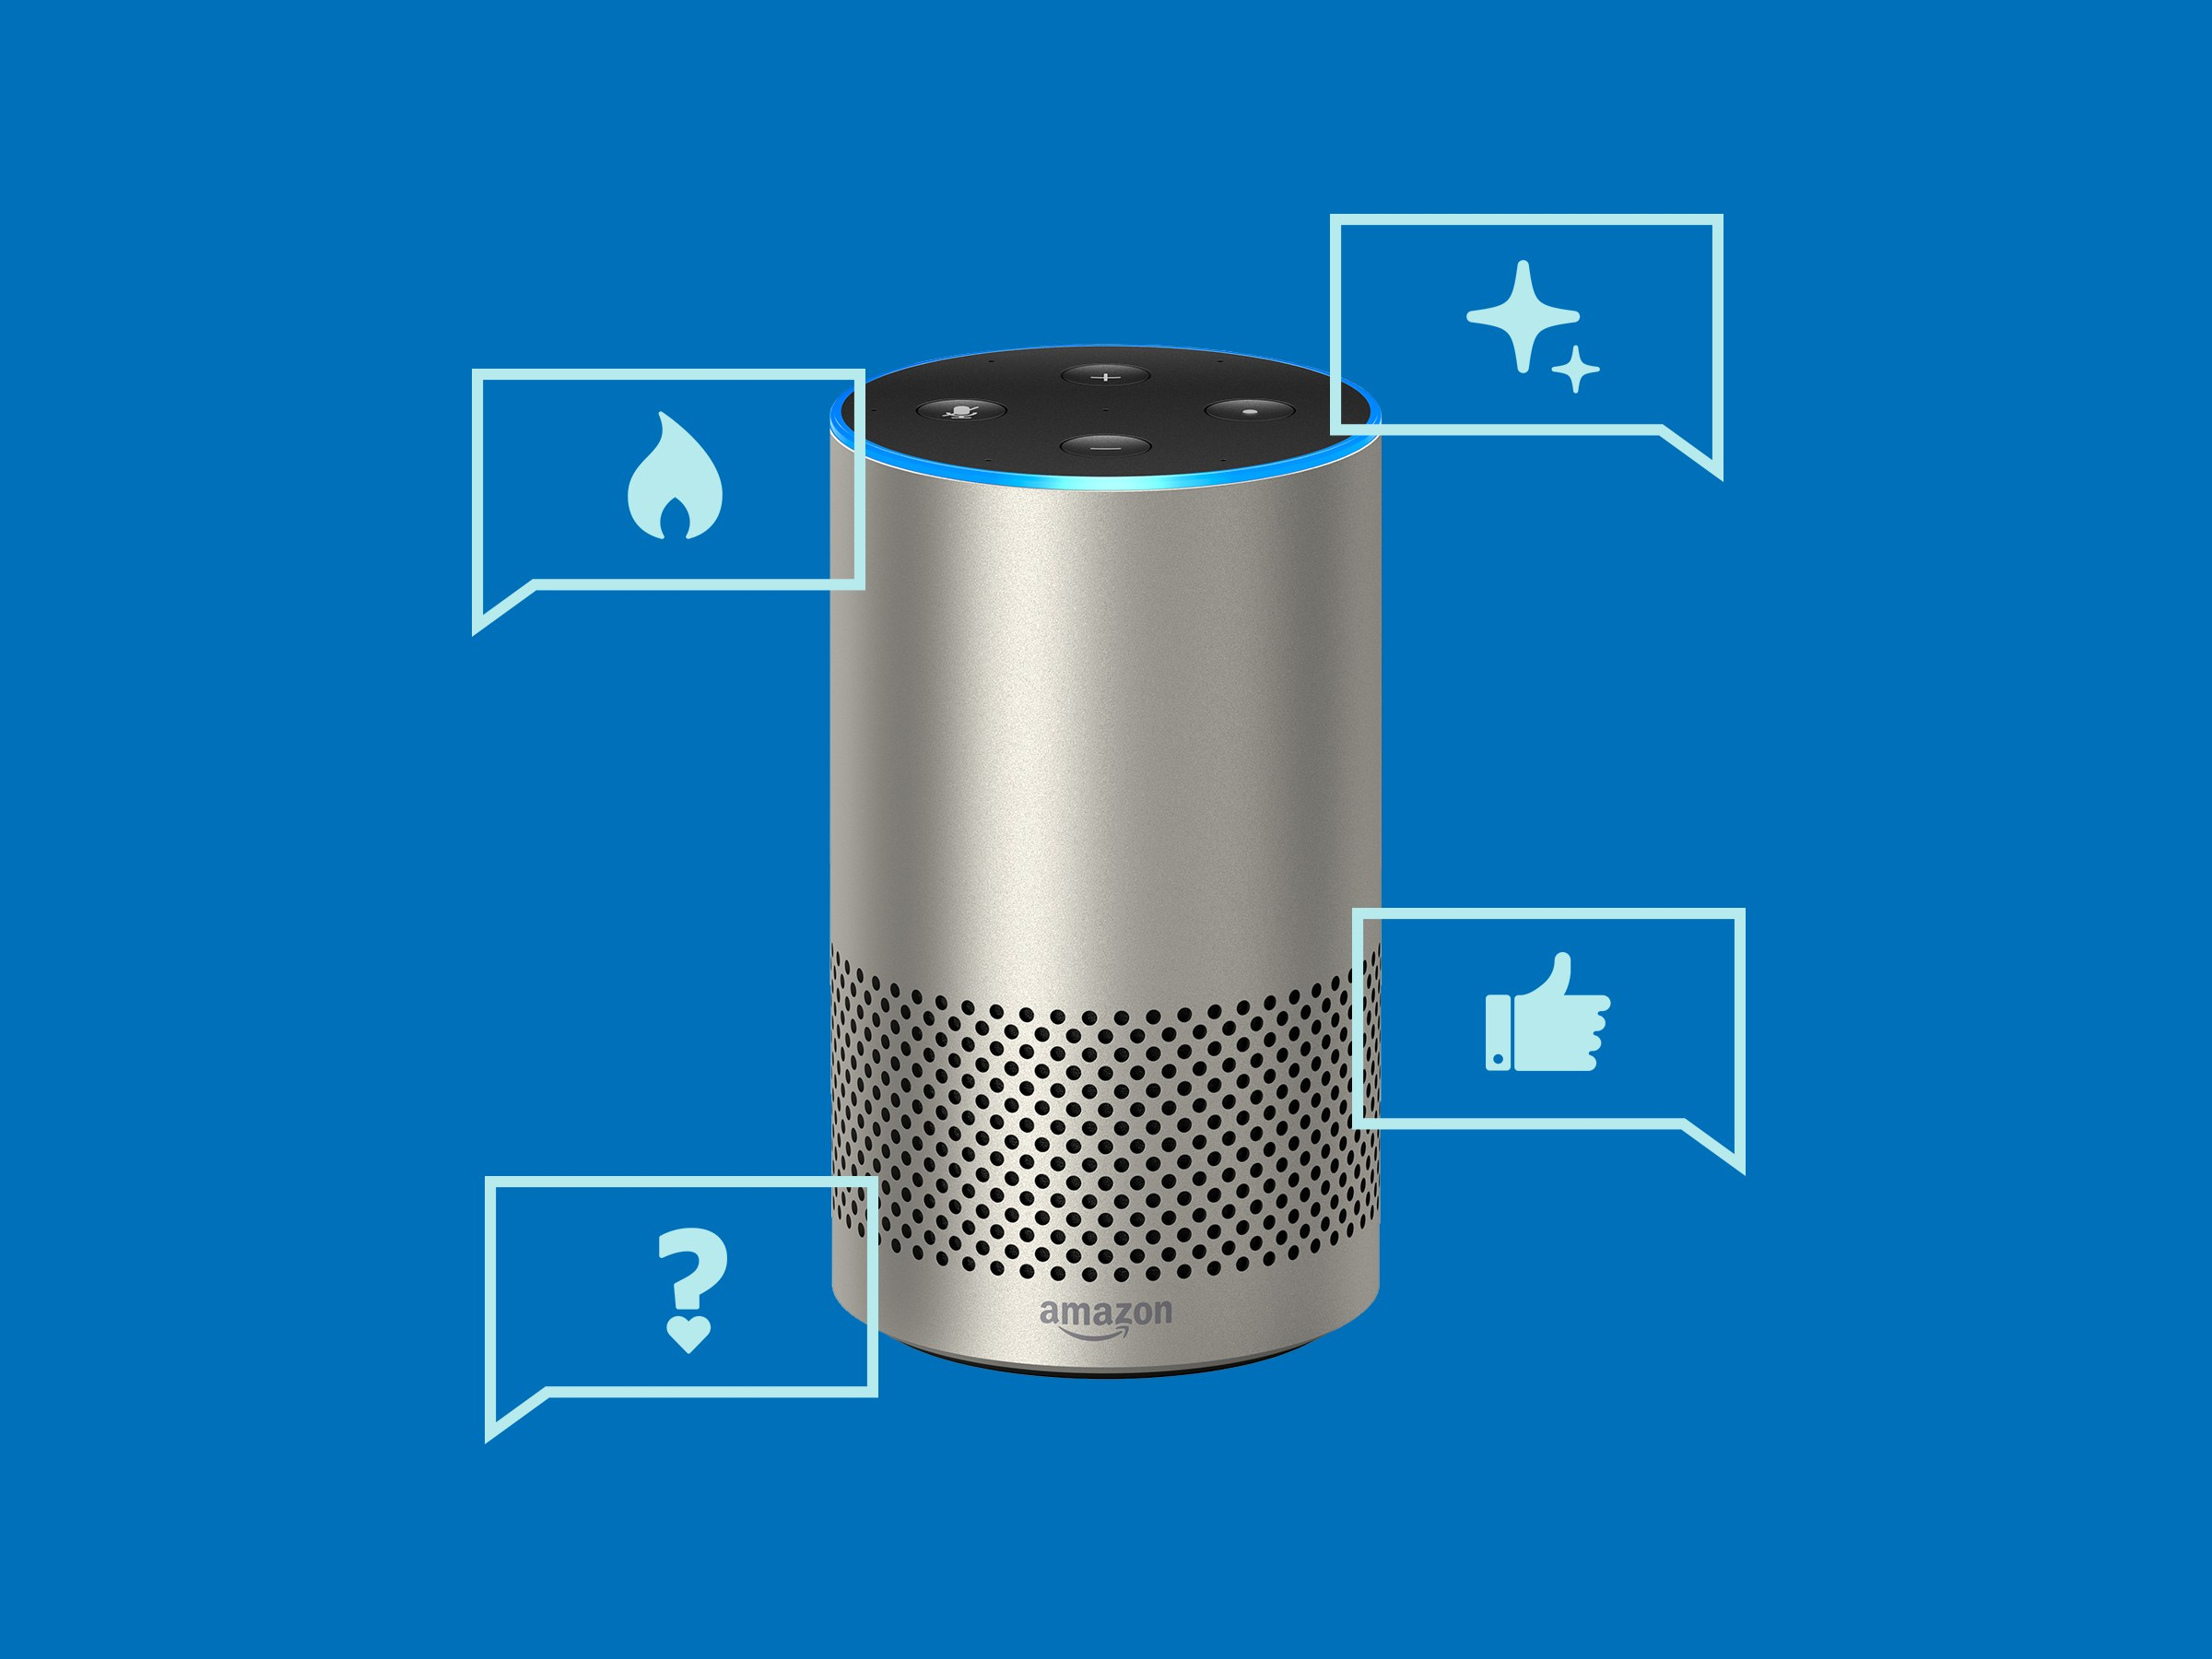

What is machine learning and ai?
Artificial Intelligence is the broader concept of machines being able to carry out tasks in a way that mimics human behaviour.
Machine Learning is a field of computer science that uses mathematical techniques to give computer systems the ability to “learn” from examples without being explicitly programmed.

Slide 8
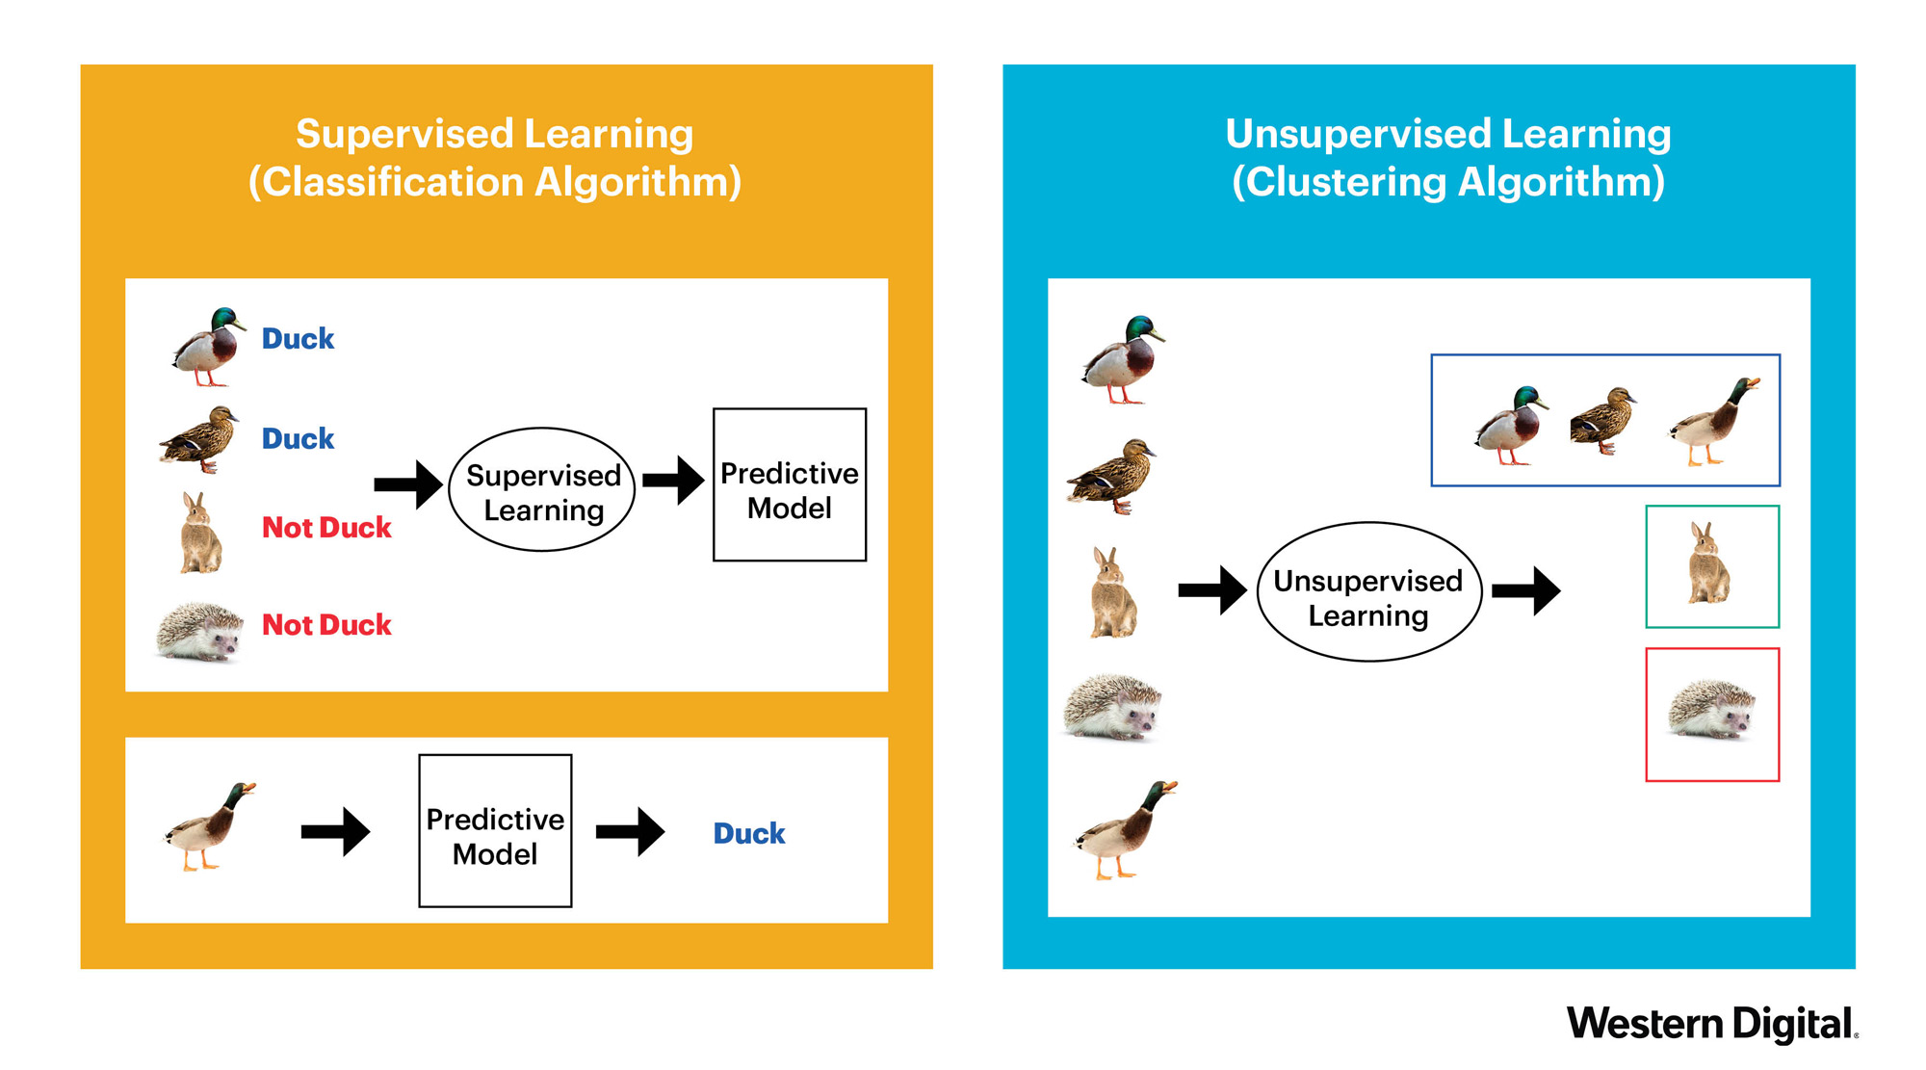
Machine learning algorithms
With labels
Without labels

Slide 9

supervised learning example: TITAnic survivor predictor
The titanic survivor predictor example will predict the probability of surviving in the Titanic based on data about passengers on the Titanic.
Go to the following link: https://docs.microsoft.com/en-us/azure/machine-learning/studio/excel-add-in-for-web-services
Let’s explore the dataset
2. Let’s follow the instructions together to get our predictions

Slide 10
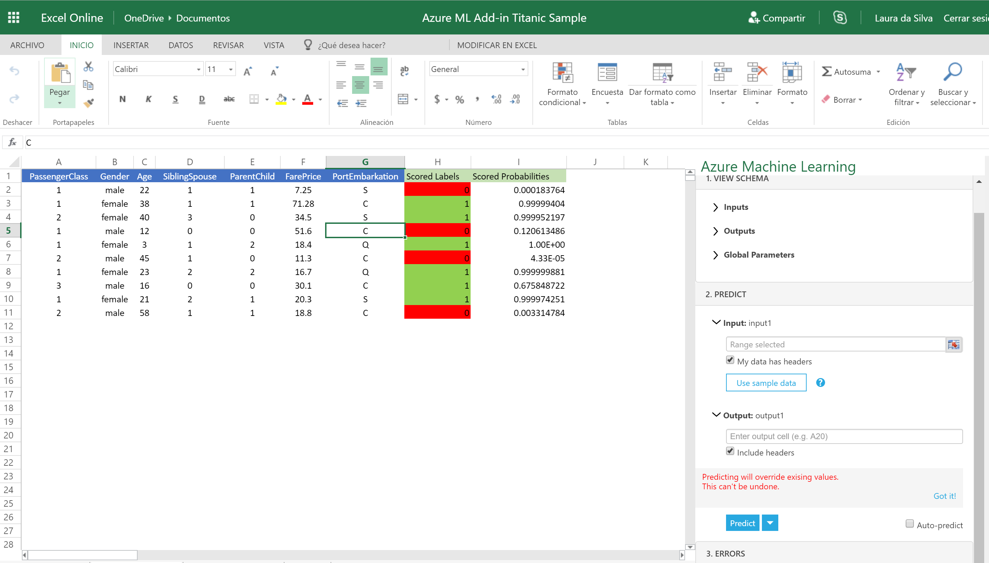
Prediction using an already deployed model

Slide 11
Data Science cycle
Titanic Survivor Predictor
Data format
Delete empty and weird values
Deploy a web service that other people can use
Binary classifier (1: survived,
0: not survived)
How well is the machine learning? Confusion matrix

Slide 12
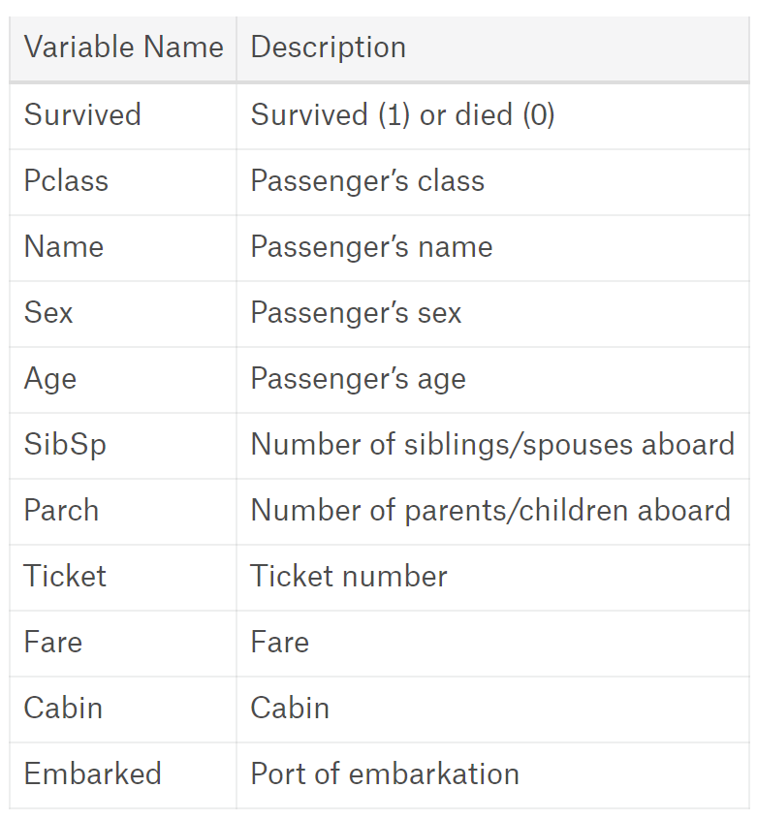
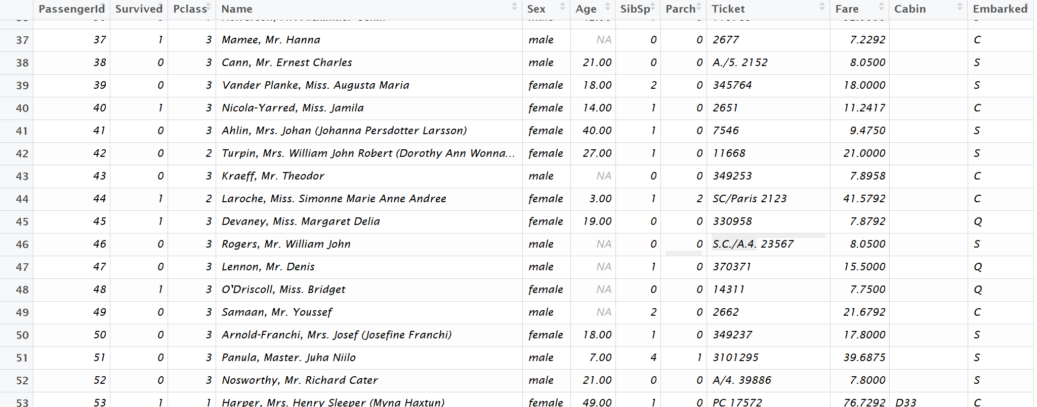
The ORIGINAL Dataset
The original dataset usually has to be transformed in order to be used
Data Dictionary

Slide 13
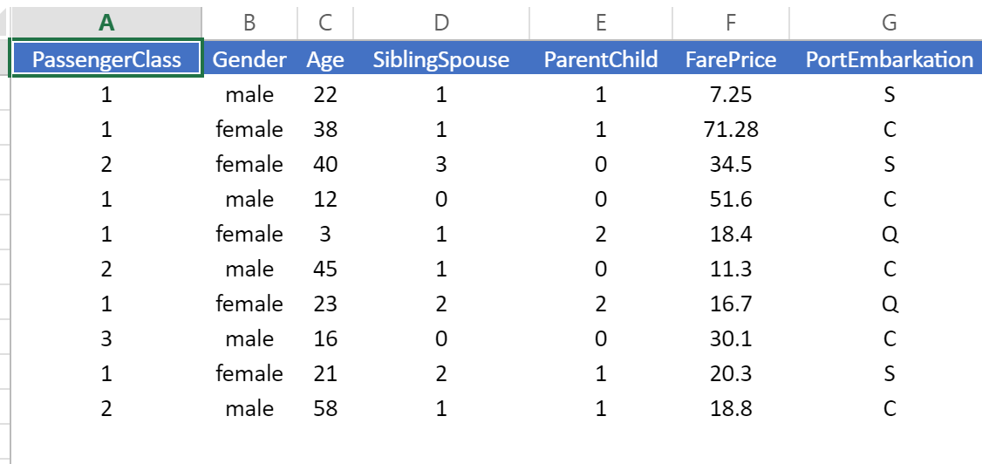
Final dataset
Attributes or features
Observations
Numerical Data
Categorical Data

Slide 14
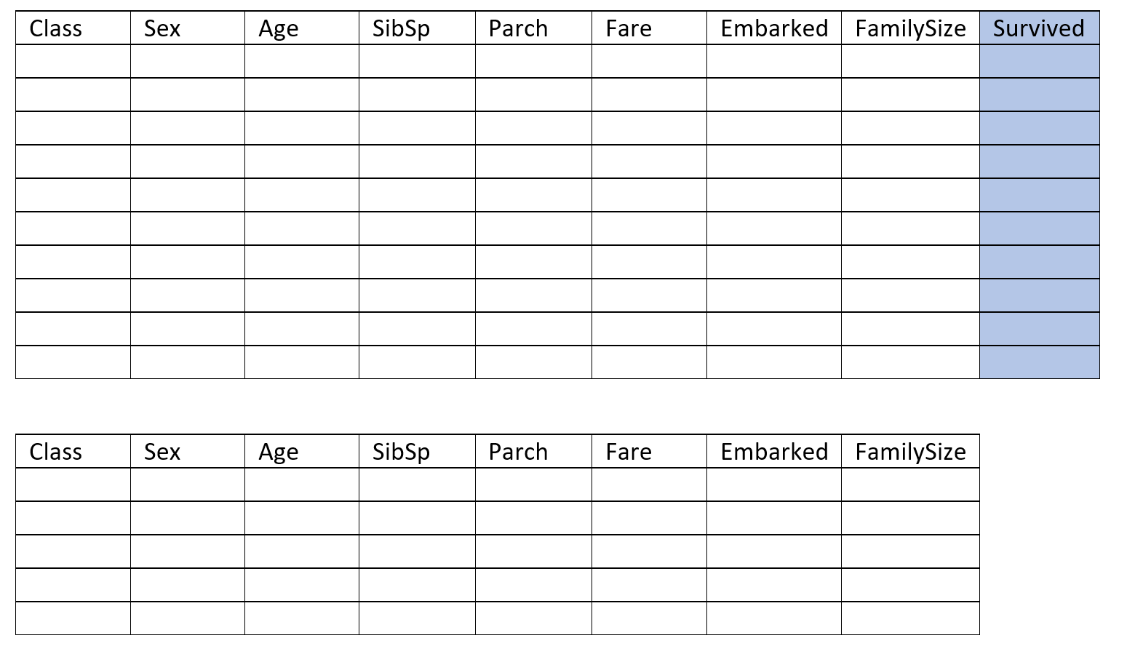
Splitting the data for training and testing
70%
30%

Slide 15
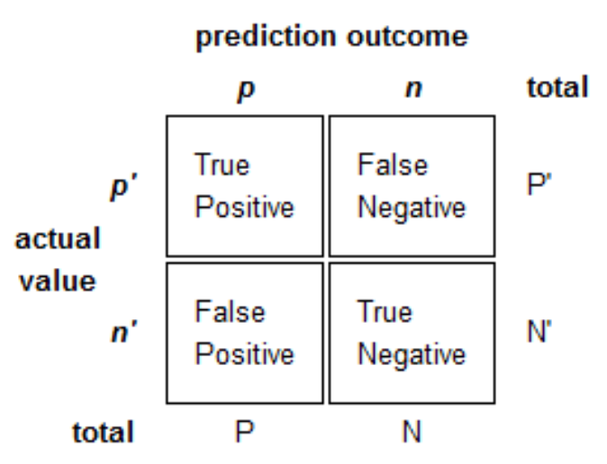
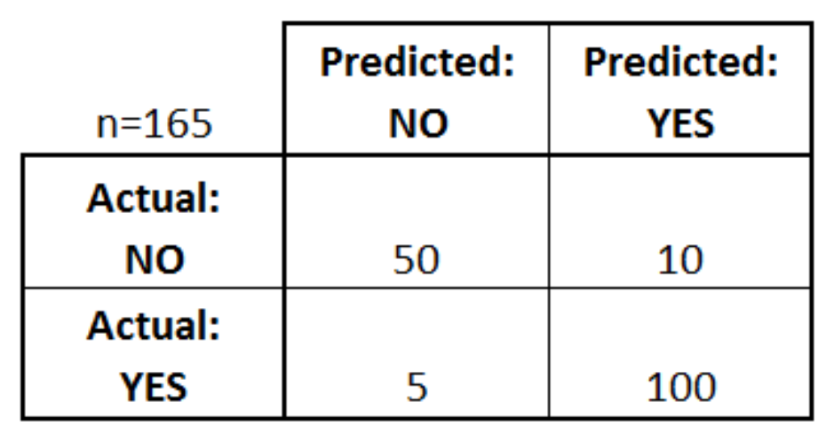
Model evaluation: the confusion matrix

Slide 16
Create your first experiment in azure machine learning studio
Sign in Azure Machine Learning Studio: https://studio.azureml.net/
Let’s follow the tutorial of creating an experiment in Azure ML for Income prediction.
Details about the dataset can be found at: https://archive.ics.uci.edu/ml/datasets/adult

Slide 17
challenges
Looking at examples you will find in the Gallery (https://gallery.azure.ai/):
Create the experiment for the Titanic survivor predictor.
Create the experiment for Sentiment analysis using messages from Twitter.
Create an experiment for movie recommendation.

