Slide 1
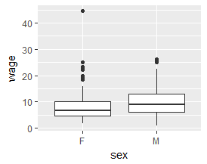
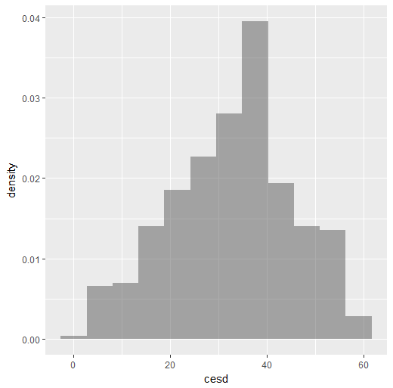
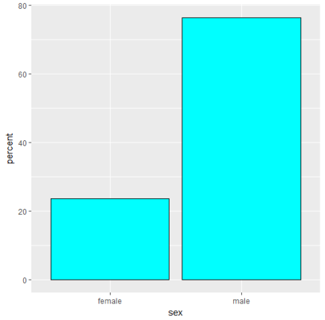
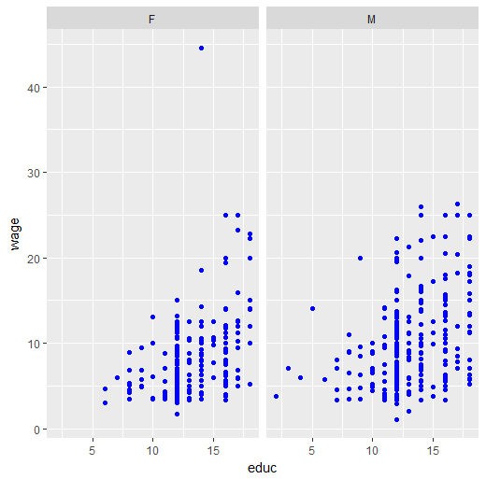
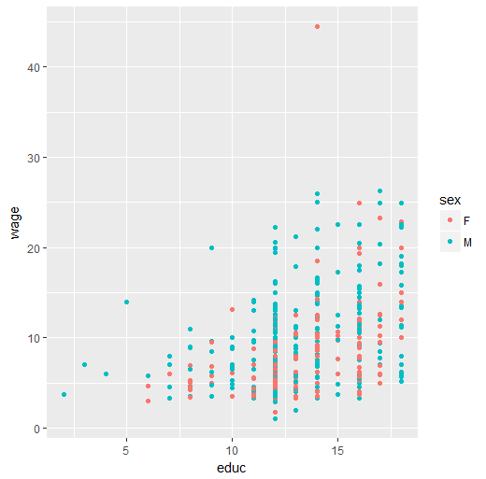
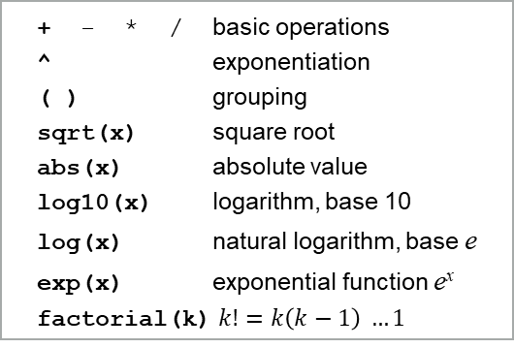
Intro stats
with mosaic
(ggformula version)
Formula interface
Examining data
One quantitative variable
Use for graphics, statistics, inference, and
modeling operations.
goal(y ~ x, data = mydata)
Read as “Calculate goal for y using
mydata “broken down by” x, or
“modeled by” x.
mean(age ~ sex, data = HELPrct)
For graphics:
goal(y ~ x | z, color = ~ w,
data = mydata)
y : y-axis variable (optional)
x : x-axis variable (required)
z : panel-by variable (optional)
w : color-by variable (optional)
gf_boxplot(wage ~ sex,
data = CPS85)
gf_point(wage ~ educ | sex,
data = CPS85, color = "blue")
gf_point(wage ~ educ,
color = ~ sex, data = CPS85)
Print short summary of all variables inspect(HELPrct)
Number of rows and columns
dim(HELPrct)
nrow(HELPrct)
ncol(HELPrct)
Print first rows or last rows
head(KidsFeet)
tail(KidsFeet, 10)
Names of variables
names(HELPrct)
Make output more readable
options(digits = 3)
Compute summary statistics
mean(~ cesd, data = HELPrct)
Other summary statistics work similarly
median() iqr() max() min()
fivenum() sd() var() sum()
Table of summary statistics
favstats(~ cesd, data = HELPrct)
Summary statistics by group
favstats(cesd ~ sex,
data = HELPrct)
Quantiles
quantile(~ cesd, data = HELPrct,
prob = c(0.25, 0.5, 0.8))
Histogram
gf_dhistogram(~ cesd, data =
HELPrct, bins = 12)
Normal probability plot
gf_qq(~ cesd, data = HELPrct)
Density plot
gf_dens(~ cesd, data = HELPrct,
color = "blue", size = 1.25)
One-sample t-test
result <- t.test(~ cesd,
mu = 34, data = HELPrct)
Extract confidence intervals and p-values
confint(result)
pval(result)
Essential R syntax
Names in R are case sensitive
Function and arguments
rflip(10)
Optional arguments
rflip(10, prob = 0.8)
Assignment
x <- rflip(10, prob = 0.8)
Getting help on any function
help(mean)
One categorical variable
Loading packages
Counts by category
tally(~ sex, data = HELPrct)
Percentages by category
tally(~ sex, format =
"percent", data = HELPrct)
gf_percents(~ sex, data =
HELPrct, fill = "cyan",
color = "black")
`
library(mosaic)
Arithmetic operations
+ - * / basic operations
^ exponentiation
( ) grouping
sqrt(x) square root
abs(x) absolute value
log10(x) logarithm, base 10
log(x) natural logarithm, base e
exp(x) exponential function e^{x}
factorial(k)$k!=k\left(k−1\right) …1$
Logical operators
== is equal to (note double equal sign)
!= is not equal to
< is less than
<= is less than or equal to
> is greater than
>= is greater than or equal to
& A & B is TRUE if both A and B are
TRUE
| A | B is TRUE if one or both of A and
B are TRUE
%in% includes; for example
"C" %in% c("A", "B") is FALSE
Tests and confidence intervals
Exact test
result1 <-
binom.test(~ (homeless ==
"homeless"), data = HELPrct)
Approximate test (large samples)
result2 <-
prop.test(~ (homeless ==
"homeless"), data = HELPrct)
Extract confidence intervals and p-values
confint(result1)
pval(result2)
RStudio® is a trademark of RStudio, Inc. • CC BY Michael Laviolette • statman54@gmail.com
Adapted from A Student’s Guide to R by NJ Horton, R Pruim & DT Kaplan • Updated: 07/18
Notes:
1

Slide 2
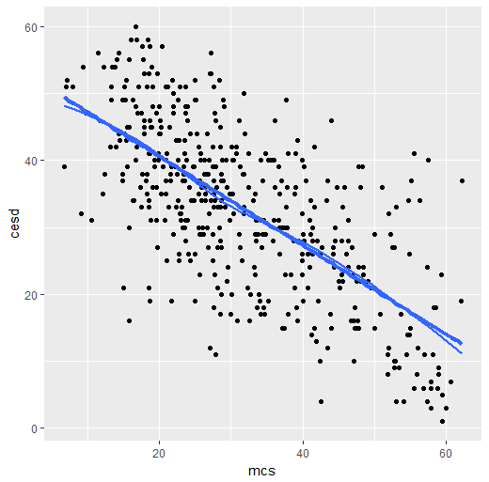
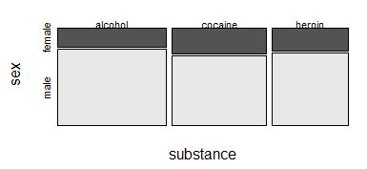
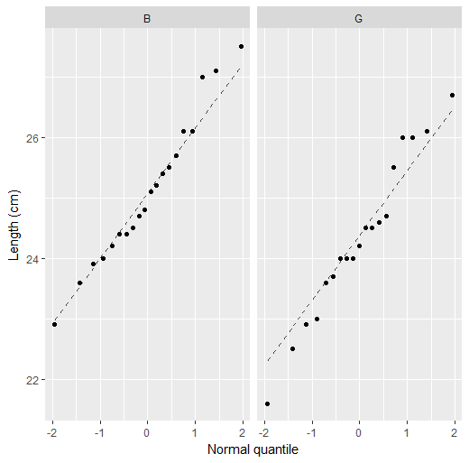
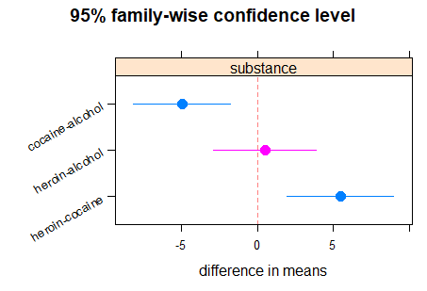
Two categorical variables
Two quantitative variables
Data manipulation
Quantitative response,
categorical predictor
Contingency table with margins
tally(~ substance + sex,
margins = TRUE,
data = HELPrct)
Percentages by column
tally(~ sex |substance,
format = "percent",
data = HELPrct)
Mosaic plot
mosaicplot(~ substance + sex,
color = TRUE, data = HELPrct)
Chi-square test
xchisq.test(~ substance + sex,
data = HELPrct,
correct = FALSE)
Correlation coefficient
cor(cesd ~ mcs, data = HELPrct)
Scatterplot with regression line and smooth
gf_point(cesd ~ mcs,
data = HELPrct) %>%
gf_smooth(linetype = "dashed",
color = "red") %>%
gf_lm(size = 1.5)
Simple linear regression
cesdmodel <- lm(cesd ~ mcs,
data = HELPrct)
msummary(cesdmodel)
Prediction
lm_fun <- makeFun(cesdmodel)
lm_fun(mcs = 35)
Extract useful quantities
anova(cesdmodel)
coef(cesdmodel)
confint(cesdmodel)
rsquared(cesdmodel)
Diagnostics; plot residuals
gf_dhistogram(~resid(cesdmodel)
gf_qq(~resid(cesdmodel))
Diagnostics; plot residuals vs. fitted
gf_point(resid(cesdmodel) ~
fitted(cesdmodel)) %>%
gf_lm(size = 2)
From dplyr package
For details, see Tidyverse cheatsheet
Drop, rename, or reorder variables
select()
Create new variables from existing ones
mutate()
Retain specific rows from data
filter()
Sort data rows
arrange()
Compute summary statistics by group
group_by()
summarize()
Two-level predictor: two-sample t test
Numeric summaries
favstats(~length | sex,
data = KidsFeet)
Graphic summaries
gf_qq(~ length | sex,
data = KidsFeet) %>%
gf_labs(x = "Normal quantile",
y = "Length (cm)") %>%
gf_qqline()
gf_boxplot(cesd ~ substance,
data = HELPrct)
Two-sample t-test and confidence interval
result <- t_test(cesd ~ sex,
data = HELPrct)
result # view results
confint(result)
More than two levels (Analysis of variance)
Numeric summaries
favstats(cesd ~ substance,
data = HELPrct)
Fit and summarize model
modsubstance <- lm(cesd ~ substance,
data = HELPrct)
anova(modsubstance)
Which differences are significant?
pairwise <- TukeyHSD(modsubstance)
mplot(pairwise)
Importing data
Import data from file or URL
MustangPrice <-
read.file("C:/MustangPrice.csv")
# NOTE: R uses forward slashes!
Dome <-
read.file("http://www.mosaic-
web.org/go/datasets/Dome.csv")
Distributions
Normal distribution function
pnorm(13, mean = 10, sd = 2)
Normal distribution function with graph
xpnorm(1.645, mean = 0, sd = 1)
Normal distribution quantiles
qnorm(0.95) # mean = 0, sd = 1
Normal distribution quantiles with graph
xqnorm(0.85, mean = 10, sd = 2)
Binomial density function (“size” means n)
dbinom(5, size = 8, prob = 0.65)
Binomial distribution function
pbinom(5, size = 8, prob = 0.65)
Central portion of distribution
cdist("norm", 0.95)
cdist("t", c(0.90, 0.99), df = 5)
Plotting distributions
plotDist("binom", size = 8,
prob = 0.65, xlim = c(-1, 9))
plotDist("norm", mean = 10,
sd = 2)
Randomization and
simulation
Fix random number sequence
set.seed(42)
Toss coins
rflip(10) # default prob is 0.5
Do something repeatedly
do(5) * rflip(10, prob = 0.75)
Draw a simple random sample
sample(LETTERS, 10)
deal(Cards, 5) # poker hand
Resample with replacement
Small <- sample(KidsFeet, 10)
resample(Small)
Random permutation (shuffling)
shuffle(Cards)
Random values from distributions
rbinom(5, size = 10, prob = 0.7)
rnorm(5, mean = 10, sd = 2)
Categorical response,
quantitative predictor
Logistic regression
logit_mod <-
glm(homeless ~ age,
family = binomial, data = HELPrct)
msummary(logit_mod)
Odds ratios and confidence intervals
exp(coef(logit_mod))
exp(confint(logit_mod))
RStudio® is a trademark of RStudio, Inc. • CC BY Michael Laviolette • statman54@gmail.com
Adapted from A Student’s Guide to R by NJ Horton, R Pruim & DT Kaplan • Updated: 07/18

