Slide 1
1D CNN
a
Categorical inputs
MLP
proto-
spectra
XRD
Continuous inputs
b
c
d
Notes:
Solving the inverse problem: predicting undamaged samples from X-ray diffraction(XRD) on damaged samples in the CascadesDB dataset. a. archetecture of neural network: a multilayer perceptron (MLP) fed to a 1 dimensional convolutional neural network (1D CNN). b. mean square error(MSE) loss for training and validation sets. c. trained model predicts an XRD from input categorical data (material composition, lattice type) and continuous data (lattice parameter, temperature, primary knock-on atom (PKA) energy, box (sample) volume). d. Performance of predicting inputs, sample properties, from XRD on damaged samples. Notice that low MSE is sufficient to guarantee prediction of PKA energy and box volume, but is insufficient for lattice parameter and temperature.

Slide 2
Categorical inputs
MLP
proto-
spectra
1D CNN
XRD
Continuous inputs

Slide 3
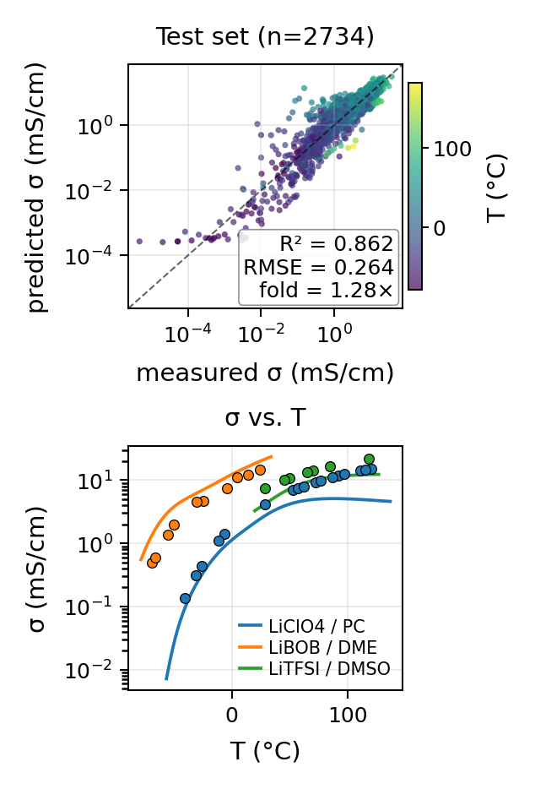
a.
d.
Categorical inputs
proto-
spectra
1D CNN
XRD
Contin-uous inputs
MLP
b.
e.
c.

