Slide 1










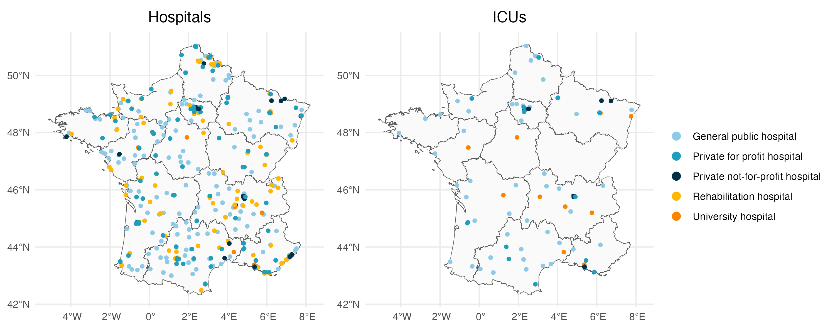
A
SPARES
2019
2020
2021
2022
Antibiotic resistance in hospitals data
Hospital metadata
Antibiotic consumption
Bacterial samples
2019
PMSI
2020
2021
2022
Hospital cohort
Hospital national identifier (finess)
Medico-administrative data
Hospital metadata
Occupied bed-days
Intubated COVID-19 bed-days
B
Bacterial samples in SPARES
• Hospitals (n=2,370,650)
• ICUs (n=258,683)
C
Hospitals reporting in SPARES
• Hospitals (n=2053)
• ICUs (n=291)
Excluded hospitals
• Did not report their antibiotic consumption or their resistance data for a given year (n=1554)
• Overseas French territories (n=25)
• Corsica (n=8)
• No national identifier (n=33)
• Not geographical entities (except university hospitals, n=105)
• Psychiatric hospitals (n=82)
• Cancer centers (n=20)
• Occupied bed-days not available in the PMSI (n=15)
• No reported infection by bacteria of interest after sample selection (n=7)
Excluded samples
• Excluded hospitals
• Unstudied bacteria
• Pediatry, psychiatry and LTC
• Patients <15
• Patients ≥15 and labelled as « new born »
Excluded phenotypes
• Inconsistent phenotype coding
Excluded samples
• Uncomplete weeks
• Not tested for the antibiotics used to define resistance (7%)
• Most recent samples when isolated within 30 days and with ≤2 phenotypic variations (S ↔ I or I ↔ R, 0.6%)
• Merge identical samples (5%)
• Merge duplicated samples with different antibiotics tested (0.04%)
• Samples isolated in another sector on the same day (0.02%)
Excluded phenotypes
• Least resistant phenotypes in duplicated samples (50%)
Final hospital cohort (n=414)
• GPH (n=156)
• PPH (n=109)
• PNPH (n=23)
• RH (n=110)
• UH (n=16)
Excluded ICUs
• Did not report their antibiotic consumption or their resistance data for a given year (n=12)
• Occupied bed-days not available in the PMSI (n=2)
Final ICU cohort (n=85)
• GPH (n=46)
• PPH (n=18)
• PNPH (n=8)
• RH (n=0)
• UH (n=13)
Selected samples
• Hospitals (n=692,551)
• ICUs (n=75,295)
D

